Slide 1
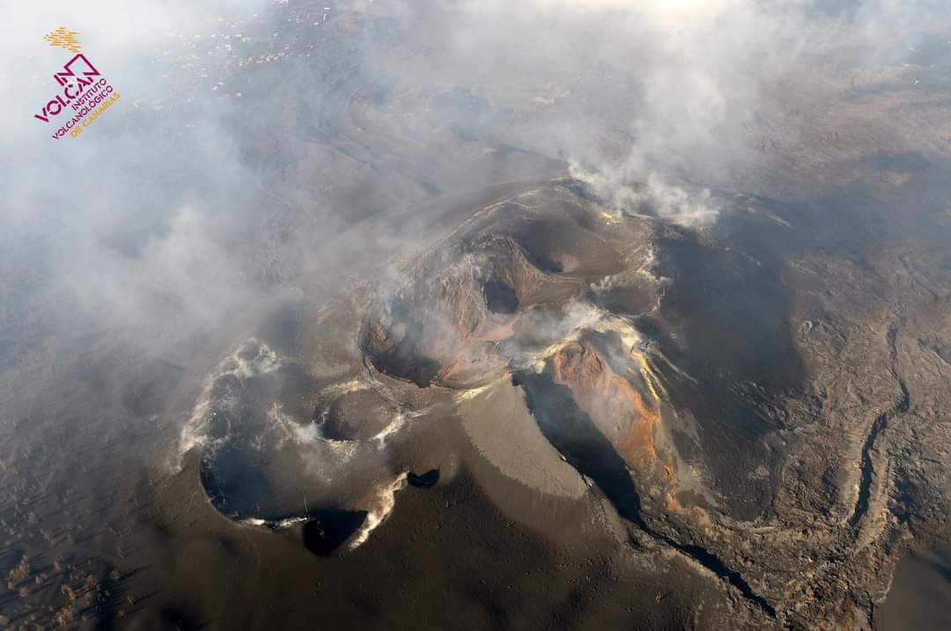




Tomographic imaging of the magmatic system feeding the 2021 Cumbre Vieja eruption (La Palma, Canary Islands).
Luca D'Auria, Ivan Koulakov, Janire Prudencio, Iván Cabrera-Pérez, Jesús M. Ibáñez, Jose Barrancos, Rubén García-Hernández, David Martínez van Dorth, Germán D. Padilla, Monika Przeor, Victor Ortega, Pedro Hernández, and Nemesio M. Peréz

Slide 2
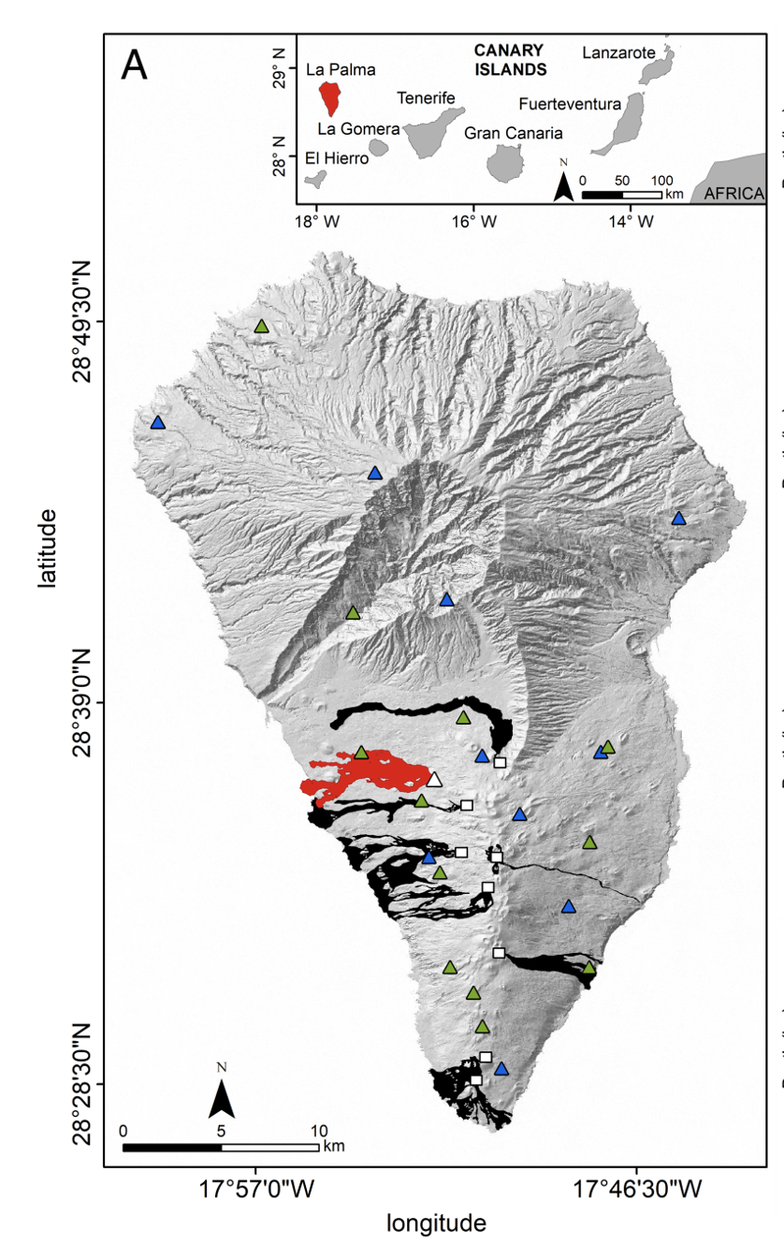
Dataset
11,349 earthquakes recorded by 22 seismic stations belonging to INVOLCAN and IGN networks
140,078 P wave and 155,231 S wave phases
Covering the:
  Precursory seismicity (2017-2021)
  Pre-eruptive (11-19 Set. 2021)
  Syn-eruptive (19 Sep. – 13 Dec. 2021)
  Post-eruptive (13-19 Dec. 2021)

Slide 3
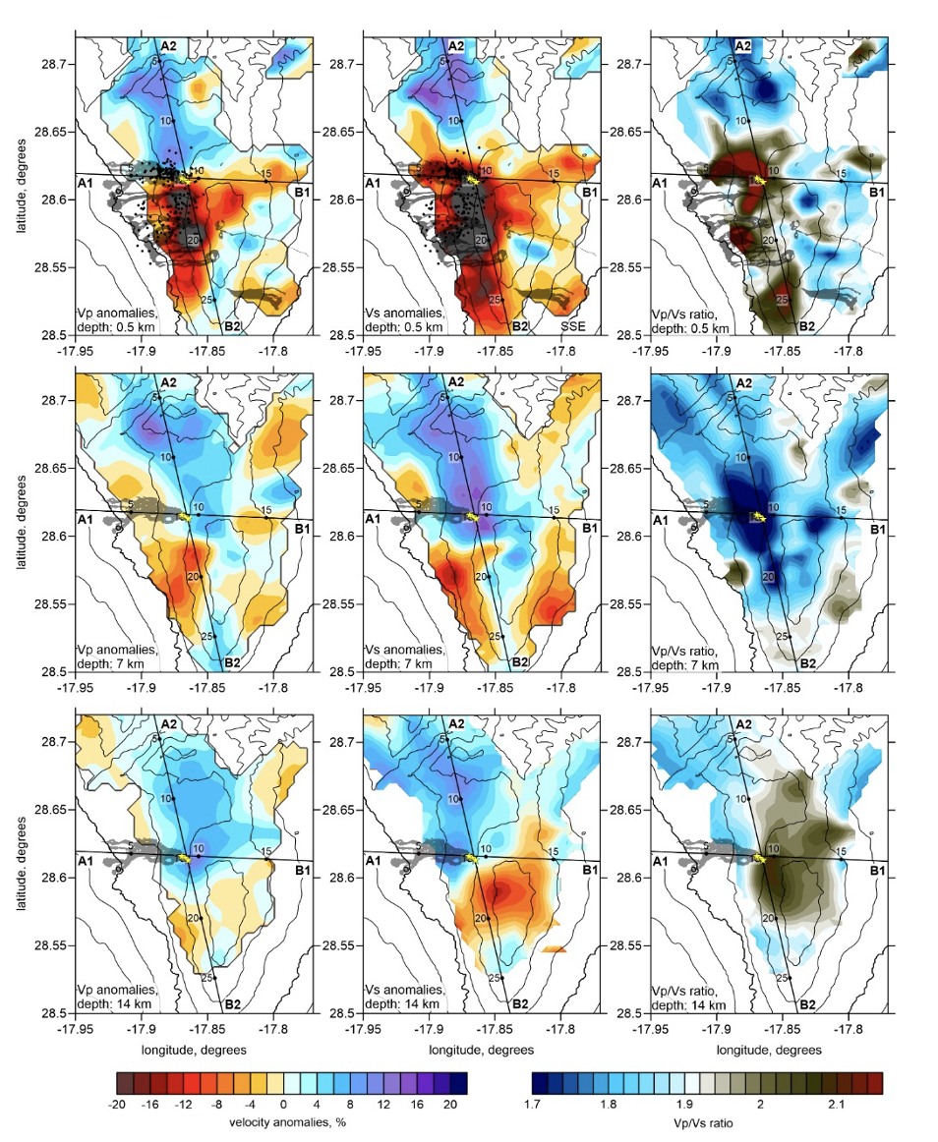
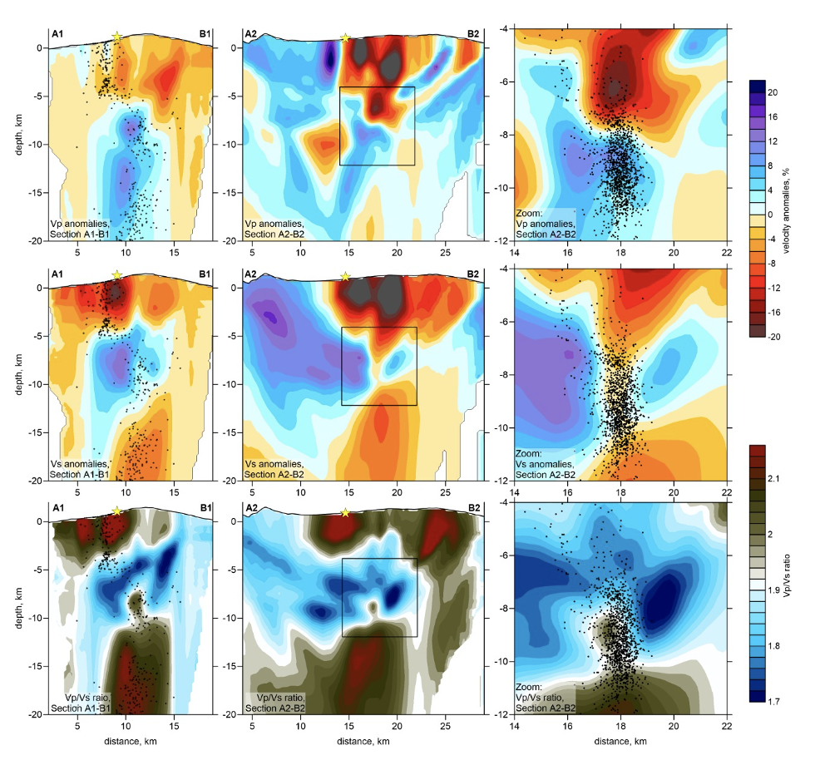
Tomographic inversion
LOTOS earthquake tomography code

Slide 4
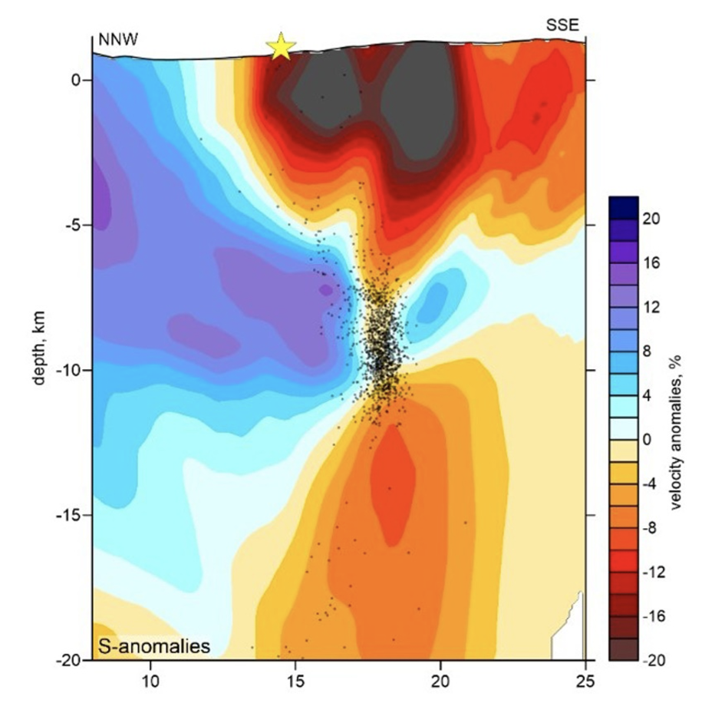
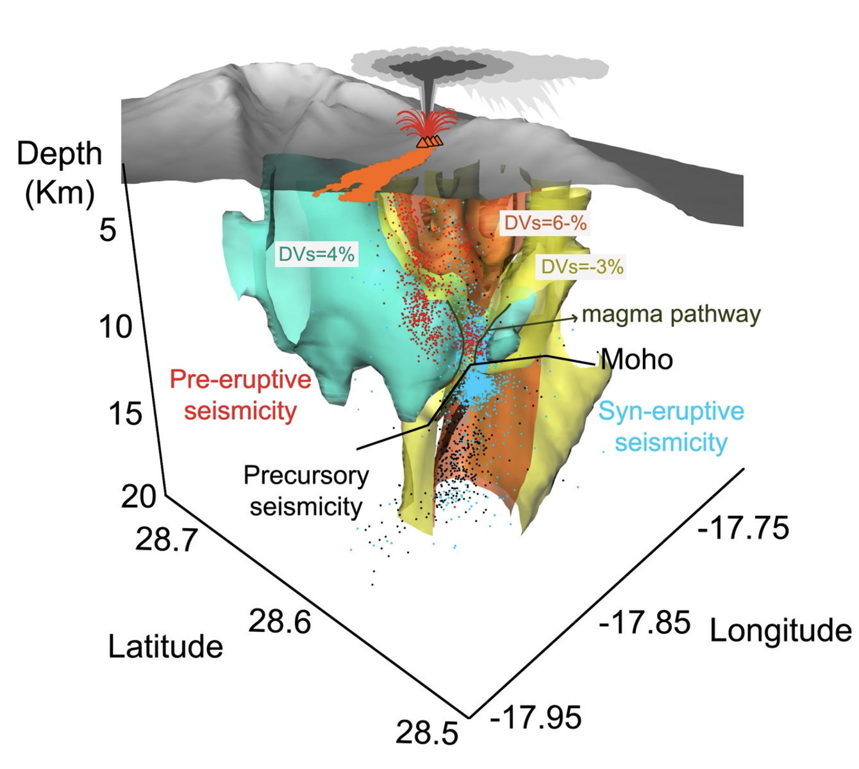
Tomographic inversion
LOTOS earthquake tomography code
?

Slide 5
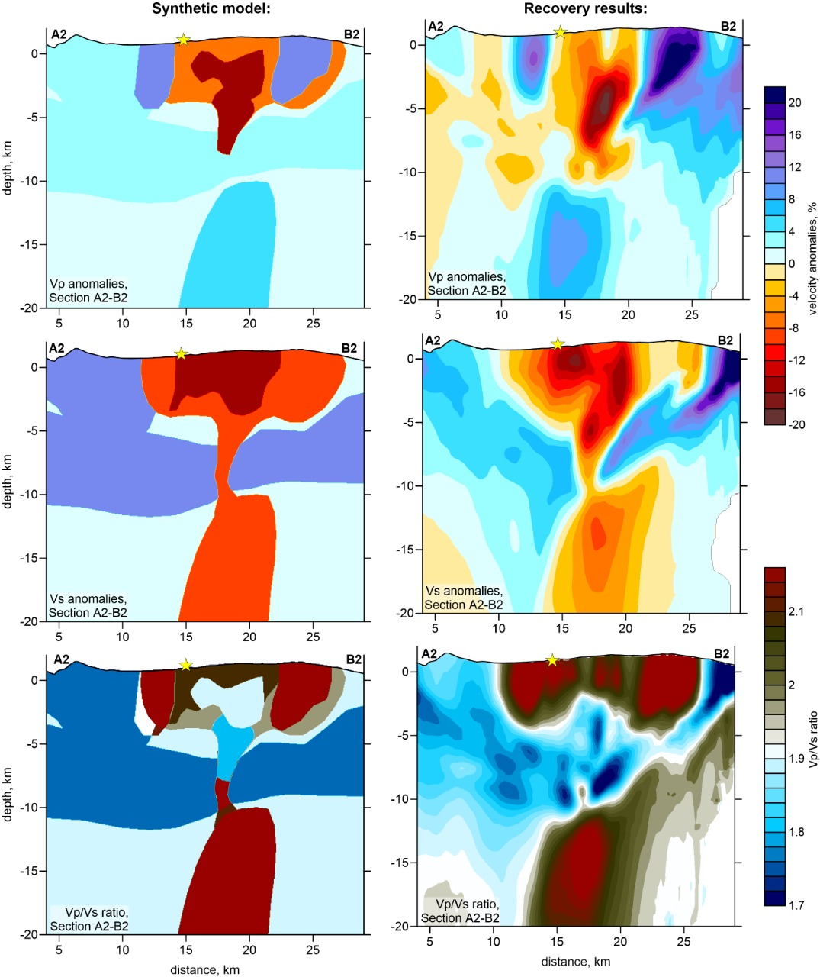
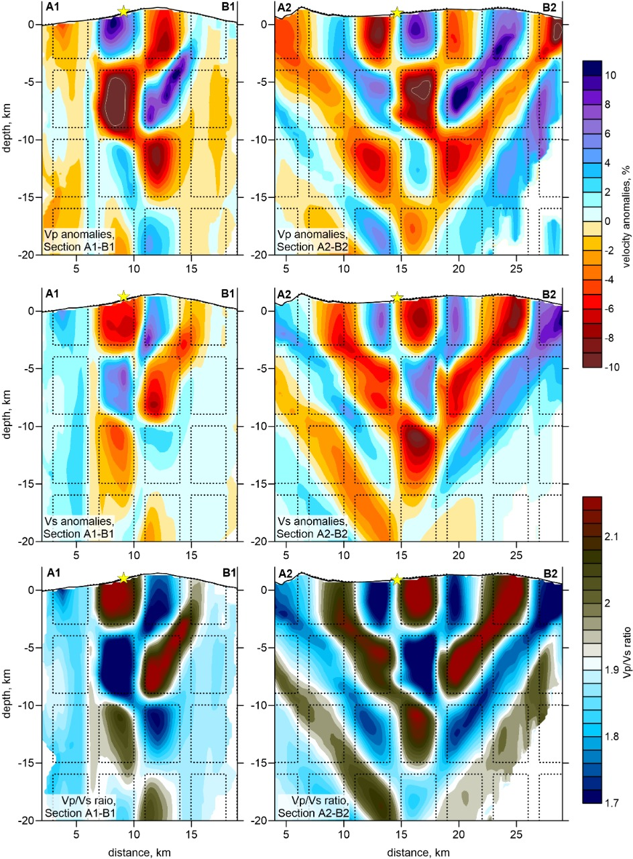
Resolution analysis

Slide 6
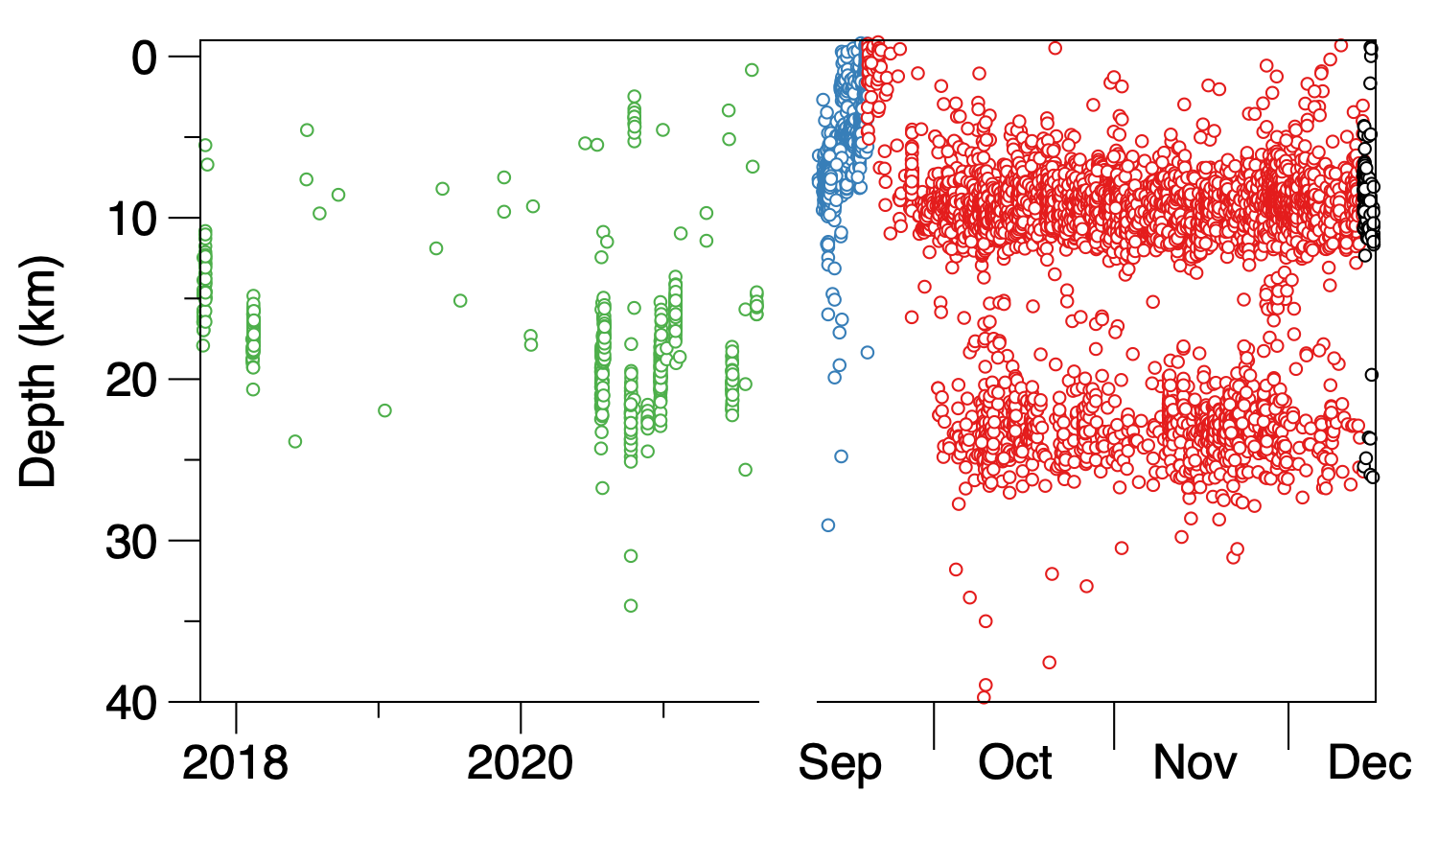
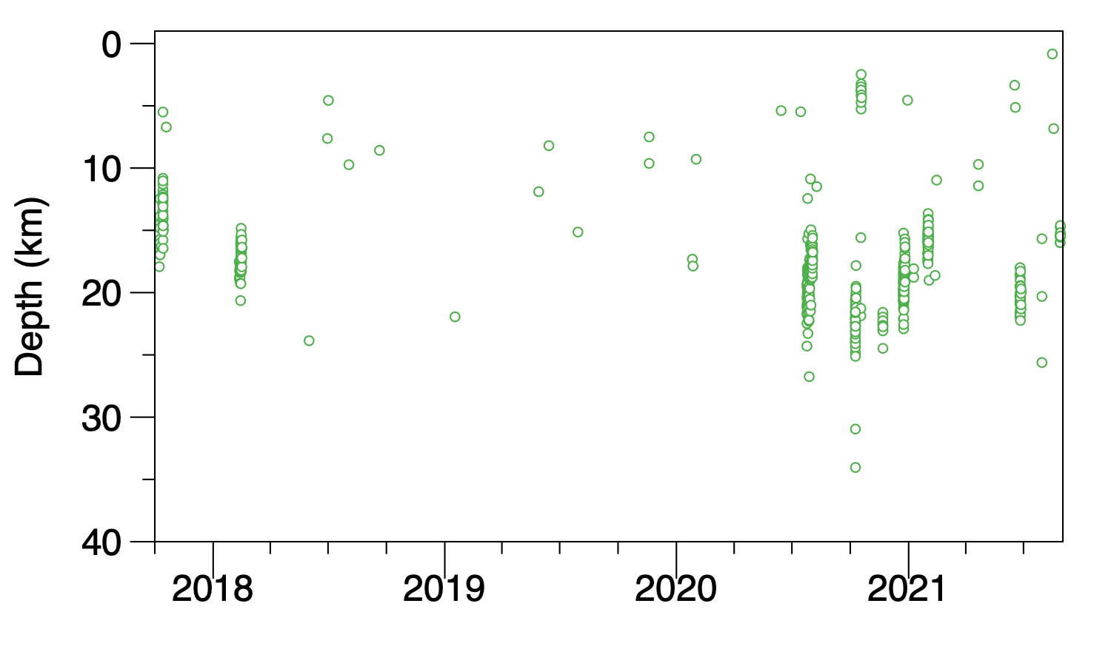
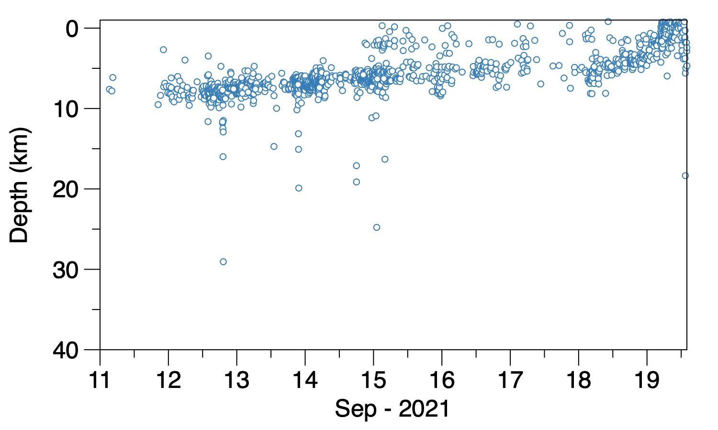
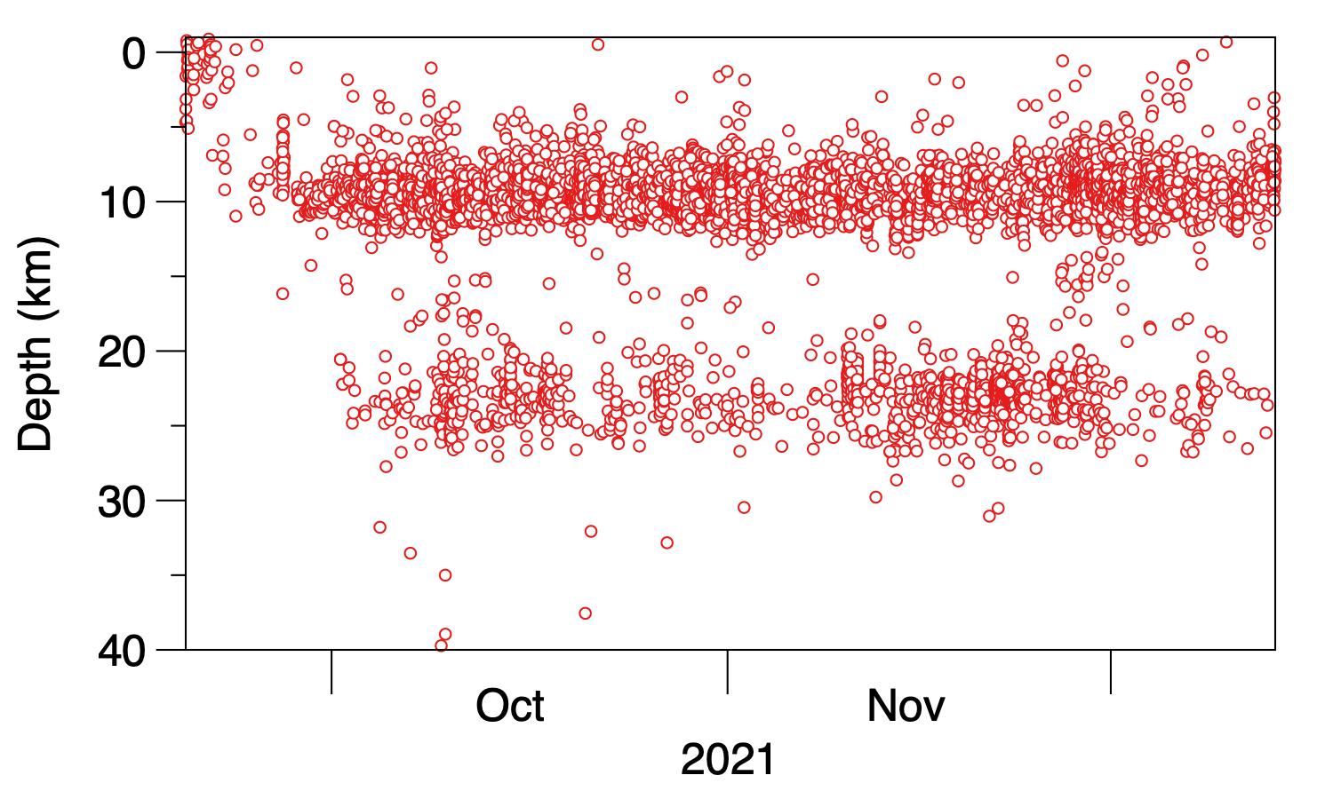
Relocated earthquakes
Precursory
Pre-eruptive
Syn-eruptive

Slide 7
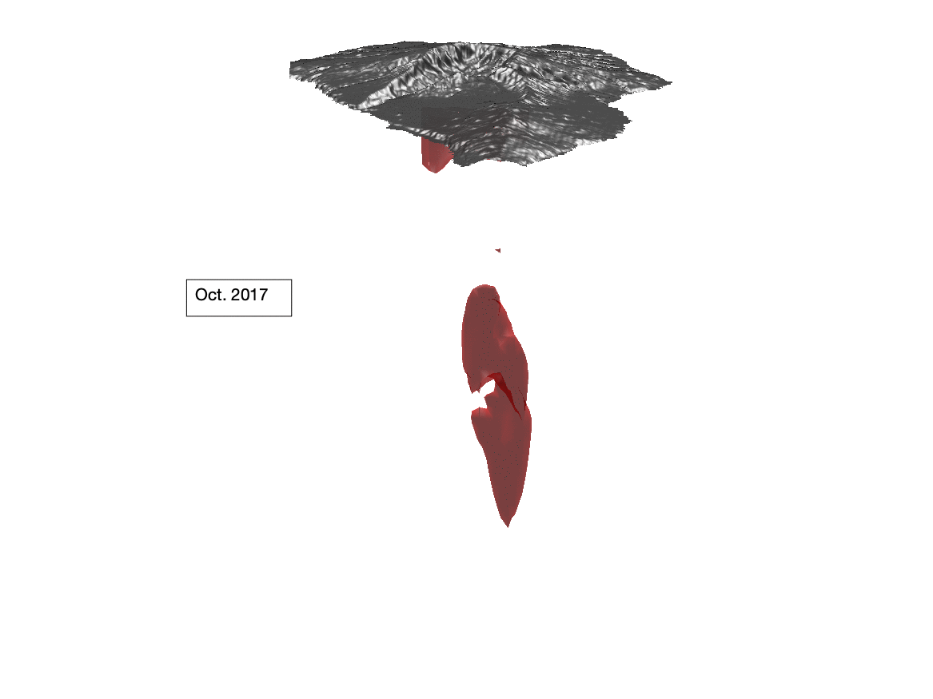
Relocated earthquakes

Slide 8
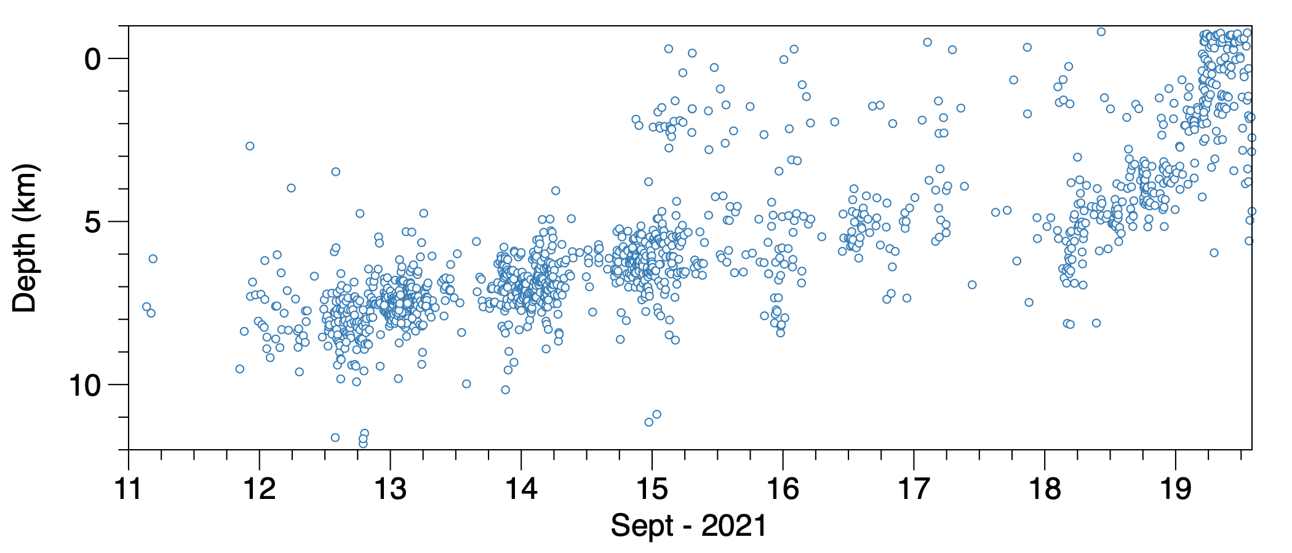
Relocated earthquakes: pre-eruptive seismicity

Slide 9
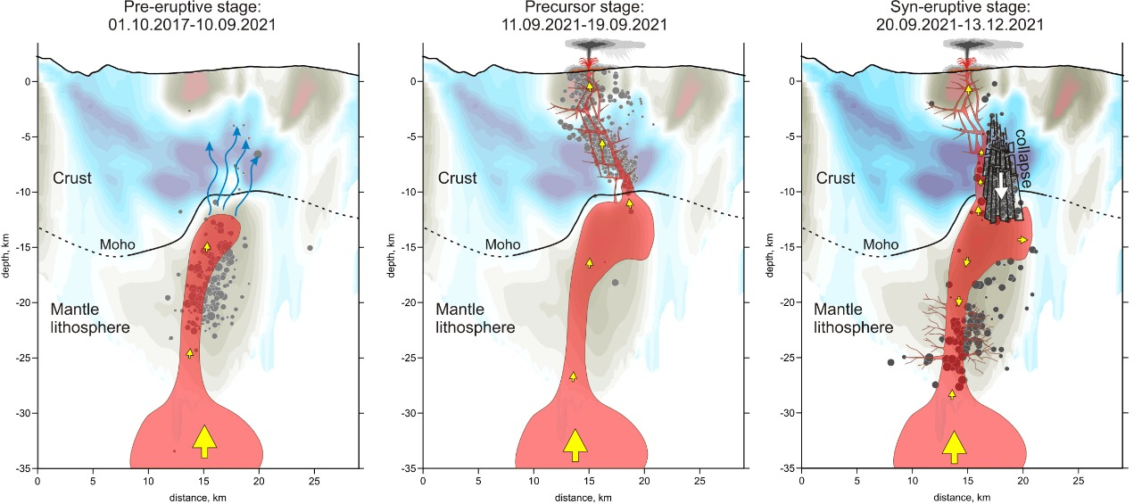
Conceptual model

Slide 10
Conclusions
Identification of a huge sub-crustal magmatic reservoir (>400 km³ ?) hints at another deeper reservoir (> 25 km).
The presence of crustal weakness zones can influence the ascent of magma and affect the occurrence of future eruptions.
The earthquake relocation in a 3D model gives a clearer picture of the whole volcanic process.

Slide 11
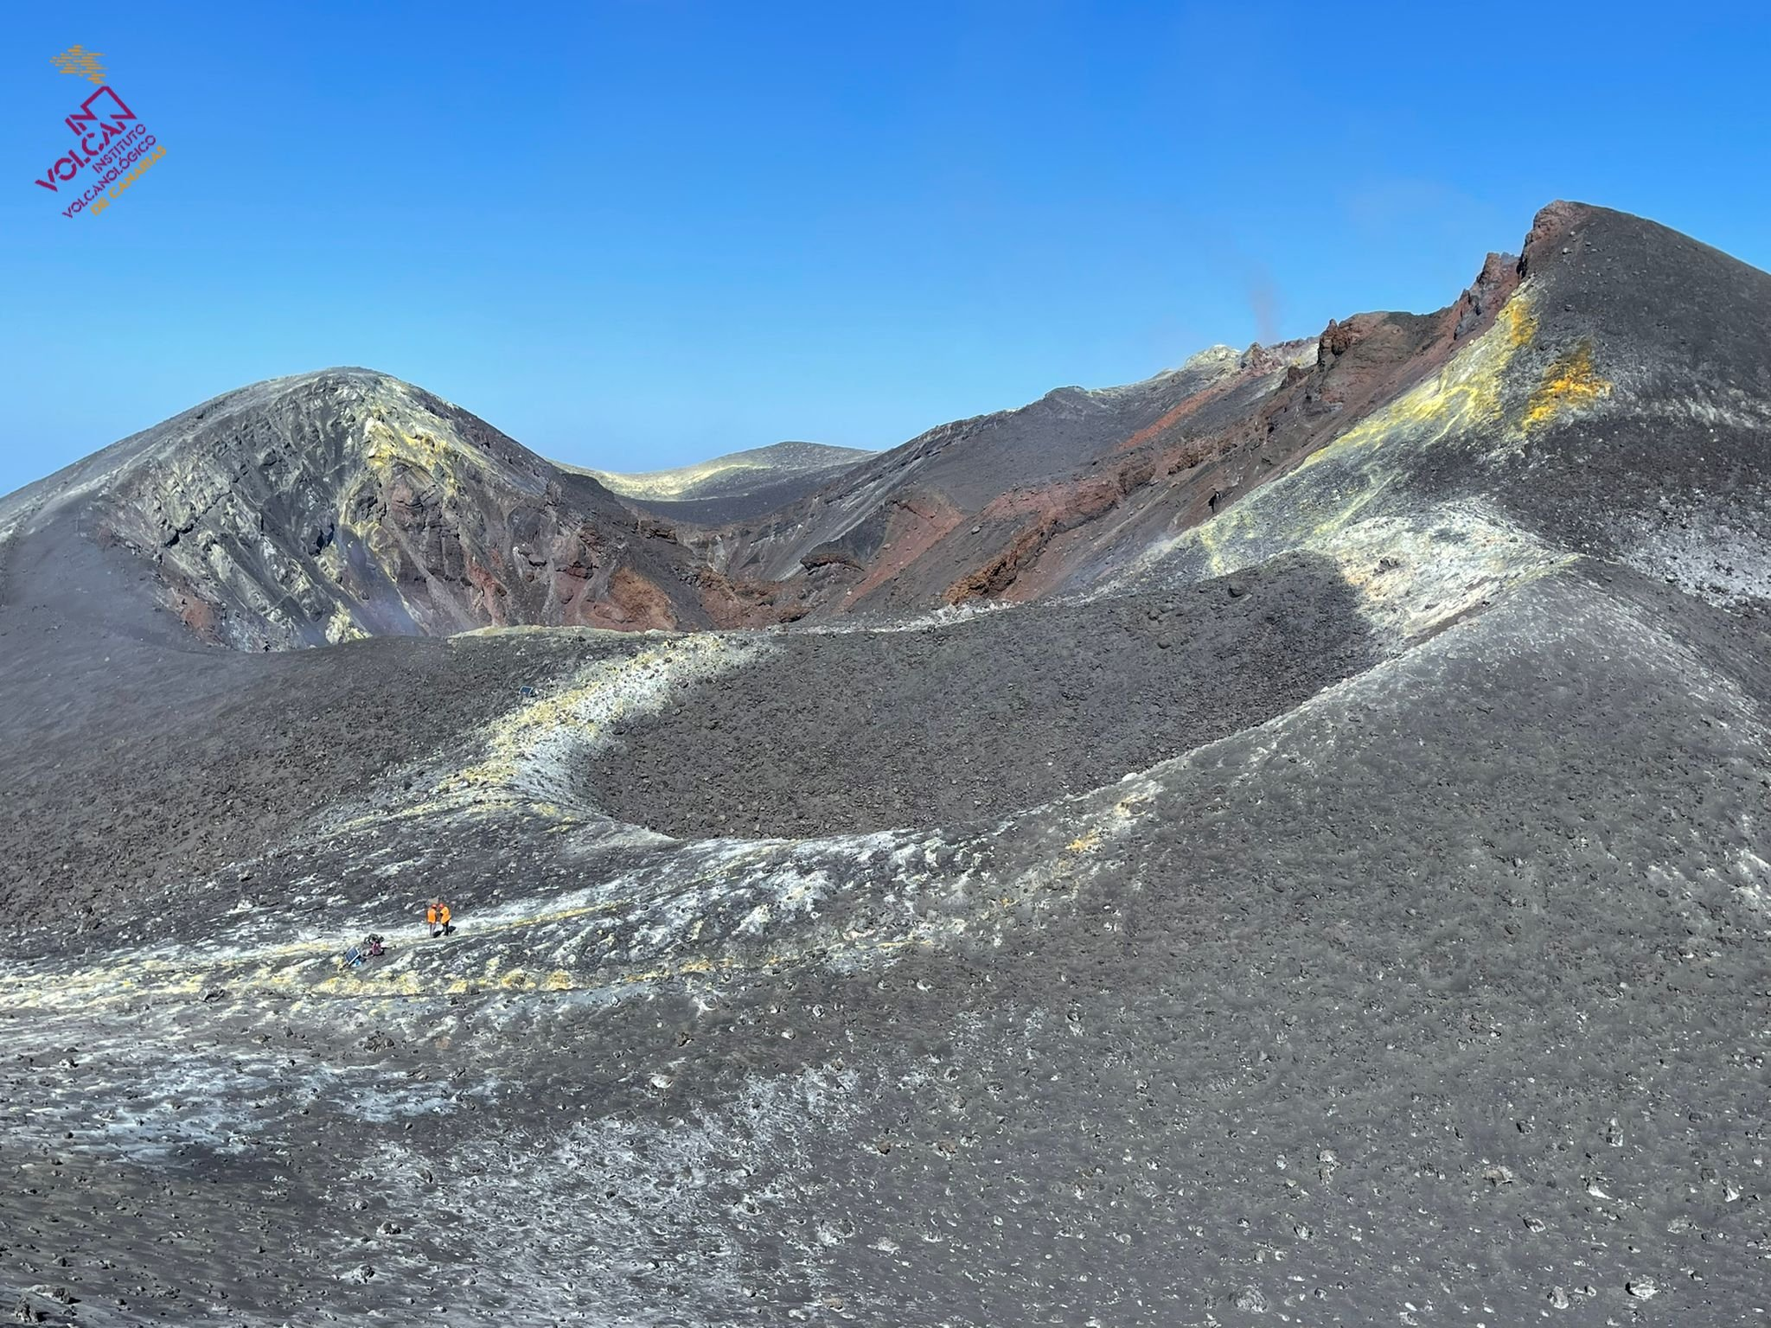
Thanks for the attention

