Slide 1
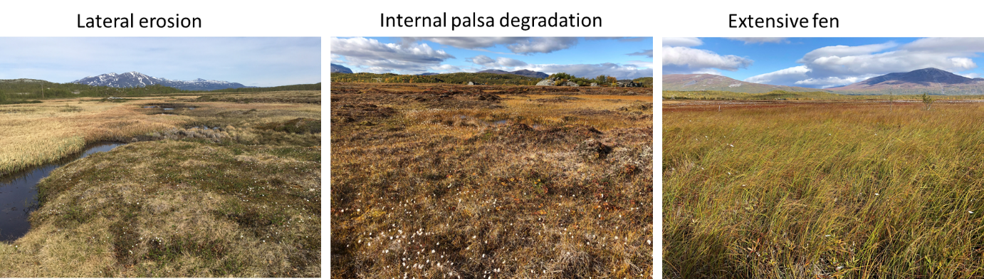
Towards a monitoring approach for understanding permafrost degradation and linked subsidence in Arctic peatlands
Betsabe de la Barreda-Bautista, Doreen Boyd, Martha Ledger, Matthias Siewert , Chris Chandler, Andrew V. Bradley, David Gee, David J. Large, Johan Olofsson, Andrew Sowter, Sofie Sjögersten
University of Nottingham, University of Umea, Terramotion Ldt
Using satellite and UAV data to measure subsidence from permafrost degradation.
Testing the hypothesis that:
Areas with shallower active layers (i.e. raised palsa areas) would have the greatest subsidence rates AND
that areas with deep active layers or no permafrost would have lower subsidence rates (e.g. fen type vegetation) as these areas have reached more stable ground surface conditions.

Slide 2
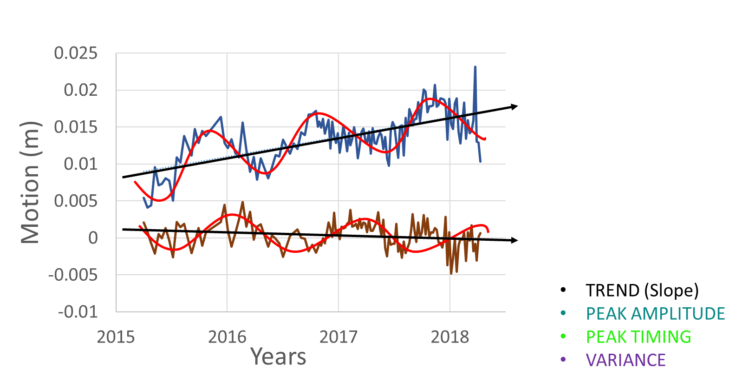
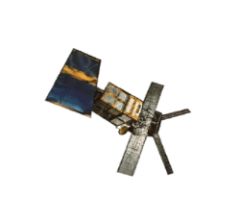
Interoferometic synoptic aperture radar InSAR for detecting subsidence
InSAR has continuous cover of the Arctic.
Measures millimetre level changes in ground motion.
Tested in a range of regions- BUT not the Arctic, has potential for pan-Arctic monitoring.
InSAR constrained to the thaw period- do we have enough data pairs to detect motion?
Small scale variability in subsidence-how is this captured by the satellite data?
Satellite
Ground
Deformation

Slide 3
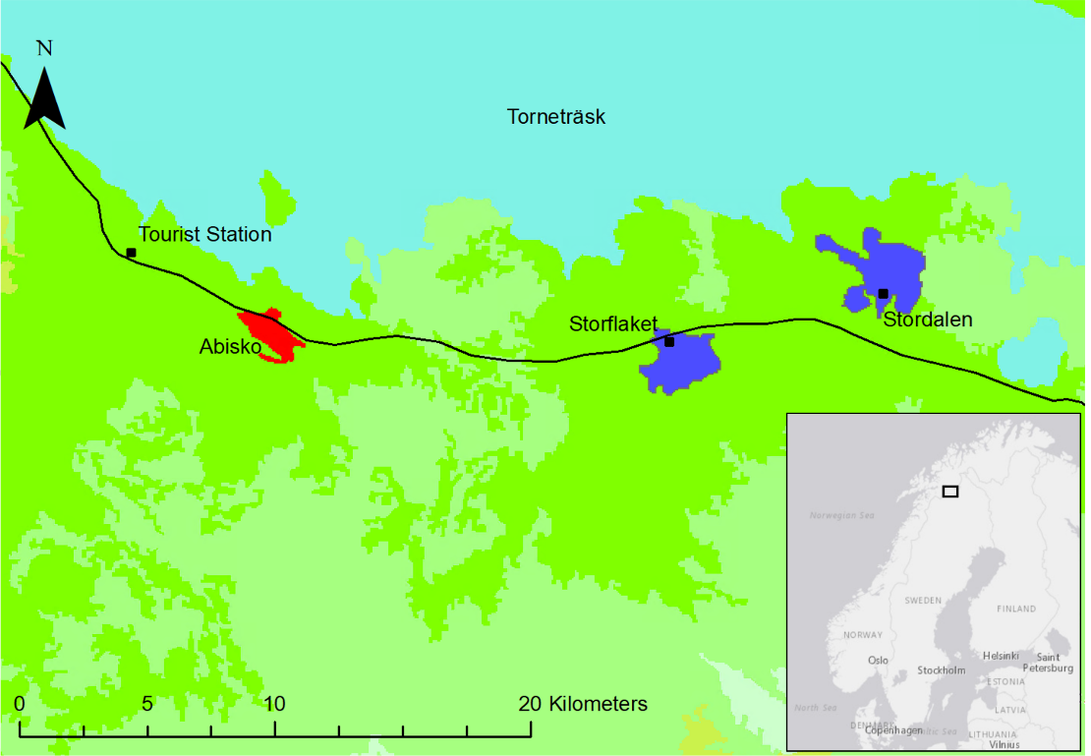
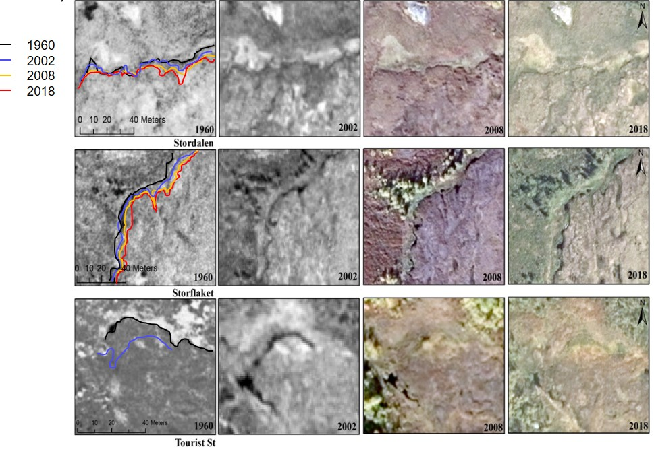
Palsa peatlands with different rates of degradation over time
Three study sites in northern Sweden
UAV, InSAR and ground truth data
Data collection between 2017 and 2020
Lateral contraction of palsas between 1960-2018:
9 m Storflaket and Tourist station mires
3 m Stordalen mire

Slide 4
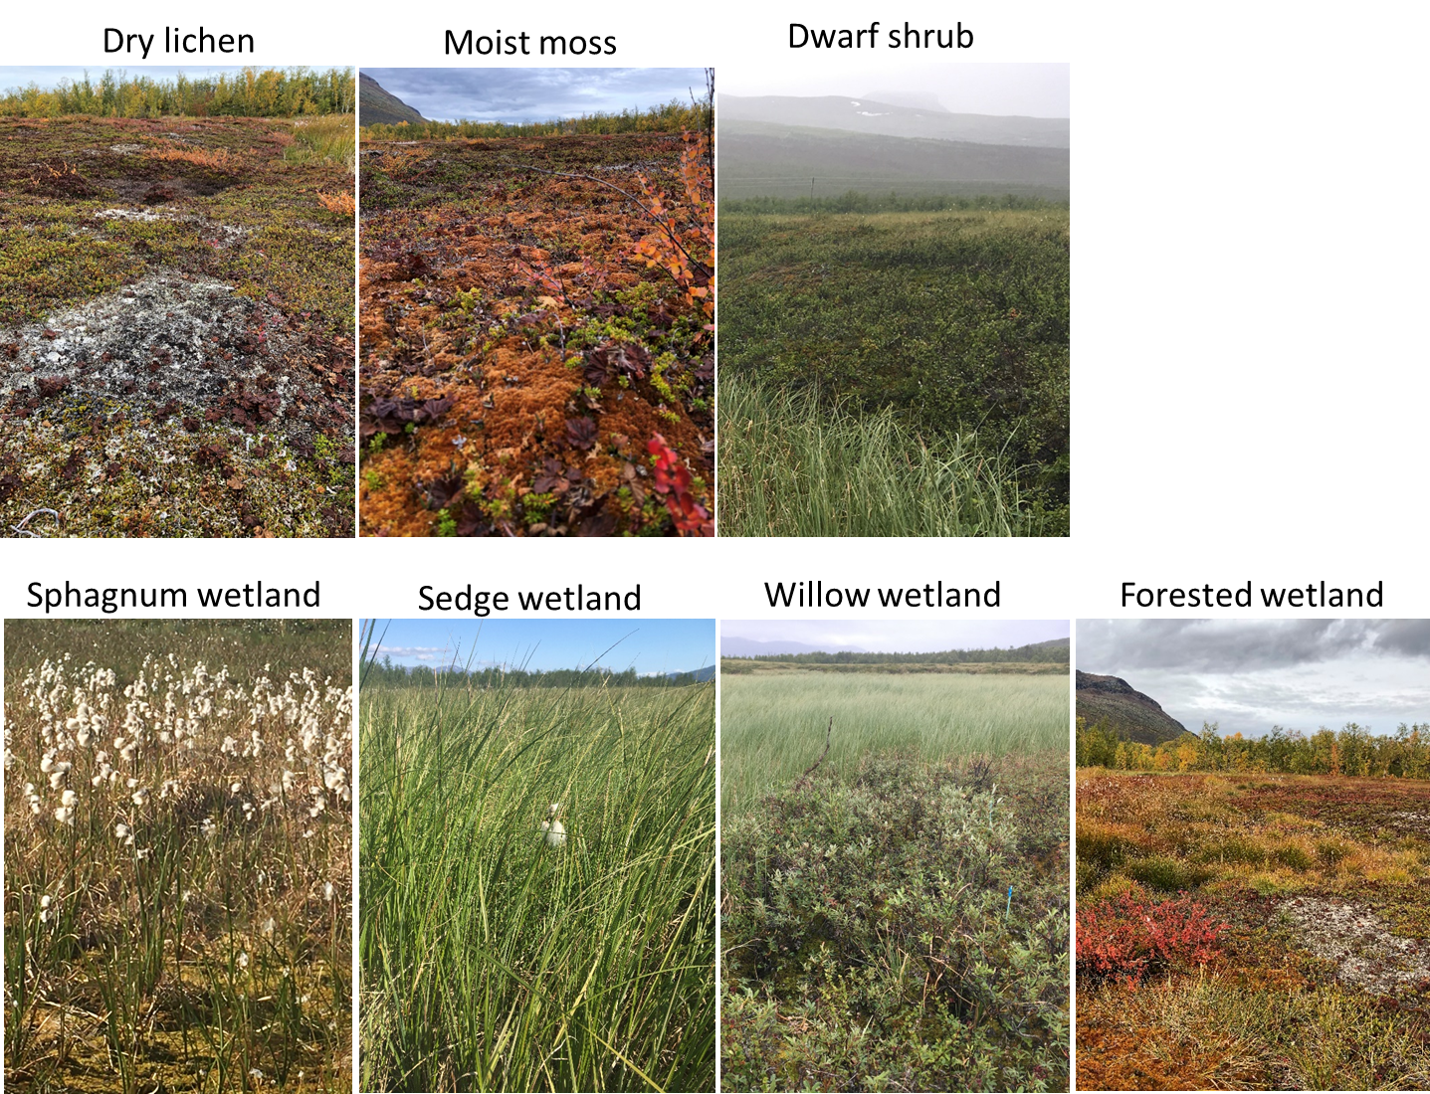
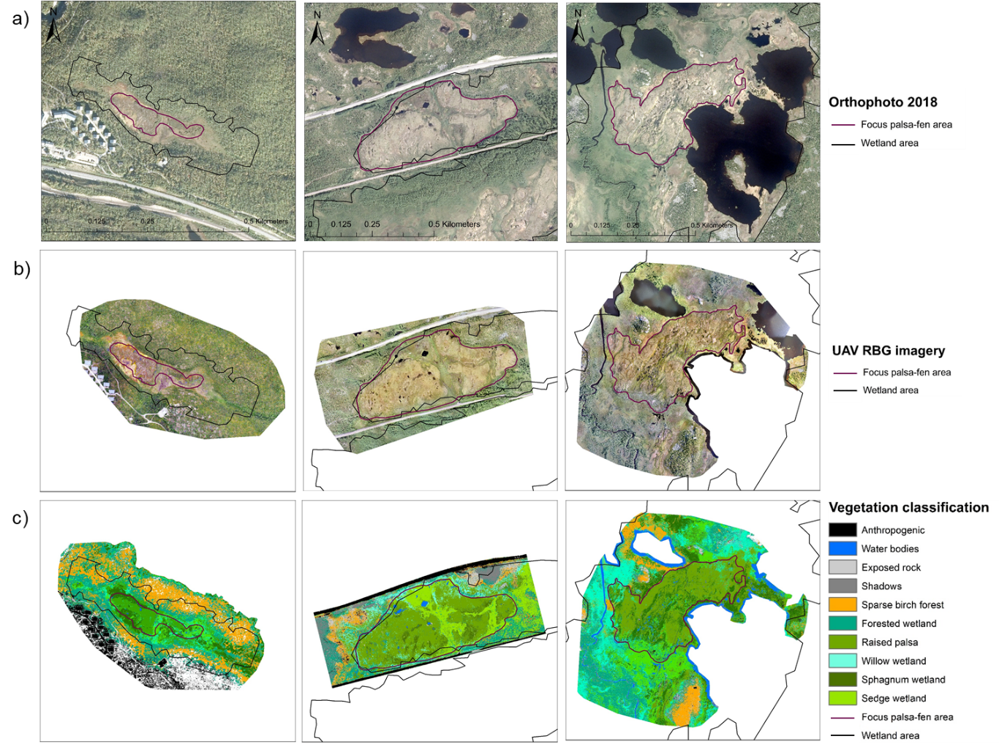
Using high resolution UAV data to map different vegetation types
UAV image images ca 3 cm resolution
Map 0.5m resolution – relevant scale for permafrost degradation

Slide 5
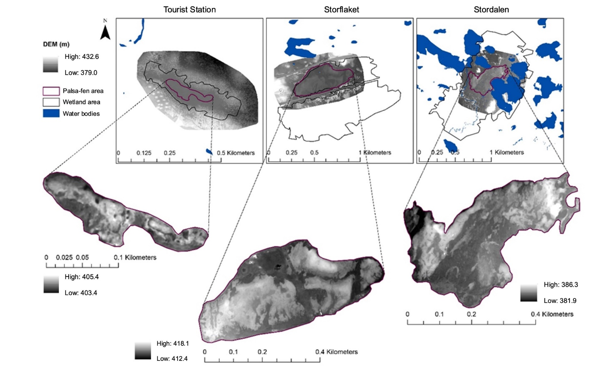
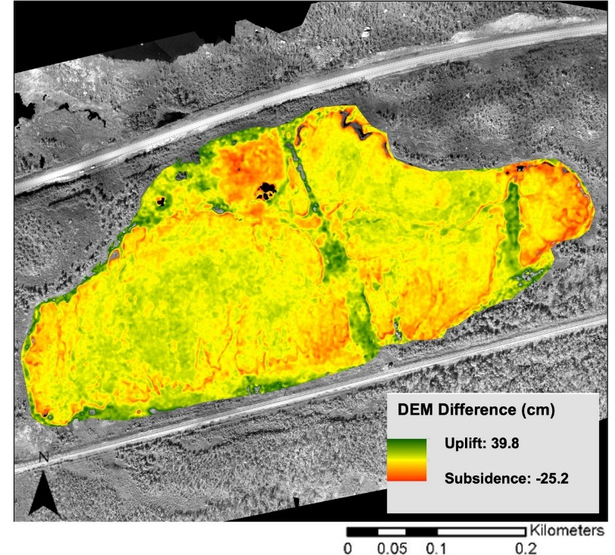
Using high resolution UAV data to measure subsidence
Repeated UAV flights in 2017 and 2020 to differential digital elevation models
Raised palsa areas surrounded by lower lying fen vegetation
High subsidence around edges of palsas experiencing lateral erosion (red areas)
UAV differential DEM method does not work over dense vegetation (green areas showing uplift)

Slide 6
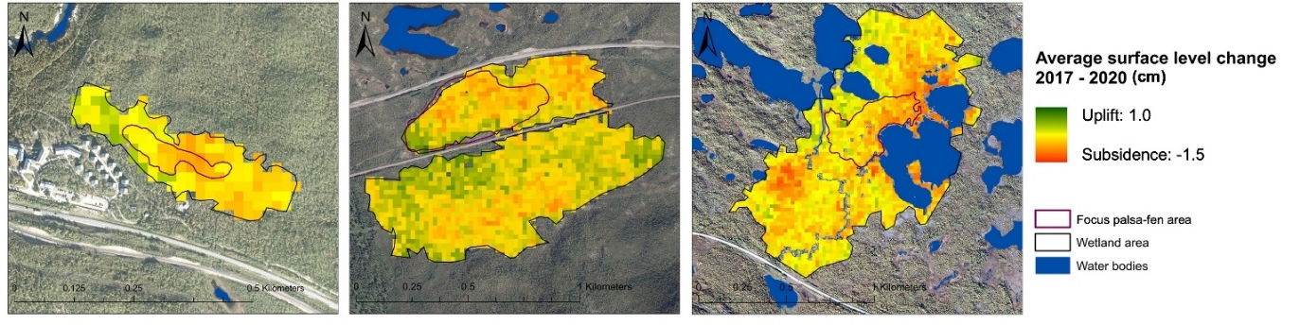
Using satellite InSAR data to measure subsidence
Coherent coverage-data quality is good!
Max subsidence rates 1.5 cm between 2017-2020
Areas of subsidence correspond to degrading area
Differences in subsidence among vegetation types
Largest subsidence in raised palsa areas
BUT fen vegetation is also subsiding- consolidation
Tourist St Storflaket Stordalen
Subsidence (cm)

Slide 7
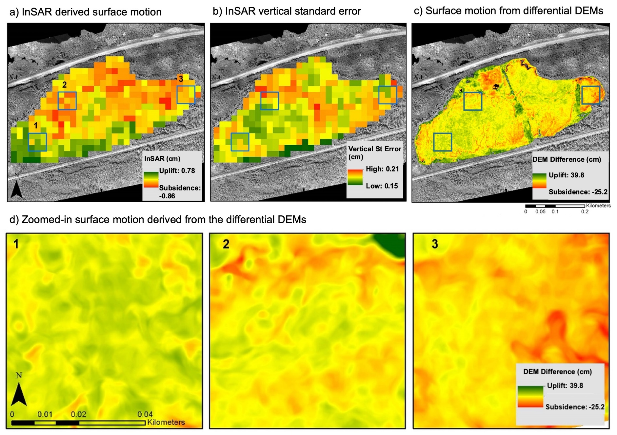
How does the subsidence patterns and rates compare between InSAR and the differential UAV digital elevation models
InSAR subsidence rates are supressed by averaging across 20m*20m pixels
InSAR can detect low levels of motion also in fen vegetation
UAV dDEMs can detect the thaw front at palsa edges
UAV dDEMs can not detect motion under dense fen vegetation

Slide 8
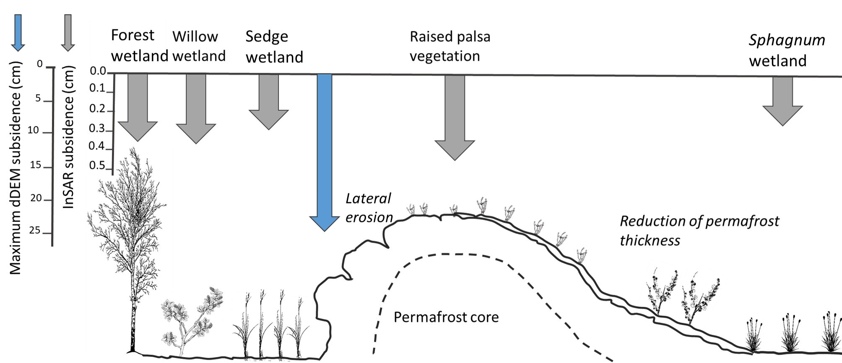
Conclusion
Subsidence from permafrost degradation is detectable with InSAR
Fine scale degradations patterns can be quantified using differential DEMs
Raised palsa peatlands are vulnerable to subsidence

Slide 9
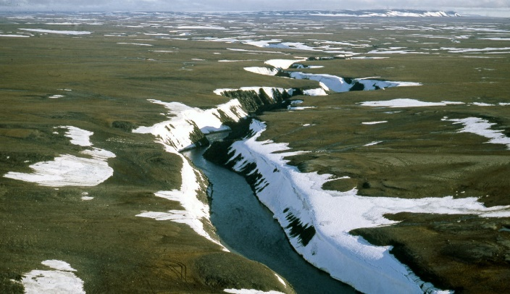
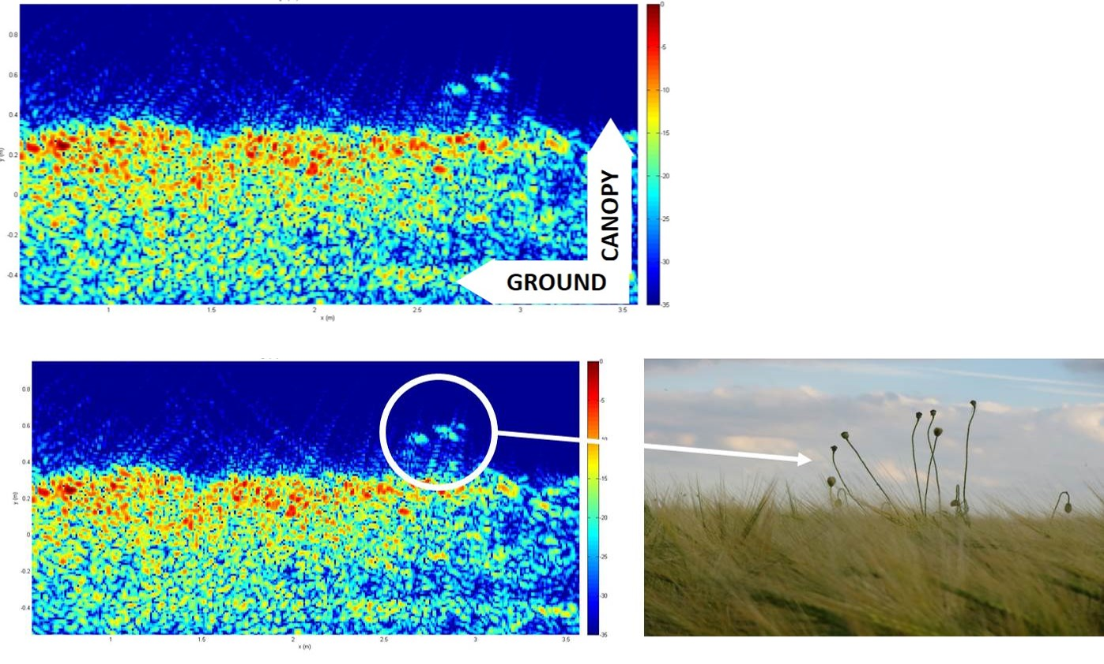
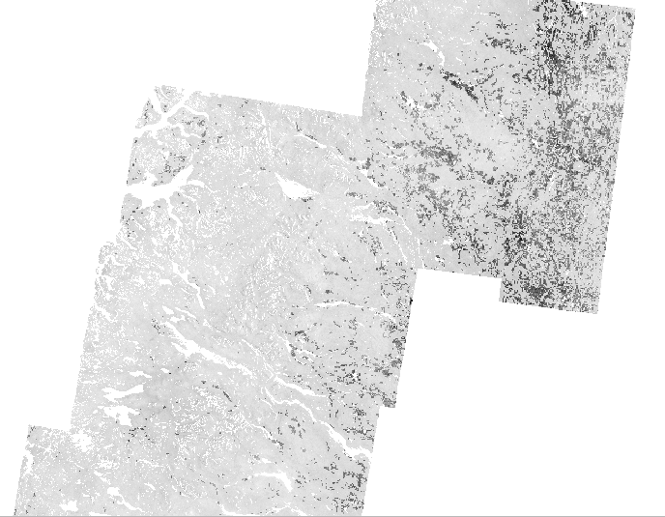
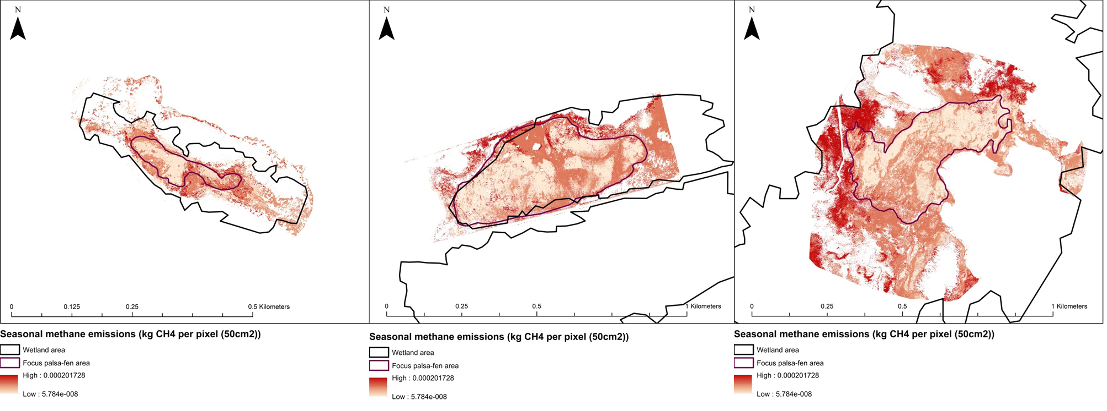
Next steps: Regional permafrost degradation and CH₄ feedbacks

