Slide 1



Metal Leaching from Surface Dust of an Informal E-Waste Recycling area in New Delhi, India
Hina Kumari* and Sudesh Yadav
School of Environmental Sciences
Jawaharlal Nehru University, New Delhi
Email: hinakumari210@gmail.com
European Geophysical Union (EGU), Held at Vienna, Austria & Online 23_{th} to 27_{th} May

Slide 2
INTRODUCTION
Electronic waste (E-waste) is discarded or end-of-life electronics and electricals.
E-waste contains a variety of metals, including precious metals (Au, Ag, and Pd) and base metals (Al, Cu and Fe) to toxic metals (As, Cr and Pb) and organic contaminants such as Polychlorinated biphenyls (PCBs), Polyaromatic hydrocarbons (PAHs), polybrominated biphenyls (PBBs), polybrominated diphenyl ethers (PBDEs).
When recycled, it has a higher economic value than mining ores so recycling of e-waste catches attention due to its monetary value, but improper collection and treatment releases toxic substances into the surrounding environment.
In India, the informal sector recycles 90% of the total e-waste, while the formal sector recycles only 10%.
Unregulated e-waste recycling treatments include crude dismantling, acid leaching, and open burning.
Soil and surface dust act as major sinks and reservoirs of metals in the environment, and are good indicators of their accumulation and distribution; metals released from e-waste recycling treatments can enter the soil profile through leaching and become easily bioavailable to plants and reaches the surface and groundwater that can affect human health.

Slide 3
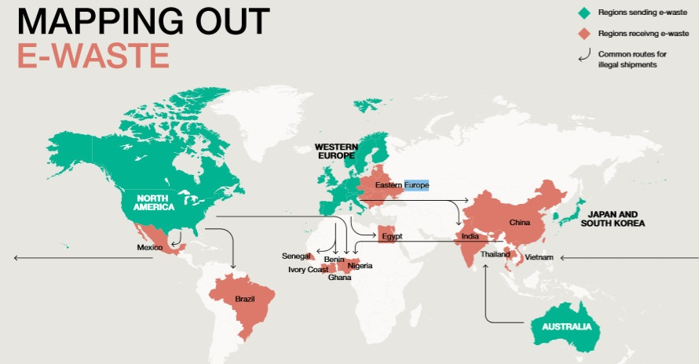
Global
E-waste Generation (53.6 Mt)
India
e-waste generation 3.23 kt
Collected and Recycled by Formal Sector (9.3 Mt) (17.4 %)
10 % recycled by Formal Sector
90 % is undocumented
(recycled by informal sector or thrown in bins)
E-waste not documented (44.3 Mt) (82.6 %)
Raw material of value $57 billion USD
E-waste generation and recycling in India
(Source: Global e-waste monitor, 2020 and CPCB,2020)
Raw material of value $10 billion USD
(4 Mt)
CO2- 98 Mt
Mercury- 50 t
Brominated Flame Retardants (BFRs)- 71 kt
Hydrochlorofluorocarbons (HCFCs)
Chlorofluorocarbons (CFCs)
Global generation of e-waste in million metric tons (Mt), value of raw material it contains and toxicants released annually (Source: Global e-waste monitor, 2020)
Movement of e-waste from developed to developing countries Source: The Global E-waste Statistics Partnership, 2018

Slide 4
Average Composition of e-waste (Source: Electricals and Electronics manufacturing in India, ASSOCHAM, NEC technologies, 2018)

Slide 5
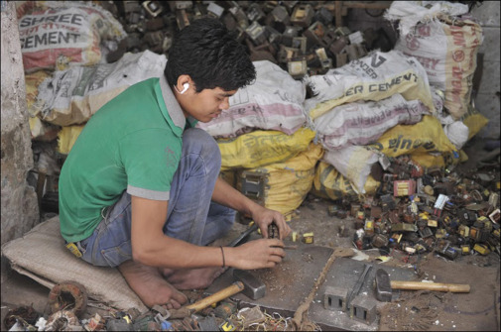
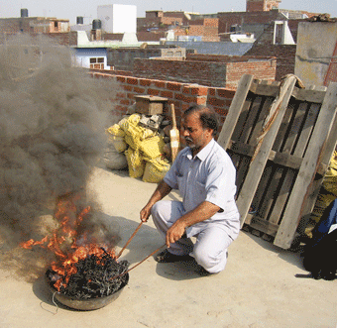
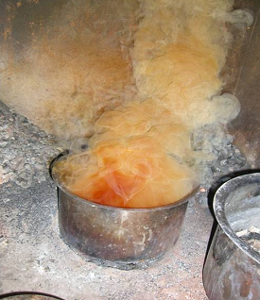
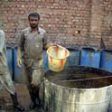
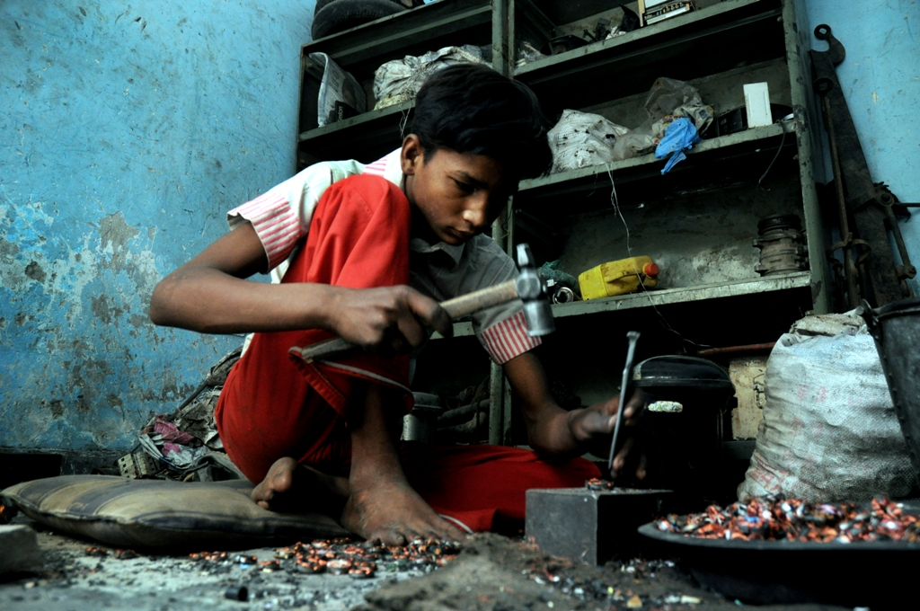
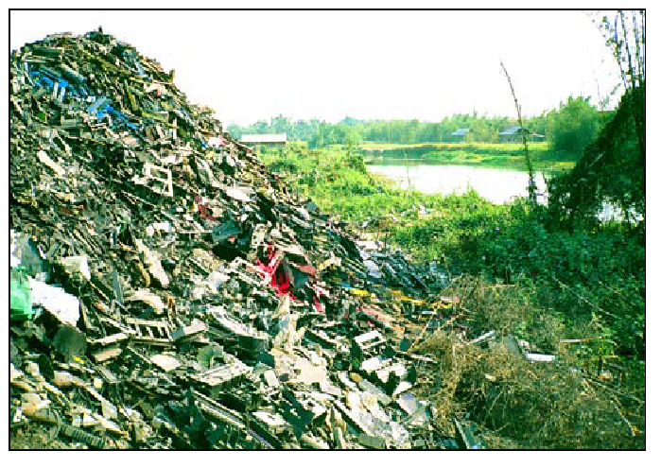
Dismantling
Open burning
Acid bath
Acid Washing
Copper recovery
Disposal
E-waste recycling techniques in informal sectors operational in India

Slide 6
OBJECTIVES
To study the mobility of elements in surface dust samples collected from informal e-waste recycling sites of Delhi, India, using different (WET and TCLP) leaching tests.
To compare the leaching potential of various elements and the effectiveness of both leaching tests (WET and TCLP).

Slide 7
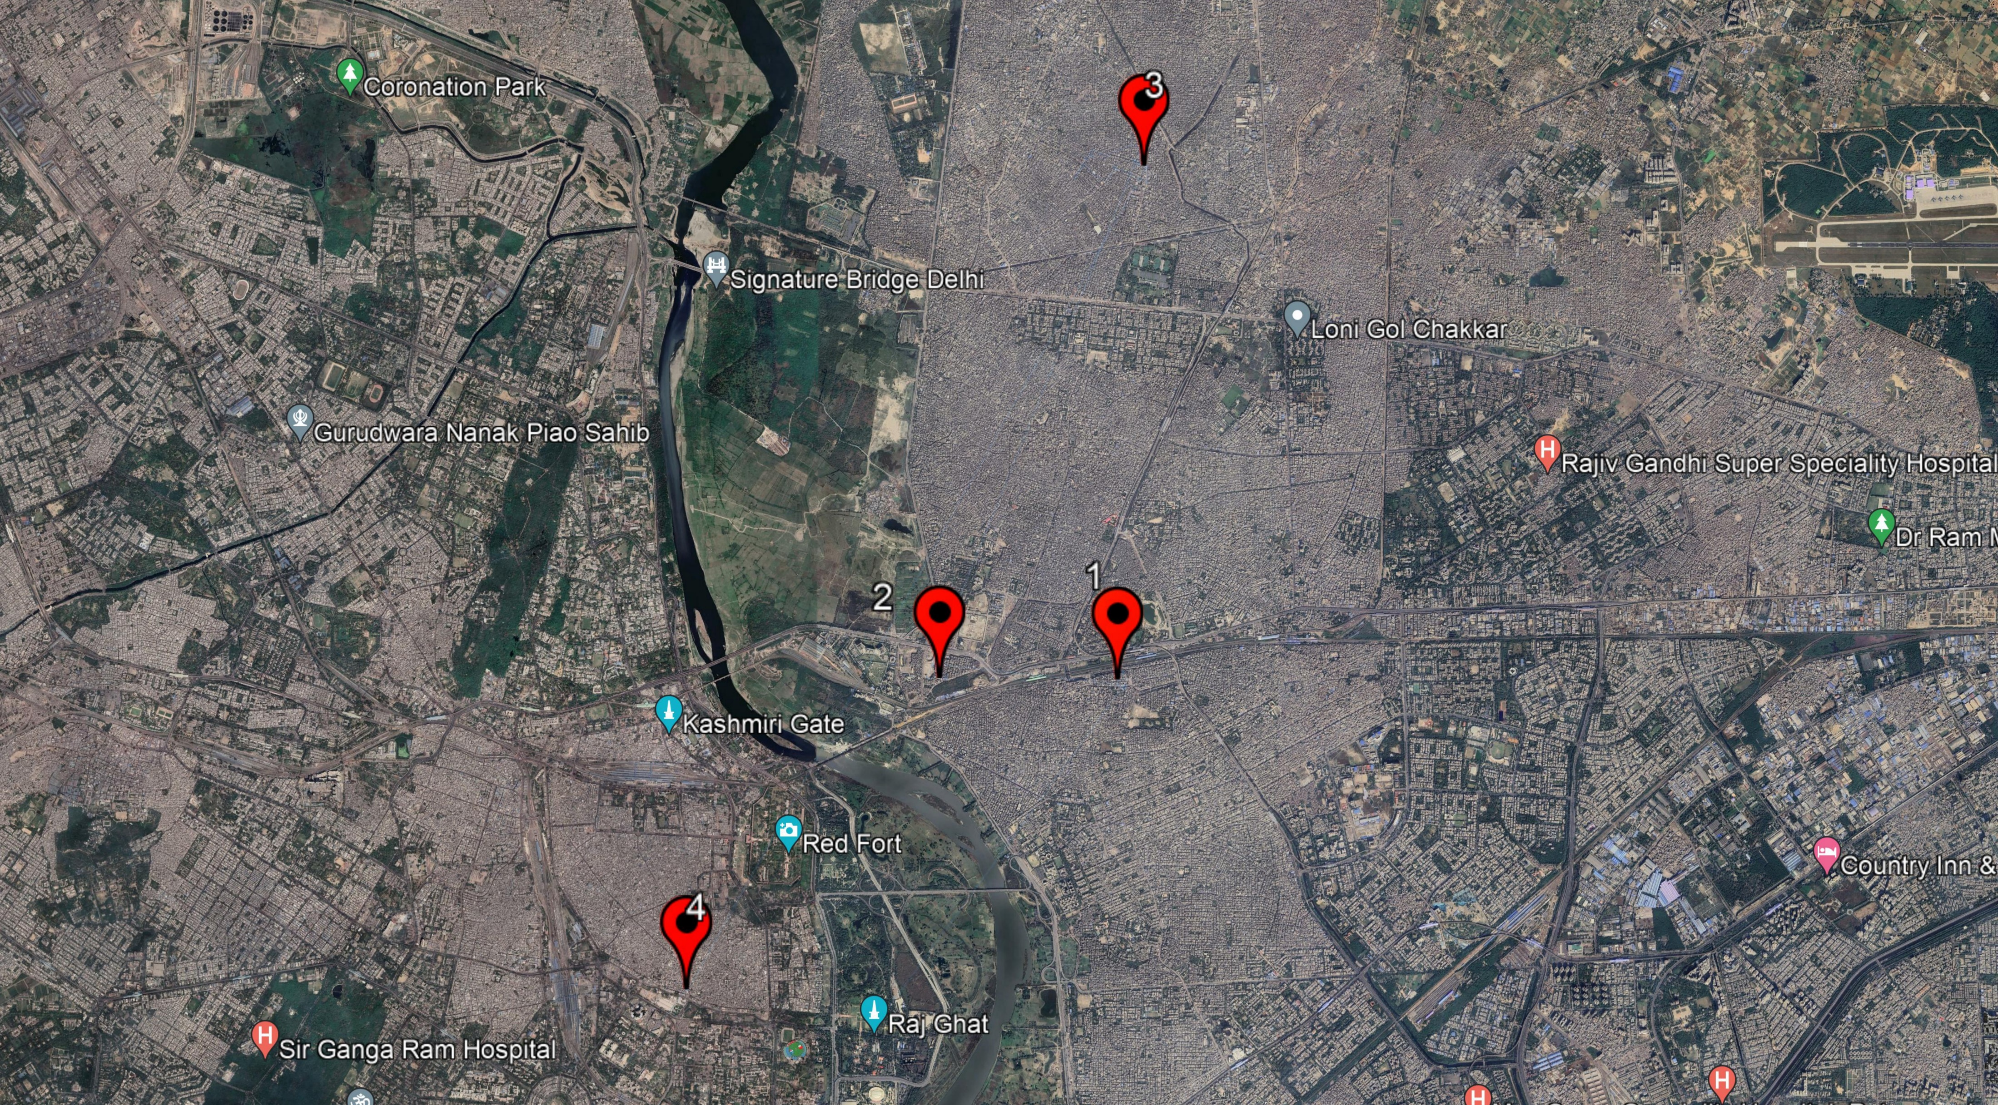
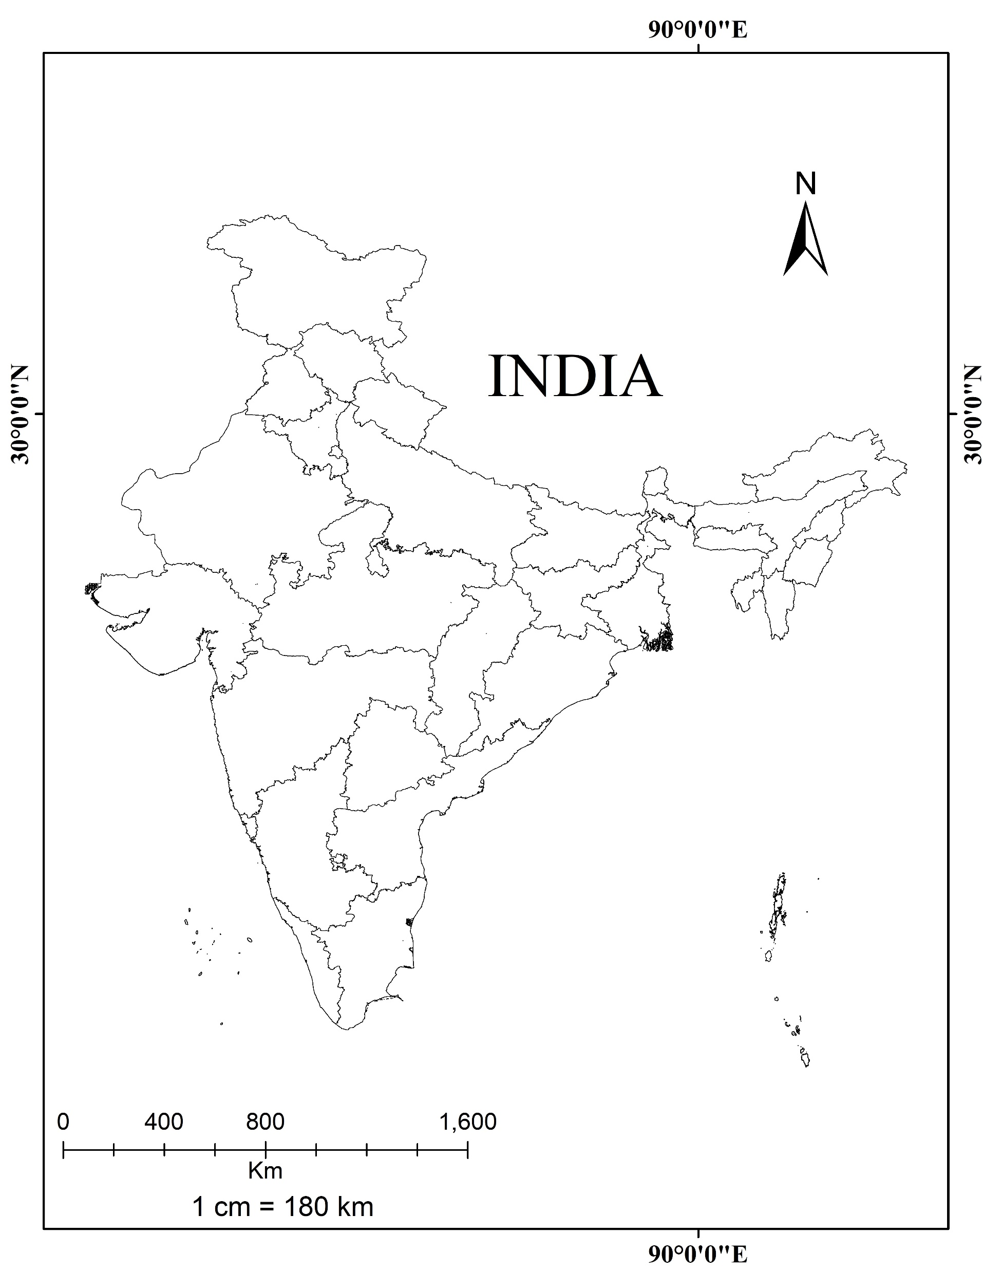
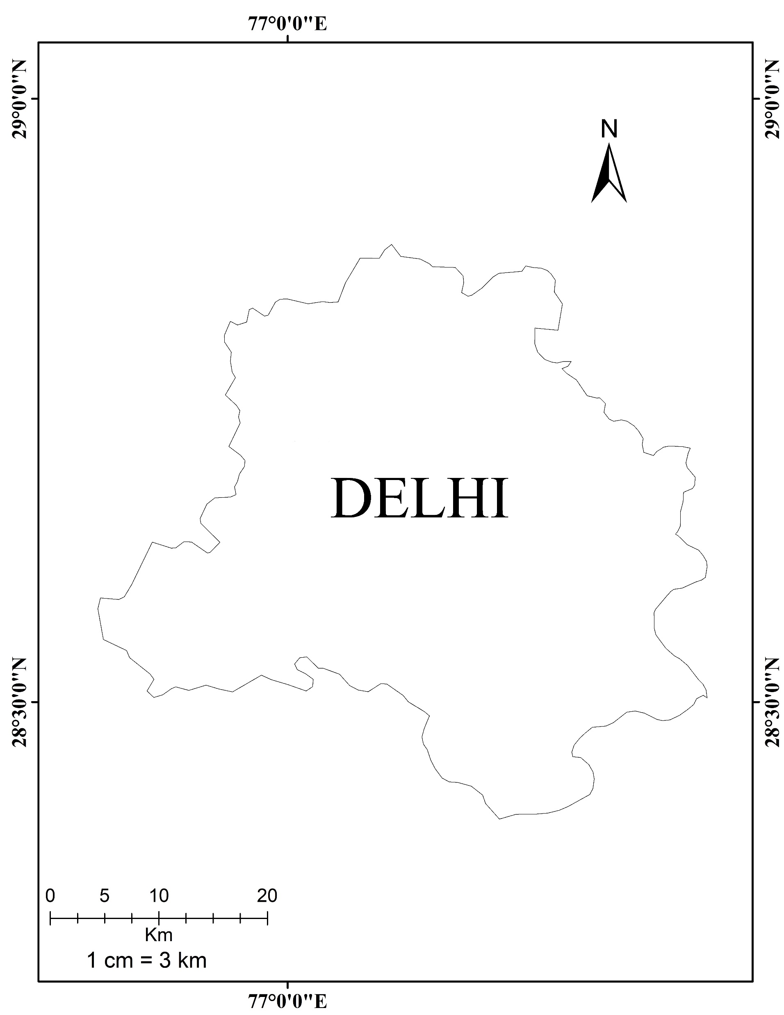

STUDY AREA
Study Area Map showing the sampling locations in Delhi, India

Slide 8
SAMPLING AND METHODOLOGY
Informal E-waste Recycling Units
Surface dust samples collected
Sample Processing
Samples air dried and sieved through 2mm sieve
Homogenized by conning and quartering
Ground to < 1mm size
Toxicity Characteristic Leaching Procedure
(TCLP) USEPA method 1311
Waste Extraction Test (WET) Department of Toxic Substances Control (DTSC; Title 22)
Leachate analysis on Inductively Coupled Plasma-Optical Emission Spectrometry (ICP-OES)

Slide 9
RESULTS
Average concentrations of Cd, Cr, Cu, Ni, Pb and Zn are exceeded Soluble Threshold Limit Concentration (STLC) regulatory limits of CDTSC (California Department of Toxic Substances and Control).
As, Ba, Co and V average concentrations are under the STLC regulatory limits.
Though the limits of Fe, Mn and Sn are not given by CDTSC, but average concentrations of Fe and Mn are exceeding the groundwater permissible limits of BIS (Bureau of Indian Standards) 0.3 mg/l and 0.1 mg/l respectively and Sn also leached in very high concentration.
*= average concentration of WET divided by 10

Slide 10
Average concentrations of As, Ba and Cr are under regulatory limits of TCLP given by USEPA, similarly Co and V are also under safe prescribed limits of STLC.
Cd (5.7 mg/l), Cu (110.3 mg/l) and Pb (91.1 mg/l) exceeded regulatory limits of 1, 25 and 5 mg/l respectively.
Ni (30.5 mg/l) and Zn (424.7 mg/l) exceeded prescribed STLC limits of 20 and 250 mg/l respectively.
Average concentration of Fe (262.1 mg/l), Mn (56.3 mg/l) and Sn (20.6) are also leached significantly.
*= STLC regulatory limits

Slide 11
The average concentration of all the elements is high in the WET as compared to TCLP test this is attributed to a difference in extraction time and citrate ion chelation property of extraction solution of WET.
As comparing the average concentration of WET to TCLP; As, Cd, Cu, Mn and Zn are leached 2 times higher; Ba, Co, Ni and Sn are 3 times higher; Cr is 6 times; Pb is 12 times; V is 25 times and Fe is about 44 times high in WET test.
*= values of WET are divided by 10
**= values of both tests divided by 2

Slide 12
In WET test leaching of elements is in order; Sn (37.7) > Cd (28.7) > Zn (27.9) > Pb (27.7) > Co (21.1) > Mn (14.8) > Ni (11.4) > Fe (8.5) > V (7.6) > Cu (7.5) > Ba (3.5) > Cr (2.9) > As (0.4).
In TCLP test leaching of elements is in order; Co (20.7) > Cd (17.1) > Zn (12.8) > Mn (7.1) > Ni (6.7) > Sn (4.9) > Cu (3.1) > Pb (2.2) > Ba (1.1) > Fe (0.4) > V (0.3) > Cr (0.2) > As (0.1).
The leaching percentage of all the elements is high in the WET as compared to TCLP test this is attributed to a difference in extraction time of both tests.

Slide 13
CONCLUSIONS
In WET test average concentration of all elements is in order; Fe > Pb > Zn > Sn > Cu > Mn > Ni > Ba > Cd > Co > Cr > V > As.
In TCLP test average concentration of all elements is in order; Zn > Fe > Cu >Pb > Mn > Ni > Sn > Ba > Cd > Co > Cr > V > As.
Leaching of some specific elements exceeded the regulatory limits in both WET and TCLP tests in surface dust samples of informal e-waste recycling sites.
Average concentration of all the elements in both tests shows the high concentration of leaching in WET test as compared to TCLP.
The leaching potential of all elements is higher in the WET test, which is due to the chelation property of citrate ion in the extraction solution of the WET test and the extraction time of both tests.
Elements leached above the threshold limits can contaminate nearby soil, surface water, and groundwater that affecting environment and human health.
To protect human health and environment, it is necessary to regulate policies effectively and develop environmentally sound new technologies for e-waste recycling.

Slide 14
THANK YOU

