Slide 1




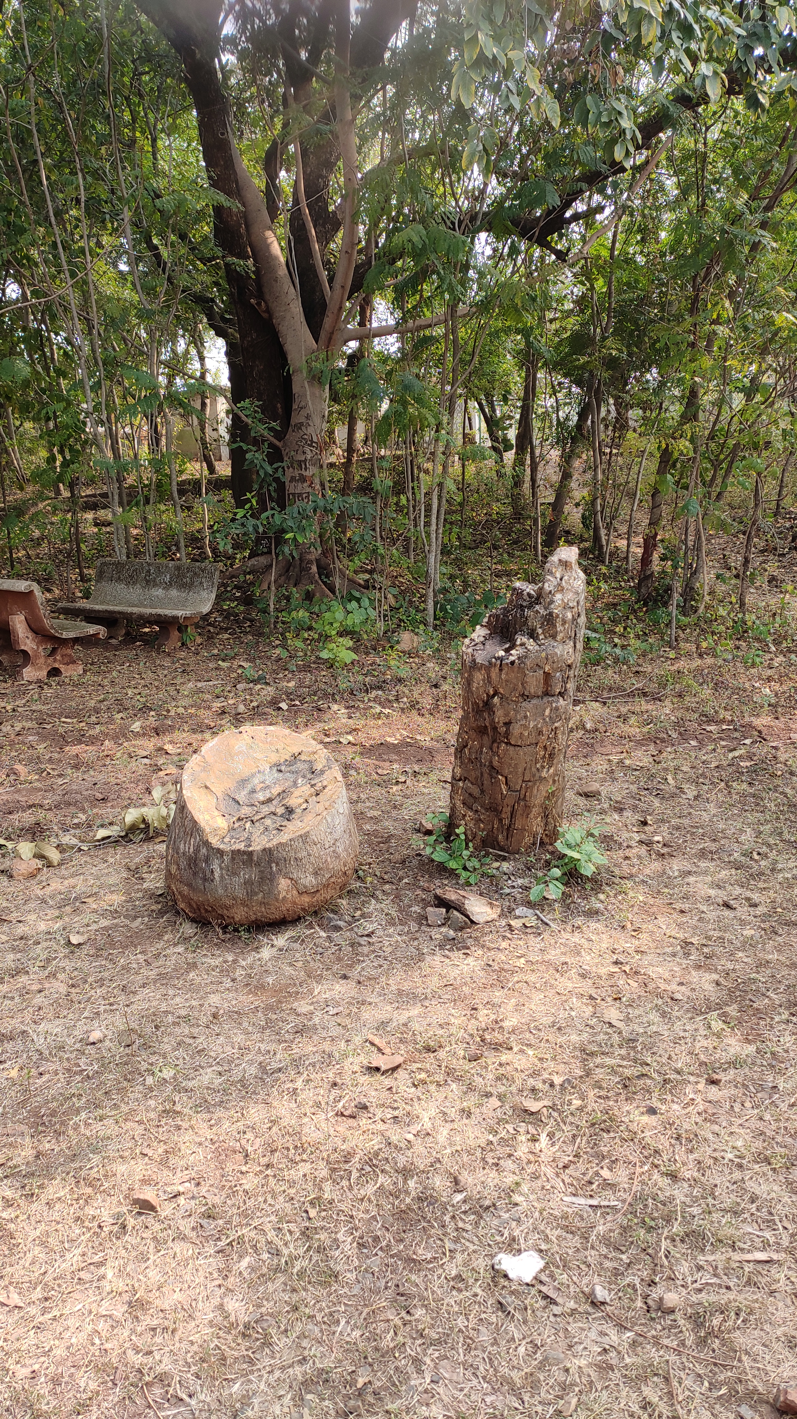
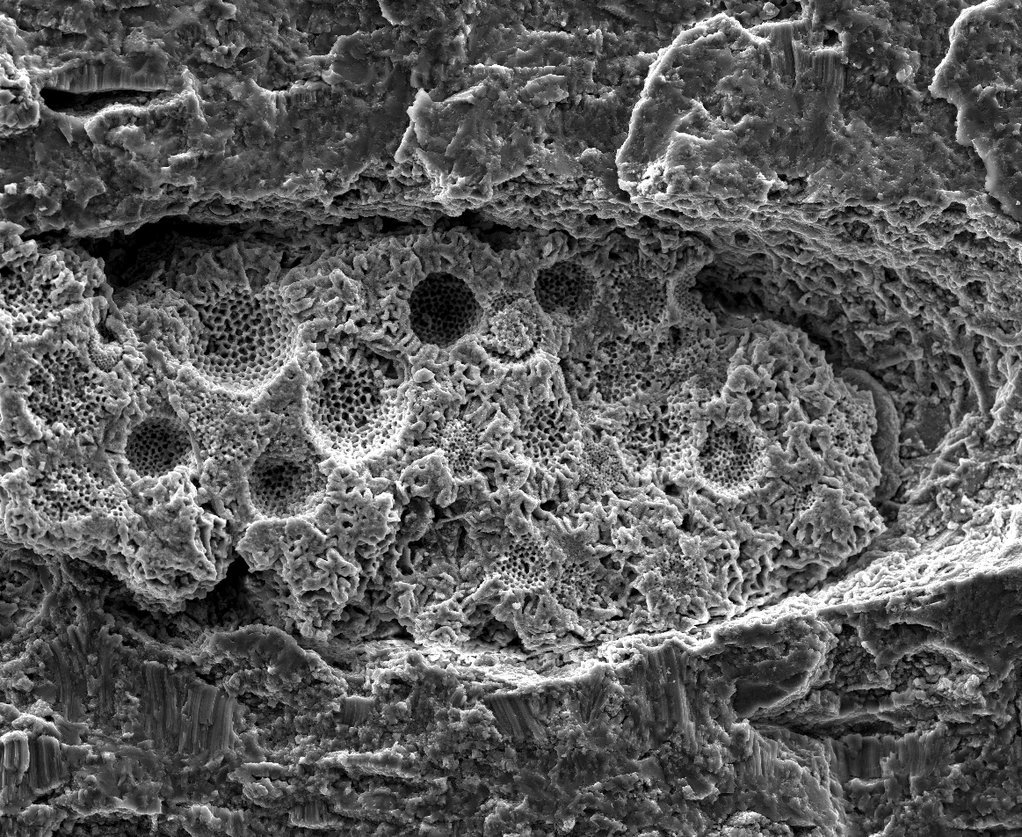



Upright petrified wood
Petrified wood under microscope
Petrified wood under SEM
Evidence of high rainfall in India during Deccan eruptions based on triple oxygen isotope composition of petrified woods
Sangbaran Ghoshmaulik, Sourendra Kumar Bhattacharya, Manoshi Hazra, Pallab Roy, Mahasin Ali Khan, Mao-Chang Liang, and Anindya Sarkar
Session: SSP2.1/CL1.1.8
Wednesday, 25 May 2022, 13:44–13:51 CET

Slide 2
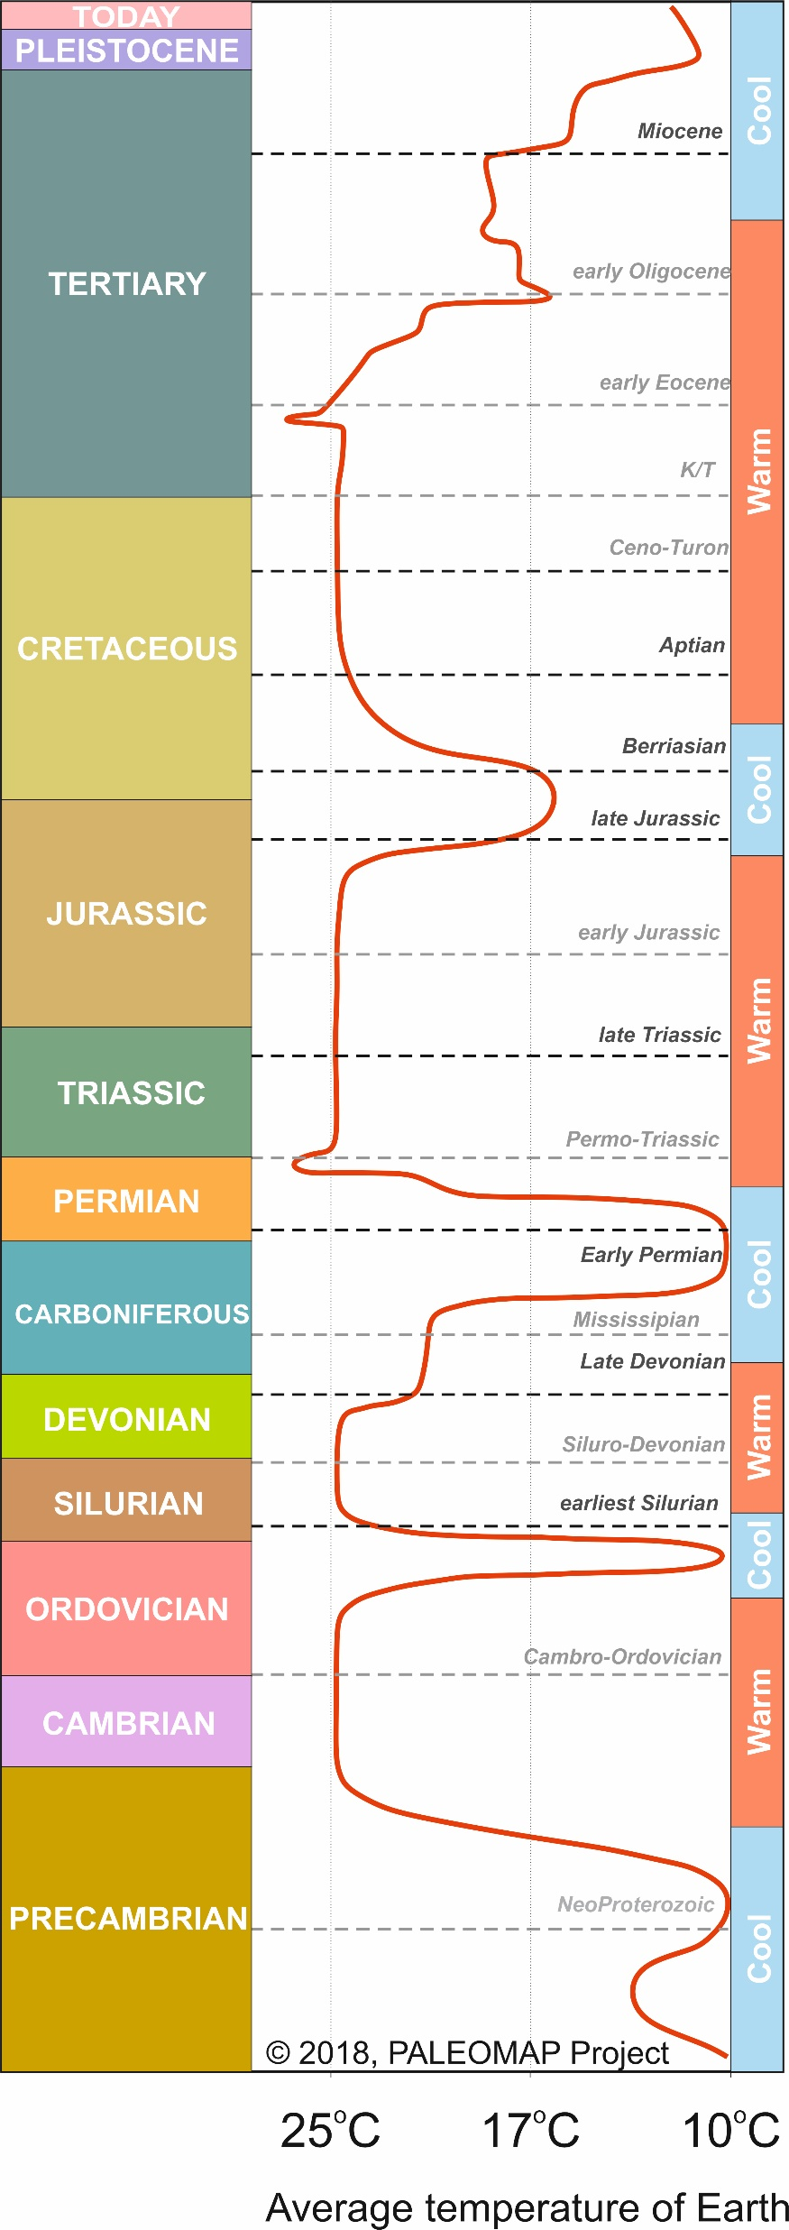
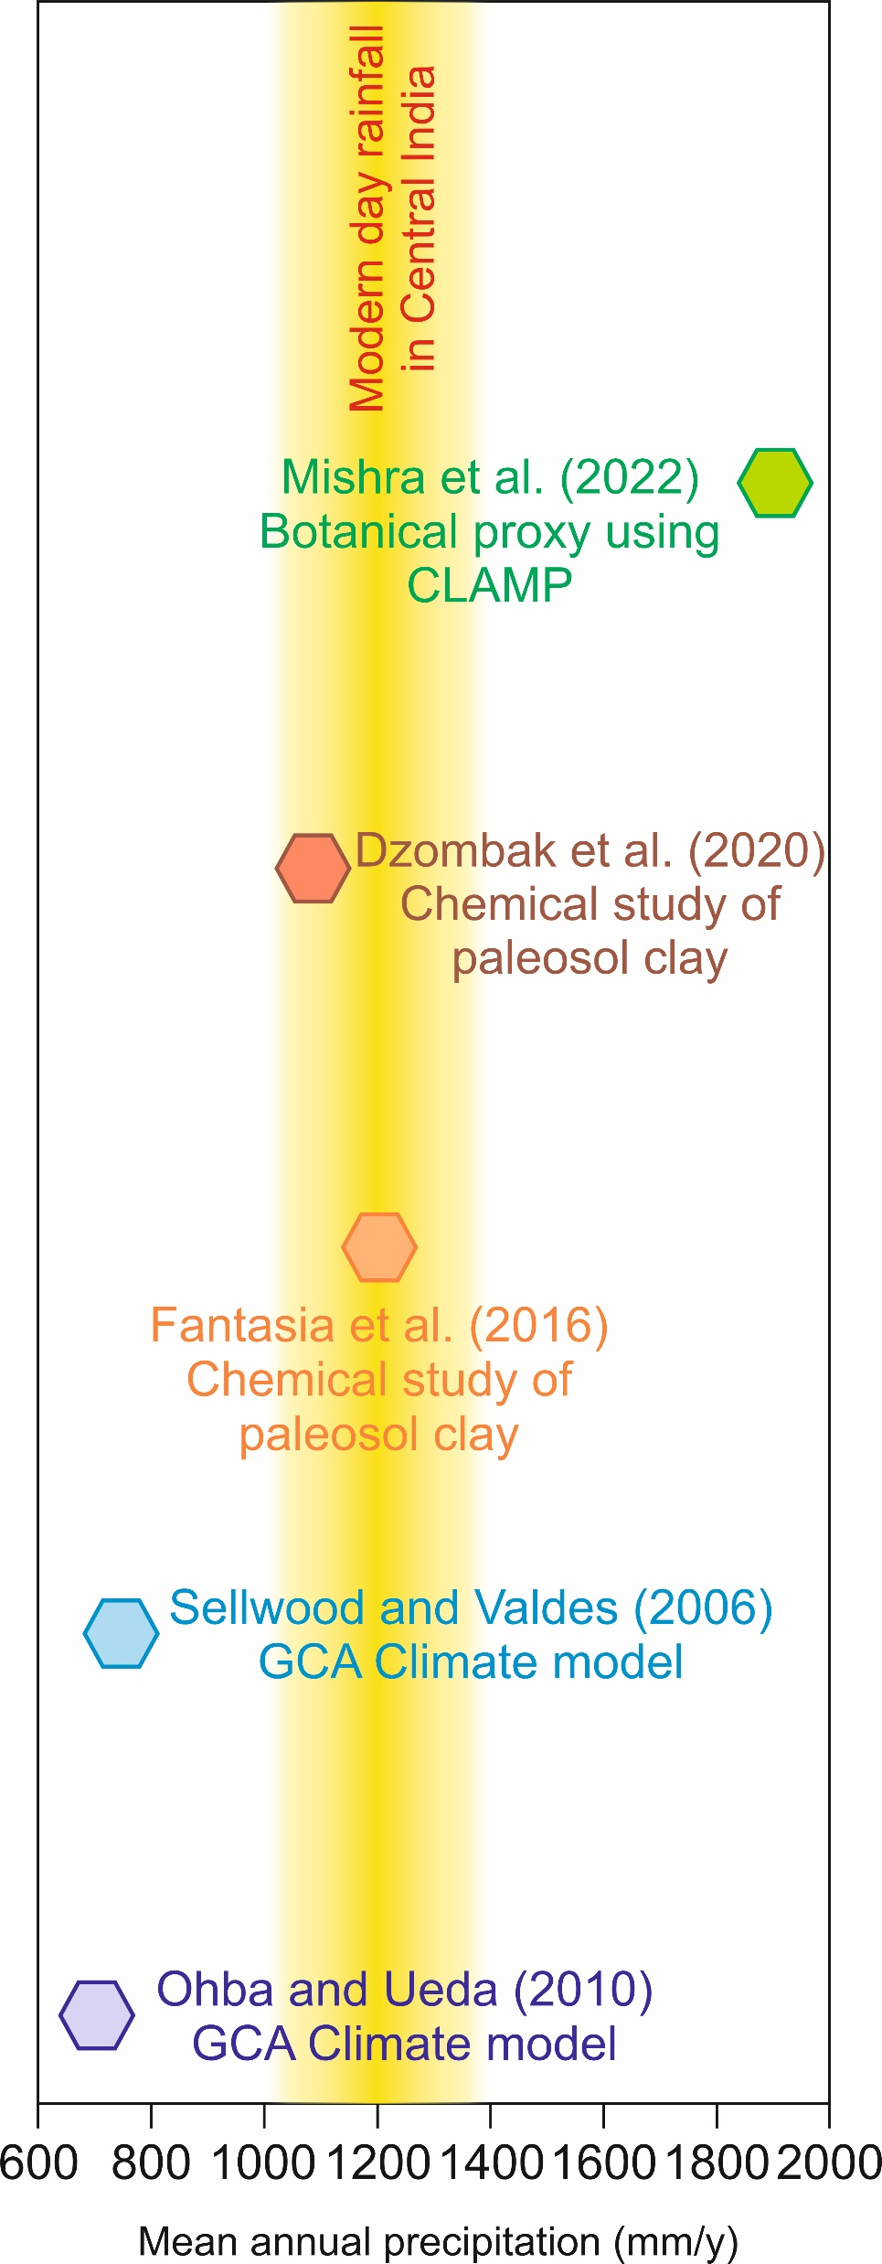

Introduction
Session: SSP2.1/CL1.1.8
The Cretaceous-Paleocene (K-T) transition is marked by a shift in climate with high global temperatures
The climatic condition prevailing across the Indian subcontinent during this K-T transition is best preserved in the concurrent authigenic deposits of Deccan Volcanic Province or DVP
Climatic conditions previously obtained from chemical studies and climatic models do not agree
In this study we analysed petrified wood for their triple oxygen isotope ratio

Slide 3
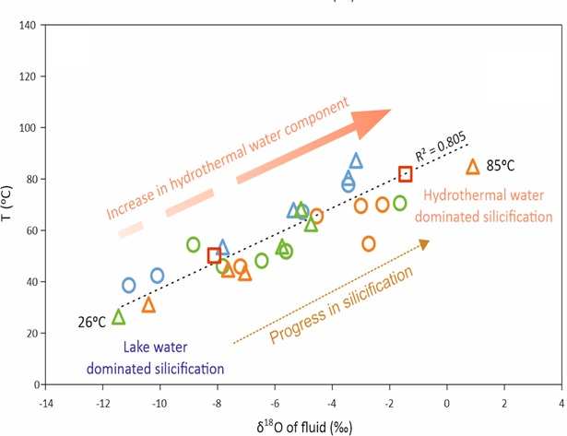
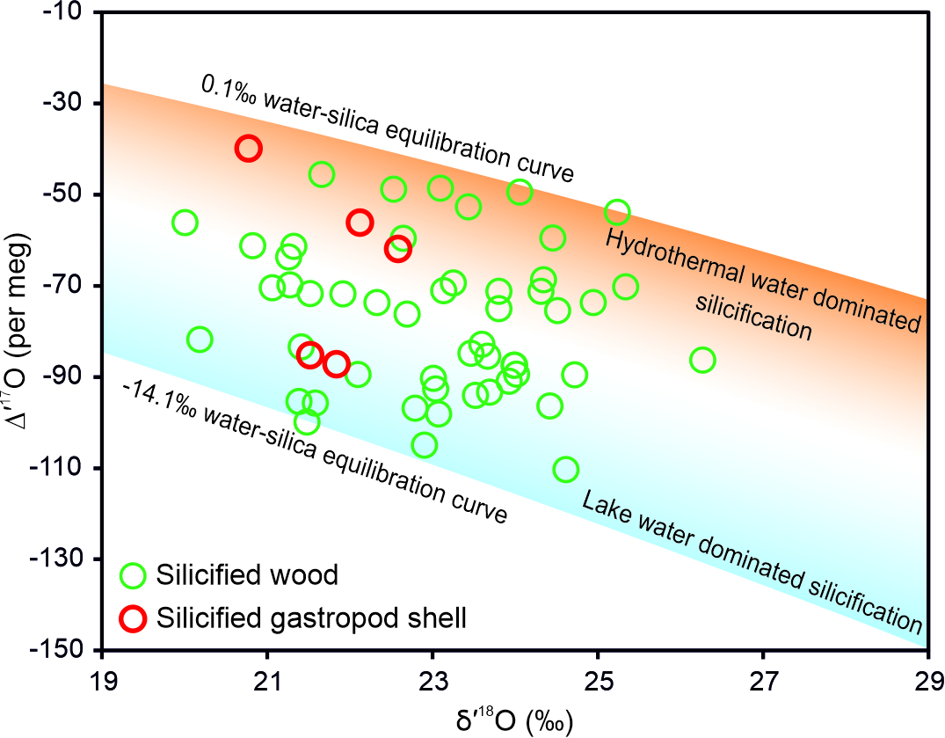
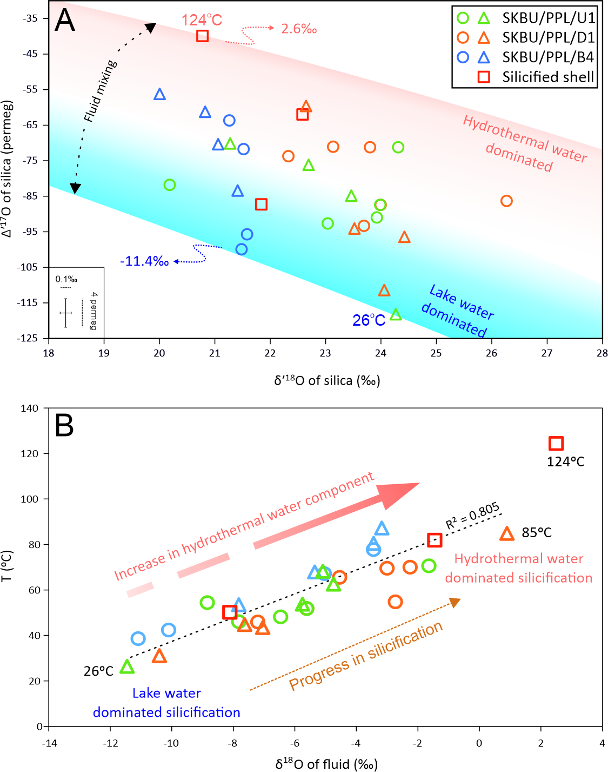
Results and Discussion
Session: SSP2.1/CL1.1.8

Slide 4
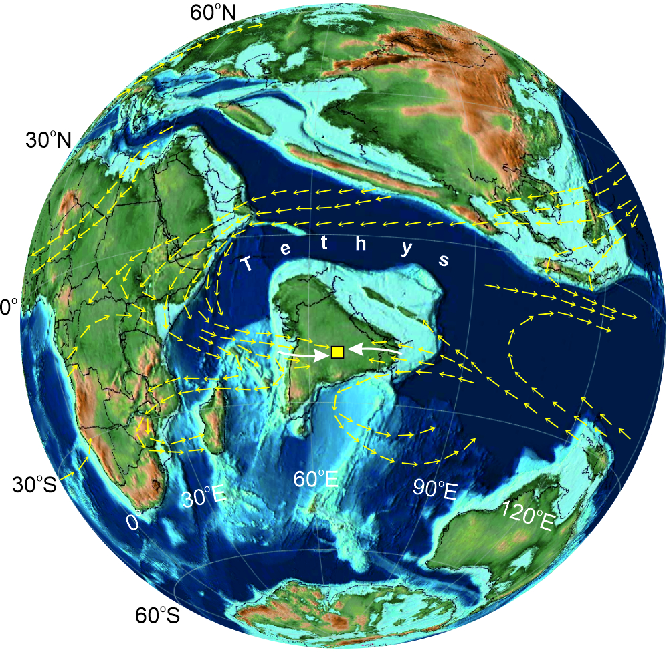
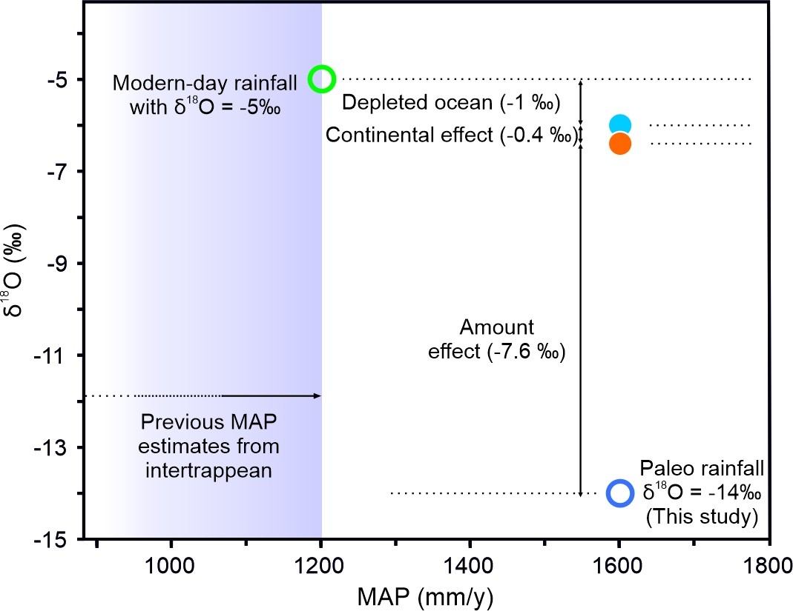
Results and Discussion
Session: SSP2.1/CL1.1.8
After Ohba and Ueda (2010)

Slide 5
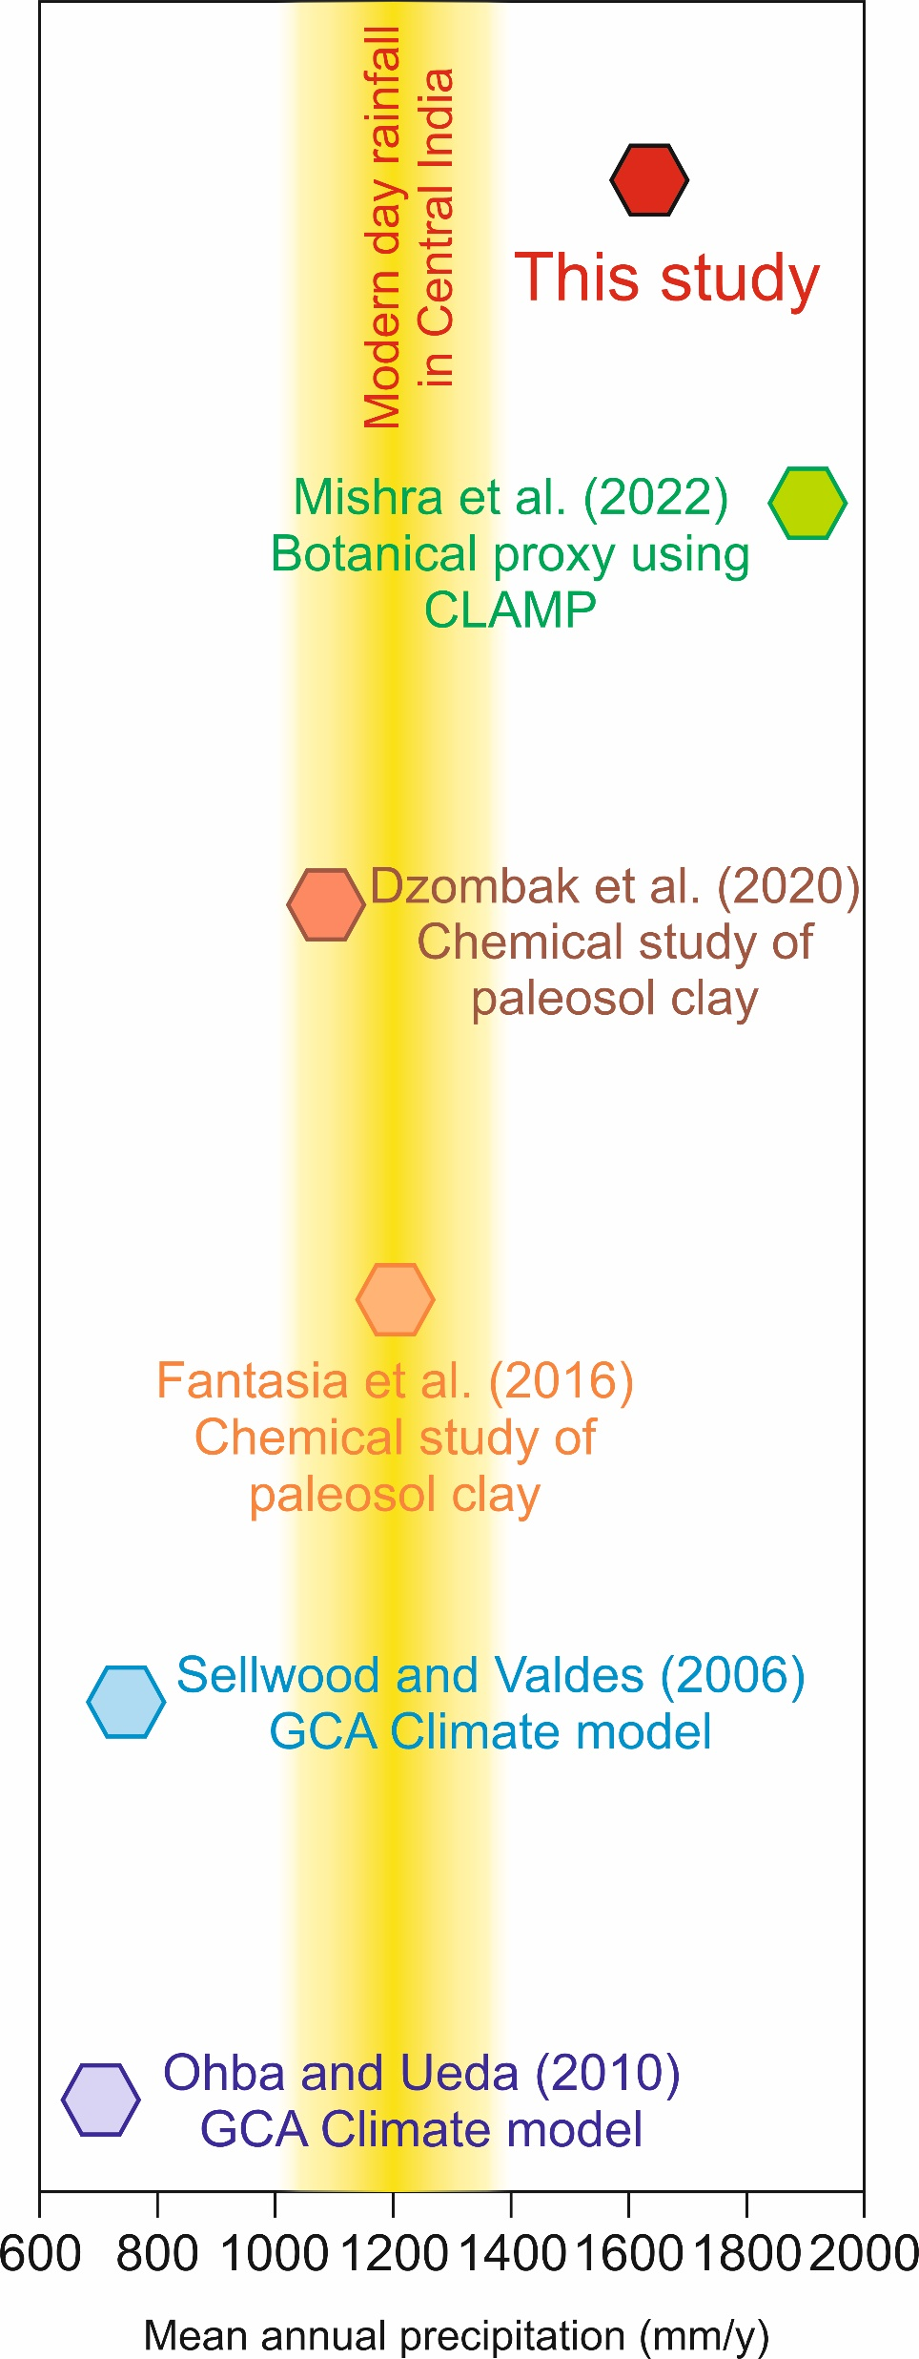
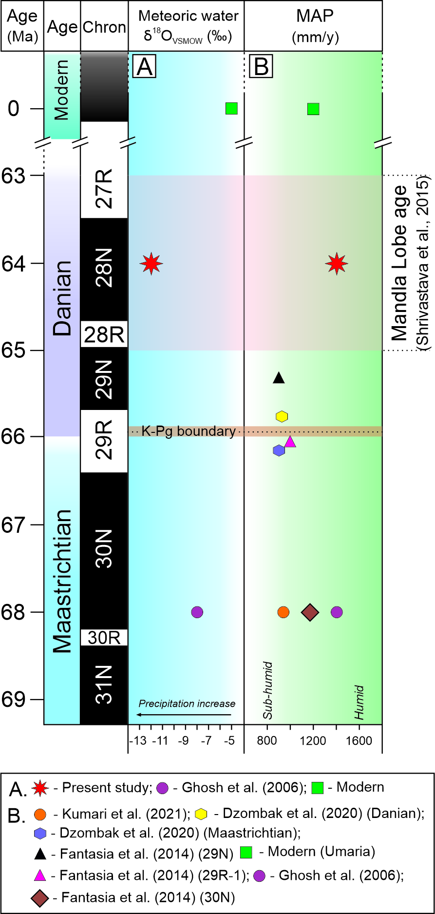
Conclusion
Session: SSP2.1/CL1.1.8
The annual paleo-precipitation or paleo-MAP amount calculated in this study is ~1700 mm/y
This MAP value is higher than the values obtained earlier from climate models and chemical studies
This MAP value is close to the values obtained from statistical studies of botanical proxies
Our results suggest that the end Cretaceous to early Paleocene India was more humid compared to today

Slide 6


Session: SSP2.1/CL1.1.8
Thank you
Sangbaran Ghosh Maulik
National Stable Isotope Facility in Geochemistry
Indian Institute of Technology Kharagpur
ghoshsangbaran@gmail.com
geosangbaran@iitkgp.ac.in

