Slide 1



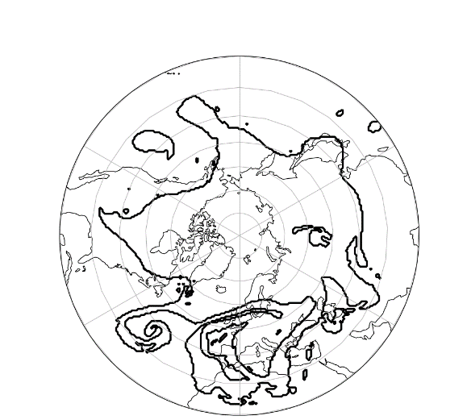
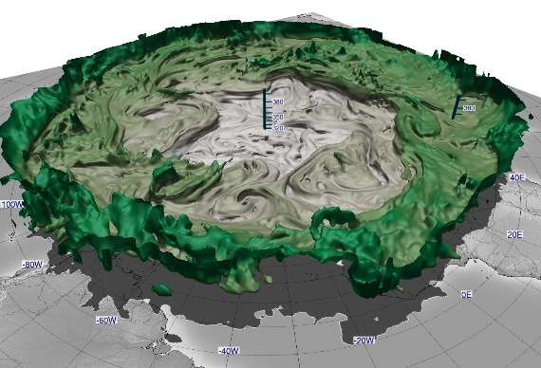
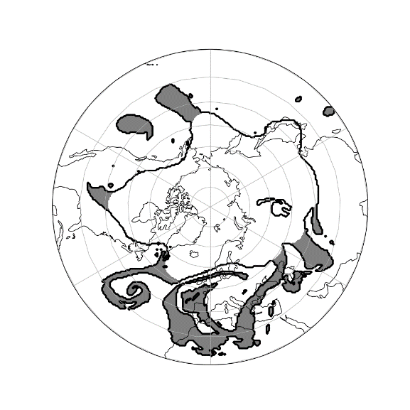
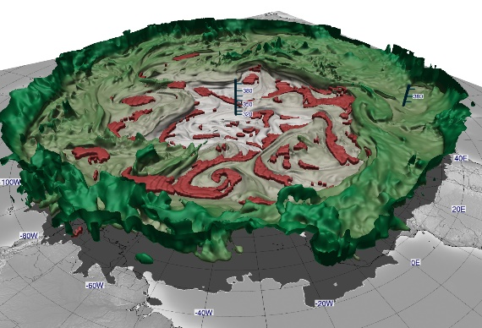
A novel method for objective identification of 3-D potential vorticity anomalies
Christoph Fischer^{1,2}, Andreas H. Fink¹, Elmar Schömer², Roderick van der Linden¹, Michael Maier-Gerber¹, Marc Rautenhaus³, Shun Yiu Chung¹, Marvin Kriening¹, Michael Riemer⁴
Institute of Meteorology and Climate Research, Karlsruhe Institute of Technology, Germany
Institute of Computer Science, Johannes Gutenberg University, Mainz, Germany
Regional Computing Centre, Visual Data Analysis Group, University of Hamburg, Hamburg, Germany
Institute of Atmospheric Physics, Johannes Gutenberg University, Mainz, Germany
Existing studies focus mainly on 2-D analysis of potential vorticity (PV)
3-D analysis reveals full structure
Novel strategy based on morphological operations, compensating distortions
Applicable to both 2-D and 3-D fields
Improvements already in 2-D
PVA Identification
2-D | 3-D

Slide 2

A novel method for objective identification of 3-D potential vorticity anomalies
Visualizations using Met.3D¹
3-D visualizations vital for interpreting processes
N
Dynamical tropopause (2-PVU boundary) shaded by isentropic height
¹ Rautenhaus, M., Kern, M., Schäfler, A., and Westermann, R.: Three-dimensional visualization of ensemble weather forecasts – Part 1: The visualization tool Met.3D (version 1.0), Geosci. Model Dev., 8, 2329-2353, doi:10.5194/gmd-8-2329-2015, 2015.
Dynamical tropopause on 27 Sep 2018. Data: ERA5

Slide 3

A novel method for objective identification of 3-D potential vorticity anomalies
Visualizations using Met.3D¹
3-D visualizations vital for interpreting processes
Anomalies in „valleys“
No distinction between streamers and cutoffs in 3-D
Identified volumetric PV anomaly (PVA)
¹ Rautenhaus, M., Kern, M., Schäfler, A., and Westermann, R.: Three-dimensional visualization of ensemble weather forecasts – Part 1: The visualization tool Met.3D (version 1.0), Geosci. Model Dev., 8, 2329-2353, doi:10.5194/gmd-8-2329-2015, 2015.
Dynamical tropopause on 27 Sep 2018 with identified anomalies by our strategy. Data: ERA5

Slide 4
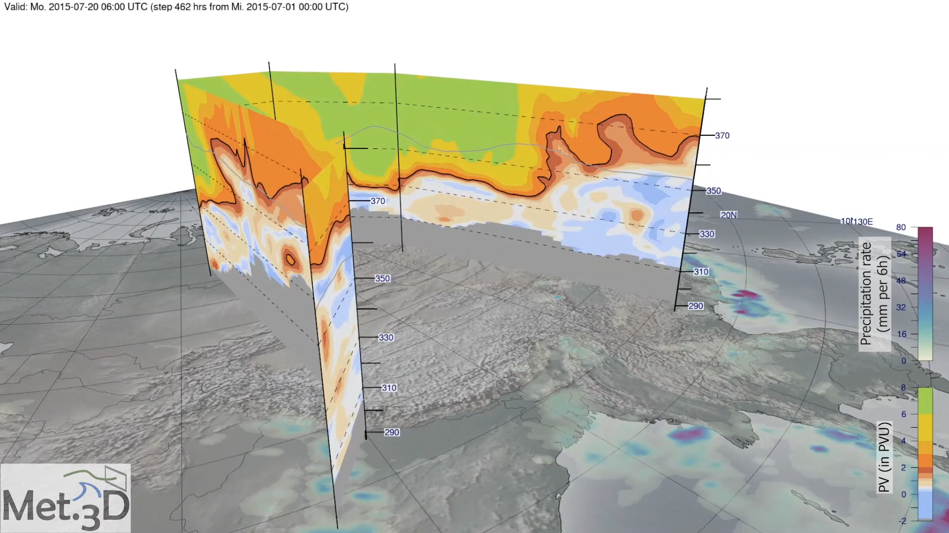


Case Study: Flooding event in Vietnam in 2015
PVA identified as precursor to the analyzed event
Robustly detected over a longer timespan compared to 2-D
Further advantages of 3-D analysis:
Based on more information → more features
Full event represented in one display
No need to choose „good“ isentrope for climatological analyses
Cross-section of PV
(black line = 2 PVU)
Fischer, C., Fink, A. H., Schömer, E., van der Linden, R., Maier-Gerber, M., Rautenhaus, M., and Riemer, M.: A novel method for objective identification of 3-D potential vorticity anomalies, Geosci. Model Dev. Discussions, 1-30, doi:10.5194/gmd-2021-424, 2022. Accepted for publication. Code and video supplement available.
Precipitation rate
@ChristophFischr

