Slide 1






24 may
2022
Lithology Mapping with Satellite, Fieldwork-based Spectral data, and Machine Learning:
the case study of Beiras Group (Central Portugal)
João Pereira
Alcides Pereira, Artur Gil, Vasco M. Mantas

Slide 2


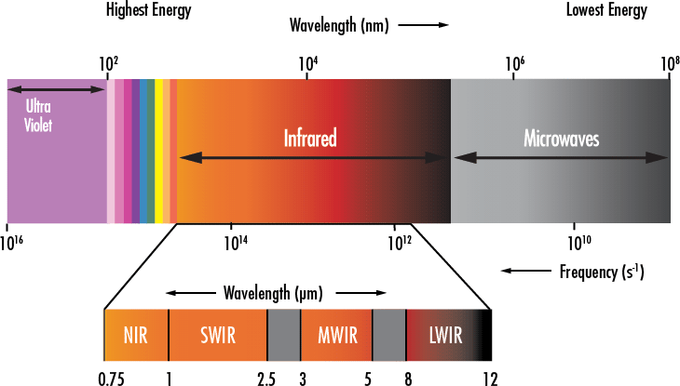



Integration of various data sources has provided valuable and detailed knowledge for geological studies
Much of remote sensing works are in the Visible-near-infrared (VNIR) , Shortwave Infrared (SWIR), mid-infrared (MIR), and thermal infrared (TIR)
Primary motivation
Gili et al (2021)

Slide 3
Main
Creating and applying new methodologies that support the Beiras Group (BG) geological characterisation
Complementaries
Perform spectral analysis of rock and soil samples
Obtain spectral data from various sources such as field and Landsat 8 data
Correlate the geochemistry of major elements with the obtained spectral data

Slide 4
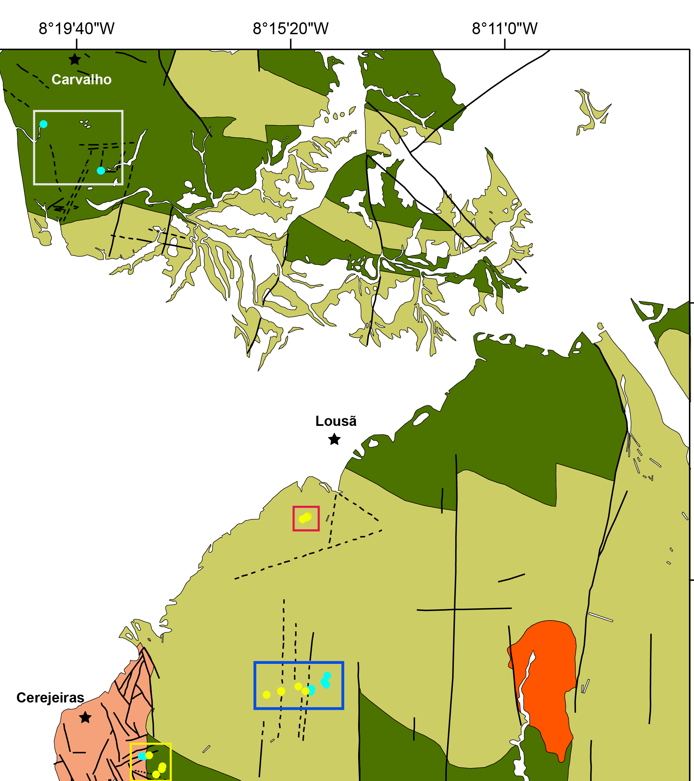
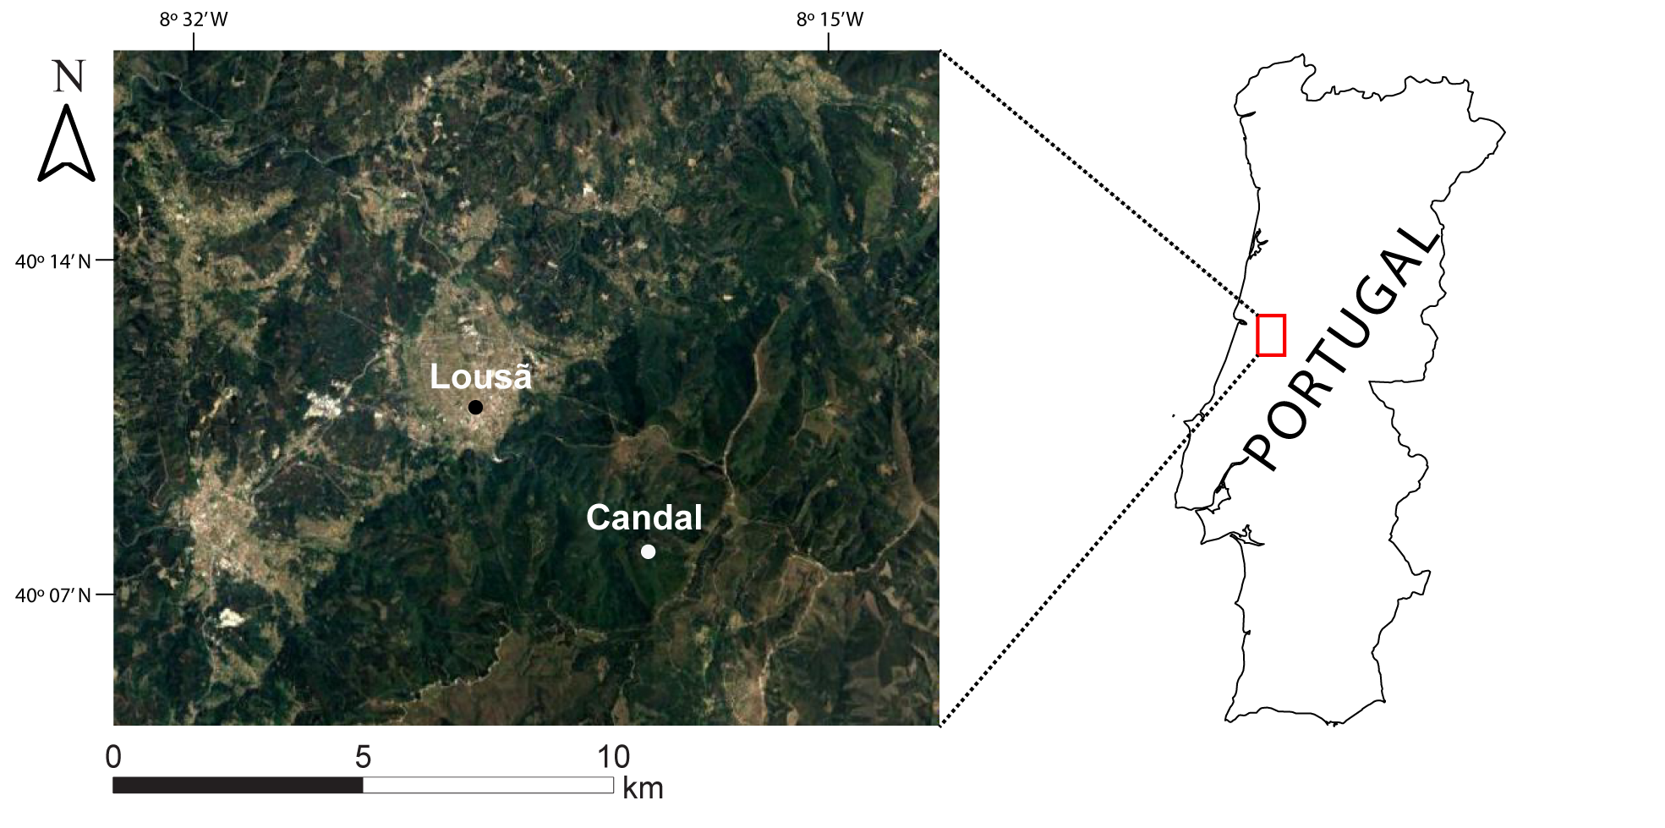


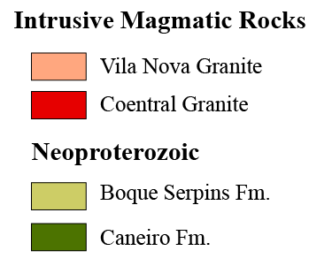
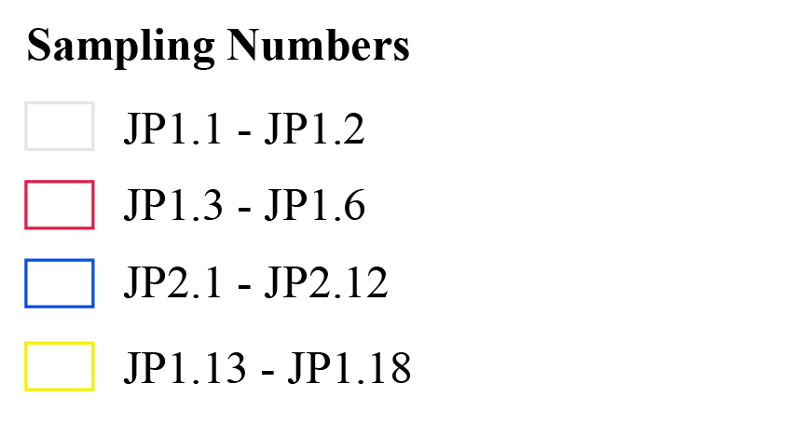
The BG has Upper Neoproterozoic Units (560 my)
Caneiro Fm. outcrops are formed dominantly by metagraywackes (NCa) with thinly bedded metapelites (NBs)
Two pre-variscan orogeny granites outcrop intruding the metasediments – Coentral Granite (GCo) and Vila Nova Granite (GVn)
Geographical setting of the study area in Central Portugal
Study area is in Central Portugal
Beiras Group (BG) is part of the Douro-Beiras Supergroup (DBS)
Simplified geological map (Soares et al, 2005) and sampling of the study area
BEIRAS GROUP

Slide 5
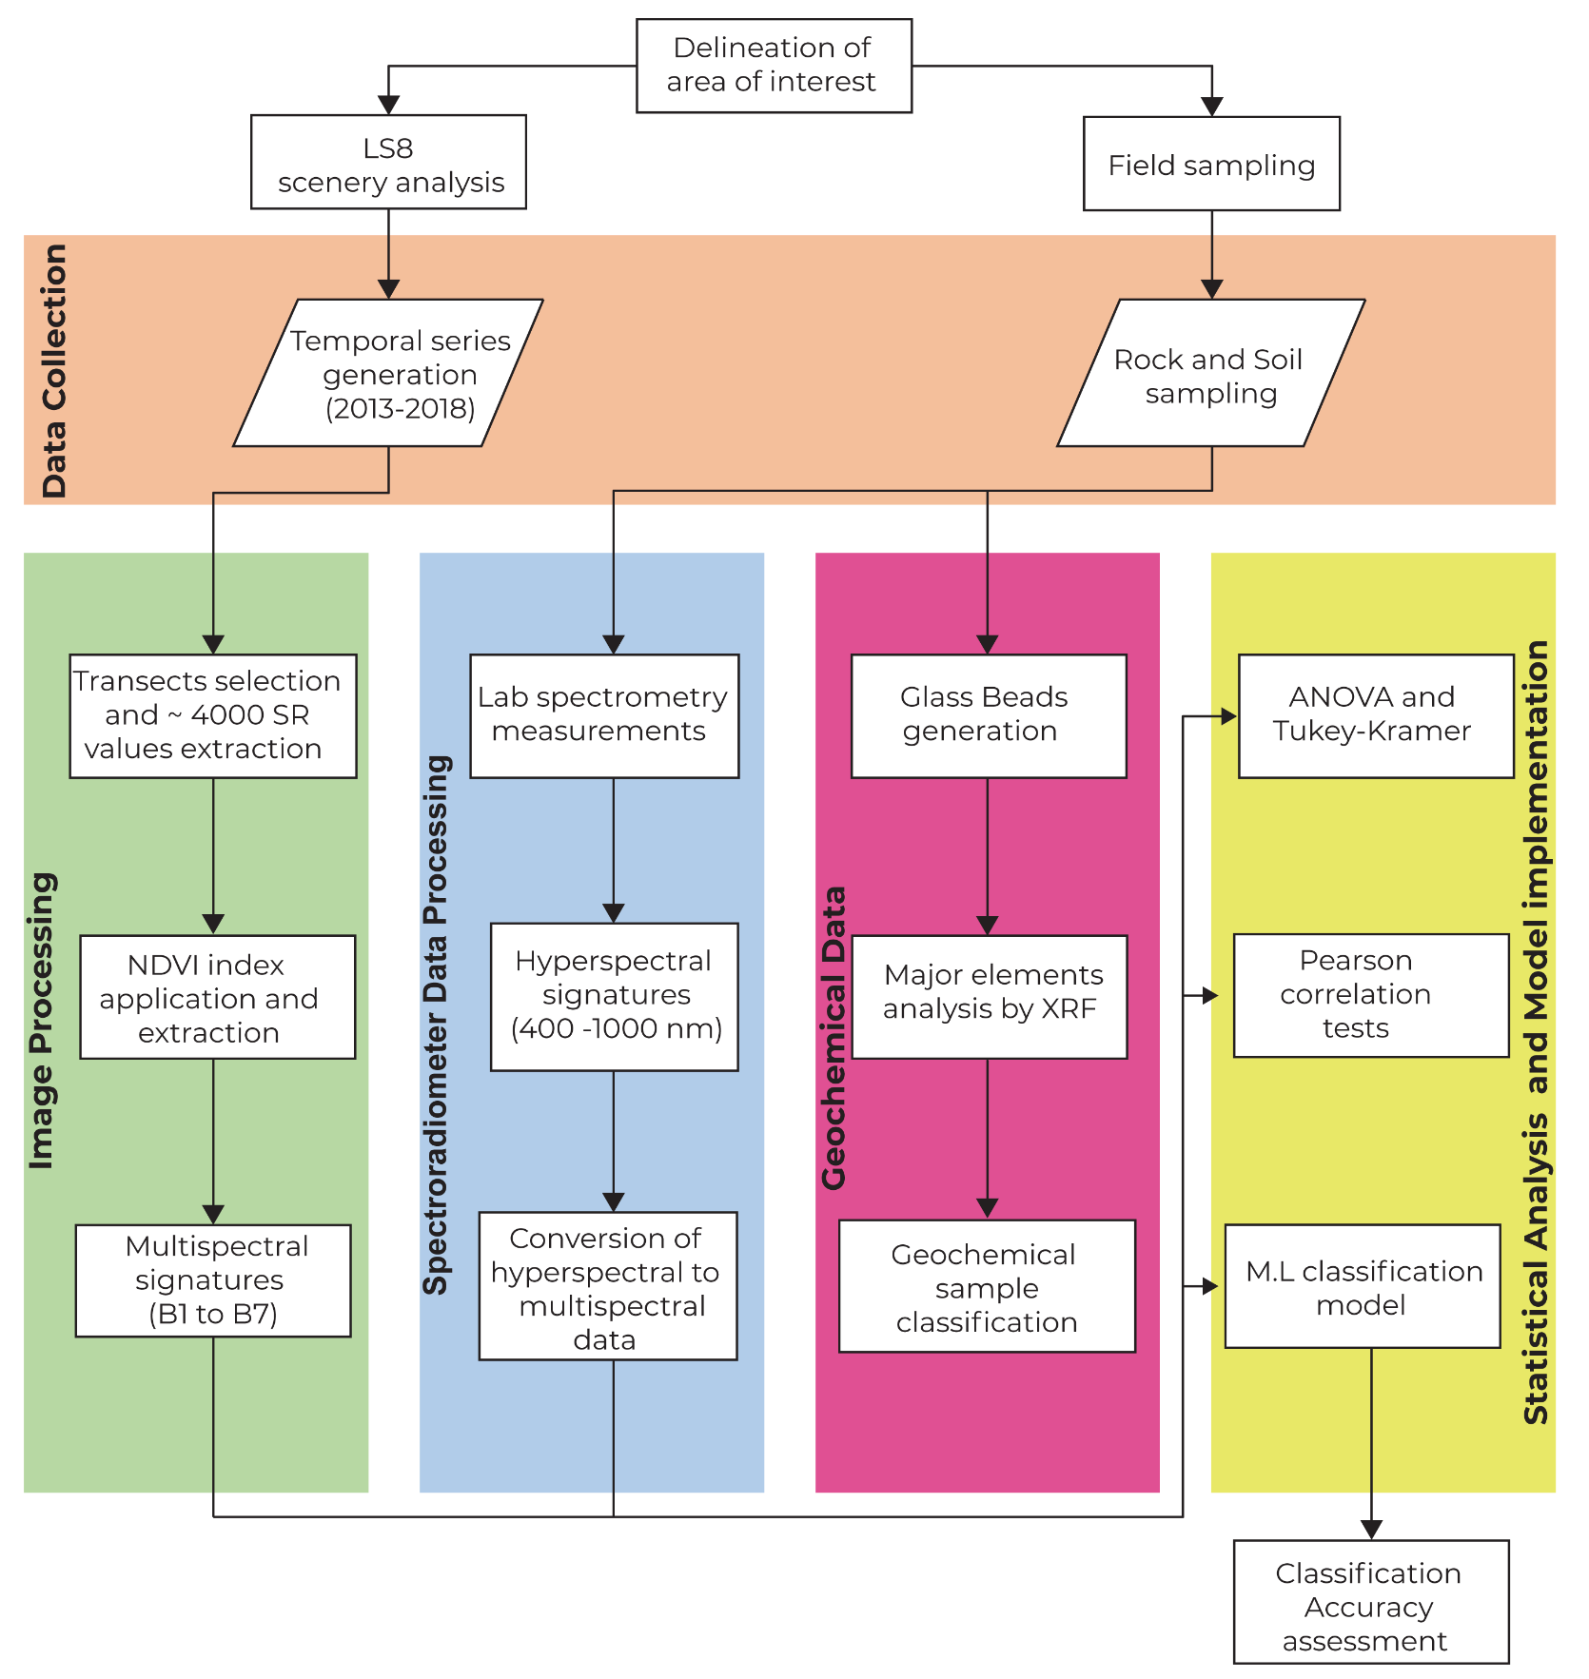
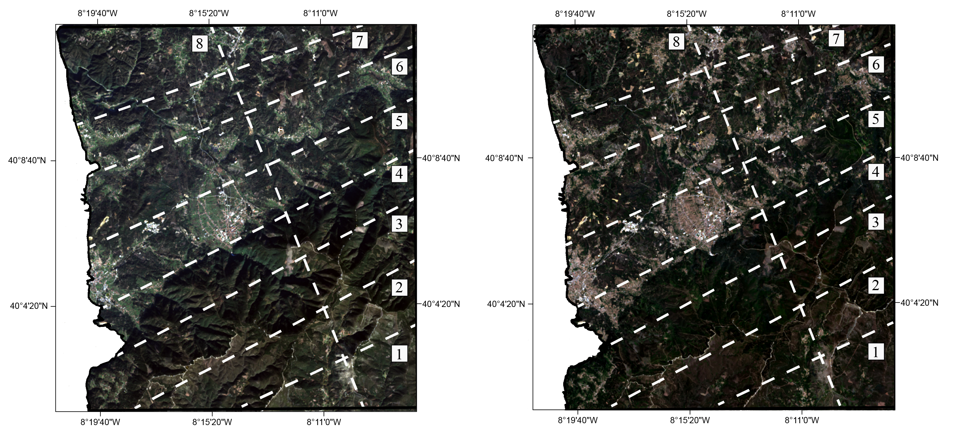
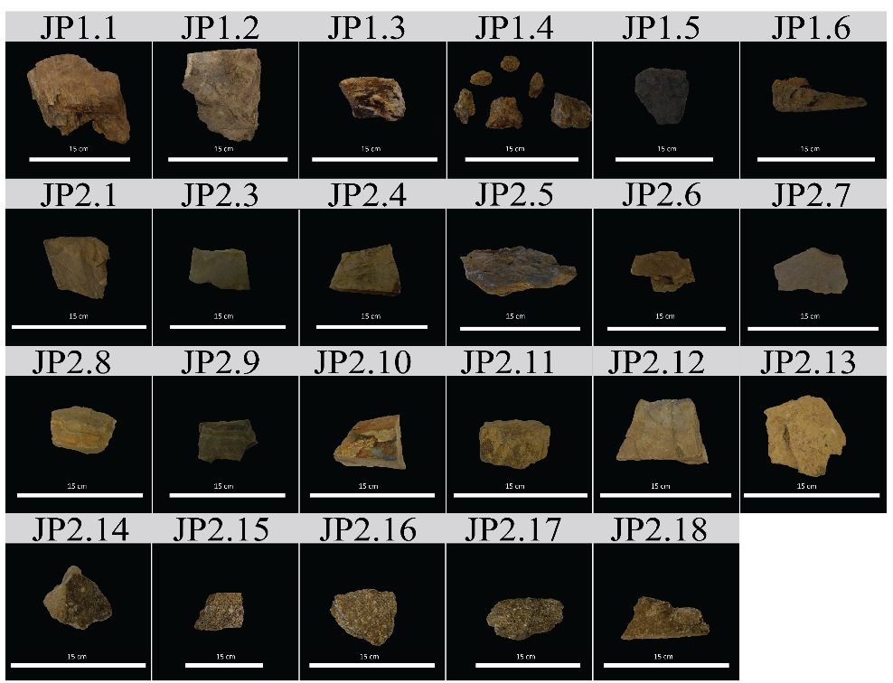
Collected data from two different sources:
Remote - Using Landsat-8 imagery for multispectral signatures analysis
In situ - Collecting rock and soil samples for hyperspectral signatures analysis and geochemical classification
(a)
(b)

Slide 6
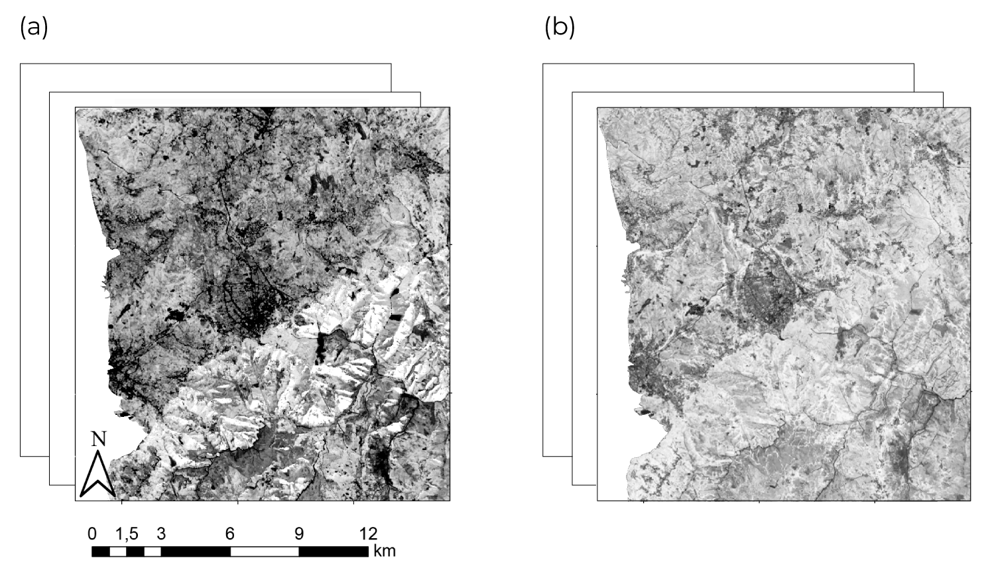
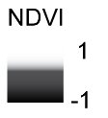
Most of the land-use/land-cover (LULC) of the study area is classified as forest and natural (CLC, 2012)
A vegetation index (NDVI) was applied:
Vegetation and anthropic occupation have a significant influence on the SR values
Higher NDVI values were identified in the rainy season (a) compared to dry (b)
The variation of NDVI between seasons is most noticeable in the northern section of the study area
January 2015
July 2015
(a)
(b)

Slide 7
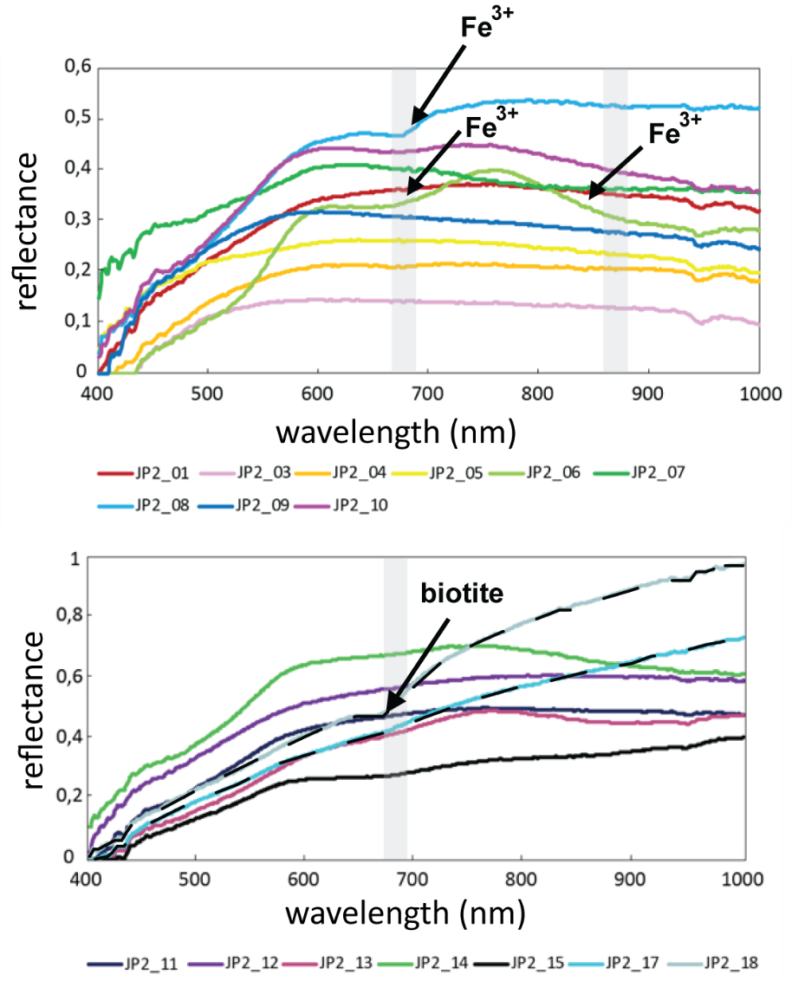
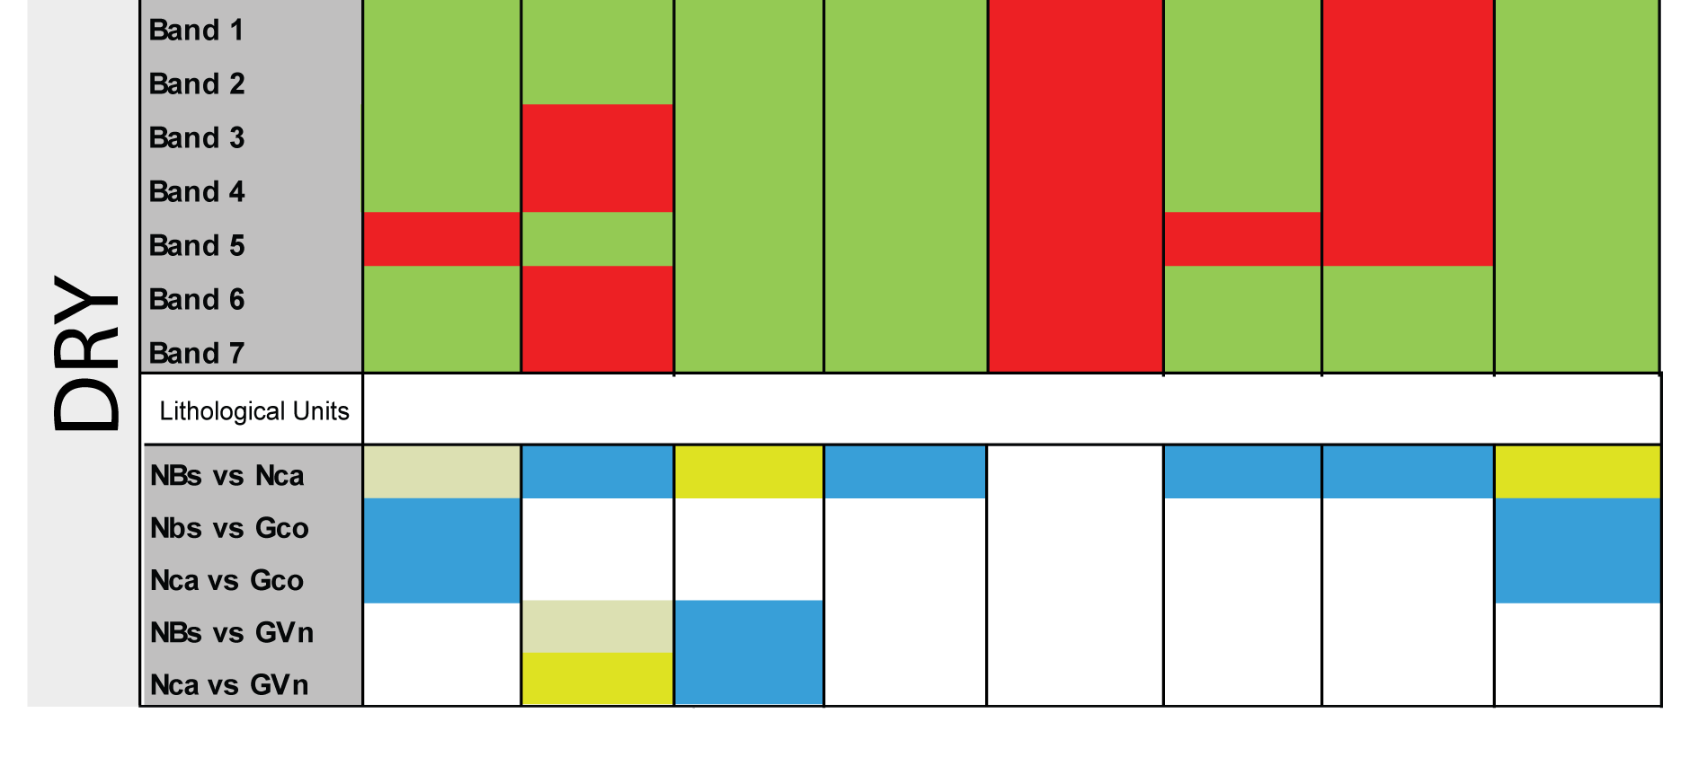
(1) Multispectral
(2) Hyperspectral
Spectral differences between metasediments and granites
Absorption features indicated the presence of minerals and chemical elements
Better SNR in the dry image
Statistical tests highlighted SR values differences between granites and metasediments

Slide 8
SR values from July 2015th were used to perform a machine learning classification technique: k-means
Higher precision when joined metapelite and metagraywacke into a single class

Slide 9
Both multi and hyperspectral methodologies highlighted significant spectral differences between metasediments and granites
Machine learning validated these results, with both confusion matrixes having successful outcomes
This enables a more expedited and truthful characterisation of rock and soil samples to support geological mapping

Slide 10
24 may
2022
Thank you!

