Slide 1




EGU22-4691
Investigating the interaction between snowmelt runoff and road in the activation of hillslope instabilities affecting a landslide-prone mountain basin through a multi-modeling approach
Luca Mauri¹, Sara Cucchiaro², Stefano Grigolato¹, Giancarlo Dalla Fontana¹, Paolo Tarolli¹
¹Department of Land, Environment, Agriculture and Forestry, University of Padova, Legnaro (PD), Italy
²Department of Agricultural, Food, Environmental and Animal Sciences, University of Udine, Udine (UD), Italy

Slide 2
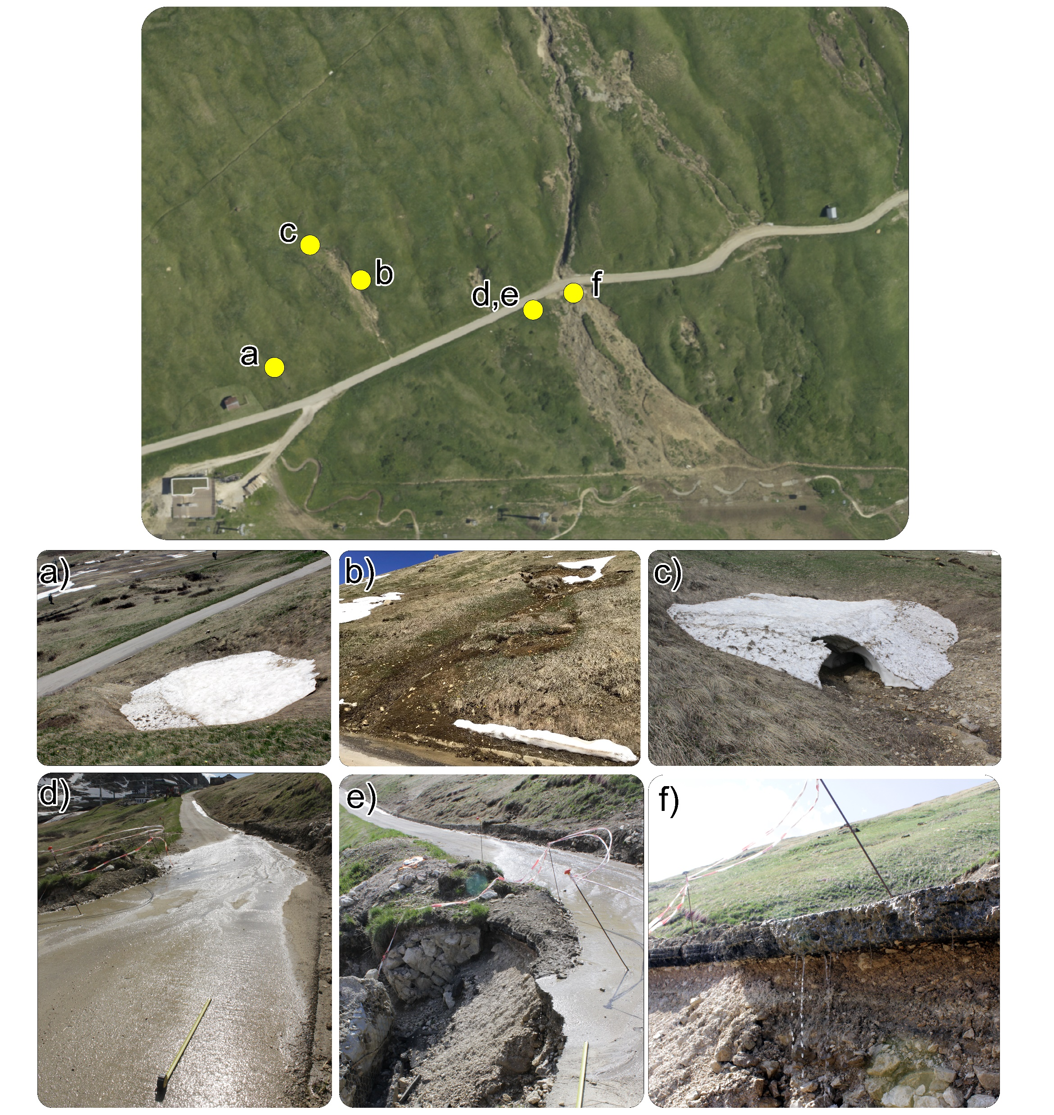
Snowmelt, roads and landslides in mountain landscapes
Snowmelt runoff is responsible for the activation of land degradation processes in mountain landscapes
Roads presence in steep slopes mountain areas is also linked with landslides occurrence
Accurate investigation of the interaction between snowmelt runoff and roads in the occurrence of hillslope failures is still obscure
Mauri et al., 2022. Evaluating the interaction between snowmelt runoff and road in the occurrence of hillslope instabilities affecting a landslide-prone mountain basin: a multi-modeling approach.
[under review in Journal of Hydrology]

Slide 3
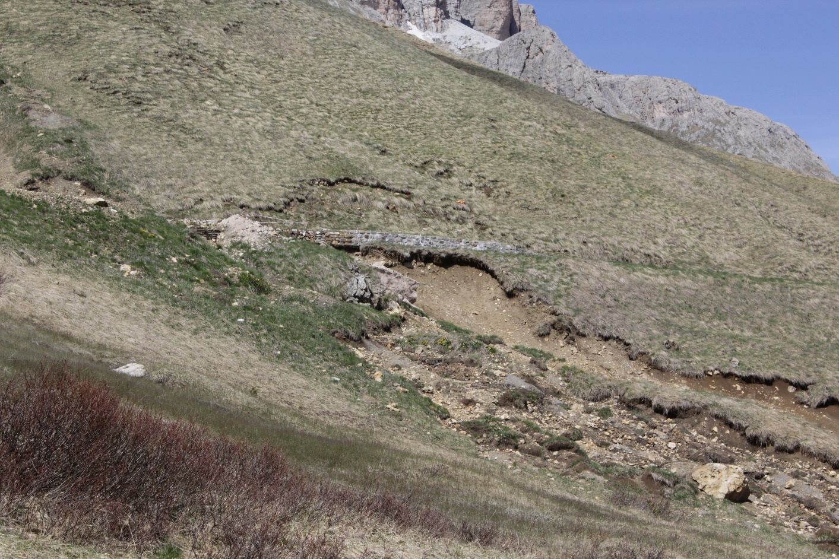
Research purpose, study area, material and methods (1/2)
Scope: to assess the relationship between snowmelt runoff, road presence and terrain instabilities affecting a landslide-prone steep slope mountain meadow (northern Italy)
Mauri et al., 2022. Evaluating the interaction between snowmelt runoff and road in the occurrence of hillslope instabilities affecting a landslide-prone mountain basin: a multi-modeling approach.
[under review in Journal of Hydrology]

Slide 4

Research purpose, study area, material and methods (2/2)
Snowmelt Runoff Model - SRM
Road Erosion Steady-State model - RESS
SImulated Water Erosion model - SIMWE
(Martinec and Rango, 2008)
(Montgomery and Dietrich, 1994; Borga et al., 2005)
(Mitasova et al., 2003)
Role of the road ?
Mauri et al., 2022. Evaluating the interaction between snowmelt runoff and road in the occurrence of hillslope instabilities affecting a landslide-prone mountain basin: a multi-modeling approach.
[under review in Journal of Hydrology]

Slide 5
Multi-modelling results and statistics (1/3)
Snowmelt Runoff Model -SRM-
Road Erosion Steady-State model -RESS-
Mauri et al., 2022. Evaluating the interaction between snowmelt runoff and road in the occurrence of hillslope instabilities affecting a landslide-prone mountain basin: a multi-modeling approach.
[under review in Journal of Hydrology]

Slide 6





Multi-modelling results and statistics (2/3)
SIMulated Water Erosion model -SIMWE-
[Instability susceptibility maps validation]
Receiver Operating Characteristic (ROC) analysis
Area Under the ROC Curve (AUC)
$$True Positive Rate=\frac{TP}{TP+FN}$$
(AUC)=0.92 (Sr), 0.94 (Rr)
$$False Positive Rate=\frac{FP}{TN+FP}$$
[predicted vs observed instabilities agreement]
Cohen’s kappa-index
(Cohen, 1960)
$$P_{C}=\frac{TP+TN}{N}$$
$$P_{E}=\frac{\left(TP+FN\right)∙\left(TP+FP\right)+\left(FP+TN\right)∙\left(FN+TN\right)}{N^{2}}$$
$$k=\frac{P_{C}−P_{E}}{1−P_{C}}$$
k= 0.58 (Sr), 0.55 (Rr)
Guzzetti et al., 2006
Mauri et al., 2022. Evaluating the interaction between snowmelt runoff and road in the occurrence of hillslope instabilities affecting a landslide-prone mountain basin: a multi-modeling approach.
[under review in Journal of Hydrology]

Slide 7
Multi-modelling results and statistics (3/3)
YesRoad vs NoRoad cross section of SIMWE-derived water depth across the landslide area
Mauri et al., 2022. Evaluating the interaction between snowmelt runoff and road in the occurrence of hillslope instabilities affecting a landslide-prone mountain basin: a multi-modeling approach.
[under review in Journal of Hydrology]

Slide 8
Conclusions
Results attested the key role played by the road in altering snowmelt runoff pathways
Results also proved the combined contribution of snowmelt runoff and road to the foreseen activation of a shallow landslide
A challenging predictive, multi-modeling approach is presented and validated
Efficient tool for prevent and mitigate the occurrence of similar land degradation processes over time
Mauri et al., 2022. Evaluating the interaction between snowmelt runoff and road in the occurrence of hillslope instabilities affecting a landslide-prone mountain basin: a multi-modeling approach.
[under review in Journal of Hydrology]

Slide 9




Thank you!
luca.mauri.2@phd.unipd.it

Slide 10
Overview of ALS surveys parameters and characteristics
Snowmelt Runoff Model (SRM) inputs
ALS-survey parameters | Information / Value
Period of the survey | April-December 2018
Survey conditions | Snow-free conditions, minimal leaves presence
LIDAR system | Optech ALTM Gemini
Number of flights | 46
Average flight altitude (a.g.l.) | 850 m
Flying speed | 75 knots
Scan angle | 32°
Laser frequency | 100 kHz
Average point density | 5 pt/m²
Input | Unit of measurement
Temperature (T) | °C
Precipitation (P) | mm/h
Snow Covered Area (SCA) | %
Temperature Lapse Rate (γ) | °Cm⁻¹
Critical Temperature (T_{CRIT}) | °C
Degree-day factor (An) | cm°C⁻¹d⁻¹
Rainfall Contributing Area (RCA) | (-)
Recession coefficient (k) | (-)
Runoff coefficient snow (Cs) | (-)
Runoff coefficient rain (Cr) | (-)
Time lag (L) | (h)
SIMulated Water Erosion (SIMWE) inputs. G stands for grassland, Rd stands for road and Rk stands for rocky areas located on the top of the watershed
Input | Value | Unit of measurement
Max snowmelt runoff (Sr_{max}) | 11.3 (May 2018) | mmh⁻¹
Saturated soil conductibility (k) | 10⁻³ (G) 0.0 (Rd, Rk) | ms⁻¹
Excess rate (May 2018) | 0.0 (G) 11.3 (Rd, Rk) | mmh⁻¹
Manning (n) | 0.045 (G) 0.016 (Rd) 0.099 (Rk) | (-)
Mauri et al., 2022. Evaluating the interaction between snowmelt runoff and road in the occurrence of hillslope instabilities affecting a landslide-prone mountain basin: a multi-modeling approach.
[under review in Journal of Hydrology]

Slide 11
Symbols and abbreviations used in models application
Road Erosion Steady-State (RESS) inputs necessary for soil stability investigations
Model | Symbol / Abbreviation | Description
Snowmelt Runoff Model (SRM) | Sr | Snowmelt runoff
 | Rr | Rainfall runoff
 | SRr | Combined Sr and Rr
 | T | Temperature
 | P | Precipitation
 | SCA | Snow Covered Area
 | γ | Temperature Lapse Rate
 | Tcrit | Critical temperature
 | An | Degree-day factor
 | RCA | Rainfall Contributing Area
 | K | Recession coefficient
 | Cs | Runoff coefficient snow
 | Cr | Runoff coefficient rain
 | L | Time lag
Road Erosion Steady-State model (RESS) | z | Soil thickness
 | ϕ | Internal friction angle
 | ρ_{s} | Soil density
 | ρ_{w} | Water density
 | Tr | Soil transmissivity
 | Coh_{s} | Soil cohesion
 | Coh_{r} | Root cohesion
 | W | Vegetation surcharge
 | r_{rc} | Relative road cut depth
 | Crit_{Sr} | Critical Sr
 | Crit_{Rr} | Critical Rr
 | Crit_{SRr} | Critical SRr
 | RI_{Sr} | Relative Impact index from Sr
 | RI_{Rr} | Relative Impact index from Rr
 | RI_{SRr} | Relative Impact index from SRr
SIMulated Water Erosion model (SIMWE) | k | Saturated soil conductibility
 | n | Manning’s n
Input | Value | Unit of measurement
DEM without road | / | (-)
Road points | / | (-)
Drainage systems location | / | (-)
Soil depth (z) | 0.5 | m
Internal friction angle (ϕ) | 35.0 | Decimal degrees
Soil density (ρ_{s}) | 1800 | kg·m⁻³
Soil transmissivity (T) | 0.3·10⁻³ | m²·s⁻¹
Soil cohesion (Coh_{s}) | 0.1 | kg·m⁻¹·s⁻²
Root cohesion (Coh_{r}) | 0.0 | kg·m⁻¹·s⁻²
Vegetation surcharge (W) | 0.0 | kg·m⁻¹·s⁻²
Road width | 4.0 | m
Relative road cut depth (r_{rc}) | 0.5 | (-)
Max rainfall runoff (Rr_{max}) | 62.8 (May 2018) | mm·h⁻¹
Max snowmelt runoff (Sr_{max}) | 11.3 (May 2018) | mm·h⁻¹
Rainfall intensity increment step | 1.0 | mm·h⁻¹
Water density (ρ_{w}) | 1000 | kg·m⁻³
Flow direction algorithm | D-inf | (-)
Mauri et al., 2022. Evaluating the interaction between snowmelt runoff and road in the occurrence of hillslope instabilities affecting a landslide-prone mountain basin: a multi-modeling approach.
[under review in Journal of Hydrology]

