Slide 1



High stress deformation and short-term thermal pulse preserved in exhumed lower crustal seismogenic faults (Lofoten, Norway)
Luca Menegon – University of Oslo, Norway
Lucy Campbell – University of Hull, UK

Slide 2
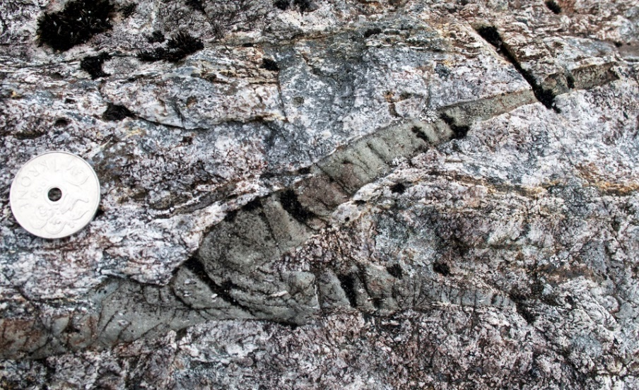
Background:
Earthquakes in the lower crust
The geological evidence:
pseudotachylytes in dry, strong granulites under fluid-absent conditions
High strength
of the dry lower crust
Transient high stresses are necessary:
how are they generated?
Menegon et al. 2017; Hawemann et al. 2018
Jackson et al. 2002

Slide 3
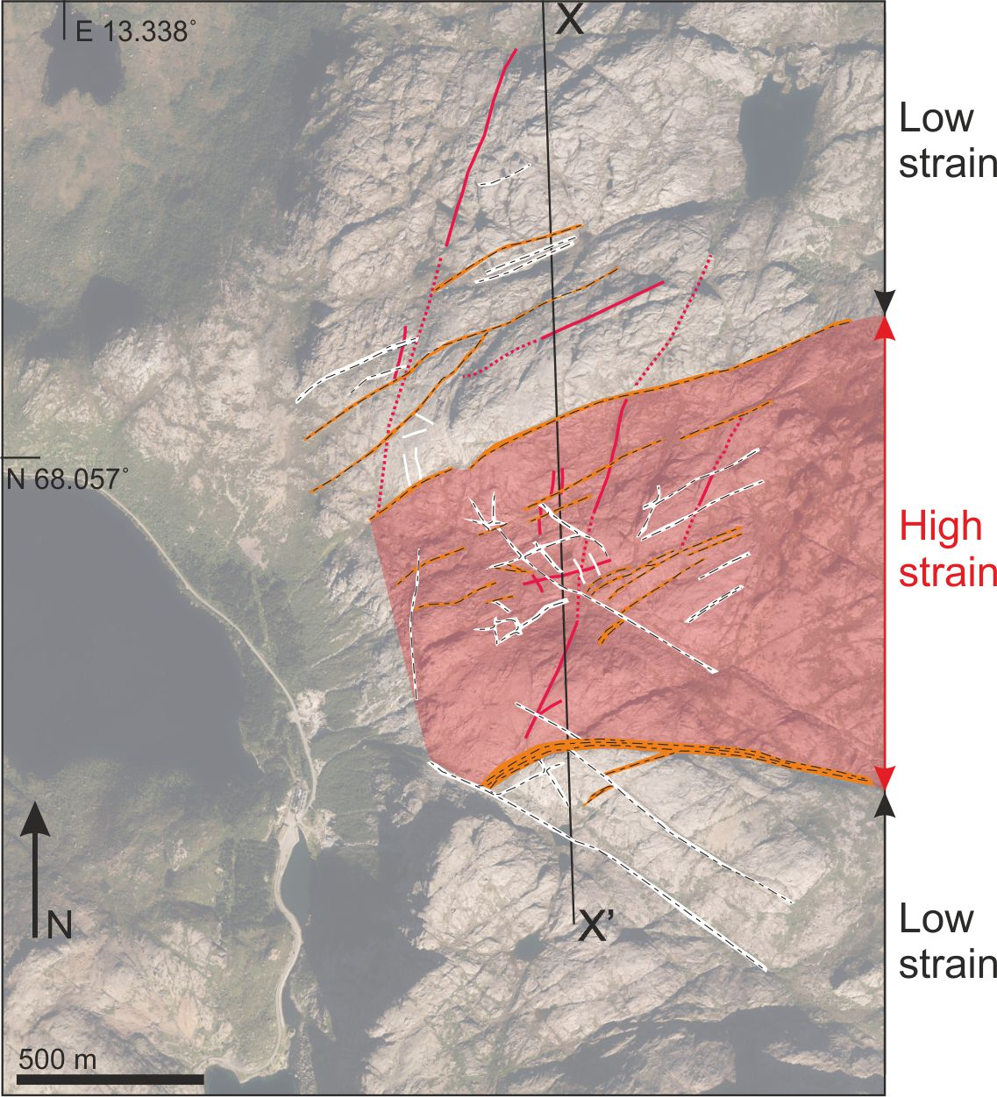
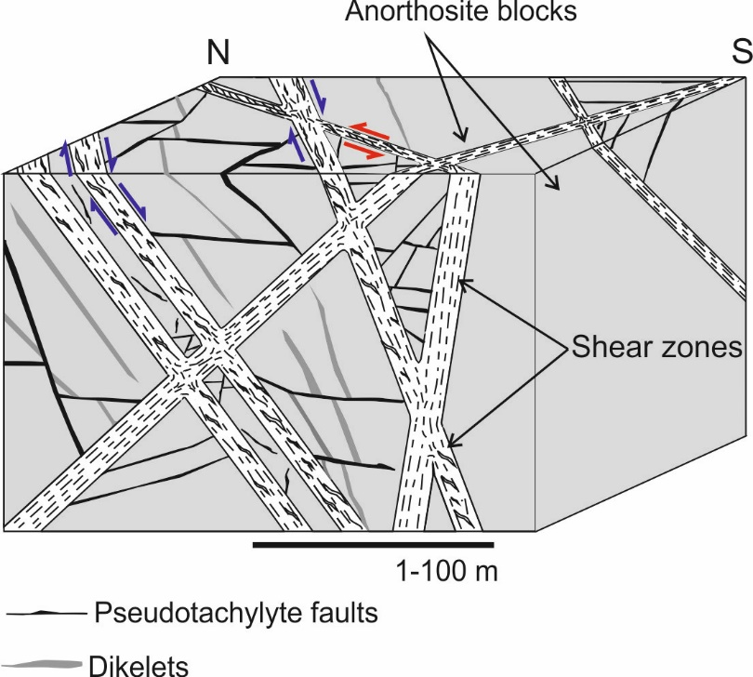
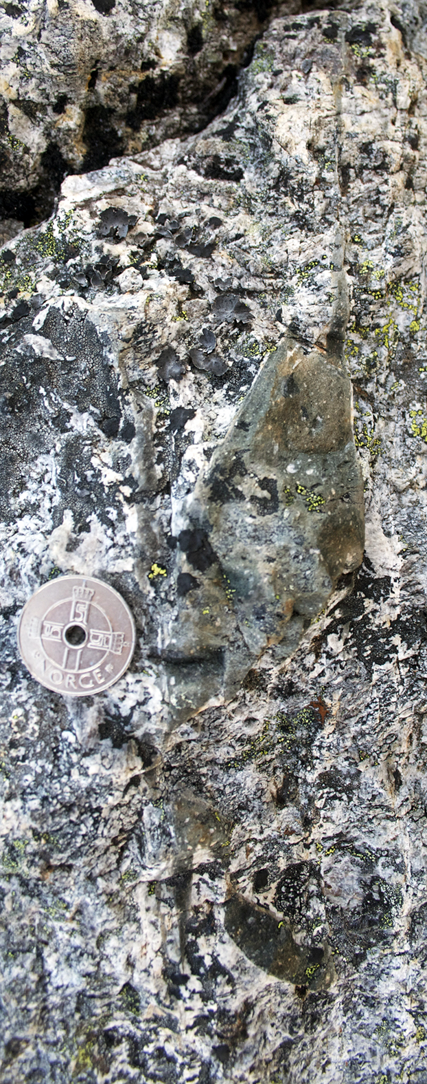
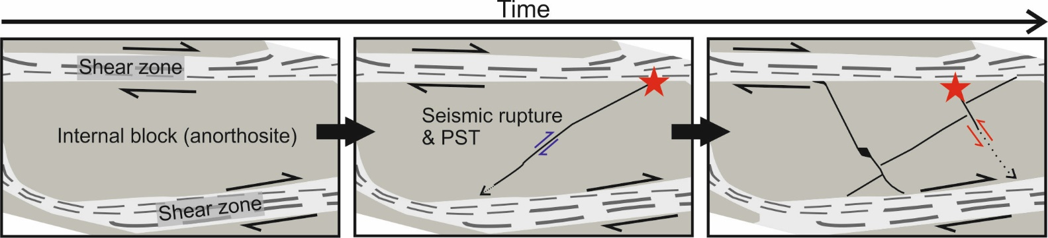
Materials: lower-crustal pseudotachylytes from Nusfjord (Lofoten)
Record of stress amplifications
Pull-apart and offset of passive markers: estimate of coseismic slip
650 – 750 °C
0.7 – 0.9 GPa
Menegon et al. 2017
Campbell et al. 2020

Slide 4
High stress drops in the Nusfjord earthquakes: high stored elastic strain?
Seismic moment:
Static stress drop:
μ = shear modulus
A = fault area (field)
S = displacement (field)
r = fault radius or semi-minor axis
C = geometrical coefficient of the fault
Campbell et al. 2020
Comparable to the yield strength of the host rock at the given depth
Is there a record of these transient high stresses in the microstructure?

Slide 5
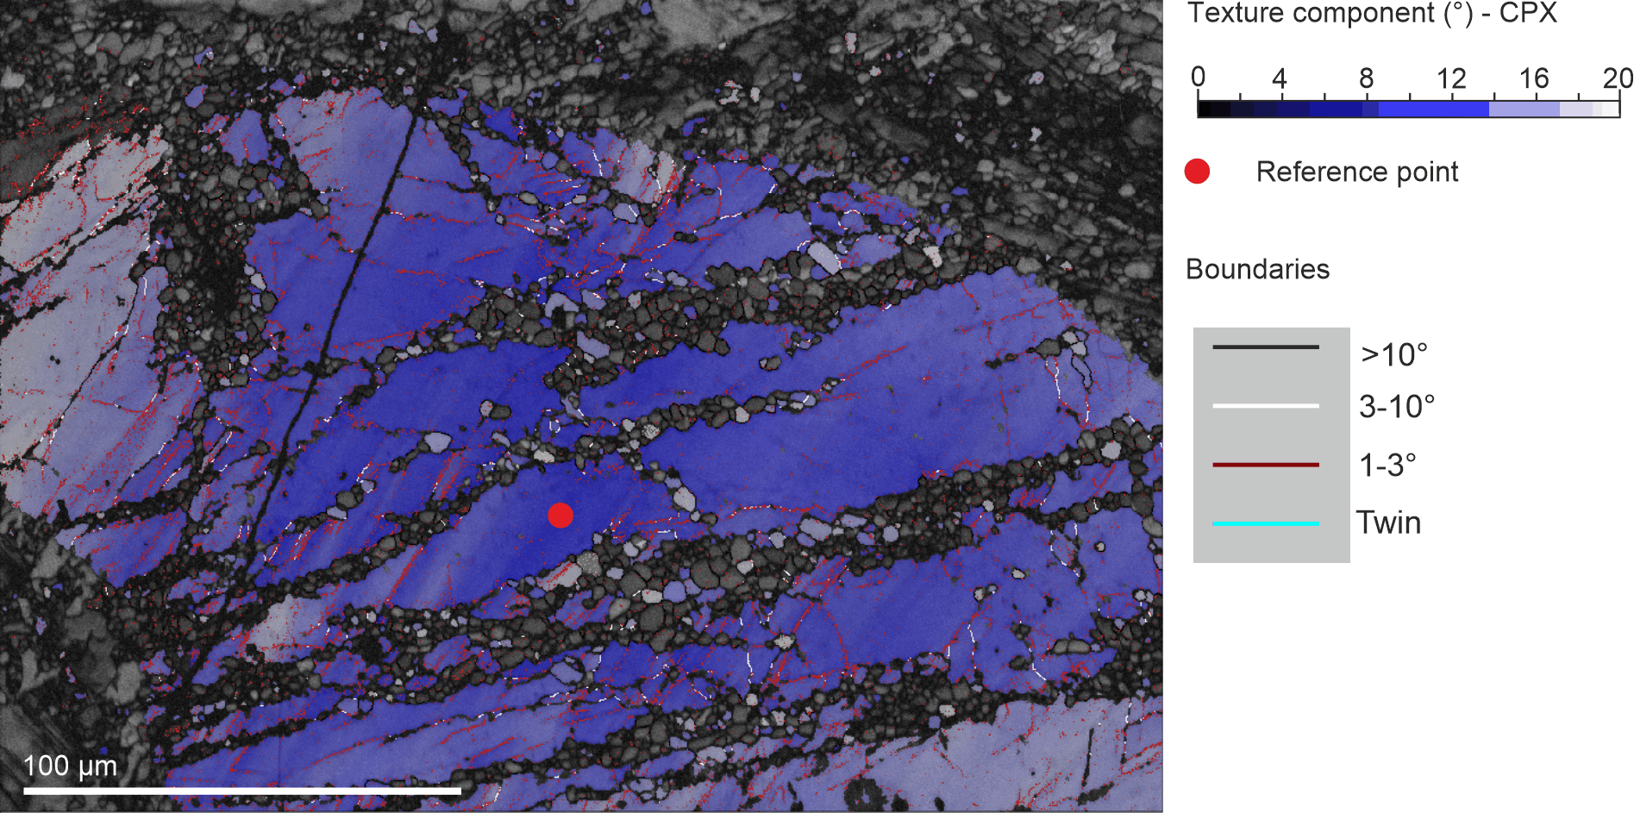
Results:
Microstructures in cpx and opx preserve evidence of transient high-stress
Distal damage zone: deformation twinning
Proximal damage zone and clasts: low-T plasticity (LTP)
Critical resolved shear stress 140 MPa
Twins very rare at distances > 2cm from the pst vein
LTP microstructures disappear at distances > 0.3 cm from the pst
Campbell & Menegon, under review

Slide 6
Results:
Microstructures in cpx and opx preserve evidence of transient high-stress
LTP in clinopyroxene at the deformation conditions of Nusfjord requires differential stresses at the gigapascal level
Campbell & Menegon, under review

Slide 7
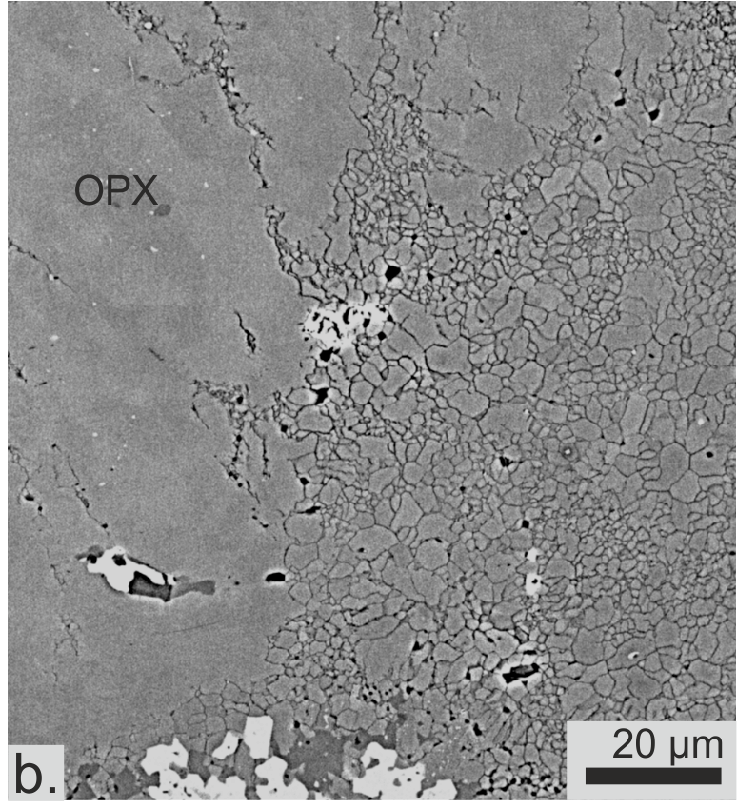
Results:
Microstructures preserve evidence of rupture propagation and thermal pulse
LTP microstructures overprinted by pulverization- syle fragmentation in the proximal damage zone
Pulverization during dynamic rupture propagation
Grain growth (annealing) of opx requires thermal pulse: frictional heat

Slide 8
Discussion and Conclusions
Sequence of overprinting microstructures linked to increasing loading (up to GPa level) and eventual rupture during one lower-crustal earthquake cycle

