Slide 1




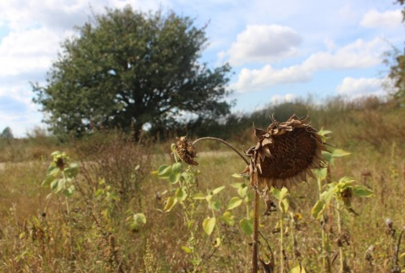
Landscape characteristics, hydroclimate and management control spatiotemporal NO₃-N patterns in a lowland catchment: implication from 30-year modelling and sensitivity analyses
How to use spatial sensitivity analysis to evaluate the parameterisation strategy of a distribution model?
Songjun Wu^{1,2}, Doerthe Tetzlaff^{1,2}, Xiaoqiang Yang¹
and Chris Soulsby^{4,1}
1 Leibniz-Institute of Freshwater Ecology and Inland Fisheries, Berlin, Germany
2 Humboldt University of Berlin, Berlin, Germany
3 Helmholtz Centre for Environmental Research, Magdeburg, Germany
4 University of Aberdeen, Aberdeen, United Kingdom

Slide 2
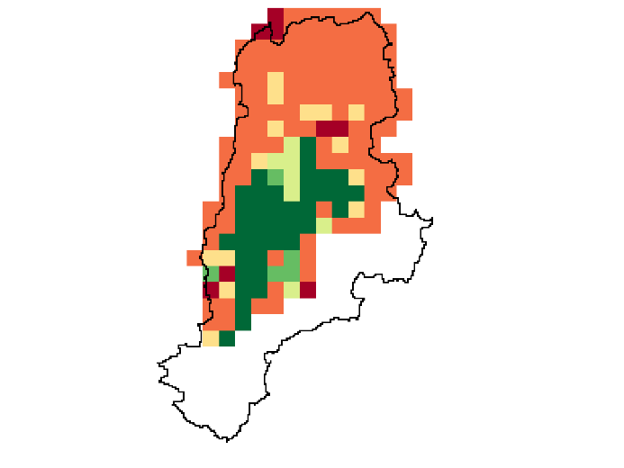
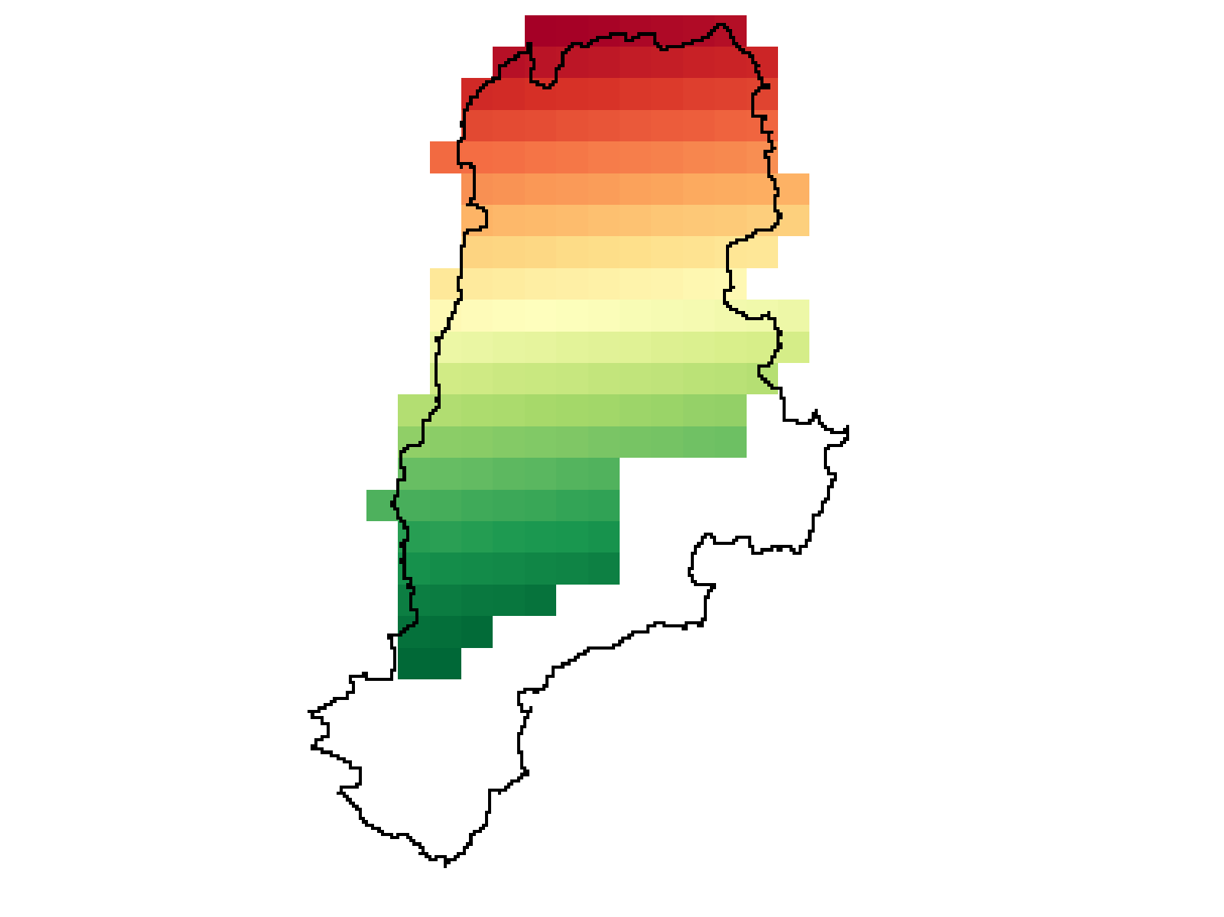
Motivation and research contents
Demnitz Millcreek catchment in Germany
66 km²; mixed land use, etc.
Discharge and NO₃-N monitored since 1992
Sensitivity analysis (SA)
input variables target variable(s)
Distributed models aggregate model domain
The same for SA!
Normal SA (not) influential parameters ✓
how well is the parameterisation strategy? ✗
Spatial SA: disentangle parameterisation to grid-based level
- 10 most important hydrological and NO₃-N parameters （mHM-Nitrate）
- Calculate sensitivity against in-stream NO₃-N (the Morris method)
- Different window lengths
- Different parameter sampling spaces
Objectives:
- To evaluate the current parameterisation strategy
Land use types
Urban
Arable land
Pasture
Wetland
Broad-leaved forest
Conifer forest
Contact: Songjun.wu@igb-berlin.de
2

Slide 3
Spatial sensitivity
SSA using full time series (1992-2019)
NO₃-N at outlet (mg/L)
Soil moisture distribution
Aquatic denitrification
Aquatic assimilation
Evapotranspiration
Groundwater flow
Soil denitrification
Mineralisation
Snow
Infiltration
Interflow
Default
Non-influential parameters
Parameterise spatially constantly
Arable land is crucial
Finer parameterisation
Forest is less important
Further aggregate?
Outlet
Hydrological constrained
NO₃-N constrained
Both constrained
Contact: Songjun.wu@igb-berlin.de
3

Slide 4
Spatiotemporal sensitivity
SSA using one-year moving window
NO₃-N at outlet (mg/L)
Move one month each time
Non-influential parameters
Can be influential in some periods
Dominant process shifts
from aquatic deni. (dry)
to soil deni. (wet)
Time-varying characteristics
Contact: Songjun.wu@igb-berlin.de
4

Slide 5
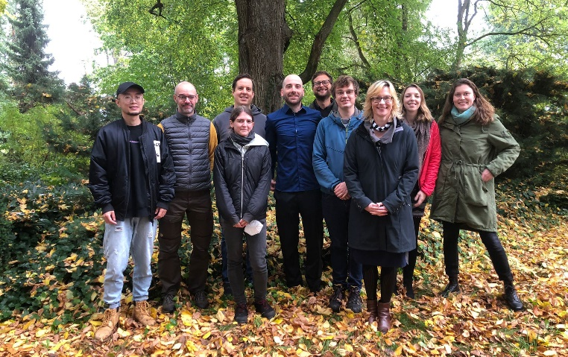
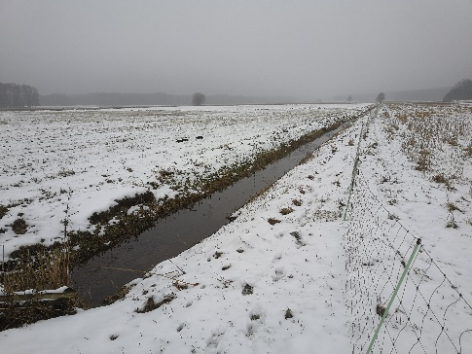
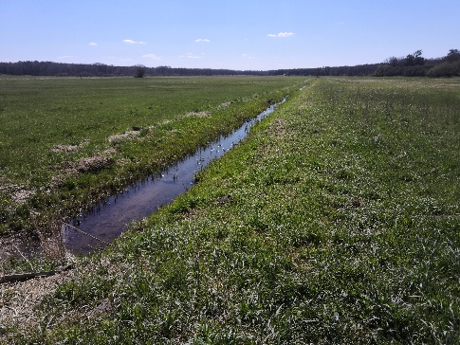
Conclusions
Parameterisation should be finer
Parameterisation should be aggregated
Snow, aquatic assimilation and soil mineralisation can be aggregated (only in long-term context)
The method is highly transferable to other catchments or models
This work:
Wu, S., Tetzlaff, D., Yang, X., & Soulsby, C. (2022). Identifying Dominant Processes in Time and Space: Time-varying Spatial Sensitivity Analysis for a Grid-based Nitrate Model, Water Resources Research. In review.
Urban
Arable land
Pasture
Wetland
Broad-leaved forest
Conifer forest
Wu, S., Tetzlaff, D., Yang, X., & Soulsby, C. (2022). Disentangling the influence of landscape characteristics, hydroclimatic variability and land management on surface water NO₃‐N dynamics: spatially distributed modelling over 30 years in a lowland mixed land use catchment. Water Resources Research.
Thanks to the team!
And IGB biogeochemistry lab for maintaining the long-term datasets!
Contact: Songjun.wu@igb-berlin.de
5

