Slide 1




Session HS7.4 – Steps towards future hydroclimatic scenarios for water resources management in a changing world
Future changes of average and extreme rainfall for the Bologna region
Rui Guo & Alberto Montanari
Department of Civil, Chemical, Environmental and Materials Engineering (DICAM), University of Bologna, Bologna, Italy. (rui.guo2@unibo.it; alberto.montanari@unibo.it )
© Authors; All rights reserved;

Slide 2
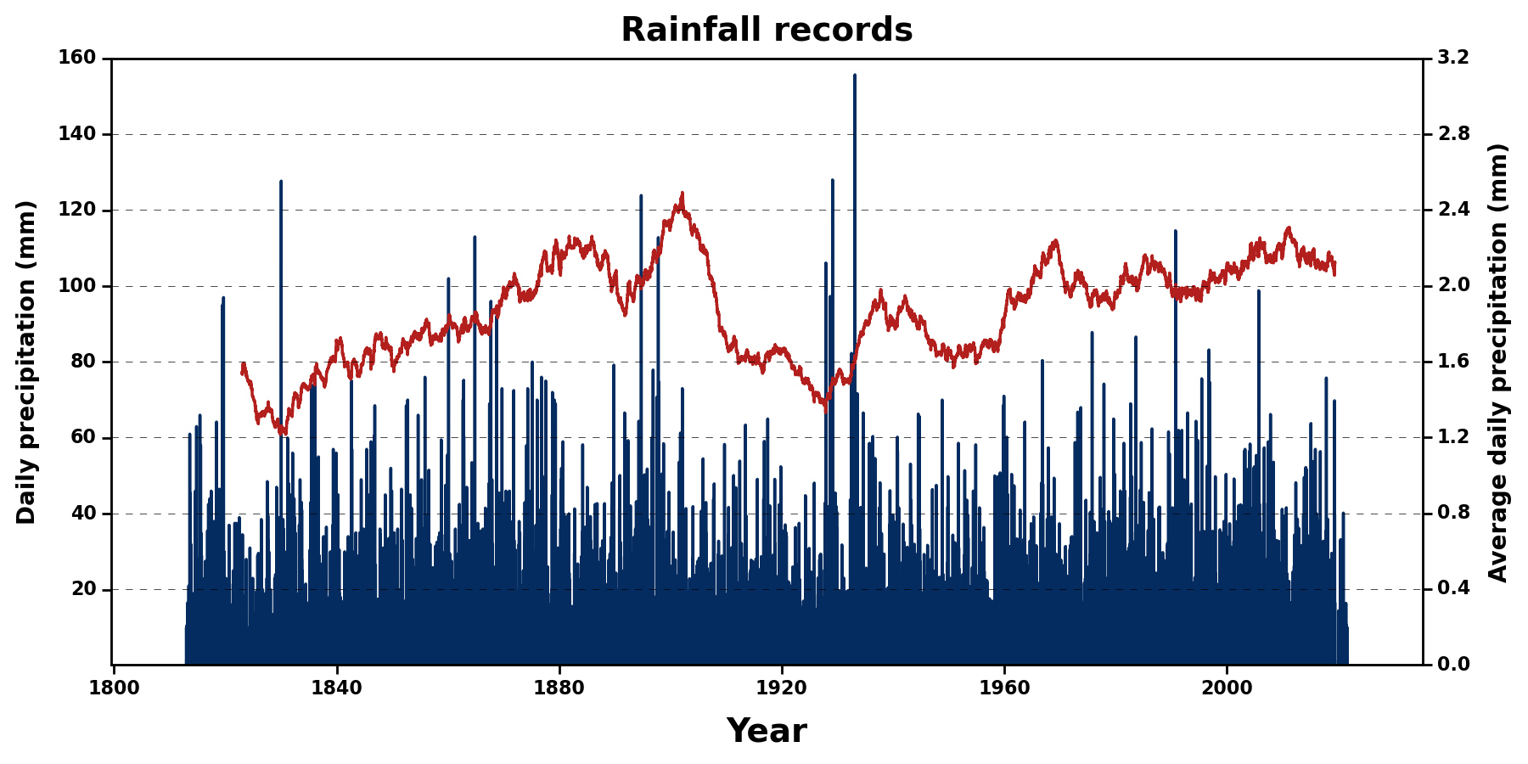
Introduction
The study aims to assess the ability of General Circulation Models (GCMs) in simulating regional scale climate.
Bologna, Italy (44.50°N, 11.35°E, 53.0m), has one of the longest daily rainfall records worldwide. It can provide essential information about past mean and extreme precipitation.
The main tasks of this study are to (i) evaluate the ability of up-to-date GCMs in simulating the statistics of long-term historical precipitation and (ii) examine how the mean and extreme precipitation will change in the future.
Time series of 202 years (1813-2014) daily rainfall records in Bologna, along with 10-year moving average (red line).

Slide 3
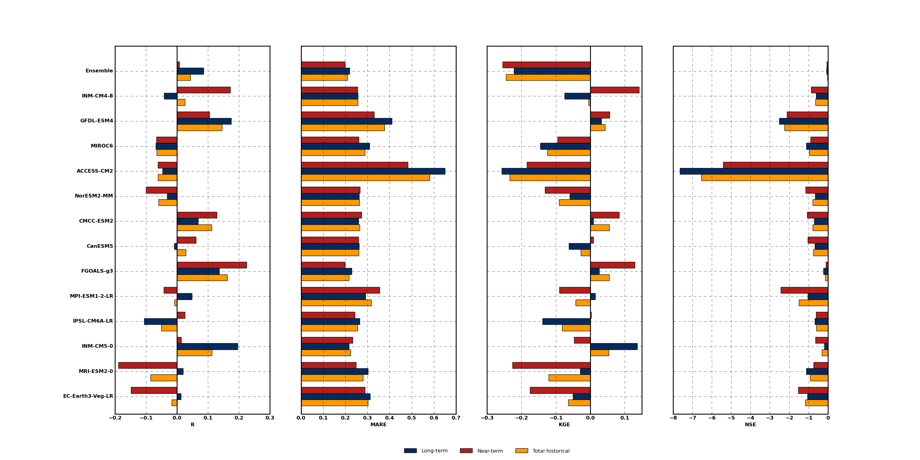
Comparison of observed and simulated statistics
The historical sequence of annual precipitation is reproduced by CMIP6 GCMs with uncertainty.
Uncertainty has been evaluated for the whole historical period, the long-term period (1850-1949) and the near-term period (1950-2014).
The multi-model ensemble mean shows no obvious better capability in replicating the sequence of annual precipitation, which performs more similarly to the mean of observation data.
Correlation coefficient (R), Mean Absolute Relative Error (MARE), Kling-Gupta efficiency (KGE), Nash-Sutcliffe efficiency (NSE) of CMIP6 GCMs and ensemble in reproducing the historical precipitation for both long-term (1850-1949), near-term (1950-2014) and the total historical period (1850-2014).
Notes:
增加图片描述
Significant uncertainty

Slide 4
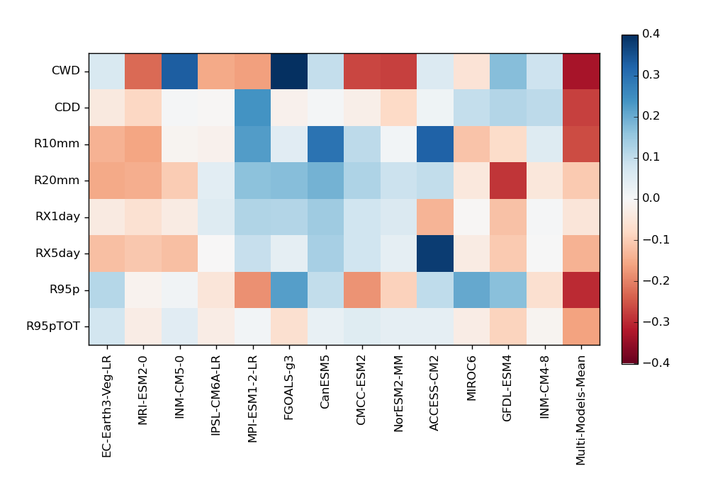
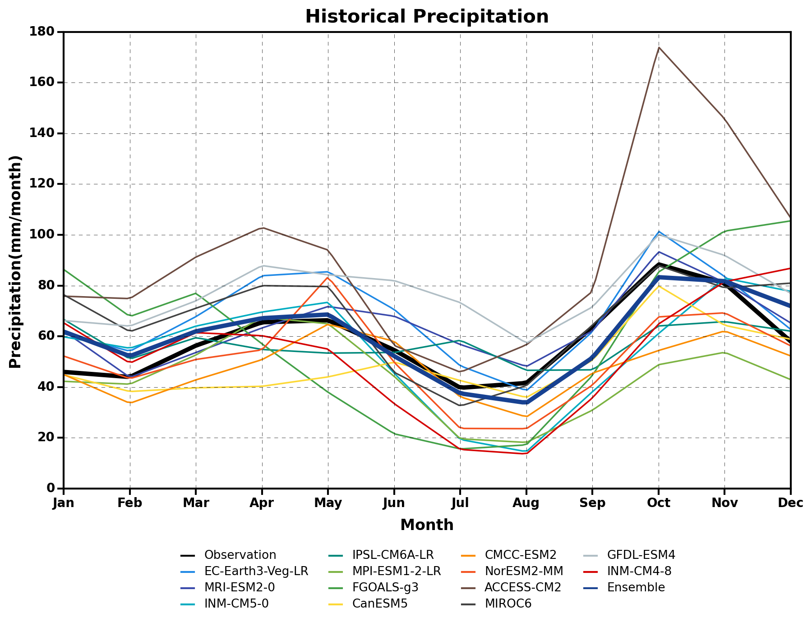
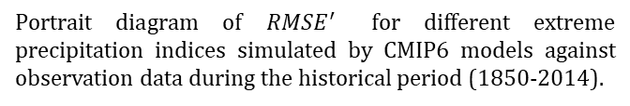
Comparison of observed and simulated statistics
Most of the models and the ensemble mean adequately replicate the bimodal precipitation pattern with peaks during March-April-May and September-October-November.
The ensemble mean results perform better than any individual models in simulating all the extreme precipitation indices.
Portrait diagram of ${RMSE}^{′}$ for different extreme precipitation indices simulated by CMIP6 models against observation data during the historical period (1850-2014).
Annual cycle of historical (1850-2014) mean monthly rainfall (mm/month) of MME and CMIP6 models against observation data.

Slide 5
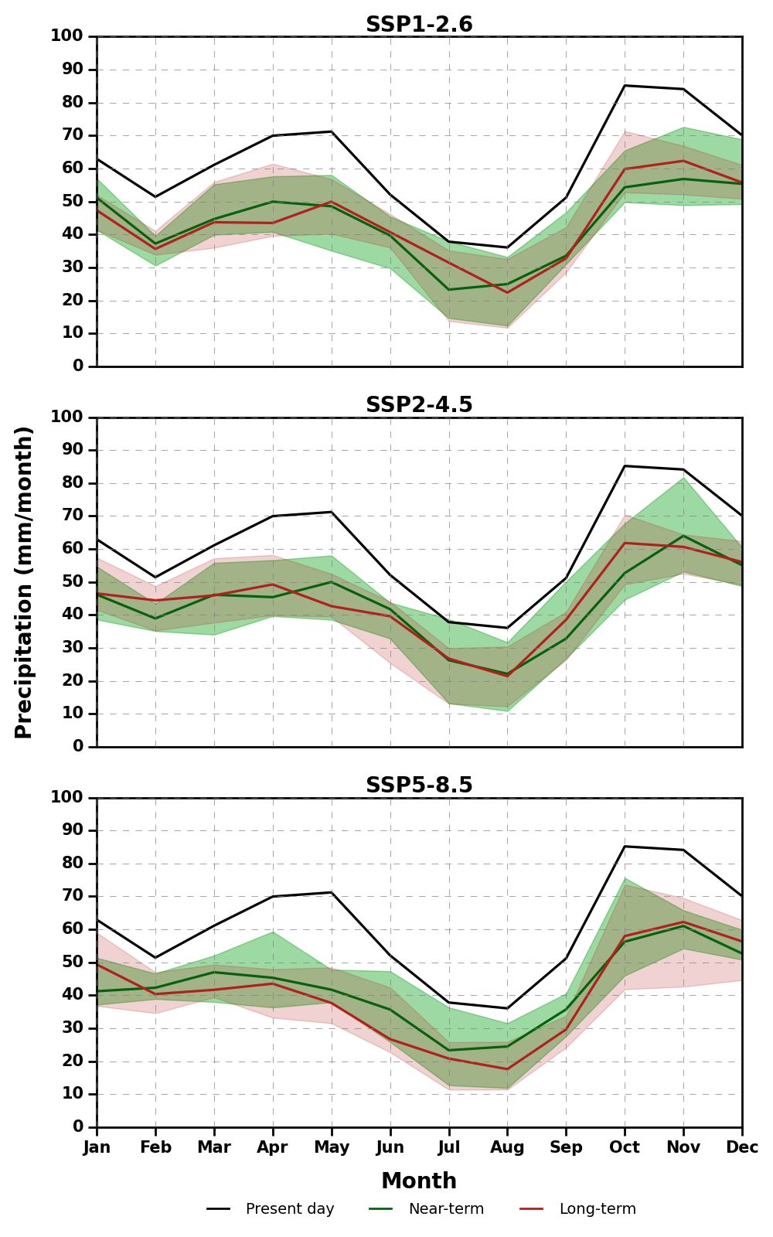
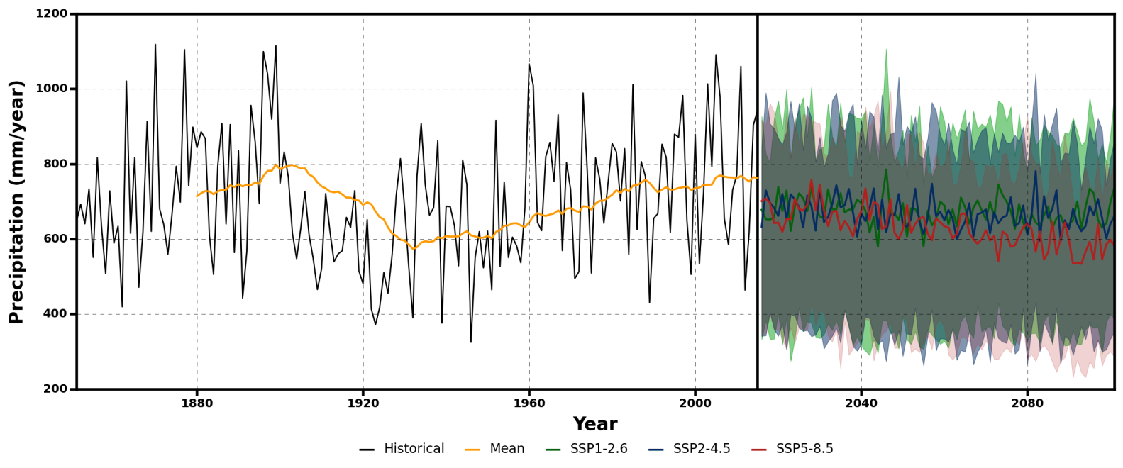
Future changes of mean precipitation
The future annual precipitation fluctuates in a relatively stationary range while a more significant decrease is shown under SSP8.5 scenario.
Monthly precipitation depicts an overall decrease under all the scenarios in each future period especially under SSP8.5 scenario in the long-term future.
Moreover, the monthly precipitation pattern will change in the future, implying that rainfall will be more likely concentrated in the fall season.
The climatological annual cycle of precipitation for multi models in present-day (1985-2014), near-term (2030-2059) and long-term (2070-2099) under SSP1-2.6, SSP 2-4.5 and SSP5-8.5 scenarios. Thick lines indicate multi-model medians while shading indicates the 25th–75th percentile model ranges.
Time series of annual precipitation for both past observation and future projection (mm/year). Historical (black), 30-year mean (yellow), SSP1-2.6 (green), SSP2-4.5 (blue), and SSP5-8.5 (red). The future projections of GCMs ensemble are shown in 25th and 75th(shading), and 50th (thick line) percentiles.

Slide 6
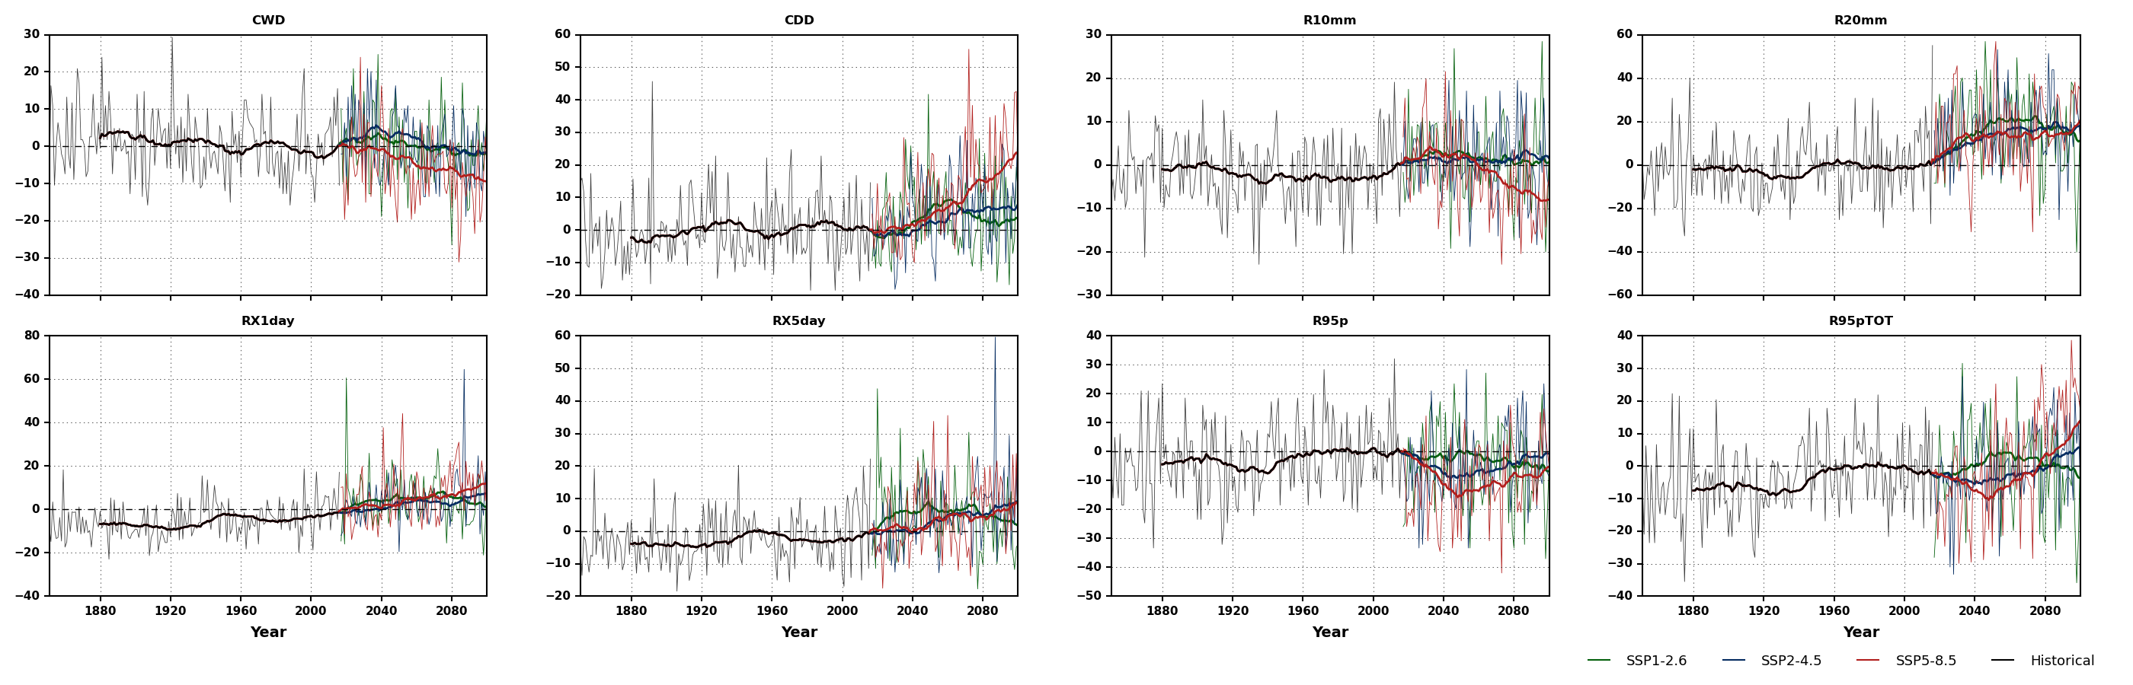
Future changes of extreme precipitation
Percentile change of extreme precipitation compared to the baseline period (1985-2014). The shade line represents the annual change and the bold line represents the 30-year average change.
Consecutive dry days (CDD) shows a sharp increase at the end of 21st century under SSP8.5 while the consecutive wet days (CWD) will decrease, which depicts an overall drier condition.
Although the heavy precipitation days (R10mm) will decrease under SSP8.5, but the very heavy precipitation days (R20mm), the maximum consecutive 1 day and 5 days precipitation (RX1day and RX5day) will increase under all the scenarios, which implies the precipitation will be more extreme.
Very wet days (R95p) will decrease but very wet days precipitation (R95pTOT) depicts an increase which indicates the very wet rainfall will be more intense especially under SSP8.5 scenario.

Slide 7
Conclusions
There is still some uncertainty in the simulation of historical annual rainfall and the performance of the model will be influenced by the choice of the historical period. However, the multi-model ensemble can simulate the seasonal pattern and extreme fairly well.
The mean annual rainfall will decrease in the future, especially under the SSP8.5 scenario. Moreover, the monthly precipitation pattern will change in the future implying that the rainfall will be more concentrated in the fall season.
The extreme precipitation also depicts a significant change in the future, especially under the SSP8.5 scenario. The consecutive dry days will increase sharply, which indicates a more severe drought condition while very heavy precipitation will occur more frequently and be more intense.
This kind of “dry will be drier and wet will be wetter” pattern will increase the risk of both drought and flood, therefore highlighting the importance of adaptation.
Thanks for your time and attention!!
Notes:
最后一页结论不说 展示只说最后一段

