Slide 1


Topological structure, fractal characteristic of fault network system and their relationship with hydrocarbon migration —Taking Wenchang 9/8 area in the Pearl River Mouth Basin as an example
Authors：Saiting Ma, Zhiping Wu,Di Wang
China University of Petroleum
May 24,2022
Notes:
Hello，everyone。 Welcome to my presentation. My title is Topological structure, fractal characteristic of fault network system and their relationship with hydrocarbon migration--Taking Wenchang 9/8 area in the Pearl River Mouth Basin as an example My name is Saiting Ma come from China University of Petroleum

Slide 2
1
Introduction
CONTENT
2
Methods
3
Result and conclusion
Notes:
The presentation can be divided into three parts. First introduction of fault network

Slide 3
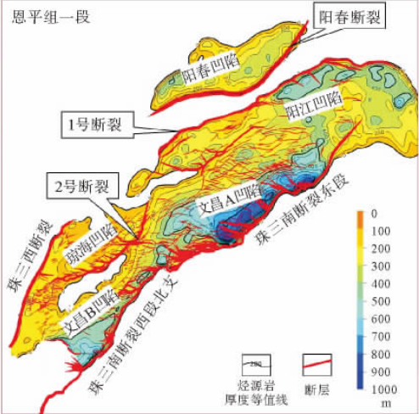
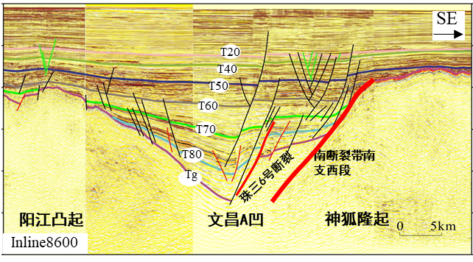
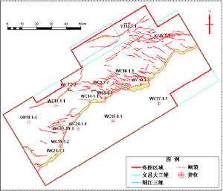
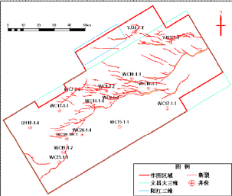
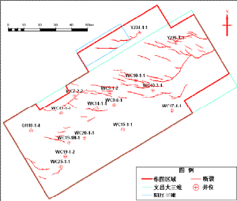
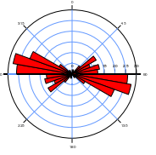
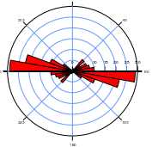
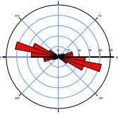
Introduction
The fault network within the petroleum basin is formed by the interaction between different faults.
（Li et al,，2014）
T70 fault network
T60 fault network
T50 fault network
(Lei et al.，2010)
Notes:
The fault network within the petroleum basin is formed by the interaction between different faults. Clarifying type is the basis and key to understand the fault network system.

Slide 4
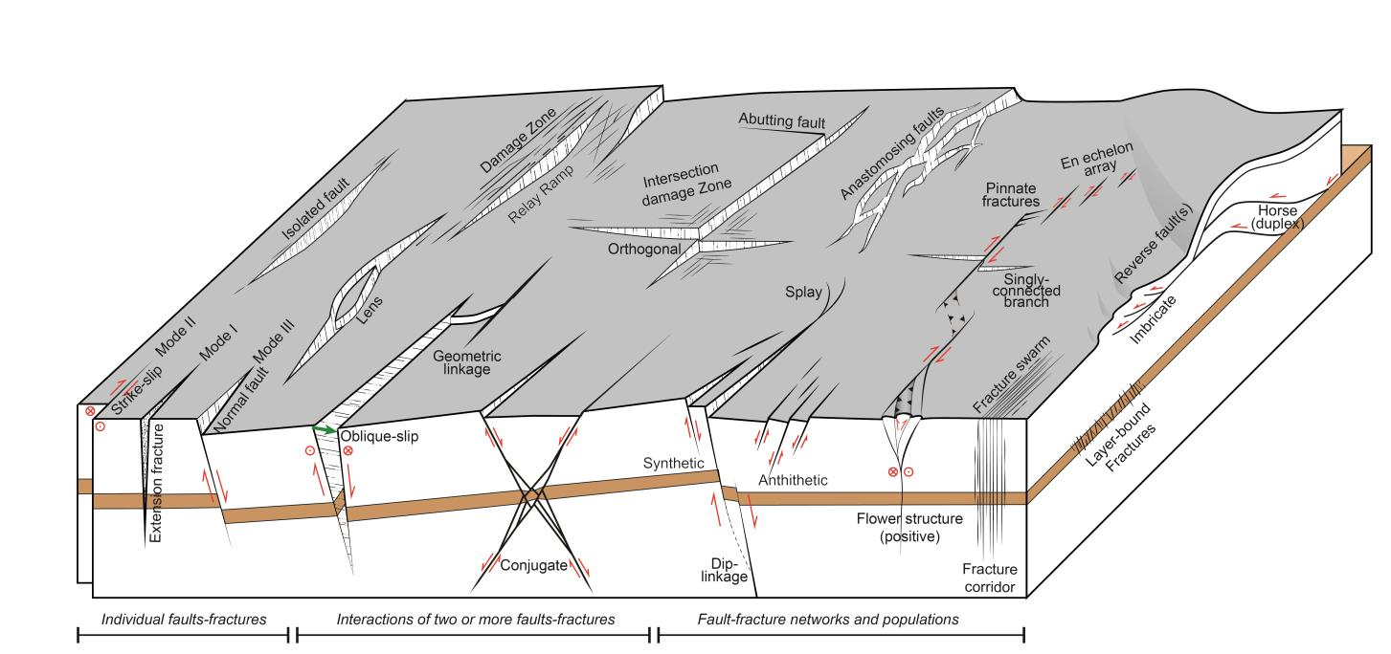
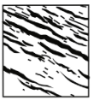
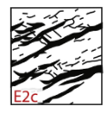
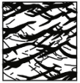
Introduction
Individual fault
Isolated fault
Interactions of two or more faults
Breached relay
Fault networks
Schematic diagram of fault networks （Peacock et al.,2016）
Clarifying the type of fracture network system is the basis and key to understand the fracture network system.
Crossing cut
（Duffy et al，2017）
Notes:
Compared with the whole fault network system, foreign scholars divide it into three types from simple to complex . 1.The simplest type is the Individual fault,. 2.The second type is the interaction between two or more faults,; 3) The third type is the complex fault network. And then how to digitize fault network？

Slide 5
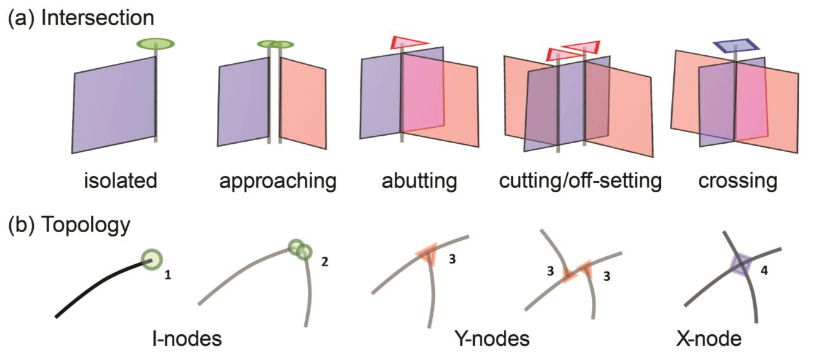
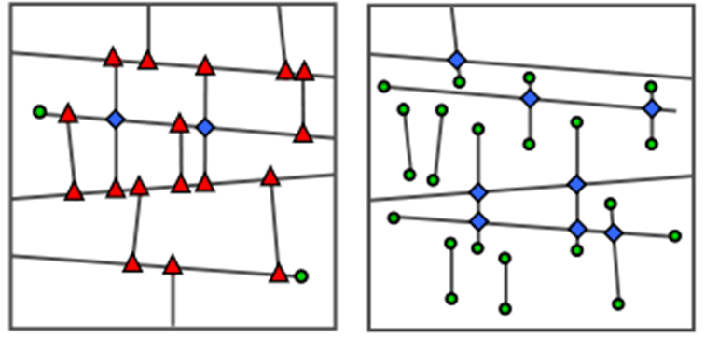
Methods
Topology is an area of mathematics that deals with the abstraction and generalization of spatial relationships such as connectivity and continuity.
Topological structure
Node type：
I、Y、X
Branch type：
I-I、I-C、C-C
Topological property
——connectivity
（Peacock et al.,2016）
The degree to which faults are connected within a network, which depends on the size, frequency, orientation, spatial correlation, scaling and topology .
（Sanderson et al，2015）
Notes:
Topology is an area of mathematics that deals with the abstraction and generalization of spatial relationships such as connectivity and continuity. The topology of a fault network is considered in terms of nodes and branches. Nodes are classified into three types: I nodes ; Y nodes and X. As branches can also be classified into three types: I-I\I-C AND C-C branches.
Two fault network systems with the same geometric characteristics such as strike, length and density may have different connectivity. So Topology can be used to quantify and compare the degree of connectivity within and between networks.

Slide 6
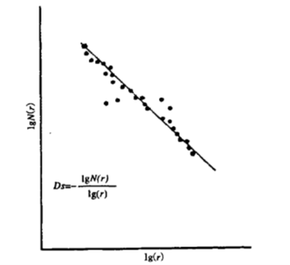
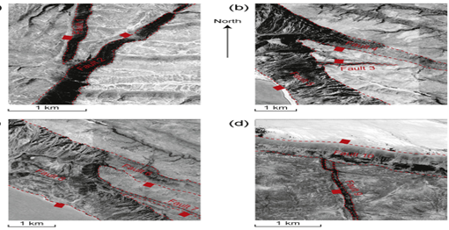
Methods
Fractal analysis provides a method of analysing patterns that are typically too complicated and discontinuous to be characterised by conventional geometry .
Fractal dimension
D provides a succinct value that may be used to characterise fractal geometry.
Fractal property
——self-similarity
Calculation and fitting of fractal dimension
The complexity of fractals lies in its properties of self-similarity. This implies that while simple geometric patterns abide by rules of general scaling，highly complex varieties scales invariably and follows the rule of power law.
（ Peacock，2017 ）
Notes:
Fractal analysis also provides a method of analysing patterns that are typically too complicated and discontinuous to be characterised by conventional geometry . The complexity of fractals lies in its properties of self-similarity. D provides a succinct value that may be used to characterise fractal geometry.

Slide 7
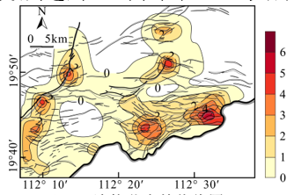
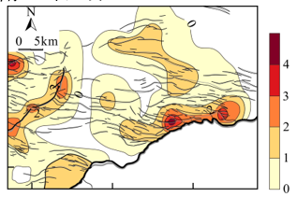
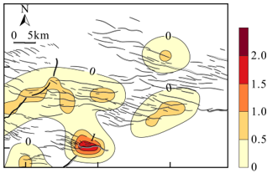
Result and conclusion
Topological structure of Wenchang 9/8 area
T70
T60
T50
Topological characteristics of T70 surface
Topological characteristics of T60 surface
Topological characteristics of T50 surface
The range of connected node is 0-7, which decreases from both sides to the middle. High value areas are scattered and distributed on the East and west sides of the study area.
The overall connected node is low, ranging from 0-2, and gradually weakens from south to north. High value areas are only developed in the south.
The overall connected node range is 0-6, and the high value area is distributed in the main faults.
Notes:
According to the quantitative relationship of nodes, the contour map in each layer is drawn to reveal the spatial differences of connectivity in different layers. In T70 surface

Slide 8
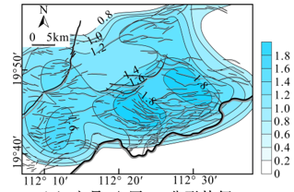
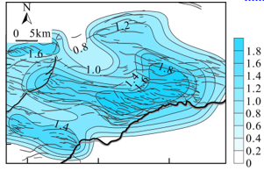
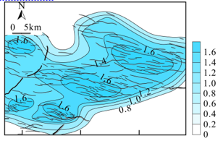
Result and conclusion
Fractal characteristic of Wenchang 9/8 area
T70
T60
T50
Fractal characteristics of T70 surface
Fractal characteristics of T60 surface
Fractal characteristics of T50 surface
The overall fractal dimension in the study area is between 0.8-1.8, and gradually decreases from the central part to both sides.
The overall fractal dimension in the study area is between 0.8-1.8, and gradually decreases from the southern part to both sides.
The overall fractal dimension in the study area is between 0.8-1.6, and gradually decreases from the central part to both sides.
Notes:
In our research ， We drew the contour map of fractal dimension to clarify the spatial change in different layers, and figour out the complexity of fault network system in different layers. In T70 surface，

Slide 9
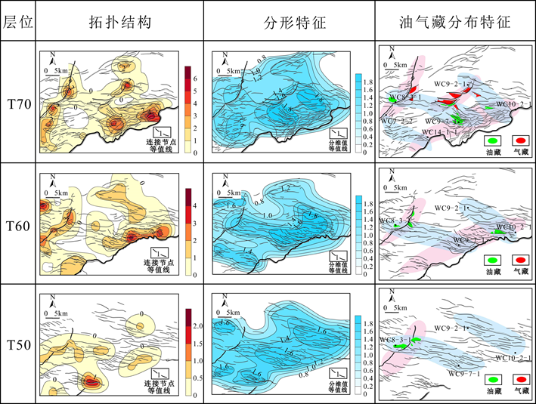
Result and conclusion
The topological structure and fractal characteristic of fault network control the overall distribution of oil and gas reservoirs.
Topological characteristic
Fractal characteristic
Hydrocarbon
The connectivity of high topological value is good, and many faults developed in the high dimensional value area, which is conducive to the formation of traps.
The overlapping area of high topological value and high dimensional value is a favorable development area of hydrocarbon reservoirs.
Notes:
The topological structure and fractal characteristic of fault network control the overall distribution of oil and gas reservoirs. In this picture，we can see The overlapping area of high topological value and high dimensional is a favorable development area of hydrocarbon reservoirs.

Slide 10
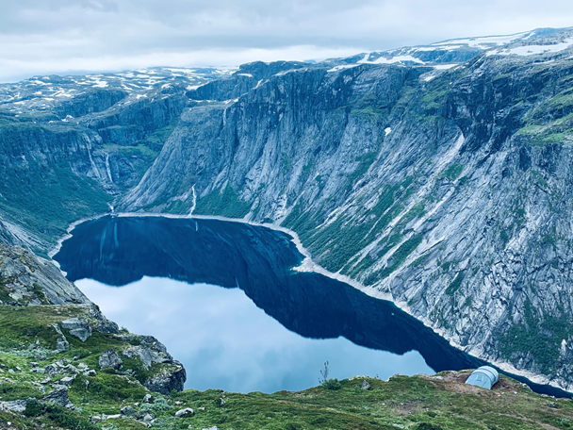
Thank you
Notes:
That is all Thank you！

