Slide 1








Vien
EGU General Assembly, 2022
MODELLING THE FENTON REACTION OF amphibole ASBESTOS
m. Tomatis, F. Turci, J.R. Petriglieri, A. Campopiano, A. Cannizzaro, P. Ballirano, M. Fantauzzi, A. Rossi, A. Bloise, M.R. Montereali, E. Nardi, and A. Pacella
Vienna, 25 May 2022

Slide 2
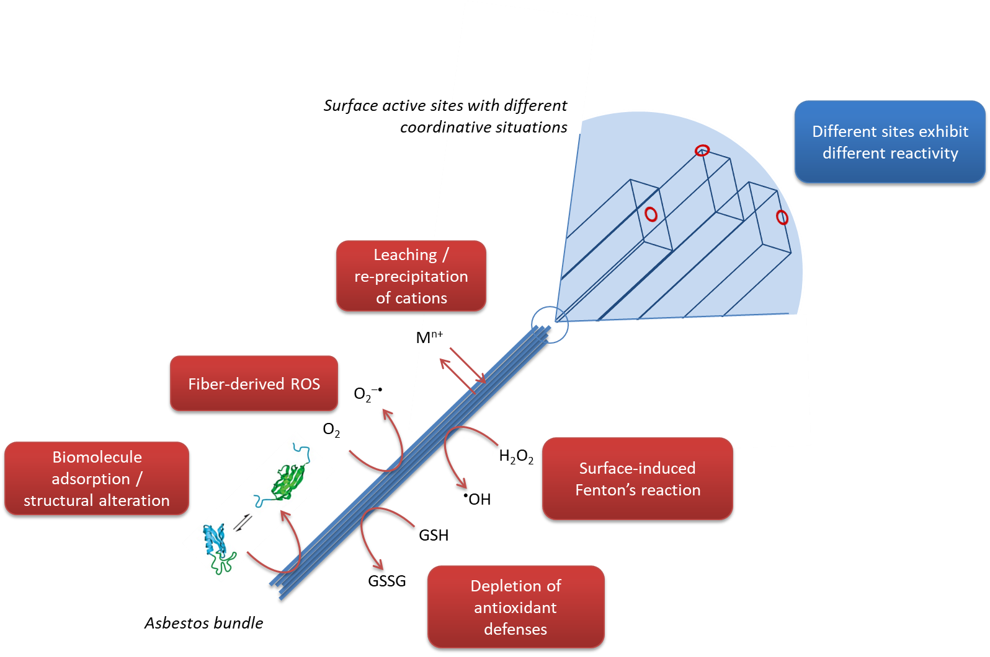
Free radical generation is one of the physico-chemical features involved in asbestos toxicity
Particle-derived free radicals may contribute to the onset of oxidative stress in lung cells
Aim of the work
To verify whether the surface reactivity is altered when fibers come in contact with
acidic environment
oxidant environment
Expected modifications:
Dissolution of surface layers
Surface Fe is responsible for free radical generation
Iron oxidation
Iron ions exposed at the surface
Fe(II)-O
Fe(III)-O
Fe(III)-OOH
oxidation
Fe reactivity depends on
coordination

Slide 3
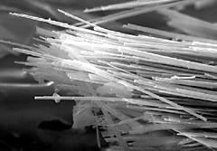
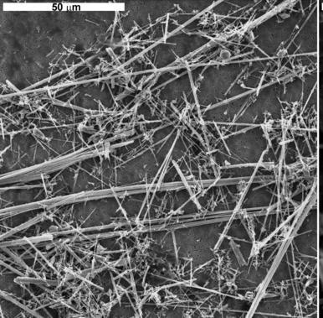
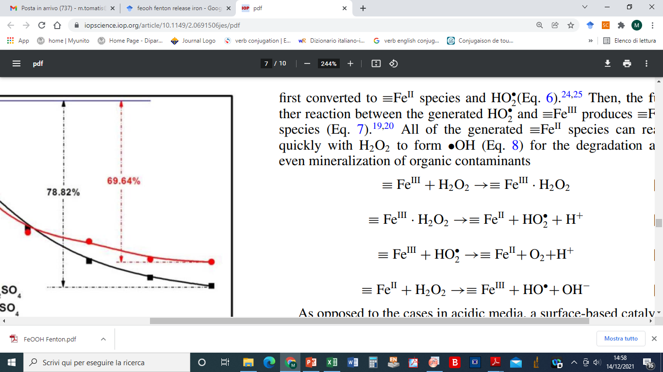
Experimental setup
Sample preparation
Incubation in simplified Gamble's solution (pH 4.5)
Amphibole asbestos
Incubation in H₂O₂ solution (pH 7.4)
Sample characterization
Surface chemical composition
Tremolite
X-ray photoelectron spectroscopy (XPS)
Ca₂Mg₅Si₈O₂₂(OH)₂
Surface reactivity in hydroxyl (•OH) radical generation
4,5% Fe
Surface: 30% Fe (II) and 70% Fe(III)
Bulk: 85 % Fe (II) and 15% Fe(III)
Spin trapping/EPR in cell-free test
Crocidolite
Na₂Fe^{III}₂(Fe",Mg)₃Si₈0₂₂(0H)₂
Reaction involved in •OH radical generation
27% Fe
Surface: 20% Fe (II) and 80% Fe(III)
Bulk: 50% Fe (II) and 50% Fe(III)
(Fenton reaction)

Slide 4
1. Effect of acidic environment
Tremolite
Crocidolite
Ca₂Mg₅Si₈O₂₂(OH)₂
Na₂Fe^{III}₂(Fe",Mg)₃Si₈0₂₂(0H)₂
Surface composition
Surface composition
•OH radical generation
pristine
1 day
7 days
tremolite
No significant alteration of surface composition
Mg decrease, Fe increase
crocidolite
Fe speciation
Fe speciation
No change of reactivity in •OH radical generation
Fe(II) decrease; Fe(III)-OOH increase
Slight increase of Fe(II)
Fe oxidation is faster than dissolution
Dissolution is faster than Fe oxidation
Pacella et al., 2021

Slide 5
2a. Effect of oxidant environment: CROCIDOLITE
•OH radical generation
Surface composition
pristine
Oxidized (only Fe(III))
Increase of surface iron
Which are the iron ions responsible for the reactivity increase?
Fe speciation
Iron dissolved and then precipitated as phosphate
Increase of the reactivity, mainly in the first hours of incubation
When no Fe(II) is avalaible (e.g in sample oxidized at 650°C) the reactivity does not increase
Increase of Fe(II)-O and Fe(III)-O
Promotion of Fe (II) from bulk to the surface enhances •OH reactivity
Fast dissolution promotes Fe from bulk to the surface

Slide 6
2b. Effect of oxidant environment: TREMOLITE
•OH radical generation
Surface iron distribution
sample | Fe(II)/Fe(III)
pristine | 0.43
after 24h incubation H₂O₂ | 0.34
Decrease of surface Fe(II)
pristine
oxidized
Fe(II) + H₂O₂ → Fe(III) + OH⁻ + •OH
(Fenton reaction)
Reduction of activity due to iron oxidation
Pristine tremolite:
decrease of reactivity after few hours of incubation in H₂O₂
Oxidized tremolite:
constant reactivity

Slide 7
Conclusion
Thank you
H₂O₂ induces remarkable changes in surface reactivity
increase of cation release to maintain charge balance at the surface
Fe(II) oxidation
erosion of the surface
reactivity increases by the exposure of fresh ions from the bulk
iron-rich fibers
surface erosion does not expose enough ions to restore the reactivity
iron-poor fibers
Both asbestos maintain a significant ability to generate free radicals

