Slide 1



Improving the parameterization of vegetation cover variability in land surface models based on satellite observations
Fransje van Oorschot – PhD candidate TU Delft/CNR-ISAC
Contact: f.vanoorschot@tudelft.nl or f.vanoorschot@isac.cnr.it
Collaborators: Andrea Alessandri (CNR-ISAC), Ruud van der Ent (TU Delft), Markus Hrachowitz (TU Delft), Souhail Boussetta (ECMWF), Franco Catalano (ENEA)
CL5.3.2 Challenges in climate prediction: multiple time-scales and the Earth system dimensions

Slide 2
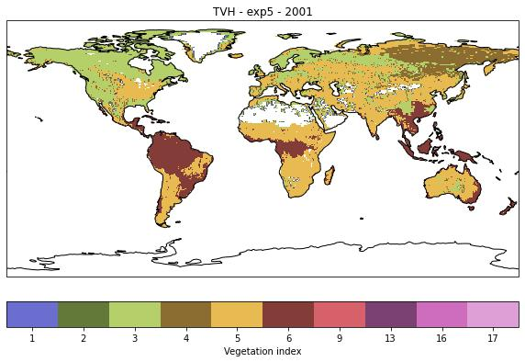
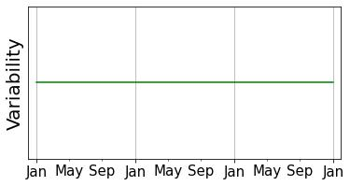
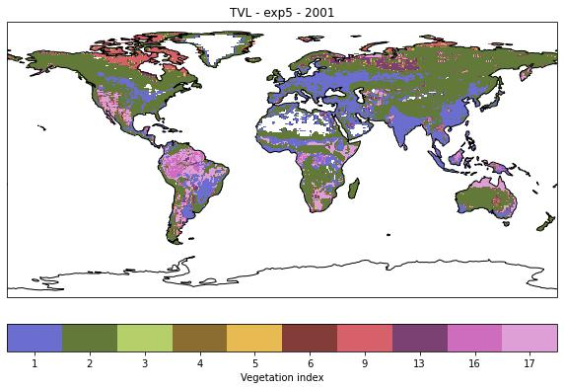


How realistic is model vegetation cover?
1. Land cover
$T_{L}$type of low vegetation
Low vegetation types
1 | Crops
2 | Short grass
9 | Tundra
13 | Bogs and Marshes
16 | Evergreen shrubs
17 | Deciduous shrubs
No temporal variability
Problem
$T_{H}$type of high vegetation
High vegetation types
3 | Evergreen needleleaf trees
4 | Deciduous needleleaf trees
5 | Deciduous broadleaf trees
6 | Evergreen broadleaf trees
Vegetation type

Slide 3
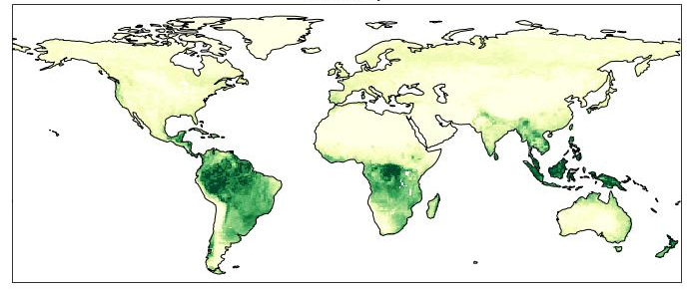
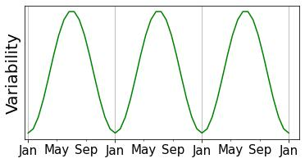
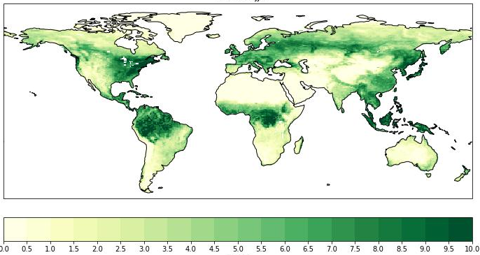
How realistic is model vegetation cover?
2. Leaf Area Index (LAI)
Measure for the density of leaves
Only seasonal variability – no inter-annual variability
Problem
LAI DJF
LAI JJA
LAI (-)

Slide 4
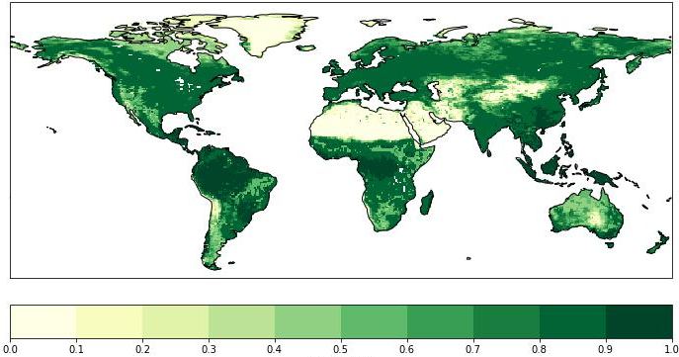
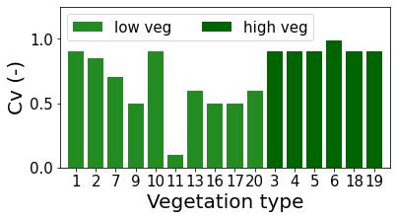
How realistic is model vegetation cover?
3. Effective vegetation cover
Represents the green, active part of vegetation cover
Effective vegetation cover
Fixed per veg type – no seasonal variations
Problem
Effective cover fraction (-)
Effective cover fraction (-)

Slide 5
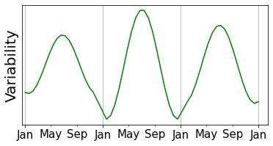
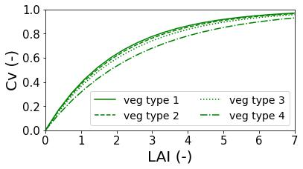
Model improvements using observational data
1. Land cover
2. Leaf Area Index
3. Effective vegetation cover
No temporal variability
Only seasonal variability – no inter-annual variability
Fixed per veg type – no seasonal variations
Effective cover fraction (-)
ESA-CCI land cover 1993-2019
Copernicus LAI and FCover 1999-2019
+
Exponential relation Fcover-LAI
Copernicus LAI 1993-2019
Inter-annual variability
Inter-annual + seasonal variability
Veg specific exponential relation with LAI

Slide 6
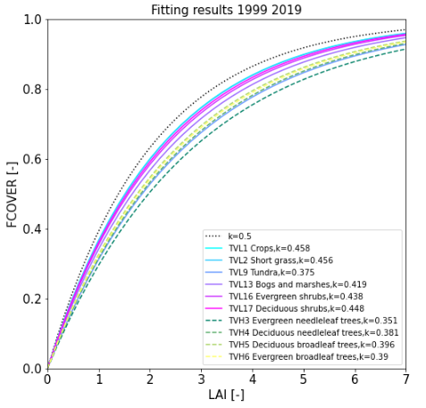
Model improvements using observational data
Vegetation specific LAI – FCover relation
3. Effective vegetation cover
Fixed per veg type – no seasonal variations
Effective cover fraction (-)
Copernicus LAI and FCover 1999-2019
+
Exponential relation Fcover-LAI
Veg specific exponential relation with LAI

Slide 7
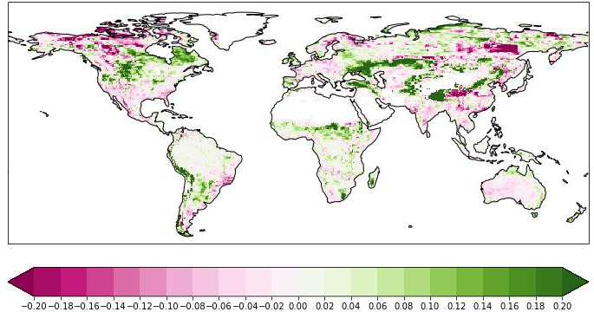
Control experiment – CTR
Sensitivity experiment – LC-LAI-EC
1. Land cover
2. Leaf Area Index
3. Effective veg cover
1. Land cover
2. Leaf Area Index
3. Effective veg cover
Only seasonal variability – no inter-annual variability
Fixed per veg type – no seasonal variations
Inter-annual + seasonal variability
Veg specific exponential relation with LAI
No temporal variability
Inter-annual variability
Effective cover fraction (-)
Effective cover fraction (-)
Correlation difference inter-annual anomalies evaporation LC-LAI-EC vs CTR *
Correlation difference LC-LAI-EC minus CTR (-)
* Reference data: FLUXCOM RS 2001-2015

Slide 8
Improving the parameterization of vegetation cover variability in land surface models based on satellite observations
Fransje van Oorschot – PhD candidate TU Delft/CNR-ISAC
Contact: f.vanoorschot@tudelft.nl or f.vanoorschot@isac.cnr.it
Collaborators: Andrea Alessandri (CNR-ISAC), Ruud van der Ent (TU Delft), Markus Hrachowitz (TU Delft), Souhail Boussetta (ECMWF), Franco Catalano (ENEA)
CL5.3.2 Challenges in climate prediction: multiple time-scales and the Earth system dimensions
8
EGU 2022 – 27 May

