Slide 1



Impact of Additional Assimilation of Dual-Polarimetric Parameters: Analysis and Forecasts in a Real Case
Bing-Xue Zhuang¹, Kao-Shen Chung¹, Chih-Chien Tsai²
¹ Dept. of Atmospheric Science, National Central University, Taiwan
² National Science and Technology Center for Disaster Reduction, Taiwan

Slide 2
Case Overview
Experiment Design
Introduction
Summary & Future Work
Results
References

Slide 3
Case Overview
Experiment Design
Introduction
Dual-polarimetric parameters have been widely used in radar data quality control, quantitative precipitation estimation and particle identification
  Ryzhkov and Zrnić 1996; Brandes et al. 2002; Park et al. 2009
A polarimetric operator is developed and can be applied in model validation or data assimilation
  Jung et al. 2008a; Jung et al. 2010
Some research tries to assimilate dual-polarimetric parameters through either variational method or EnKF
  Wu et al. 2000 ; Jung et al. 2008b; Li and Mecikalski 2010, 2012; Yokota et al. 2016;
  Putnam et al. 2019; Tsai and Chung 2020
This study assimilates additional dual-polarimetric parameters LETKF in a real case to investigate the impact in different microphysics parameterization (MP) schemes
1
Summary & Future Work
Results
References

Slide 4
Case Overview
Experiment Design
Introduction
Summary & Future Work
Results
References

Slide 5
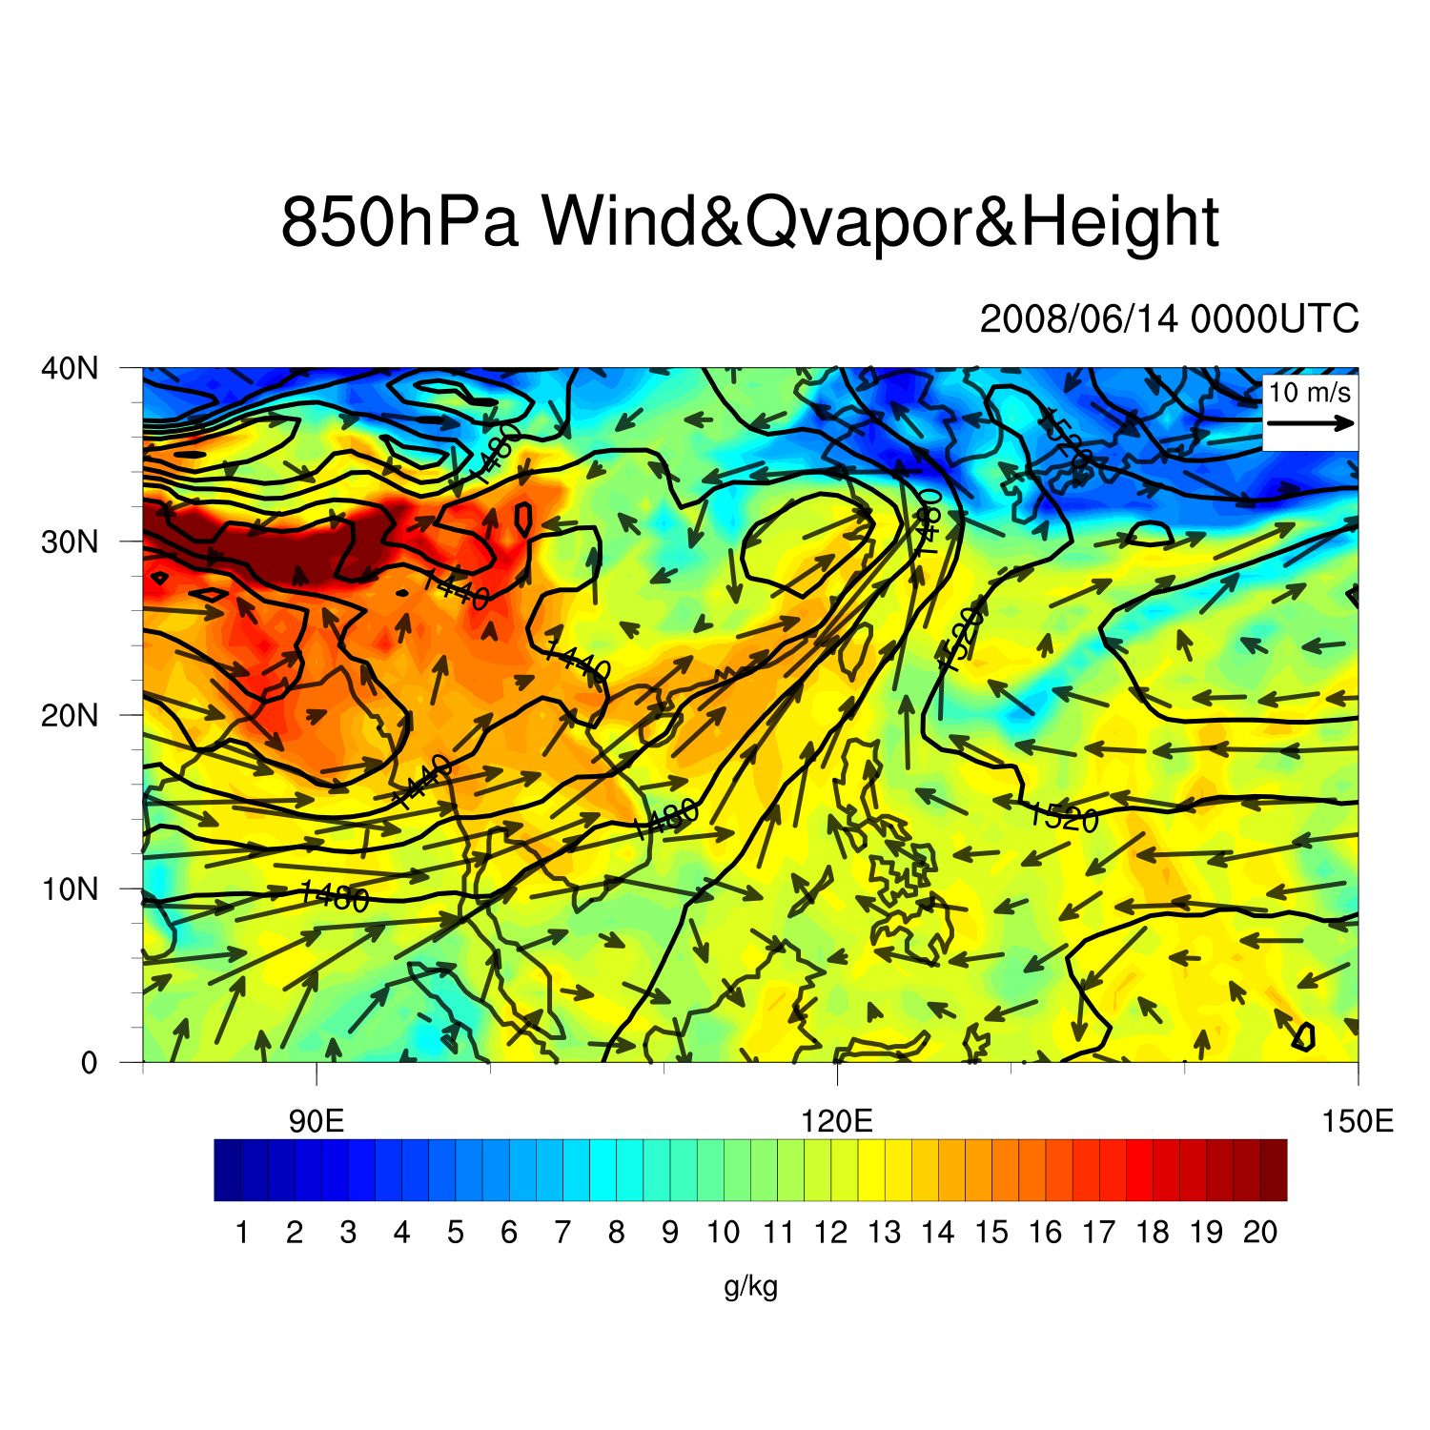
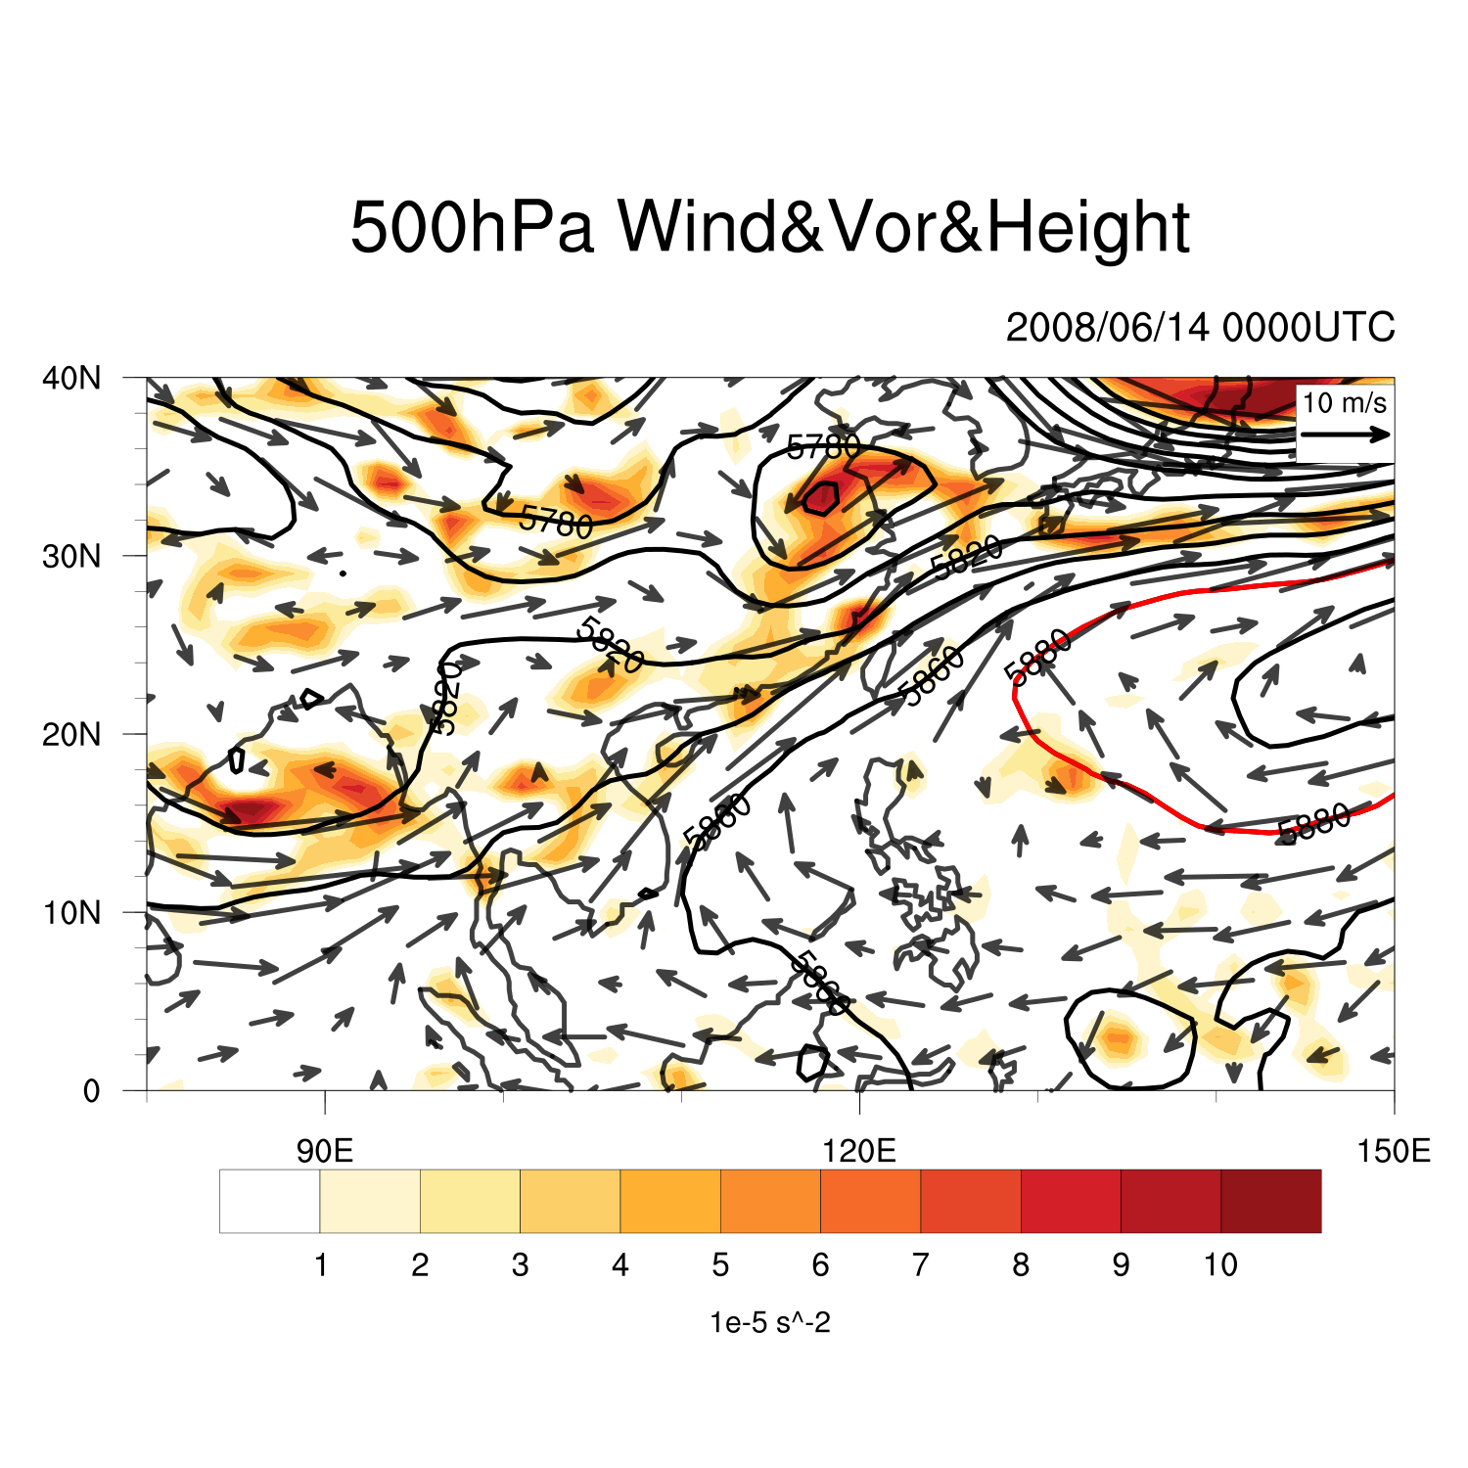
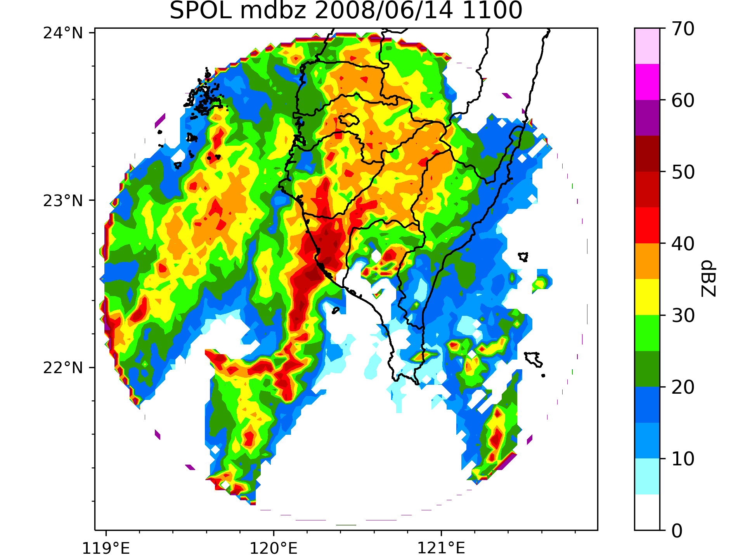
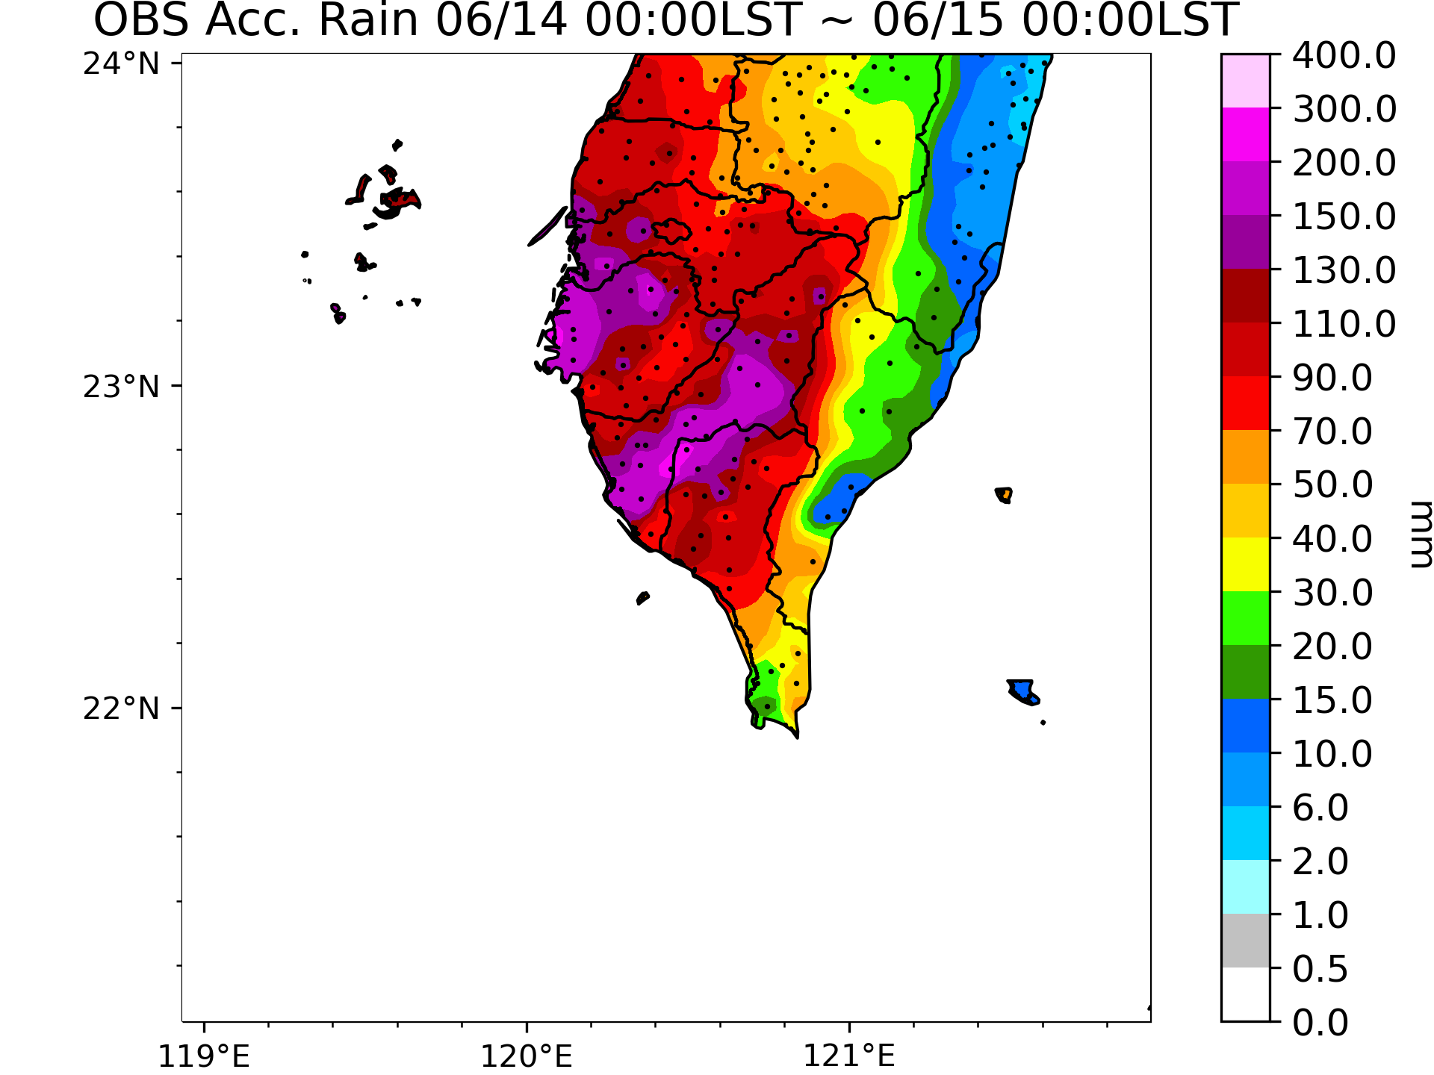
Case Overview
Experiment Design
Squall Line in 2008 SoWMEX IOP8 14th June
Southwestern wind transports warm and moist air to Taiwan Strait
A strong short wave trough and weak subtropical high on the upper level
24-hour rainfall exceeded 200 mm
Introduction
2
Summary & Future Work
Results
References

Slide 6
Case Overview
Experiment Design
Introduction
Summary & Future Work
Results
References

Slide 7
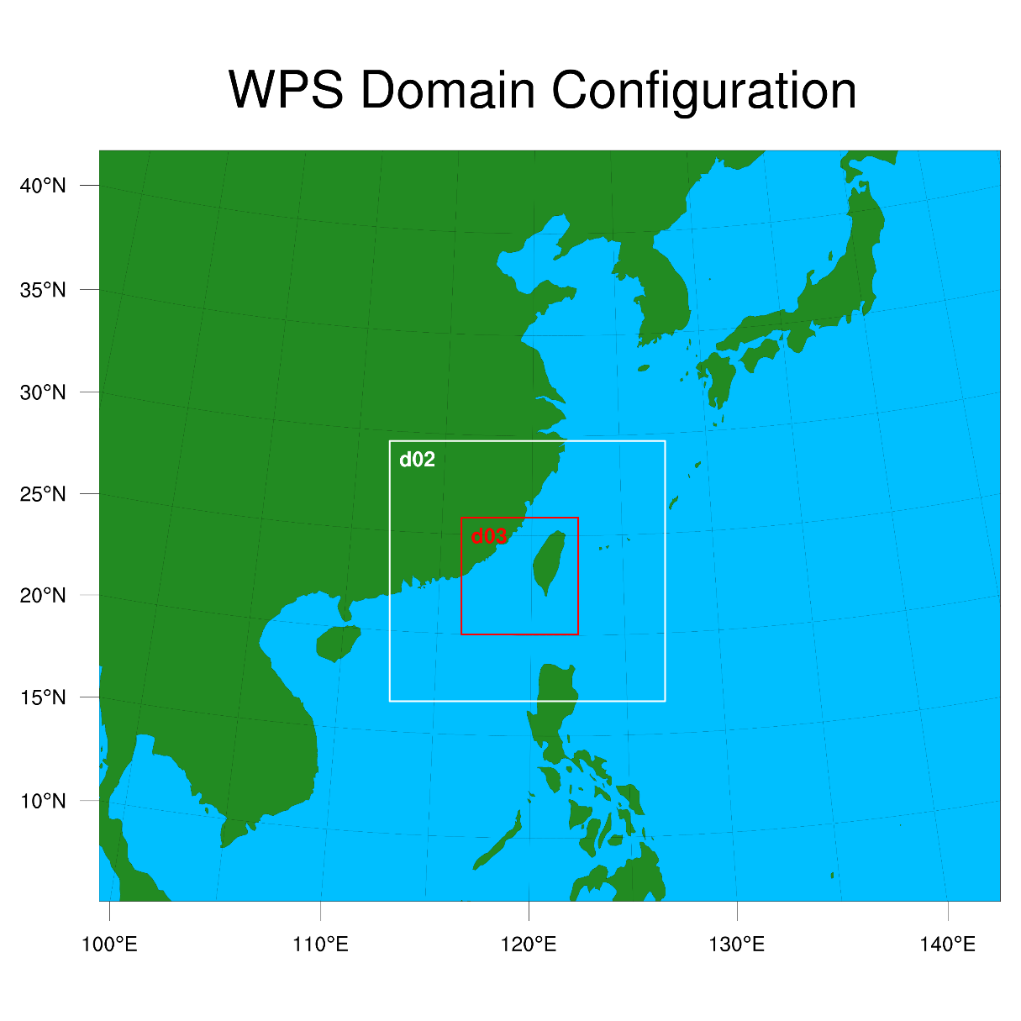

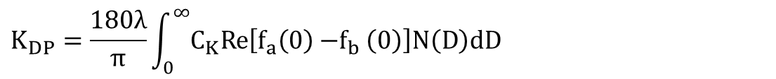
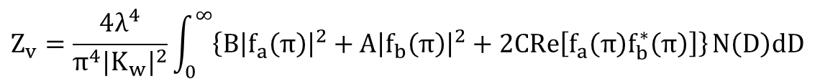
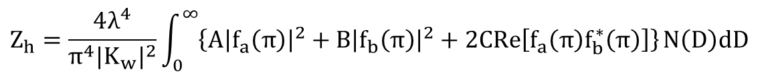

Experiment Design
Case Overview
Numerical model: Weather Research and Forecast V3.9.1
Polarimetric operator (Jung et al. 2008a)
WRFV3.9.1 Setup
IC and BC | NCEP FNL analysis 1 degree
Initial Time | 0000 UTC 14th June 2008 / 1800 UTC 19th July 2020
Horizontal Resolution | 27km、9km、3km
Vertical Resolution | 52 eta levels
Physics Parameterization
LW Radiation | RRTM scheme
SW Radiation | Dudhia scheme
PBL | YSU scheme
Cumulus | Grell-Devenyi ensemble scheme
Microphysics | GCE scheme, WSM6 scheme, WDM6 scheme MOR scheme
Squall Line
Introduction
T-matrix
Power Law Fitting
$$Z_{h}=\frac{4λ^{4}}{π^{4}{|K_{w}|}^{2}}\int_{0}^{∞}{\left\{A{\left|f_{a}\left(π\right)\right|}^{2}+B{\left|f_{b}\left(π\right)\right|}^{2}+2CRe\left[f_{a}\left(π\right)f_{b}^{∗}\left(π\right)\right]\right\}}N\left(D\right)dD$$
$$Z_{v}=\frac{4λ^{4}}{π^{4}{|K_{w}|}^{2}}\int_{0}^{∞}{\left\{B{\left|f_{a}\left(π\right)\right|}^{2}+A{\left|f_{b}\left(π\right)\right|}^{2}+2CRe\left[f_{a}\left(π\right)f_{b}^{∗}\left(π\right)\right]\right\}}N\left(D\right)dD$$
$$K_{DP}=\frac{180λ}{π}\int_{0}^{∞}{C_{K}Re\left[f_{a}\left(0\right){−f}_{b}\left(0\right)\right]N\left(D\right)dD}$$
$$f={αD}^{β}$$
$N\left(D\right)=N_{0}$ $D^{μ}e^{−ΛD}$
3
Summary & Future Work
Results
References

Slide 8
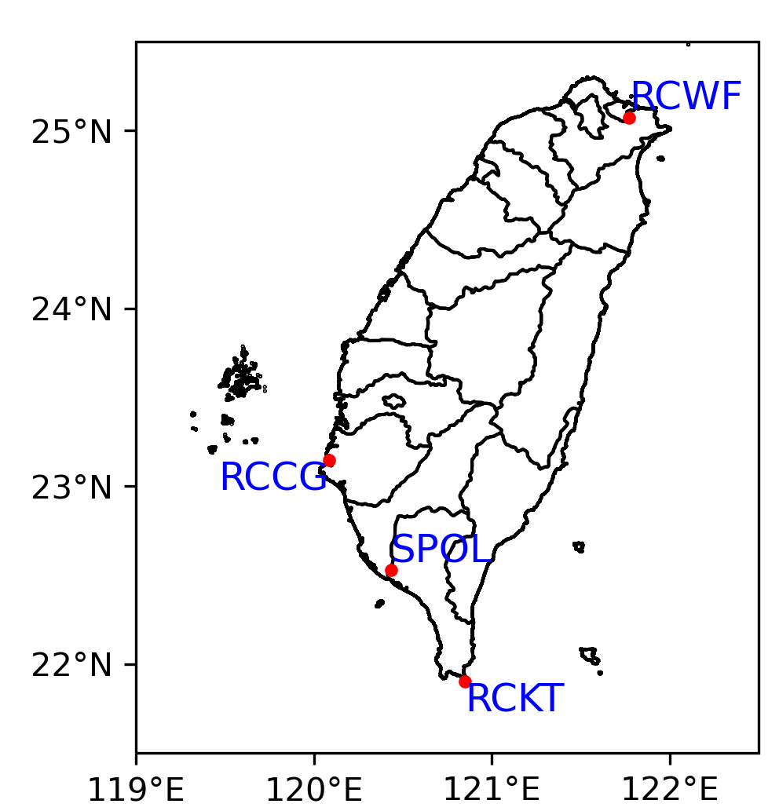
Experiment Design
Case Overview
LETKF assimilation flow chart
10-hour spin up
6-hour QPF
···
···
···
···
···
···
···
···
···
50 members
···
···
Introduction
···
···
14 June 2008
0000 UTC
14 June 2008
1000 UTC
EnKF cycling period
14 June 2008
1100 UTC
Assimilation interval: 15 minutes
Number of cycles: 5
Radar: RCWF, RCCG, RCKT, SPOL
Observation data: V_{r}, Z_{H}, Z_{DR} and K_{DP}
Superobs: 4.5° and 4.5 km for SPOL; 5° and 5 km for RCWF, RCCG, RCKT
Observation error: 3 m/s for V_{r}, 5 dBZ for Z_{H}, 0.2 dB for Z_{DR}, 0.5 deg/km for K_{DP}
Assimilation threshold: Altitude < 4 km (Z_{DR}, K_{DP}), Z_{DR} > 0.0 dB, K_{DP} > 0.0 deg/km
 | U、V | W | PH、T | q_{v}、q_{c}、q_{i}、N_{Tc}、N_{Ti} | q_{r}、q_{s}、q_{g}、N_{Tr}、N_{Ts}、N_{Tg}
Horizontal localization radius (km) | 36 | 12 | 12 | 24 | 12
Vertical localization radius (km) | 4
Inflation factor | 1.08
4
Summary & Future Work
Results
References

Slide 9
Case Overview
Experiment Design
Introduction
Summary & Future Work
Results
References

Slide 10
Case Overview
Experiment Design
Introduction
Results
Summary & Future Work
Impact in Different MP Schemes
Ctrl Run
 | V_{r} | Z_{H} | Z_{DR} | K_{DP}
Scheme_VrZ | V | V
Scheme_VrZZdr | V | V | V
Scheme_VrZKdp | V | V |  | V
Scheme_VrZZK | V | V | V | V
References
Scheme: GCE, WSM6, WDM6, MOR
5

Slide 11
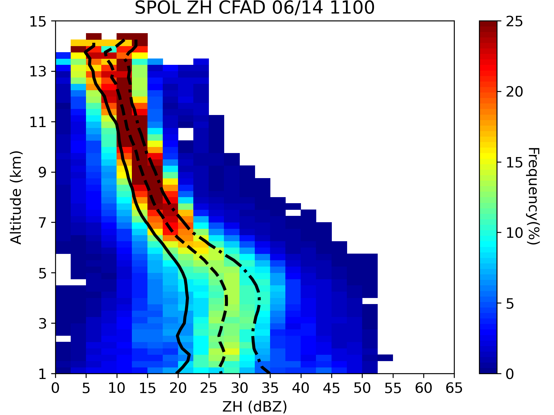
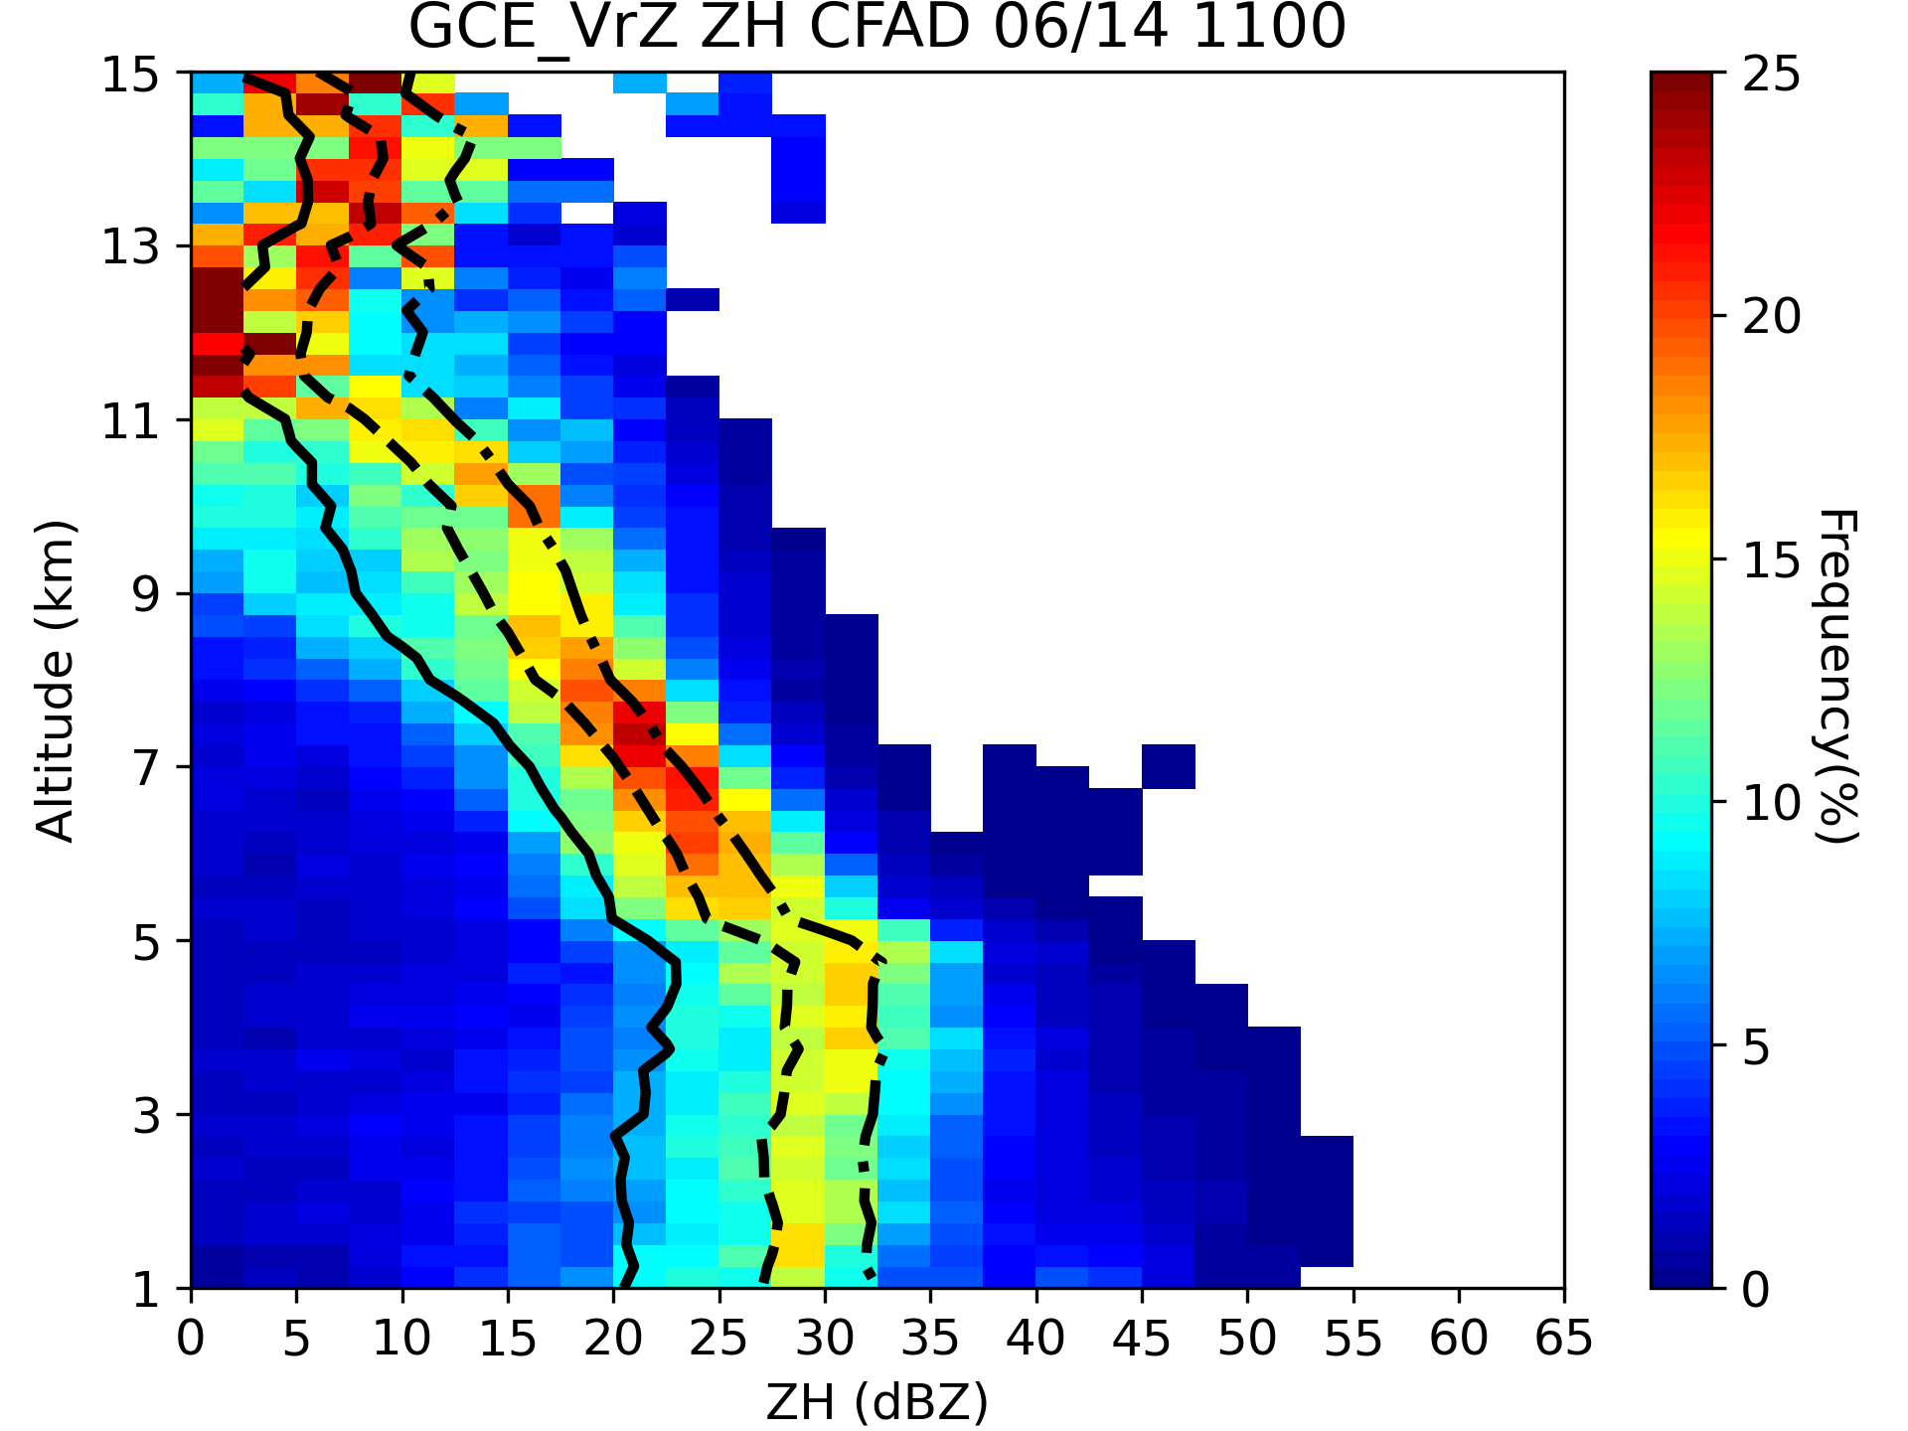
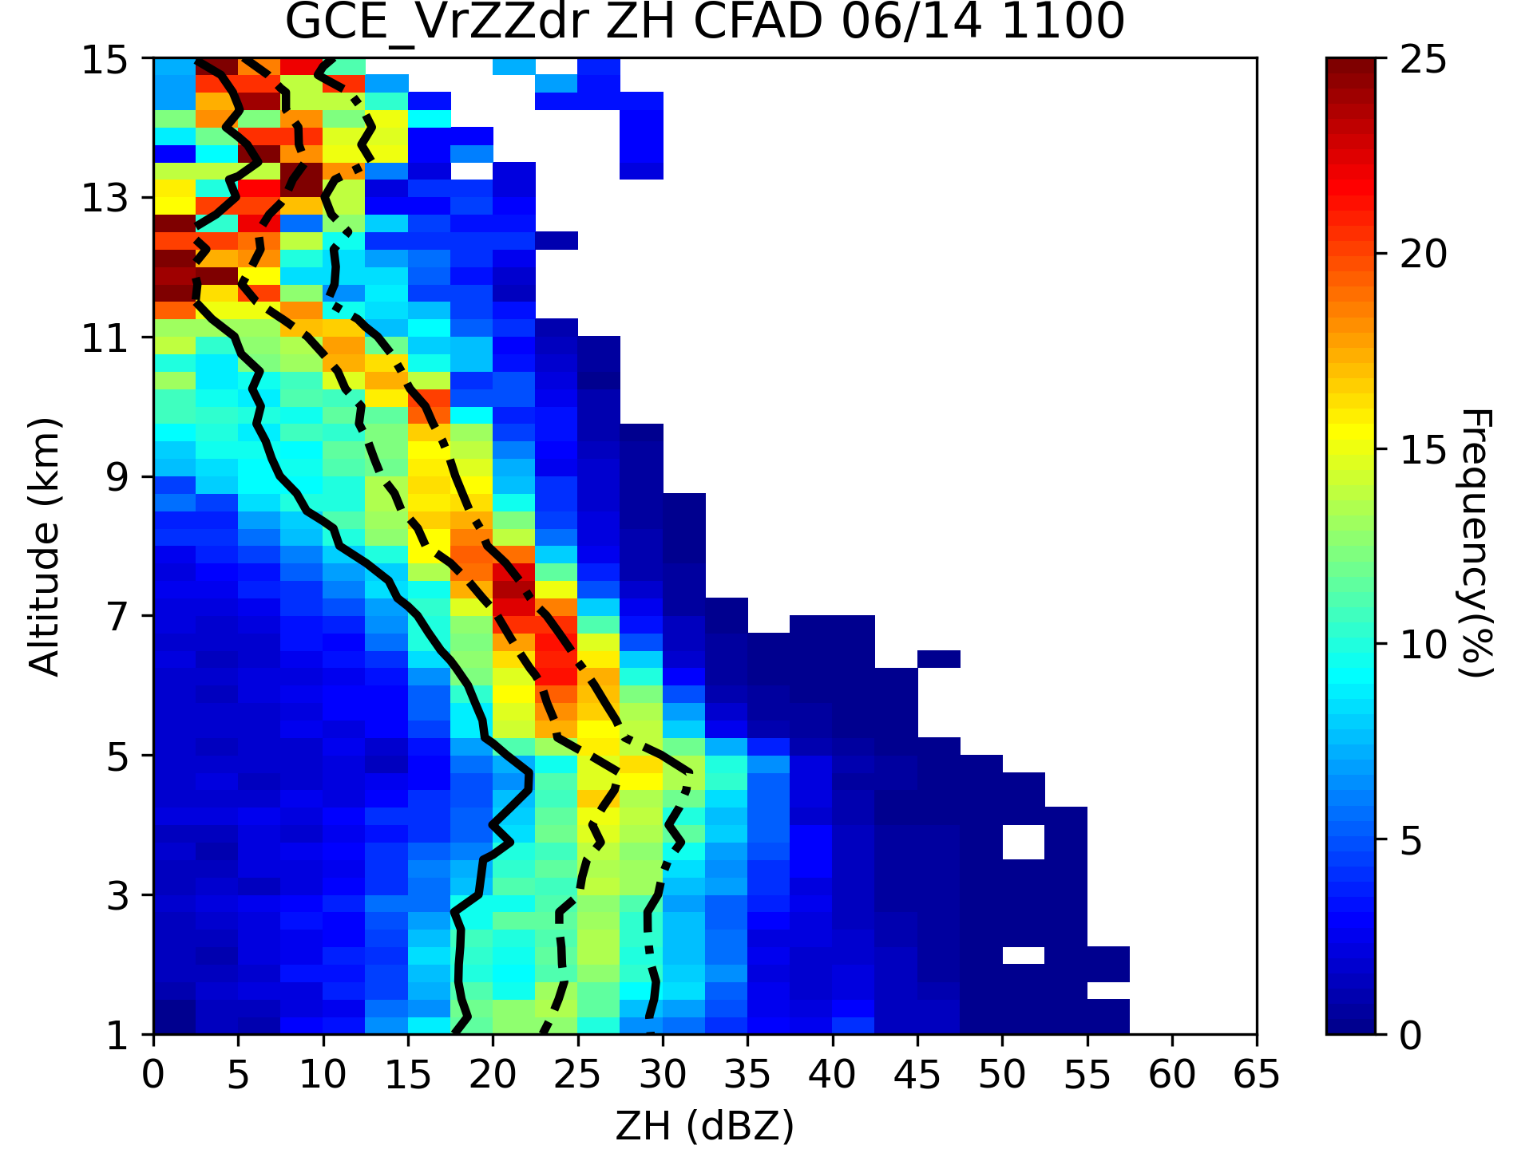
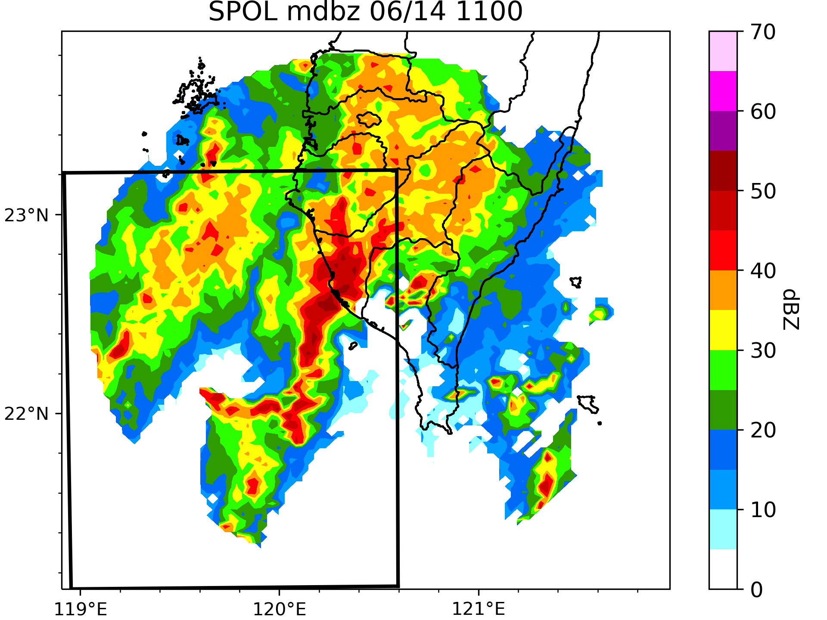
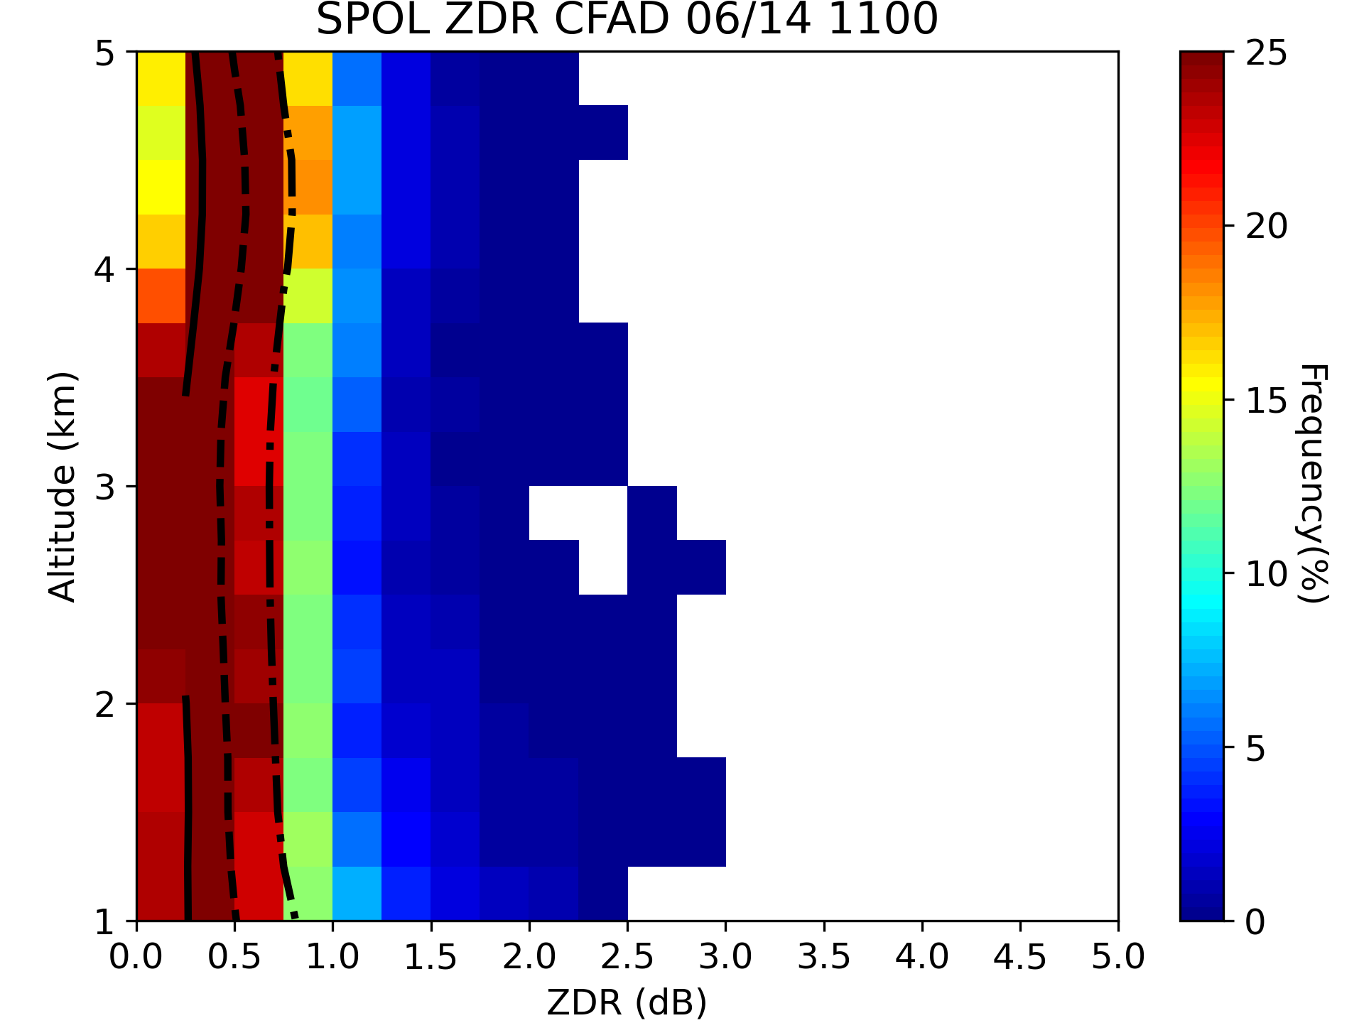
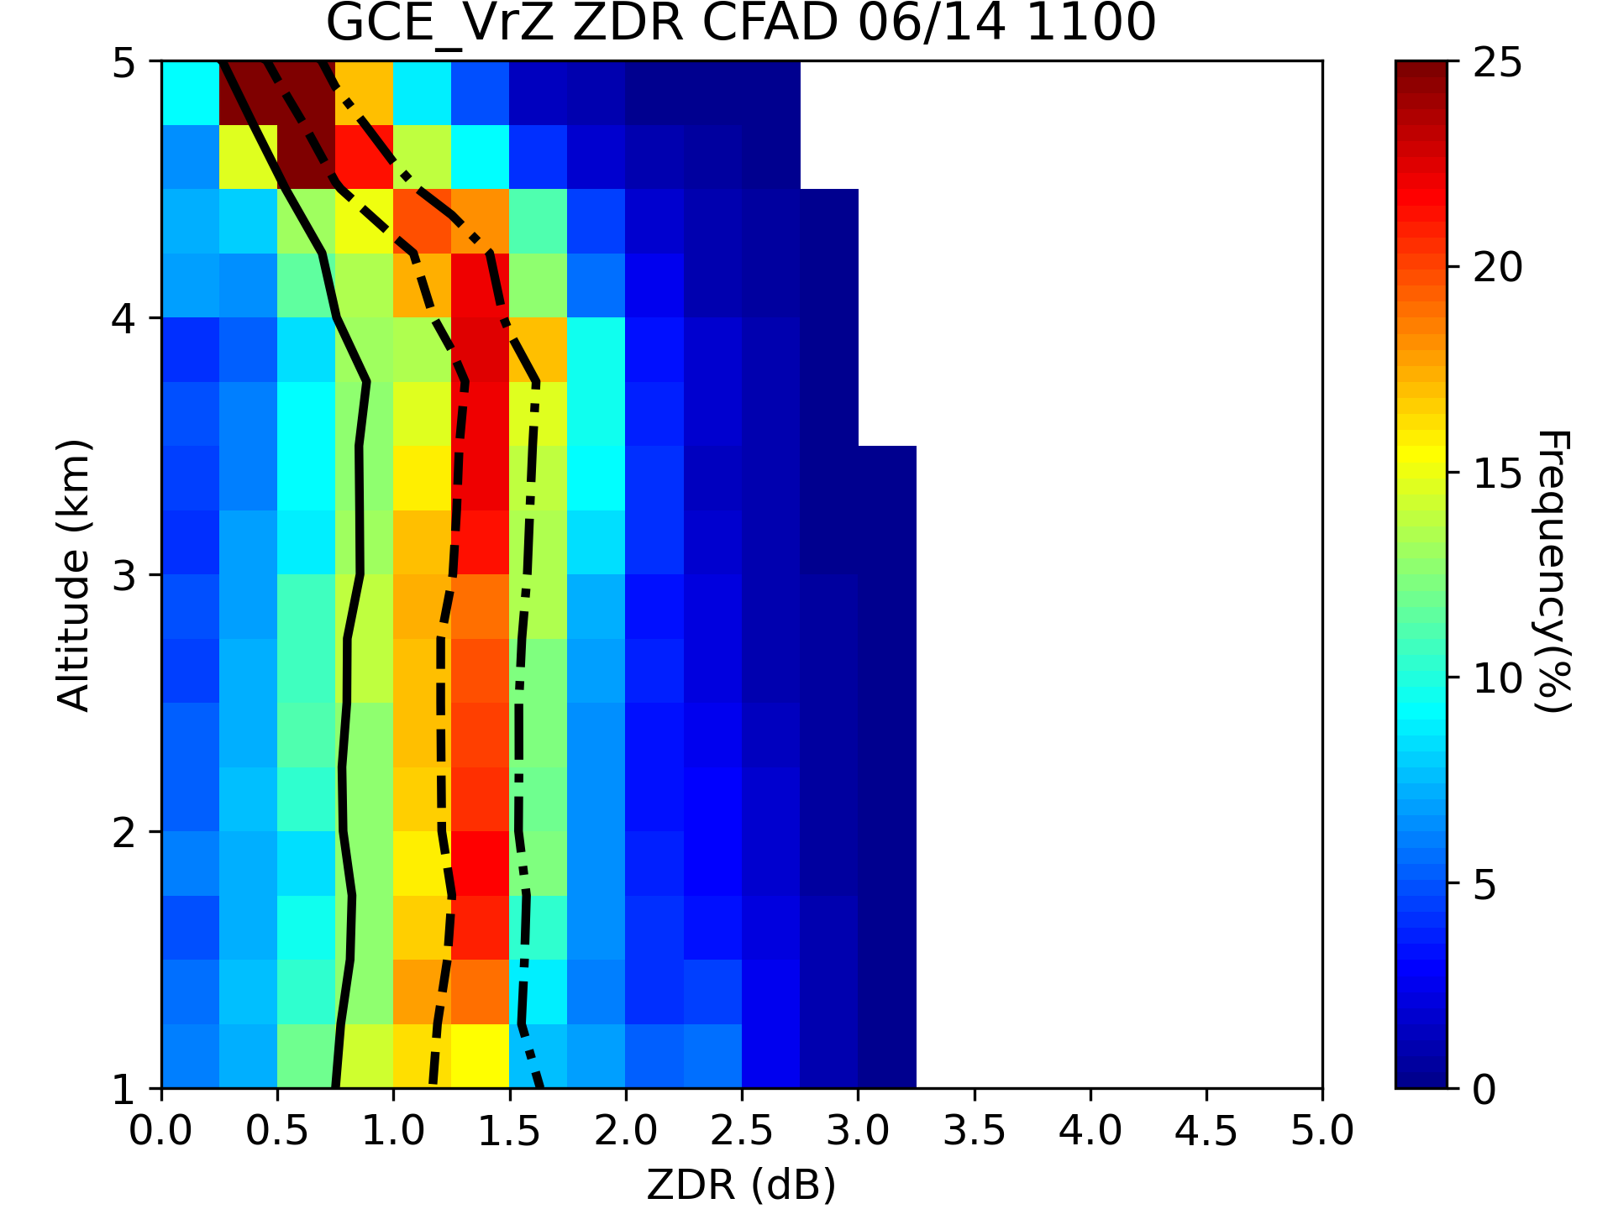
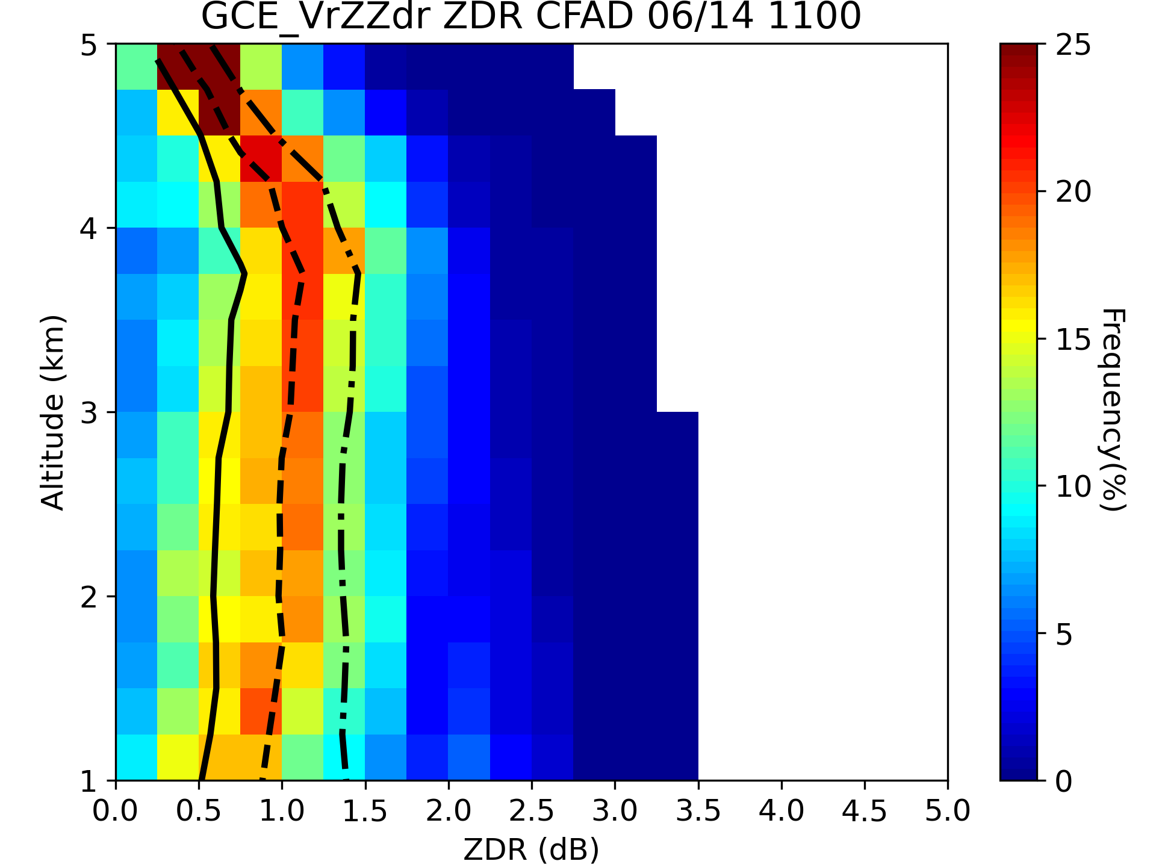
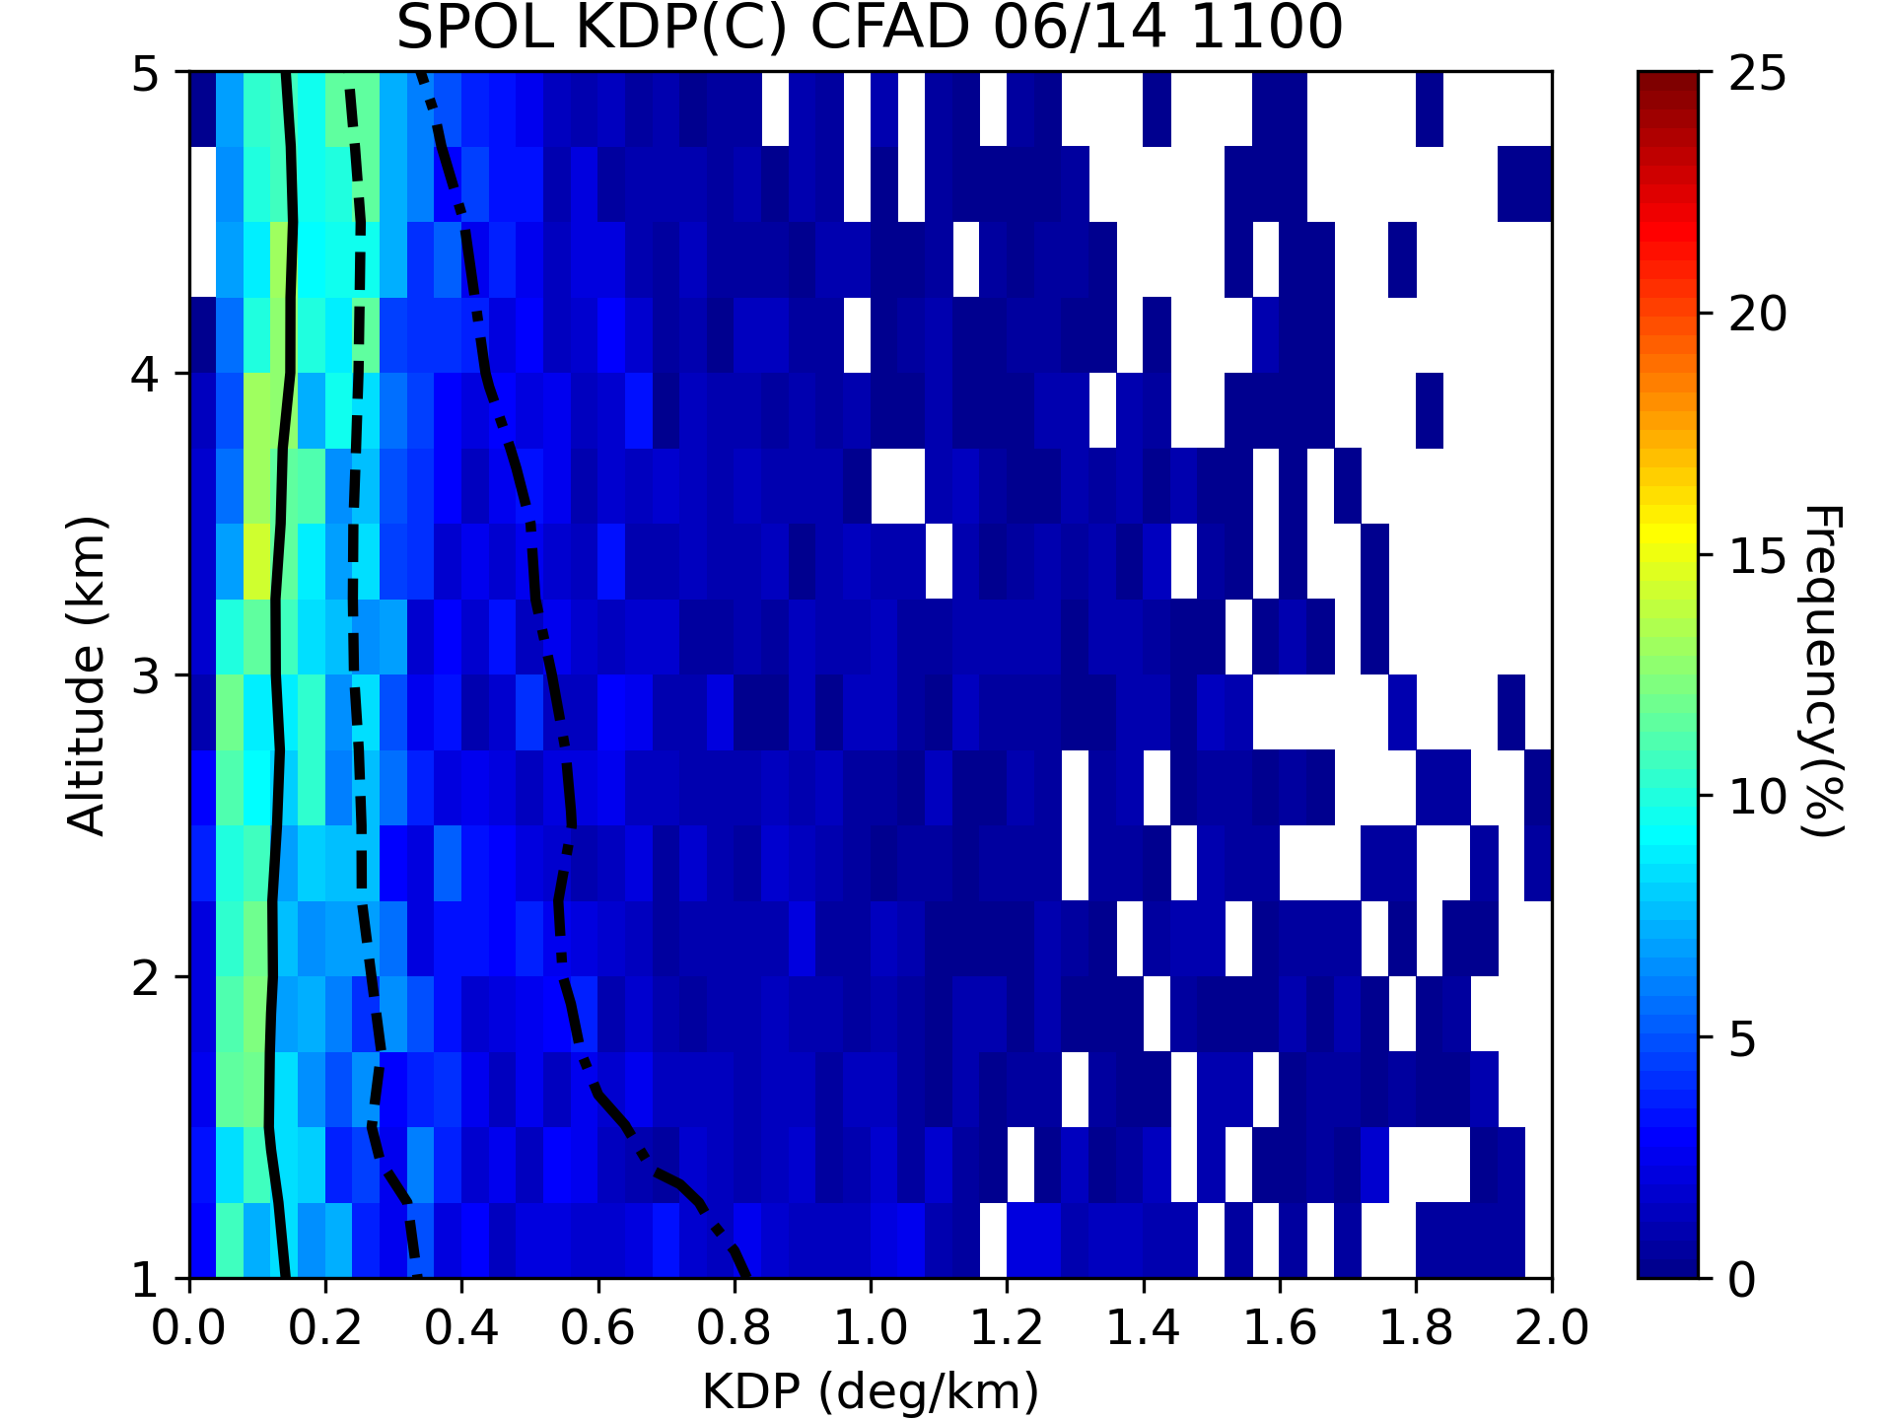
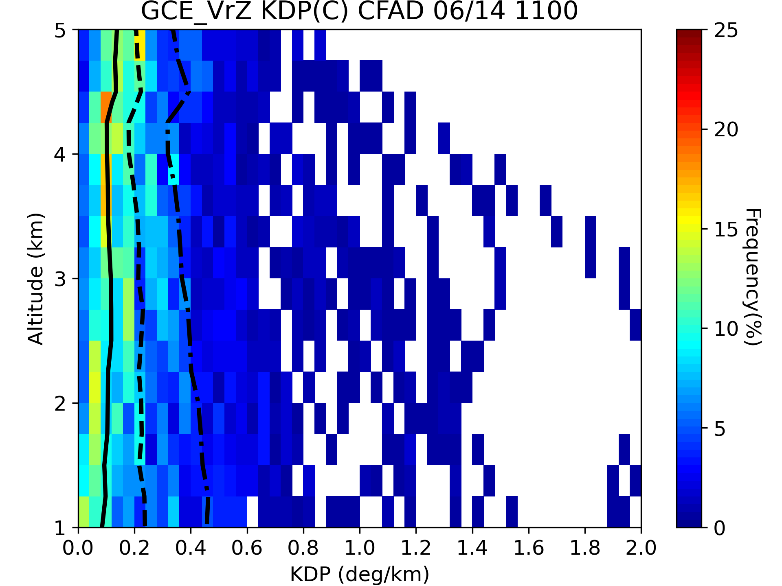
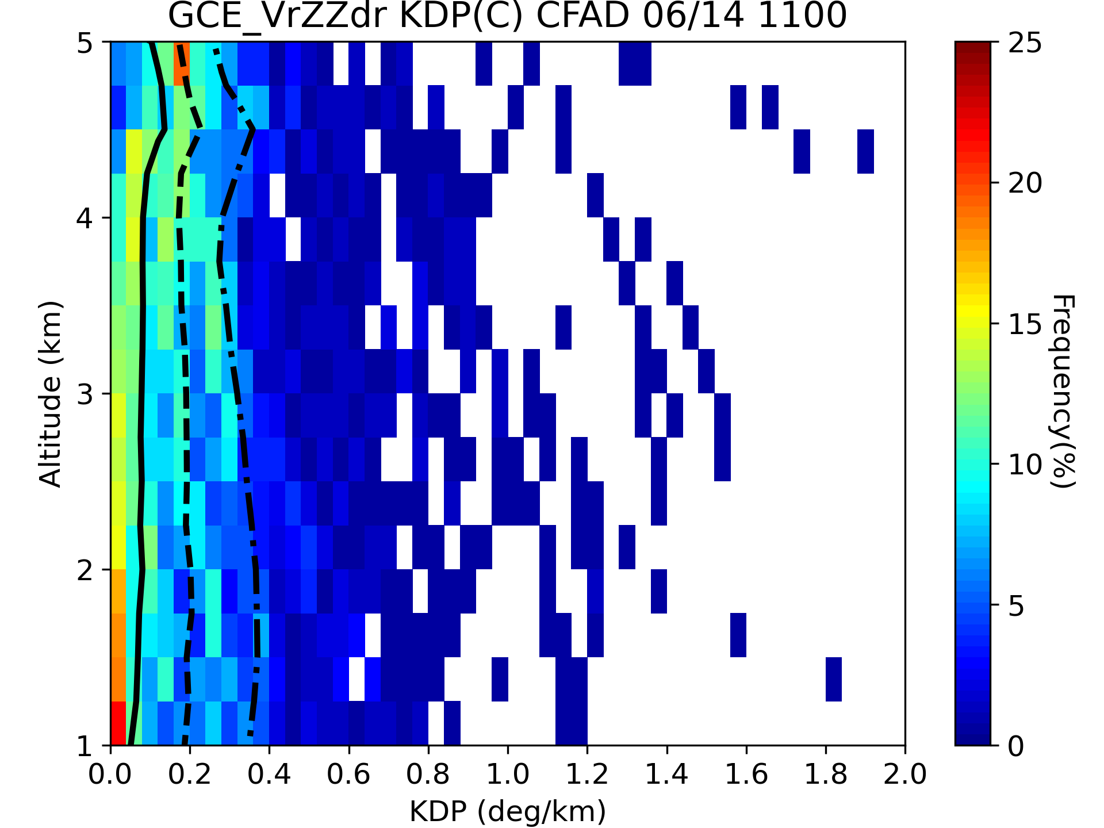
Results
Analysis Field
SPOL
GCE _VrZ
GCE _VrZZdr
Z_{H}
With additional Z_{DR}
Quartiles of Z_{H}, Z_{DR} and K_{DP} are smaller
Z_{DR}
K_{DP}
6

Slide 12
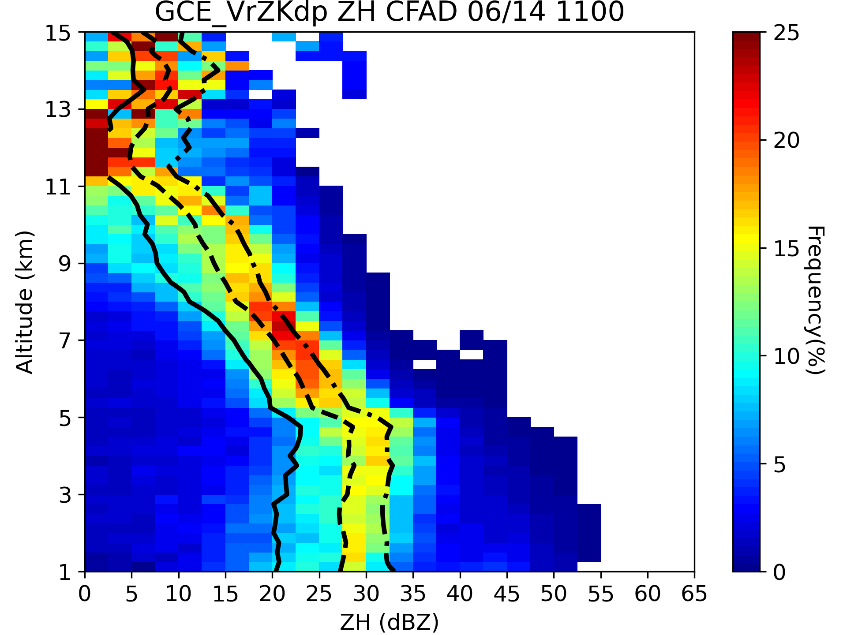
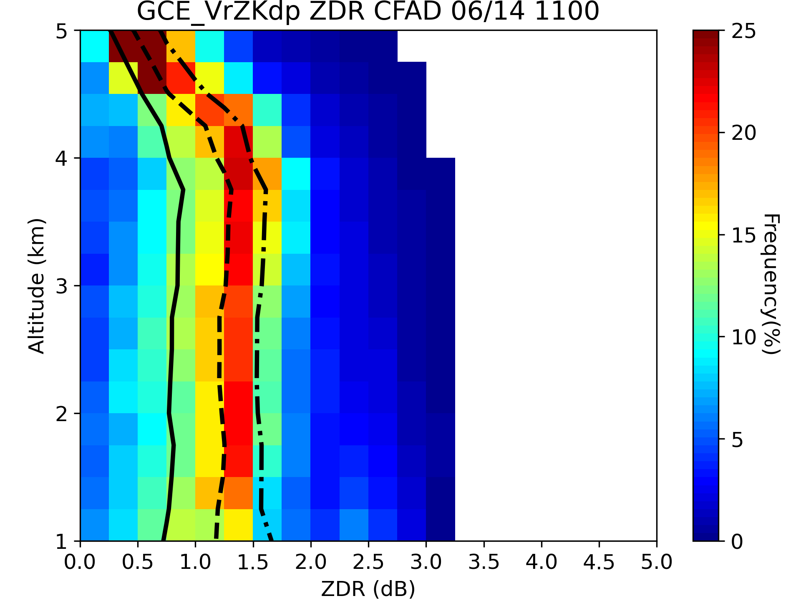
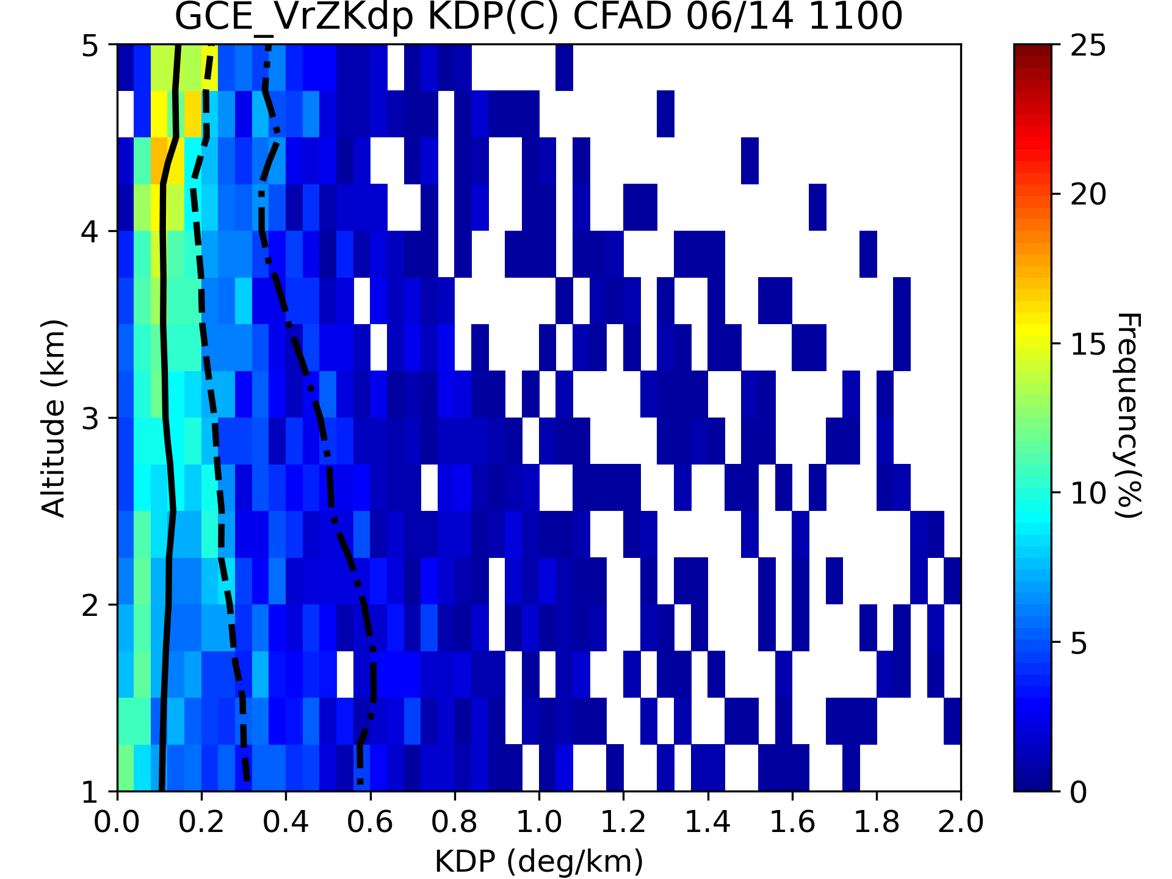
Results
Analysis Field
SPOL
GCE _VrZ
GCE _VrZKdp
Z_{H}
With additional Z_{DR}
Quartiles of Z_{H}, Z_{DR} and K_{DP} are smaller
With additional K_{DP}
Frequency maximum of Z_{DR} is higher
The 3rd quartile of K_{DP} is larger (0.6 °/km)
Z_{DR}
K_{DP}
7

Slide 13
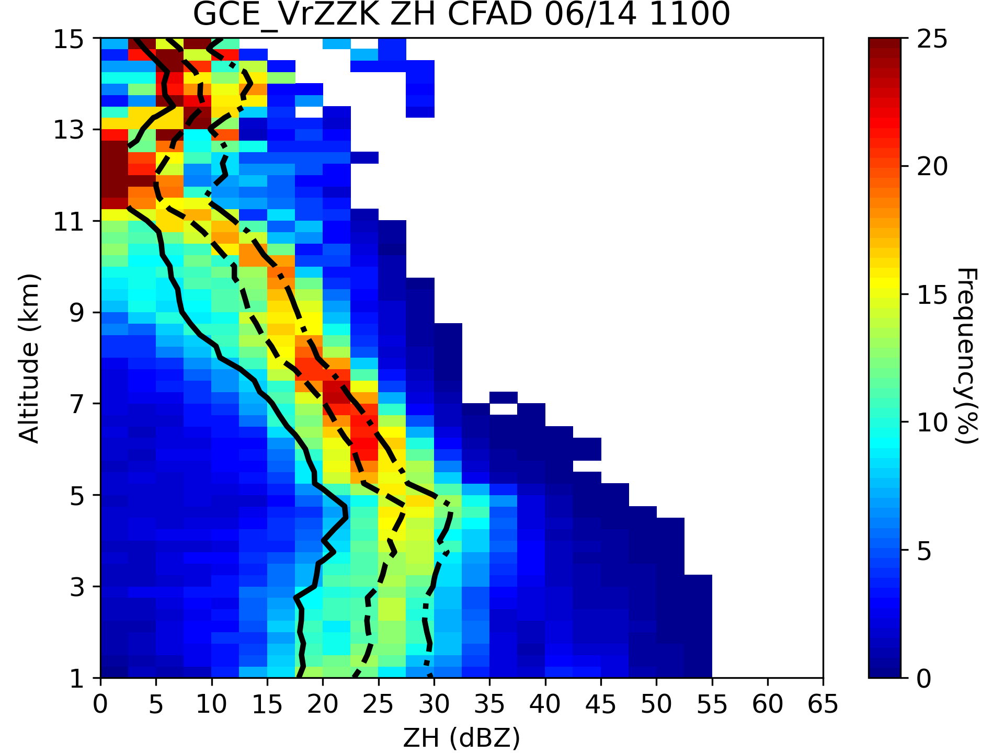
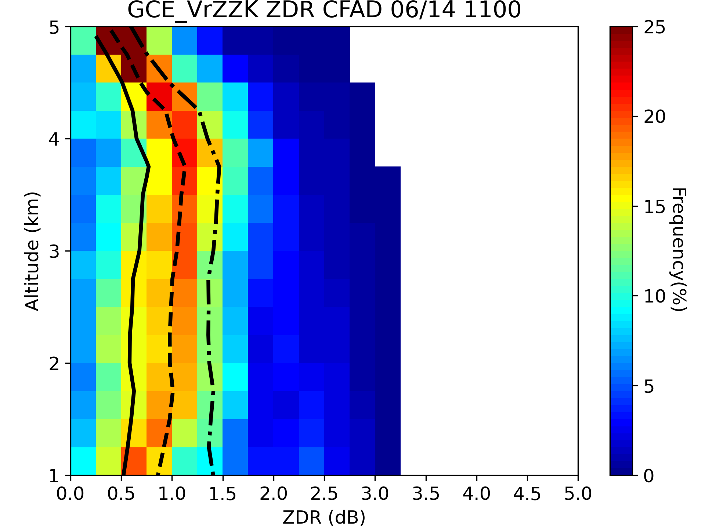
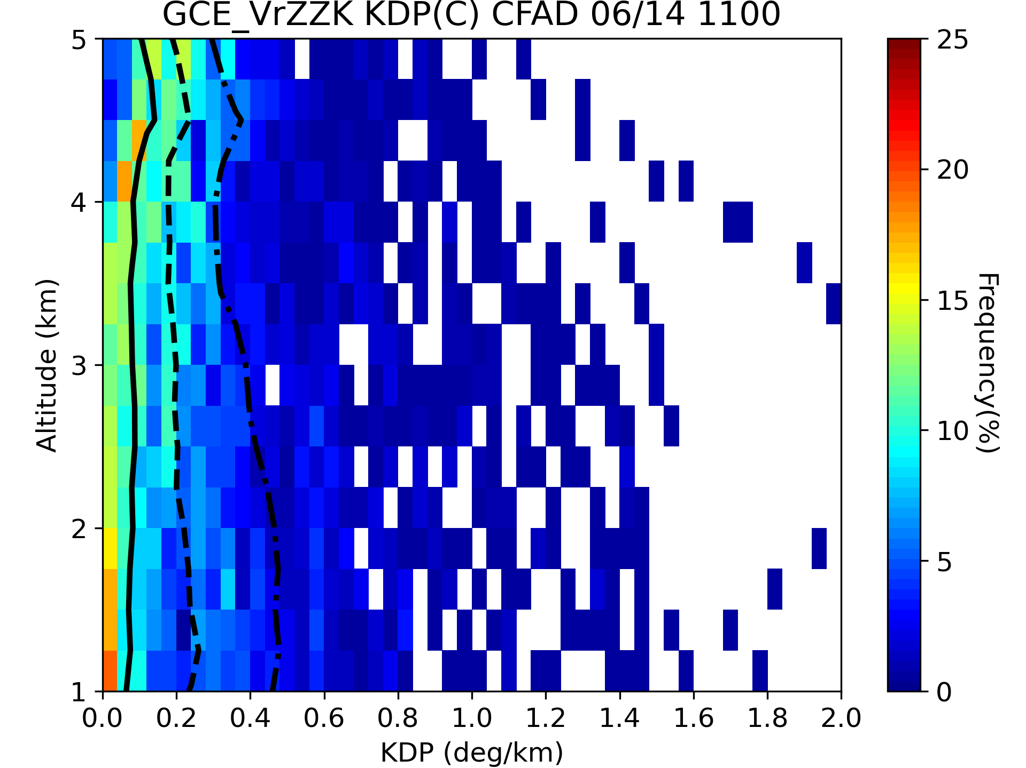
Results
Analysis Field
SPOL
GCE _VrZ
GCE _VrZZK
Z_{H}
With additional Z_{DR}
Quartiles of Z_{H}, Z_{DR} and K_{DP} are smaller
With additional K_{DP}
Frequency maximum of Z_{DR} is higher
The 3rd quartile of K_{DP} is larger (0.6 °/km)
With additional Z_{DR} & K_{DP}
Quartiles of Z_{H} and Z_{DR} are smaller
The improvement of K_{DP} is limited (0.4 °/km)
Z_{DR}
K_{DP}
8

Slide 14
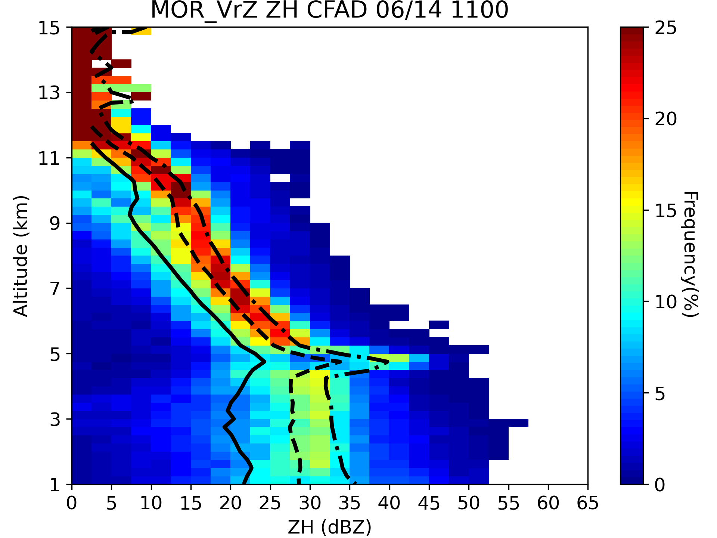
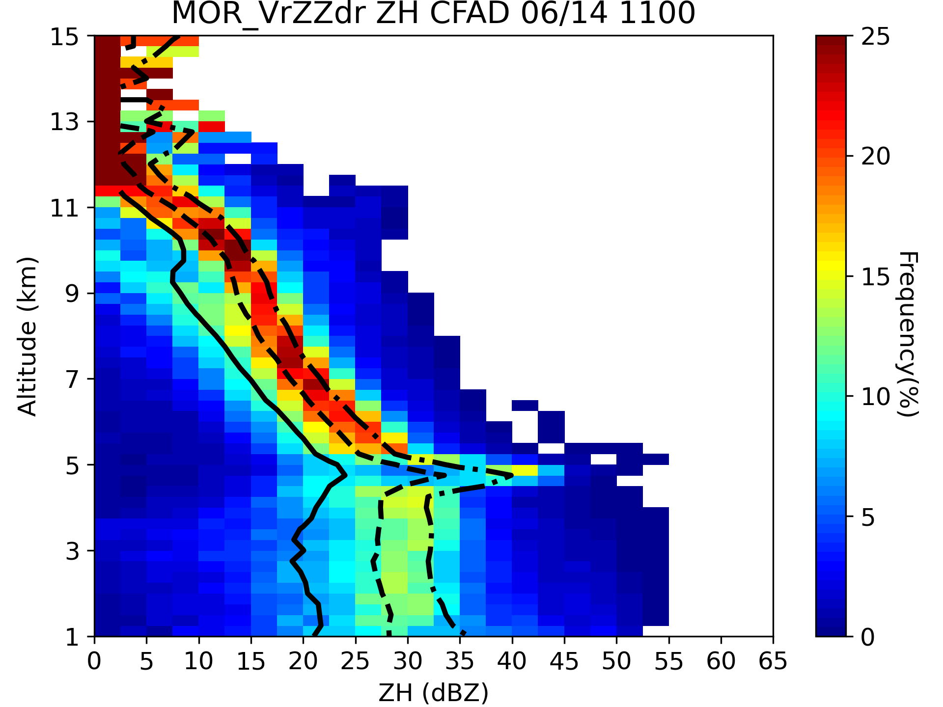
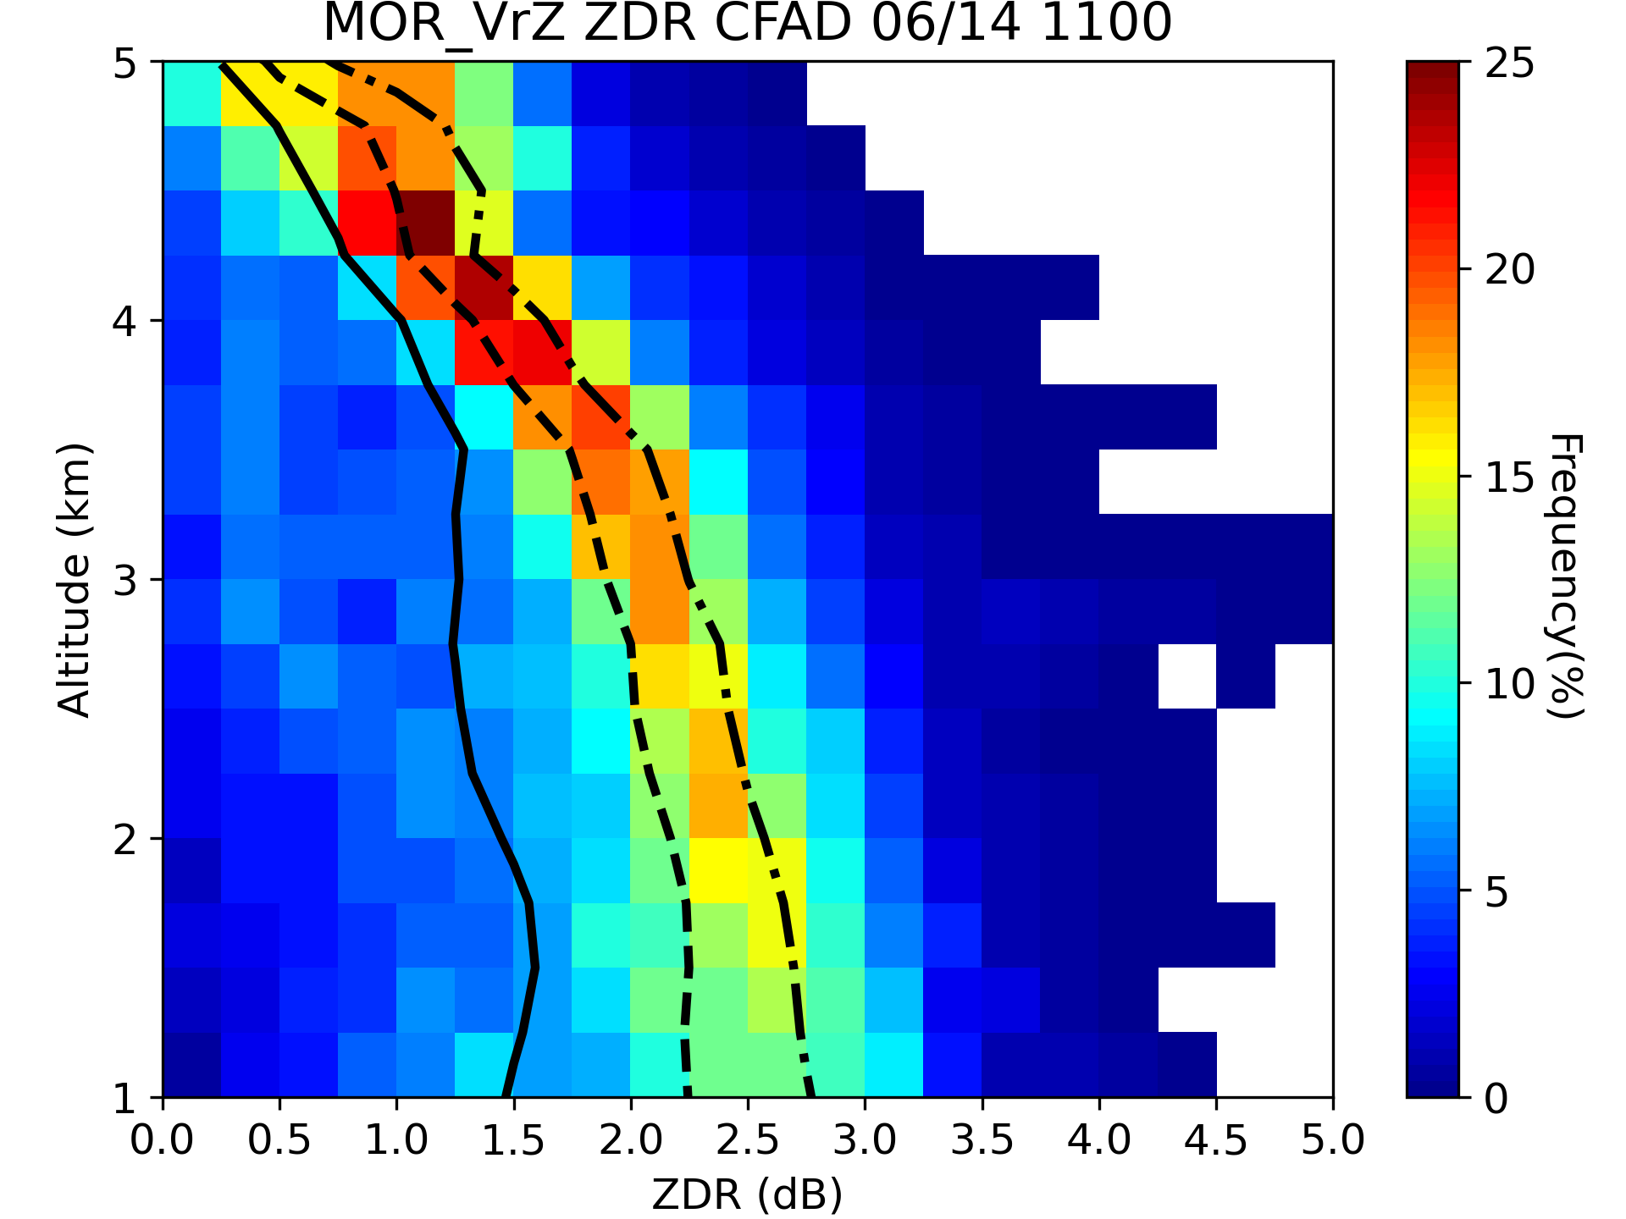
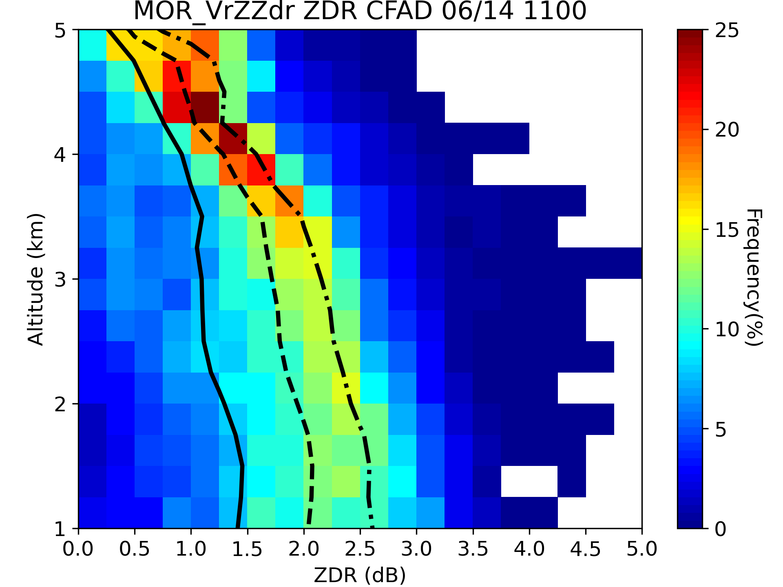
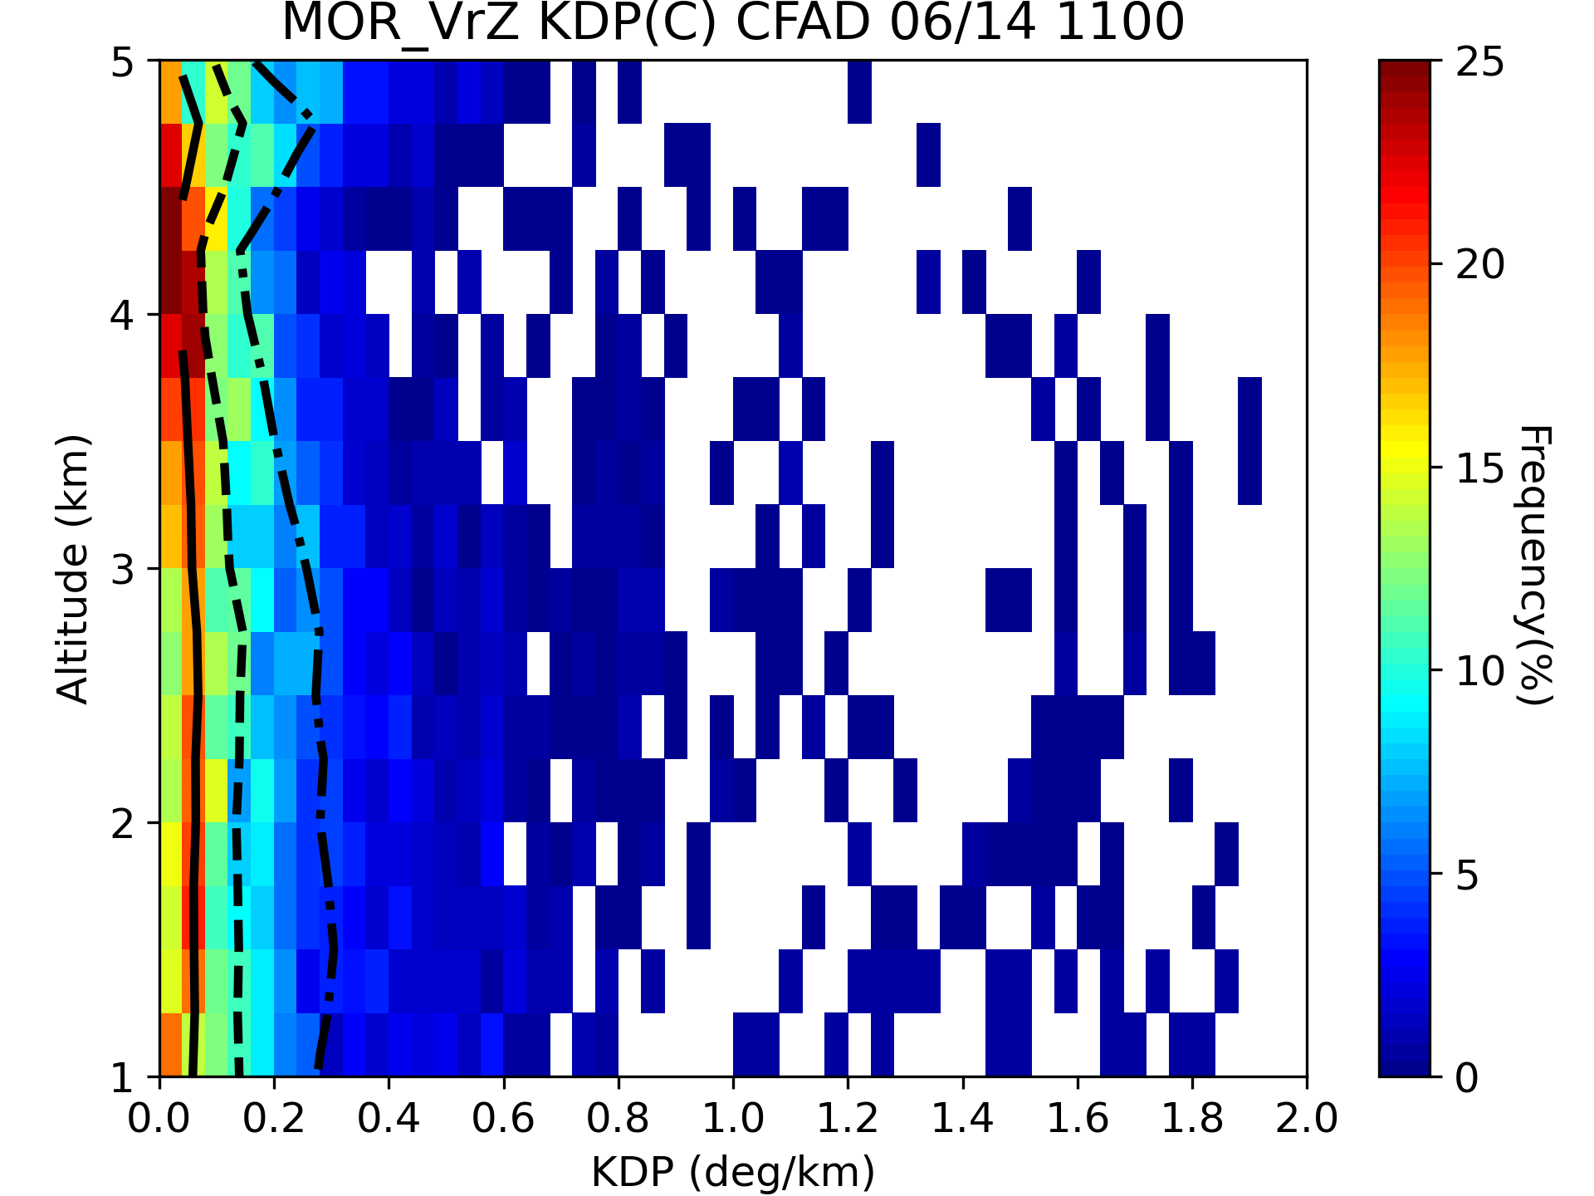
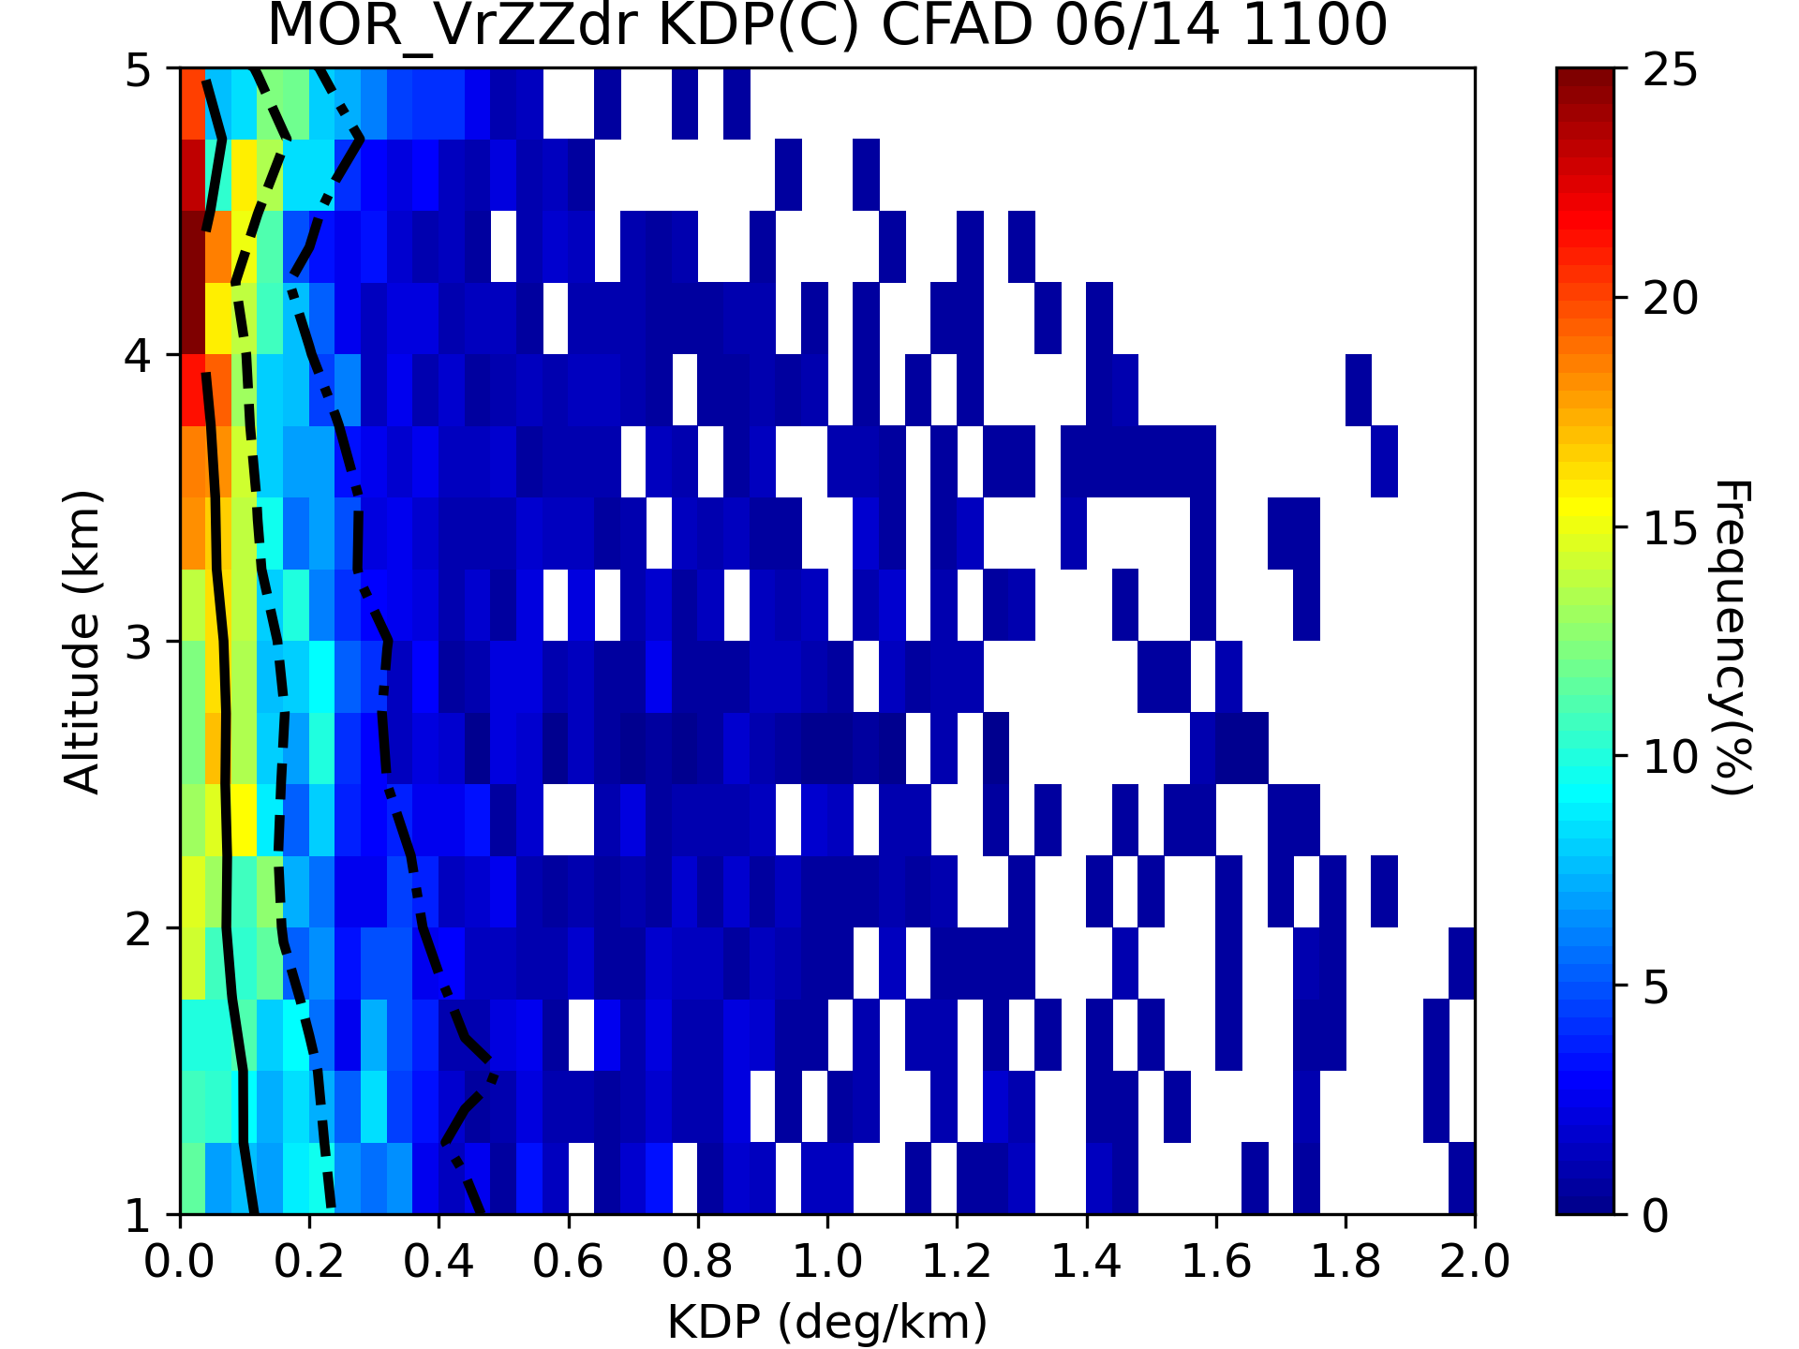
Results
Analysis Field
SPOL
MOR_VrZ
MOR_VrZZdr
Z_{H}
With additional Z_{DR}
Quartiles of Z_{DR} are smaller
Quartiles of K_{DP} are larger
Z_{DR}
K_{DP}
9

Slide 15
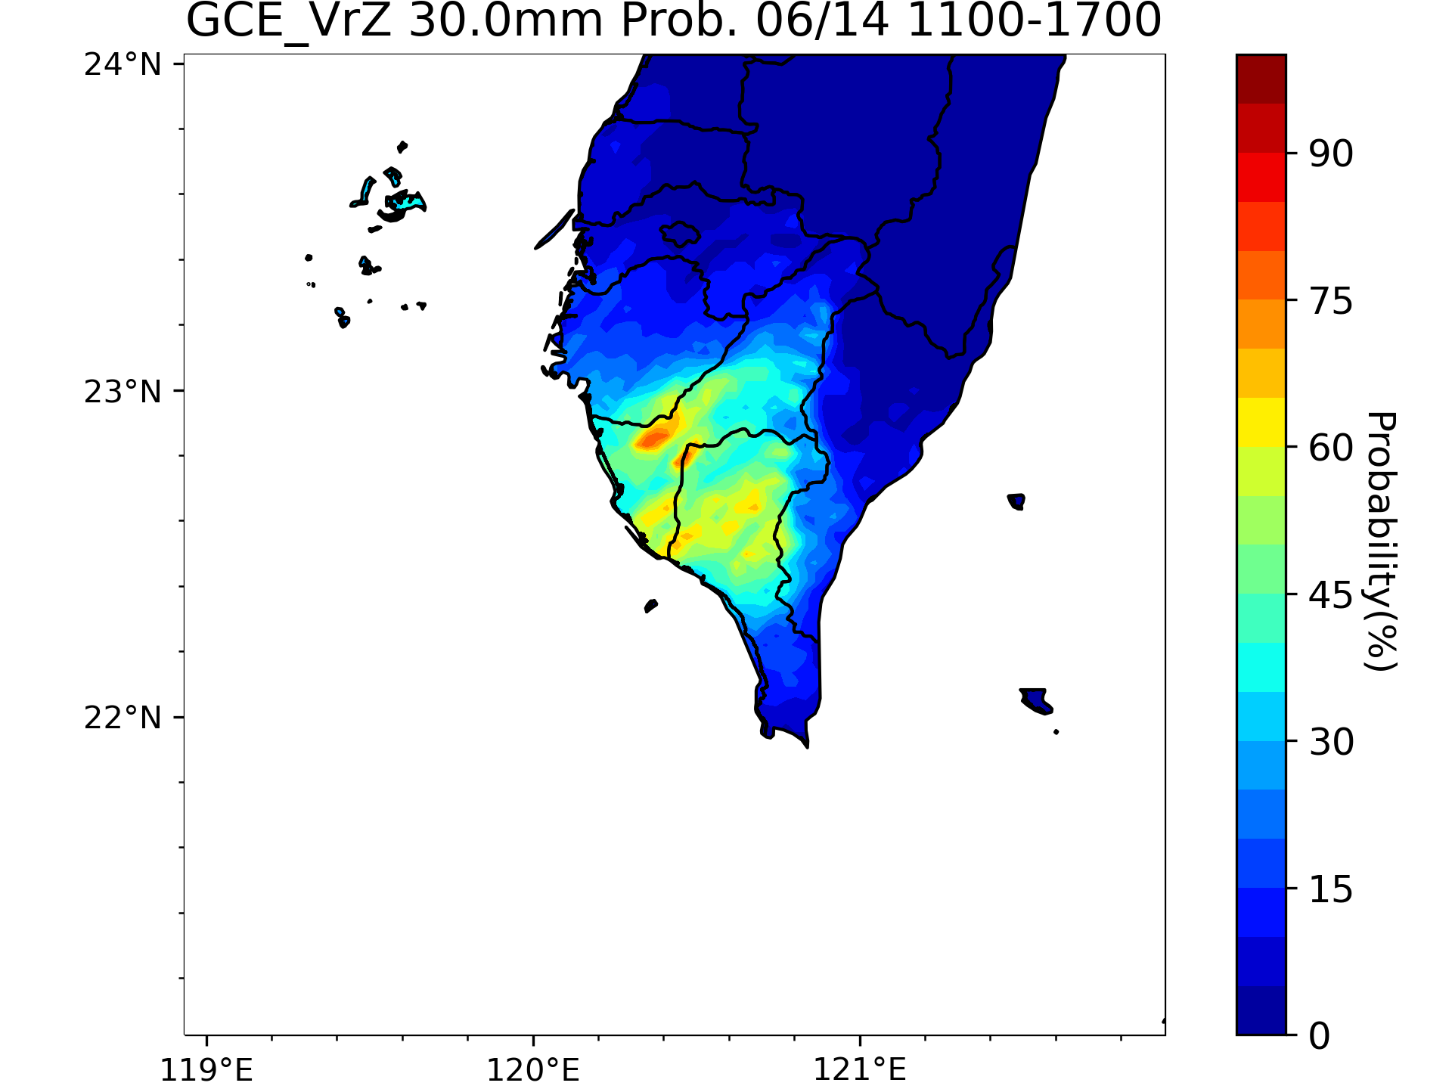
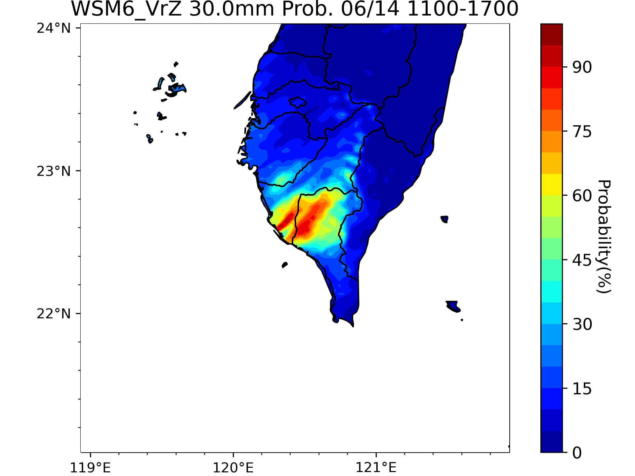

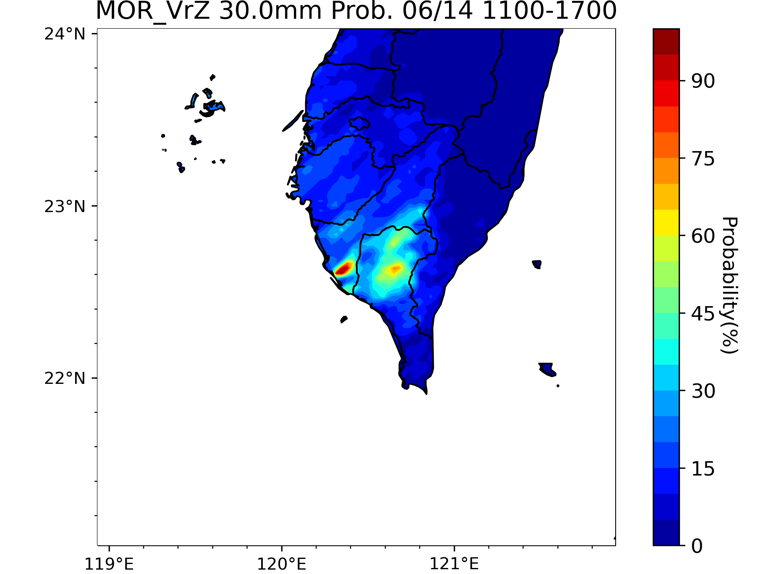
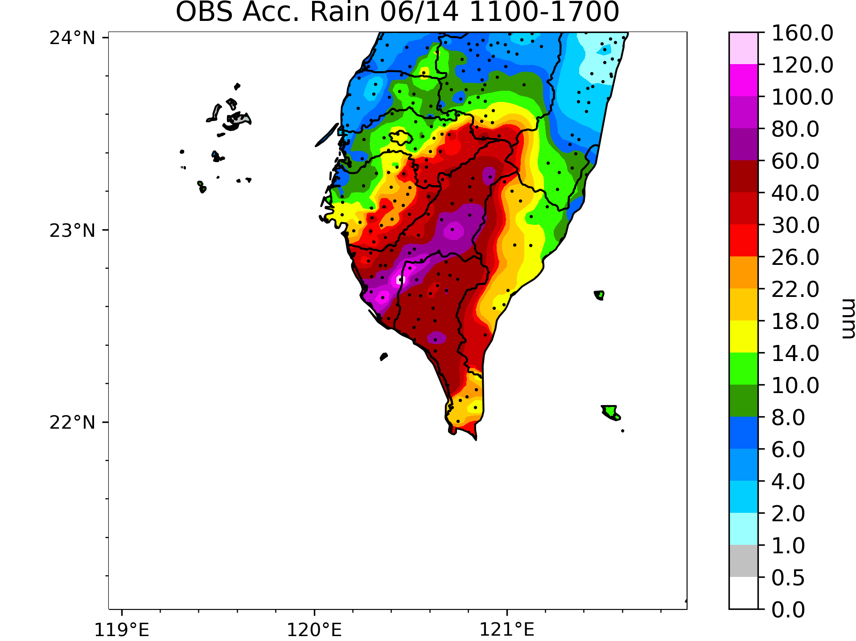
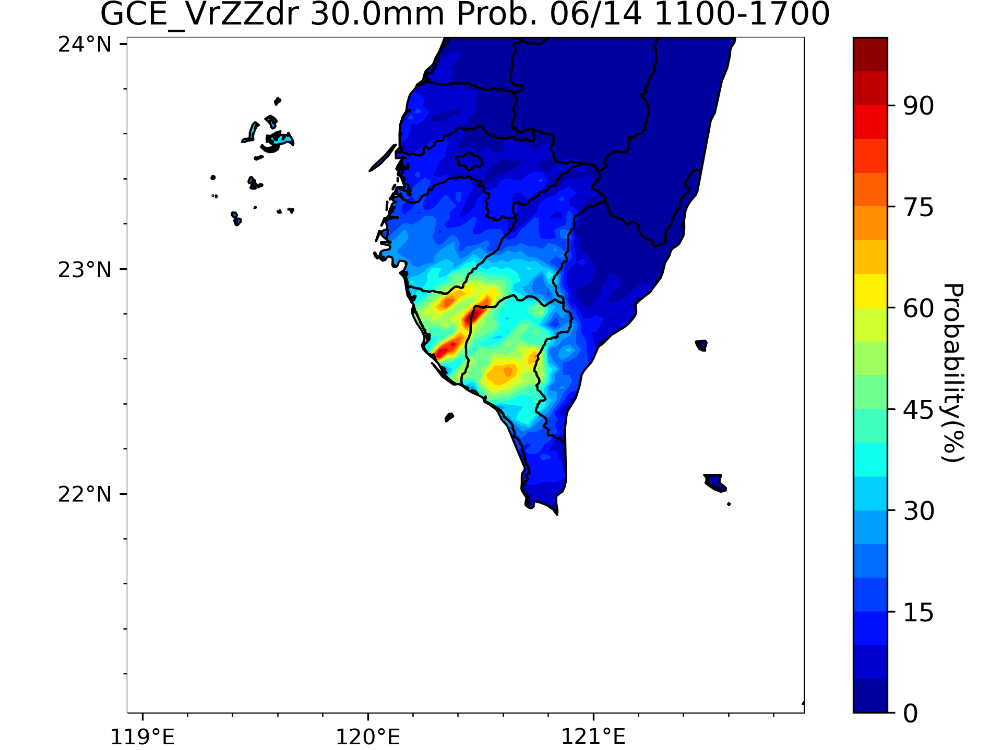
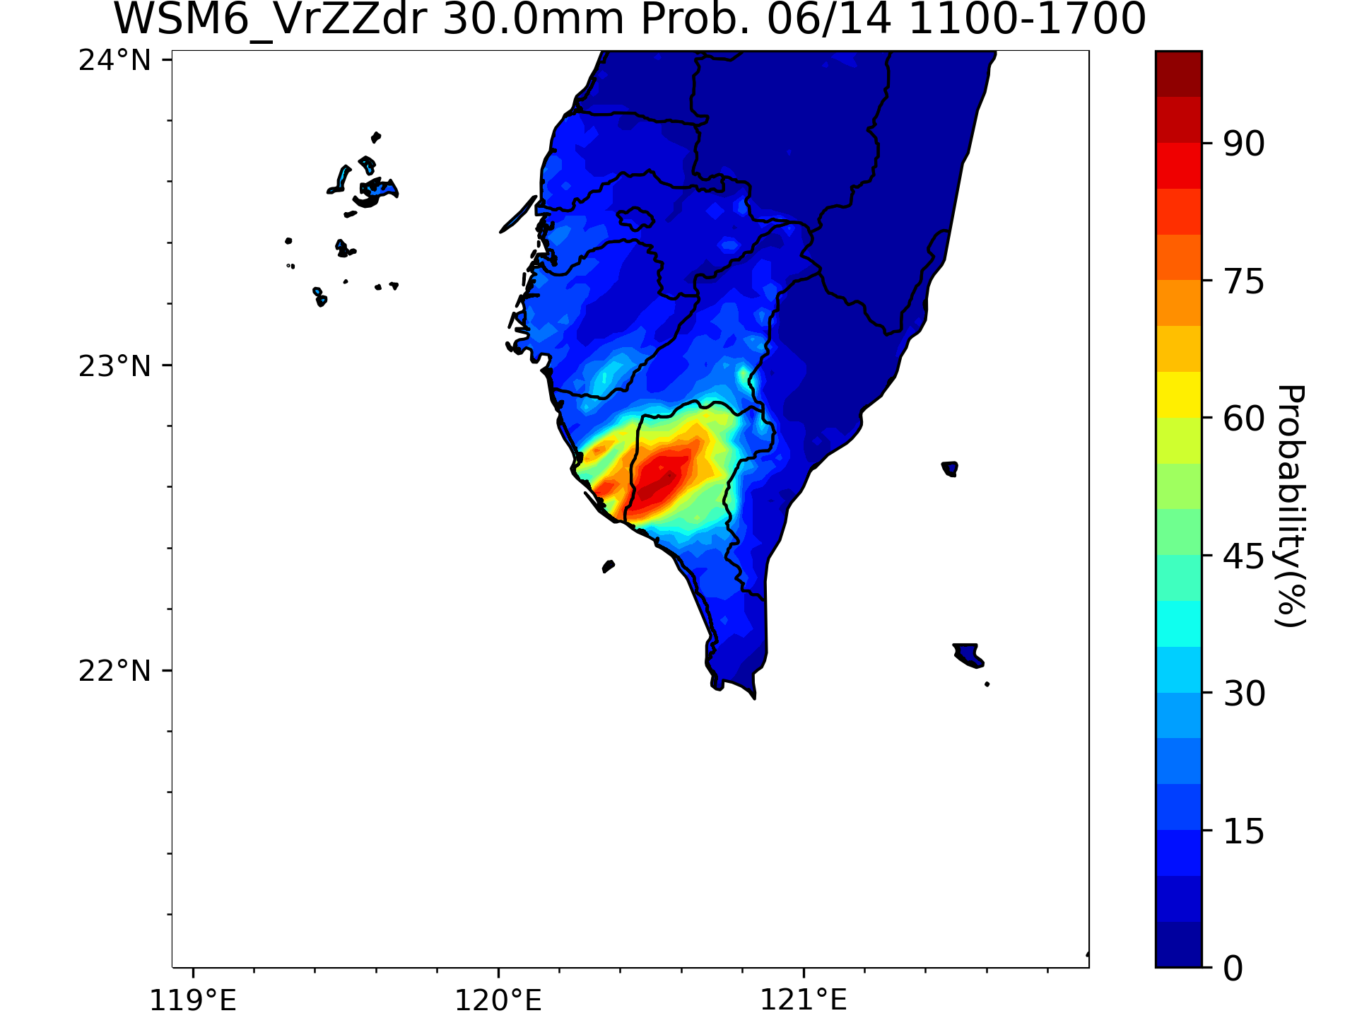
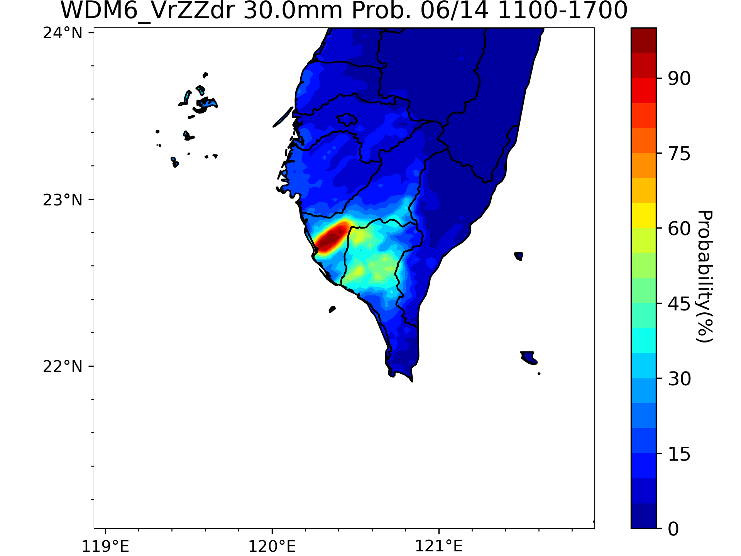
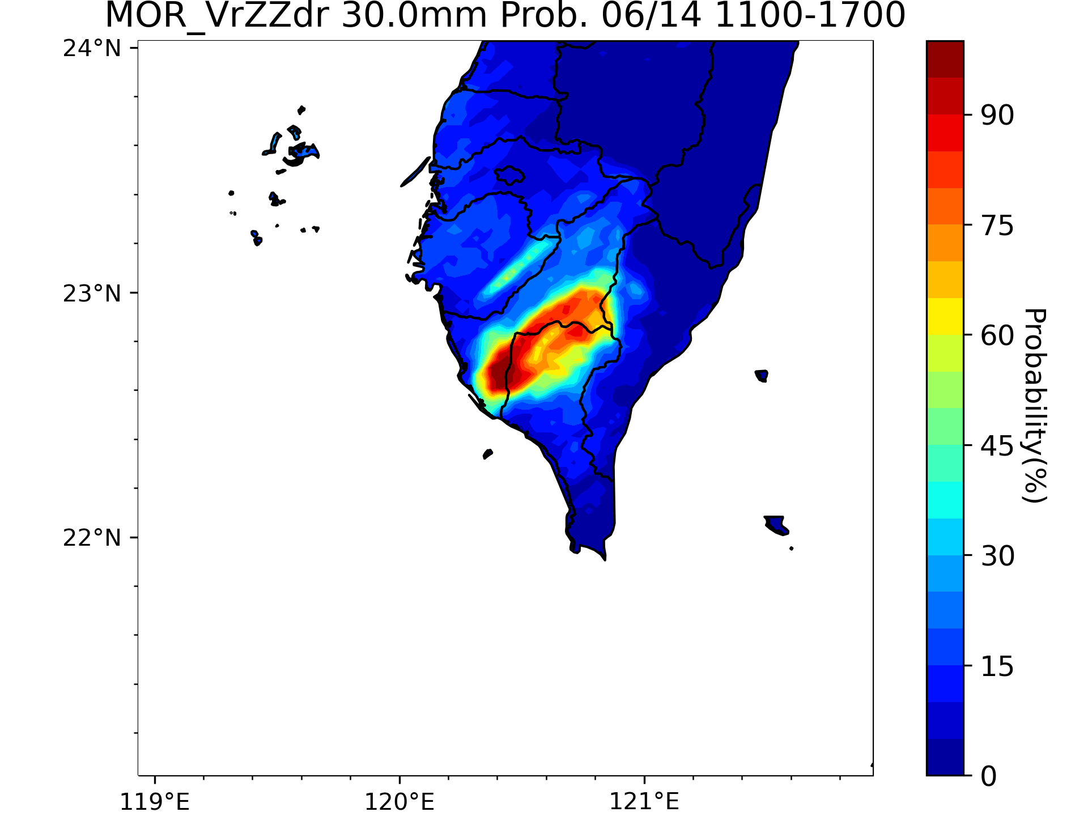
Case Overview
Experiment Design
Introduction
Results
Short-Term QPF
Summary & Future Work
Probability of 6-Hour Rainfall > 30 mm
GCE_VrZ
WSM6_VrZ
WDM6_VrZ
MOR_VrZ
Observation
References
GCE_VrZZdr
WSM6_VrZZdr
WDM6_VrZZdr
MOR_VrZZdr
The probability is higher even if Z_{DR} is assimilated with single moment schemes
The probability is much higher when Z_{DR} is assimilate with MOR
10

Slide 16
Case Overview
Experiment Design
Introduction
Summary & Future Work
Results
References

Slide 17
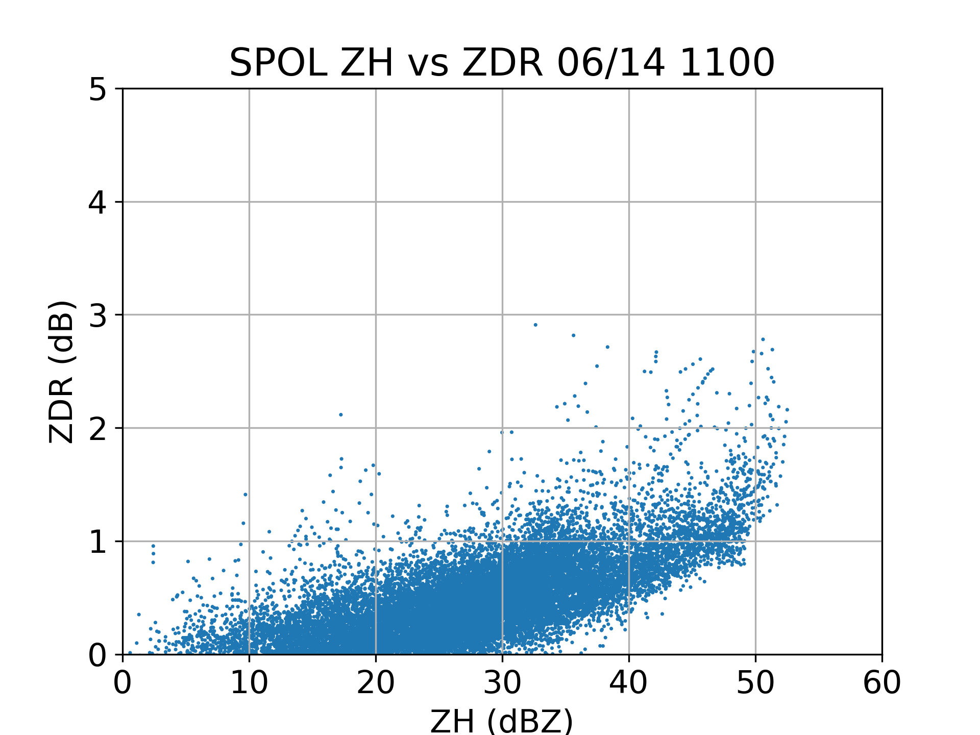
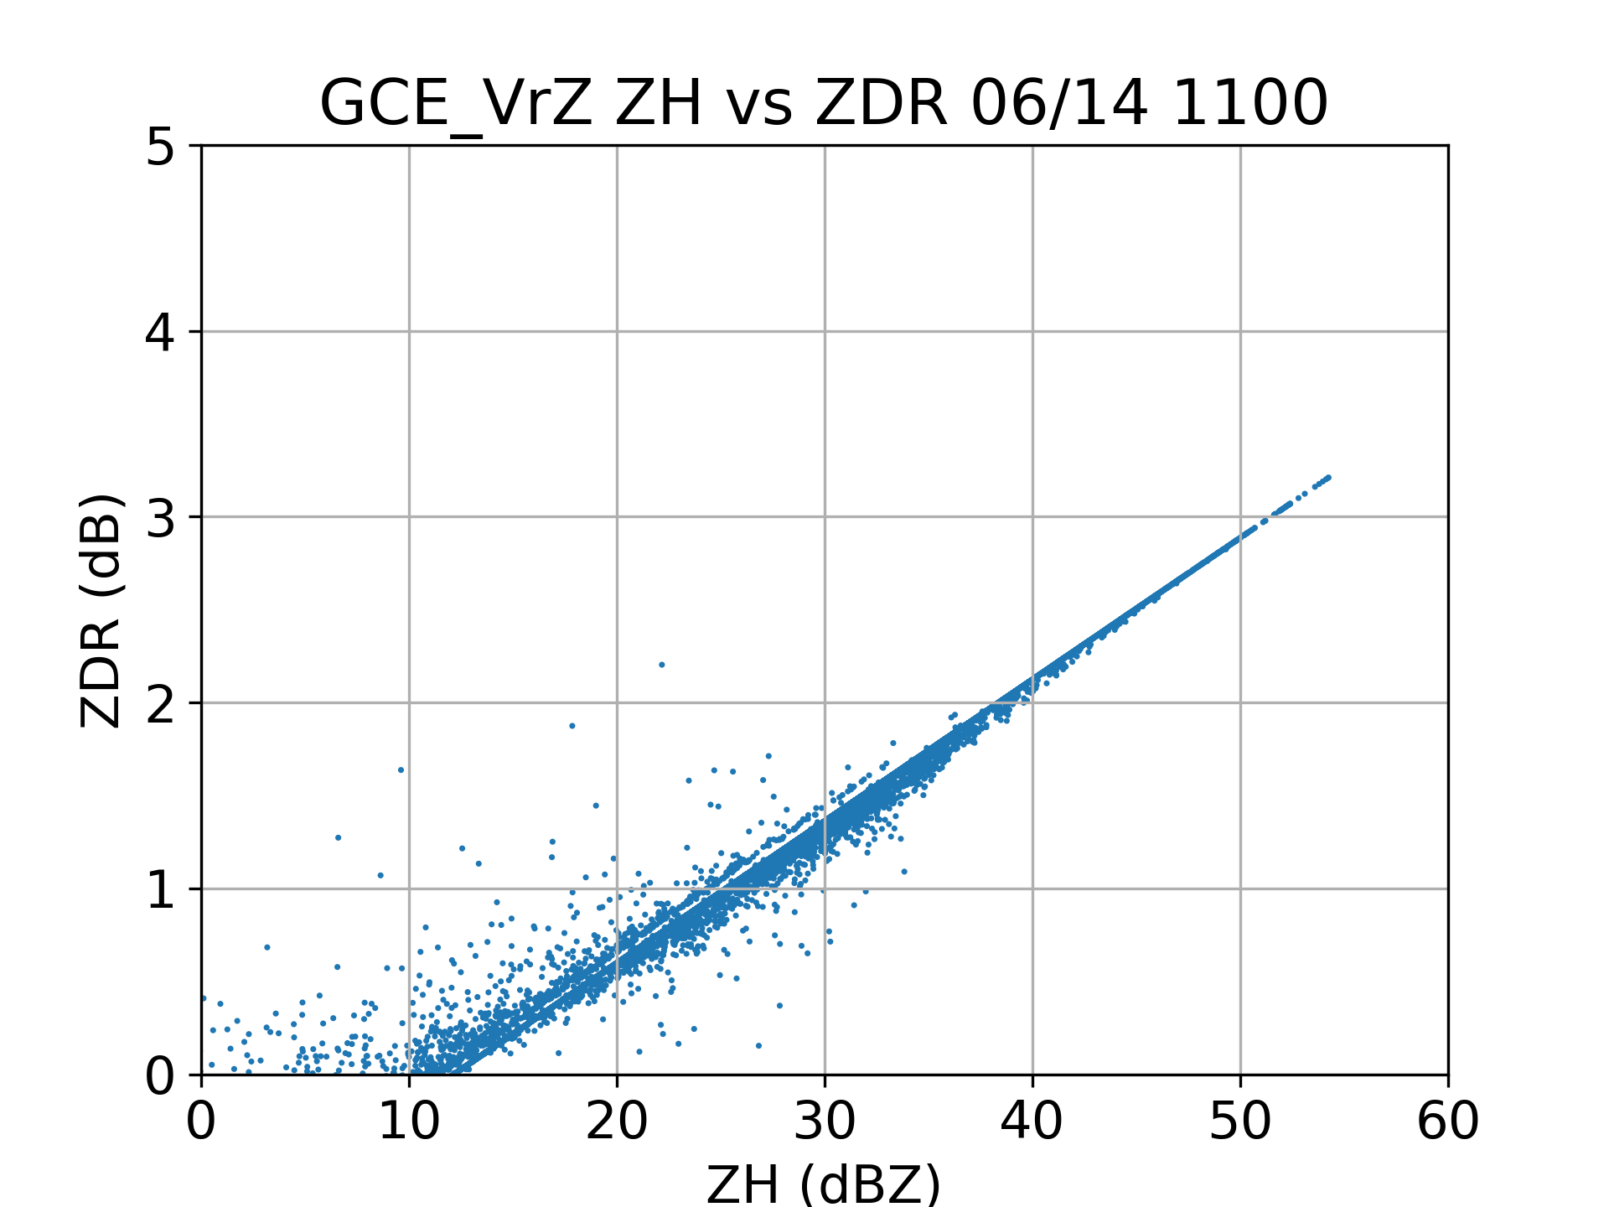
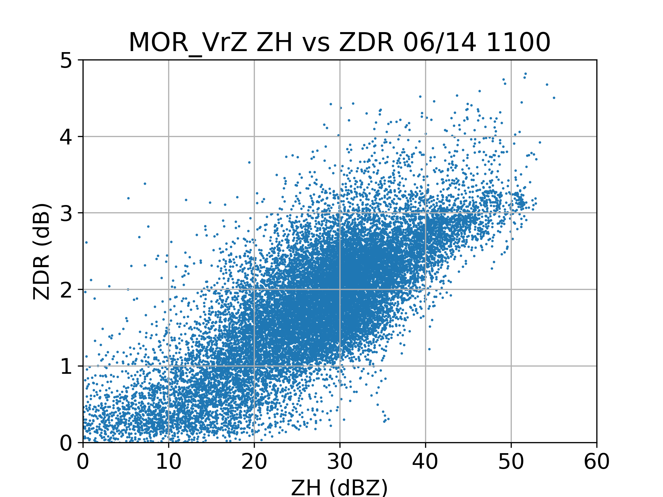
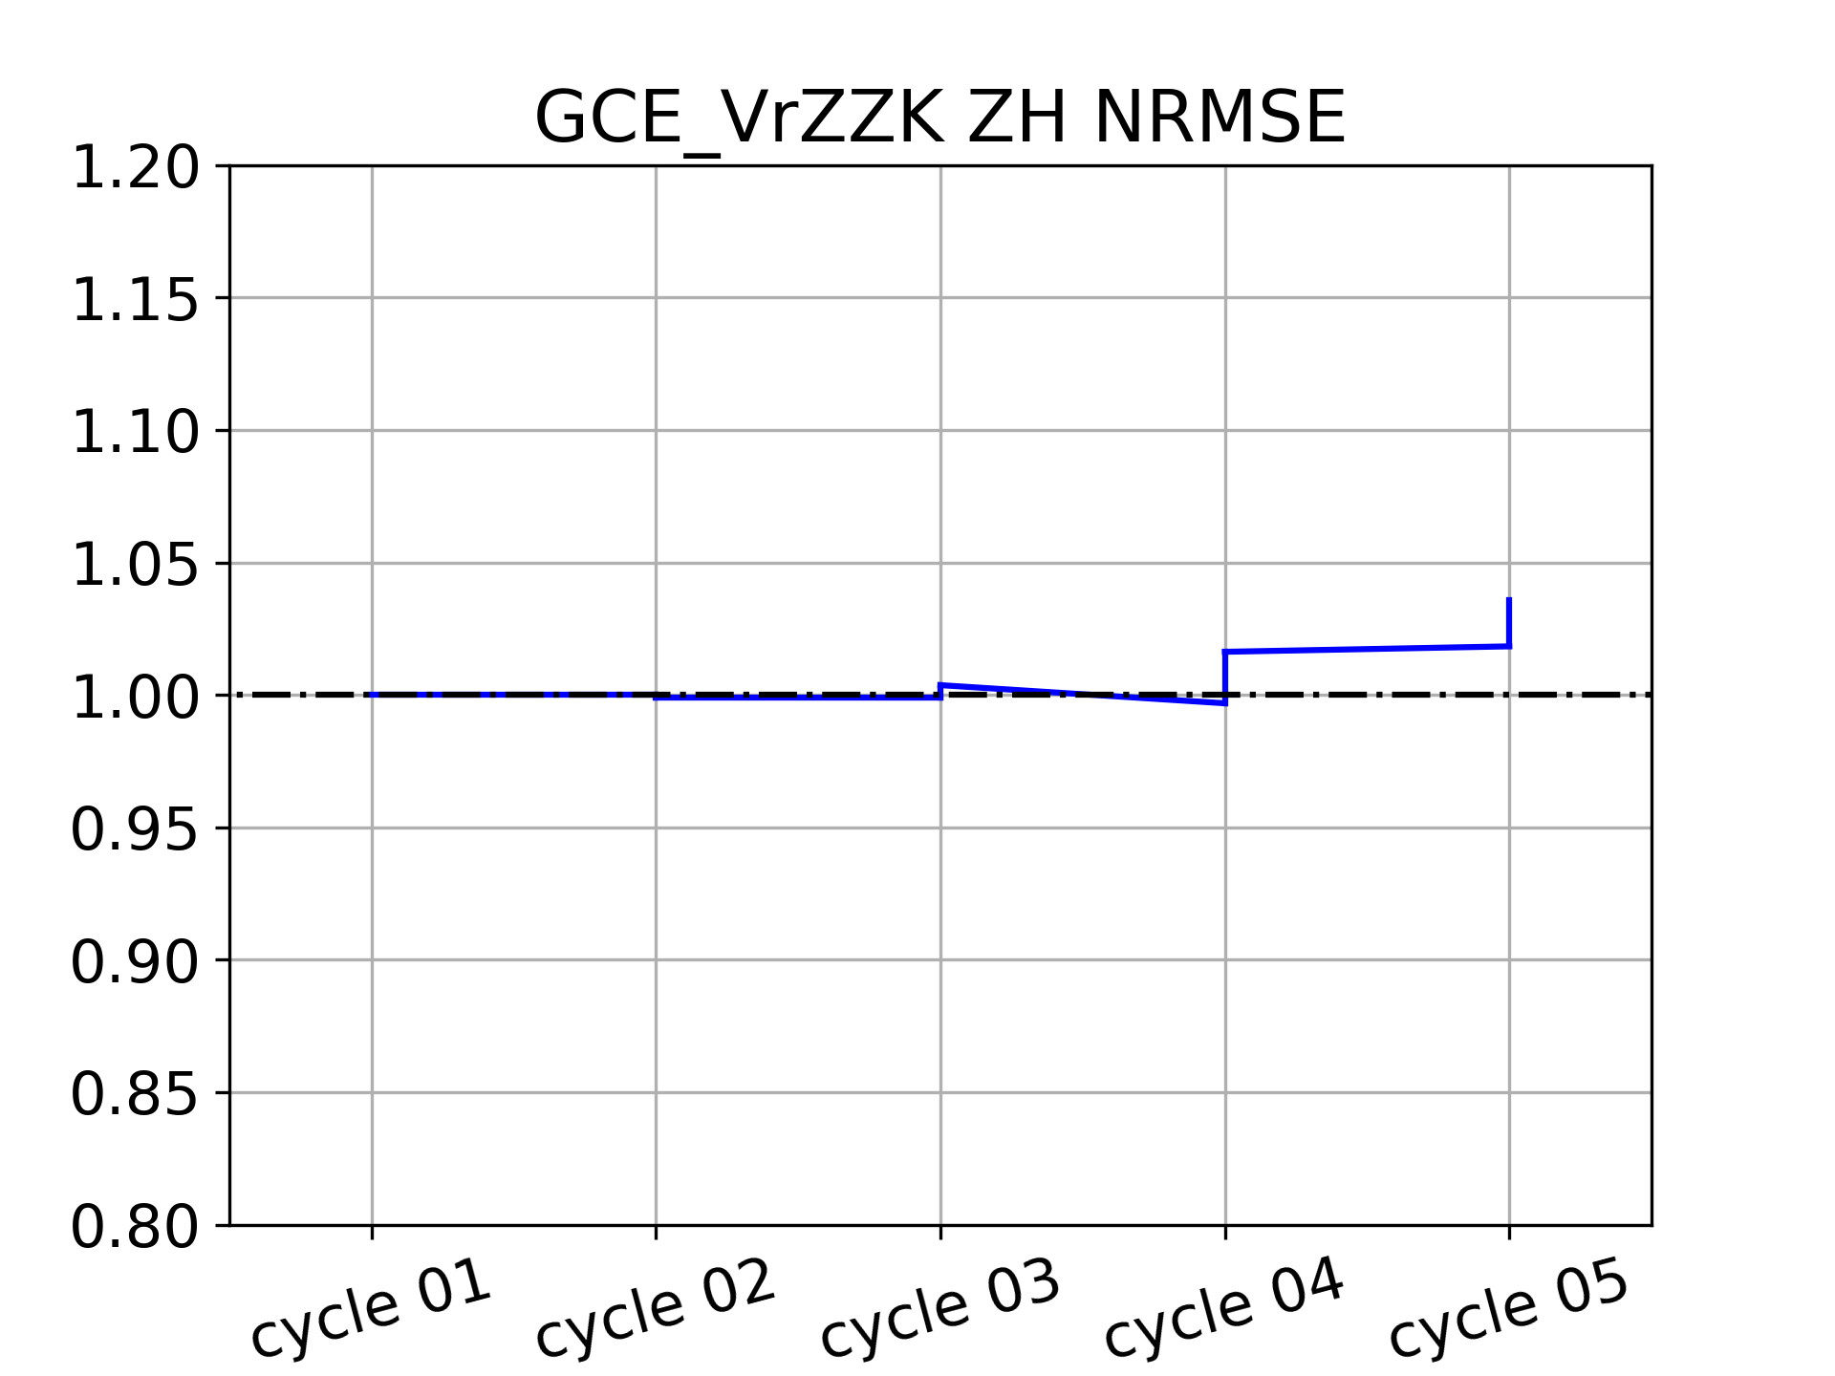
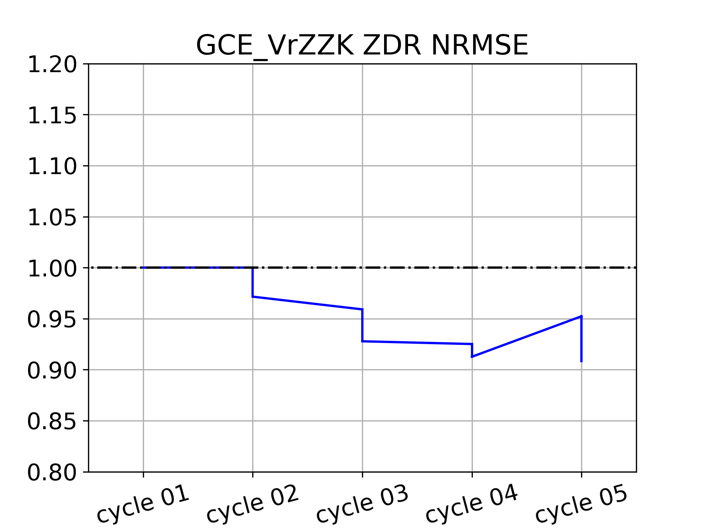
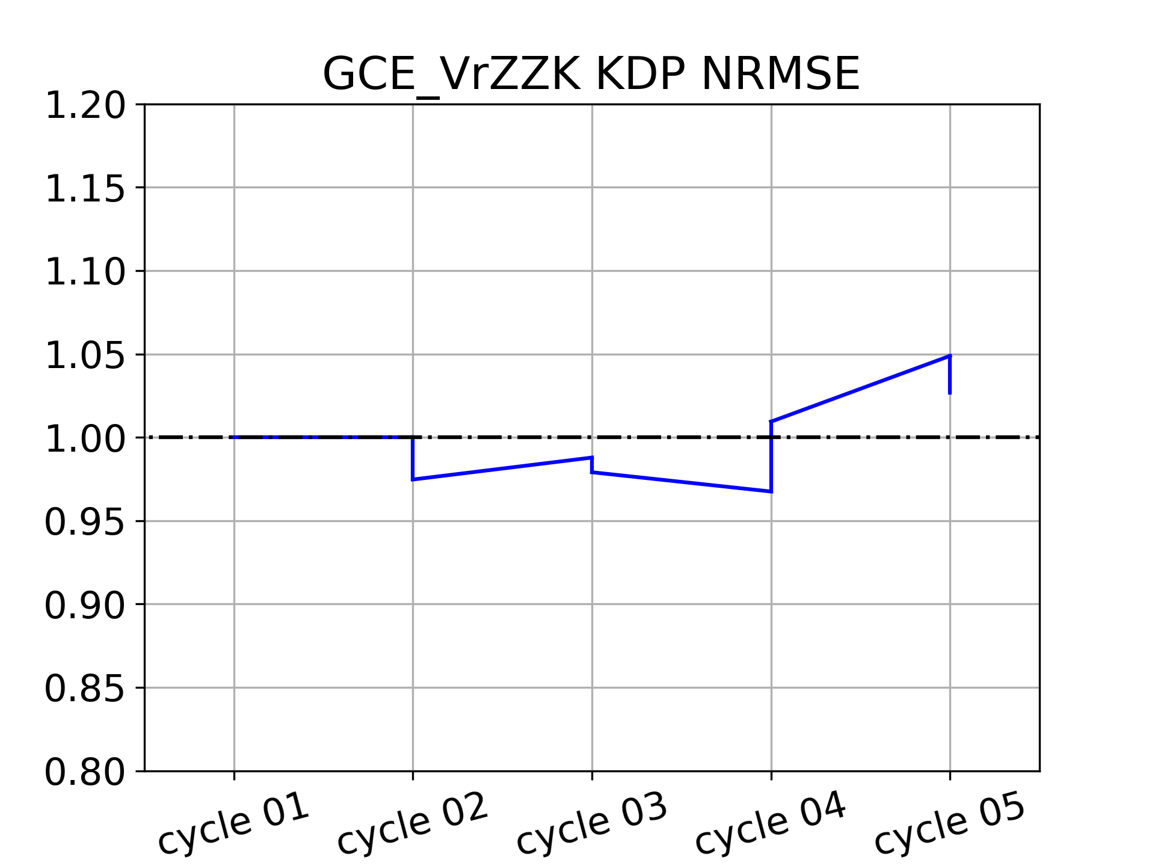
Case Overview
Experiment Design
Introduction
Summary & Future Work
Impact in different MP schemes
Determined by q_{x}
Determined by q_{x} and N_{Tx}
Results
References
A case with overestimated Z_{DR} and underestimated Z_{H} (K_{DP})
Single moment schemes
Assimilating additional dual-polarimetric parameters might deteriorate the analysis
11

Slide 18
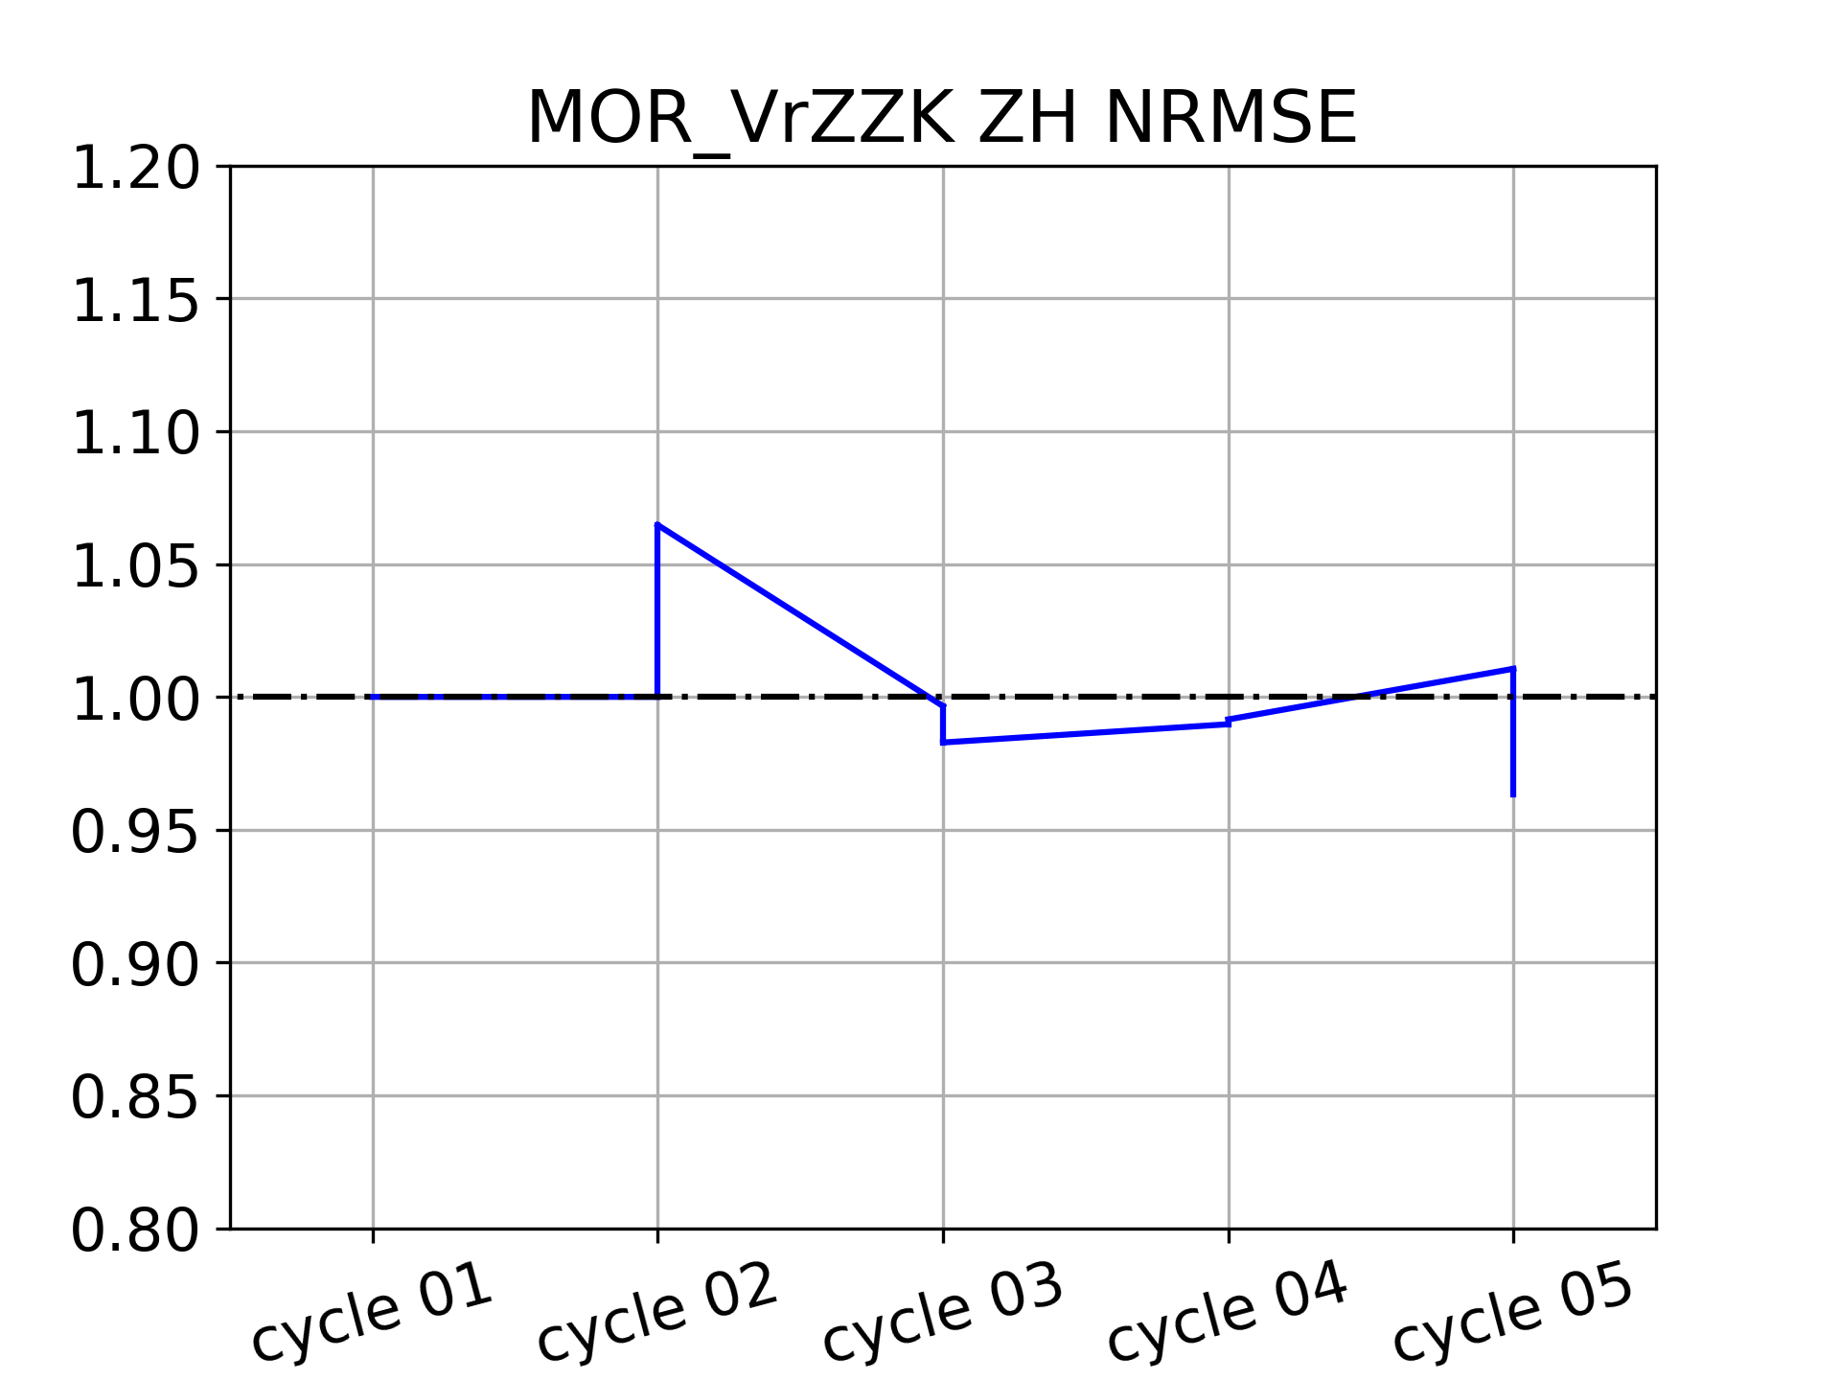
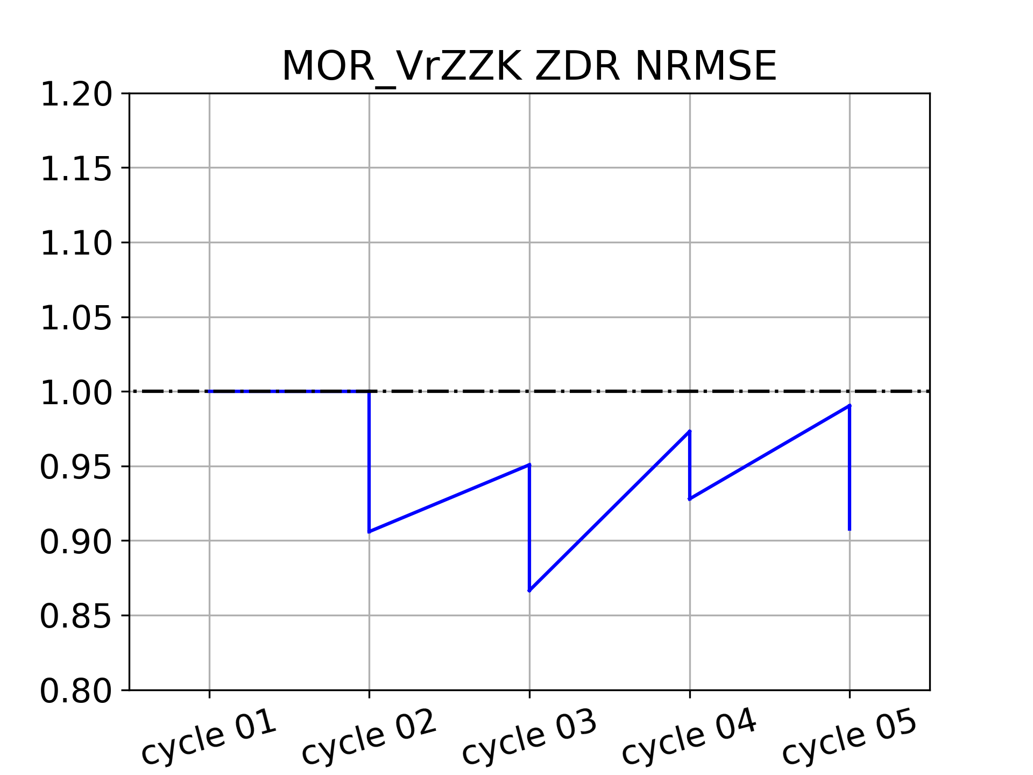
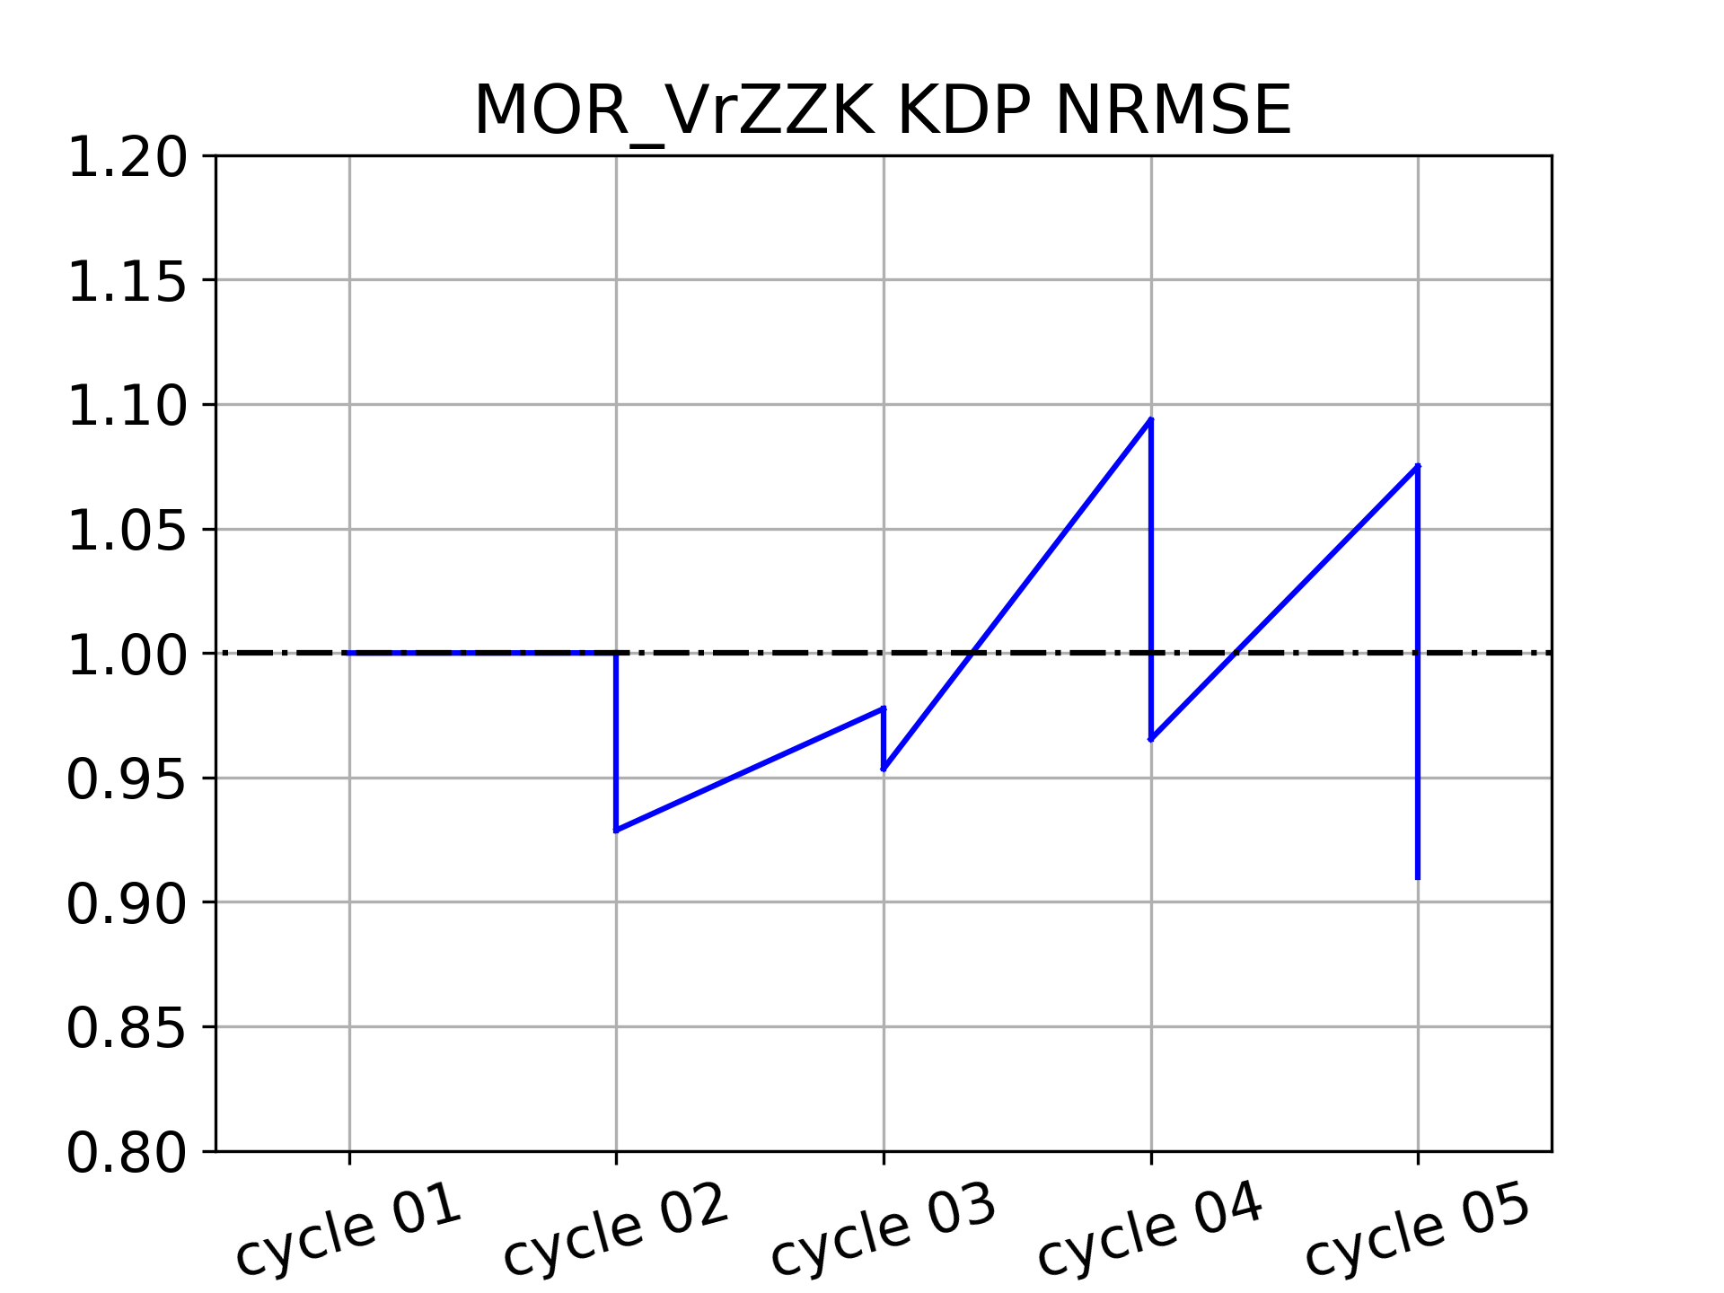
Case Overview
Experiment Design
Introduction
Summary & Future Work
Impact in different MP schemes
Determined by q_{x}
Determined by q_{x} and N_{Tx}
Results
References
A case with overestimated Z_{DR} and underestimated Z_{H} (K_{DP})
Single moment schemes
Assimilating additional dual-polarimetric parameters might deteriorate the analysis
Double moment schemes
Adjustment of microphysics variables is more flexible
More Suitable
12

Slide 19
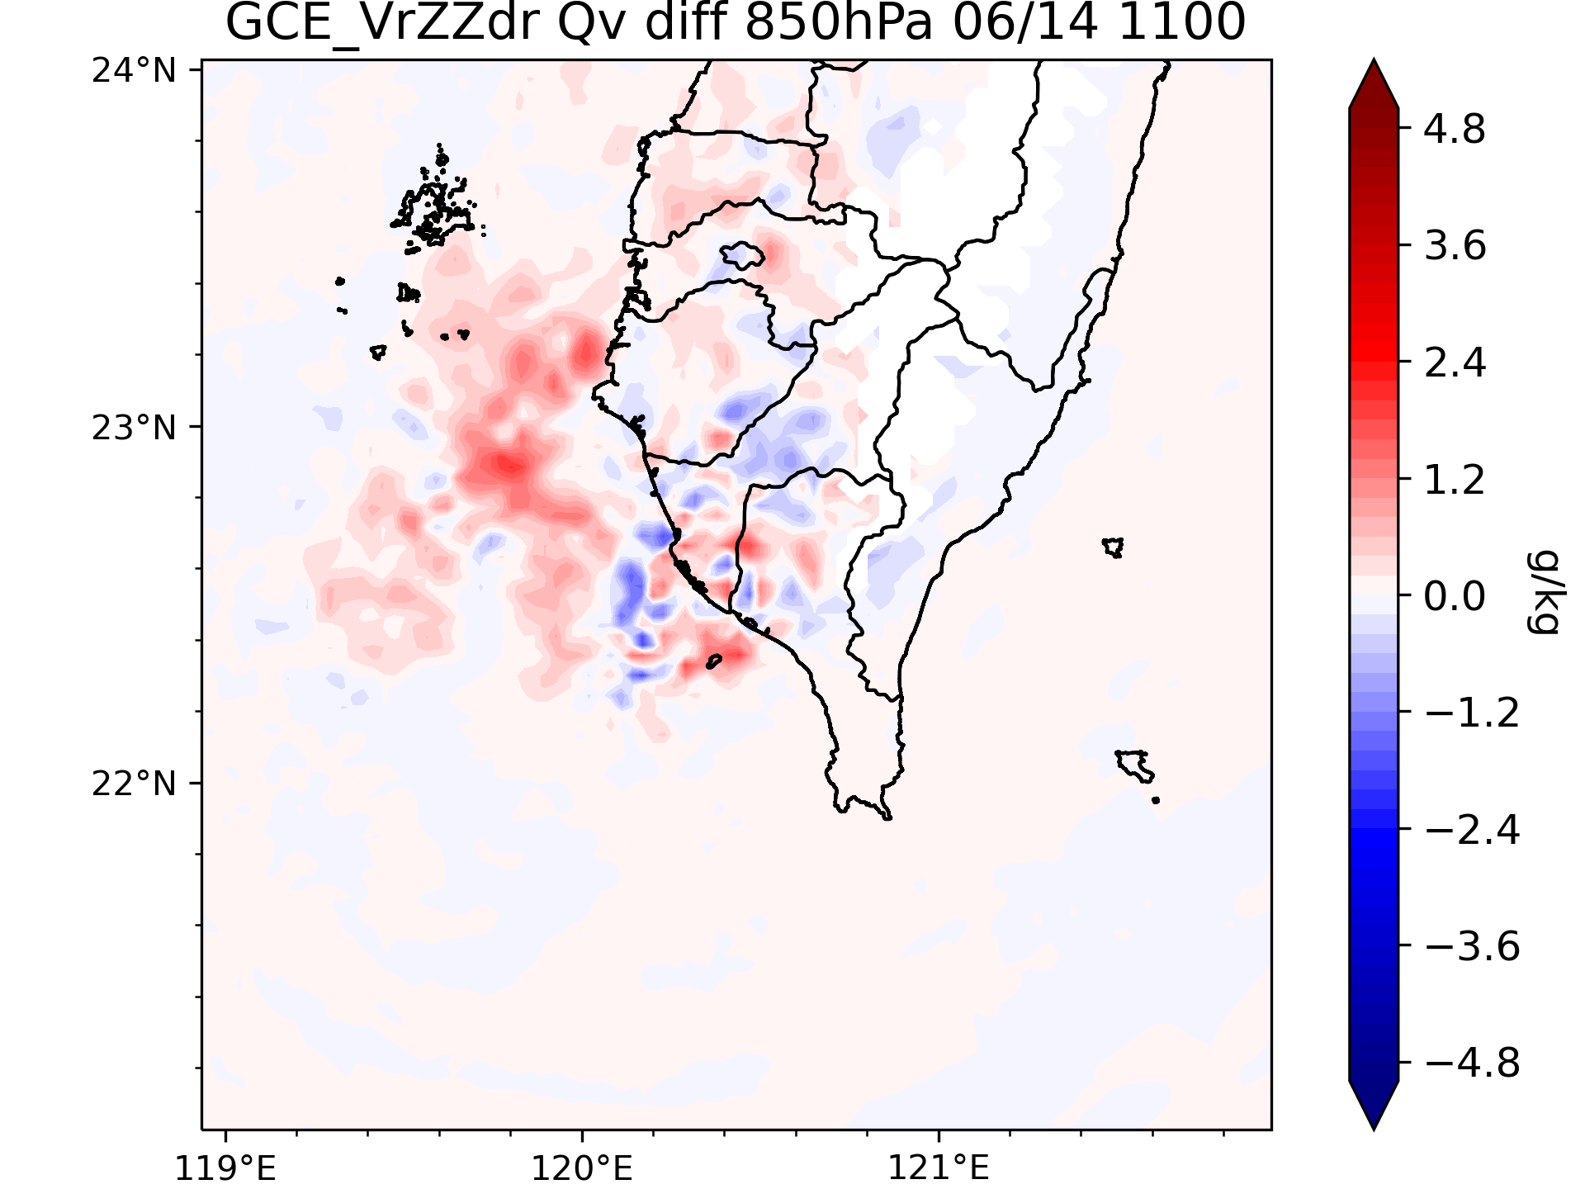
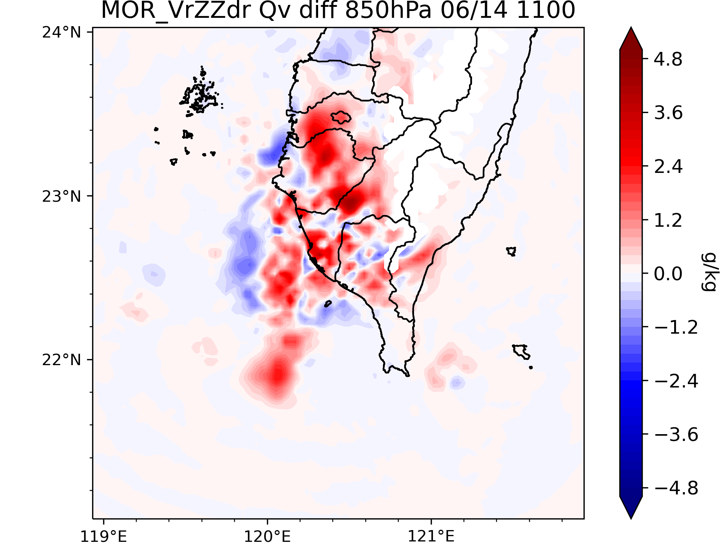
Case Overview
Experiment Design
Introduction
Summary & Future Work
Short-Term QPF
GCE_VrZ
GCE_VrZZdr
Results
References
MOR_VrZ
MOR_VrZZdr
The probability is higher when Z_{DR} is assimilated with either single moment schemes or double moment schemes
Assimilation of Z_{DR} generates more water vapor through the cross correlation and improves the QPF
Assimilating additional dual-polarimetric parameters can improve the performance of the short-term QPF, especially heavy rainfall
13

Slide 20

Case Overview
Experiment Design
Introduction
Summary & Future Work
A novel approach to assimilate Z_{DR}
Smaller Z_{DR}
Larger Z_{DR}
Smaller Raindrop → Smaller Z_{DR}
Larger Raindrop → Larger Z_{DR}
Results
References
Make use of the high correlation between Z_{DR} and D_{m} to generate more correction in the Z_{DR} analysis
13

Slide 21
Case Overview
Experiment Design
Introduction
Summary & Future Work
Results
References

Slide 22
Case Overview
Experiment Design
Introduction
Summary & Future Work
References
Brandes, E. A., G. Zhang, and J. Vivekanandan, 2002: Experiments in Rainfall Estimation with a Polarimetric Radar in a Subtropical Environment. Journal of Applied Meteorology, 41, 674-685.
Jung, Y., G. Zhang, and M. Xue, 2008b: Assimilation of Simulated Polarimetric Radar Data for a Convective Storm Using the Ensemble Kalman Filter. Part I: Observation Operators for Reflectivity and Polarimetric Variables. Monthly Weather Review, 136, 2228-2245
Jung, Y., M. Xue, G. Zhang, and J. M. Straka, 2008a: Assimilation of Simulated Polarimetric Radar Data for a Convective Storm Using the Ensemble Kalman Filter. Part II: Impact of Polarimetric Data on Storm Analysis. Monthly Weather Review, 136, 2246-2260.
Jung, Y., M. Xue, and G. Zhang, 2010: Simulations of Polarimetric Radar Signatures of a Supercell Storm Using a Two-Moment Bulk Microphysics Scheme. Journal of Applied Meteorology and Climatology, 49, 146-163.
Li, X., and J. R. Mecikalski, 2010: Assimilation of the dual-polarization Doppler radar data for a convective storm with a warm-rain radar forward operator. JGR Atmospherics, 115.
Li, X., and J. R. Mecikalski, 2012: Impact of the Dual-Polarization Doppler Radar Data on Two Convective Storms with a Warm-Rain Radar Forward Operator. Monthly Weather Review, 140, 2147-2167.
Lin, Y.-L., R. D. Farley, and H. D. Orville, 1983: Bulk Parameterization of the Snow Field in a Cloud Model. Journal of Applied Meteorology and Climatology, 22, 1065-1092.
Marshall, J. S., and W. M. K. Palmer, 1948: The Distribution of Raindrops with Size. Journal of Atmospheric Sciences, 5, 165-166.
Results

Slide 23
References
Park, H. S., A. V. Ryzhkov, D. S. Zrnić, and K.-E. Kim, 2009: The Hydrometeor Classification Algorithm for the Polarimetric WSR-88D: Description and Application to an MCS. Weather and Forecasting, 24, 730-748.
Putnam, B., M. Xue, Y. Jung, N. Snook, and G. Zhang, 2019: Ensemble Kalman Filter Assimilation of Polarimetric Radar Observations for the 20 May 2013 Oklahoma Tornadic Supercell Case. Monthly Weather Review, 147, 2511-2533.
Rutledge, S. A., and P. Hobbs, 1983: The Mesoscale and Microscale Structure and Organization of Clouds and Precipitation in Midlatitude Cyclones. VIII: A Model for the “Seeder-Feeder” Process in Warm-Frontal Rainbands. Journal of Atmospheric Sciences, 40, 1185-1206.
Ryzhkov, A., and D. Zrnić, 1996: Assessment of Rainfall Measurement That Uses Specific Differential Phase. Journal of Applied Meteorology and Climatology, 35, 2080-2090.
Snyder, C., and F. Zhang, 2003: Assimilation of Simulated Doppler Radar Observations with an Ensemble Kalman Filter. Monthly Weather Review, 131, 1663-1677.
Sun, J., and N. A. Crook, 1997: Dynamical and Microphysical Retrieval from Doppler Radar Observations Using a Cloud Model and Its Adjoint. Part I: Model Development and Simulated Data Experiments. Journal of the Atmospheric Sciences, 54, 1642-1661.
Ulbrich, C. W., 1983: Natural Variations in the Analytical Form of the Raindrop Size Distribution. Journal of Applied Meteorology and Climatology, 22, 1764-1775.
Wu, B., J. Verlinde, and J. Sun, 2000: Dynamical and Microphysical Retrievals from Doppler Radar Observations of a Deep Convective Cloud. Journal of the Atmospheric Sciences, 57, 262-283.

Slide 24
Case Overview
Experiment Design
Introduction
Summary & Future Work
References
Xiao, Q., Y.-H. Kuo, J. Sun, W.-C. Lee, E. Lim, Y.-R. Guo, and D. M. Barker, 2005: Assimilation of Doppler Radar Observations with a Regional 3DVAR System: Impact of Doppler Velocities on Forecasts of a Heavy Rainfall Case. Journal of Applied Meteorology and Climatology, 44, 768-788.
Yokota, S., H. Seko, M. Kunii, H. Yamauchi, and H. Niino, 2016: The Tornadic Supercell on the Kanto Plain on 6 May 2012: Polarimetric Radar and Surface Data Assimilation with EnKF and Ensemble-Based Sensitivity Analysis. Monthly Weather Review, 144, 3133-3157.
Zhang, F., C. Snyder, and J. Sun, 2004: Impacts of Initial Estimate and Observation Availability on Convective- Scale Data Assimilation with an Ensemble Kalman Filter. Monthly Weather Review, 132, 1238-1253.
Results

Slide 25
Case Overview
Experiment Design
Introduction
Summary & Future Work
Results
References

Slide 26
Thanks for Your Listening

