Slide 1

ONIOM QM/MM investigation of iodide oxidation by ozone on an aqueous particle
Antoine Roose, Céline Toubin, Florent Réal, Henning Finkenzeller, Rainer Volkamer, Markus Ammann, Valérie Vallet
https://meetingorganizer.copernicus.org/EGU22/EGU22-4762.html

Slide 2
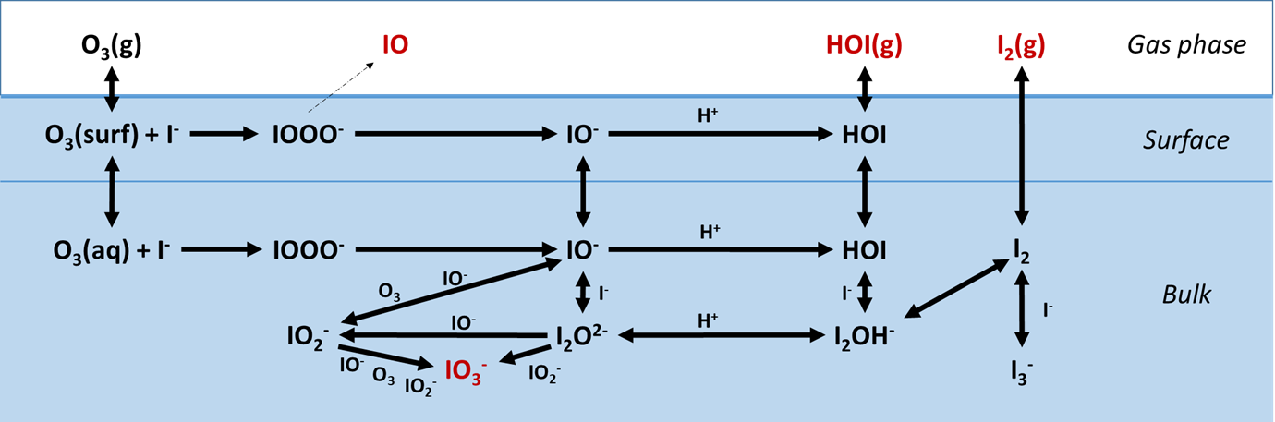
Oxidation of iodide
Oxidation of iodide by ozone → major iodine activation pathway at the ocean surface
Surprisingly large fraction of iodide of total particulate iodine in the troposphere AND the stratosphere
Large turnover of iodide oxidation by ozone in the aerosol phase
Temperature dependence not well constrained, IO yield suggested so far in one study only.
Saiz-Lopez et al., 2012; Carpenter et al., 2013; Baker and Yodle, 2021; Koenig et al. 2020; Koenig et al., 2021; Moreno et al., 2020; Sakamoto et al., 2009

Slide 3
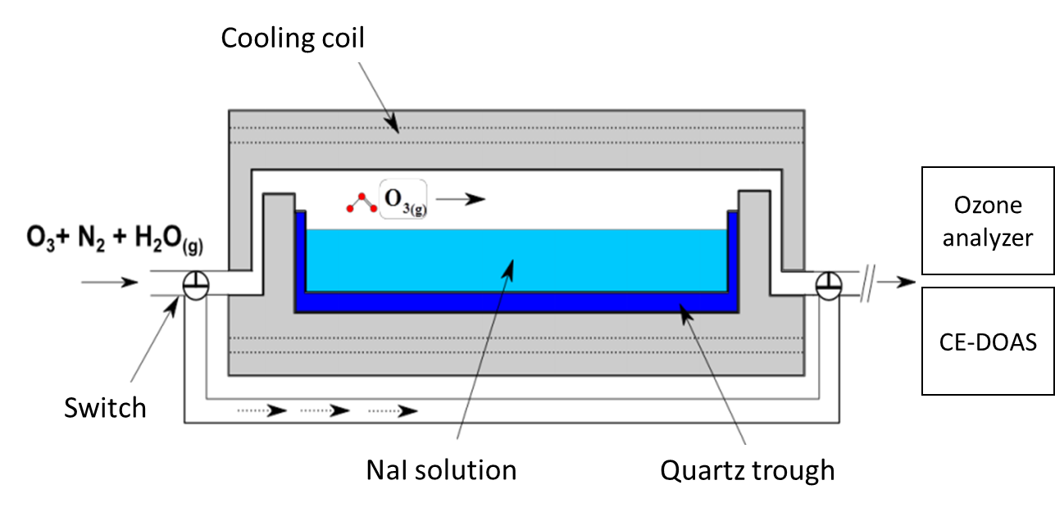
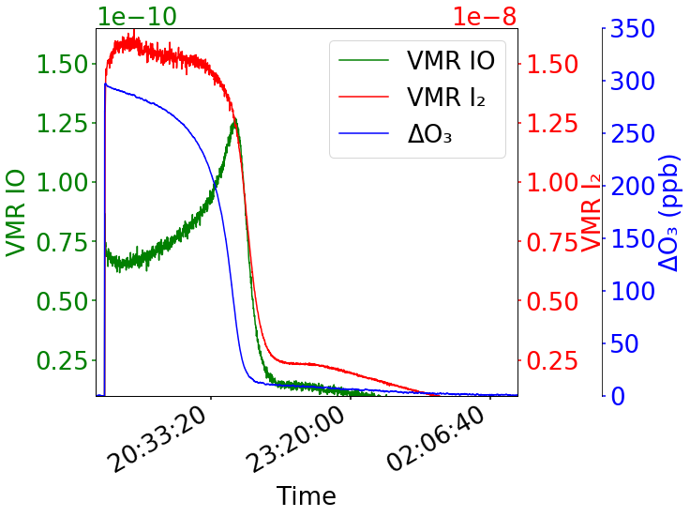
Experimental observation
Ammann et al., EGU22-5484, Mon, 23 May
IO radical yield from iodide oxidation by ozone on aqueous aerosol proxy surfaces
https://meetingorganizer.copernicus.org/EGU22/EGU22-5484.html
Conclusion:
Some aspects of IO formation are consistent with a surface process as suggested by Sakamoto et al. (2009), but other aspects indicate secondary reactions having a significant contribution.

Slide 4
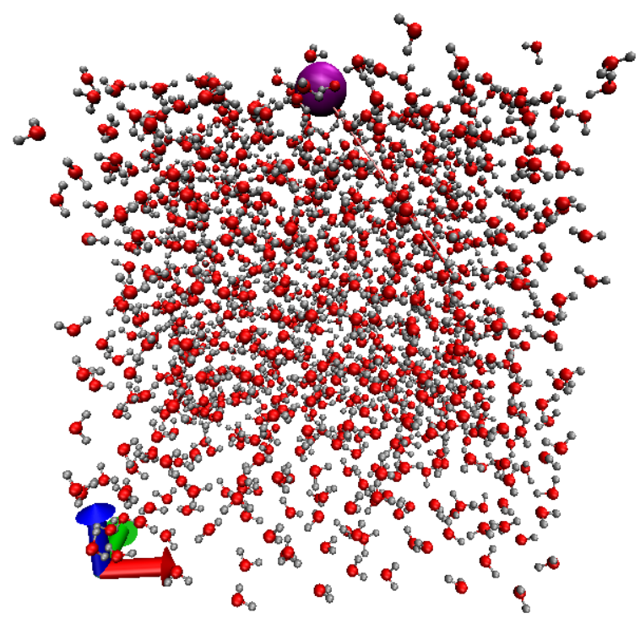
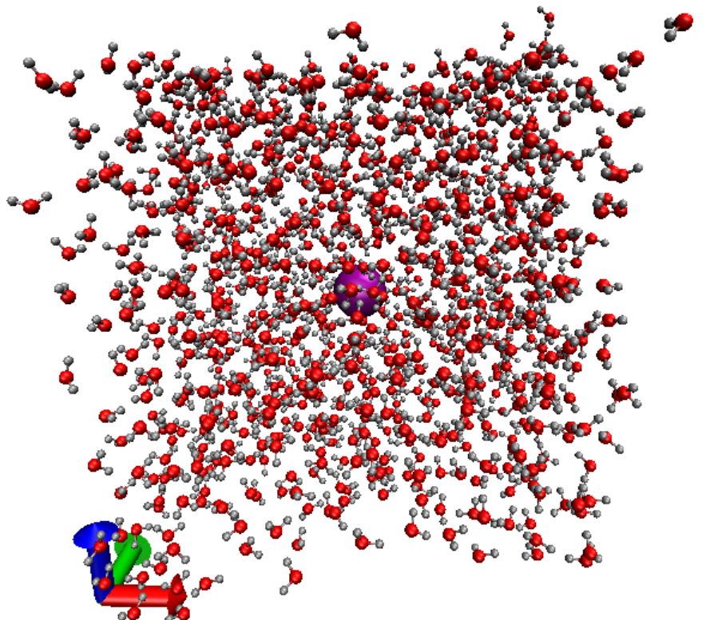
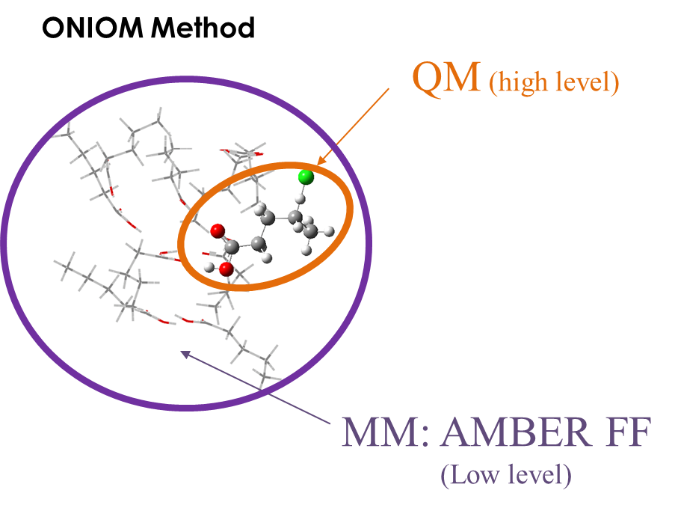
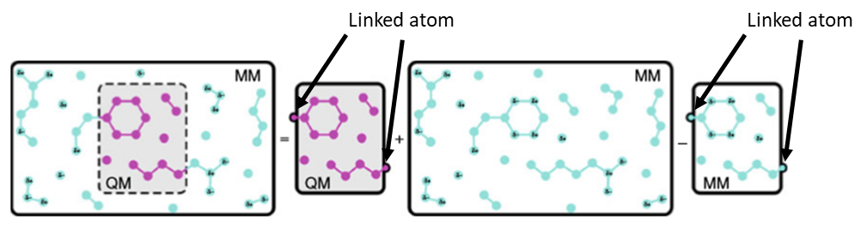
Reactivity on aerosol phase: Theoretical level
Aerosol system → too large for basic quantum mechanic (QM) methodology
ONIOM (Our own N-layered Integrated molecular Orbital and Molecular mechanics) QM/MM method has been used to study the reactivity on snapshots built by molecular dynamics (MM)
Slabs built by F. Real (PhLAM/Univ. Lille) using polarized force field with surface active iodide and bulk iodide
Real et al., 2016
$$E_{QM/MM}=E_{QM}\left(QM\right)+E_{MM}\left(QM/MM\right)−E_{MM}\left(QM\right)$$

Slide 5
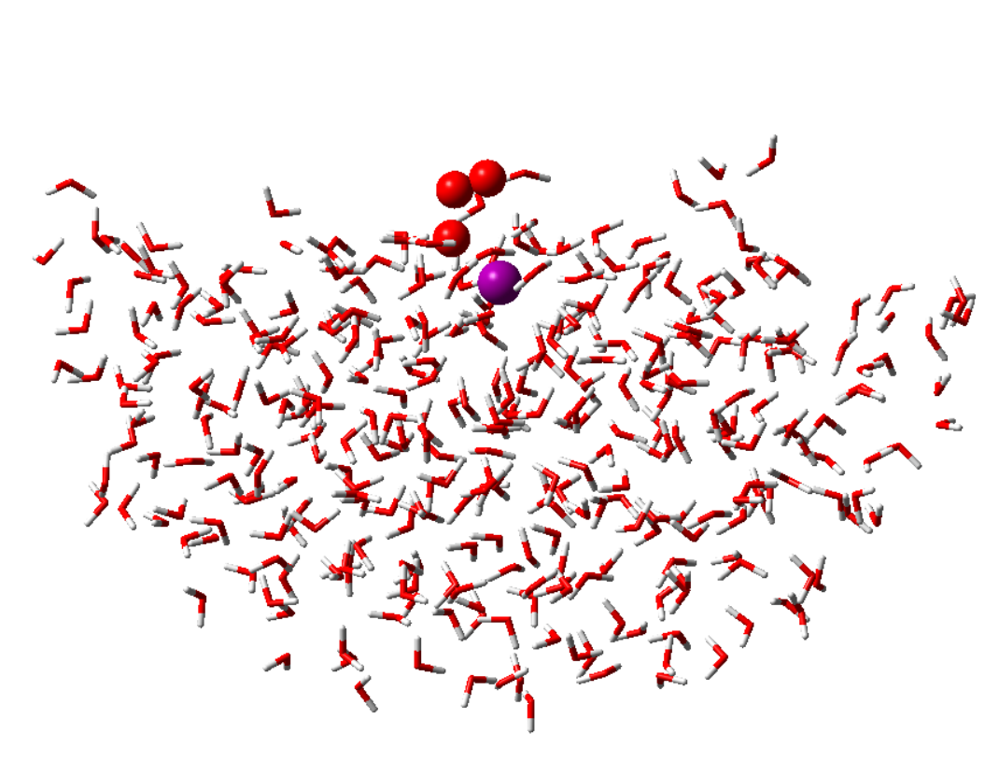
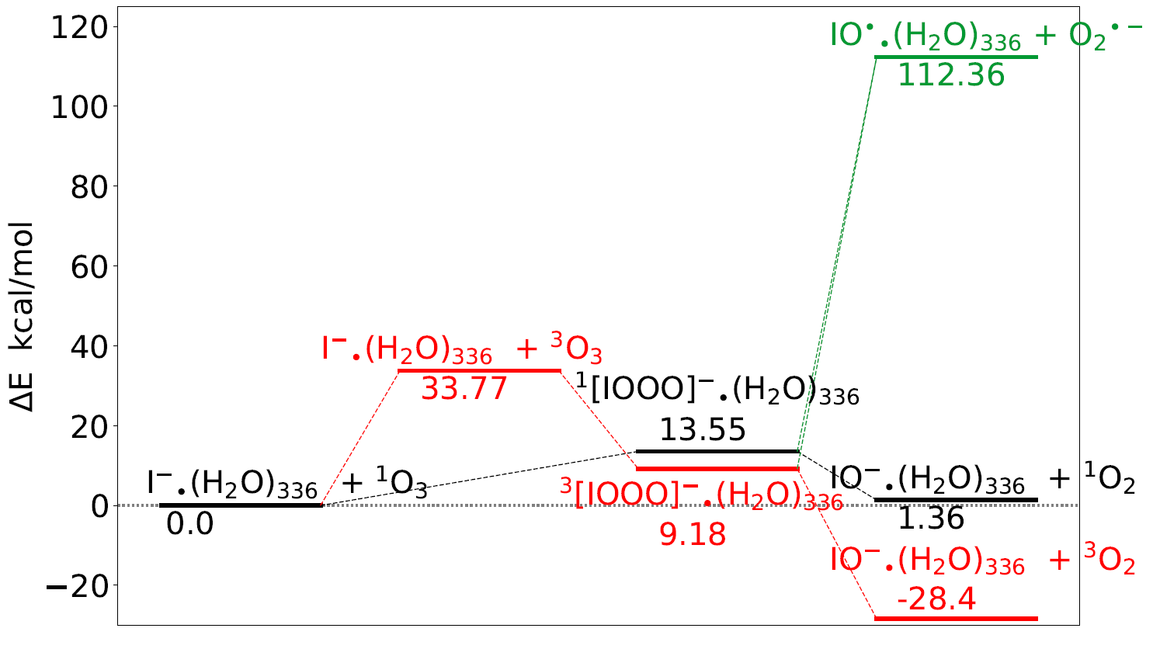
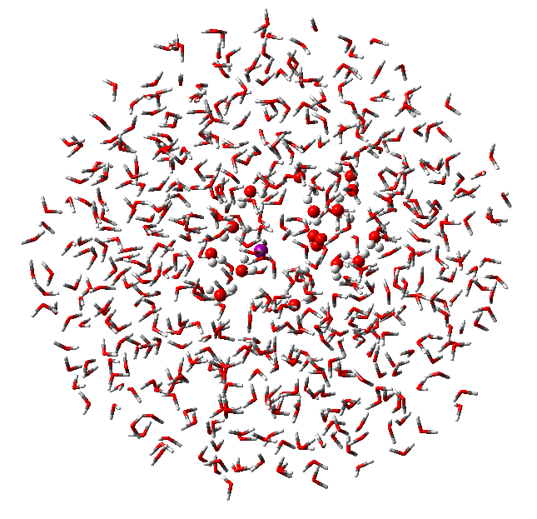
Reactivity on aerosol phase: ONIOM method
ONIOM(CCSD(T)/aug-cc-pVTZ-PP:aug-cc-pVQZ-PP//M06-2X/aug-cc-pVTZ-PP/PM6)
 | Singlet state | Triplet state | Mixed state | IO radical formation
E_{a} (kcal/mol) | 13.6 | Barrierless (after O₃ excitation E≈33.8 kcal/mol ) | 9.18
ΔH (kcal/mol) | 1.36 | -62.1 | -28.4 | 112.4
Next steps:
Aerosol phase (bulk) : Ongoing
Better sampling of spin mixed state PES: TSSMM (B. Yang et al. 2018)

Slide 6


Acknowledgements
M. Ammann (PSI)
V. Vallet (PhLAM/Univ. Lille)
C. Toubin (PhLAM/Univ. Lille)
F. Real (PhLAM/Univ. Lille)
R. Volkamer (CIRES/Univ. Colorado Boulder)
H. Finkenzeller (CIRES/Univ. Colorado Boulder)
M. Infuso (PhLAM/PC2A/Univ. Lille)
F. Louis (PC2A/Univ. Lille)
Thank you for your attention!
Contact:
Antoine.roose@psi.ch

Slide 7
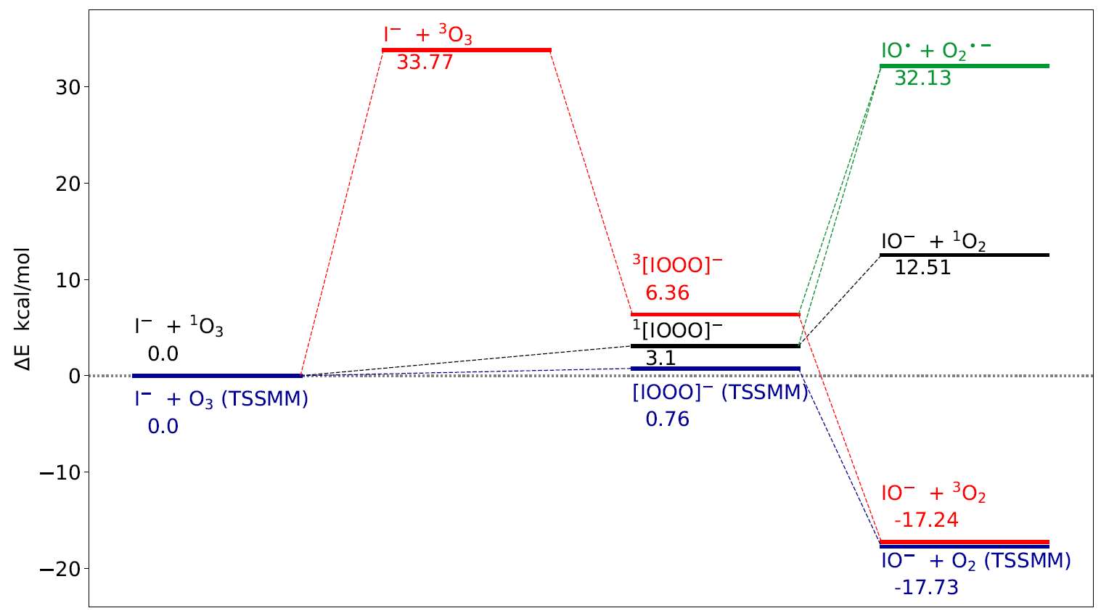
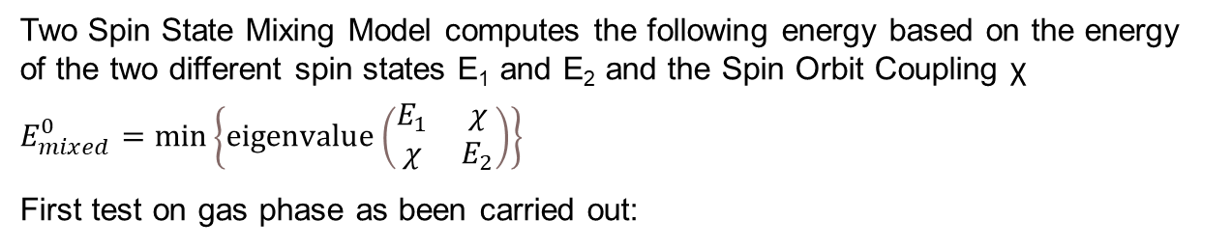
TSSMM : Sampling the mixed spin PES
Two Spin State Mixing Model computes the following energy based on the energy of the two different spin states E₁ and E₂ and the Spin Orbit Coupling χ
$$E_{mixed}^{0}=min\left\{eigenvalue\left(\begin{matrix}E_{1} & χ \\ χ & E_{2}\end{matrix}\right)\right\}$$
First test on gas phase as been carried out:
B. Yang et al. 2018
Gas phase
CCSD(T)/aug-cc-pVTZ-PP:aug-cc-pVQZ-PP//M06-2X/aug-cc-pVTZ-PP

