Slide 1



Using high-resolution topography to solve “periglacial puzzles”: A semi-automated approach to monitor solifluction movement
Marije Harkema, Jana Eichel, Wiebe Nijland,
Steven de Jong, Daniel Draebing, Teja Kattenborn
May 24th 2022
Abstract:
1

Slide 2
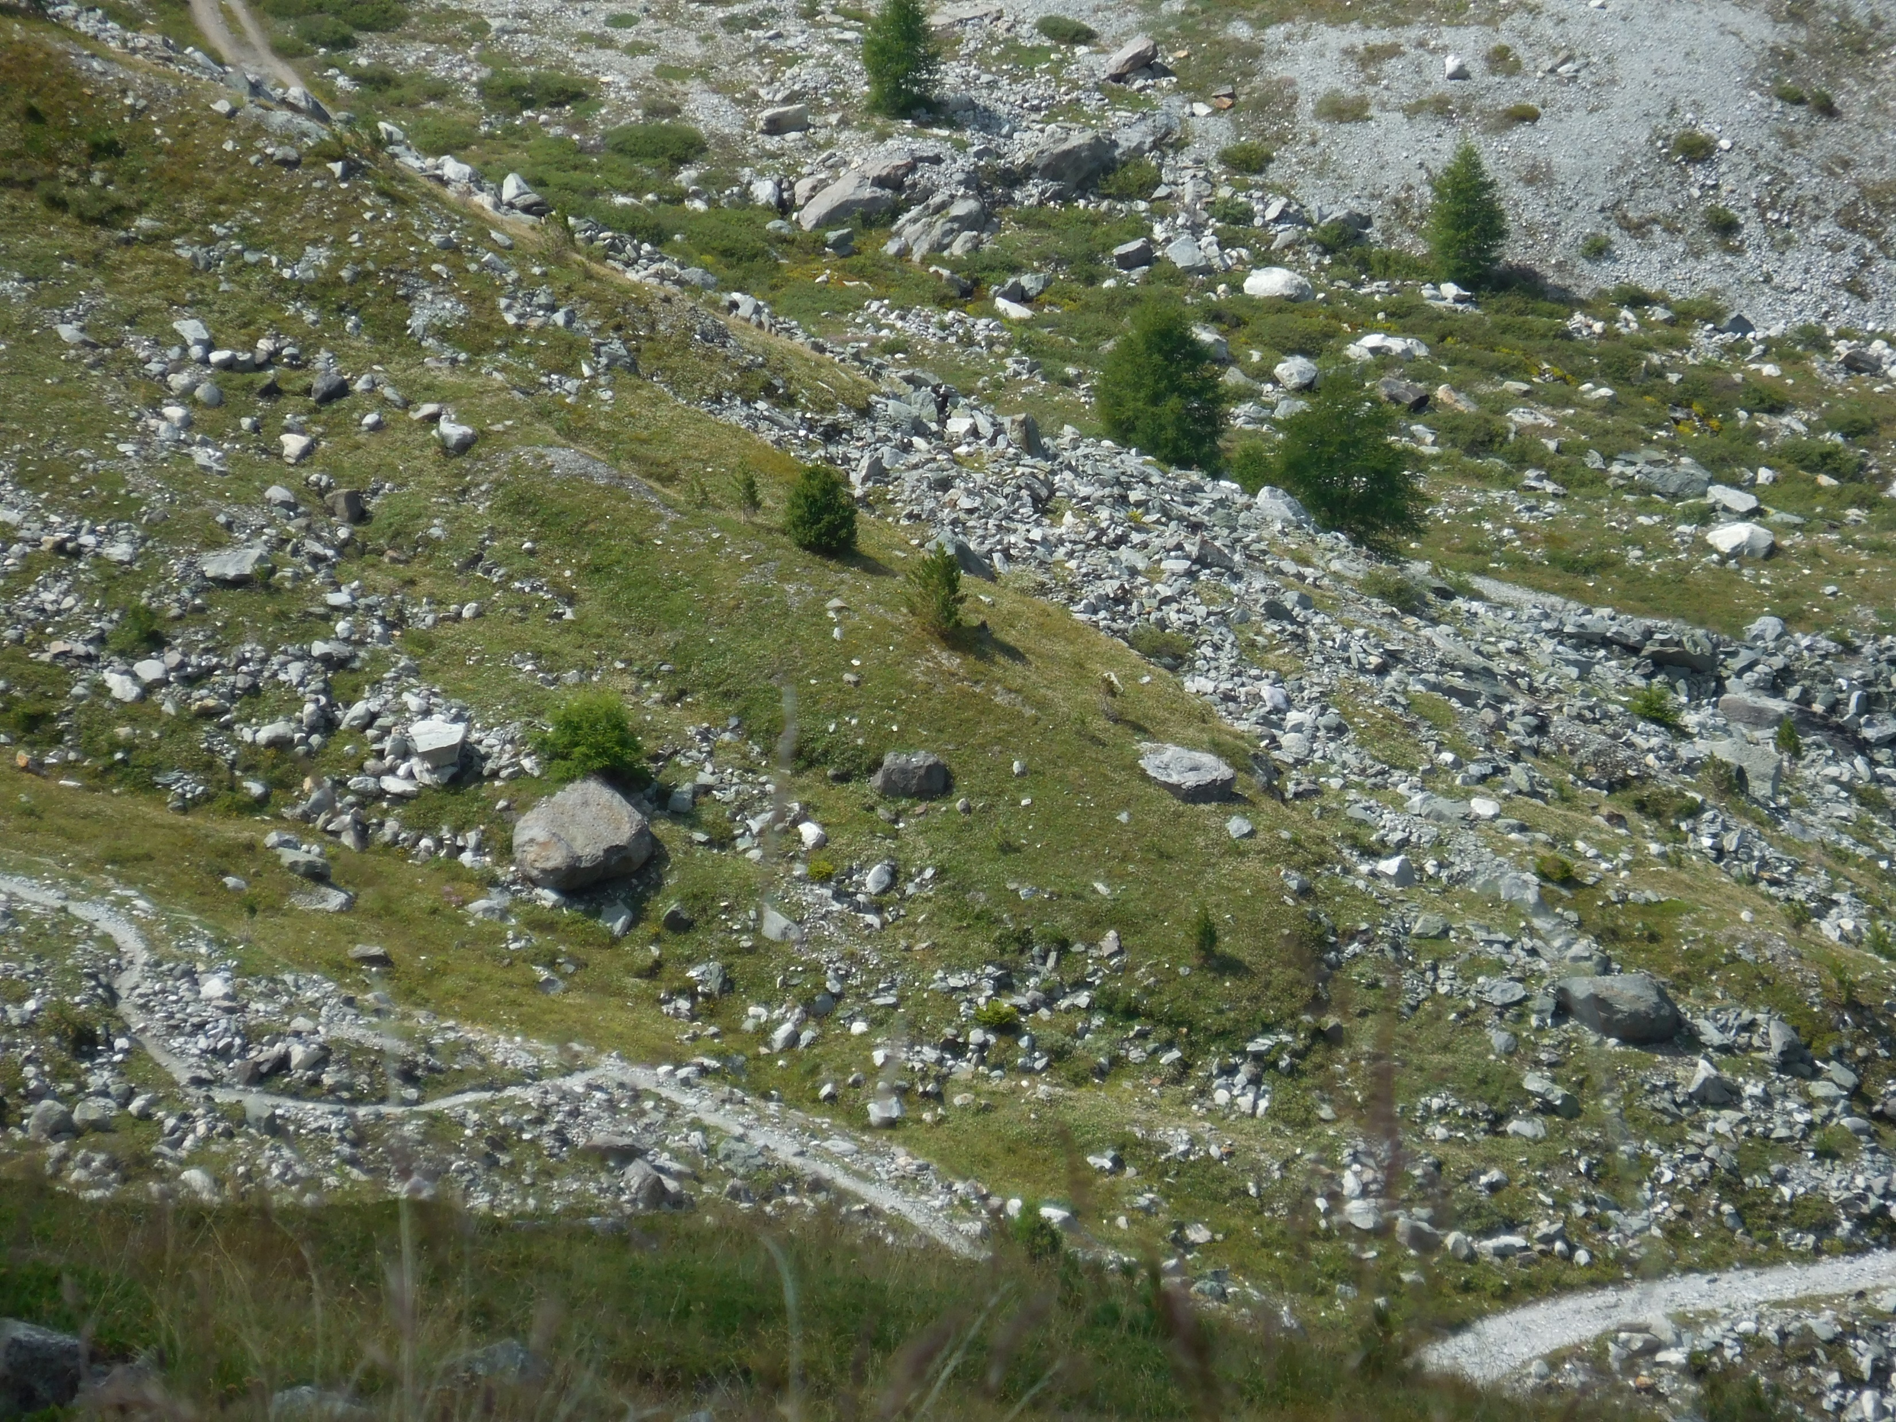
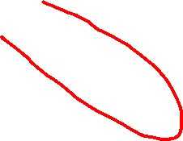
Introduction
Solifluction & Turf-banked Solifluction lobes (TBLs)
Knowledge gap: a fast (semi-) automatic method to map TBL movement with a high spatiotemporal resolution at landform scale
Aim:
Quantify movement of solifluction lobes with a high spatial resolution over five years
Determine local factors controlling the movements
2

Slide 3
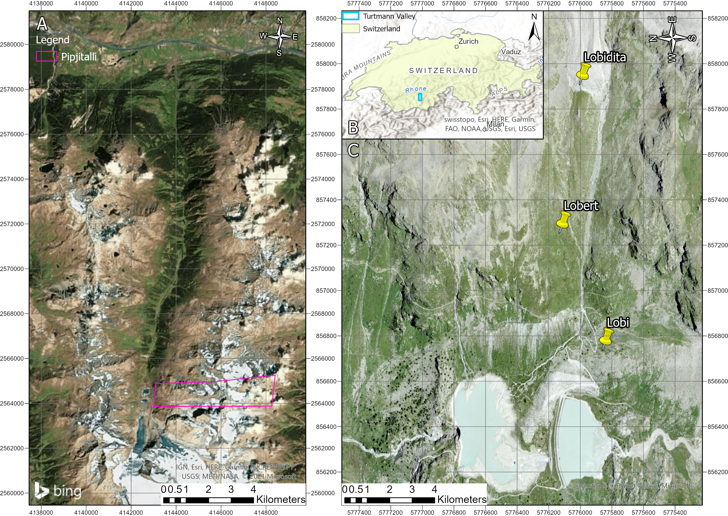
Methods
Study area
Turtmann Valley,
Switzerland
3

Slide 4
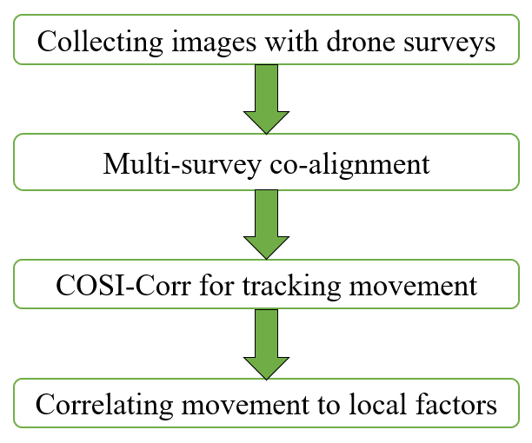
Methods
4

Slide 5
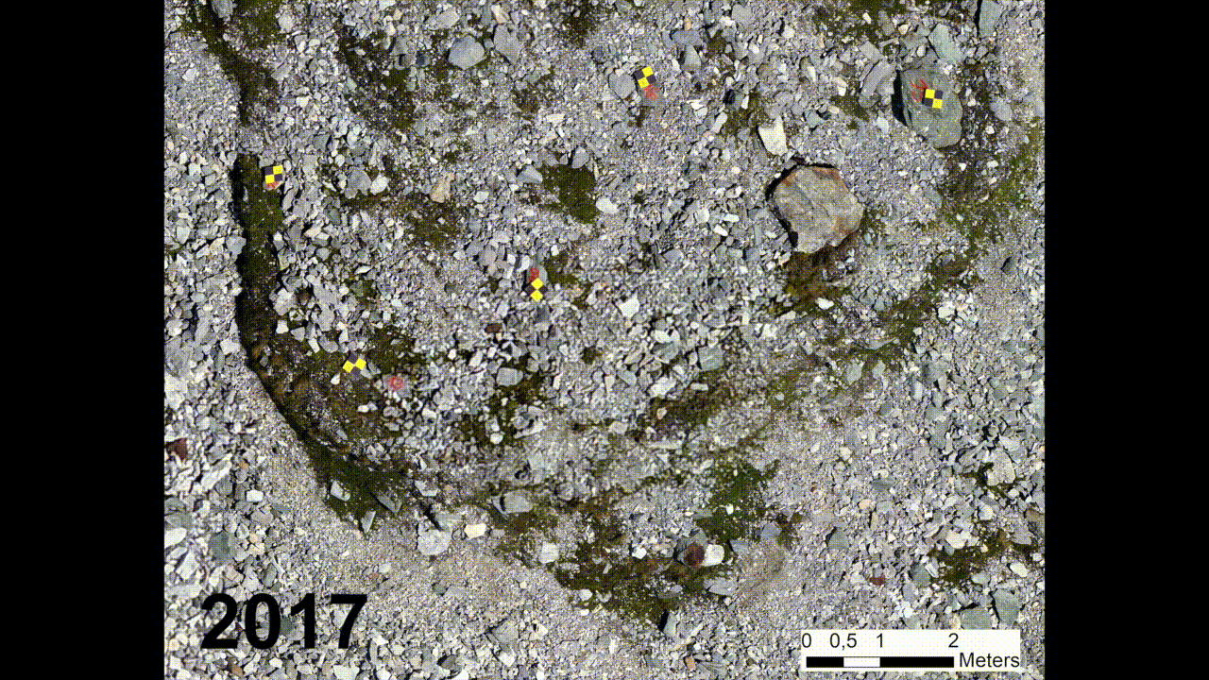
Result & Discussion – Co-Alignment
Reprojection errors between 0.503 and 0.625 pixels
Resolution of 5 mm/pixel
Significant movement >1 pixel
Reaching accuracies below mean lobe movement rates
5

Slide 6
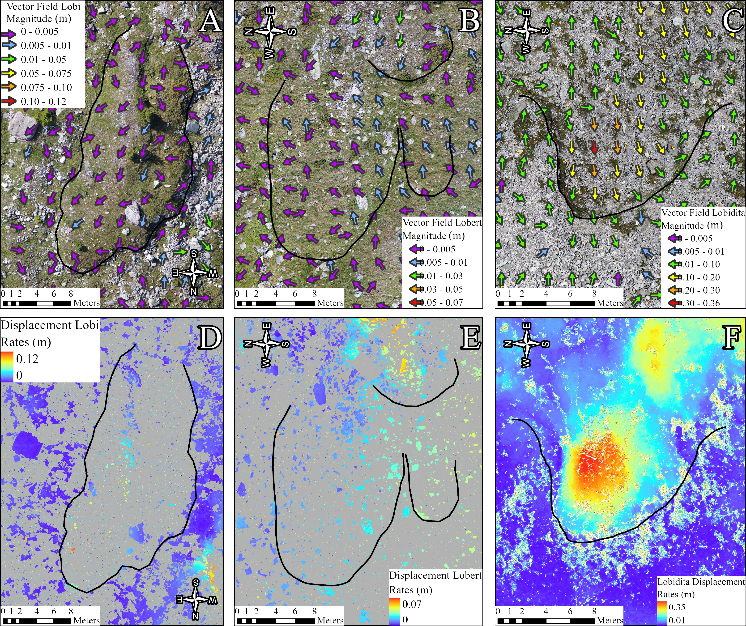
Results & Discussion - Movement
Accurate movement mapping in mm
Movement rates correspond with literature
Vegetation changes resolved with mask
6

Slide 7
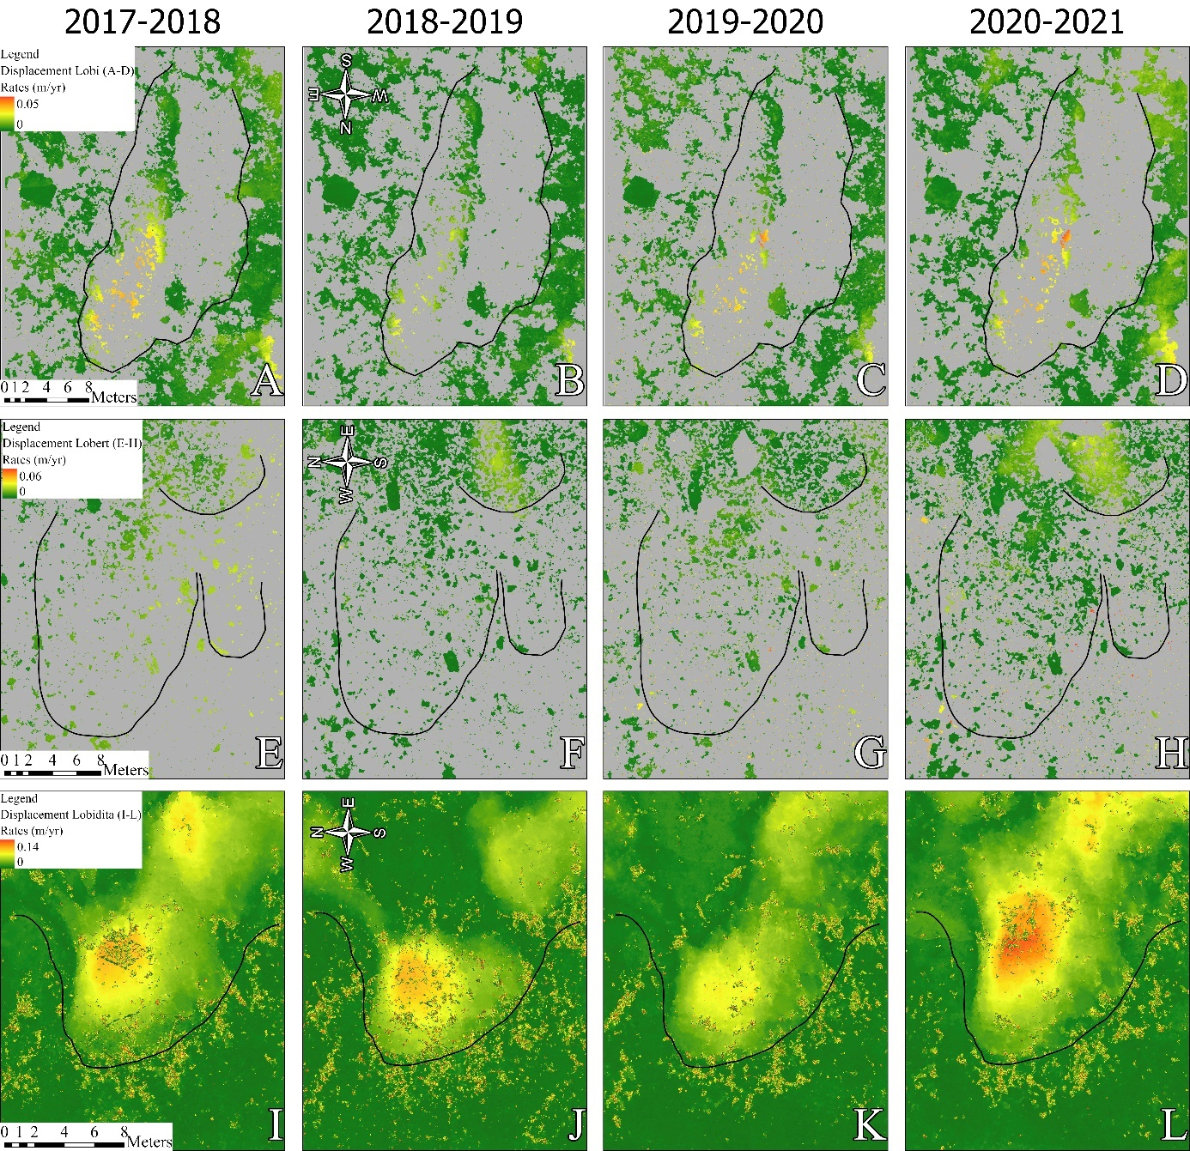
Results & Discussion - Movement
Locations where highest movement is present changes between the different years
7

Slide 8
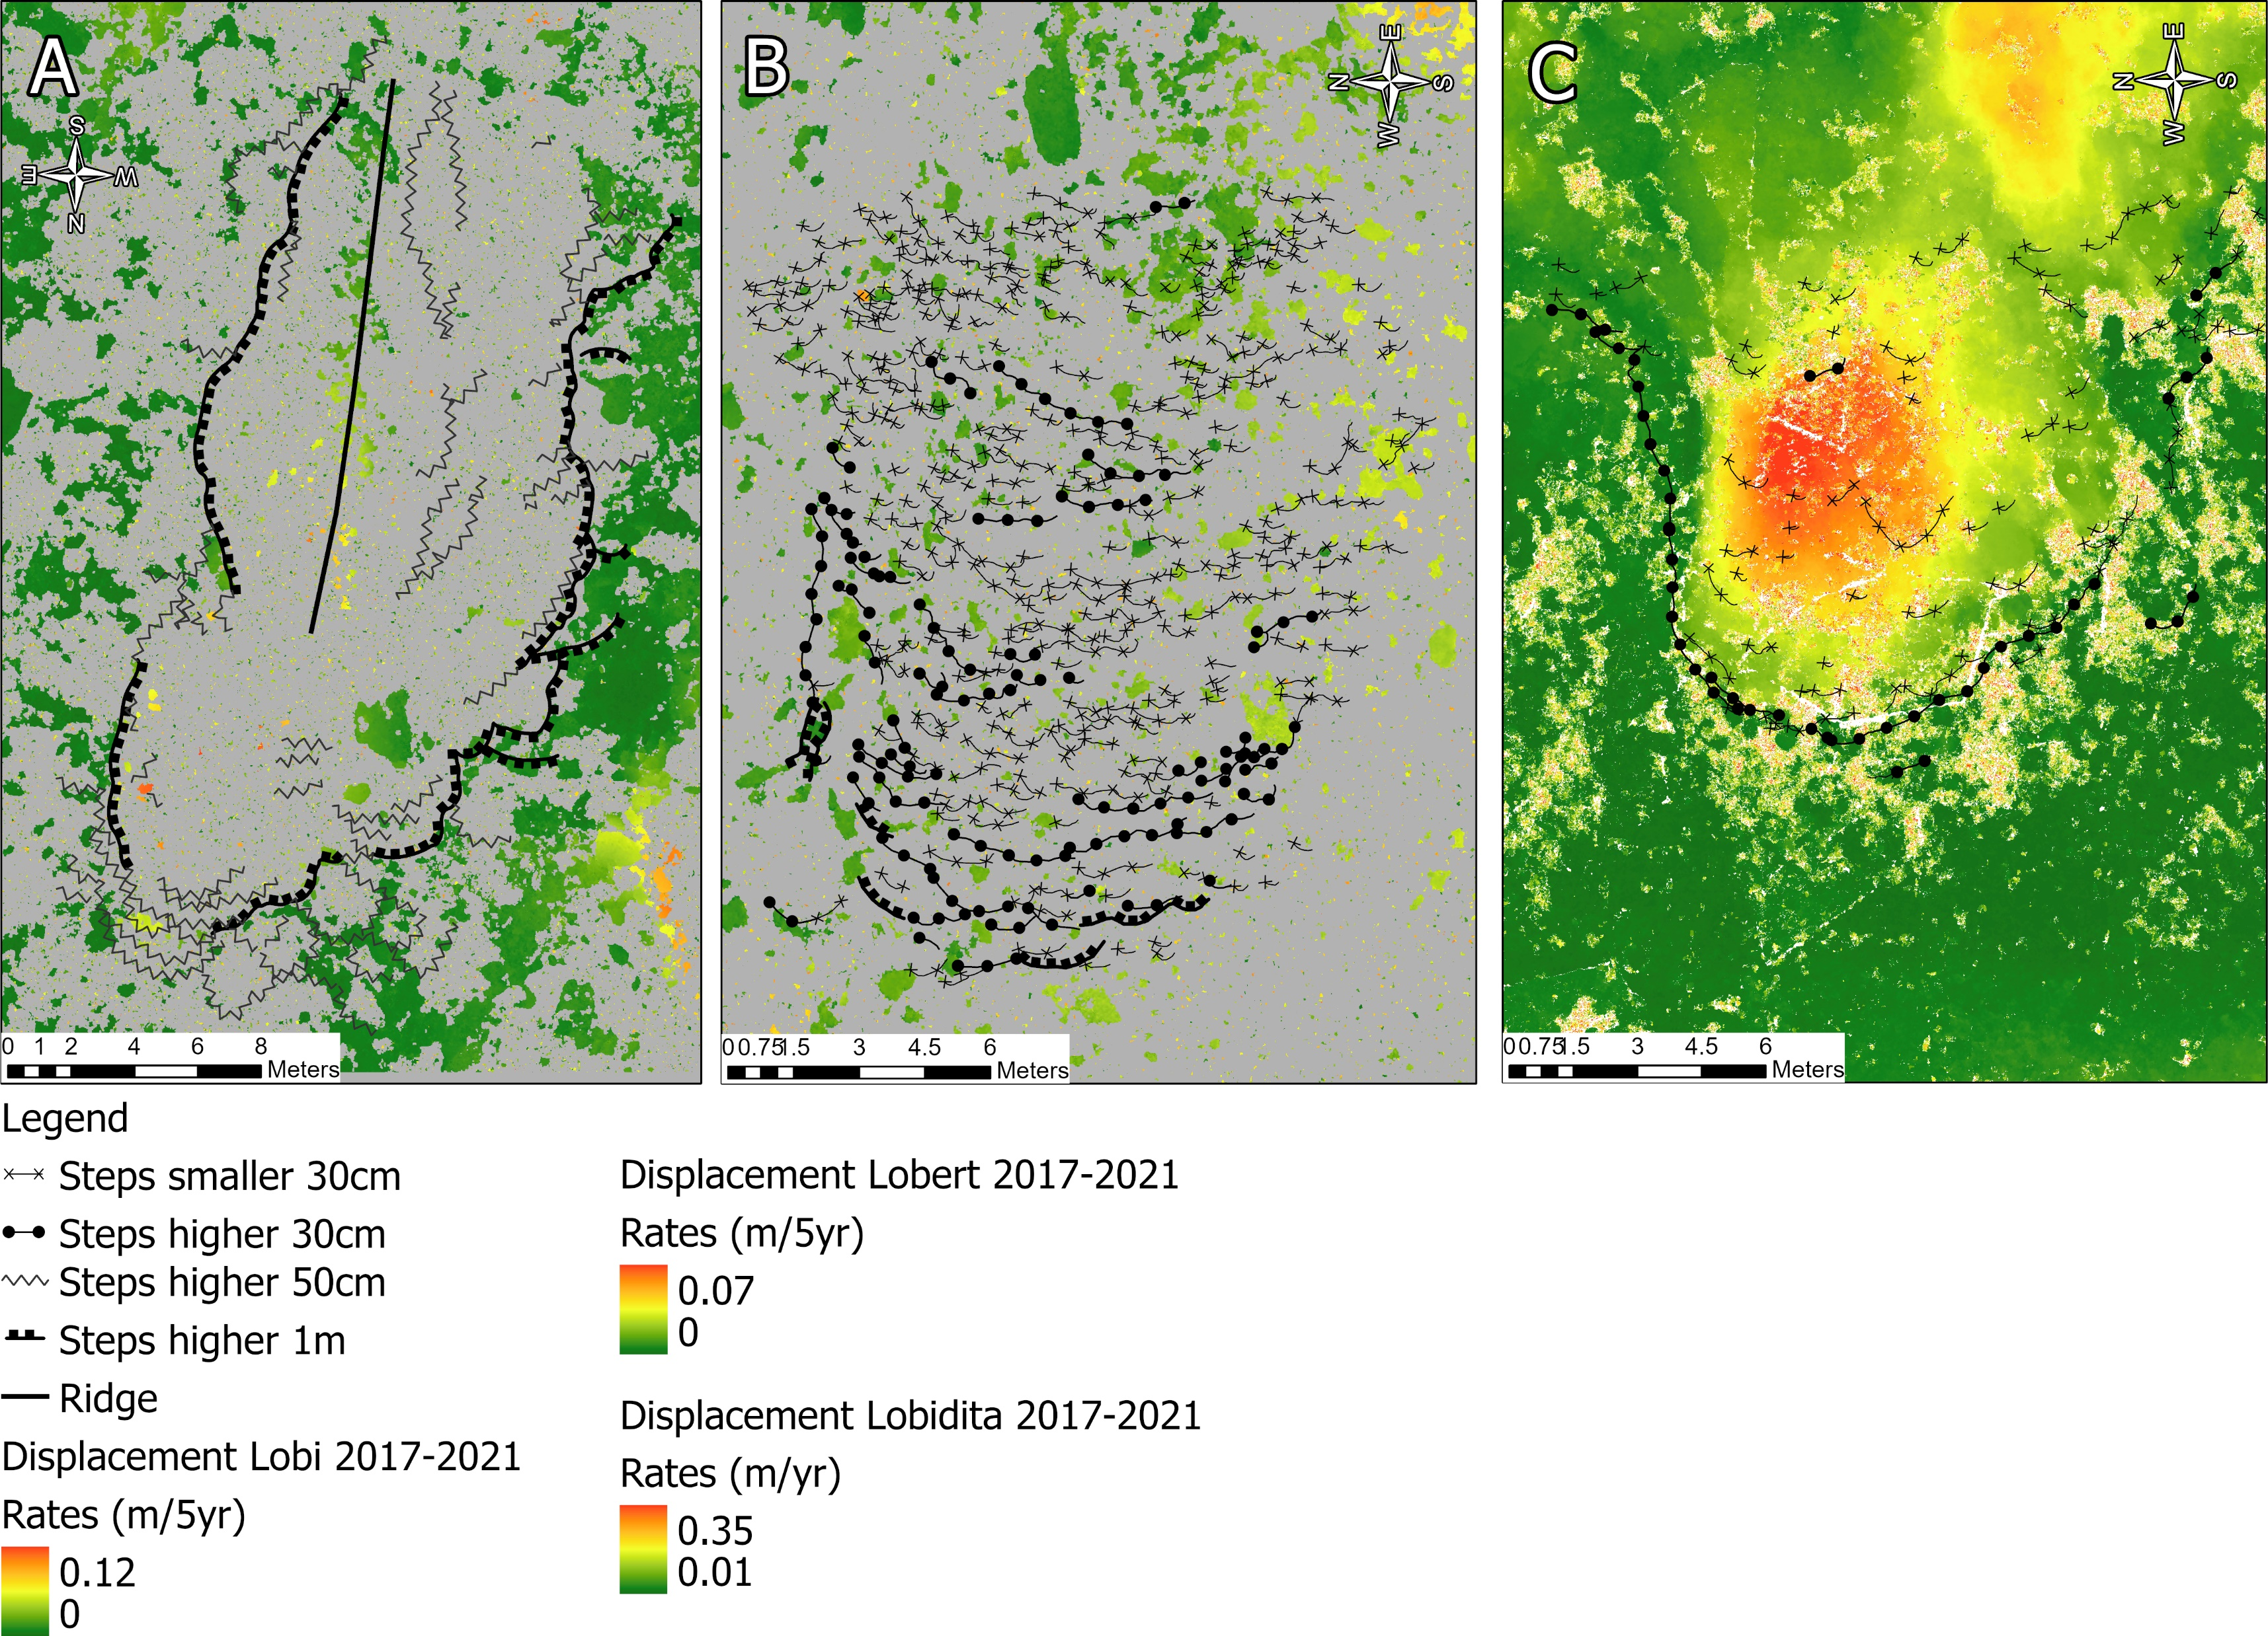


Results & Discussion – Local Factors
Geomorphic properties
Vegetation Species
8

Slide 9
Take Home Message
The combination of co-alignment and COSI-Corr allowed accurate movement mapping at mm scale
Solifluction lobe movement differs between and within lobes and relates to risers and vegetation
Harkema, M.R., Eichel, J., Nijland, W., De Jong, S.M., Kattenborn, T. (in preparation): Using high-resolution photogrammetry to solve “periglacial puzzles”: A semi-automated approach to monitor solifluction movement
Abstract:
9

