Slide 1



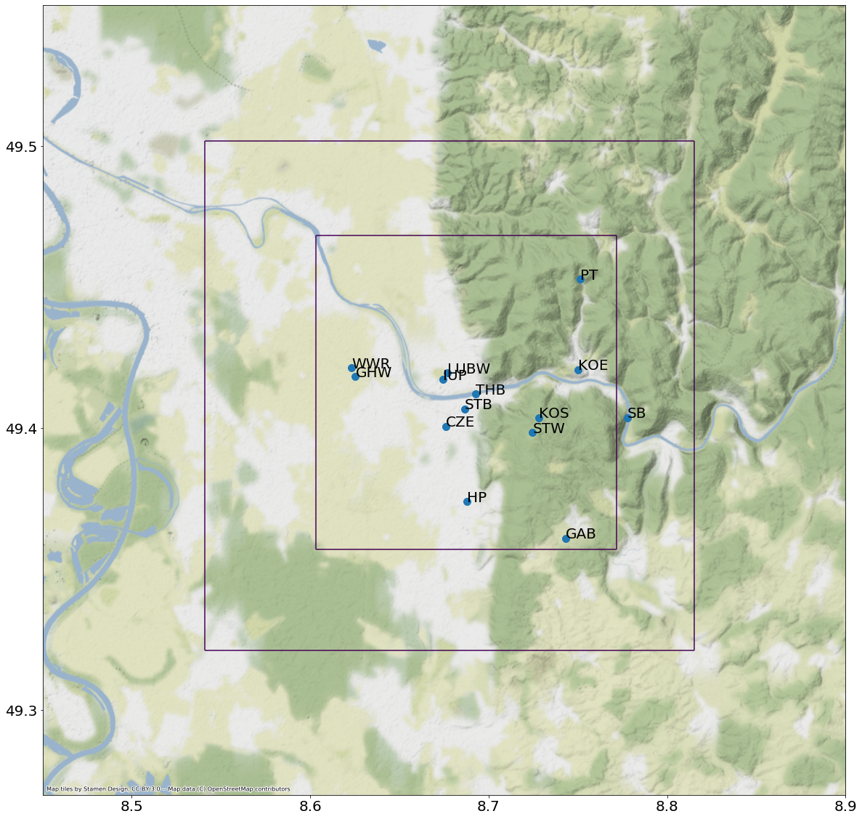

High-resolution meteorological simulations in Heidelberg using GRAMM/GRAL model for inverse modelling
Robert Maiwald¹, Simone Wald¹, Ivo Suter², Dominik Brunner², André Butz^{1,3}, and Sanam N. Vardag^{1,3}
¹Institute of Environmental Physics, Heidelberg University, Heidelberg, Germany
²EMPA, Air Pollution / Environmental Technology, Switzerland
³Heidelberg Center for the Environment, Heidelberg University, Germany
GRAL
GRAMM
5 km

Slide 2
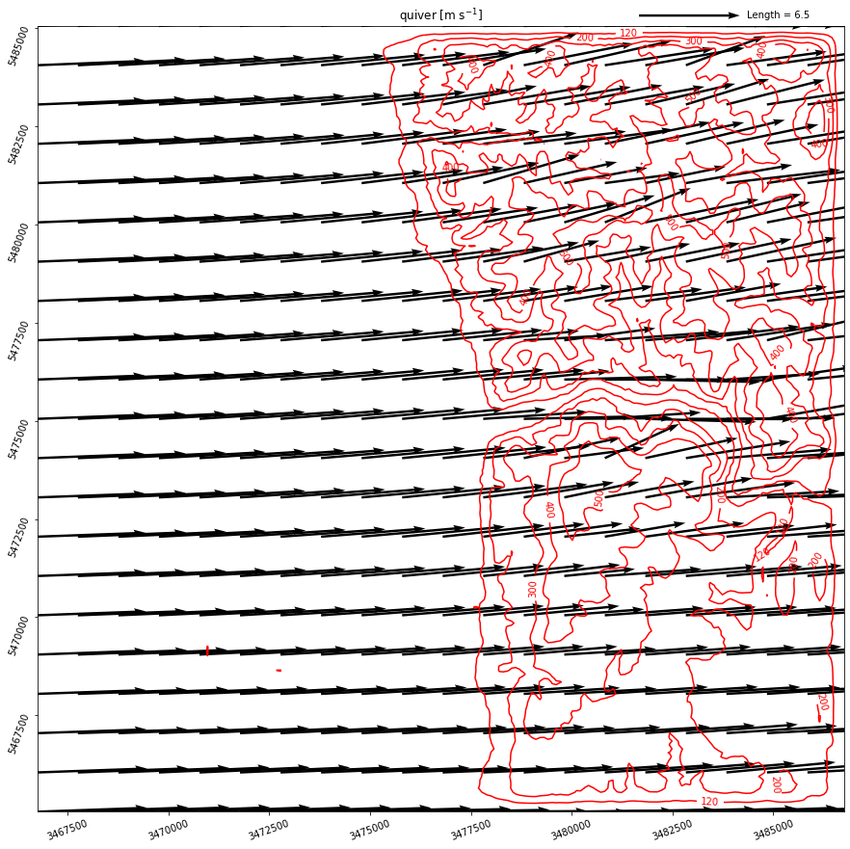
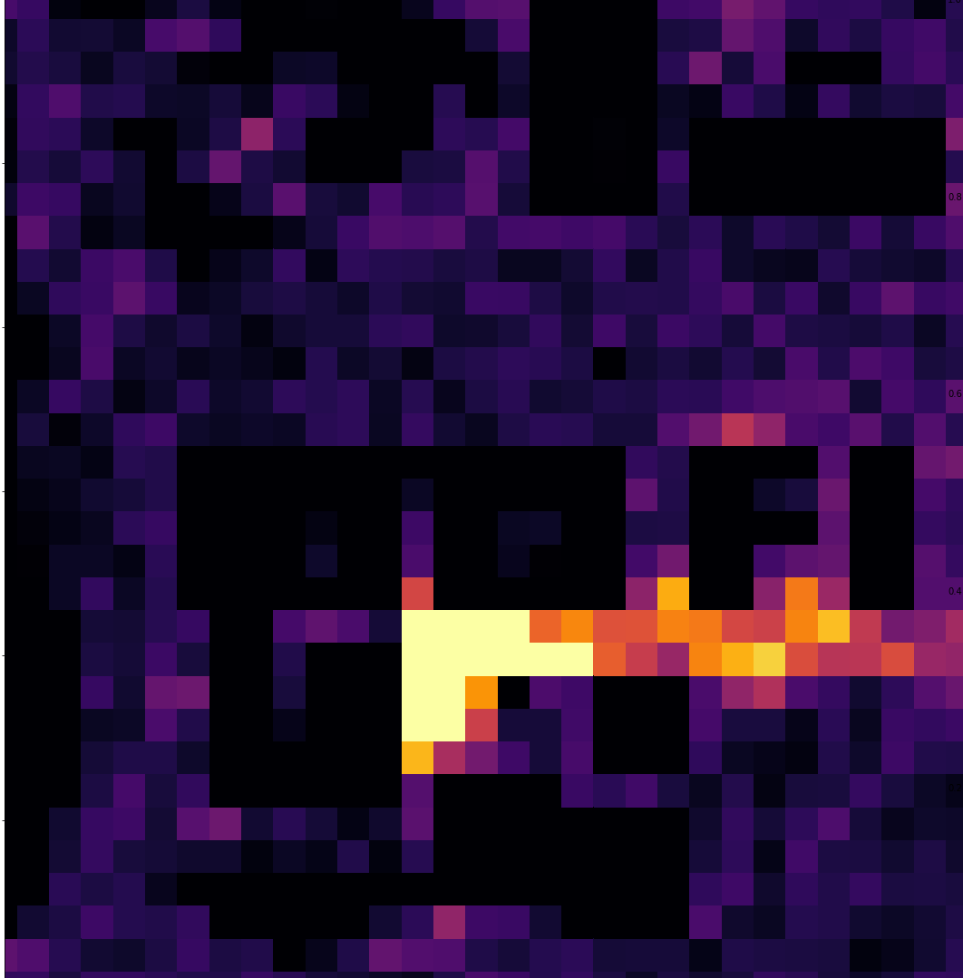
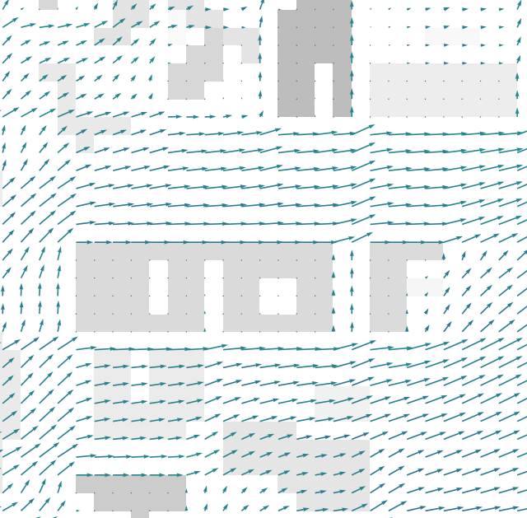
Atmospheric transport
GRAMM, 20km x 20km, 100m resolution
GRAL, 12km x 12km, 10m resolution
(+dispersion)
Wind stations
Catalog
1h
1h
1h
GRAL
High-resolution
+
Long timescales
GRAMM
Topography, land use, synoptic forcing
+ building shapes
Preliminary
RMSE of 1 m/s
Bias of 0.6 m/s
5 km
+ emissions

Slide 3
Partitioning into basis maps
to create a catalog for emission scenarios
1h
1h
Linear combination
1h
catalog
emission scenario
basis emission maps of sources
apply Bayesian Inversion

Slide 4
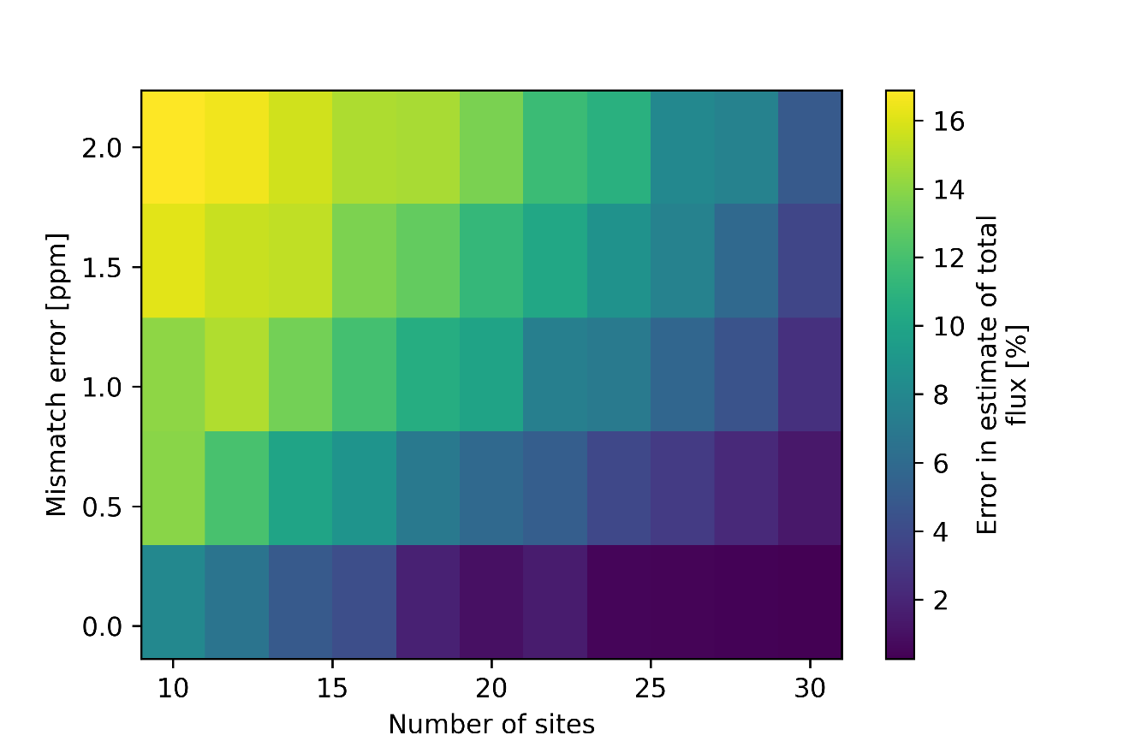
Sensitivity of toy model reproduces results
from Turner et al., 2016
Estimation error for quality of measurements vs. quantity

Slide 5
High-resolution meteorological simulations in Heidelberg using GRAMM/GRAL model
Setup
Catalog-based approach
Hourly steady-state
Bayesian Inversion
Qualitatively reproduces results from other studies
1h
1h
1h
Outlook
High-resolution
Long timescales
Bayesian inversion with Generative Neural Networks
For any questions or a meet-up at the EGU:
rmaiwald@iup.uni-heidelberg.de

