Slide 1
EGU General Assembly 2022
“APPLICATION OF FREQUENCY RATIO MODELLING TECHNIQUE FOR PREDICTIVE FLOODED AREA SUSCEPTIBILITY MAPPING USING REMOTE SENSING AND GIS”
AUTHOR & CO-AUTHORS:
Khushboo Jariwala, Prasit Agnihotri, Dhruvesh Patel, Azaz Pathan, Usman Mohseni, and Nilesh Patidar
PRESENTER:
Khushboo Jariwala,
Research Scholar, Sardar Vallabhbhai National Institute of Technology, Surat, Gujarat, India.

Slide 2
CONTENT
Introduction
Study area
Data required and Methodology
Data analysis
Results and Conclusion
References

Slide 3
INTRODUCTION
Coastal areas are directly vulnerable to natural disasters like floods, which causes massive damages to natural resources and human resources.
Dam induces floods can be devastating for surrounding low lying areas. Bharuch is a district with substantial industrial growth, and intended human activities were causing an imbalance in natural resources for planning and fulfilling other demands.
Floods can be devastating concerning the Bharuch district's social, economic, and environmental perspectives.
The proper analysis becomes very important to reduce the impact and find mitigation measuring techniques.

Slide 4
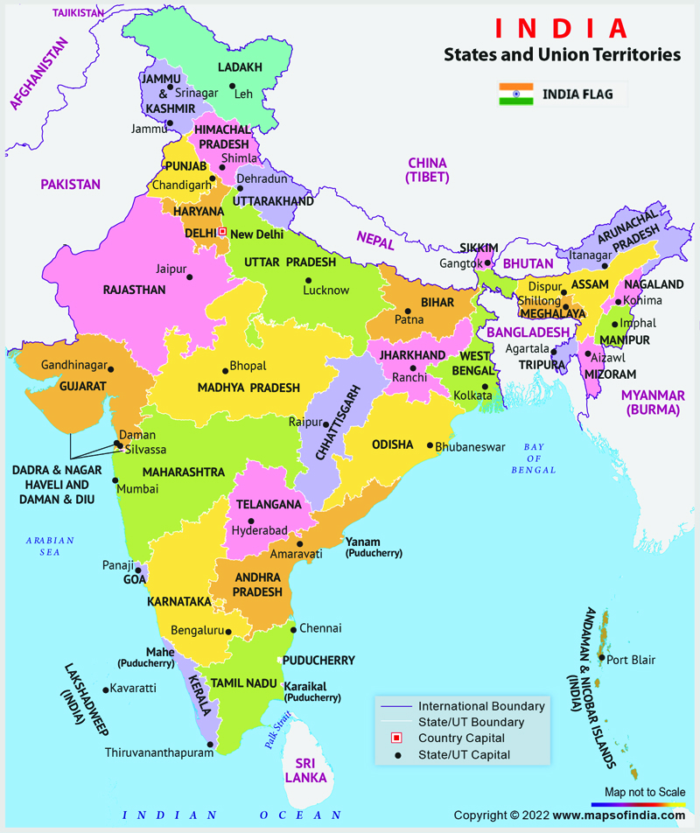
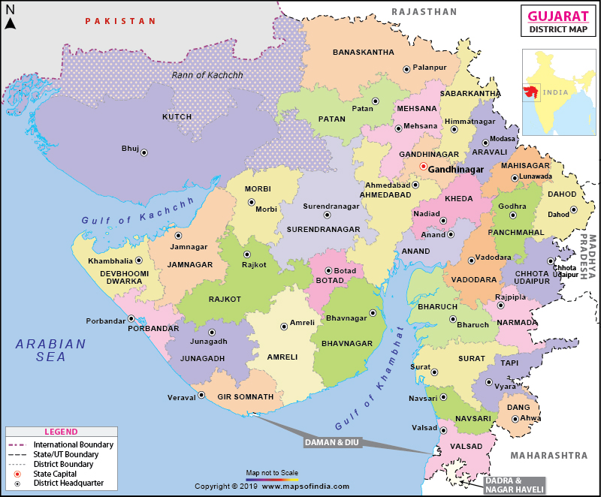

Slide 5
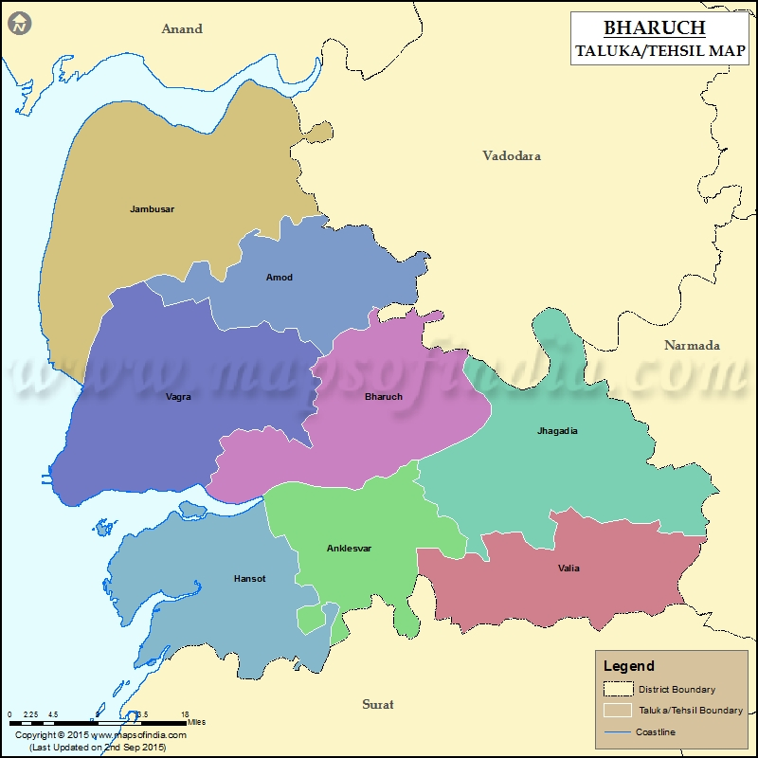
BHARUCH DISTRICT
Total district area = 6,509 sq km(170 sq km is urban and 6339 sq km is rural)
Total population (2020-21 as per aadhar uidai.gov.in feb 2019 data) = 1,721,632(524,959 are in urban area and 1,026,060 are in rural area)

Slide 6
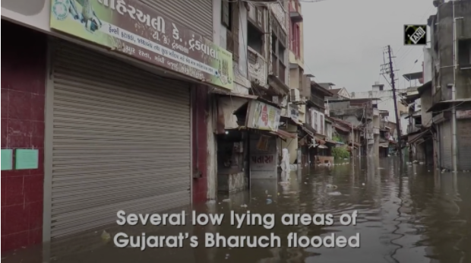
Past disasters occurrence in Bharuch district

Slide 7
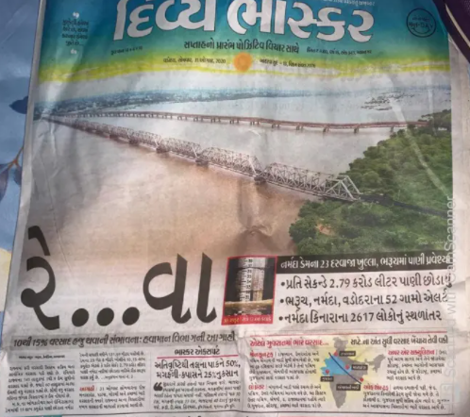
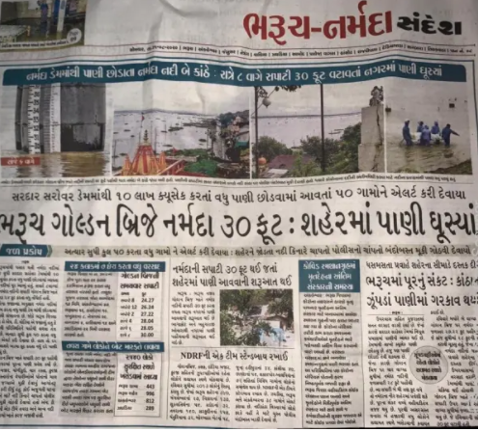

Slide 8
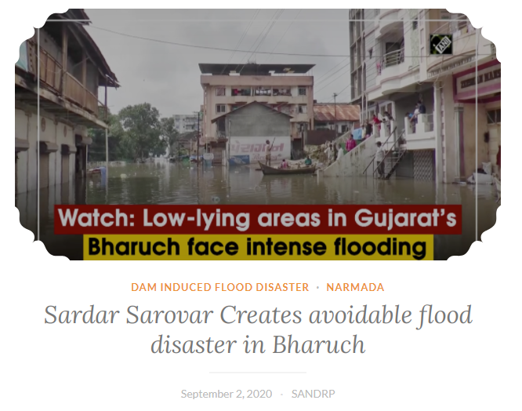

Slide 9
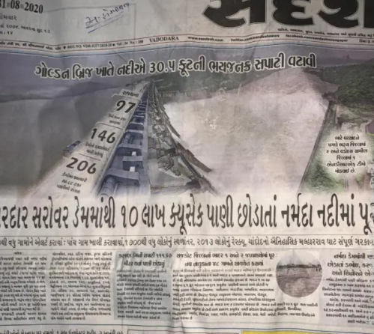
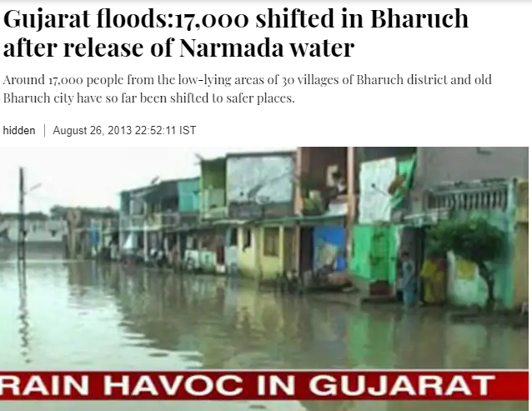

Slide 10
Flood susceptibility mapping
Mapping and analysis of flood susceptibility is one of the most important elements of early warning systems or strategies for prevention and mitigation of future flood situations since it identifies the most vulnerable areas based on physical conditions that determine the propensity for flooding. Therefore, the term susceptibility can be also perceived as one of the dimensions of vulnerability assessment.

Slide 11
Tools used for susceptibility analysis
Analytical Hierarchy Process(AHP)
Multi-Criteria Decision support Approach (MCDA)
Weights of Evidence (WofE)
Adaptive neuro-fuzzy interface system
Artificial Neural Networks (ANN)
Frequency Ratio (FR) model

Slide 12
Parameters used for susceptibility analysis using FR Ratio model
Land use/ Land cover
Elevation
Slope
River network
Topographical Wetness Index (TWI)
Surface runoff
Lithology
Soil texture
Distance from river

Slide 13
Data required and sources
Sr no. | Data | Source | year | Sofware used | Purpose
1 | Satellite imagery | USGS Earth explorer | Year 2021 | ArcGIS 10.2.2 | LULC Map preparation
2 | World Geological map | GSI | - | ArcGIS 10.2.2 | Lithology data
3 | Daily rainfall data | IMD Pune | June 2021 | MS Excel | CN number analysis/Surface runoff
4 | Soil map of India | SOI Portal | - | MS Excel and ArcGIS | Soil texture
5 | Landsat imagery for Premonsoon and post monsoon seasons | USGS Earth explorer | 1990 2010 2020 | ArcGIS 10.2.2 | Historical flood occurence
6 | Digital Elevation data | USGS Earth explorer | 2020 | ArcGIS 10.2.2 | Elevation, slope and TWI

Slide 14
1. Land use/ Land cover Map preparation
The preparation of LULC map needed Satellite image of the district from the year 2021. Which is obtained from USGS Earth explorer having 30 m resolution.
The classification method used is maximum likelihood classification. The classification scheme is based on NRSC (National Remote Sensing Center- operated by ISRO) level-1 classification.

Slide 15
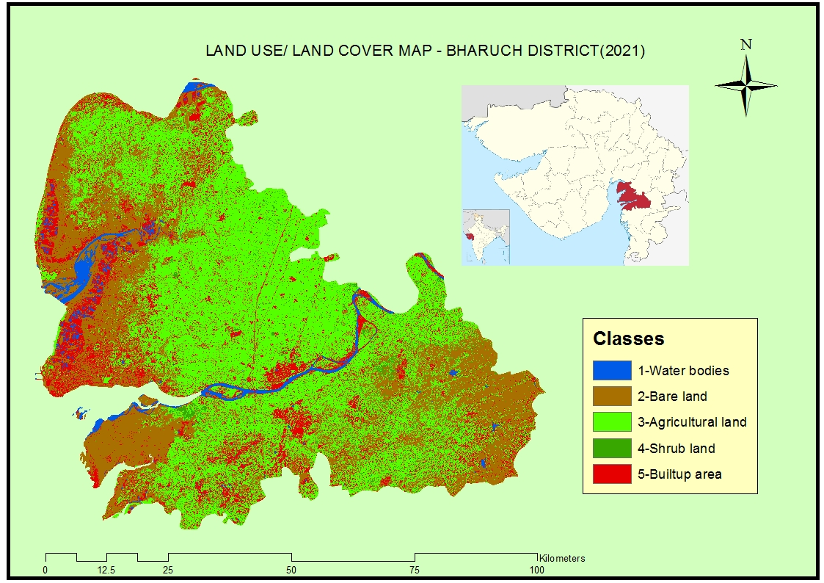

Slide 16
2. Elevation map
This map is prepared using SRTM DEM data of BHARUCH district which are obtained from USGS Earthexplorer portal in a 30 m resolution. Those DEM data are processed for contour which is used to obtain contour lines in the study area as well as raster classification is done is various classes having difference in elevation value.
The maximum elevation is 255 m which is represented by blue color.
The contour interval was taken as 40 m.

Slide 17
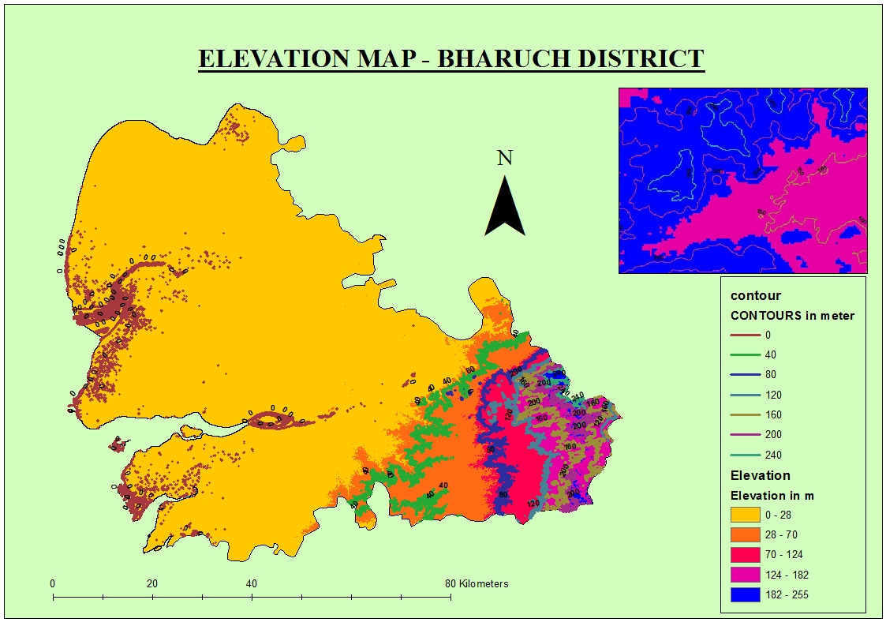

Slide 18
3. Slope map
A slope map is a topographic map showing changes in elevation on a highly detailed level. Slope map is created using Digital elevation model of Bharuch district and ArcGIS tool “Slope”.
With help of slope tool digital elevation raster is converted to percentage slope and plotted into raster.

Slide 19
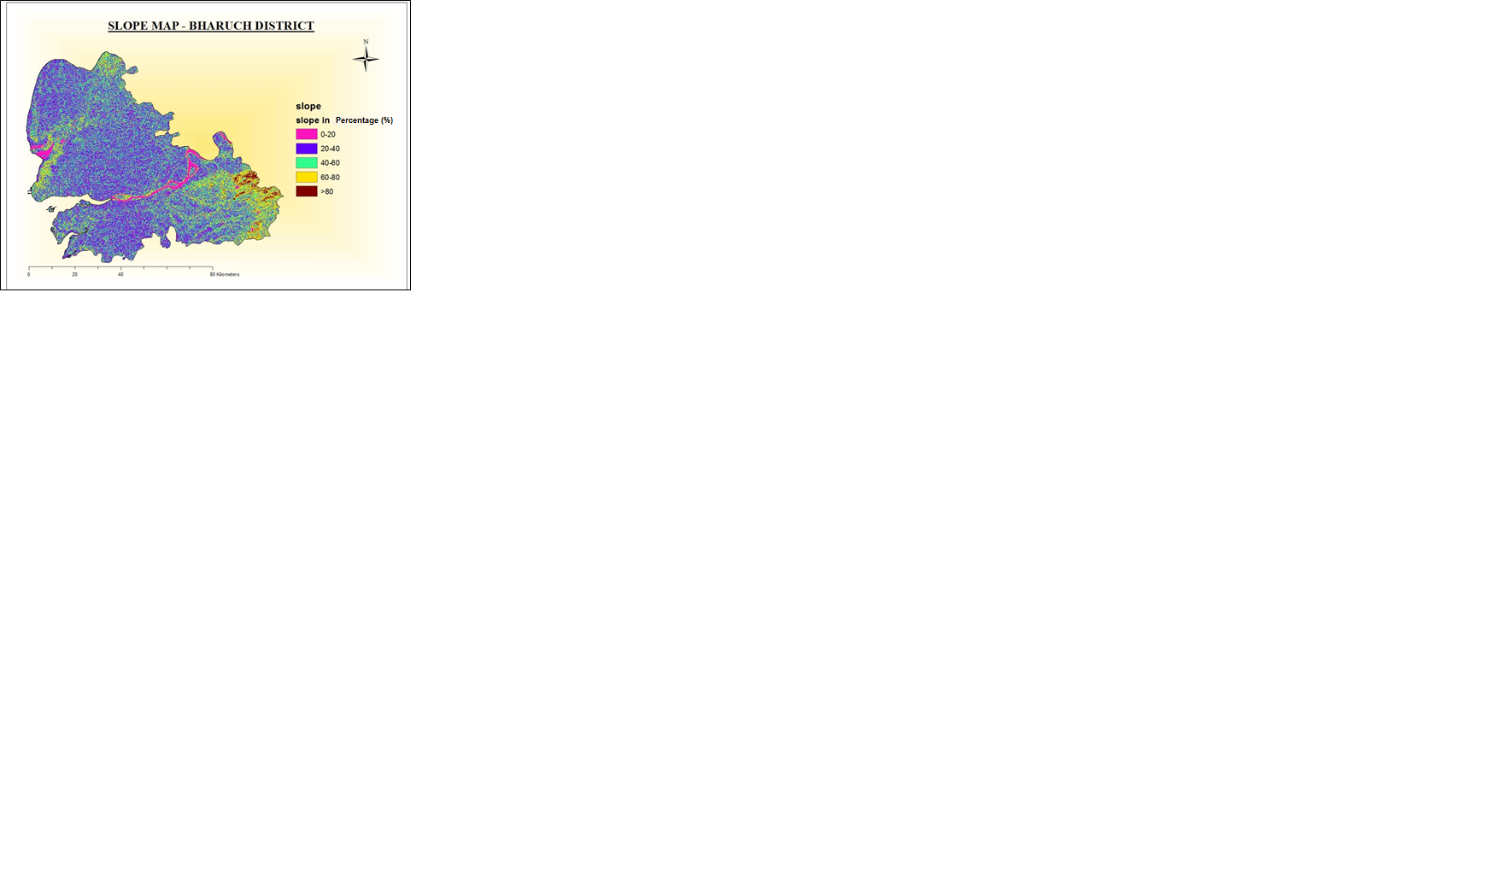

Slide 20
4. Topographical wetness index map
The Topographic Wetness Index (TWI) is a useful model to estimate where water will accumulate in an area with elevation differences. It is a function of slope and the upstream contributing area:
TWI = ln(a/tan B)
Where: a = upslope contributing area (m2)
B = slope in radians
To derive Topographic wetness index map raster calculator tool is used with flow accumulation and slope as input data. The first step is to compute flow direction raster from the digital elevation data.

Slide 21
This the raster file which is mainly used to prepare TWI map. Now the Map algebra is used for computing TWI as per the equation given but before that, flow accumulation raster is separated with lowest values. After that slope is calculated from Spatial analyst tool-> surface-> slope. It is than calculated as Tangential slope (tan(slope)) in Map algebra function.
Now Function used in Map algebra for computing TWI as Ln of [Flow accumulation (deducted lowest values)]/ [Tangential slope]. Raster calculator then provide result with topographic wetness index map.

Slide 22
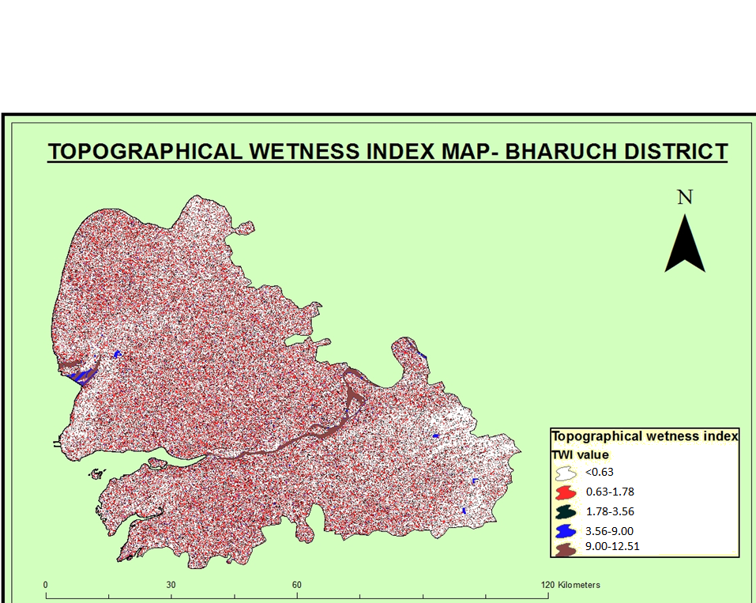

Slide 23
5. Lithology map
Lithology is the basis of subdividing rock sequences into individual lithostratigraphic units for the purposes of mapping and correlation between areas.
A geologic map or lithological map is a special-purpose map made to show various geological features. Rock units or geologic strata are shown by color or symbols. Bedding planes and structural features such as faults, folds, are shown with strike and dip or trend and plunge symbols which give three-dimensional orientations features.
The vector file showing lithology of district area is obtained from world geological map from Geological survey of India, Department of soil survey and Land use planning.

Slide 24
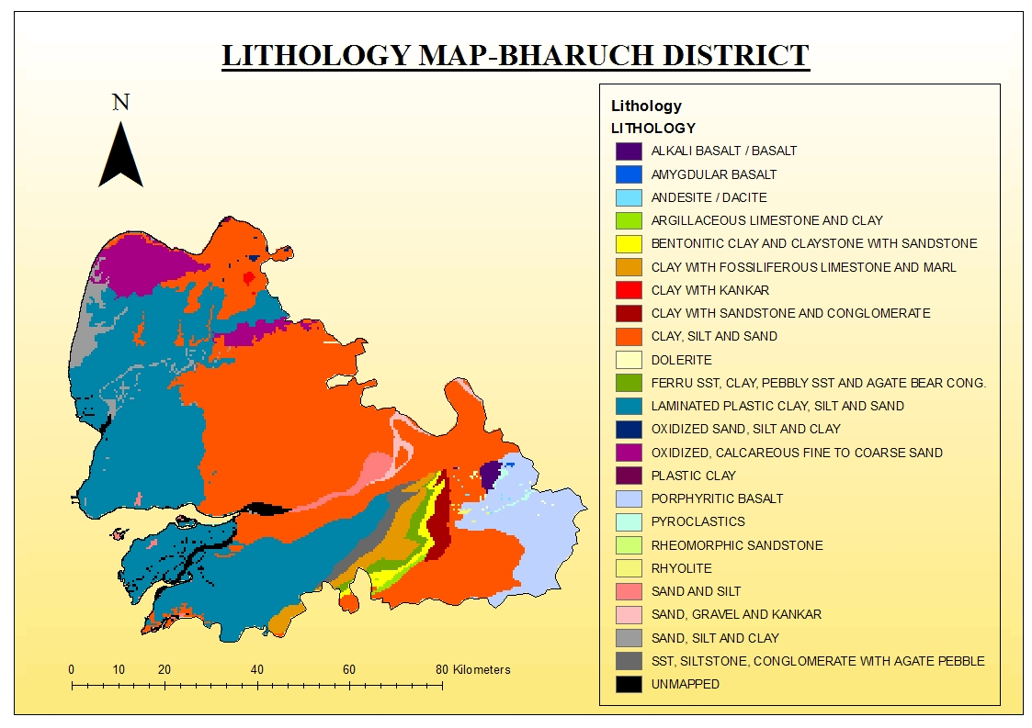

Slide 25
6. Soil map
Soil mapping is very important for the correct implementation of sustainable land use management. In recent decades, soil mapping methods and data availability have increased exponentially, improving the quality of the maps produced.
The Survey of India, one of the India’s largest collections of natural resource soil information. For years, SOI soils were mapped using geopolitical boundaries, often county boundaries. The SOI soils data is available for download.

Slide 26
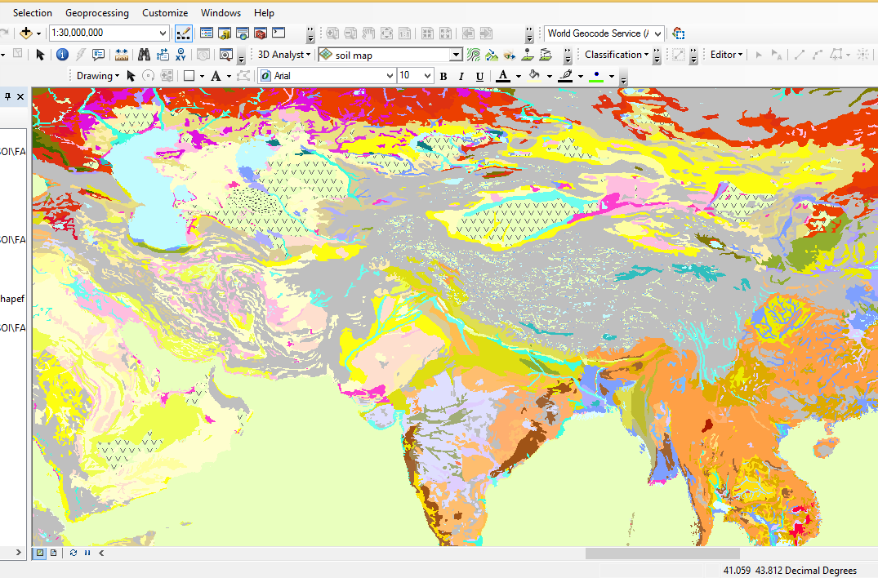

Slide 27
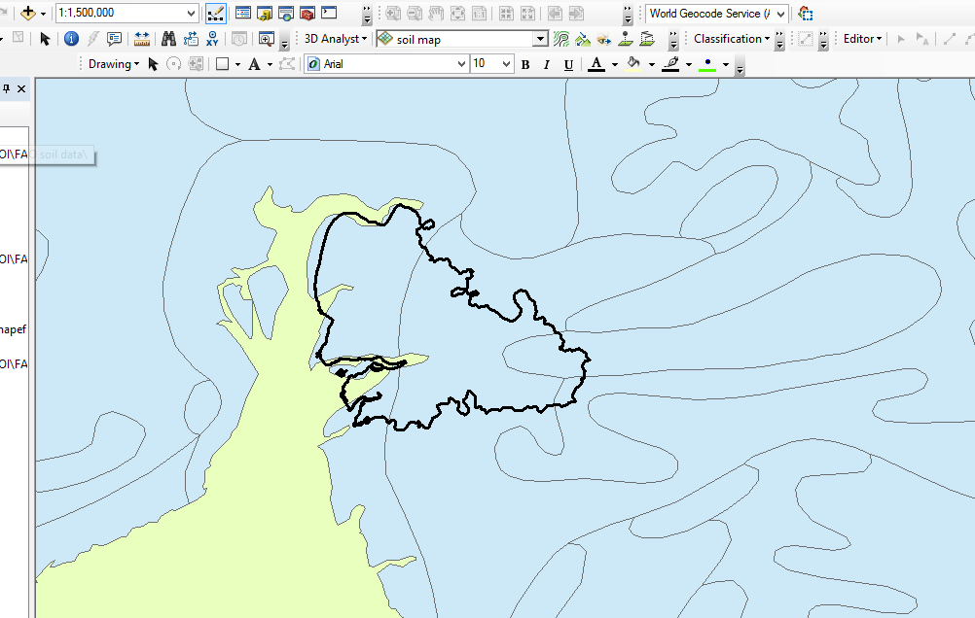

Slide 28
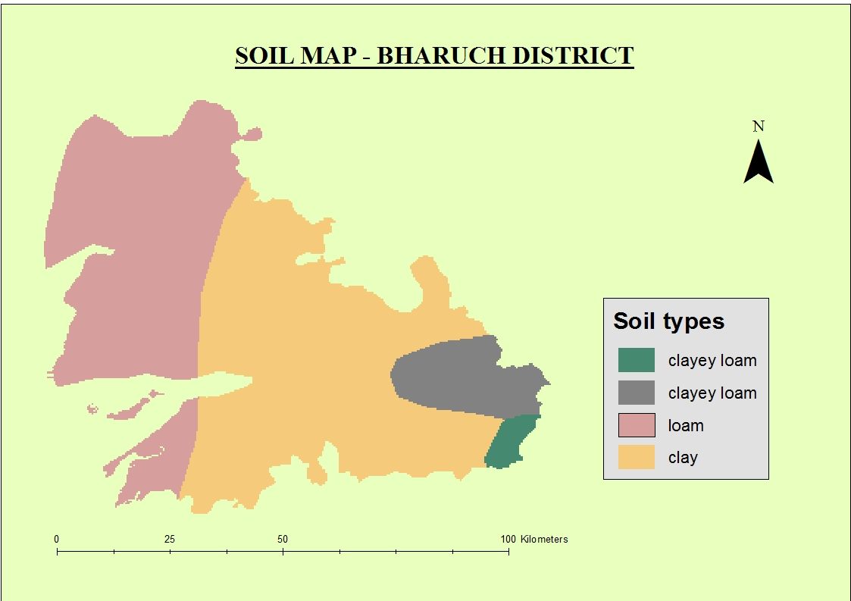

Slide 29
7. River Network map
River Network is a method of assigning a numeric order to links in a stream network. This order is a method for identifying and classifying types of streams based on their numbers of tributaries. Some characteristics of streams can be inferred by simply knowing their order.
The Stream Order tool has two methods proposed by Strahler (1957) and Shreve (1966). We have used Strahler method.

Slide 30
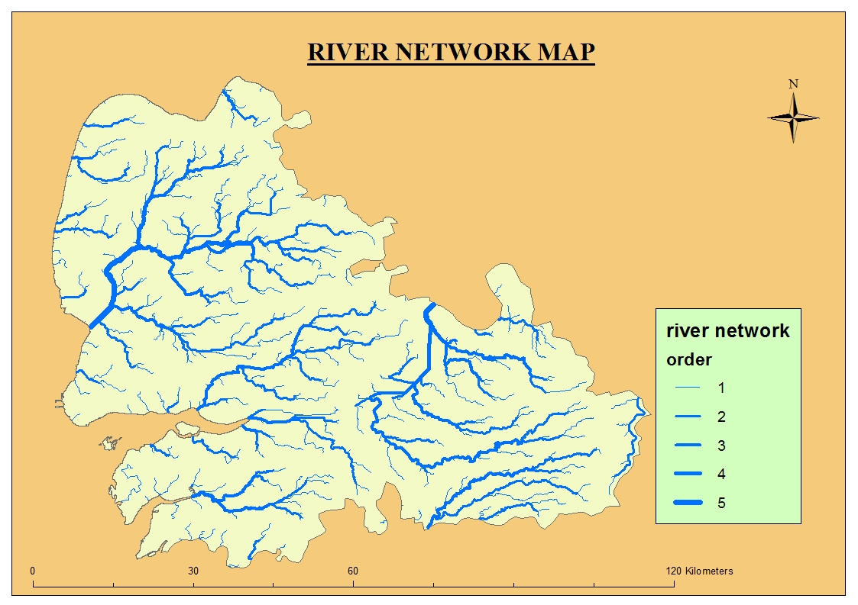

Slide 31
8. Suface runoff map
Surface runoff map is prepared using SCS curve number analysis for computing runoff. This method helped find out Runoff from different basin areas and then the compiled runoff gave the surface runoff map. The input criteria for computing runoff is soil data and land use data.
Subdistricts are extracted from district boundary and LULC is carried out from which SCS curve number method is used to compute individual CN number. HSG for individual Subdistricts area and AMC condition is applied to compute CN number for each class.

Slide 32
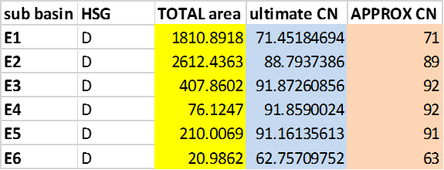

Slide 34
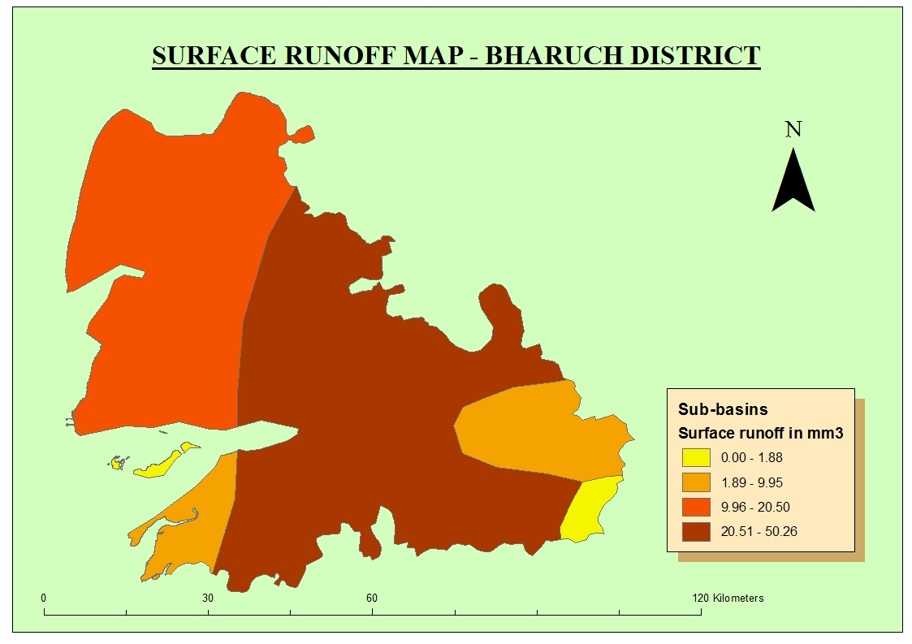

Slide 35
9. Distance from river map
The map indicates, for each pixel in district of the originally binary picture, the shortest distance to the nearest pixel of river. Euclidean distance output raster function is used to derive this map with help of ArcGIS.
The Euclidean distance output raster contains the measured distance from every cell to the nearest river pixel. The distances are measured as the crow flies (Euclidean distance) in the projection units of the raster, and are computed from cell center to cell center.

Slide 36
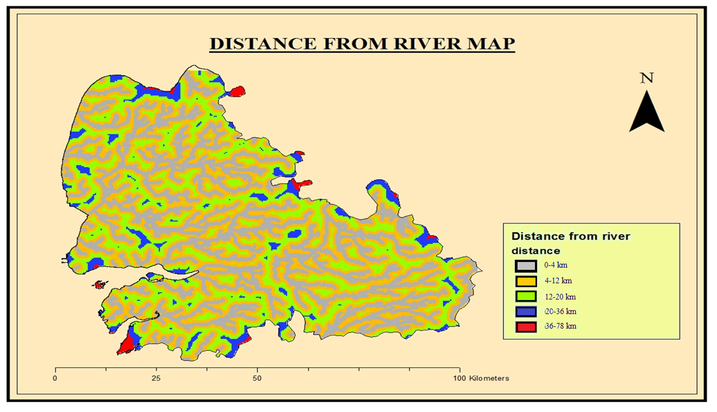

Slide 37
FR Ration Modelling
Mapping of historic or past flood records is essential to identify the future flood events. Which are obtained from Landsat imagery of years 1990, 2010 and 2020 both for pre monsoon and post monsoon season.
It is then classified in ArcMap to see the change in water level near the river bank. Totally, 151 historic flood locations were collected from news reports and satellite data of pre and post-flood event. Among 151 flood locations, 72 were used for modelling. Frequency Ratio (FR) model was adopted for this study. This model establishes a quantitative relationship between the occurrence of flood events and various flood determining parameters. The FR index values were calculated using following equation.

Slide 38
FSI = Σ FR
Where FSI and FR are the Flood Susceptibility Index and Frequency Ratio for each factor, respectively.
The FR is the ratio of flooded area to the total study area that delineates flooded area from non-flooded area. Following equation was used to calculate the FR value.
FR = (E/F) / (M/L)
Where E is the number of flood events for each factor; F is the total number of flood events; M is the areal coverage (histogram) of the each factor; L is the total areal coverage (histogram) of the study area. The FR value indicates the types of correlation between factors and floods.
FR value higher than 1 indicates strong flood correlation; on the other hand, a value lower than 1 indicates weak flood correlation. Table shows the FR value for each parameter.

Slide 39
Finally, all the parameters are converted into raster format and spatial resolution of each raster layer was set to 30 m x 30 m cell size and it is integrated in Arc GIS based on database. And this integrated database was reclassified into four flood susceptibility class namely low, medium, high and very high.

Slide 40
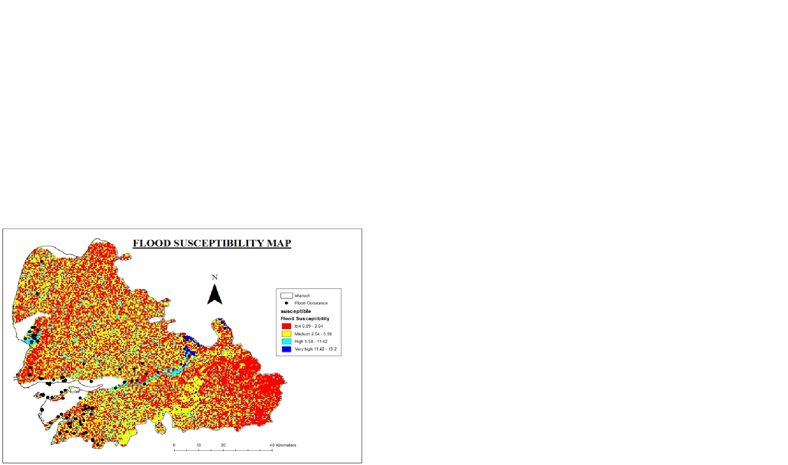

Slide 41
CONCLUSION

Slide 42
The study intended to analyse the flood susceptibility zones of Bharuch by using FR model. Nine independent parameters, namely landuse/land cover, slope, elevation, soil, lithology, Topographic Wetness Index (TWI), distance from the river, river network and surface runoff, were used as an input of FR model for flood susceptibility mapping. The known fact that the higher the input, the greater would be the accuracy of the result. So, mapping of flood susceptible zones through FR model could be done only to the areas where the required flood locations are minimum 72 points. In total, 151 flooded locations were collected from news reports and satellite data of pre- and post-flood event. The created flood susceptibility zone using FR model was classified into five (Very high, high, medium and low and very low). The high and very high classes are highly vulnerable for flood. Hence, the FR model is well suitable for predicting the flood susceptibility zone. The result of this analysis will be helpful for decision makers to execute appropriate flood management in future.

Slide 43
S.No | Flood susceptibility class | Range of FR value
1 | Very high | More than 13.2
2 | High | 5.58-11.42
3 | Medium | 2.04-5.58
4 | Low | 0.99-2.04
5 | Very low | Less than 2.04

Slide 44
REFERENCES

Slide 45
Athar, H. (2015) Teleconnections and variability in observed rainfall over Saudi Arabia during 1978-2010. Atmospheric Science Letters, 16, 373–379. https://doi.org/10.1002/asl2.570.
Babar, S.F. and Ramesh, H. (2013) Analysis of south west monsoon rainfall trend using statistical techniques over Nethravathi basin. International Journal of Advanced Technology in Civil Engineering, 2(1), 2231–5721.
Banacos, Peter C (2011) Box and whisker plots for local climate datasets: interpretations and creation using excel 2007/2010. Eastern Region Technical Attachment No. 2011 01
Beyene, A.N. (2015) Precipitation and temperature trend analysis in Mekelle city Northern Ethiopia, the case of Illala Meteorological station. Journal of Earth Science and Climatic Change, 5(19), 46–52.
Bhutiyani, M.R., Kale, V.S. and Pawar, N.J. (2007) Long-term trends in maximum, minimum and mean annual air temperatures across the Northwestern Himalaya during the twentieth century. Climate Change, 85, 159–177.
Duan, W., Bin, H., Sahu, N., Pingping, L., Daniel, N., Maochuan, H. and Kaoru, T. (2017) Spatiotemporal variability of Hokkaido's seasonal precipitation in recent decades and connection to water vapour flux. International Journal of Climatology, 37(9), 3660 3673.
Adiat, K. A. N., Nawawi, M. N. M., & Abdullah, K. (2012). Assessing the accuracy of GIS-based elementary multi criteria decision analysis as a spatial prediction tool–a case of predicting potential zones of sustainable groundwater resources. Journal of Hydrology, 440–41, 75–89.
Amutha, R., & Porchelvan, P. (2009). Estimation of surface runoff in malattar sub-watershed using SCS-CN method. Journal of Indian Society of Remote Sensing, 37(2), 291–304.
BEVEN, K. J., & KIRKBY, M. J. (1979). A physically based variable contributing area model of basin hydrology. Hydrological Sciences Bulletin, 24, 43–69.
Bhatt, C. M., & Mishra, A. (2016). Chennai floods, 2015 (a satellite and field based assessment study). Report of Disaster Manage- ment Support Division.
Billa, L., Shattri, M., Mahmud, A. R., & Ghazali, A. H. (2006). Comprehensive planning and the role of SDSS in flood disaster management in Malaysia. Disaster Prevention and Management, 15, 233–240.
Bisht, D. S., Chatterjee, C., Kalakoti, S., Upadhyay, P., Sahoo, M., & Panda, A. (2016). Modeling urban floods and drainage using SWMM and MIKE URBAN: A case study. Natural Hazards, 84(2), 749–776.
Bonham-Carter, G. F. (1994). Geographic information systems for geoscientists: modeling with GIS. In F. Bonham-Carter (Ed.), Computer methods in the geosciences. Oxford: Pergamon press.
Qin, C.-Z., Zhu, A.-X., Pei, T., Li, B.-L., Scholten, T., Behrens, T., & Zhou, C.-H. (2011). An approach to computing topographic wetness index based on maximum downslope gradient. Precision Agriculture, 12, 32–43.
Chen, Y. R., Yeh, C. H., & Yu, B. (2011). Integrated application of the analytic hierarchy process and the geographic information system for flood risk assessment and flood plain management in Taiwan. Natural Hazards, 59(3), 1261–1276.

Slide 46
Thank you!!

