Slide 1
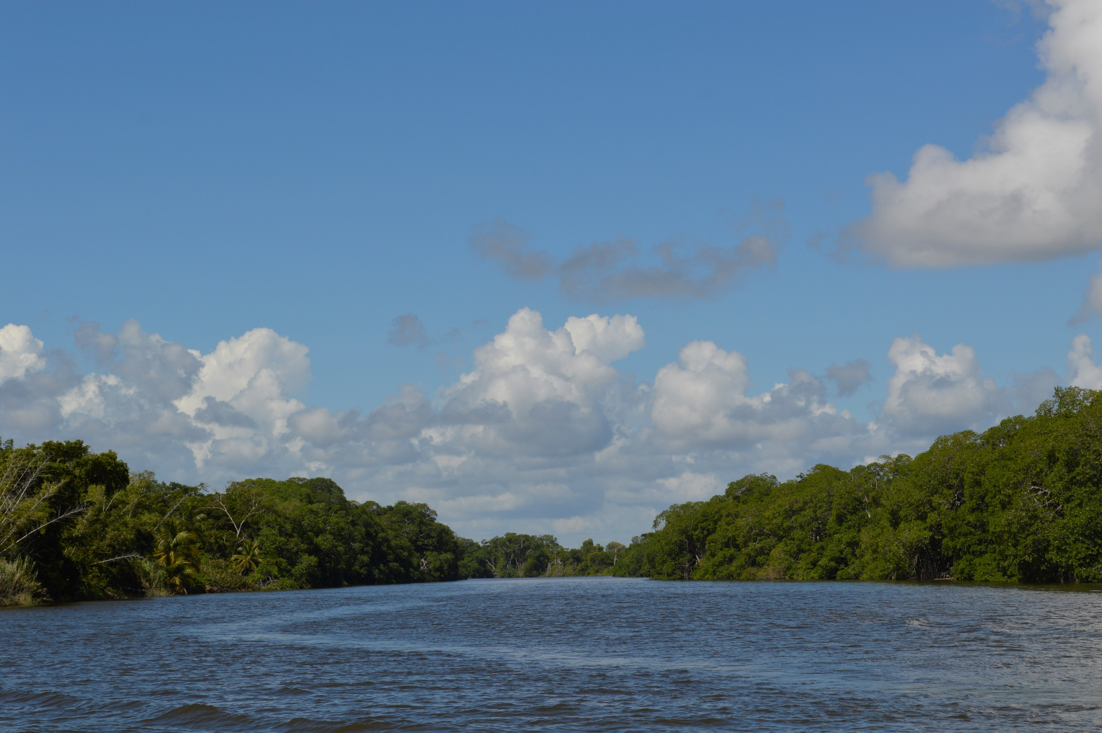









The role of the Belize River in localised coastal ocean acidification
Sarah Cryer^{1,2}
Stacey Felgate², Peter Brown², James Strong², Filipa Carvalho², Terry Wood², Gilbert Andrews³, Samir Rosado³, Arlene Young³, Millie Goddard-Dwyer², Socratis Loucaides², Richard Sanders^{2,4} and Claire Evans²
University of Southampton, 2)National Oceanography Centre, Southampton, 3) Coastal Zone Management Authority and Institute, Belize City, Belize, 4) Norwegian Research Centre and Bjerknes Climate Change Centre
@SarahECryer
#CMEBelize
s.e.cryer@soton.ac.uk

Slide 2




The Coastal Ocean is the transition zone between land and open ocean
RIVER
COASTAL OCEAN
OPEN OCEAN
Sarah Cryer s.e.cryer@soton.ac.uk
@SarahECryer

Slide 3
In the coastal ocean there are multiple sources of CO₂
RIVER
COASTAL OCEAN
OPEN OCEAN
CO₂
?
CO₂
FRESHWATER
CO₂
CO₂
CO₂
OPEN
OCEAN
pCO₂ = ~400-µatm
pH = 8.1
Sarah Cryer s.e.cryer@soton.ac.uk
@SarahECryer

Slide 4

What is controlling pH in a tropical coastal environment?
RIVER
COASTAL OCEAN
OPEN OCEAN
CO₂
?
CO₂
FRESHWATER
CO₂
pH?
CO₂
CO₂
OPEN
OCEAN
ECOSYSTEM METABOLISM
Respiration →
pCO₂ = ~400-µatm
pH = 8.1
$${CH}_{2}O+ O_{2} ↔ {CO}_{2}+ H_{2}O$$
← Photosynthesis
CARBONATE BUFFERING
$${CO}_{2}+ H_{2}O ⇌ H_{2}{CO}_{3 }⇌HCO_{3}^{−}+ H^{+} ⇌{CO}_{3}^{2−}+2H^{+}$$
Sarah Cryer s.e.cryer@soton.ac.uk
@SarahECryer

Slide 5
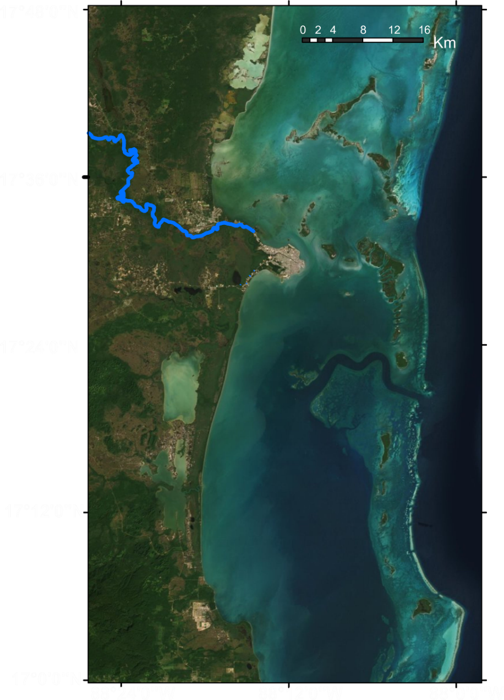
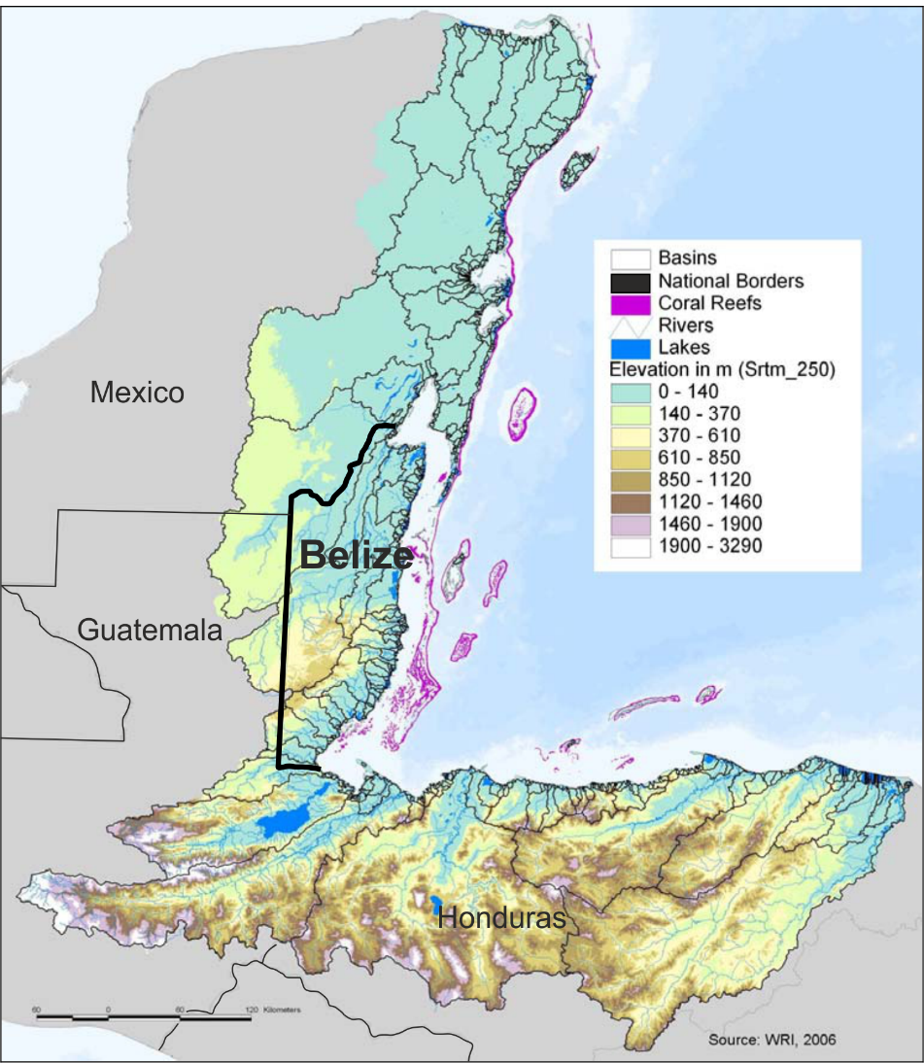
Belize is undergoing increasing rates of deforestation – does this impact their coastal environment?
Continental shelf
Barrier Reef
Belize City
Meso-American
Barrier Reef

Slide 6
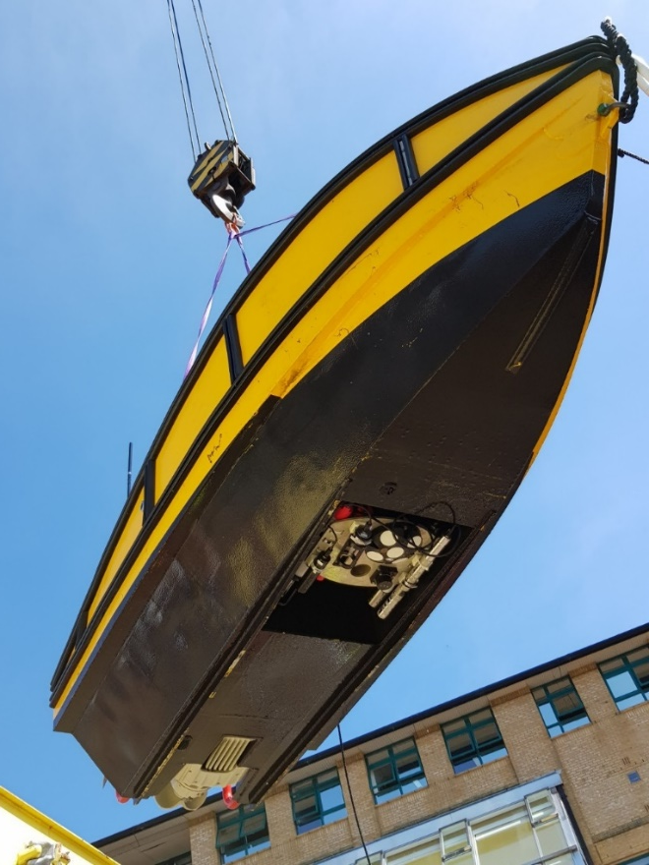
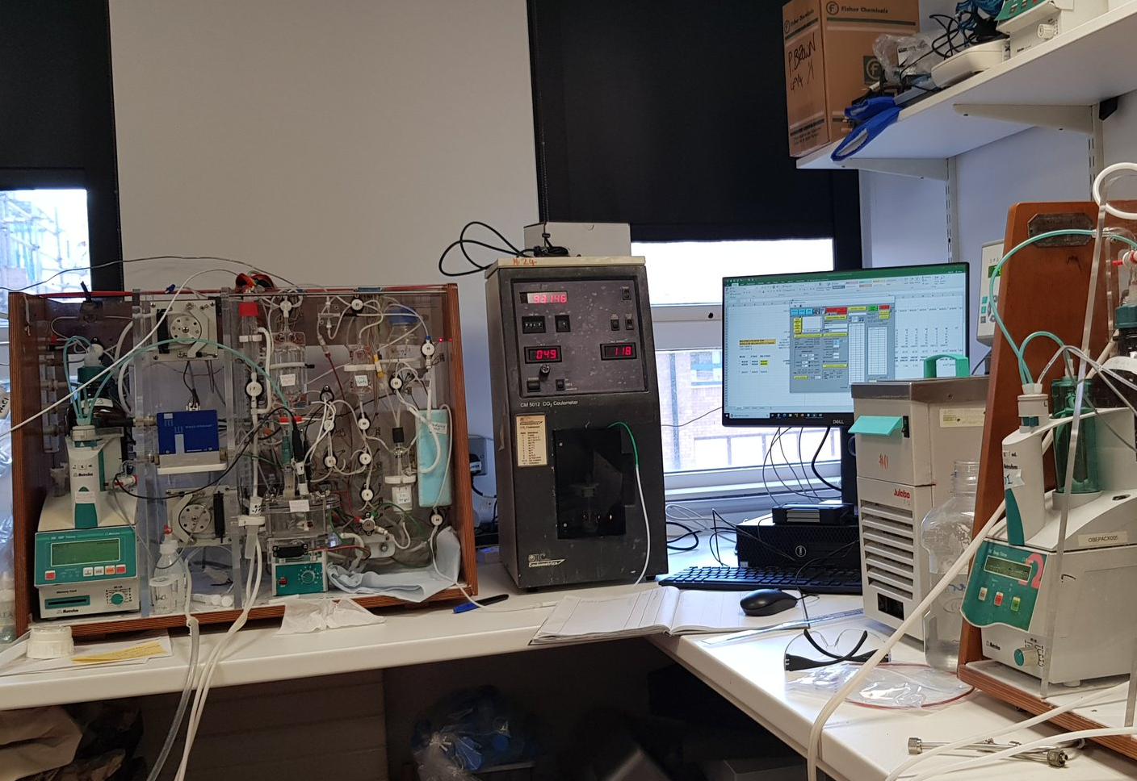
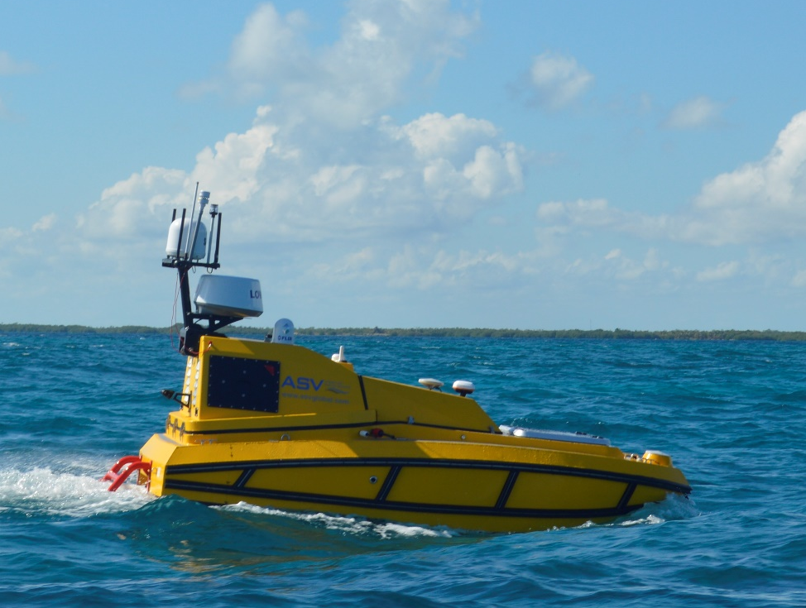
Used a combination of discrete water samples and sensors mounted on an ASV
Sarah Cryer s.e.cryer@soton.ac.uk
@SarahECryer

Slide 7
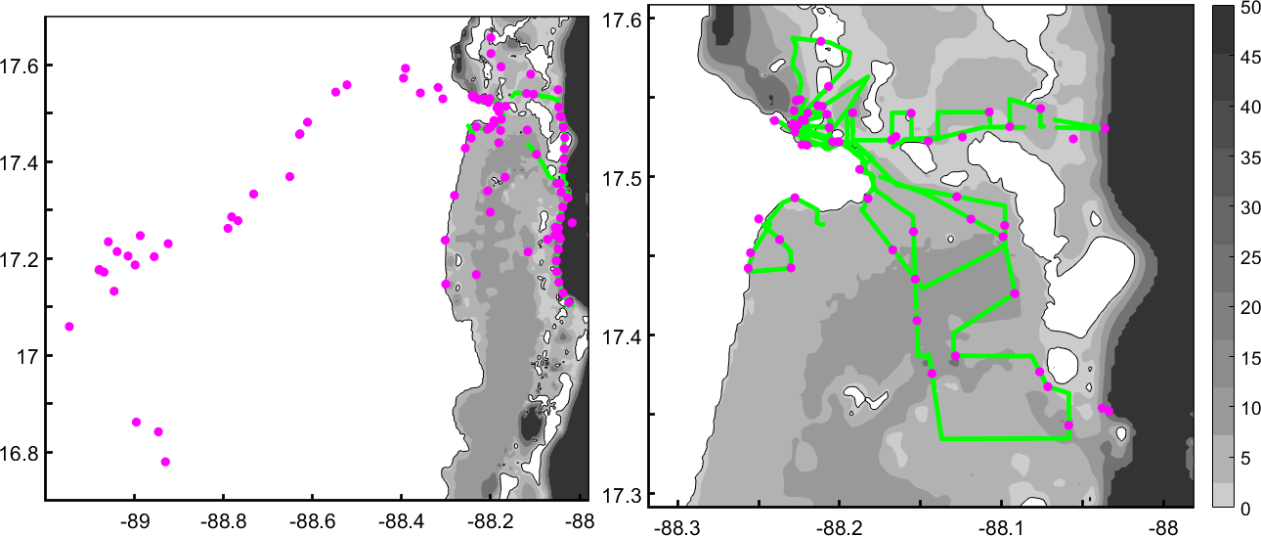
Two Field Campaigns
Oct-Nov 2018
Nov 2019
ASV Tracks
Discrete Samples
ASV Tracks
Discrete Samples
Sarah Cryer s.e.cryer@soton.ac.uk
@SarahECryer

Slide 8
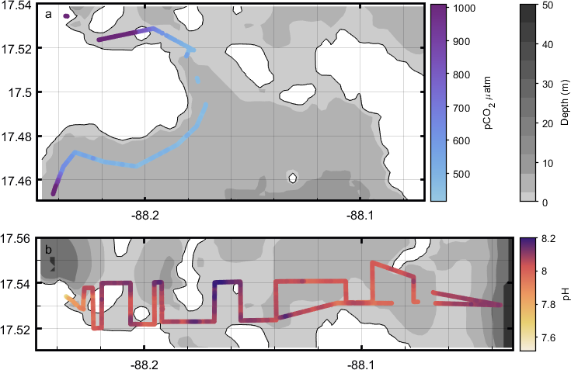
The Belize River is a source of high CO₂, low pH water to the coastal environment.
Sarah Cryer s.e.cryer@soton.ac.uk
@SarahECryer

Slide 9
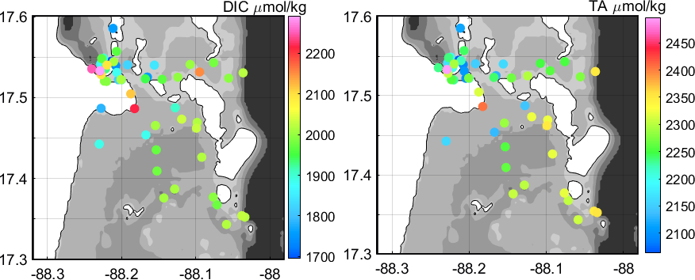
It is not obvious that high pCO₂, low pH water reaches the coral reef.
Sarah Cryer s.e.cryer@soton.ac.uk
@SarahECryer

Slide 10
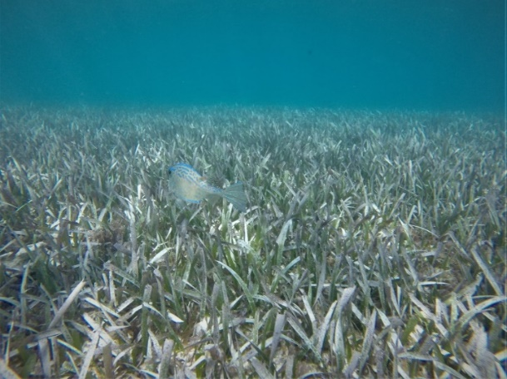
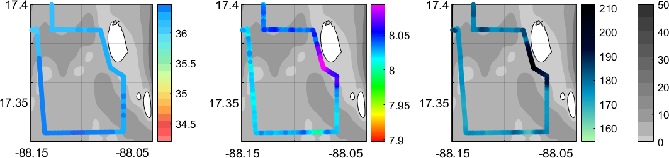
Seagrass is photosynthesising, consuming CO₂ and increasing pH.
Salinity
pH
Oxygen
Salinity
pH
O₂ µmol/kg
Depth (m)
Sarah Cryer s.e.cryer@soton.ac.uk
@SarahECryer

Slide 11
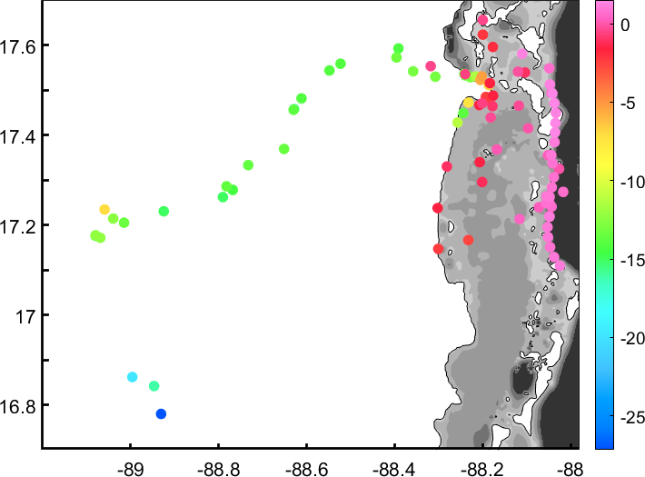
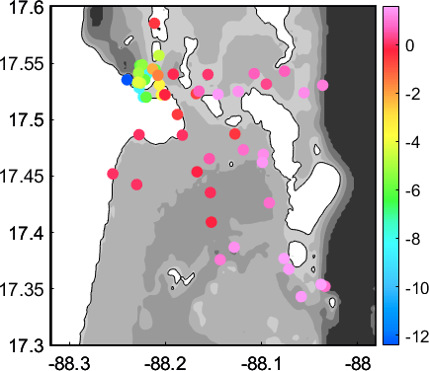
δ¹³C_{DIC} is more negative in the river and more positive at the reef.
+
More ¹³C
δ(‰)
-
Less ¹³C
δ¹³C_{DIC}
δ¹³C_{DIC}
Oct-Nov 2018
Nov 2019
Respiration dominating in the river?
Photosynthesis dominating in coastal ocean?
Sarah Cryer s.e.cryer@soton.ac.uk
@SarahECryer

Slide 12
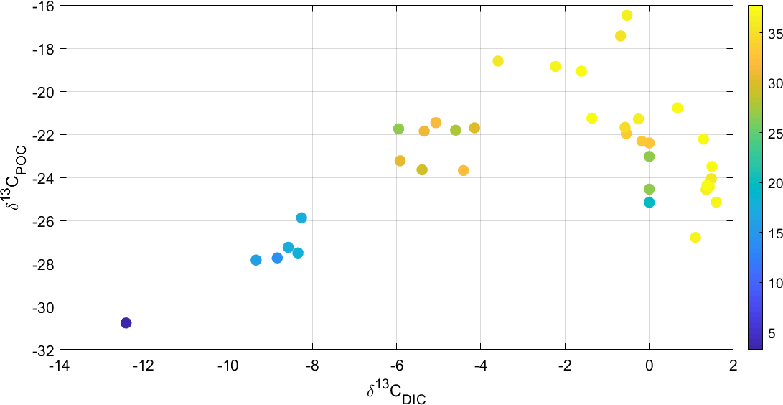
δ¹³C_{DIC} and δ¹³C_{POC} are less negative with increasing salinity.
+
More ¹³C
δ(‰)
-
Less ¹³C
Sarah Cryer s.e.cryer@soton.ac.uk
@SarahECryer

Slide 13
Linear relationship between δ¹³C_{DIC} & δ¹³C_{POC} - some variation potentially from ecosystem metabolism.
Salinity
Sarah Cryer s.e.cryer@soton.ac.uk
@SarahECryer

Slide 14
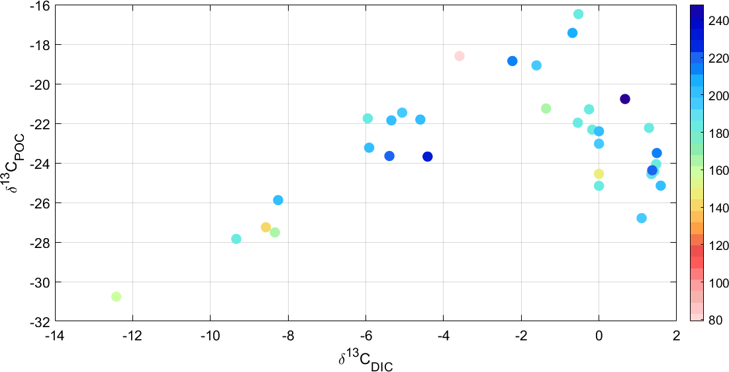
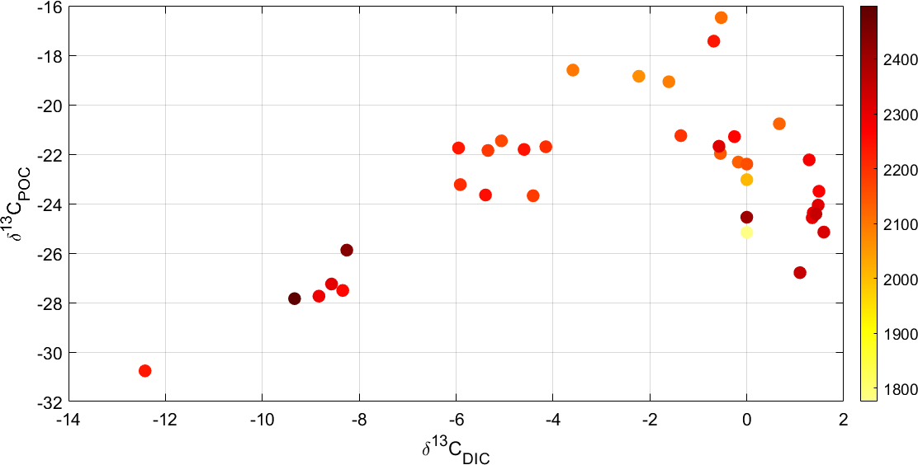
Respiration is potentially driving δ¹³C_{DIC} & δ¹³C_{POC} signature more than photosynthesis.
O₂ µmol/kg
DIC µmol/kg
Sarah Cryer s.e.cryer@soton.ac.uk
@SarahECryer

Slide 15
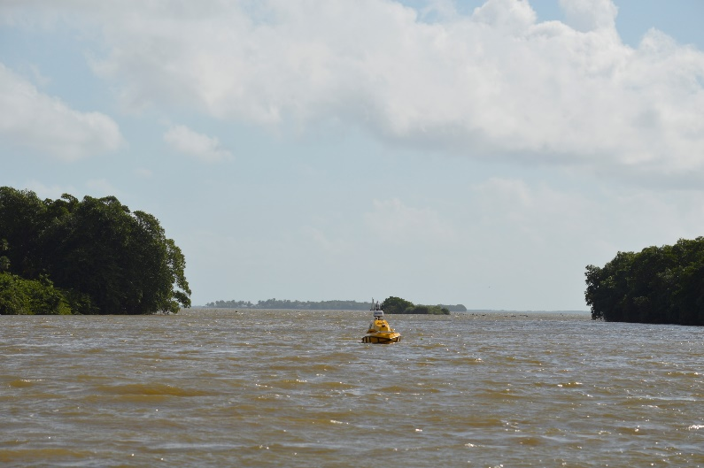

Summary
Belize River is a source of high CO₂, low pH water.
Seagrass removes CO₂ before it reaches the reef.
We identify a range of δ¹³C_{DIC} signatures from - 25‰ (river) to +2.5 ‰ (reef).
δ¹³C_{DIC} does not appear to correlate with O₂ but is more negative with increasing DIC.
Sarah Cryer s.e.cryer@soton.ac.uk
@SarahECryer

Slide 16
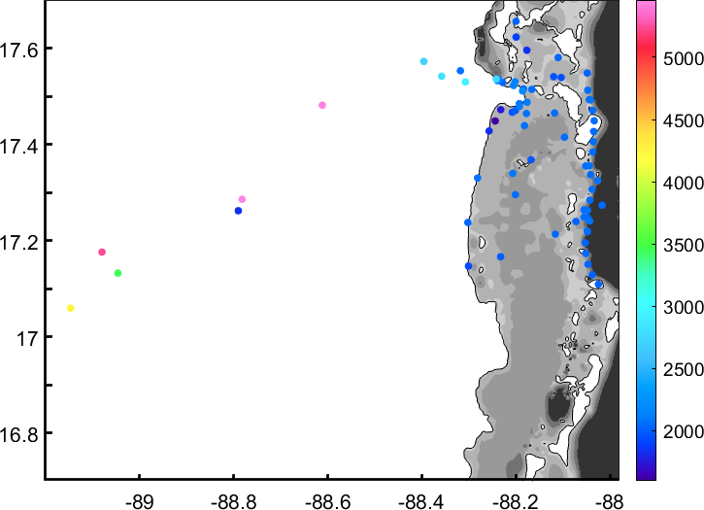
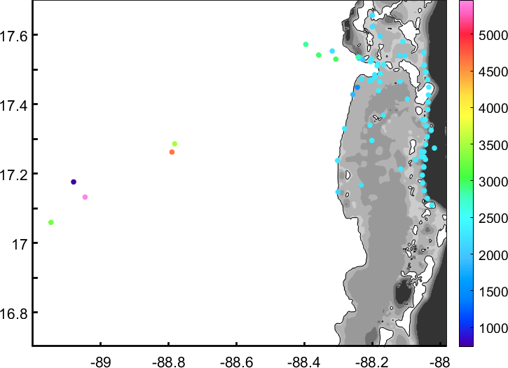
Highest DIC and TA is in river – but very difficult to measure.

Slide 17
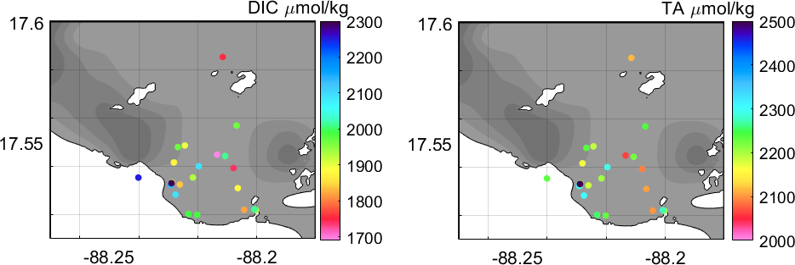
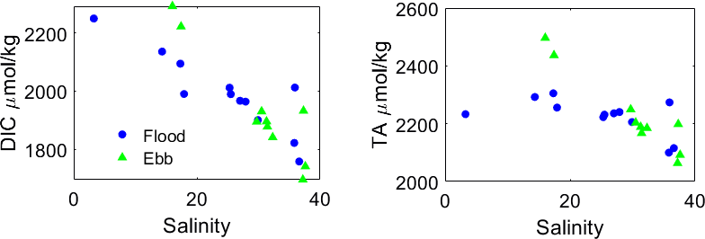
River Mouth
Tide is not greatly affecting the distribution of DIC and TA.
Both DIC and TA decrease with Salinity
Sarah Cryer s.e.cryer@soton.ac.uk
@SarahECryer

