Slide 1
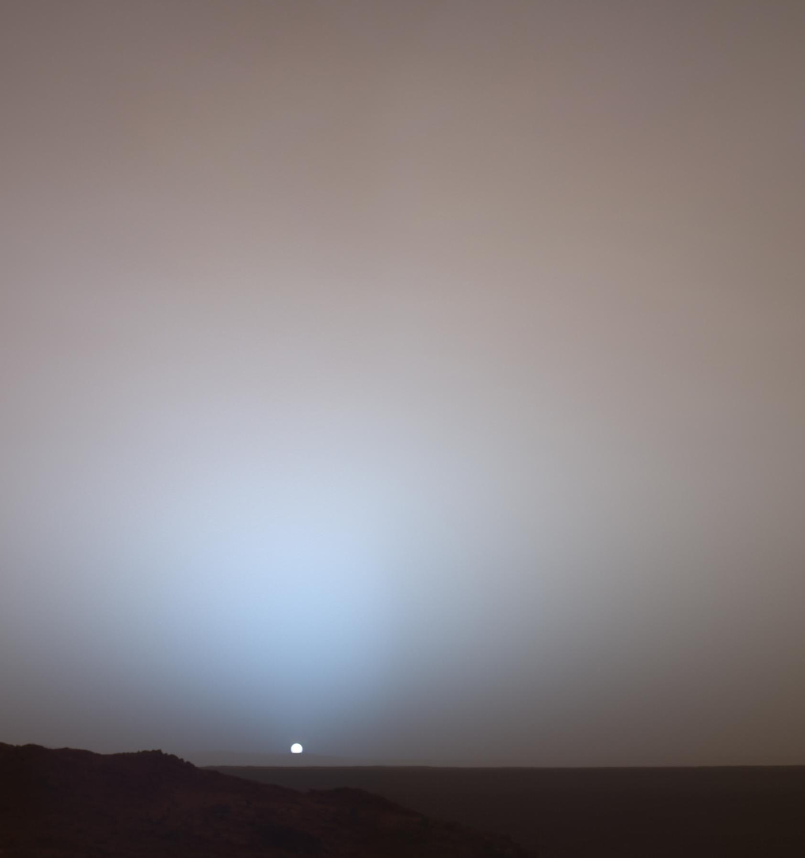




Tool for optimizing the scientific operations and performance of the
Mars lander
Harri Haukka
Development Manager
Space Research and Observation Technologies, Finnish Meteorological Institute
Helsinki, Finland (harri.haukka@fmi.fi)
Photo: NASA
EGU22-4823
https://doi.org/10.5194/egusphere-egu22-4823

Slide 2
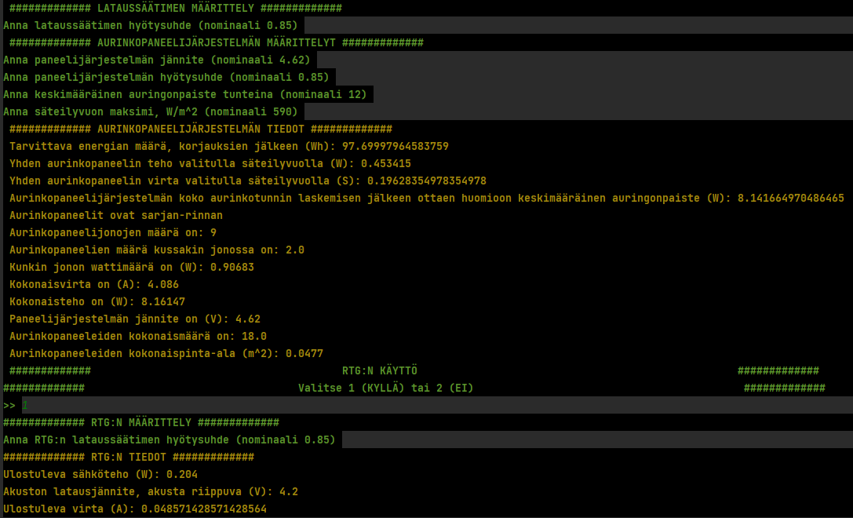
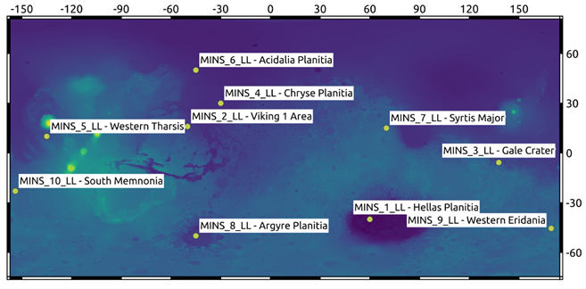
Background of the developed tool
Background for tool (initial problem to be solved): FMI has need for simulating the scientific payload operations and relevant system electronics in any location on Mars on any time of the Martian year.
  Specific goals: Optimize the payload operations in each selected location, define required power system composition (solar panels, batteries, RTG, etc.) within the lander physical limits.
Tool called “HoMES” made with Python and utilizes the Mars Climate Database (5.3) solar irradiance values.
  Fully “tunable” tool (program). All specification can be defined case-by-case (lander, mission, etc.).
  MetNet and MiniPINS (system electronics and payload) as a reference missions
In simulation charts (following slides) the green is the battery level, in red is the solar energy, the blue present solar irradiance level and in yellow the RTG level (when available).
Above: A screenshot of the HoMES tool user interface.
Below: Landing and used simulation locations defined within the Mars MiniPINS project (also valid for the Mars MetNet project).

Slide 3
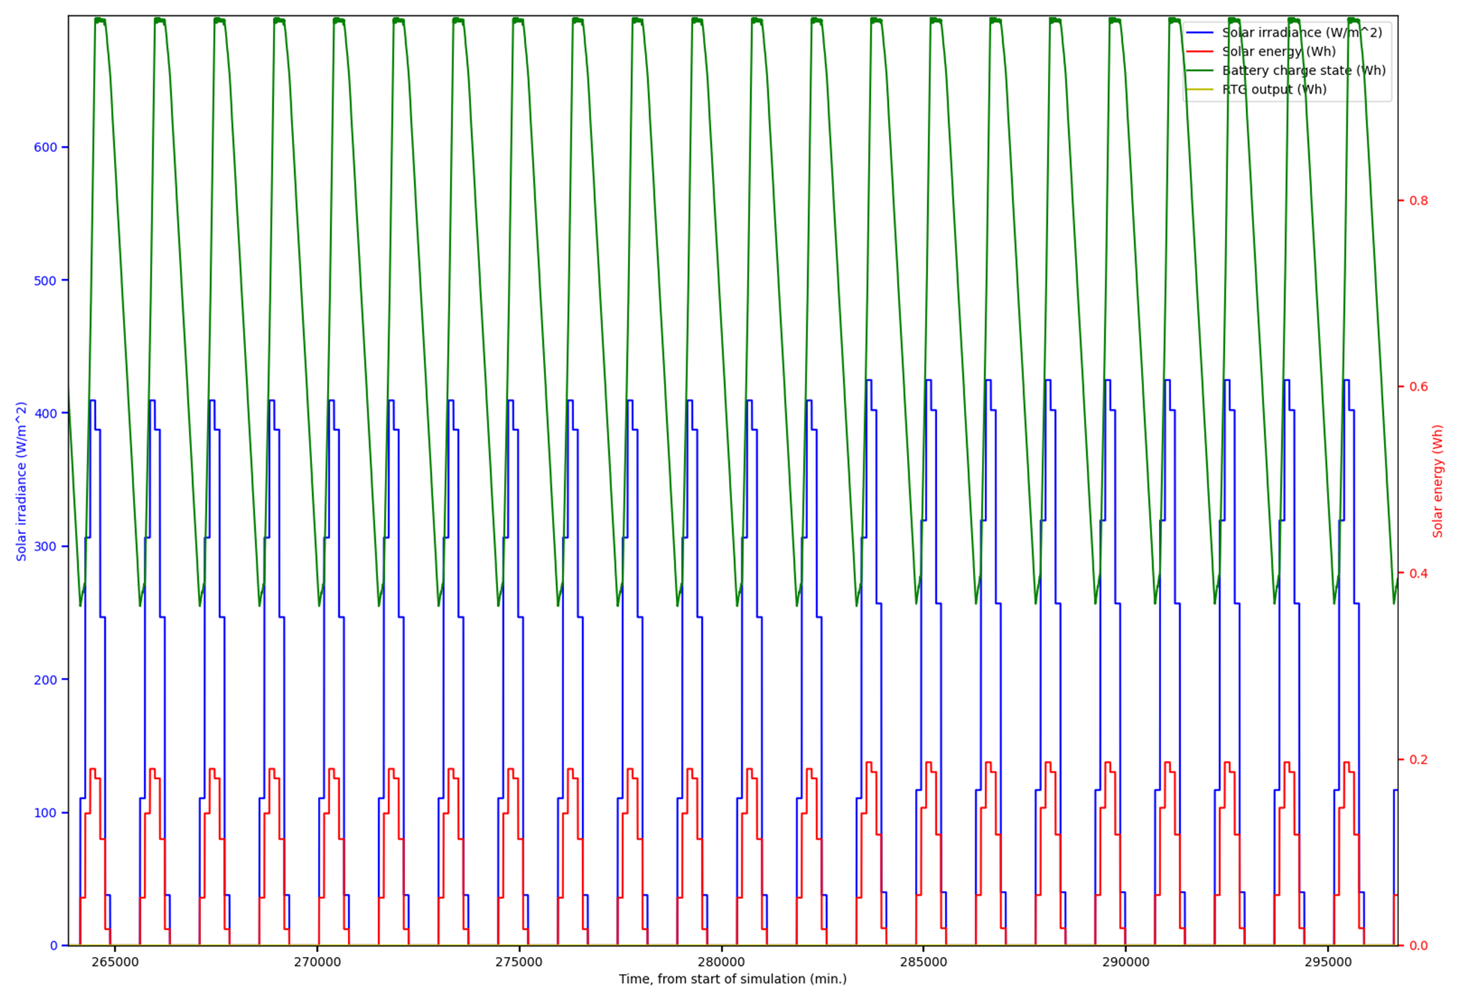
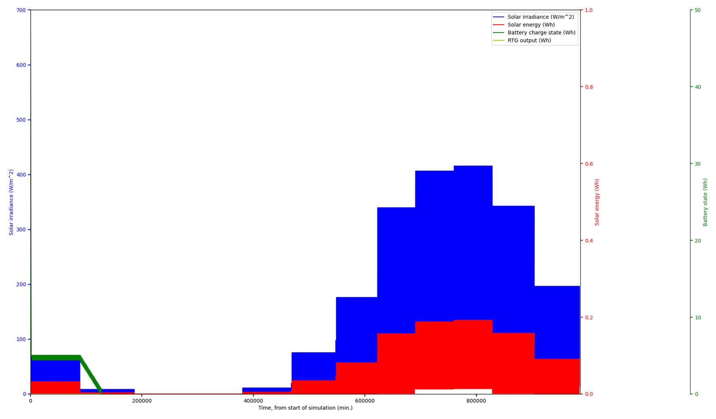
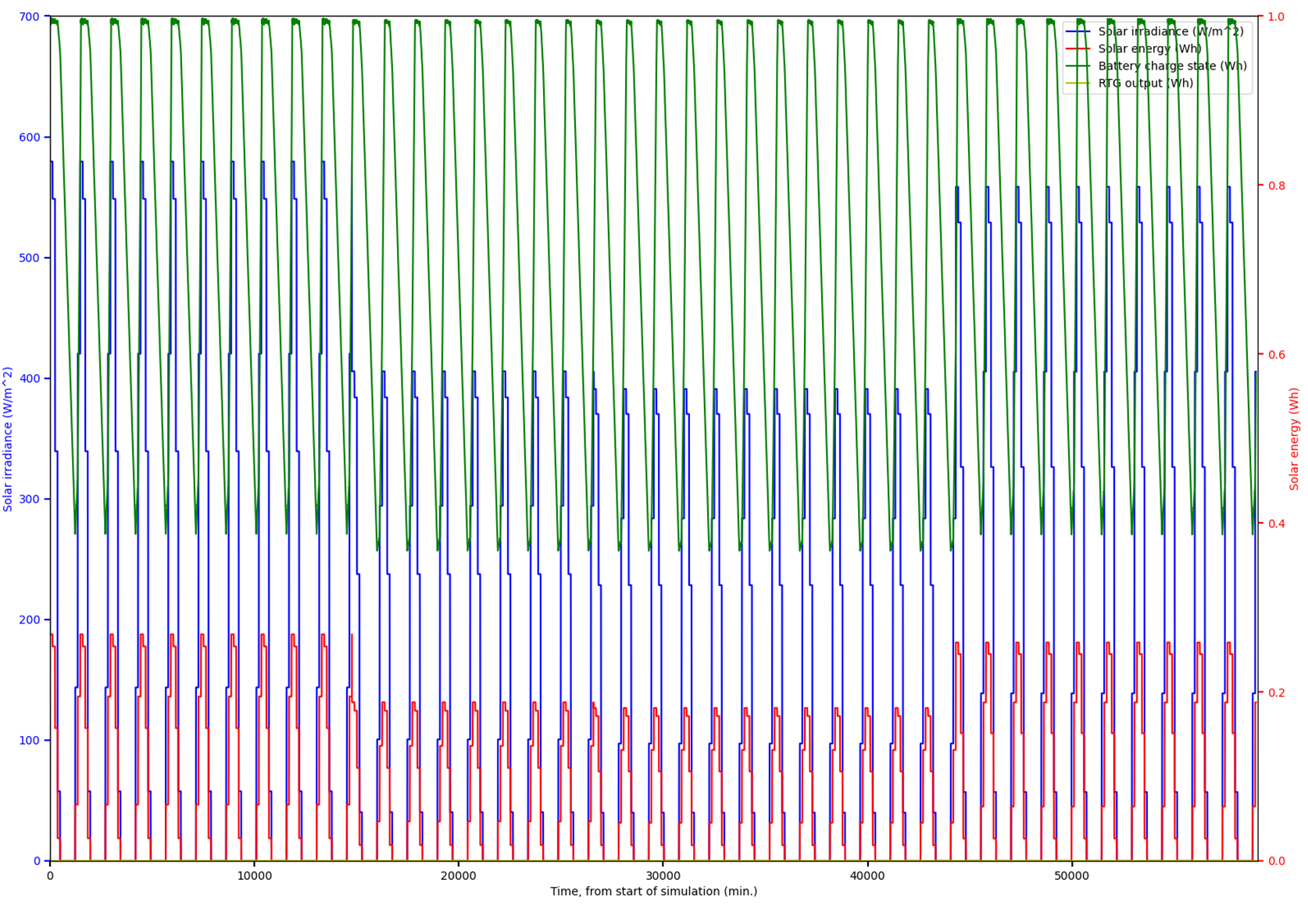
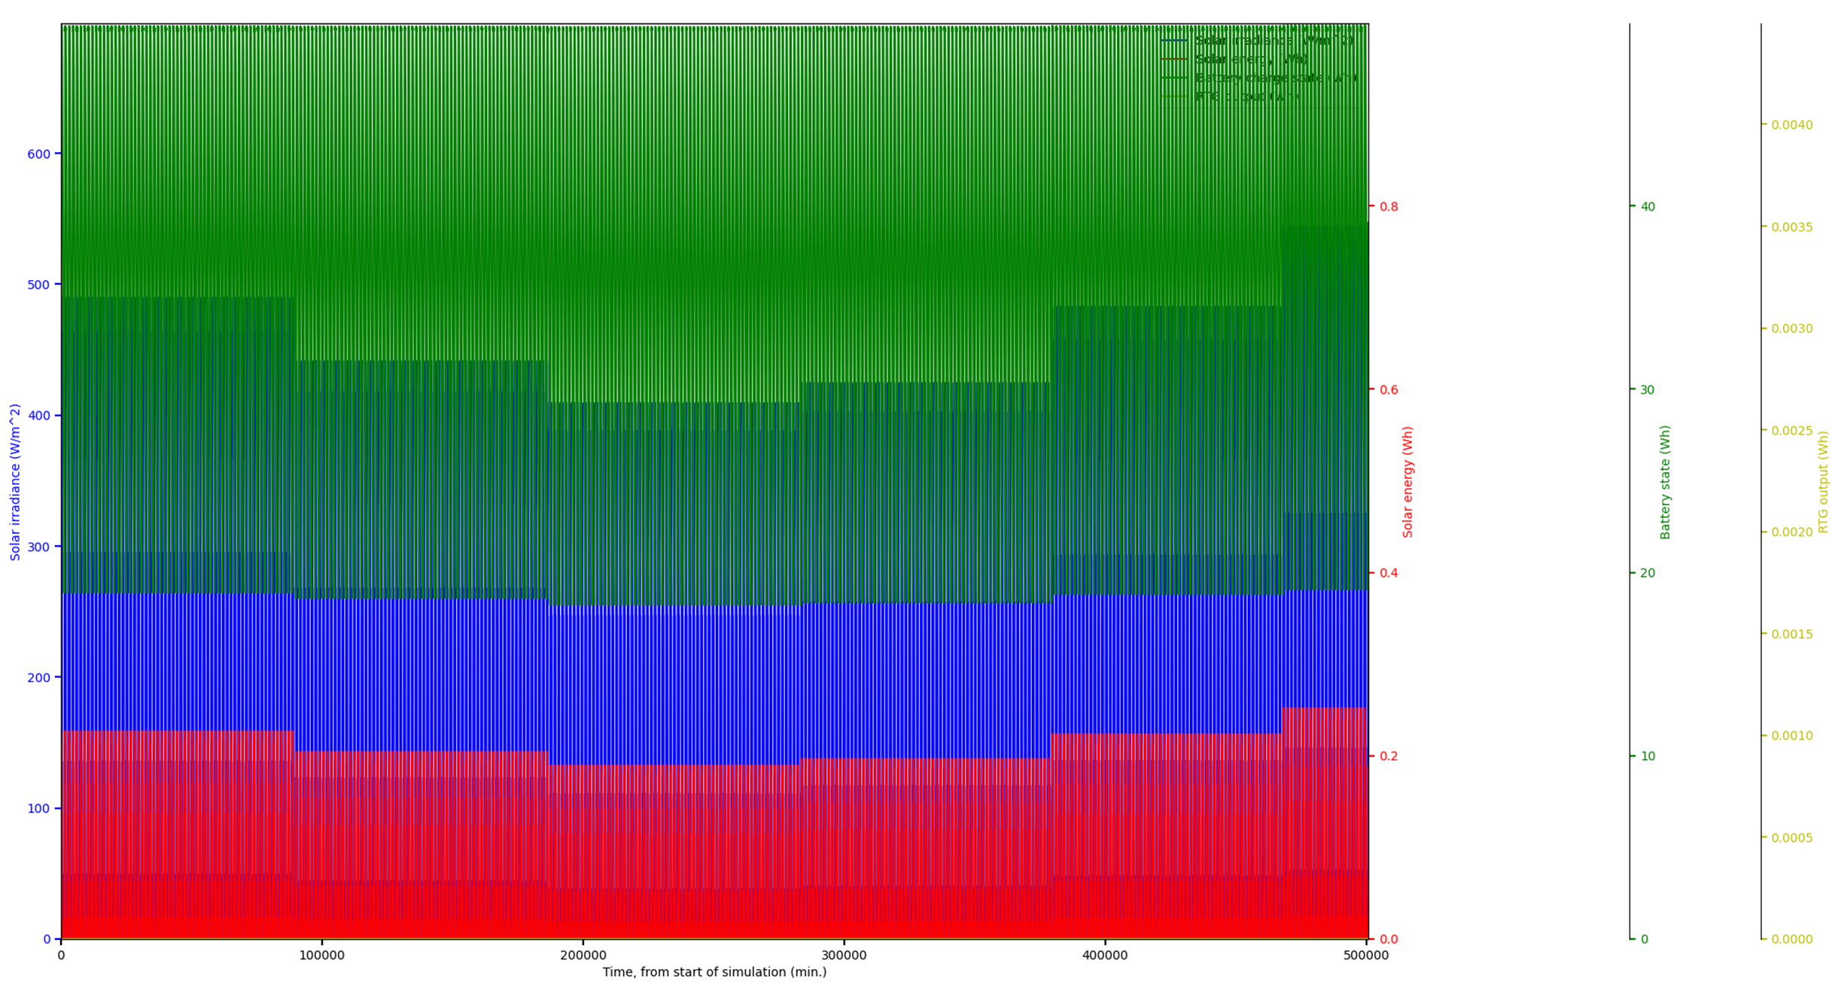
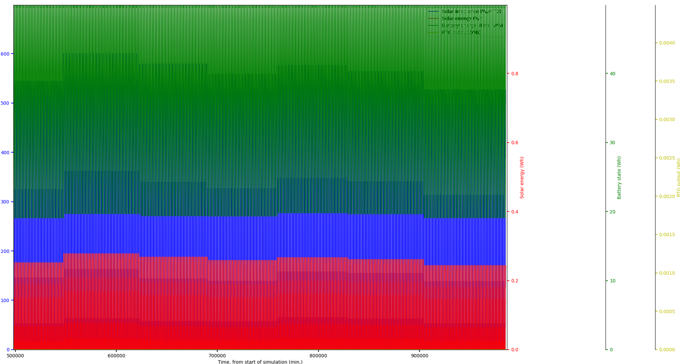
Four studied use cases and simulations
Case A (normal operation):
  Gale; 5S, 140E
    One year on Mars
    With and without RTG
    Normal load
    Data transmission once a day
    (Virtual) dust storms (intensities 30%, 60% and 80%) introduced
  Gale Crater preliminary results:
    Operation will not be interrupted at any point, even without RTG under normal circumstances.
Figure right above: Gale Crater local Winter (Sample)
Figure right below: Virtual dust storm case (summer), 30% reduction in radiation flux, duration 20 days.
Gale crater simulation run. The whole year of Mars.

Slide 4
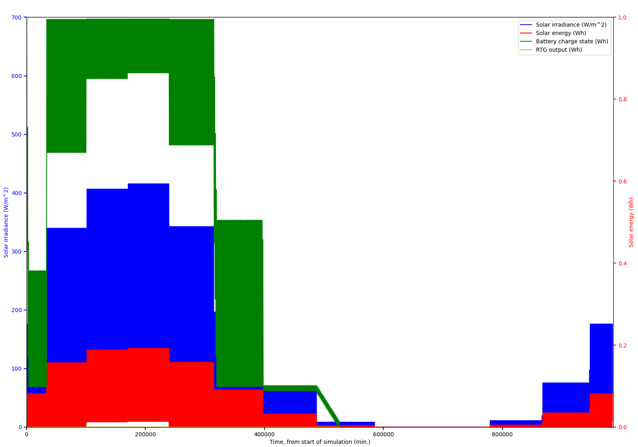
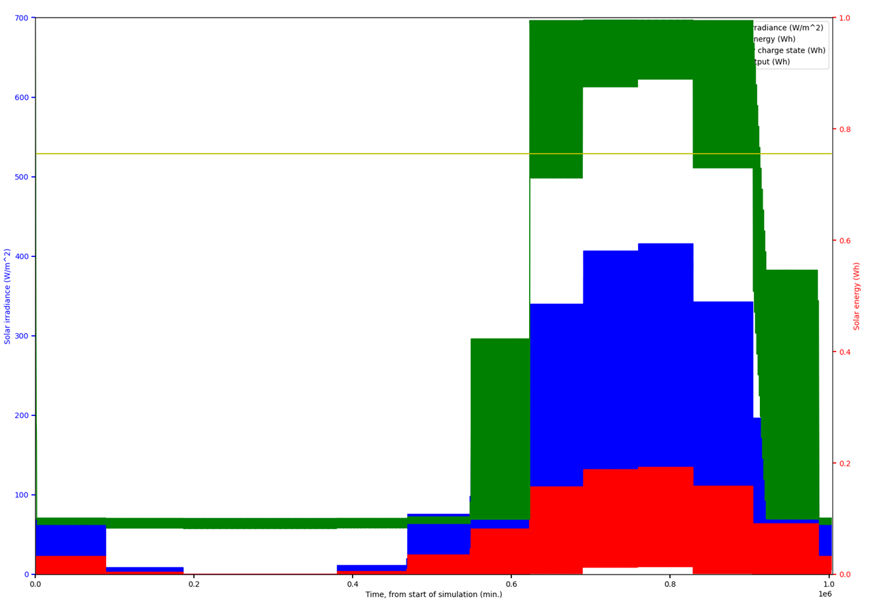
Case B (very low power, few functions mainly in standby mode):
  Mars Polar Lander landing area; 73S, 150 W
    One year on Mars
    With and without RTG
    Special load / cyclogram
    Data transmission once a day (default)
Figure above on the right: Special load, no RTG, start time local “January”.
Figure below on the right: Same as above, except start time, local summer (start)
Figure on the left: Adding RTG to the system will help the lander survive the winter.
In the polar regions, RTG is mandatory if you want to stay operational over the winter.
Note the “Nightless night” phenomenon in summer

Slide 5
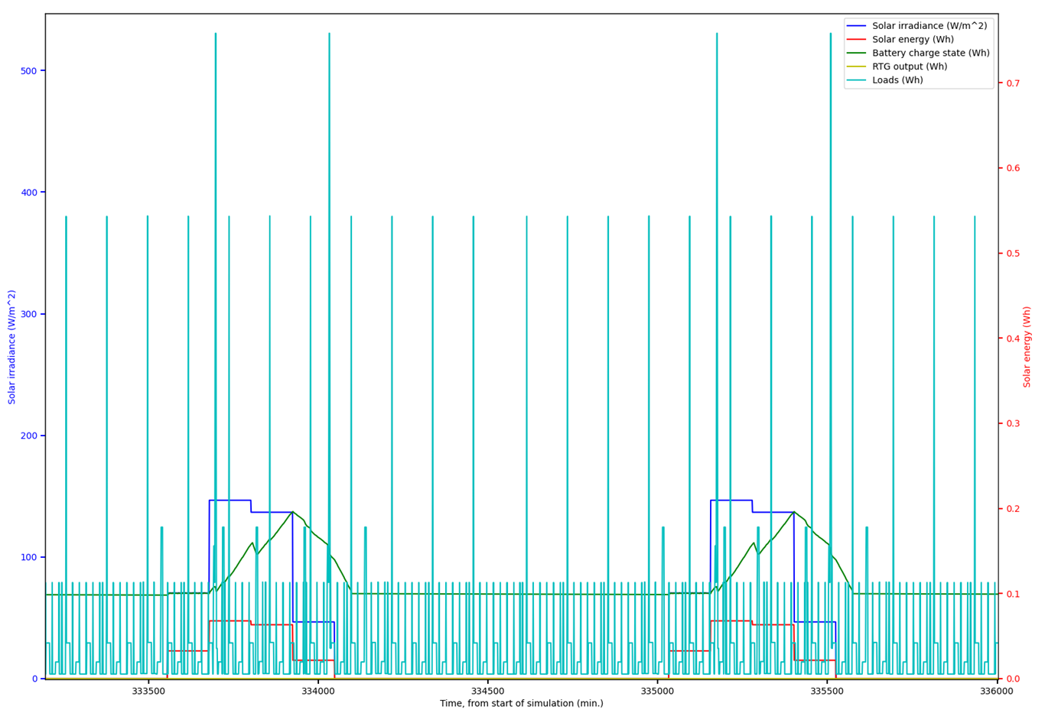
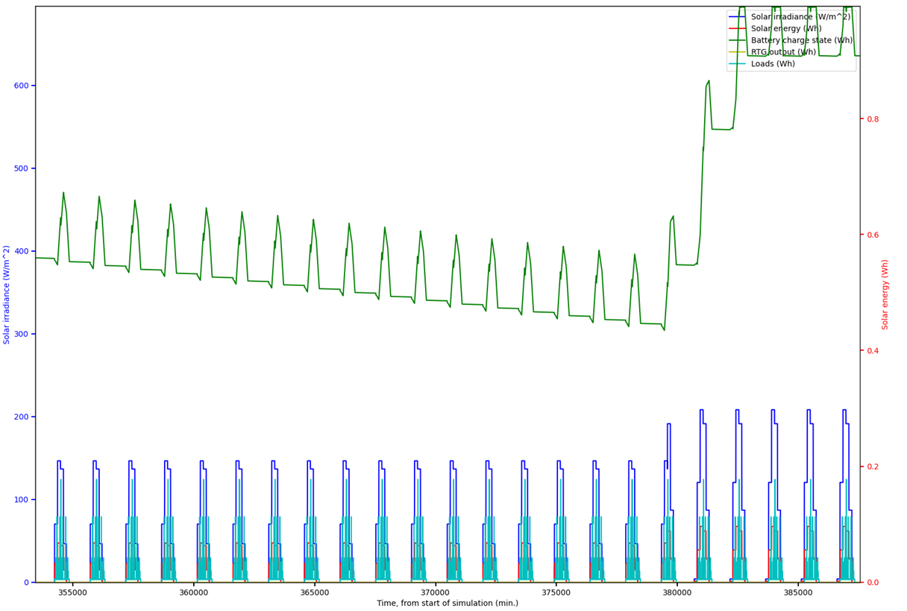
Case C (Low battery power in winter, reduction of functions and focus on data transmission):
  Western Eridania, 45.5S; 169.5E
  In a more detailed analysis, a selected time period from the local wintertime
  Without RTG
  Special load
  Data transmission once a day
Above figure on the right: Normal load during local winter, sample
Below figure on the right: Special operation cyclogram in late local winter
The special operation cyclogram is “tuned” so that the lander can survive the local winter.
Other landing sites must have their own operating cyclograms defined case-by-case.

Slide 6
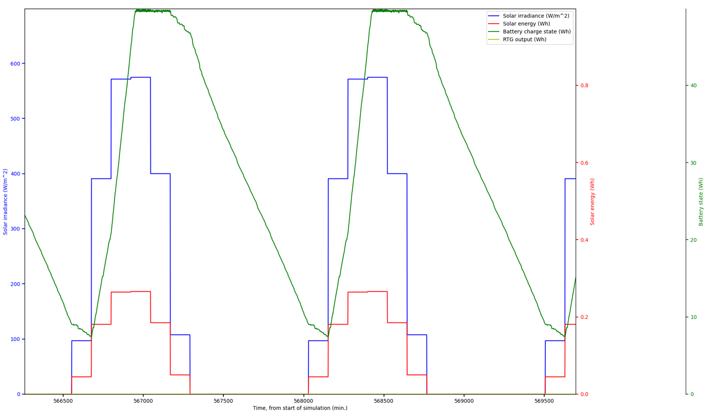
Case D (A lot of energy and possible increase in activities):
  Western Tharsis, south of Olympos Mons; 10N, 135W
    In a more detailed analysis, a selected time period for the local summer
    Without RTG
    Special load
    Data transmission once a day
Figure on the right: A sample of about two days from the local summer.
  The operating cyclogram is designed so that the in the lander does not drift into safety mode (purple line) during the night

Slide 7
Summary and conclusions
The main conclusions from the performed simulations are:
  The lander may operate at least ± 15 degrees on either side of the equator without interruption. In this area, there is no need to use RTG as part of an energy production system.
  In the above-mentioned area, during the local summer, we can use a special operating cyclogram in which the payload of the lander is used considerably more than in the normal situation. In this case, however, the dimensioning of the night-time functions must be taken into account so that the lander does not drift. to the safety mode, where all measurements are stopped.
  During the local winter (15+ degrees), we may have to run a special cyclogram that restricts daytime functions, even stopping nighttime measurements altogether.
  In the north and in the south, the choice of RTG will have to be considered on a case-by-case basis. The work examined the landing area of ​​the Mars Polar Lander and found that near the polar regions, RTG is an absolutely necessary part of the energy production system.
  The only way for a lander to survive over the local winter in the polar regions is to use an RTG that is sufficient to maintain standby.
  For the simulated dust storm cases, we concluded that in a region within ± 15 degrees of the equator, a low intensity (30% decrease in radiation flux) dust storm does not yet critically interfere with the landing operation. If the intensity of the dust storm increases significantly (to more than 60 percent), the settler will drift into safety mode within a few days. Adding RTG to the energy production system will not significantly improve the situation
Irradiances used in this study:
Mars Climate Database 5.3
http://www-mars.lmd.jussieu.fr/
Full thesis (in Finnish):
http://urn.fi/URN:NBN:fi:aalto-2021121910916

