Slide 1
The Ionospheric Alfvén Resonator Observed at Eskdalemuir Observatory
R. M. Hodnett [1], T. K. Yeoman [1], D. M. Wright [1], C. D. Beggan [2]
[1] School of Physics and Astronomy, University of Leicester, UK
[2] British Geological Survey, Edinburgh, UK
rmh38@leicester.ac.uk

Slide 2
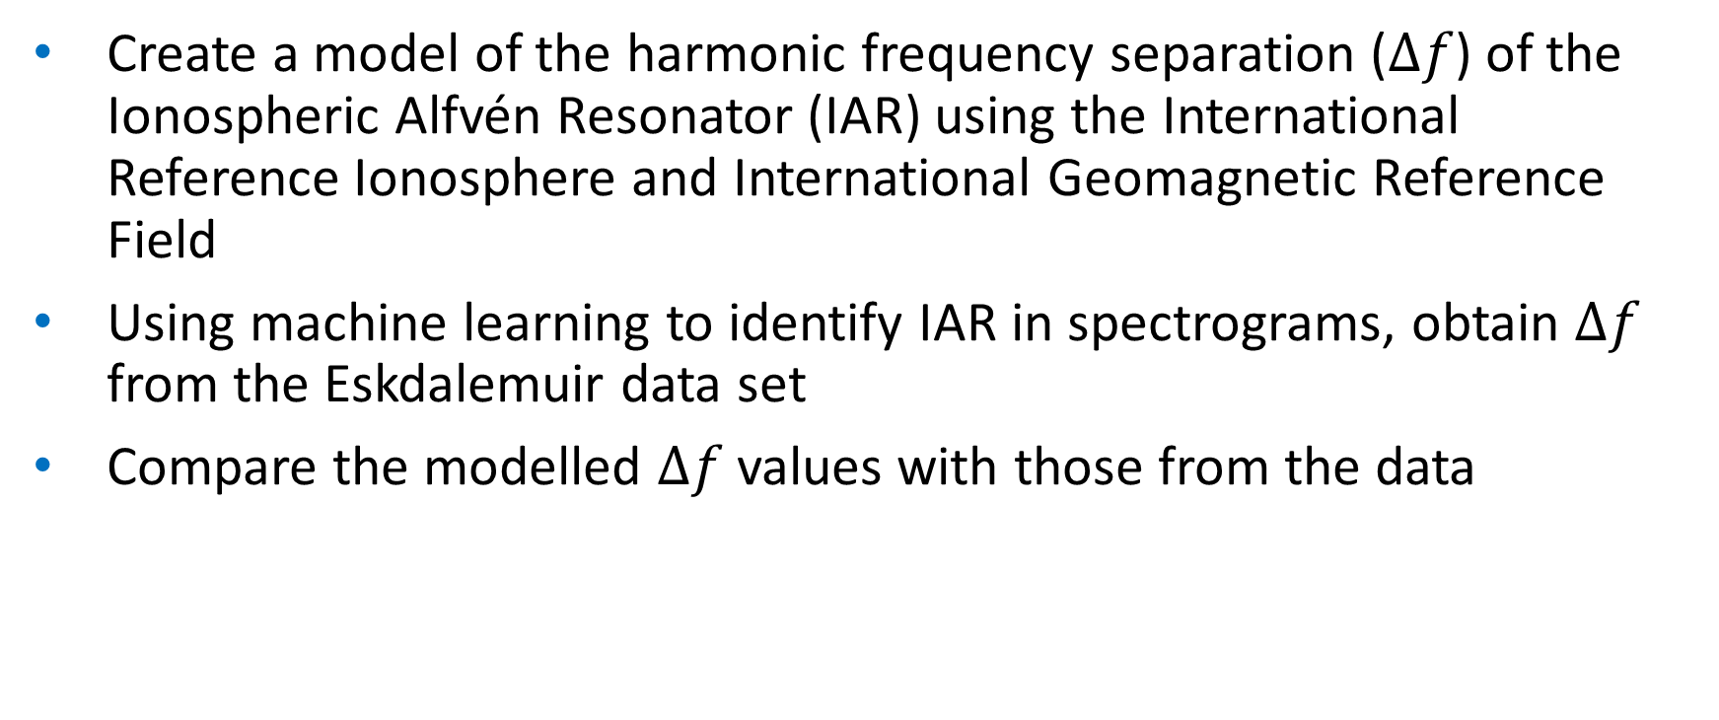
Aims
Create a model of the harmonic frequency separation ($∆f$) of the Ionospheric Alfvén Resonator (IAR) using the International Reference Ionosphere and International Geomagnetic Reference Field
Using machine learning to identify IAR in spectrograms, obtain $∆f$ from the Eskdalemuir data set
Compare the modelled $∆f$ values with those from the data

Slide 3
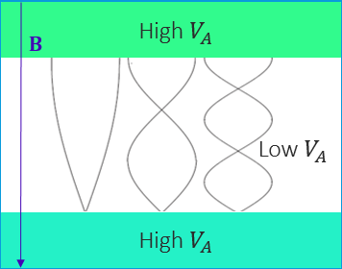
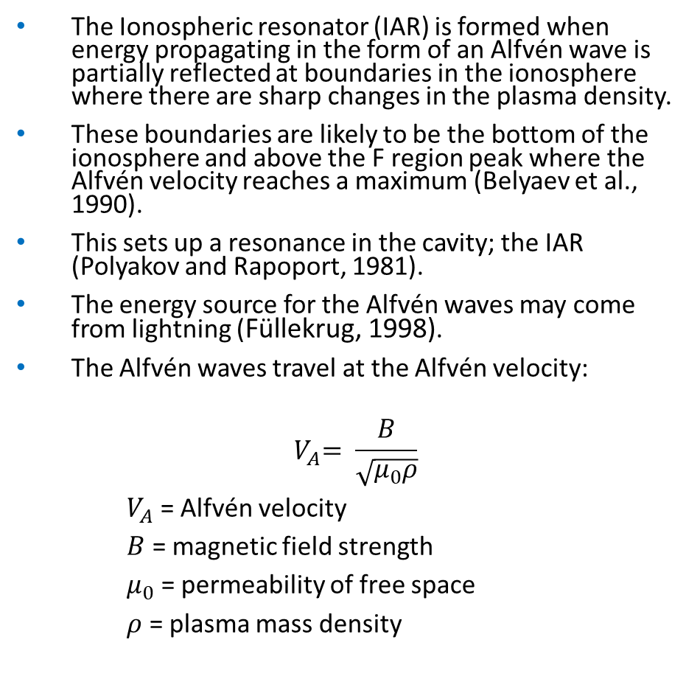
Ionospheric Alfvén Resonances (IAR) - background
The Ionospheric resonator (IAR) is formed when energy propagating in the form of an Alfvén wave is partially reflected at boundaries in the ionosphere where there are sharp changes in the plasma density.
These boundaries are likely to be the bottom of the ionosphere and above the F region peak where the Alfvén velocity reaches a maximum (Belyaev et al., 1990).
This sets up a resonance in the cavity; the IAR (Polyakov and Rapoport, 1981).
The energy source for the Alfvén waves may come from lightning (Füllekrug, 1998).
The Alfvén waves travel at the Alfvén velocity:
$${ V}_{A}= \frac{B}{\sqrt{μ_{0}ρ}}$$
$V_{A}$ = Alfvén velocity
$B$ = magnetic field strength
$μ_{0}$ = permeability of free space
$ρ$ = plasma mass density
Standing waves in the IAR cavity, adapted from Hebden et al. (2005).

Slide 4
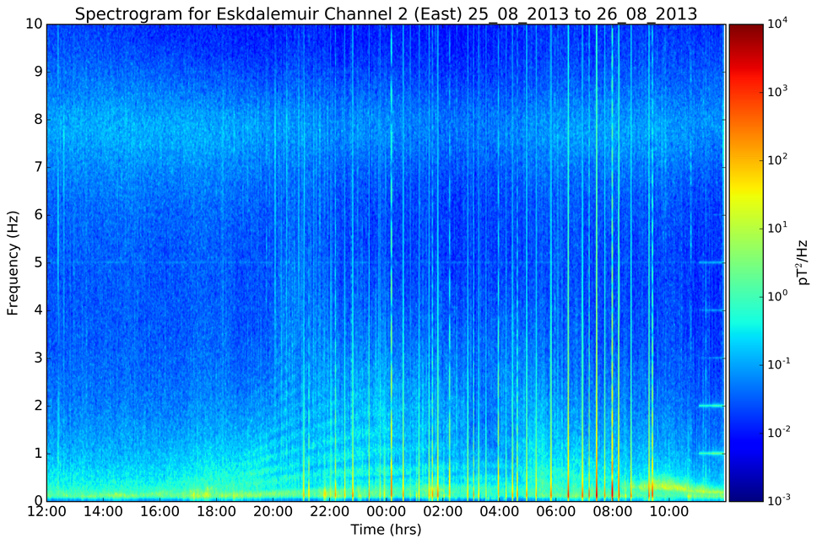
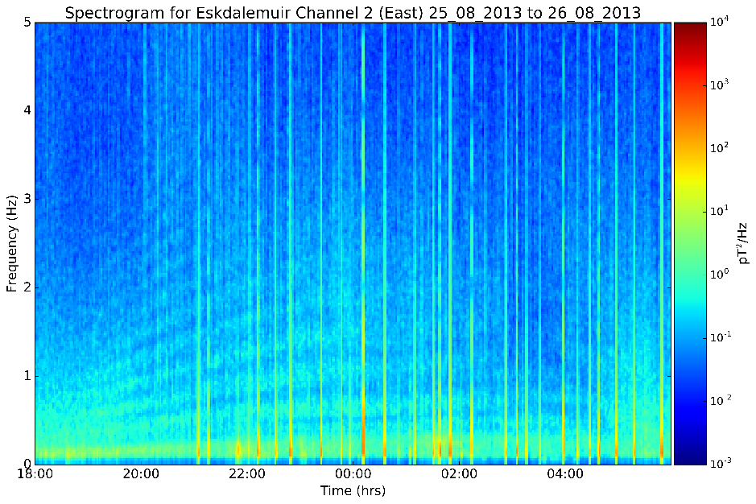

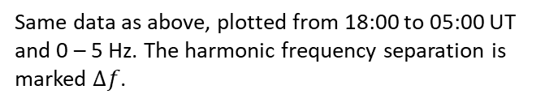
Data
The data (BGS, 2022) comes from Eskdalemuir magnetic observatory which is located in Scotland, UK. It is a British Geological Survey site and has two induction coil magnetometers, orientated north – south (Channel 1) and east – west (Channel 2), relative to magnetic north. (BGS Geomagnetism, 2022).
The IAR appear as discrete spectral bands in the spectrogram. The bands correlate with the different harmonics. The frequencies usually range from 0.5 – 10 Hz. They are most visible in the spectrograms during the nighttime hours.
The harmonic frequency separation is the distance between two harmonics at a given time. This is a useful property as it shows the frequency variation of the IAR.
Latitude | 55.314° N
Longitude | 356.794° E
Geomagnetic Latitude | 57.546° N
Geomagnetic Longitude | 83.279° E
L- Shell | 3.46
Spectrogram from 12:00 UT on 25/08/2013 to 12:00 UT on 26/08/2013. The IAR are appear in the red box, occurring from around 18:00 – 05:00 UT.
Location of Eskdalemuir magnetic observatory.
$$∆f$$
Same data as above, plotted from 18:00 to 05:00 UT and 0 – 5 Hz. The harmonic frequency separation is marked $∆f$.

Slide 5



Modelling the IAR
We have made a model of the harmonic frequency separation ($∆f$) of the IAR at Eskdalemuir, which can then be compared with the $∆f$ obtained from the model.
To do this, we found the time of flight for the Alfvén wave to travel up and down the IAR cavity, and hence the frequency.
The Alfvén velocity is not constant due to changing plasma mass density, and so we found $V_{A}$ for every $dl$ up the field line above Eskdalemuir.
The magnetic field strength is found from the International Geomagnetic Reference Field 2015 model (IGRF, 2022).
The plasma mass density is found from the International Reference Ionosphere model (IRI, 2022).
$V_{A}$ = Alfvén velocity
$B$ = magnetic field strength
$μ_{0}$ = permeability of free space
$ρ$ = plasma mass density
$T_{f}$ = time of flight
$a/b$ = the bottom/top boundary IAR cavity
$l$ = size of the cavity
$$V_{A}= \frac{B}{\sqrt{μ_{0}ρ}}$$
$${ T}_{f}=2 \int_{a}^{b}{\frac{1}{V_{A}}} dl$$
$$∆f= \frac{1}{T_{f}}$$

Slide 6
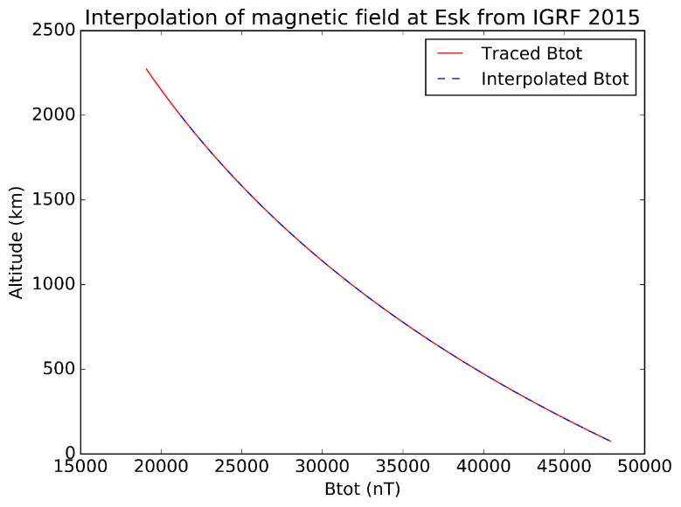
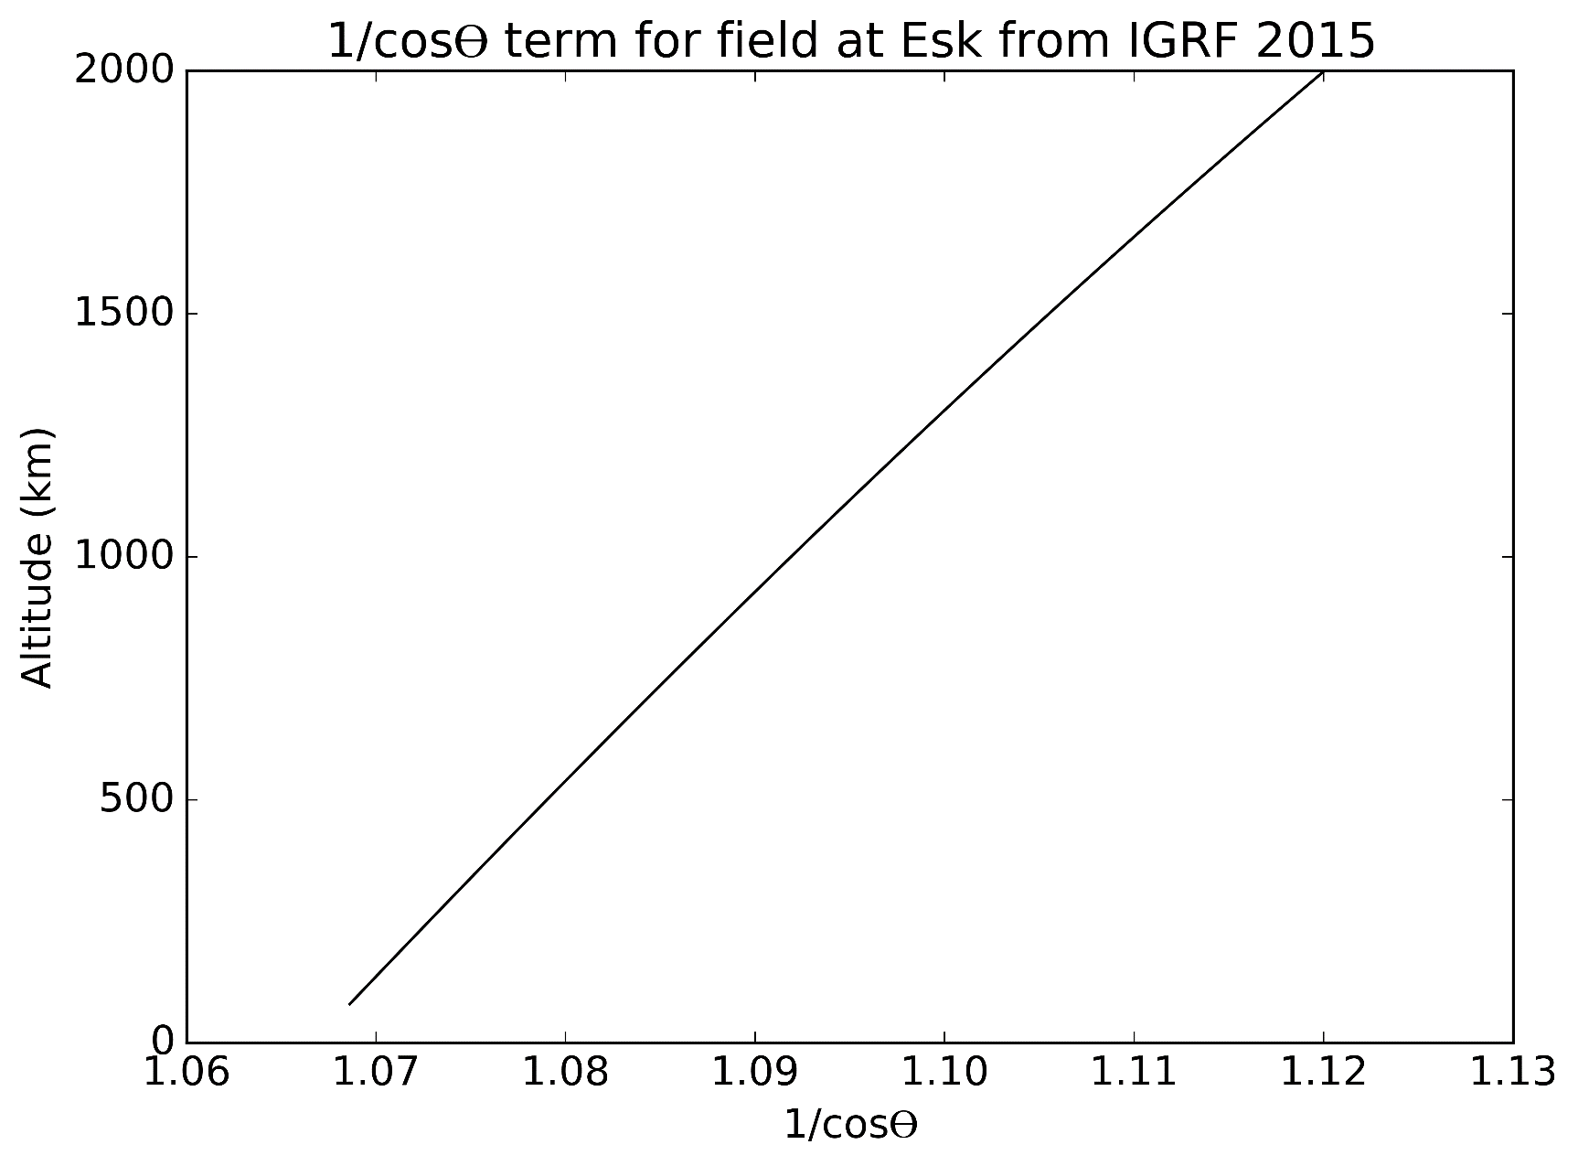

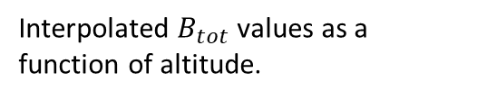


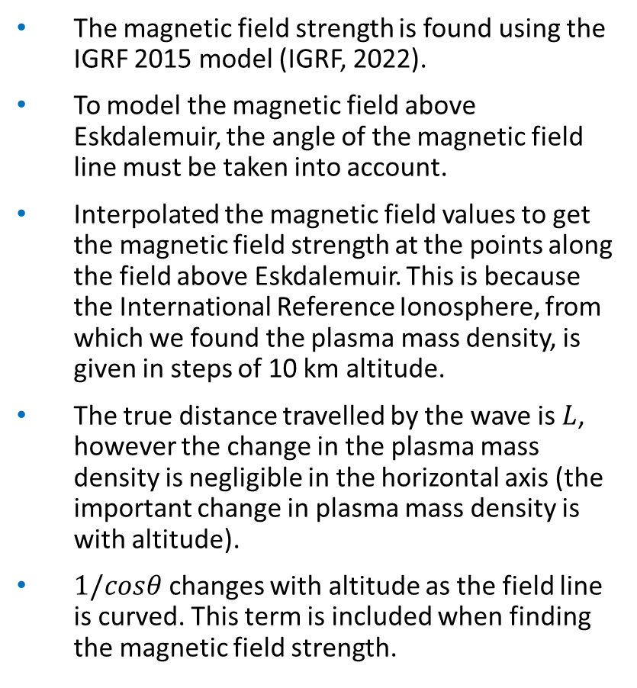


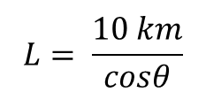

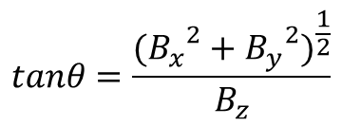
Modelling the IAR: Magnetic Field
The magnetic field strength is found using the IGRF 2015 model (IGRF, 2022).
To model the magnetic field above Eskdalemuir, the angle of the magnetic field line must be taken into account.
Interpolated the magnetic field values to get the magnetic field strength at the points along the field above Eskdalemuir. This is because the International Reference Ionosphere, from which we found the plasma mass density, is given in steps of 10 km altitude.
The true distance travelled by the wave is $L$, however the change in the plasma mass density is negligible in the horizontal axis (the important change in plasma mass density is with altitude).
$1/cosθ$ changes with altitude as the field line is curved. This term is included when finding the magnetic field strength.
$$θ$$
$$θ$$
$$B_{tot}$$
$$L$$
$$B_{z}$$
$$10 km$$
$${({B_{x}}^{2}+{B_{y}}^{2})}^{\frac{1}{2}}$$
Esk
$$L= \frac{10 km}{cosθ}$$
$$tanθ=\frac{{({B_{x}}^{2}+{B_{y}}^{2})}^{\frac{1}{2}}}{B_{z}}$$
Interpolated $B_{tot}$ values as a function of altitude.
1/𝑐𝑜𝑠𝜃 term as a function of altitude.

Slide 7
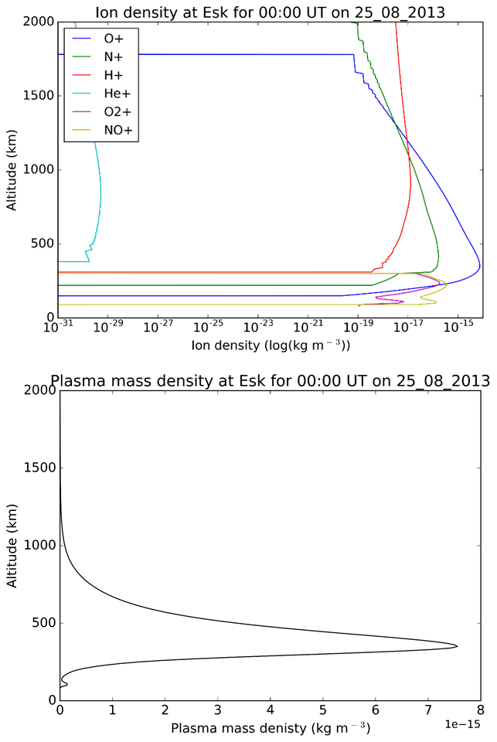
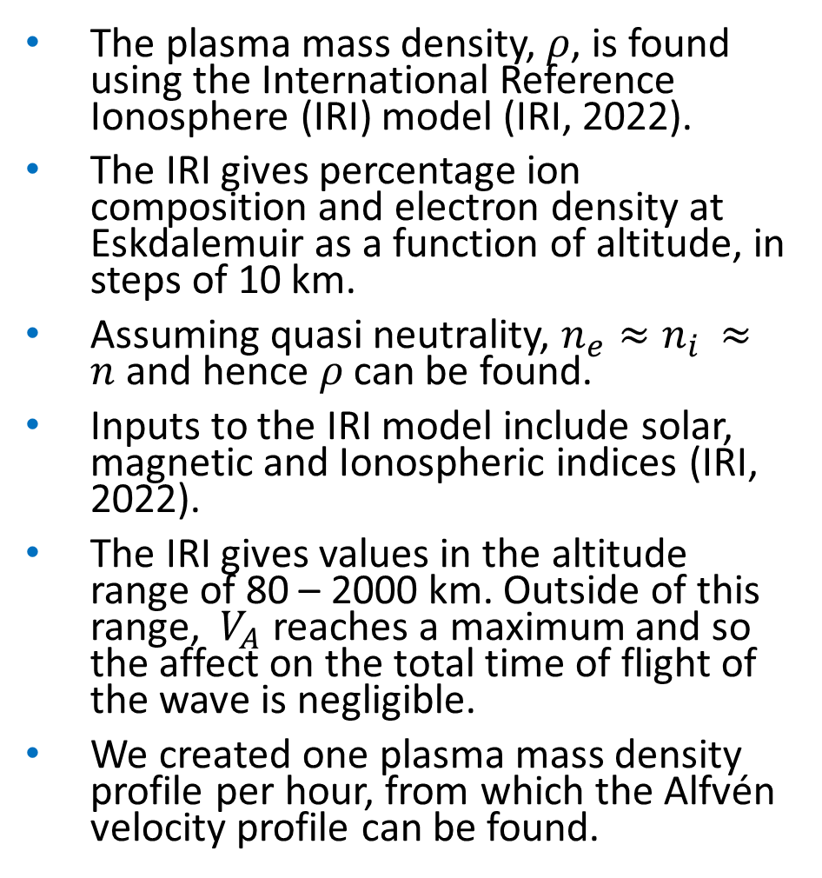
Modelling the IAR: Plasma mass density
The plasma mass density, 𝜌, is found using the International Reference Ionosphere (IRI) model (IRI, 2022).
The IRI gives percentage ion composition and electron density at Eskdalemuir as a function of altitude, in steps of 10 km.
Assuming quasi neutrality, $n_{e}≈n_{i }≈n$ and hence 𝜌 can be found.
Inputs to the IRI model include solar, magnetic and Ionospheric indices (IRI, 2022).
The IRI gives values in the altitude range of 80 – 2000 km. Outside of this range, ${ V}_{A}$ reaches a maximum and so the affect on the total time of flight of the wave is negligible.
We created one plasma mass density profile per hour, from which the Alfvén velocity profile can be found.
Ion density profiles for 00:00 UT 25/08/2013. Oxygen ions dominate the density.
Plasma mass density profile for 00:00 UT 25/08/2013. The peak in density corresponds to the F region peak.

Slide 8
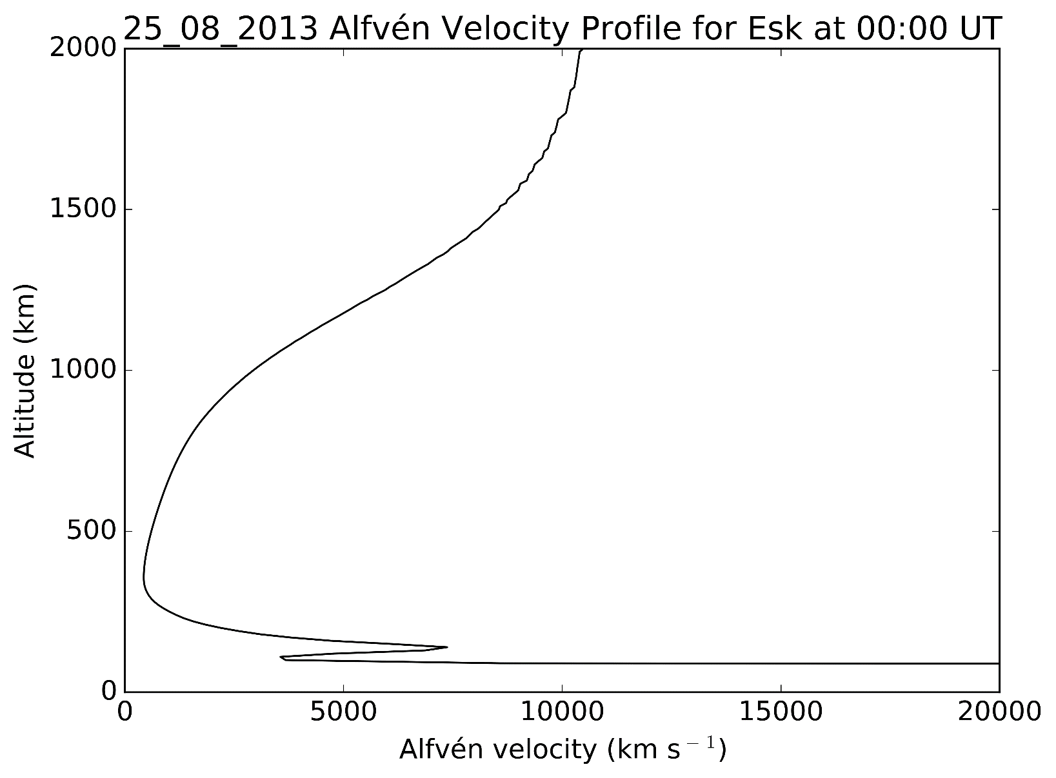
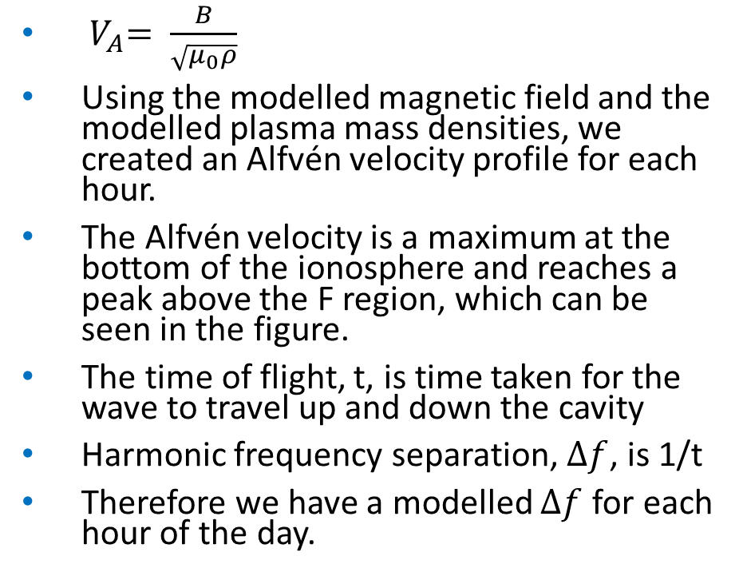

Modelling the IAR: Alfvén Velocity and $∆f$
${ V}_{A}= \frac{B}{\sqrt{μ_{0}ρ}}$
Using the modelled magnetic field and the modelled plasma mass densities, we created an Alfvén velocity profile for each hour.
The Alfvén velocity is a maximum at the bottom of the ionosphere and reaches a peak above the F region, which can be seen in the figure.
The time of flight, t, is time taken for the wave to travel up and down the cavity
Harmonic frequency separation, $∆f$, is 1/t
Therefore we have a modelled $∆f$ for each hour of the day.
Alfvén velocity profile for 23/08/2013 00:00 UT.

Slide 9
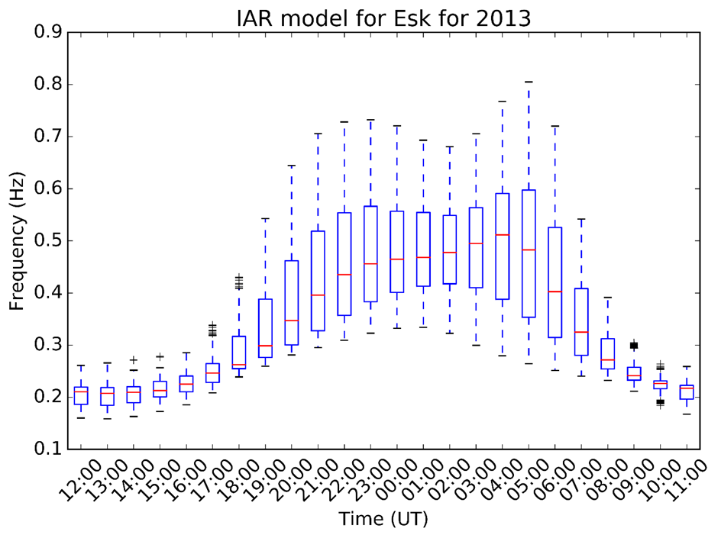

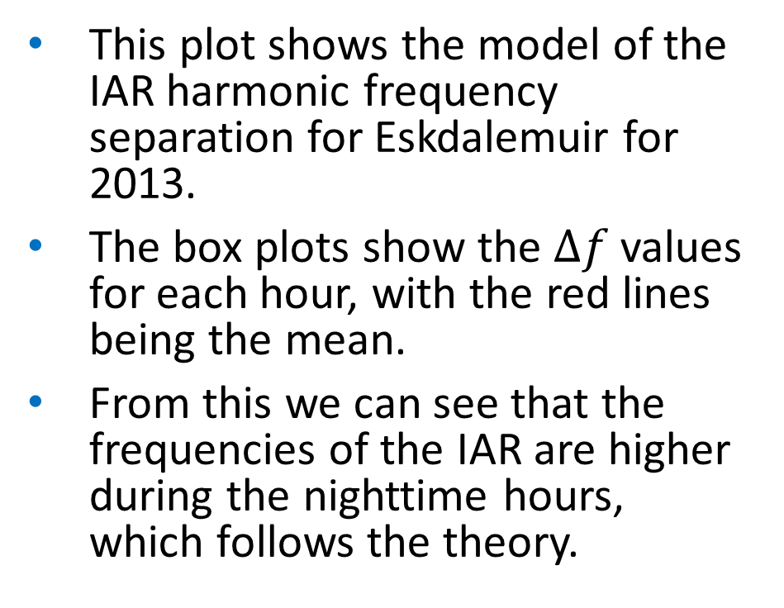
Modelled $∆f$ Results
This plot shows the model of the IAR harmonic frequency separation for Eskdalemuir for 2013.
The box plots show the $∆f$ values for each hour, with the red lines being the mean.
From this we can see that the frequencies of the IAR are higher during the nighttime hours, which follows the theory.

Slide 10
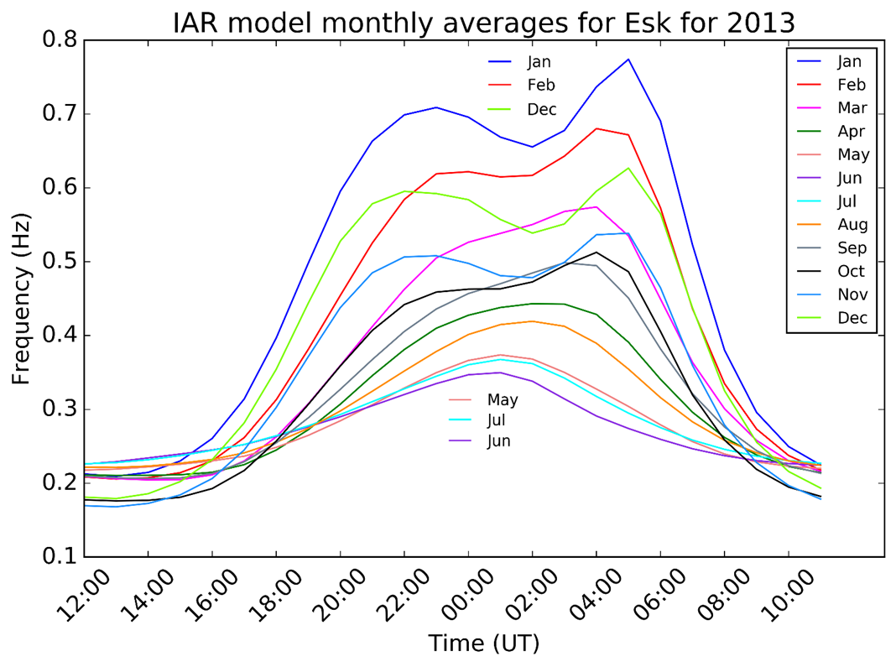
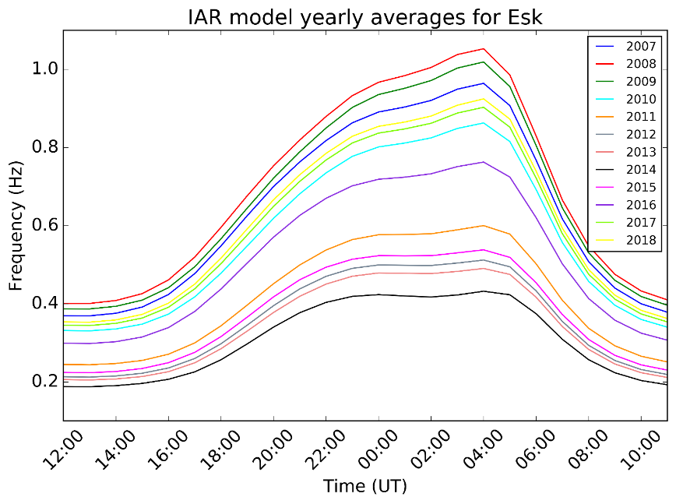

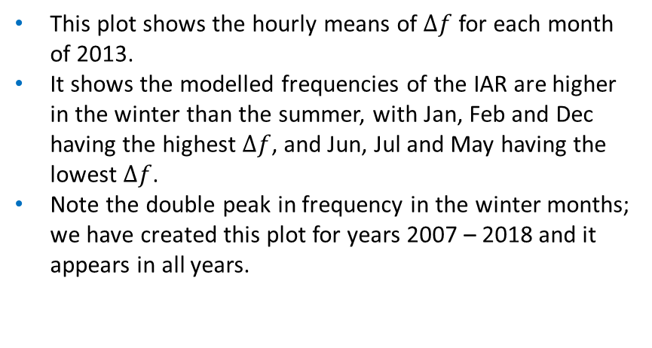
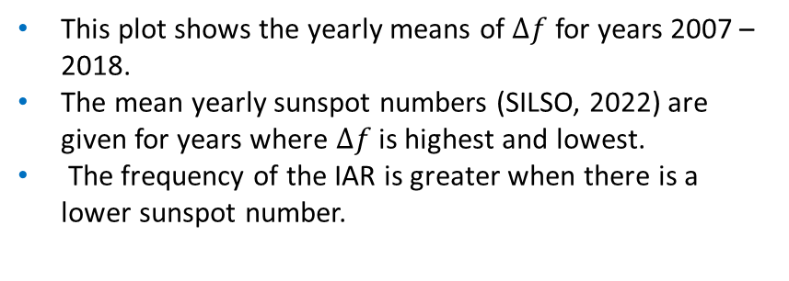
Modelled $∆f$ - Results
Lower sunspot
Number (4, 5, 13)
Higher sunspot
Number (80, 90, 130)
This plot shows the hourly means of $∆f$ for each month of 2013.
It shows the modelled frequencies of the IAR are higher in the winter than the summer, with Jan, Feb and Dec having the highest $∆f$, and Jun, Jul and May having the lowest $∆f$.
Note the double peak in frequency in the winter months; we have created this plot for years 2007 – 2018 and it appears in all years.
This plot shows the yearly means of $∆f$ for years 2007 – 2018.
The mean yearly sunspot numbers (SILSO, 2022) are given for years where $∆f$ is highest and lowest.
The frequency of the IAR is greater when there is a lower sunspot number.

Slide 11
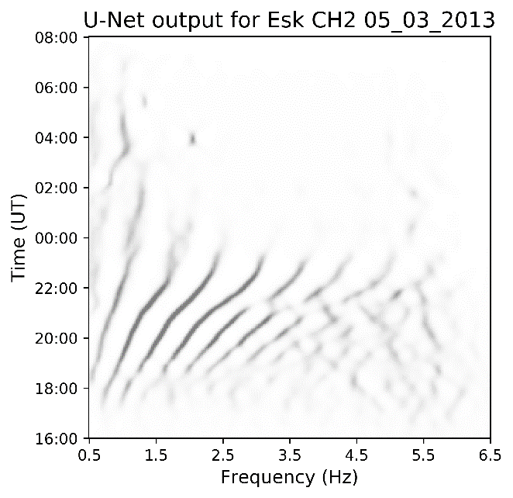
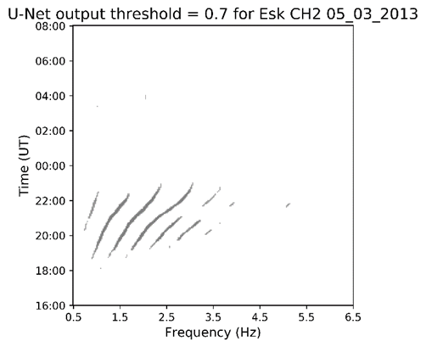
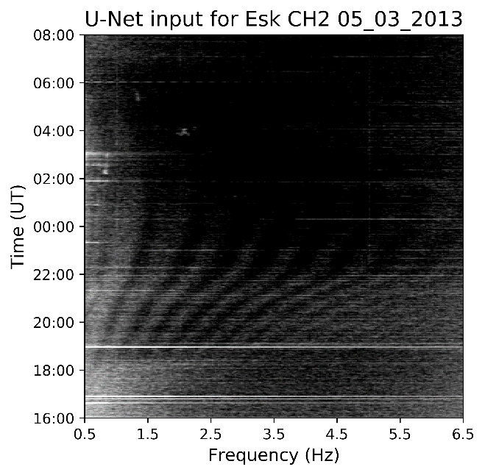
Identifying IAR with Machine Learning
Marangio et al. (2020) developed a method for identifying IAR in spectrograms using the fully convolutional neural network U-Net (Ronneberger et al, 2015).
Created a training set consisting of a mixture of manually drawn labels and labels generated by the automatic detection method by Beggan. (2014).
Input greyscale spectrogram to the U-Net.
Output is an image where a darker pixel represents a higher probability that it is an IAR.
Threshold at 0.7 which gave the more accurate result.
Output of the U-Net before a threshold is applied. The darker the pixel colour, the more likely it is IAR.
Input to the U-Net is a greyscale spectrogram. The frequencies go from 0.5 – 6.5 Hz, and the time from 16:00 – 08:00 UT, which contains most of the IAR harmonics. The plot is rotated to follow the method from Marangio et al. (2020). The inputs and outputs do not include axis (they are shown here for better understanding of the images).
After a threshold of 0.7 is applied. 6 harmonics are clearly visible and noise is extremely reduced. From this, we can now find the harmonic frequency separation.

Slide 12
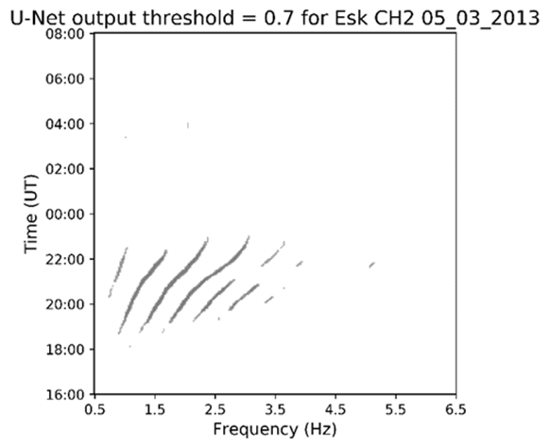
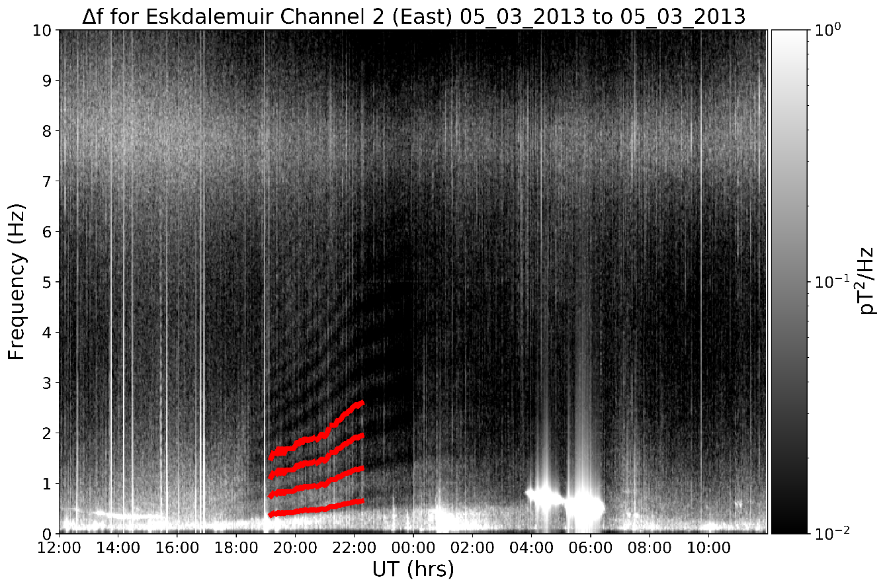
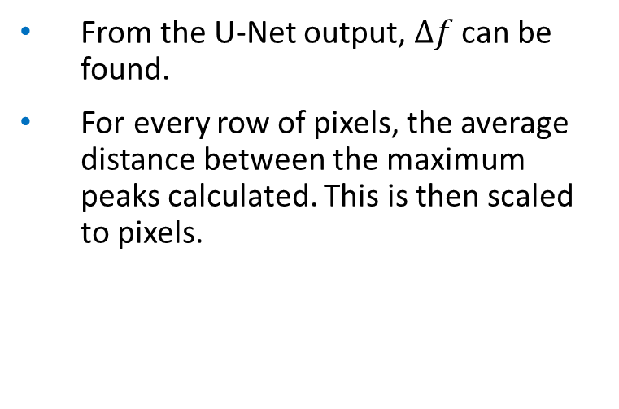
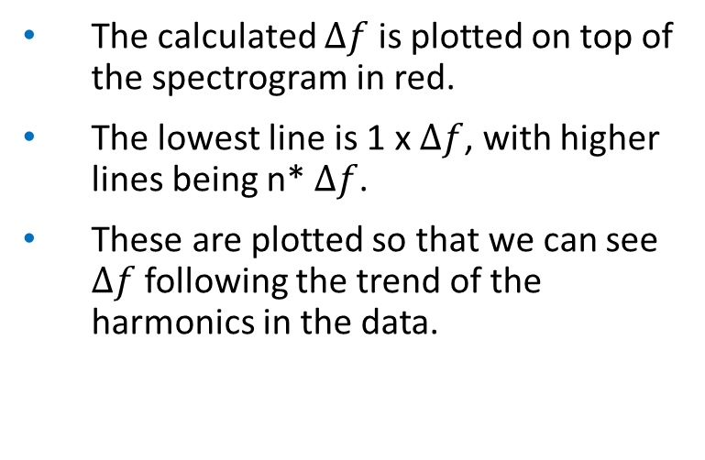

Finding the harmonic frequency separation from the data
From the U-Net output, $∆f$ can be found.
For every row of pixels, the average distance between the maximum peaks calculated. This is then scaled to pixels.
U-Net output with harmonic frequency separation marked for one row.
$$∆f$$
The calculated $∆f$ is plotted on top of the spectrogram in red.
The lowest line is 1 x $∆f$, with higher lines being n* $∆f$.
These are plotted so that we can see $∆f$ following the trend of the harmonics in the data.

Slide 13
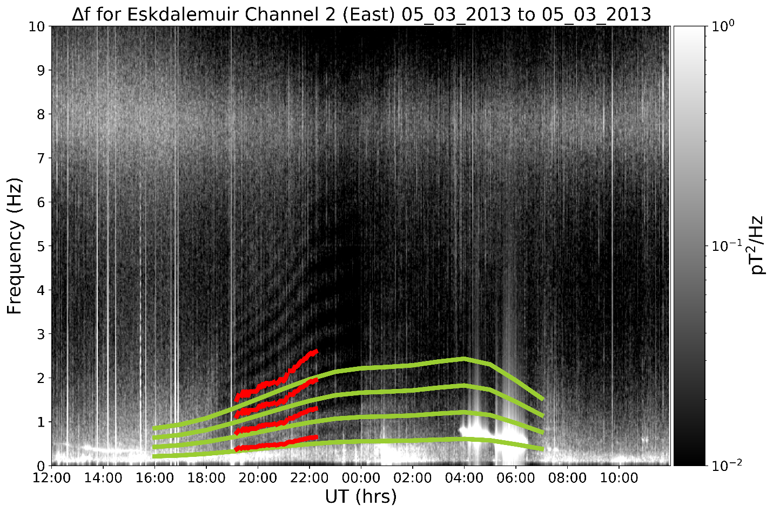
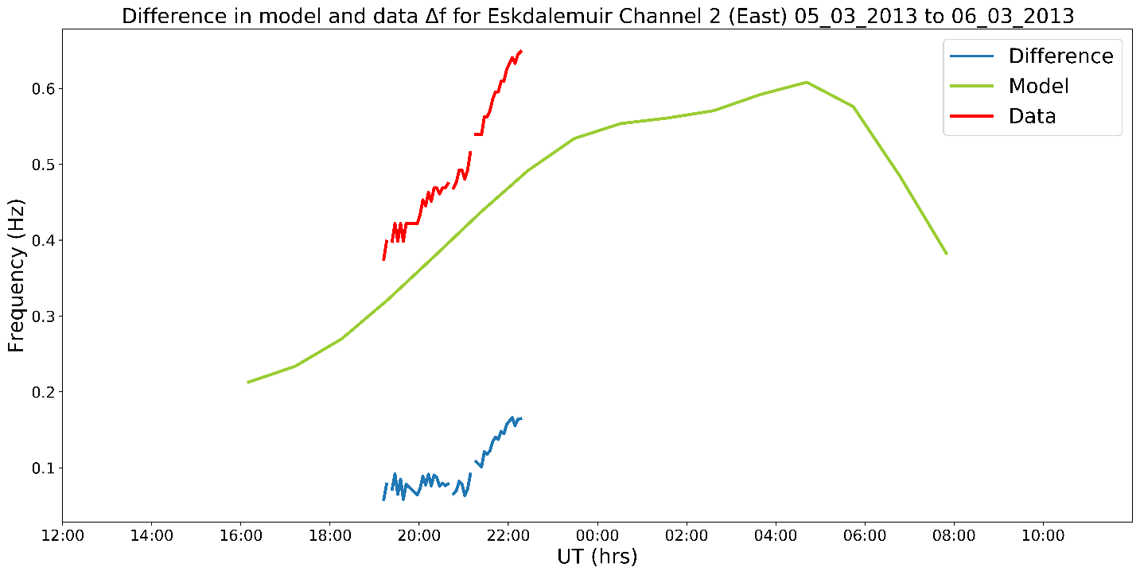
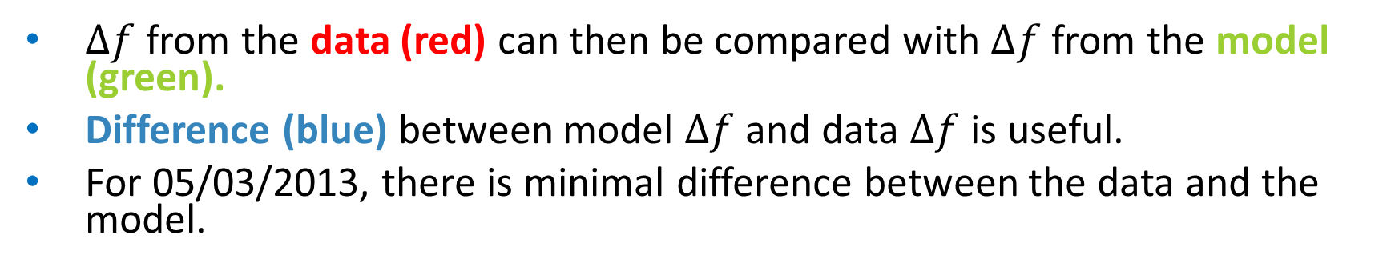
Comparison with the Model
$∆f$ from the data (red) can then be compared with $∆f$ from the model (green).
Difference (blue) between model $∆f$ and data $∆f$ is useful.
For 05/03/2013, there is minimal difference between the data and the model.

Slide 14
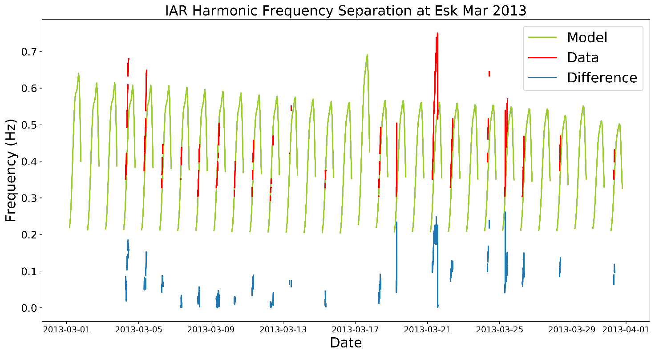
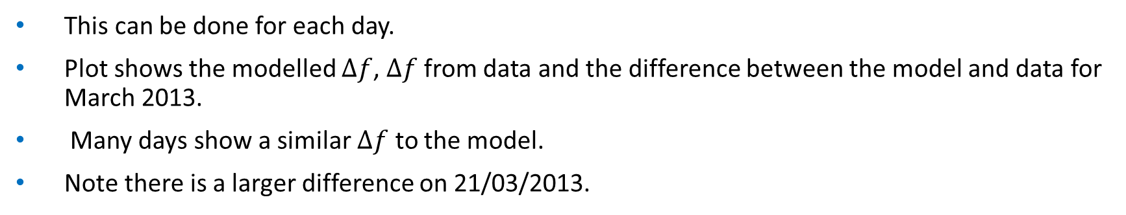
2013 Results
This can be done for each day.
Plot shows the modelled $∆f$, $∆f$ from data and the difference between the model and data for March 2013.
Many days show a similar $∆f$ to the model.
Note there is a larger difference on 21/03/2013.

Slide 15
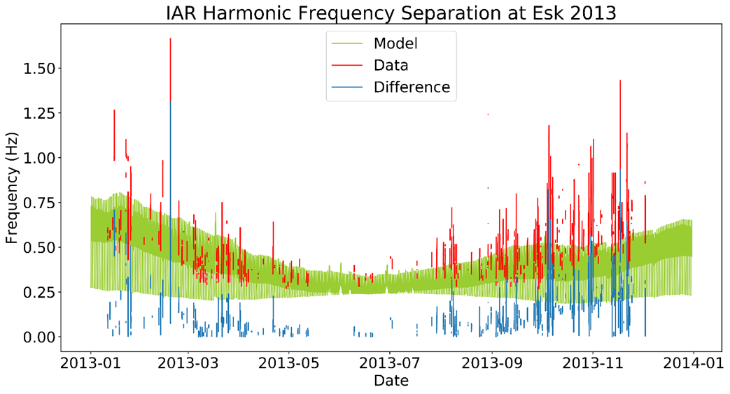
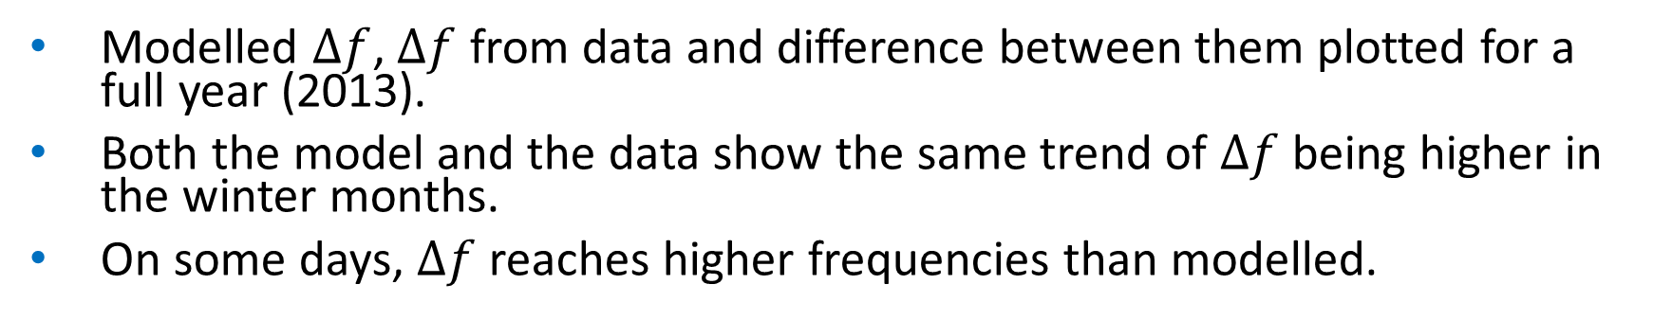
2013 Results
Modelled $∆f$, $∆f$ from data and difference between them plotted for a full year (2013).
Both the model and the data show the same trend of $∆f$ being higher in the winter months.
On some days, $∆f$ reaches higher frequencies than modelled.

Slide 16
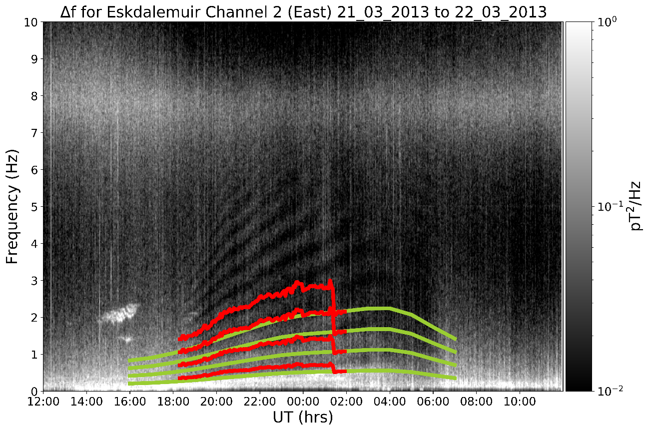
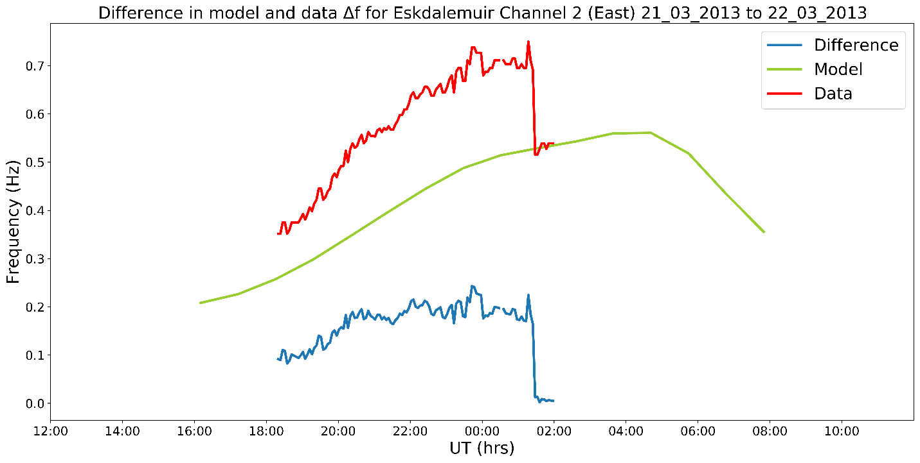
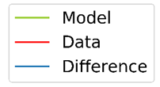


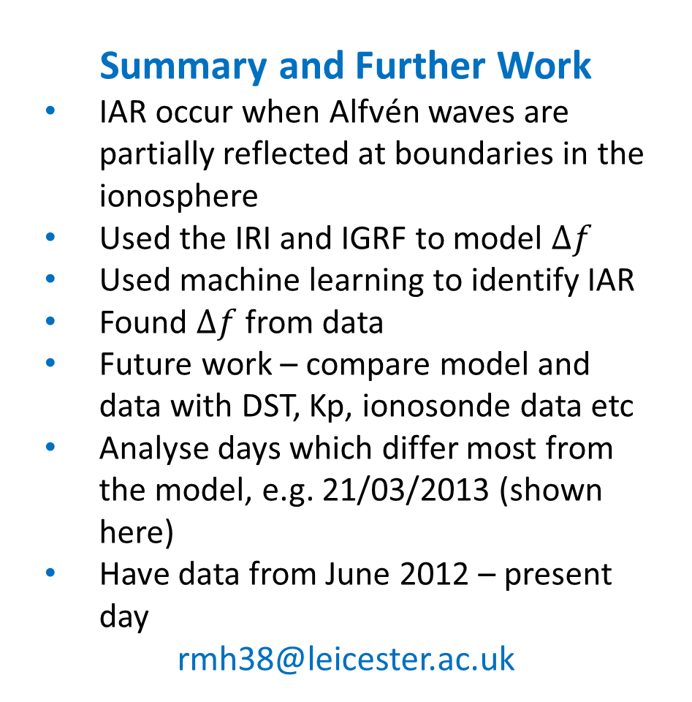
Summary and Further Work
IAR occur when Alfvén waves are partially reflected at boundaries in the ionosphere
Used the IRI and IGRF to model $∆f$
Used machine learning to identify IAR
Found $∆f$ from data
Future work – compare model and data with DST, Kp, ionosonde data etc
Analyse days which differ most from the model, e.g. 21/03/2013 (shown here)
Have data from June 2012 – present day
rmh38@leicester.ac.uk

Slide 17
References
Beggan, C.D., 2014. Automatic detection of ionospheric Alfvén resonances using signal and image processing techniques. Ann. Geophys. 32, 951–958. http://dx.doi.org/10.5194/angeo-32-951-2014.
Belyaev, P. P., Polyakov, S., Rapoport, V., & Trakhtengerts, V. Y. (1990). The ionospheric Alfvén resonator. Journal of Atmospheric and Terrestrial Physics, 52(9), 781–788. https://doi.org/10.1016/0021-9169(90)90010-K
British Geological Survey (2022). Deposited Data Search. https://webapps.bgs.ac.uk/services/ngdc/accessions/index.html?simpleText=induction%20coil (Date accessed 18/05/22)
British Geological Survey (2022). Eskdalemuir Magnetic Observatory. http://www.geomag.bgs.ac.uk/operations/eskdale.html (Date accessed 18/05/22)
Füllekrug, M., & Reising, S. C. (1998). Excitation of earth-ionosphere cavity resonances by sprite-associated lightning flashes. Geophysical Research Letters, 25(22), 4145–4148. https://doi.org/10.1029/98GL02590
Hebden, S. R., Robinson, T. R., Wright, D. M., Yeoman, T., Raita, T., & Bösinger, T. (2005). A quantitative analysis of the diurnal evolution of ionospheric Alfven resonator magnetic resonance features and calculation of changing IAR parameters. Annales Geophysicae, 23(5), 1711–1721. https://doi.org/10.5194/angeo-23-1711-2005
International Geomagnetic Reference Field (2022). https://www.ngdc.noaa.gov/IAGA/vmod/igrf.html (Date accessed 18/05/22)
International Reference Ionosphere (2022). https://irimodel.org/ (Date accessed 18/05/22)
Marangio, P., Christodoulou, V., Filgueira, R., Rogers H. F., & Beggan, C. D. (2020). Automatic detection of Ionospheric Alfvén Resonances in magnetic spectrograms using U-net. Computers & Geosciences, 145, 104598. https://doi.org/10.1016/j.cageo.2020.104598
Polyakov, S. V., & Rapoport, V. (1981). Ionospheric Alfvén resonator, Geomag. Aeronomy, 21, 816.
Ronneberger, O., Fischer, P., Brox, T., 2015. U-net: Convolutional networks for biomedical image segmentation. Lecture Notes in Computer Science, 234–241. https://doi.org/10.1007/978-3-319-24574-4_28
Sunspot Index and Long term Solar Observations (2022). Sunspot number. WDC-SILSO, Royal Observatory of Belgium, Brussels. https://www.sidc.be/silso/datafiles (Date accessed 18/05/22).

