Slide 1


Precision of Galileo satellite orbits obtained from simulated VLBI observations
Wolf H.¹, Böhm J.¹, Nothnagel A.¹, Hugentobler U.², Schartner M.³
¹TU Wien, Department of Geodesy and Geoinformation
²TU München, Institute for Astronomical and Physical Geodesy
³ETH Zürich, Department of Civil, Environmental and Geomatic Engineering
EGU 2022

Slide 2

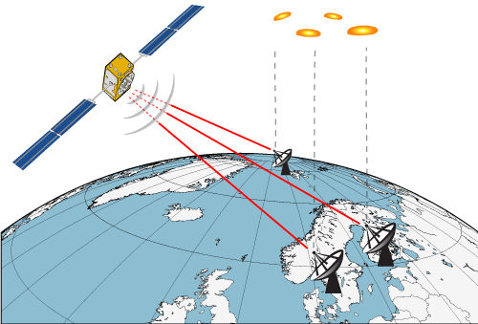

Overview
Comparing evaluation of satellite observations for estimating orbit arcs by analysis …
… beforehand
Dilution of Precision (DOP) factors as indicator for sensitivity of satellite observations
... of simulations
precision of estimated orbit arc assessed based on Monte Carlo simulations
26.05.2022
EGU 2022

Slide 3
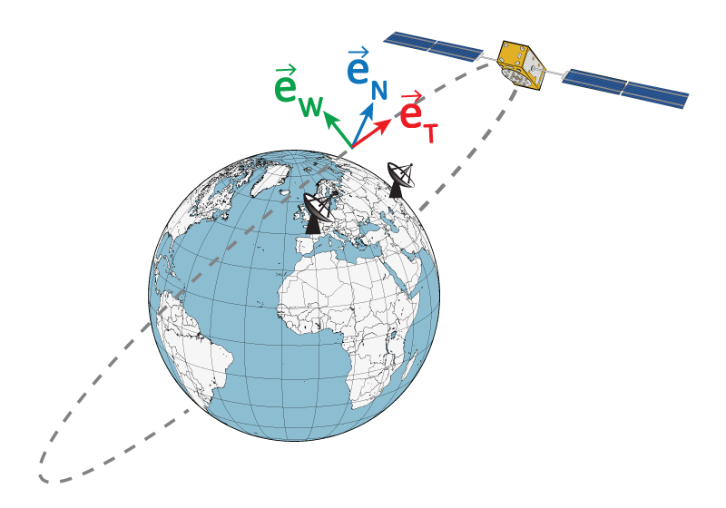
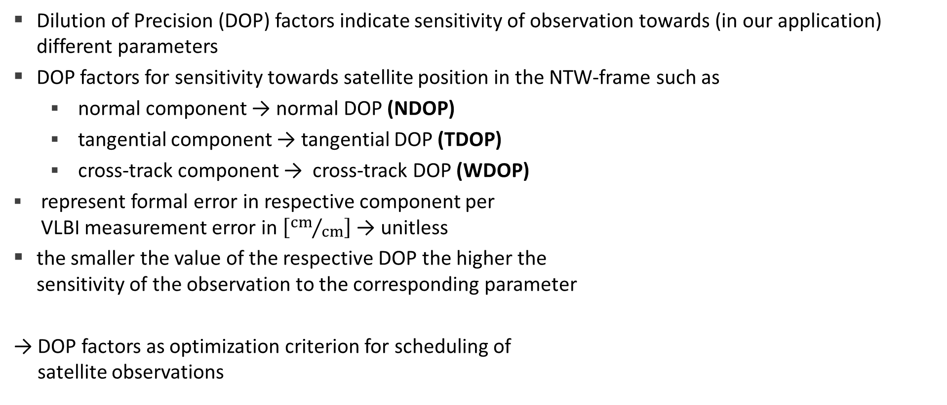
Evaluation of satellite observations
Dilution of Precision (DOP) factors indicate sensitivity of observation towards (in our application) different parameters
DOP factors for sensitivity towards satellite position in the NTW-frame such as
  normal component → normal DOP (NDOP)
  tangential component → tangential DOP (TDOP)
  cross-track component → cross-track DOP (WDOP)
represent formal error in respective component per
VLBI measurement error in $\left[{cm}/{cm}\right]$ → unitless
the smaller the value of the respective DOP the higher the
sensitivity of the observation to the corresponding parameter
→ DOP factors as optimization criterion for scheduling of
satellite observations
26.05.2022
EGU 2022

Slide 4

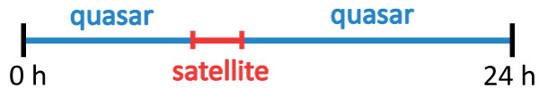

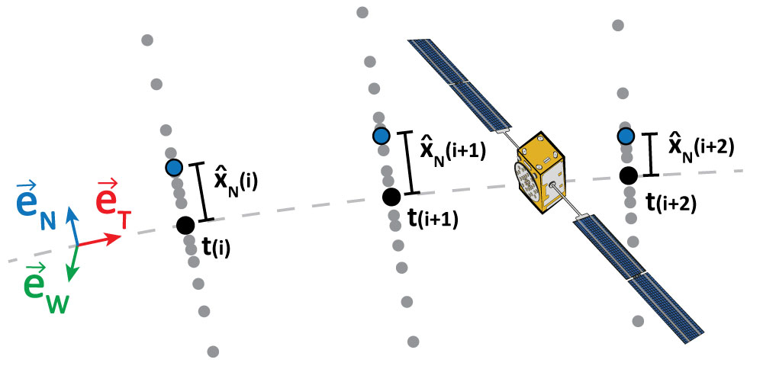
Precision of Galileo satellite orbits
schedules
creating schedules including quasar and satellite observations
simulations
1000 simulations with 50 [ps] white noise for satellite scans
analysis
estimation of offset from a-priori orbit (sp3) for the individual
components of satellite position as piecewise linear offsets
precision of adjusted arc in terms of repeatability
26.05.2022
EGU 2022

Slide 5
Scheduling of satellite and quasar obs.
VieSched++ is used to create schedules including satellite and quasar observations
  satellite scans with 5 seconds duration
  30 seconds break in between for calibration, slewing, …
  e.g. 24 hour session including satellite observations for 40 minutes from 4:00 to 4:40
    4:00:00 – 4:00:05
    4:00:35 – 4:00:40
    …
    4:39:40 – 4:39:45
    → in total 69 satellite scans
  remaining part of schedule is filled with quasar observations
    more than 100 scheduled sources for each schedule
26.05.2022
EGU 2022

Slide 6
Adjustment of Galileo satellite orbits
Vienna VLBI and Satellite Software (VieVS) for simulating and analysing the schedules
  1000 simulations
    white noise of 50 [ps] for satellite observations
  estimation of offset from a-priori orbit (sp3) for the individual components of satellite position
  estimation settings
    source coordinates
    station coordinates
    troposphere
    clock
    EOP
    satellite position
      as continuous piecewise linear offsets
      estimation interval: 10 min precision of adjusted arc in terms of repeatability
      relative constraints for each component: 10 cm
26.05.2022
EGU 2022

Slide 7
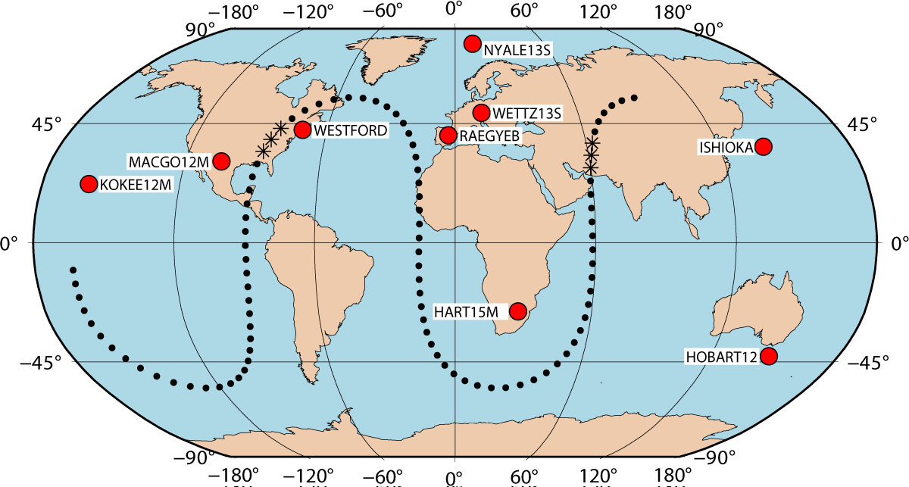
Scenario I: GSAT0208
06.02.2022 00:00 – 00:00
9 station network
Obs. period A: 08:10 – 08:50
  KOKEE12M
  MACGO12M
  NYALE13S
  WESTFORD
  WETTZ13S
  RAEGYEB
Obs. period B: 21:50 – 22:30
  HART15M
  ISHIOKA
  NYALE13S
  RAEGYEB
  WETTZ13S
26.05.2022
EGU 2022

Slide 8
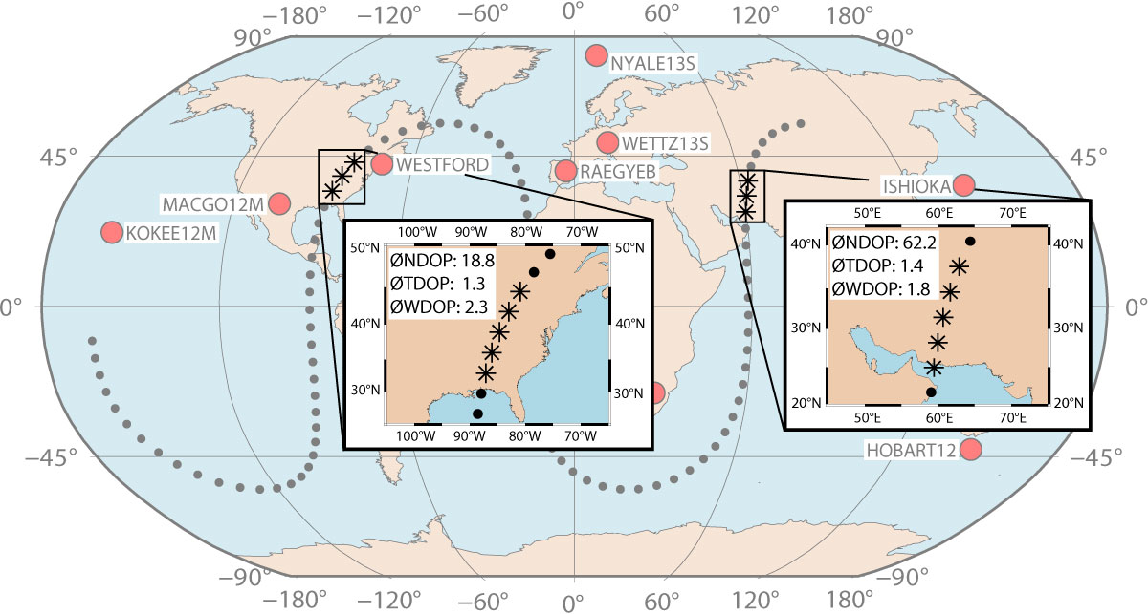
Scenario I: GSAT0208
06.02.2022 00:00 – 00:00
9 station network
Obs. period A: 08:10 – 08:50
  #stations: 6
  ØNDOP: 18.8
  ØTDOP: 1.3
  ØWDOP: 2.3
Obs. period B: 21:50 – 22:30
  #stations: 5
  ØNDOP: 62.2
  ØTDOP: 1.4
  ØWDOP: 1.8
26.05.2022
EGU 2022

Slide 9
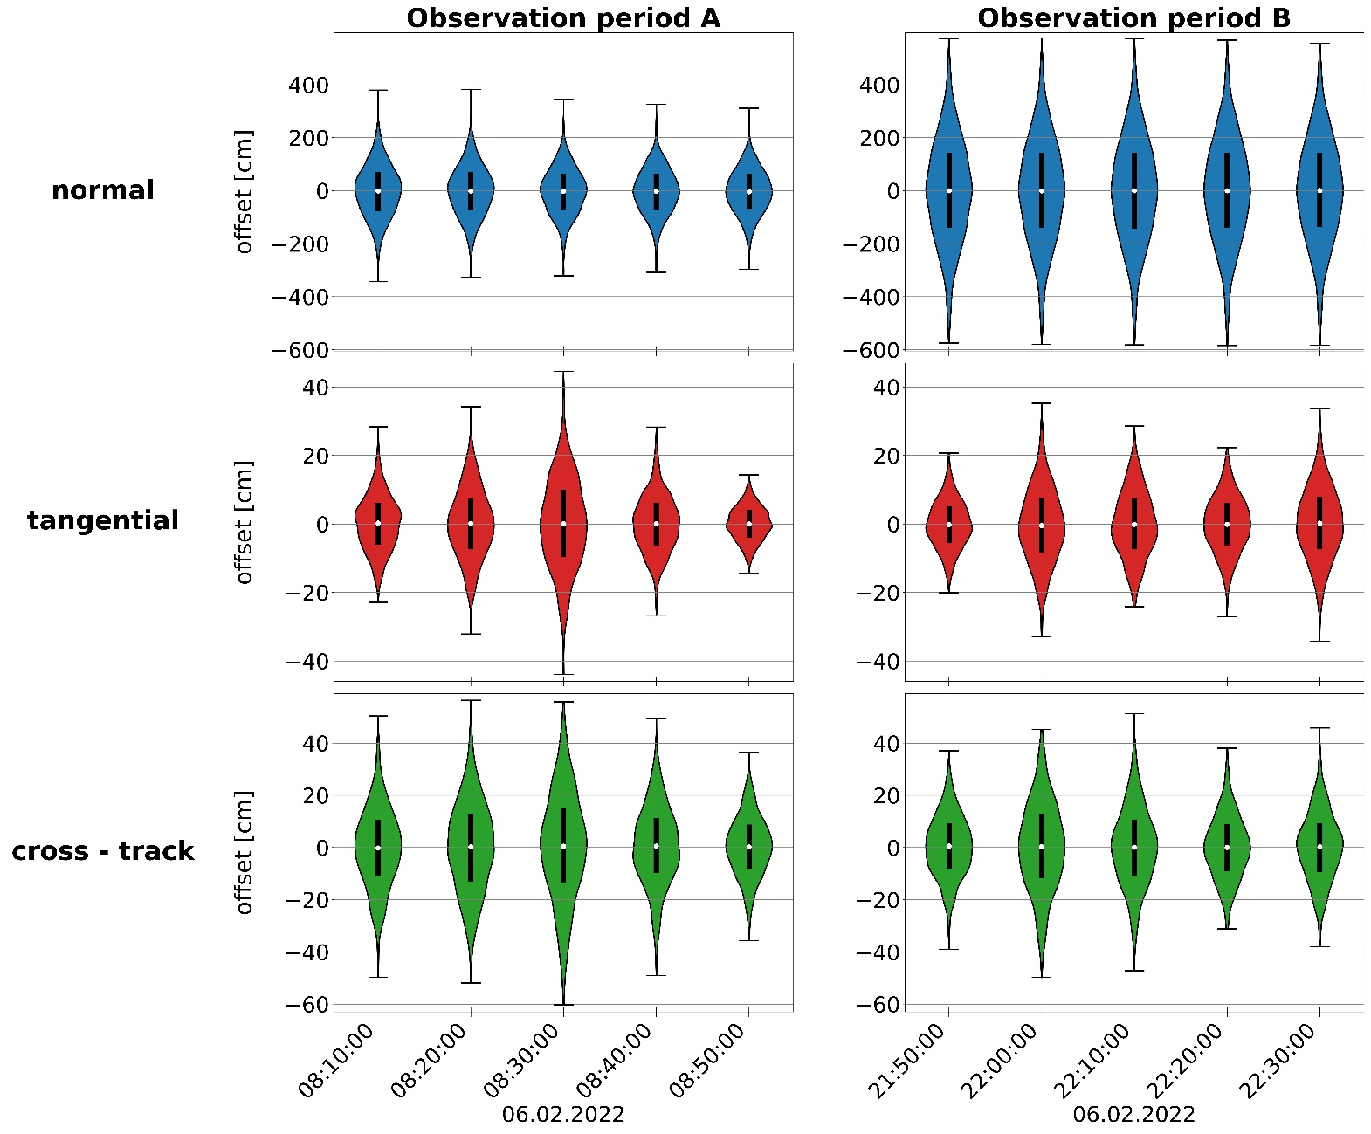
Scenario I: GSAT0208
Obs. period A: 08:10 – 08:50
  #stations: 6
  ØNDOP: 18.8
  ØTDOP: 1.3
  ØWDOP: 2.3
Obs. period B: 21:50 – 22:30
  #stations: 5
  ØNDOP: 62.2
  ØTDOP: 1.4
  ØWDOP: 1.8
26.05.2022
EGU 2022

Slide 10
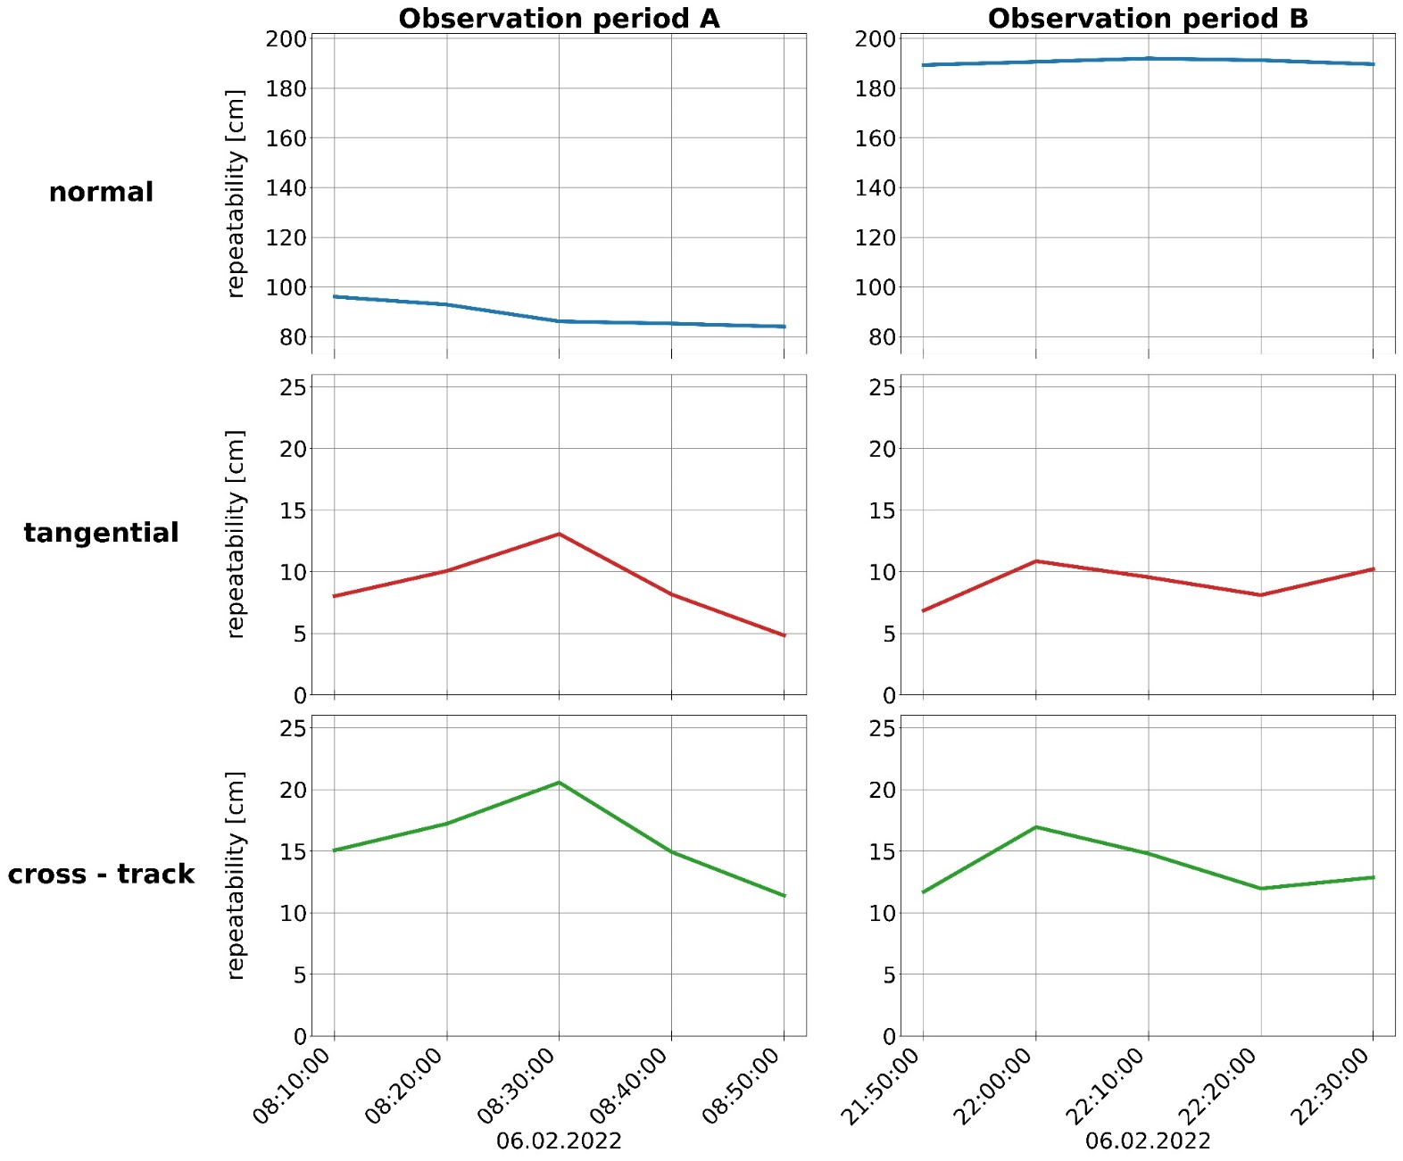
Scenario I: GSAT0208
Obs. period A: 08:10 – 08:50
  #stations: 6
  ØNDOP: 18.8
  ØTDOP: 1.3
  ØWDOP: 2.3
Obs. period B: 21:50 – 22:30
  #stations: 5
  ØNDOP: 62.2
  ØTDOP: 1.4
  ØWDOP: 1.8
26.05.2022
EGU 2022

Slide 11
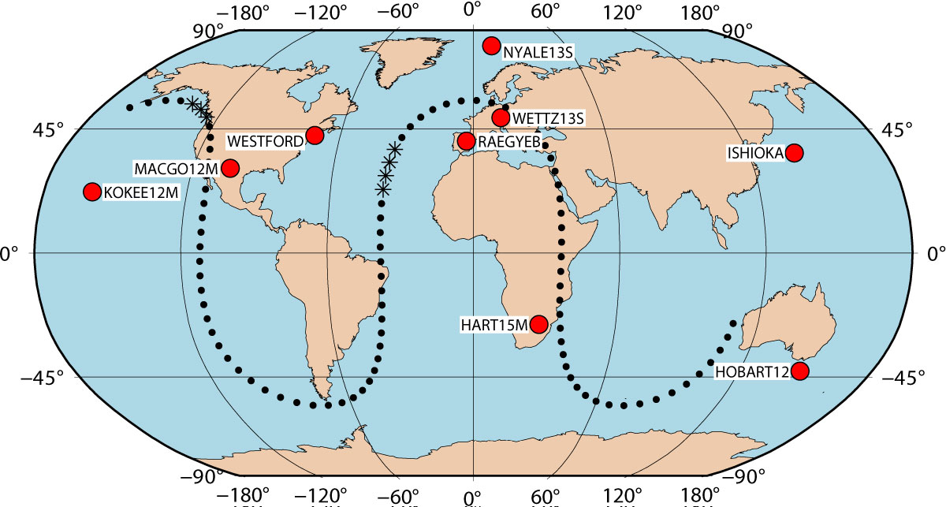
Scenario II: GSAT0206
06.02.2022 00:00 – 00:00
9 station network
Obs. period A: 00:50 – 01:40
  ISHIOKA
  KOKEE12M
  MACGO12M
  NYALE13S
  WESTFORD
Obs. period B: 12:10 – 13:00
  MACGO12M
  NYALE13S
  RAEGYEB
  WESTFORD
  WETTZ13S
26.05.2022
EGU 2022

Slide 12
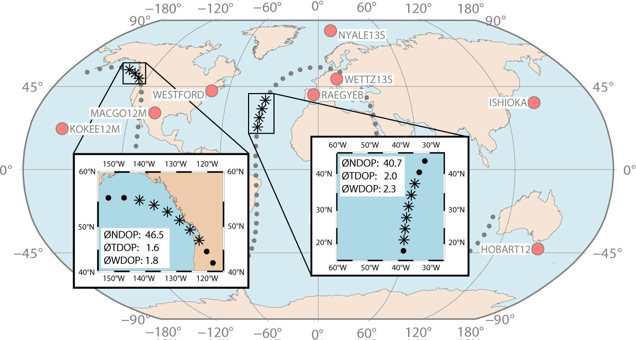
Scenario II: GSAT0206
06.02.2022 00:00 – 00:00
9 station network
Obs. period A: 00:50 – 01:40
  #stations: 5
  ØNDOP: 46.5
  ØTDOP: 1.6
  ØWDOP: 1.8
Obs. period B: 12:10 – 13:00
  #stations: 5
  ØNDOP: 40.7
  ØTDOP: 2.0
  ØWDOP: 2.3
26.05.2022
EGU 2022

Slide 13
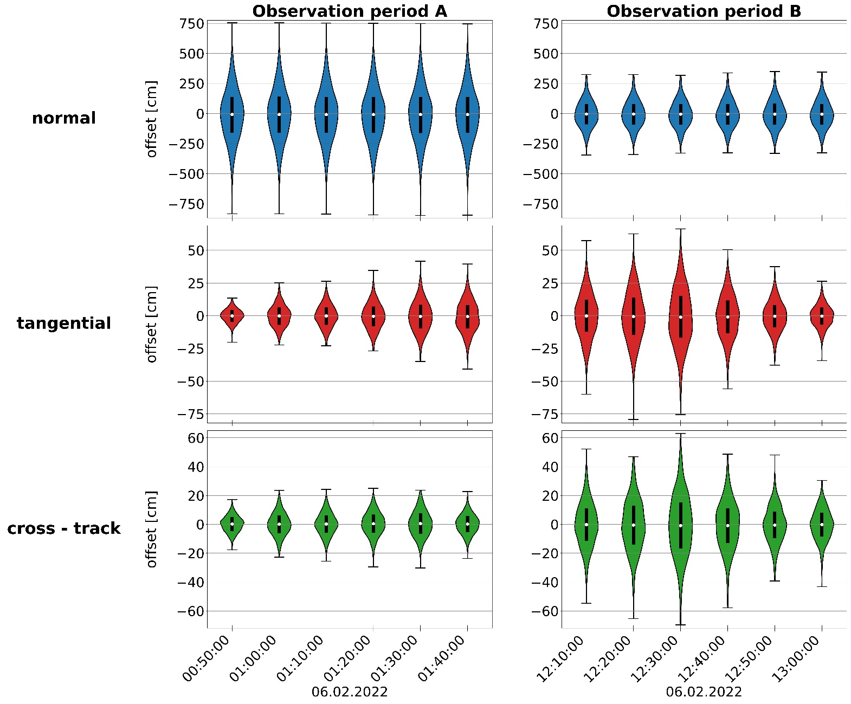
Scenario II: GSAT0206
Obs. period A: 00:50 – 01:40
  #stations: 5
  ØNDOP: 46.5
  ØTDOP: 1.6
  ØWDOP: 1.8
Obs. period B: 12:10 – 13:00
  #stations: 5
  ØNDOP: 40.7
  ØTDOP: 2.0
  ØWDOP: 2.3
26.05.2022
EGU 2022

Slide 14
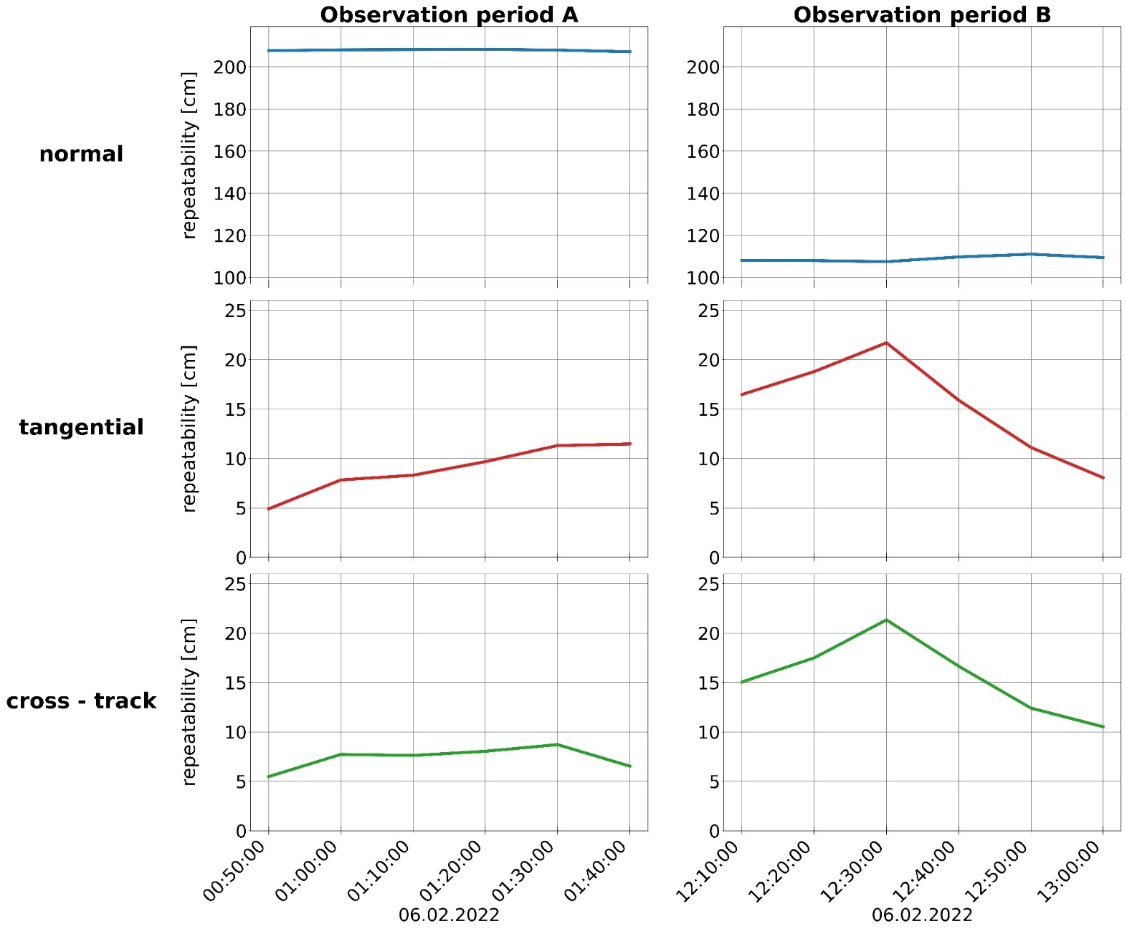
Scenario II: GSAT0206
Obs. period A: 00:50 – 01:40
  #stations: 5
  ØNDOP: 46.5
  ØTDOP: 1.6
  ØWDOP: 1.8
Obs. period B: 12:10 – 13:00
  #stations: 5
  ØNDOP: 40.7
  ØTDOP: 2.0
  ØWDOP: 2.3
26.05.2022
EGU 2022

Slide 15
Conclusion
precision of the adjusted arc is dependent on observation geometry
DOP factors and results of analysis based on Monte Carlo simulations concur
DOP factors could be used as optimization criterion during the scheduling process
observations rather insensitive to satellite normal component → contraints advisable
26.05.2022
EGU 2022

Slide 16
References
Wolf H. (2021): Satellite Scheduling with VieSched++, Master Thesis, Technical University of Vienna.
Hellerschmied A. (2018): Satellite Observations with VLBI, Doctoral Thesis, Technical University of Vienna.
Klioner S. (1991): General Relativistic Model of VLBI Observables, Proceedings of the AGU Chapman Conference on Geodetic VLBI: Monitoring Global Change, Washington D.C., April 22-26. 1991.
VieSched++: https://github.com/TUW-VieVS/VieSchedpp/
26.05.2022
EGU 2022

