Slide 1
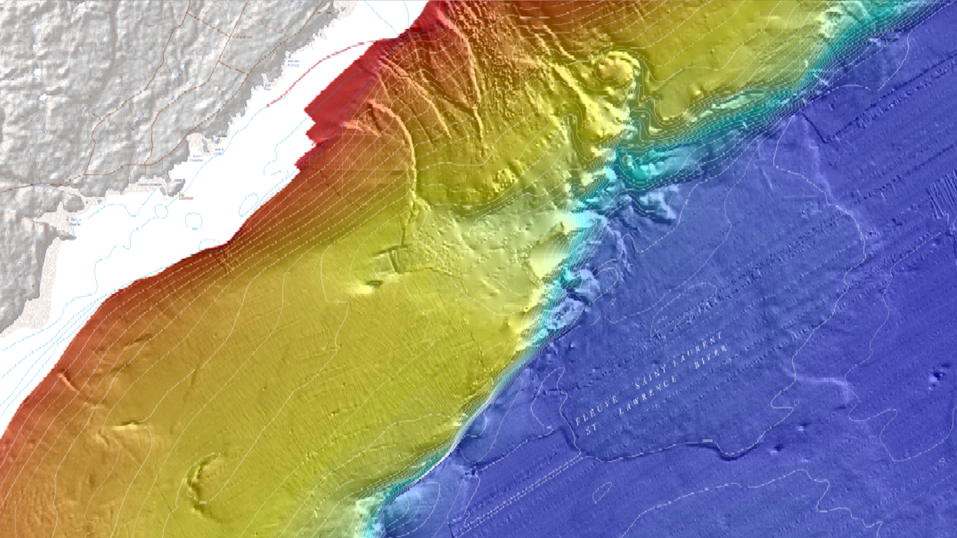
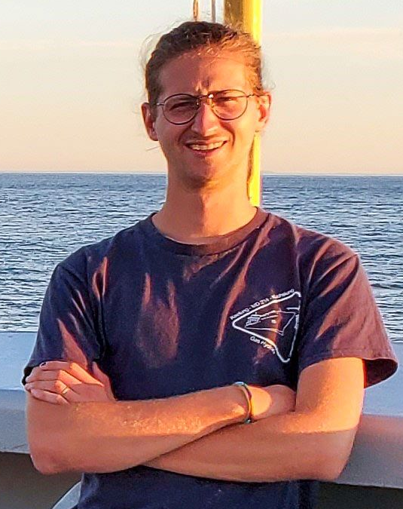







Earthquake-triggered submarine landslides in the St. Lawrence Estuary during the last two millennia and the record of the major 1663 CE M ≥ 7 event
Méril Mérindol^{1,2}, Guillaume St-Onge¹, Nabil Sultan², Patrick Lajeunesse³, Sébastien Garziglia²
¹ Institut des sciences de la mer de Rimouski (ISMER), Canada Research Chair in Marine Geology, Université du Québec à Rimouski and GEOTOP, Canada
² Geo-Ocean UMR6538, Ifremer, CNRS, UBO, UBS, Plouzané, France
³ Département de géographie and Centre d’études nordiques, Université Laval, Québec, Québec, Canada

Slide 2
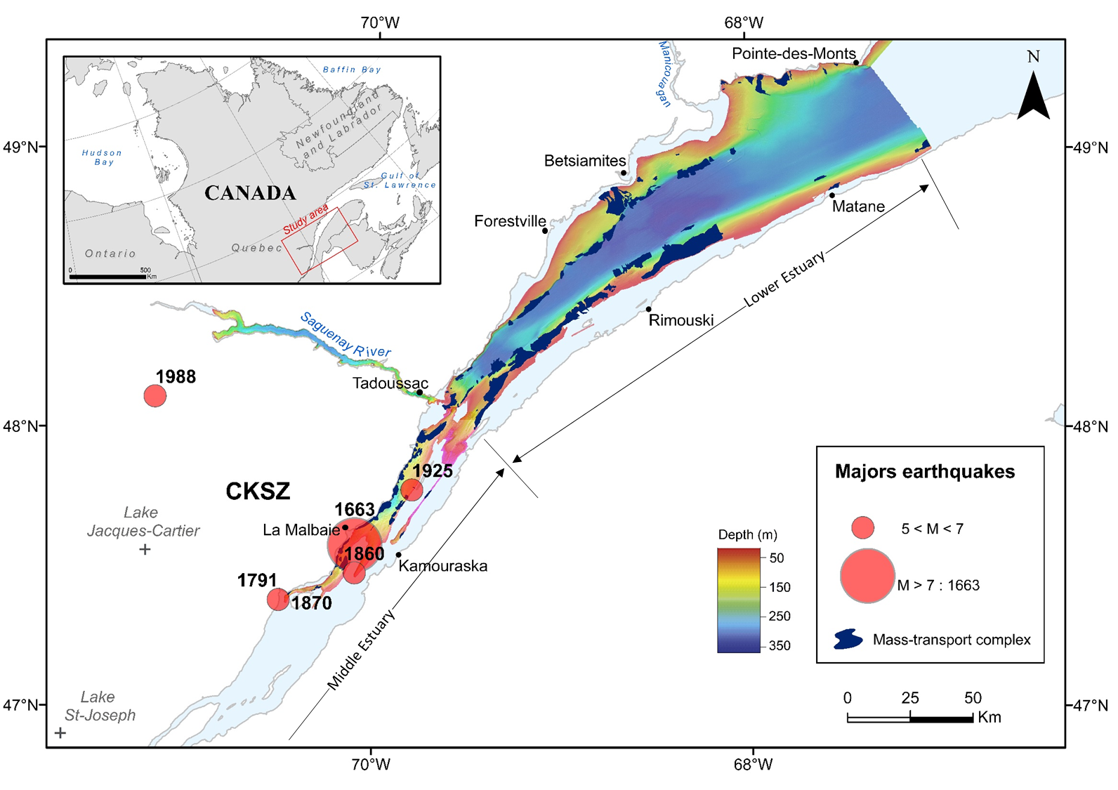
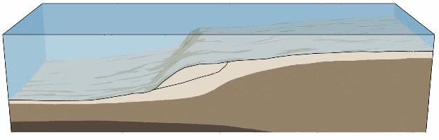


Introduction
Materials and Methods
Results
Discussion
Conclusion
Seismicity → Submarine landslides ?
Identify and characterize rapidly deposited layers (RDLs) resulting from landslides (e.g., turbidite)
Use of ¹⁴C to date RDLs
Compare them to historical earthquakes
Modified from Geoscience Australia, 2016
Mérindol et al., in prep.
EGU 2022 – ts4.4 – Earthquake-triggered submarine landslides in the St. Lawrence Estuary during the last two millennia and the record of the major 1663 CE M ≥ 7 event – M.Mérindol

Slide 3
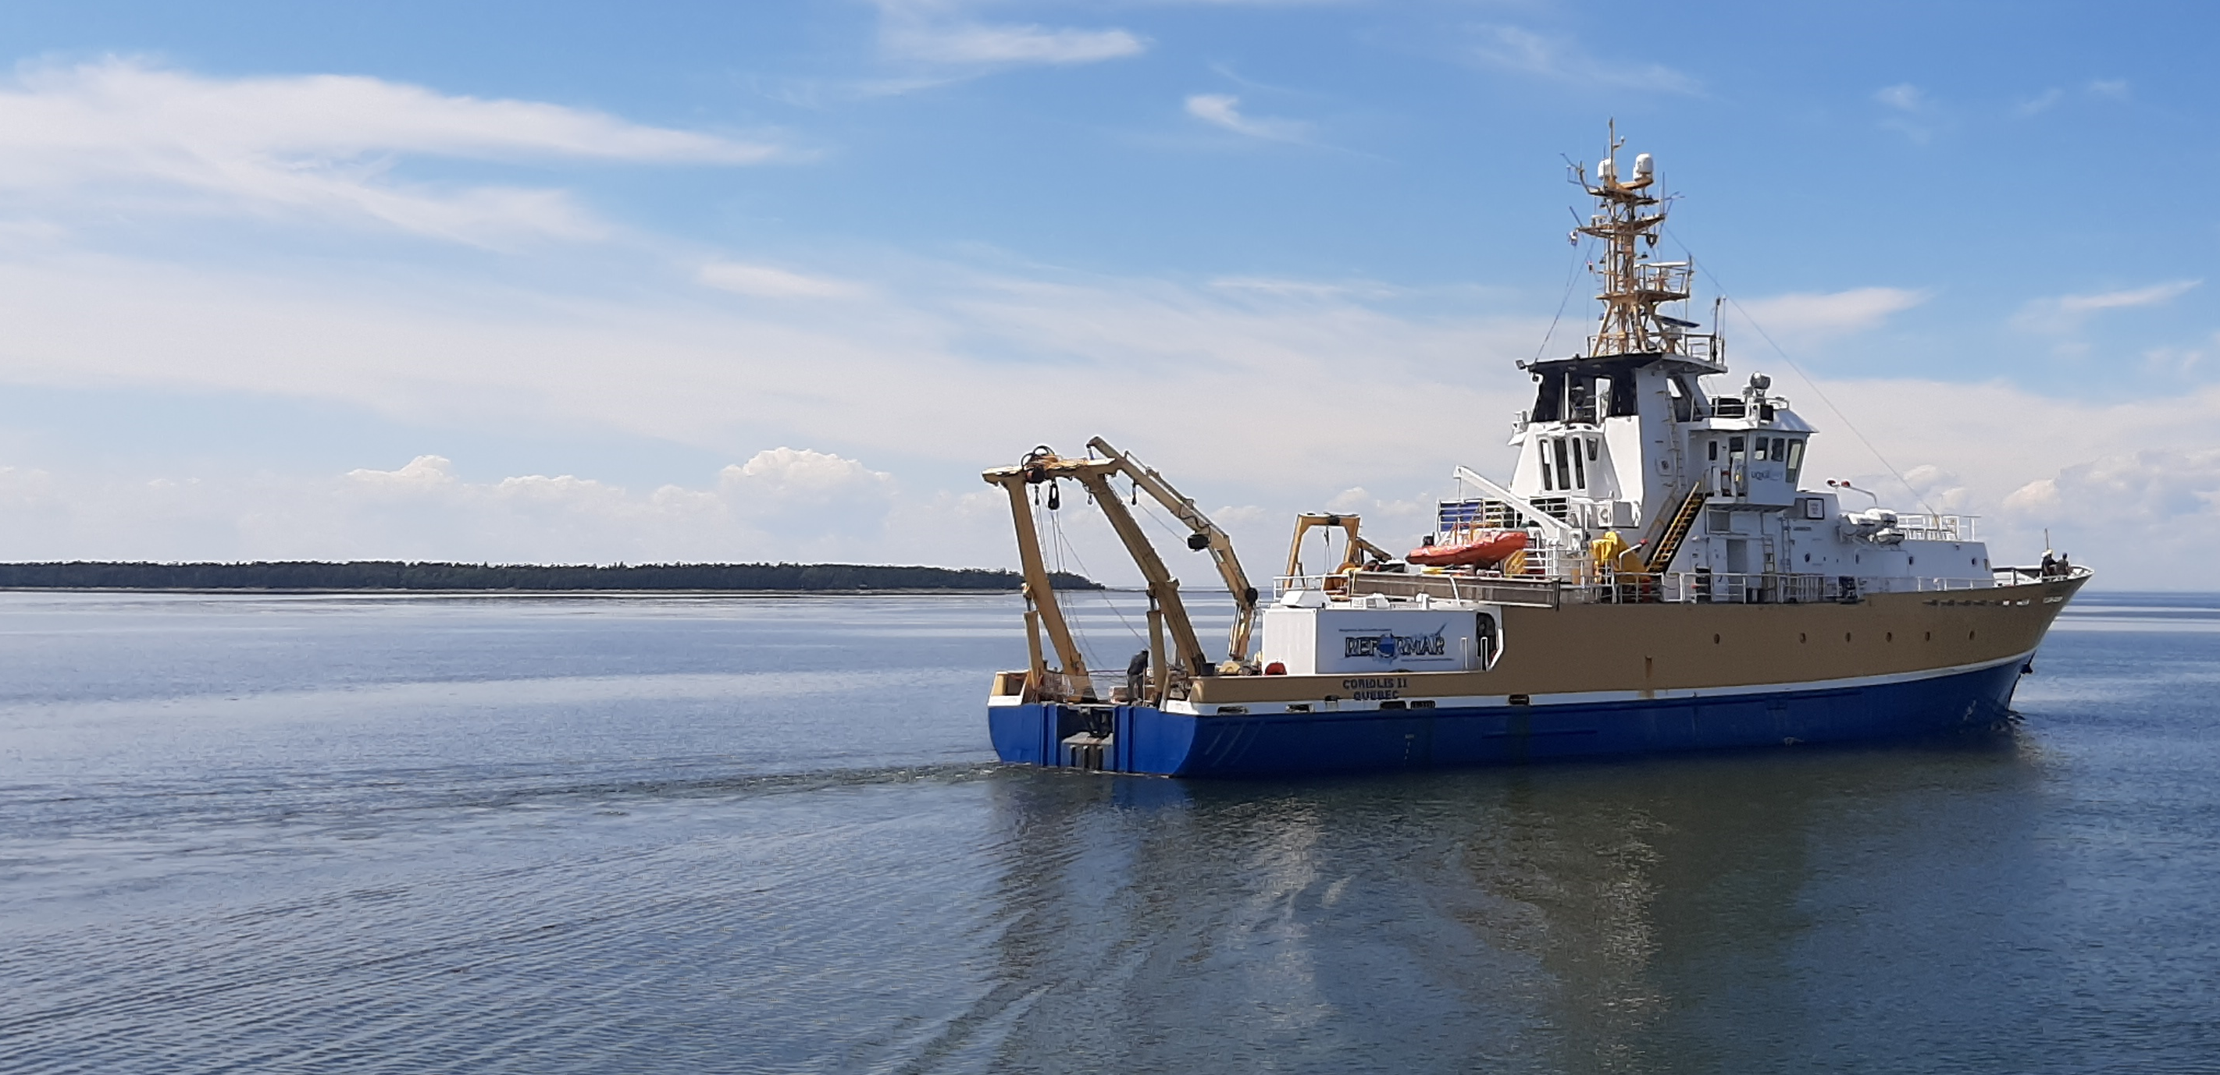
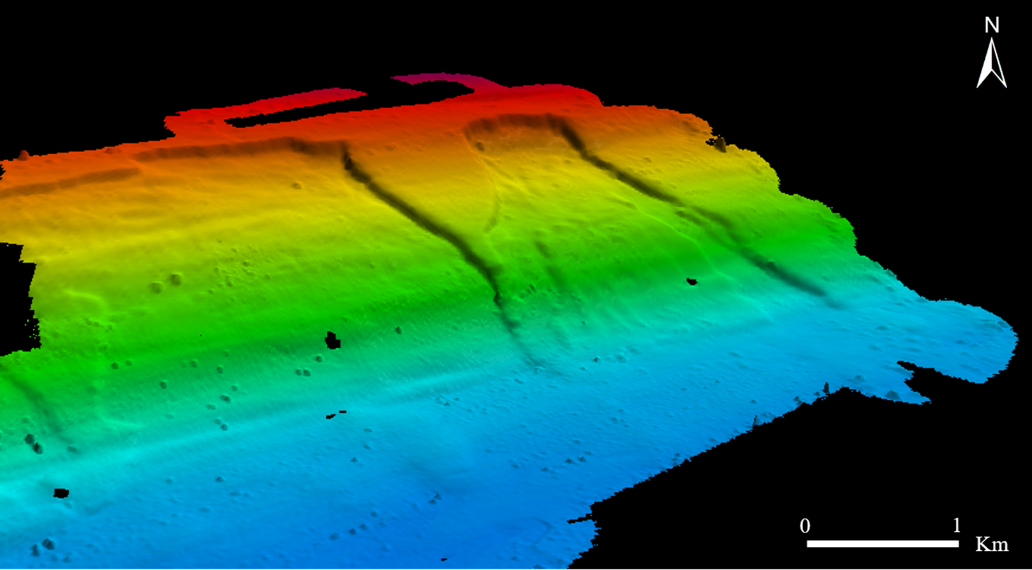
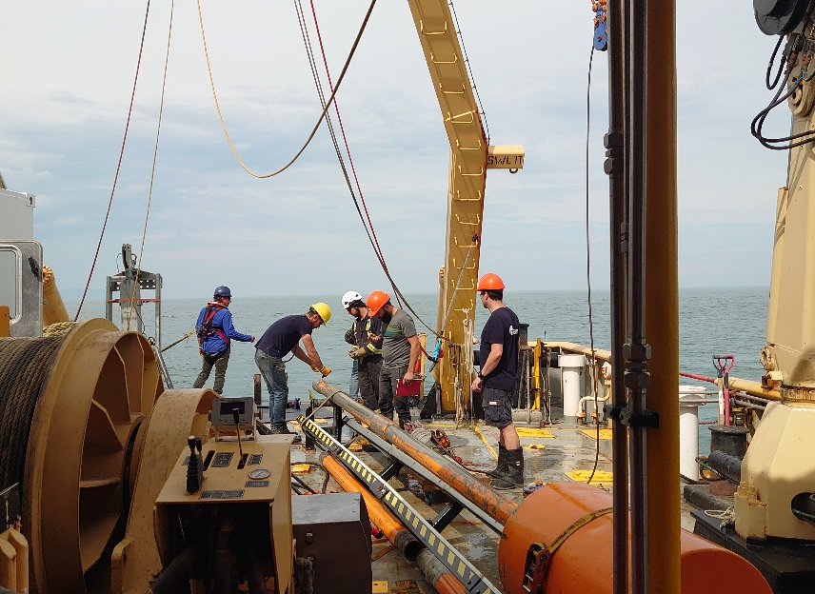
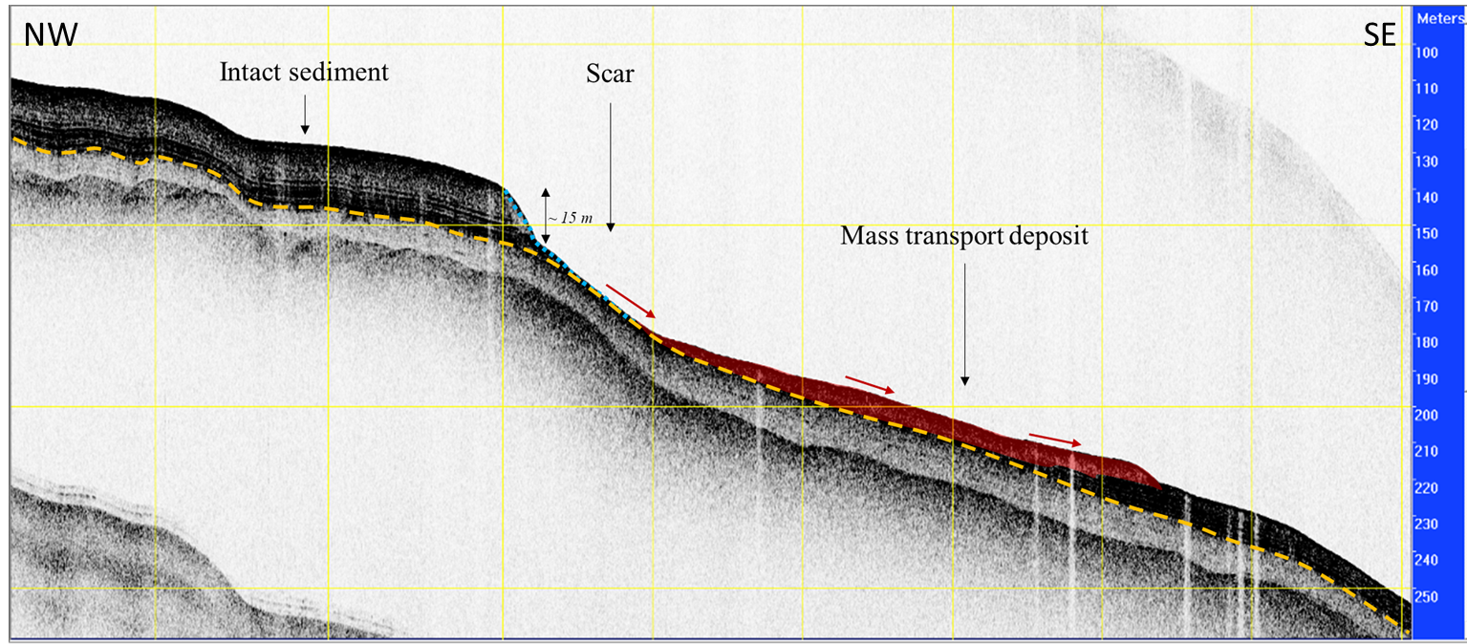
Introduction
Materials and Methods
Results
Discussion
Conclusion
S ubmarine
L andslides:
I dentification and
D ating
in the St. Lawrence
E stuary
© Arthur Bieber
Distal deposits
EGU 2022 – ts4.4 – Earthquake-triggered submarine landslides in the St. Lawrence Estuary during the last two millennia and the record of the major 1663 CE M ≥ 7 event – M.Mérindol

Slide 4
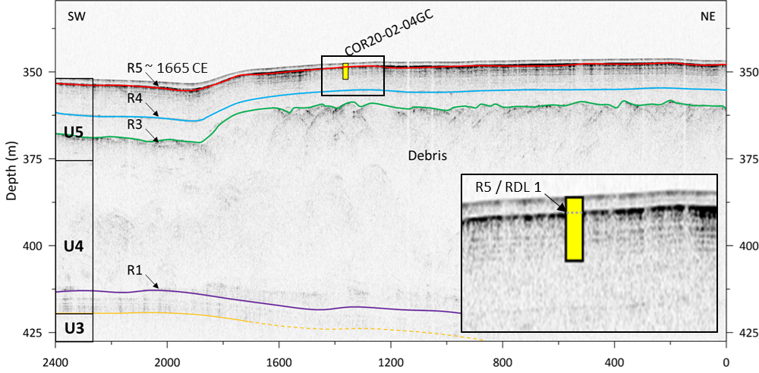
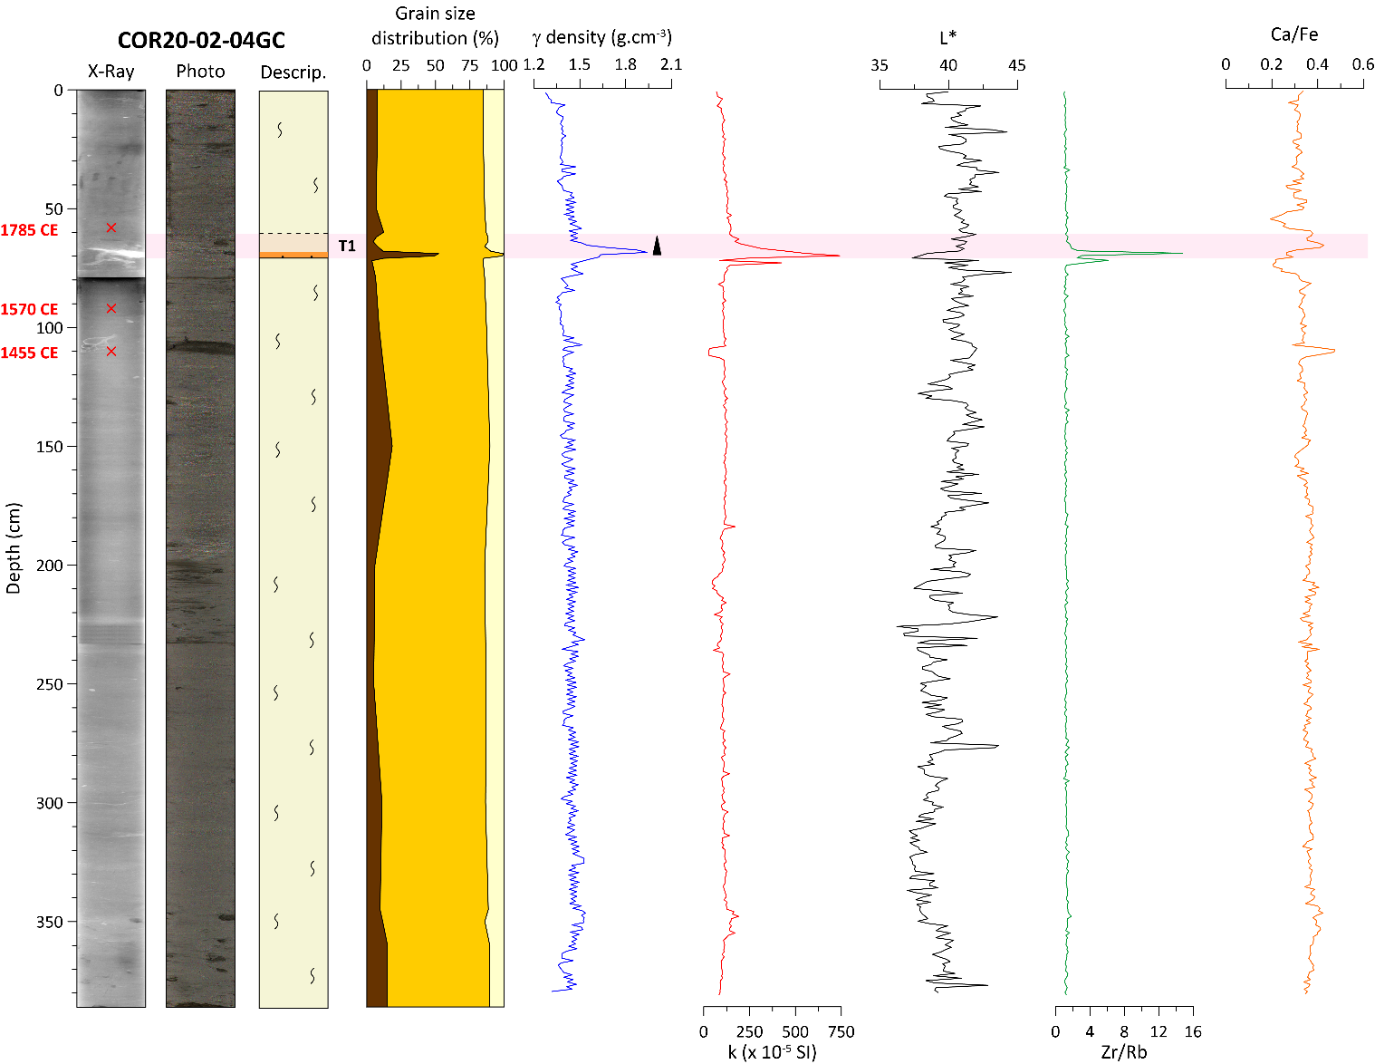
Introduction
Materials and Methods
Results
Discussion
Conclusion
Mérindol et al., in prep.
Mérindol et al., in prep
Mérindol et al., in prep.
EGU 2022 – ts4.4 – Earthquake-triggered submarine landslides in the St. Lawrence Estuary during the last two millennia and the record of the major 1663 CE M ≥ 7 event – M.Mérindol

Slide 5
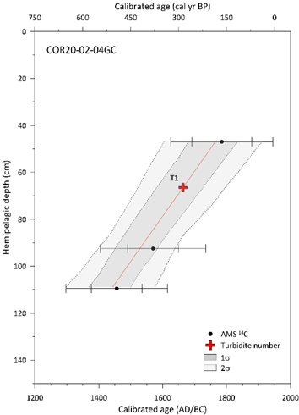
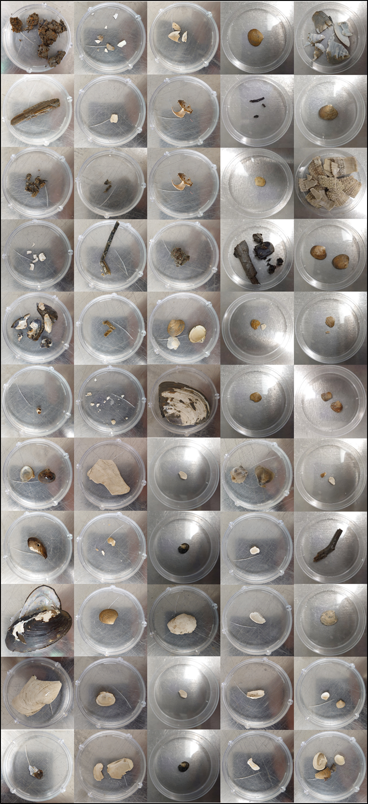
Introduction
Materials and Methods
Results
Discussion
Conclusion
Shell samples
Age model
~1665 ± 70 CE
Mérindol et al., in prep
EGU 2022 – ts4.4 – Earthquake-triggered submarine landslides in the St. Lawrence Estuary during the last two millennia and the record of the major 1663 CE M ≥ 7 event – M.Mérindol

Slide 6
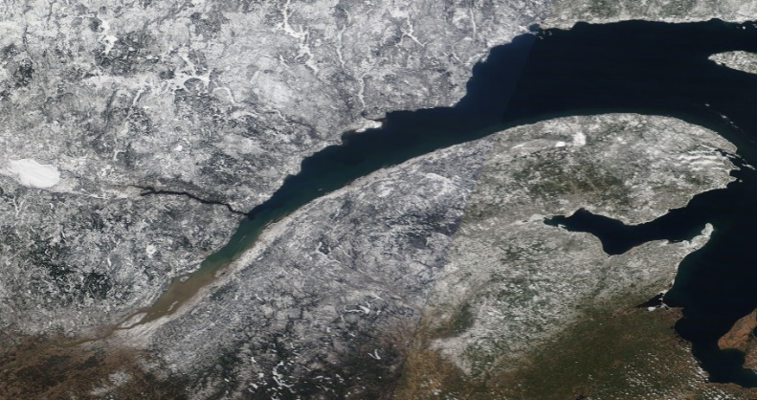
Introduction
Materials and Methods
Results
Discussion
Conclusion
Synchronous submarine landslides over 250 km
Trigger factors possible:
rapid relative sea-level rise
storms
earthquakes
~1850 CE
~1635 CE
Mérindol et al., in prep
EGU 2022 – ts4.4 – Earthquake-triggered submarine landslides in the St. Lawrence Estuary during the last two millennia and the record of the major 1663 CE M ≥ 7 event – M.Mérindol

Slide 7
Introduction
Materials and Methods
Results
Discussion
Conclusion
Synchronous submarine landslides over 250 km
Trigger factors possible:
rapid relative sea-level rise
storms
earthquakes
~1850 CE
~1635 CE
Relationship between submarines landslides and seismicity in eastern Canada.
Mérindol et al., in prep
EGU 2022 – ts4.4 – Earthquake-triggered submarine landslides in the St. Lawrence Estuary during the last two millennia and the record of the major 1663 CE M ≥ 7 event – M.Mérindol

Slide 8
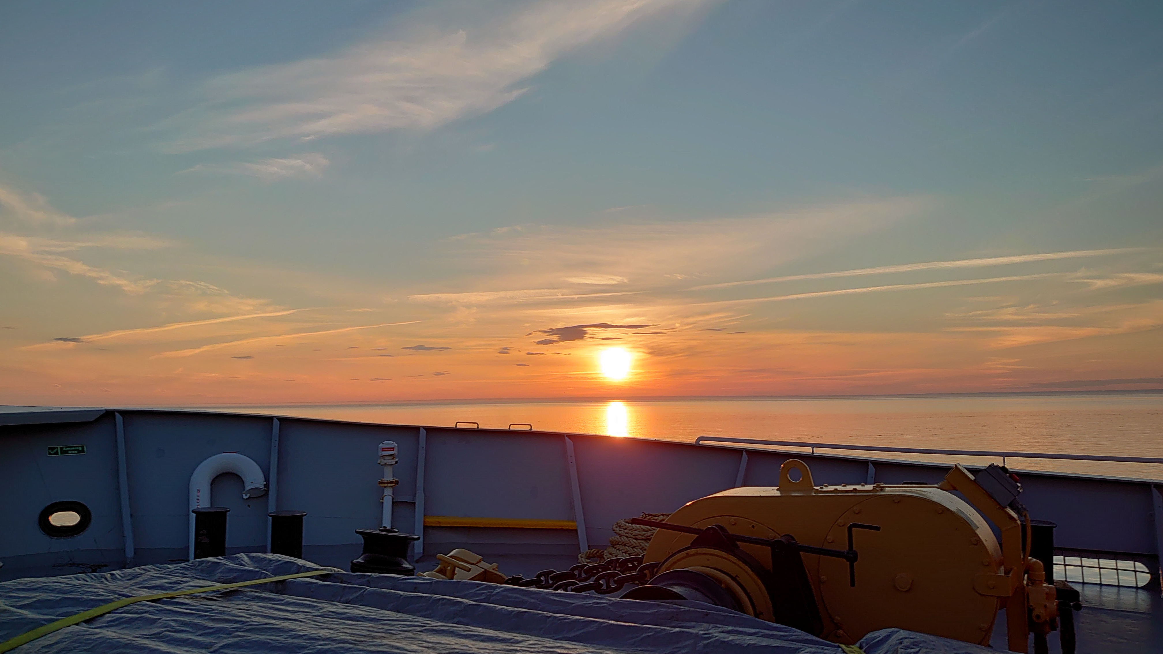



Thank you !
This work was supported by ISblue project, Interdisciplinary graduate school for the blue planet (ANR-17-EURE-0015) and co-funded by a grant from the French government under the program "Investissements d'Avenir".
The SLIDE2020 expedition was supported by ship time of the Odyssée Saint-Laurent program of the Réseau Québec maritime (RQM). G. St-Onge and P. Lajeunesse acknowledge the financial support of the Natural Sciences and Engineering Research Council of Canada (NSERC) through their discovery and previous ship time grants.
meril.merindol@ifremer.fr
8

