Slide 1







SOURCE TO SEA: THE RELATIONSHIP BETWEEN CARBON AND IRON IN A MID LATITUDE FJORD
Celeste Kellock¹
Craig Smeaton², Nadeem Shah³, William Austin², and Christian Schrӧder¹
¹University of Stirling , Biological and Environmental Sciences , United Kingdom
(celeste.kellock@stir.ac.uk)
²School of Geography and Sustainable Development, University of St Andrews, St Andrews, KY16 9AL
³Forest Research, Northern Research Station, Midlothian, EH25 9SY
As this is a research is in progress please do not tweet / screenshot images of this data.
Happy to connect on twitter otherwise.

Slide 2
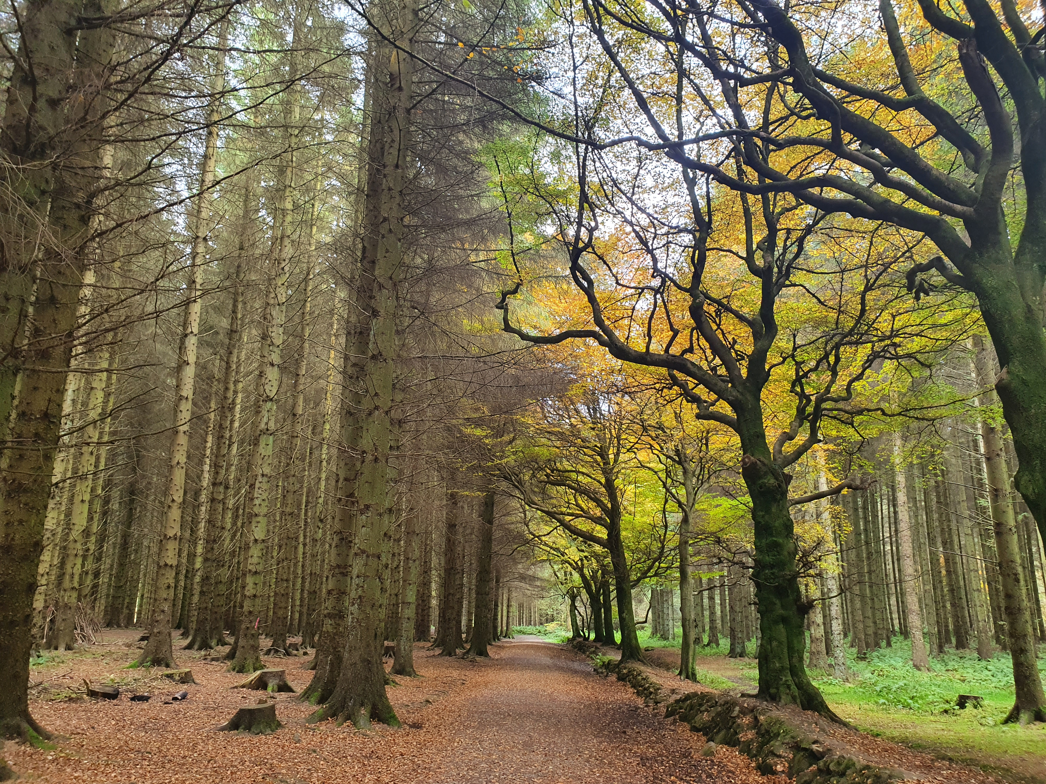
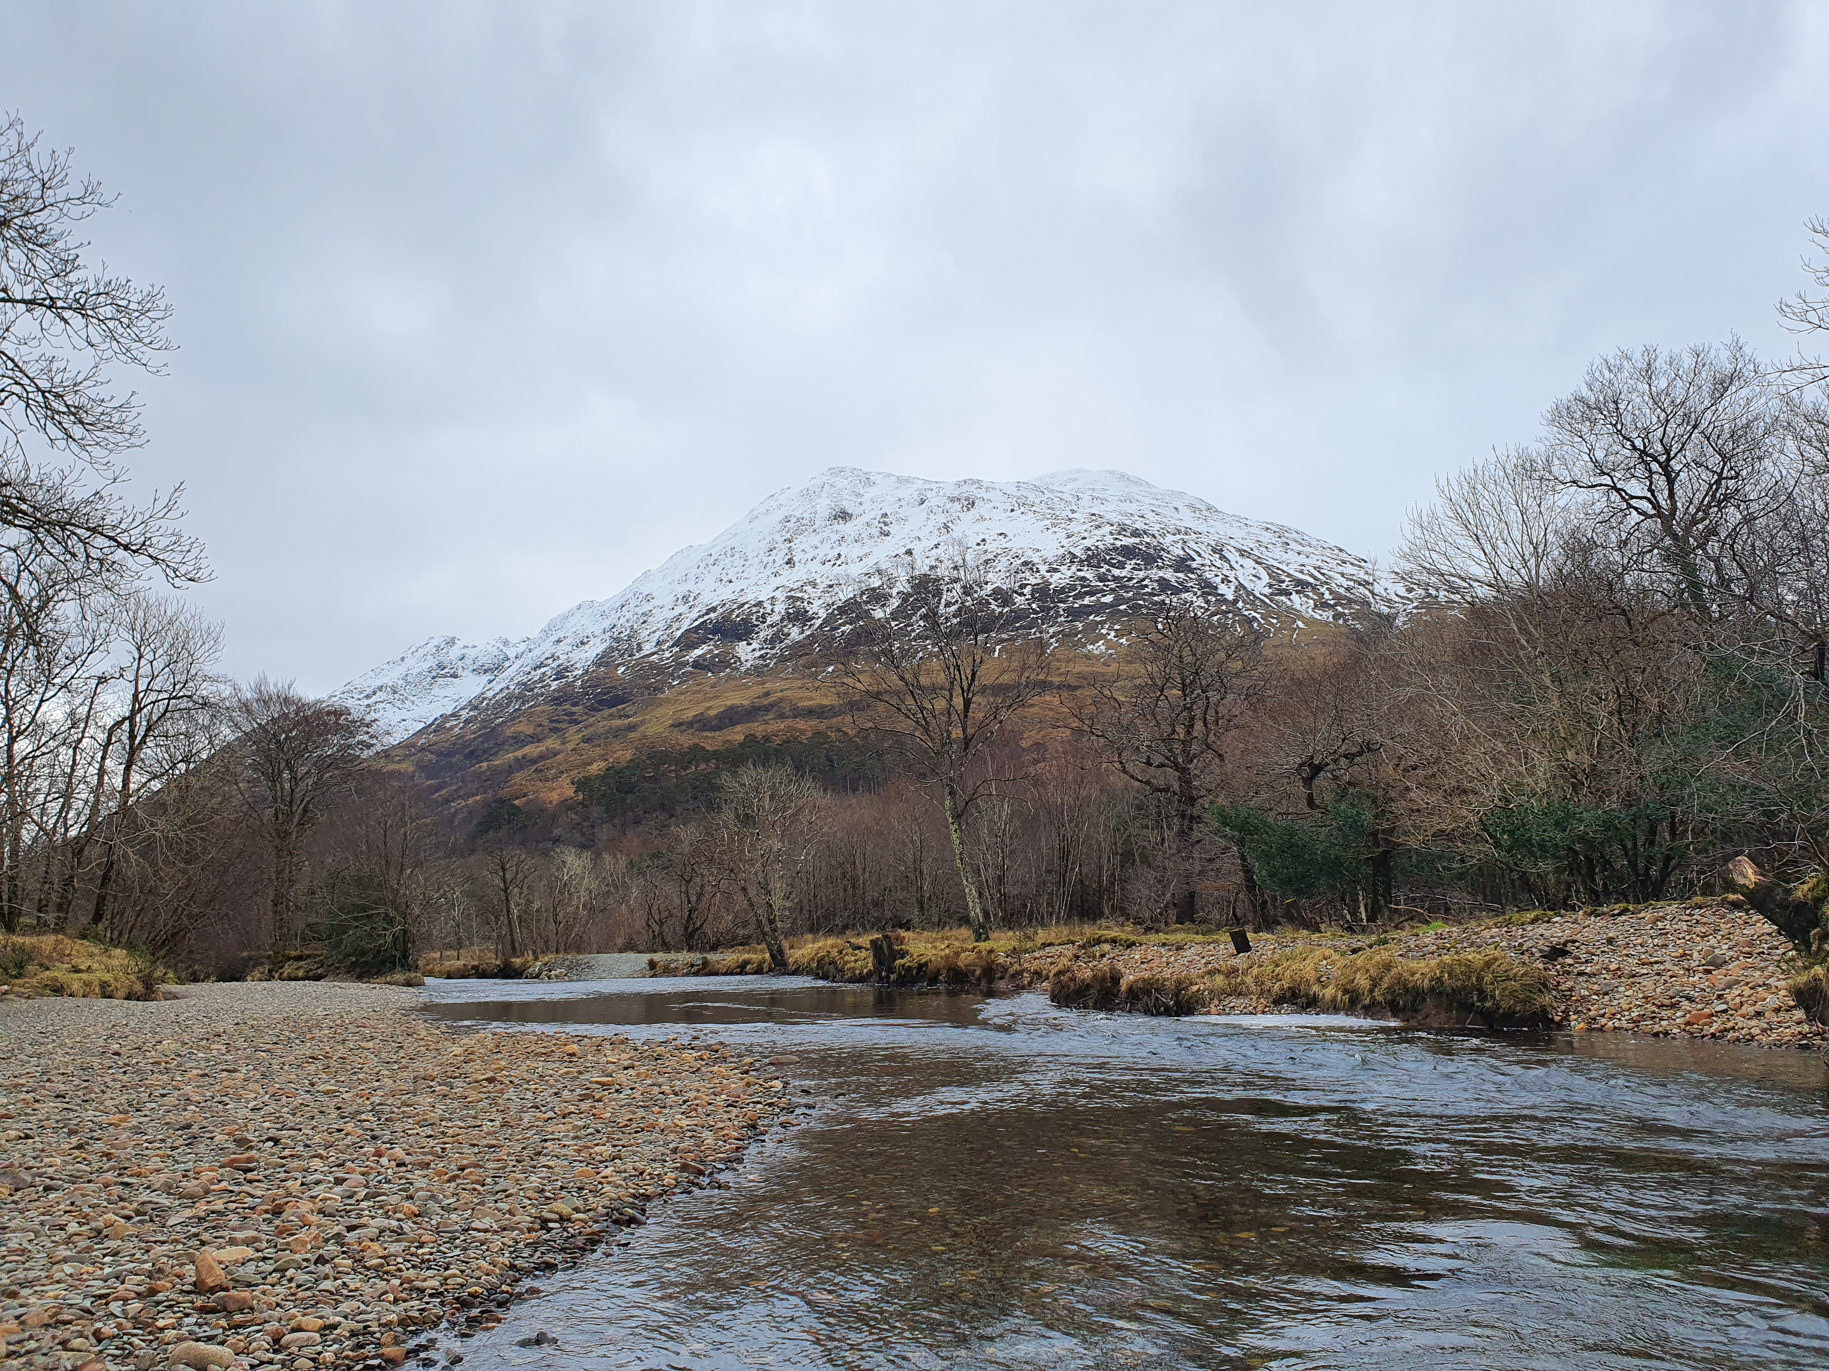
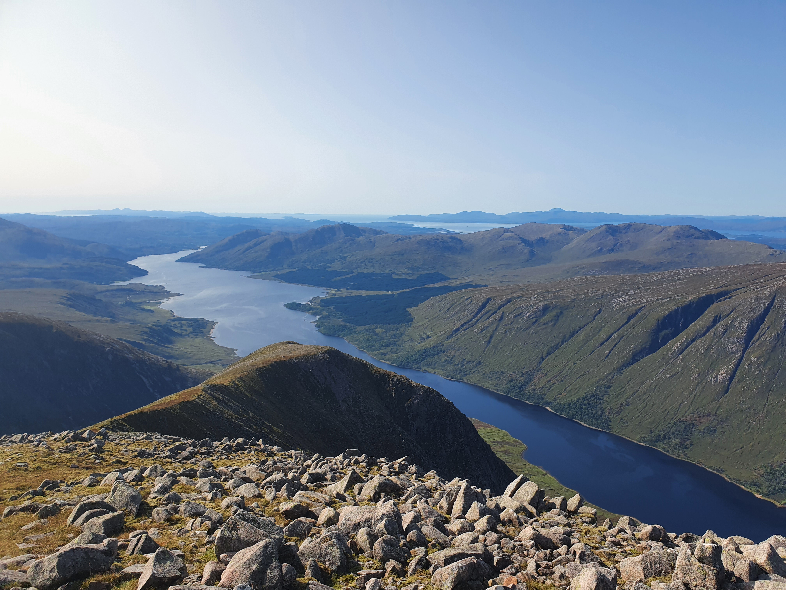
INTRODUCTION
celeste.kellock@stir.ac.uk
@celestethelion

Slide 3
RESEARCH FOCUS
celeste.kellock@stir.ac.uk
@celestethelion
C
FJORD SEDIMENT SAMPLES ARE THE FOCUS OF THIS PRESENTATION
Fe
C
Fe
C
Fe
Refers to Smeaton et al., 2016, 2017, 2019, Lalonde et al., 2012.

Slide 4
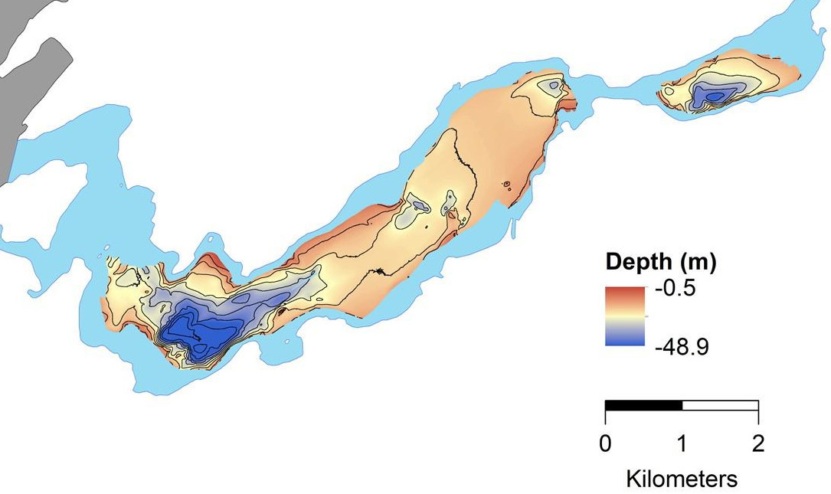
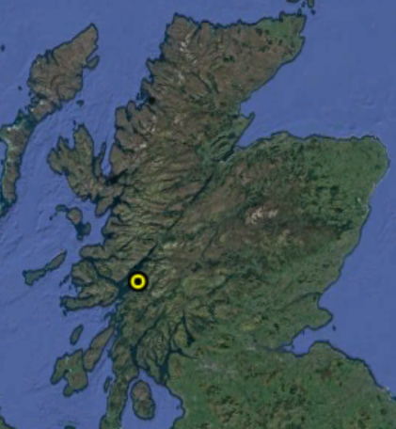
BATHYMETRY
celeste.kellock@stir.ac.uk
@celestethelion
Loch Creran Bathymetric map
UB1
LB1
UB2
LB2
Bathymetric map from Hunt et al., 2022. Edited.

Slide 5
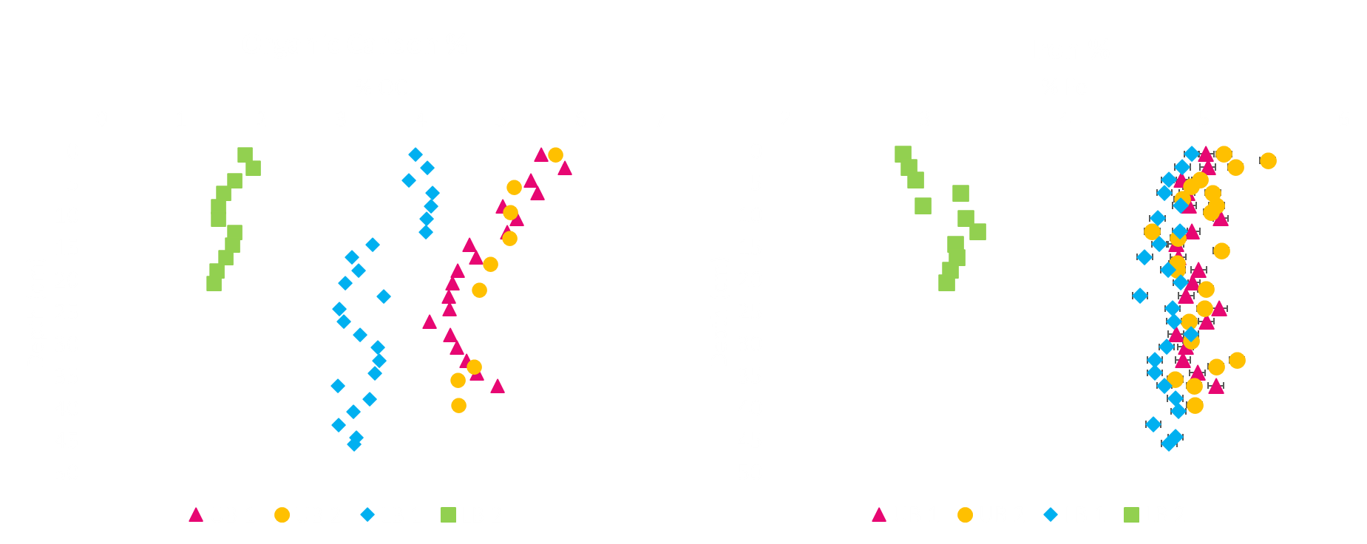
IRON AND CARBON
celeste.kellock@stir.ac.uk
@celestethelion

Slide 6
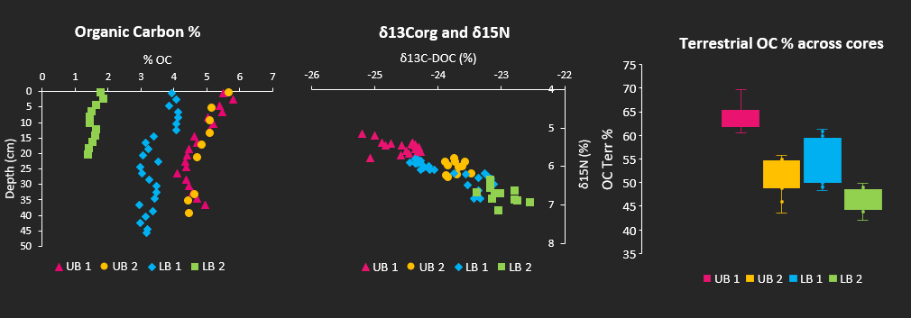
ORGANIC CARBON CYCLING AND ISOTOPES
celeste.kellock@stir.ac.uk
@celestethelion
Terrestrial
Marine

Slide 7
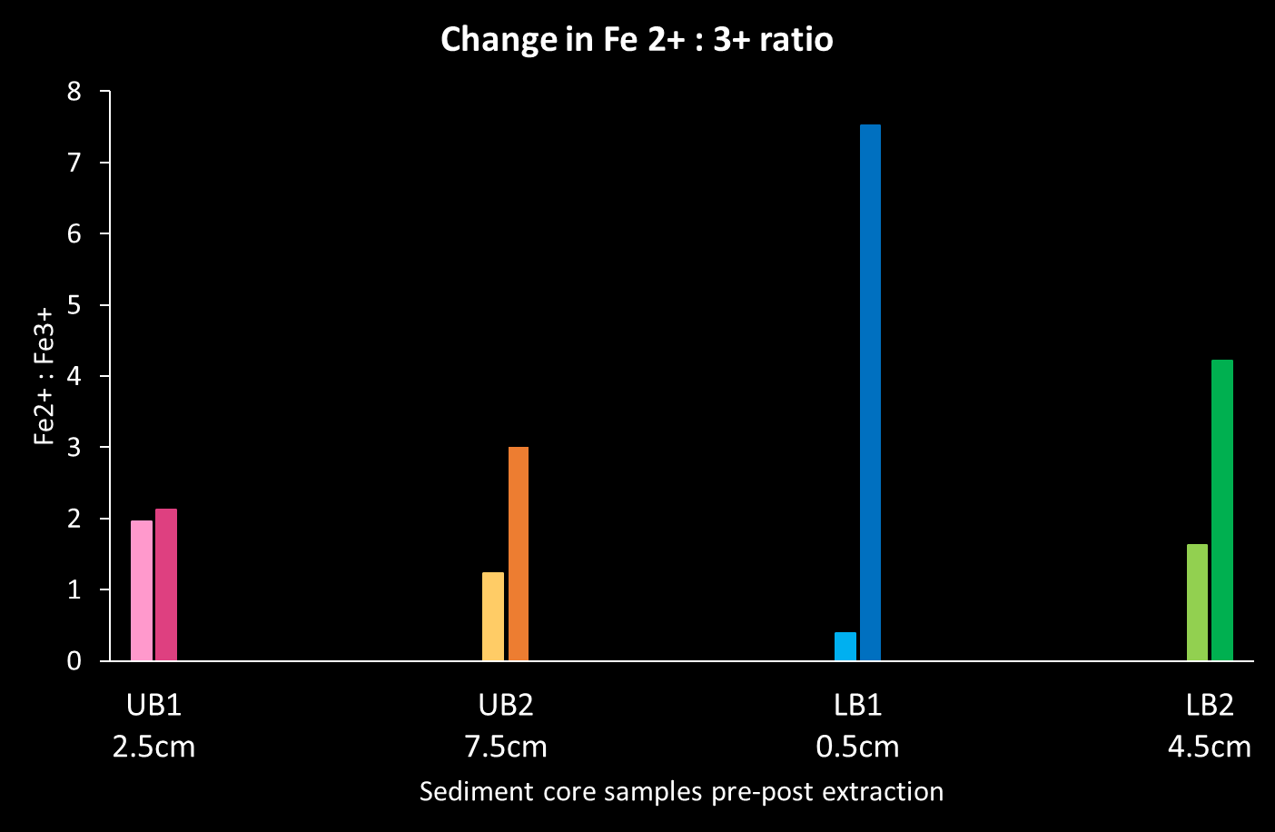
PRELIMINARY EXTRACTION RESULTS
celeste.kellock@stir.ac.uk
@celestethelion

Slide 8
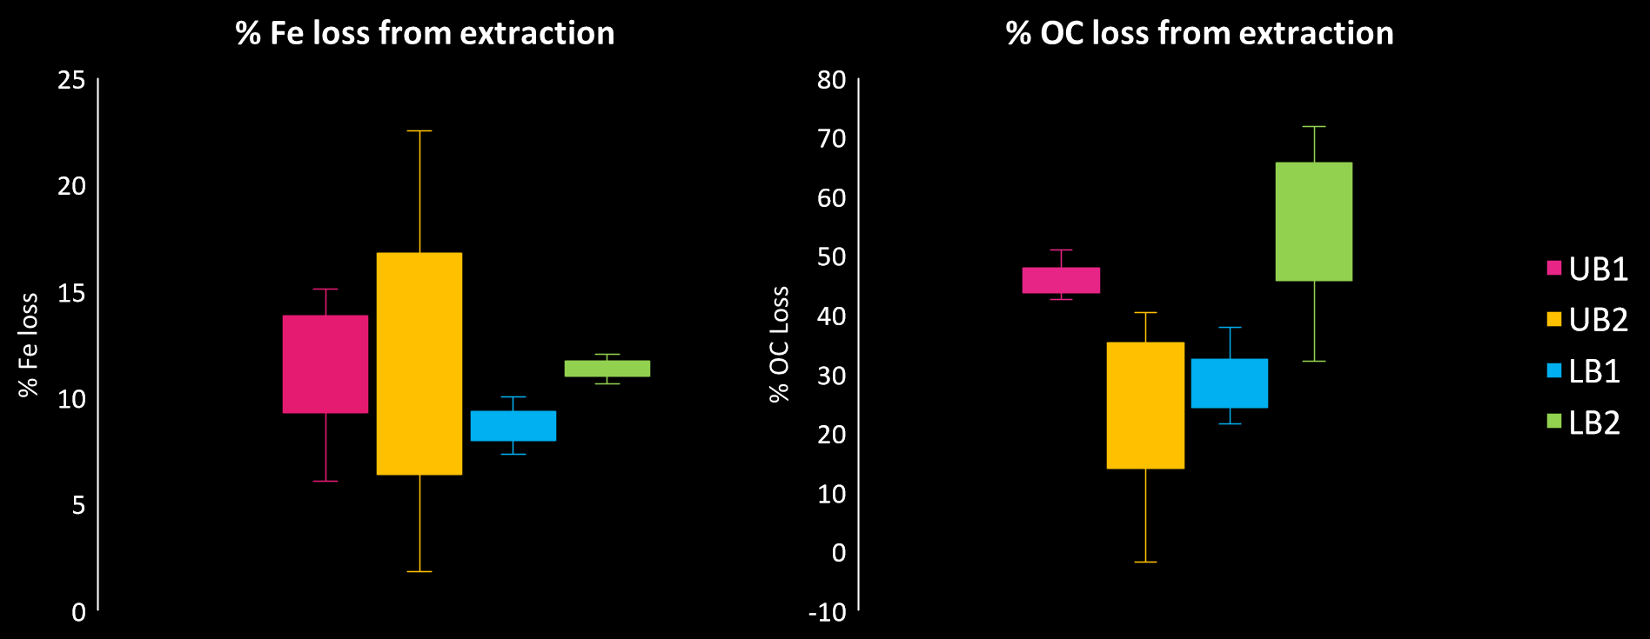
PRELIMINARY EXTRACTION RESULTS
celeste.kellock@stir.ac.uk
@celestethelion

Slide 9
SUMMARY
celeste.kellock@stir.ac.uk
@celestethelion
DIFFERENT SOURCES OF IRON AND ORGANIC CARBON.
ASSOCIATIONS ARE NOT LINEAR THROUGHOUT FJORD.
PRESENCE OF REACTIVE IRON MINERALS.
EFFECTIVE EXTRACTION METHODS.
40-70% OF THE ORGANIC CARBON IN LOCH CRERAN IS OF TERRESTRIAL ORIGIN.
HIGHLIGHTING THE INFLUENCE TERRESTRIAL PROCESSES MAY HAVE ON COASTAL PROCESSES.
ANALYSIS ONGOING TO DETERMINE SOURCES OF ORGANIC CARBON.
IS THERE PREFERENTIAL BINDING BETWEEN SPECIES?

Slide 10
THANK YOU FOR YOUR TIME, ANY FURTHER QUESTIONS PLEASE SEE THE CONTACT DETAILS BELOW
Email
celestekellock@stir.ac.uk
Twitter
@celestethelion
@ourearthpodcast

Slide 11
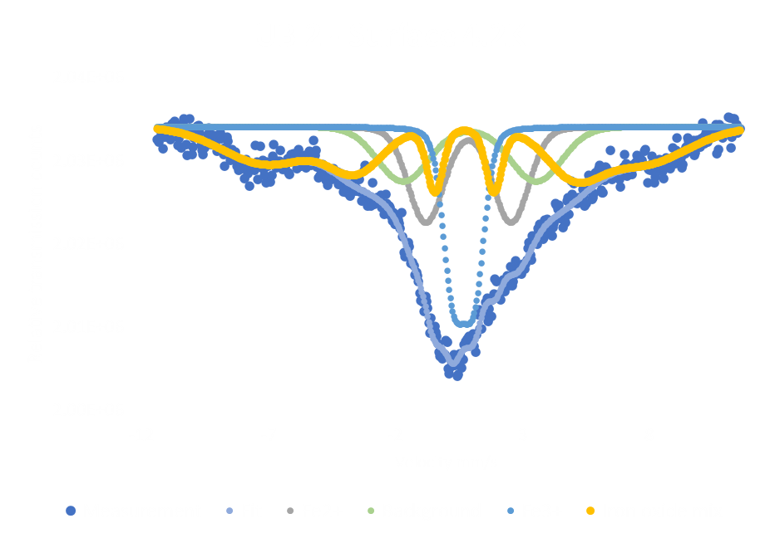
PRELIMINARY EXTRACTION RESULTS
celeste.kellock@stir.ac.uk
@celestethelion
Notes:
Extra slide

Slide 12
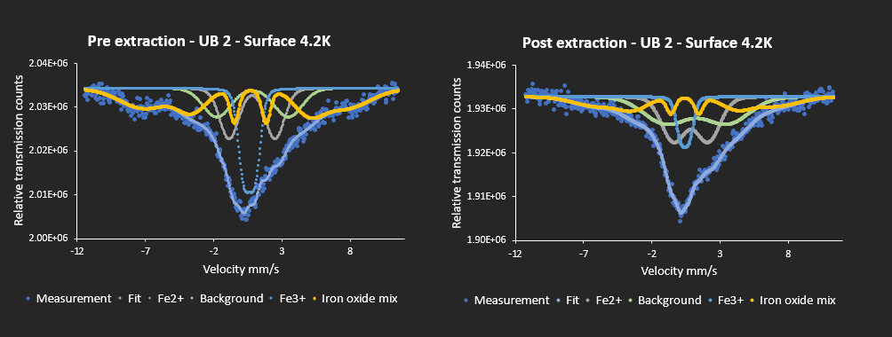
PRELIMINARY EXTRACTION RESULTS
celeste.kellock@stir.ac.uk
@celestethelion
Notes:
Extra slide

