Slide 1
Enhancing planetary imagery with the holistic attention network algorithm
Denis Maxheimer^{1,4}, Ioannis Markonis¹, Masner Jan², Curin Vojtech¹, Pavlik Jan², and Solomonidou Anezina³
¹Czech University of Life Sciences, Faculty of Environmental Sciences, Czechia
²Czech University of Life Sciences, Faculty of Economics and Management, Czechia
³California Institute of Technology: Pasadena, CA, US
⁴Email: xgold007@studenti.czu.cz

Slide 2
Abstract
The recent developments in computer vision research in the field of Single Image Super Resolution (SISR) can help improve the satellite imagery data quality and, thus, find application in planetary exploration.
The aim of this study is to enhance planetary surface imagery, in planetary bodies that there are available data but in a low resolution.
Here, we have applied the holistic attention network (HAN) algorithm to a set of images of Saturn’s moon Titan from the Titan Radar Mapper instrument in its Synthetic Aperture Radar (SAR) mode, which was on board the Cassini spacecraft.
HAN can find correlations among hierarchical layers, channels of each layer, and all positions of each channel, which can be interpreted as an application and intersection of previously known models.

Slide 3
Objectives
Prepare an imagery dataset for training and validation
Find the best configuration of the algorithm applicable for the planetary imagery data
Train the algorithm till reasonable train loss numbers are met
Test on different kind of data (resolution, imagery source)
Choose the most promising scale factor x2, x4 or x8
Analyze the results and how they can be improved

Slide 4
Methodology
Algorithm used in this work is a modified version of an original HAN algorithm, since it allows to easily train on original data
In particular, algorithm is made using PyTorch, Pillow and OpenCV python packages
Docker is used for code deployment on server
Two main training approaches: x2 and x8 upscaling
Training is performed using CPU resources
Dataset for training contains 254 395 images and 30 000 more for validation

Slide 5
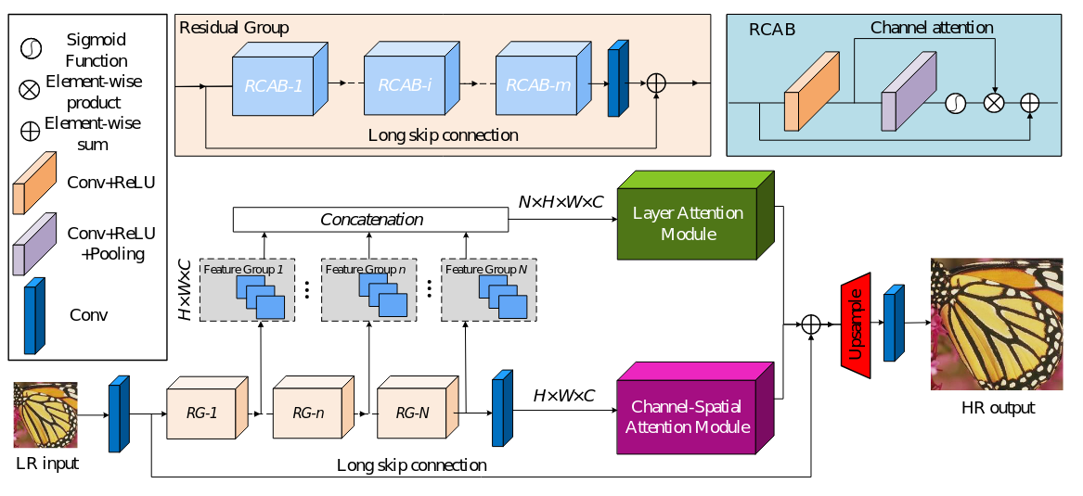
Methodology
HAN - is a Holistic Attention Network, which was proposed as combination of Layer Attention Module (LAM) and Channel-Spatial Attention Model(CSAM) to model the correlation among different layers ^{[1]}.
Fig. 1. Network architecture of the HAN ^{[1]}.

Slide 6
Train configuration (x2 upscaling)
Best validation loss is 0.46 for 5 epochs
n_rg (number of residual groups) → 10
n_rcab (number of residual groups) → 20
n_feats (number of feature maps)→ 64
patch size → 60
batch size → 16
normalization (number of color channels to use) → 0/ no normalization

Slide 7
Train configuration (x8 upscaling)
Best validation loss is 24.85 for 249 epochs trained on Earth imagery data using GPU
Best validation loss is 1.65 for 270 epochs continued training on _____ imagery data using CPU
n_rg → 10
n_rcab → 20
n_feats → 64
patch size → 60
batch size → 4
normalization → 0/ no normalization

Slide 8
Results
Test is made for images with different resolution:
Already high resolution Titan image
Low resolution crop of Titan image
Low resolution Earth image
For better estimation of the results (since pictures are compressed in presentation), images can be found via google drive link:
https://drive.google.com/drive/folders/1mq88ImgNd-8Rcapb-ToGBhFRE4Z6XOo2?usp=sharing

Slide 9
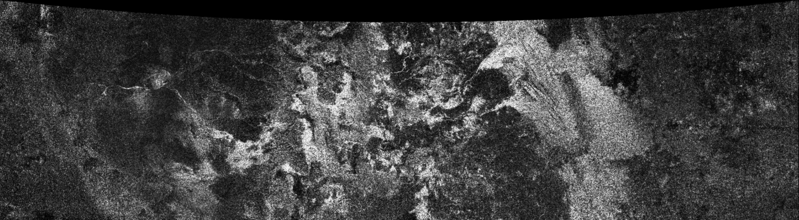
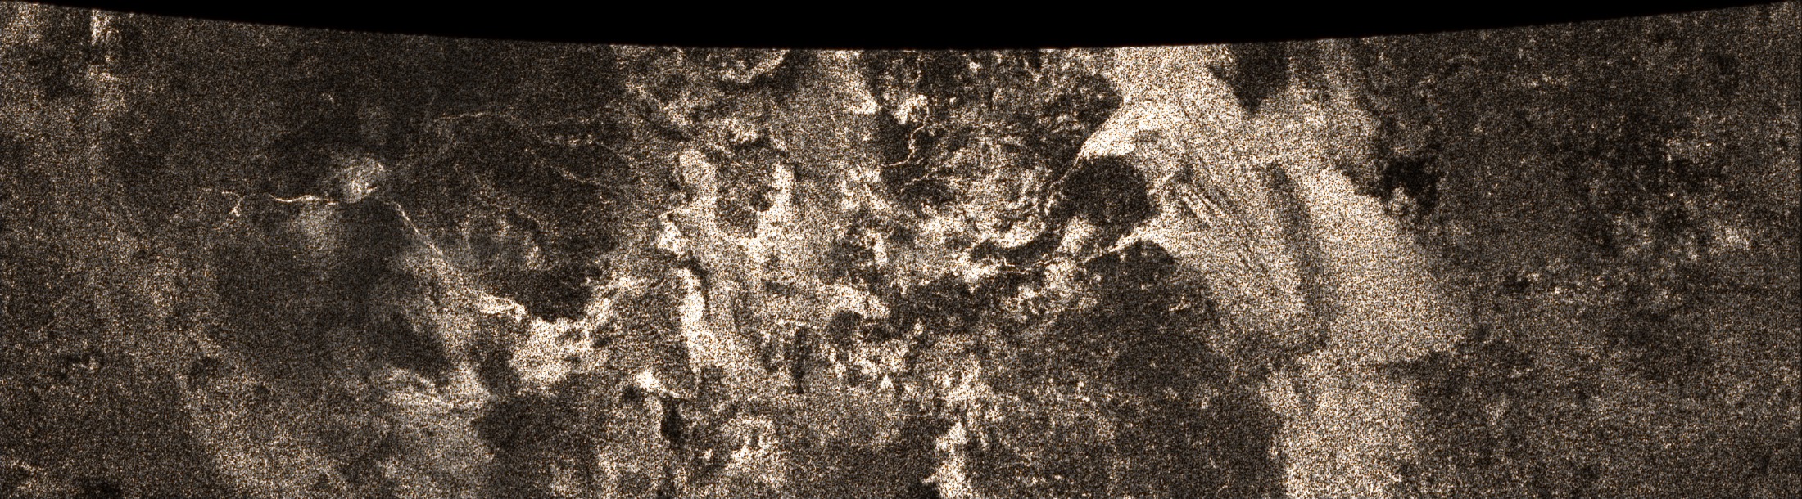
Big Titan Image
Original Image - lower resolution [3107x862px]
Double datasets train - higher resolution [24856x6896px]

Slide 10
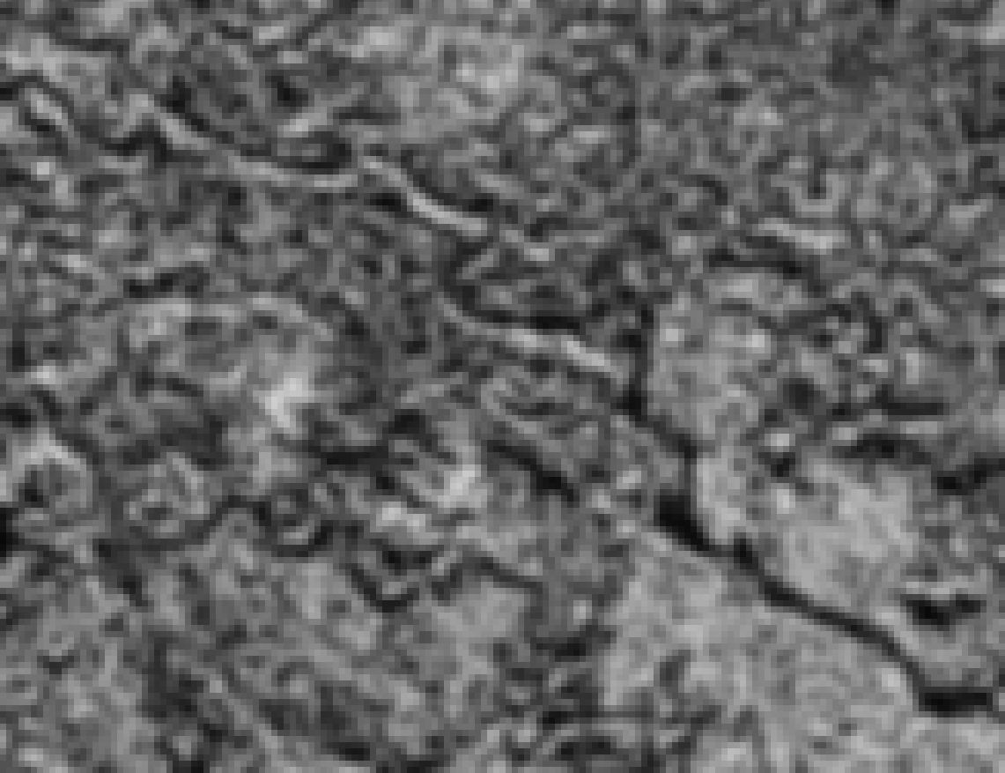
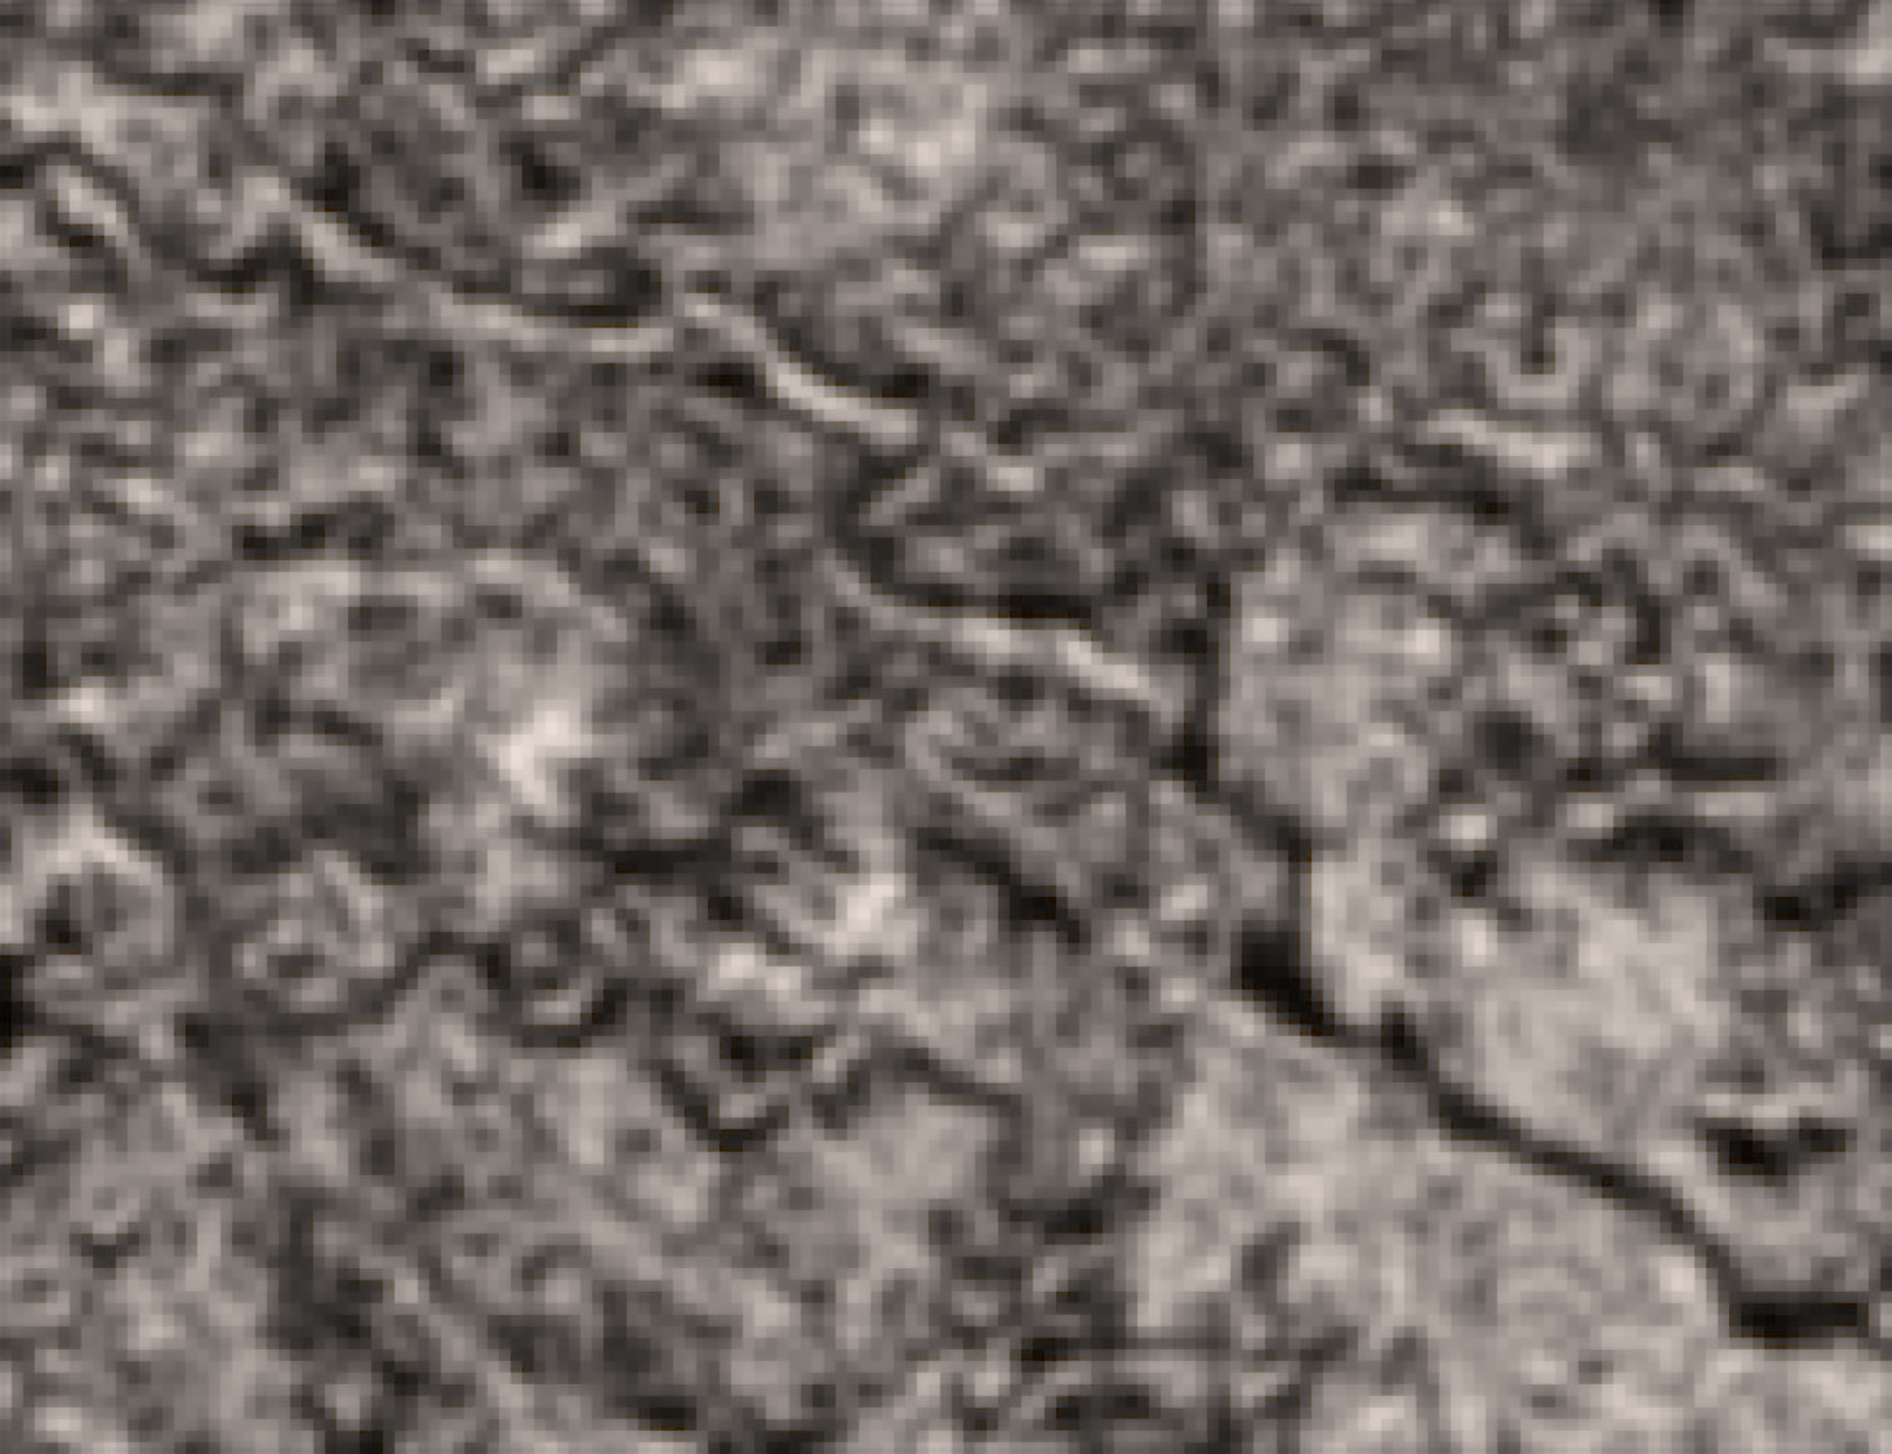
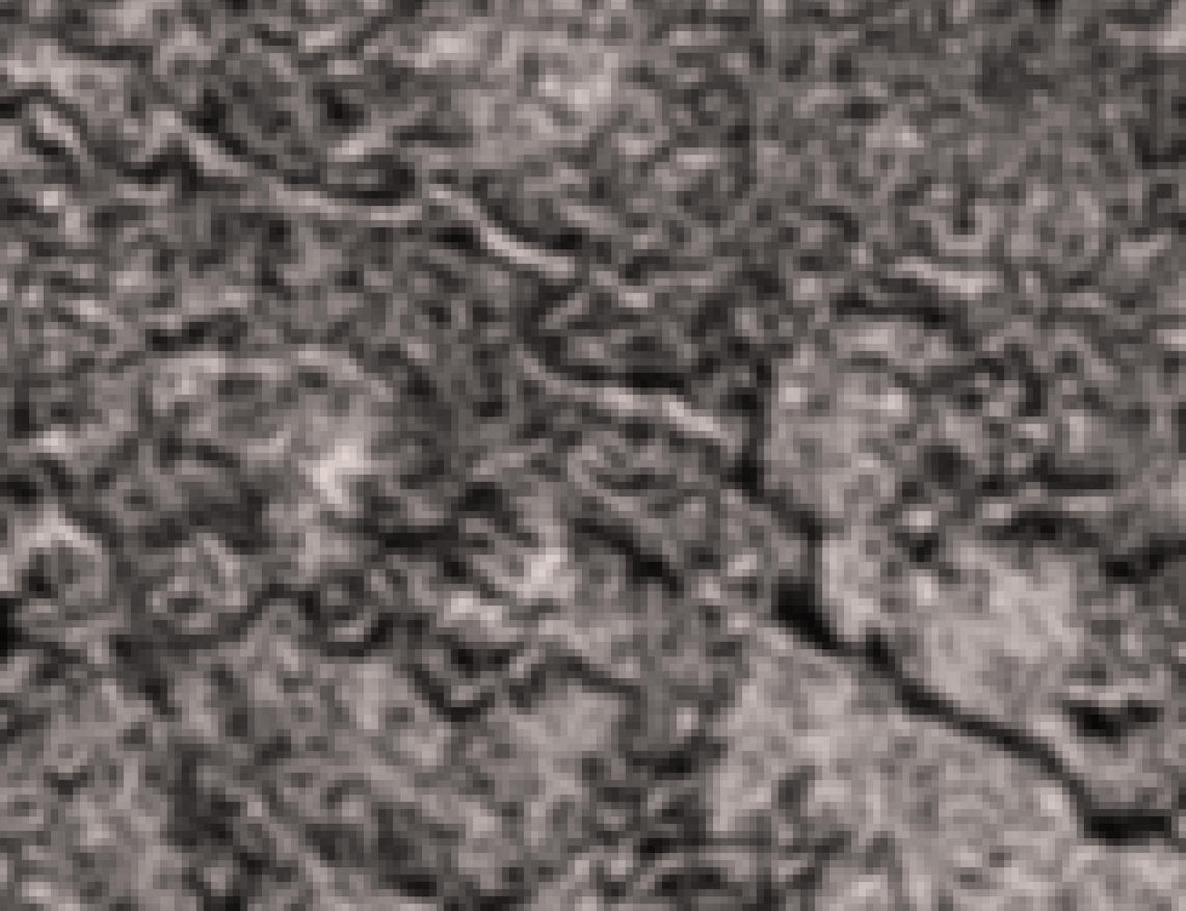
Small Titan image
Original - low resolution
[1141x877px]
Single dataset train - high resolution [9128x7016px]
Double datasets train - high resolution [9128x7016px]

Slide 11
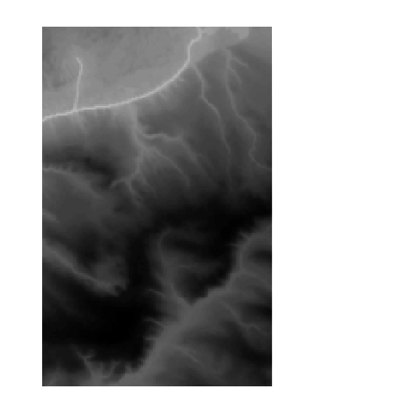
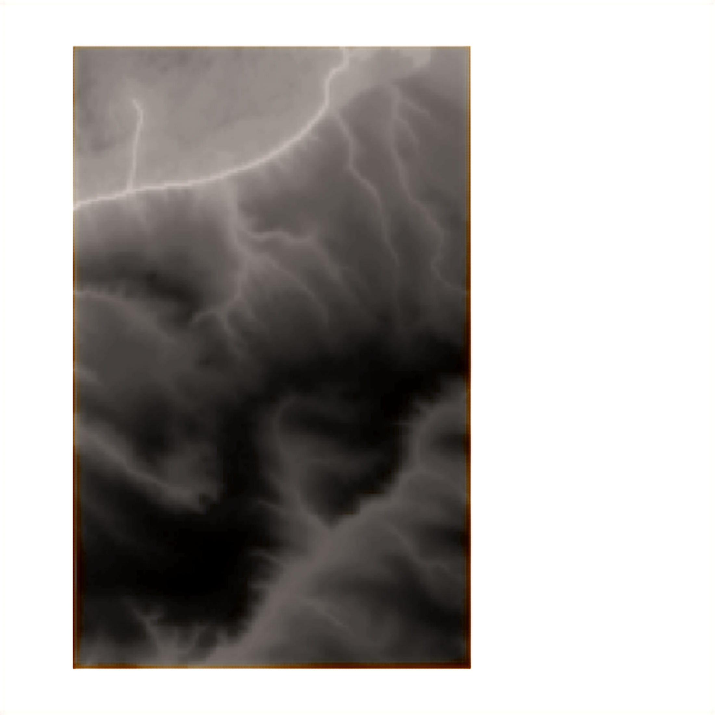
Small Earth Image
Original - low resolution [480x480px]
(incl. white borders)
Double datasets train - low resolution
[3840x3840px]
(incl. white borders)

Slide 12
Summary
Training had been made using big enough datasets
The best validation loss values are reasonable for corresponding number of epochs and scale factor
The improvement of the upscaled image is seen, when zoomed out
Image zoomed in features resolution is not significantly improved
Using Holistic Attention Network algorithm for planetary imagery upscaling looks promising, however results are yet not useful enough
Further steps would be to train using other datasets, which would be more useful for planetary images upscaling.

Slide 13
References
1. Ben Niu, g, Kaihao Zhang, Xiaochun Cao, Haifeng Shen, “Single Image Super-Resolution via a Holistic Attention Network”, 20 Aug 2020, arXiv:2008.08767v1 [eess.IV]

