Slide 1





Nutrient inputs by aeolian deposition in the sahelian soils
Rizewana Marécar (1), B. Marticorena (1), G. Bergametti (2), C. Galy-Lacaux (3), J. L. Rajot(1,4), S. Chevaillier(1), A. Féron(2), S. Triquet (2), M. Diaz-Alvez (3)
(1) Univ Paris Est Créteil and Université de Paris, CNRS, LISA, F-94010 Créteil, France
(2) Université de Paris and Univ Paris Est Créteil, CNRS, LISA, F-75013 Paris, France
(3) UPS, Toulouse, CNRS, IRD, LAERO, F-31400
(4) iEES Paris, UMR IRD 242, Univ Paris Est Créteil, Sorbonne Université, CNRS, INRA, Université de Paris, Bondy, F-93143

Slide 2
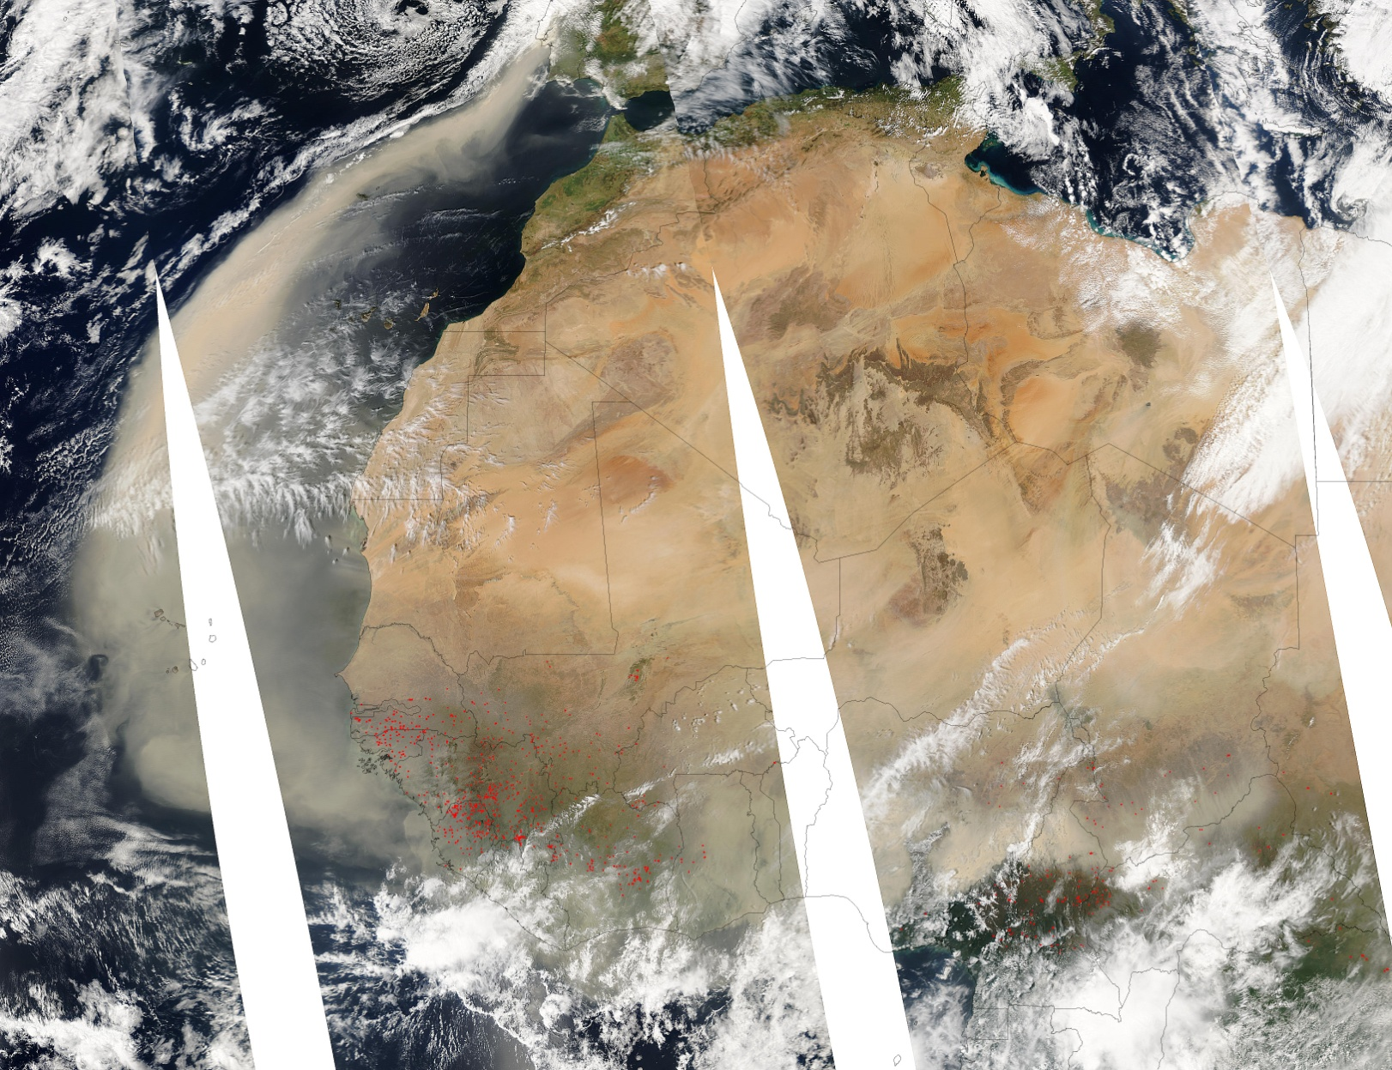
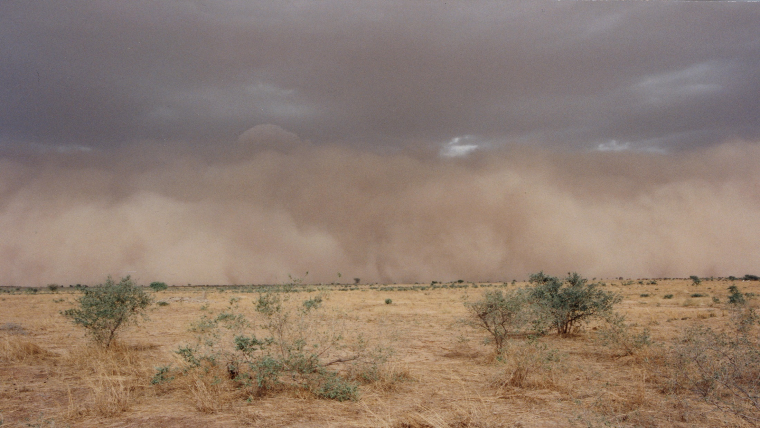
context
The Sahara-Sahel region is the most intense source of dust in the world.
But the Sahel is submitted to semi-arid conditions that impacts the local mineral dust content.
During the dry season :
large amounts of Saharan dust is exported and deposited over the Sahel while local dust emissions are low
During the wet season :
The vegetation cover is low at the beginning of the wet season and allows intense dust emissions by convective systems
The precipitation associates with convective systems produce large wet deposition fluxes
_ The Sahel is an area of emission AND deposition of dust

Slide 3
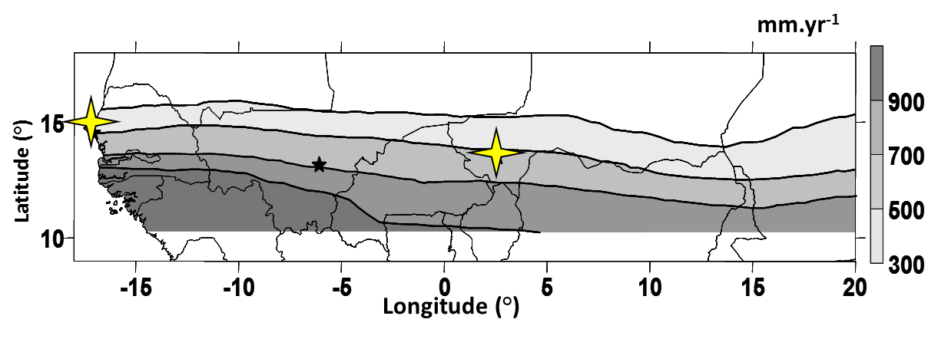
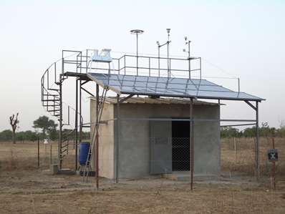
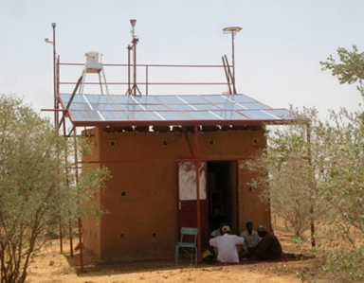
context
Question :
Does dust deposition represent a significant input of nutrients for Sahelian soils ?
Objectives :
quantify the nutrients inputs (Ca, K, P, C) important for the soil due to dust deposition
trace the sources of deposited dust in Sahel
Deployment :
Up-grade of the INDAAF stations to sample and analyse aerosols and deposition in Niger and Senegal
Location of stations : Bambey (Senegal) and Banizoumbou (Niger) INDAAF (International Network to study Deposition and Atmospheric Composition in Africa; https://indaaf.obs-mip.fr/)

Slide 4
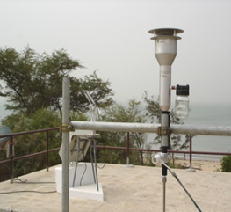
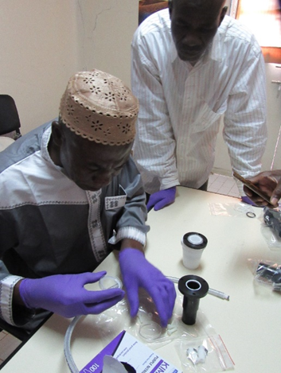
Methods/ sampling and analysis
aerosols
Sampled with a PM10 (Particulate Matter <10µm) inlet once a week
Elemental analysis with a XRF and C analysis with IRD analyzer

Slide 5
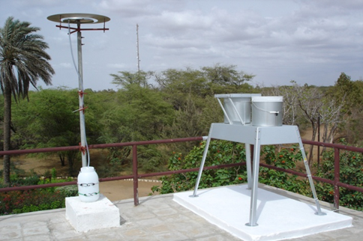
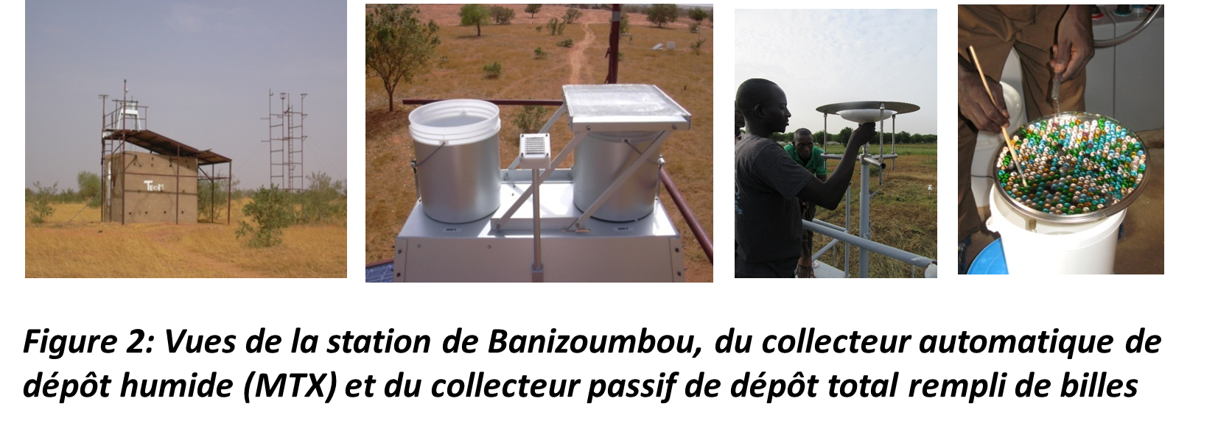
Methods/ sampling and analysis
aerosols
ATMOSPHERIC DEPOSITS : SOLUBLE AND INSOLUBLE FRACTION
Sampled with a PM10 (Particulate Matter <10µm) inlet once a week
Elemental analysis with a SFX and C analysis with IRD analyzer
Total deposition collected on a inverted Frisbee
Wet deposits are collected during rainfall with an automatic collector (MTX)
(Marticorena et al., 2017)

Slide 6
Methods/ sampling and analysis
aerosols
ATMOSPHERIC DEPOSITS : SOLUBLE AND INSOLUBLE FRACTION
Sampled with a PM10 (Particulate Matter <10µm) inlet once a week
Elemental analysis with a SFX and C analysis with IRD analyzer
Insoluble fraction :
Deposits were recovered by rinsing, decanting, and drying, then weighed
ICP-MS analysis for elemental composition; combustion + gaz phase chromatography for C and N

Slide 7
Methods/ sampling and analysis
aerosols
ATMOSPHERIC DEPOSITS : SOLUBLE AND INSOLUBLE FRACTION
Sampled with a PM10 (Particulate Matter <10µm) inlet once a week
Elemental analysis with a SFX and C analysis with IRD analyzer
Soluble fraction :
an aliquot of rinse water for total deposition and rainwater for wet deposition is taken and kept frozen with thymol
Analysis by IC (soluble anions and cations ) and by ICP-MS for elemental composition

Slide 8
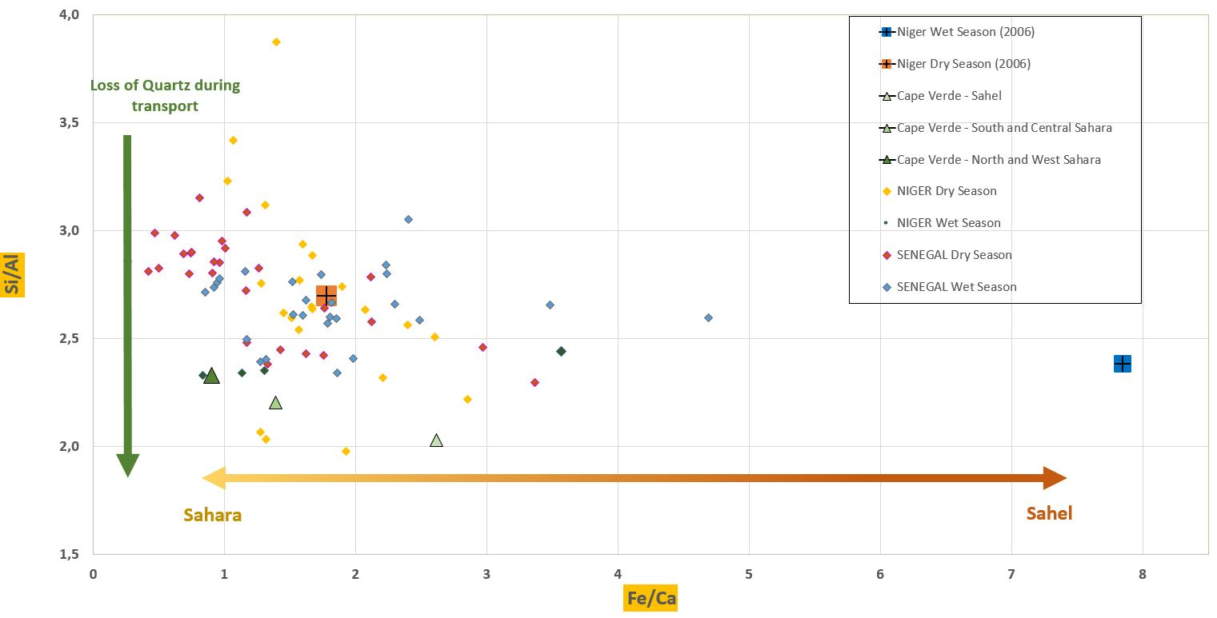
results : AEROSOLS
Si/Al
Fe/Ca

Slide 9
results : AEROSOLS
- Aerosol composition is consistent with previous results
- dry season = saharan sources signatures in Niger and Senegal
- Wet season = Sahelian source signature in Niger but a different signature in Senegal
Si/Al

Slide 10
results : ATMOSPHERIC DEPOSITS
Total mass for aerosols = sum of oxides from elemental composition
Total mass for deposits = sum of dissolved species + insoluble mass
// = no analysis or no data

Slide 11
results : ATMOSPHERIC DEPOSITS
- Seasonal variations in aerosol and deposits composition are observed at the two stations
- the % are lower in the deposits than in the aerosols
- Ca, K and P are mainly found in the soluble fraction
Total mass for aerosols = sum of oxides from elemental composition
Total mass for deposits = sum of dissolved species + insoluble mass
// = no analysis or no data

Slide 12
results : ATMOSPHERIC DEPOSITS
Annual deposition flux : ~200 g/m²
Annual inputs (kg/ha)
estimated with the min and max % in the deposits
Ca : 19 - 34
K : 3 - 62
P : 1 - 29
C : 46 - 58

Slide 13
CONCLUSION
Aerosols and atmospheric deposits have been collected by local operators in proper conditions for chemical analysis for more than 3 years in Niger and Senegal
Aerosol composition suggests a Saharan dust origin in the dry season while in the wet season a local sahelian signature is observed in the Niger but not in Senegal.
The %of the nutrients of interest for sahelian soil in the atmospheric deposits are in the same order of magnitude but lower that in the aerosols, and higher than in Sahelian soils
Further investigations are required to combine for the seasonal differences in the nutrients content and deposition fluxes and deposition processes (wet/dry)
The estimated annual input for Ca, K, P and C are significant and comparable to the input by manure in typical sahelian agro-pastoral environments

Slide 14
Thank you for your attention

