Slide 1


Spatial-temporal dynamics of salinity profiles measured in the freshwater lens system of the malta mean sea level aquifer (Msla)
Demichele Francesco, Sapiano Manuel, Mamo Julian, Schembri Michael
Energy and Water Agency, Malta
Portoghese Ivan
National Research Council of Italy, Water Research Institute (CNR-IRSA)

Slide 2
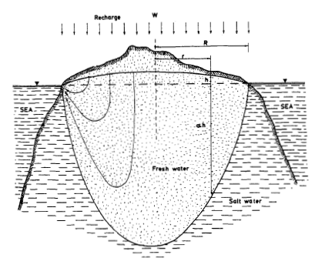
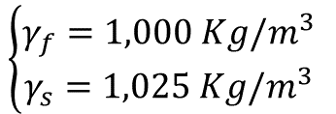


Idealised lens in a permeable oceanic island
Assumptions:
Hydrostatic conditions
Two stationary immiscible fluids of different density in equilibrium
Sharp interface
Same water pressure on both sides of the sharp interface
$$z=\frac{γ_{f}}{γ_{s}−γ_{f}} h_{f}=α h_{f}≈40 h_{f}$$
$$\left\{\begin{aligned}γ_{f}=1,000 Kg/m^{3} \\ γ_{s}=1,025 Kg/m^{3} \end{aligned}\right.$$
$$z≈40 h_{f}$$
STUDY AREA
EC PROFILES
AND STRATIGRAPHY
EC INTERFACES
CONCLUSIONS
* Falkland, Custodio et al. (1991)
** Ghyben (1889) and Herzberg (1901)
Notes:
GH equation widely applied in my study area
Assumptions

Slide 3
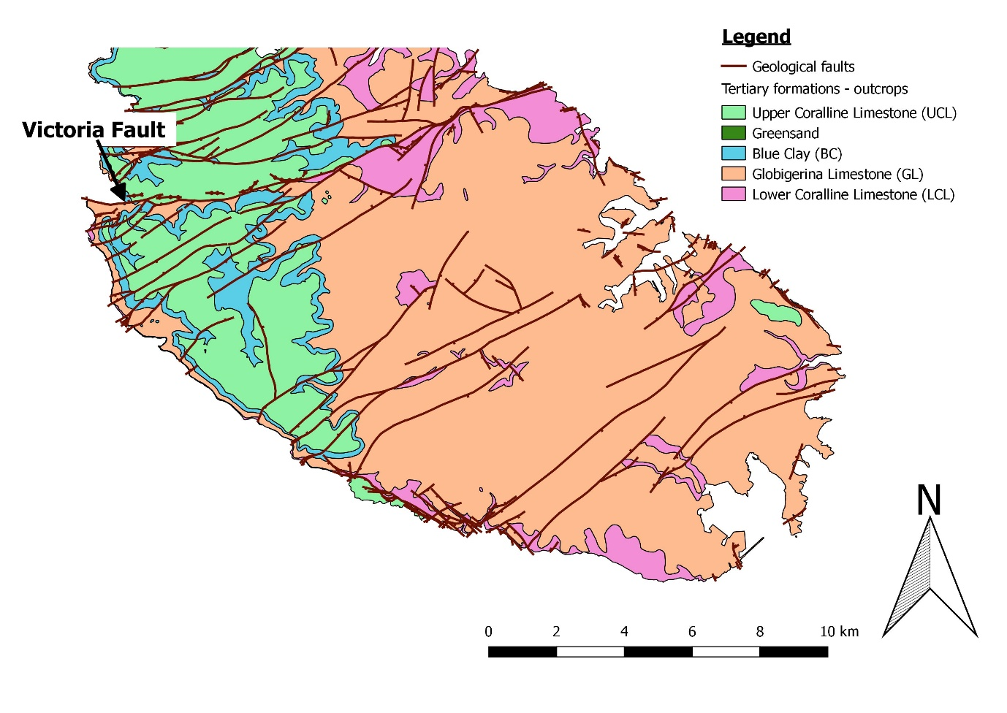
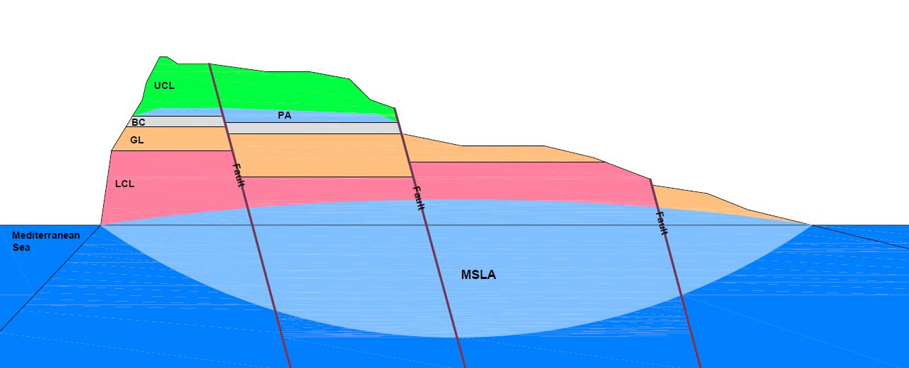
Conceptual diagram
Deep Monitor Boreholes (DMBs)
Perched Aquifer
Mediterranean Sea
Mean Sea Level Aquifer
(MSLA)
Mediterranean Sea
Mixed Water/Transition Zone
STUDY AREA
EC PROFILES
AND STRATIGRAPHY
EC INTERFACES
CONCLUSIONS
*Modified after 2nd Water Catchment Management Plan of the Maltese Islands (2015)
Notes:
The reality is different
High dynamicity
1 year profiling the three DMBs
Geological formations

Slide 4
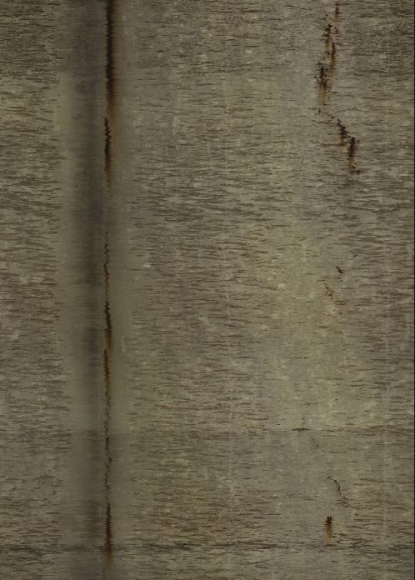
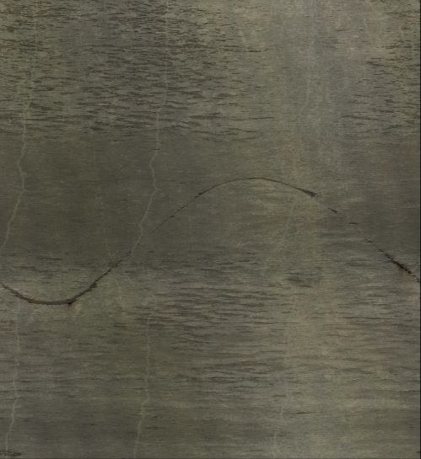
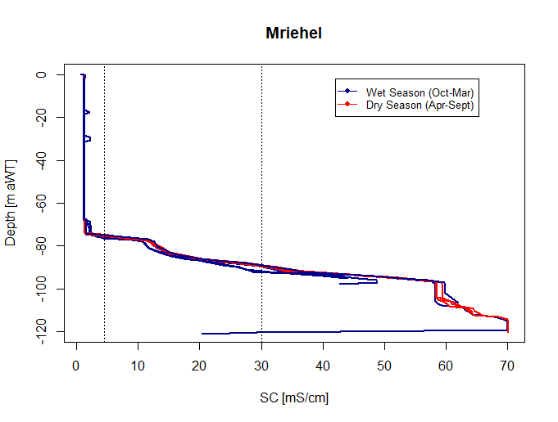
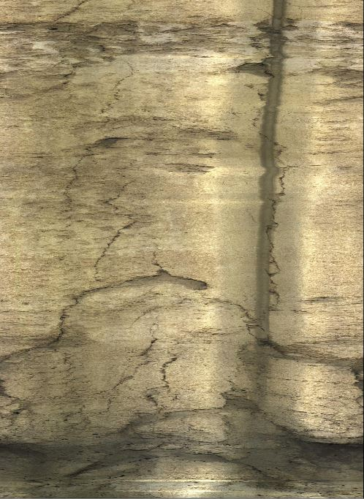
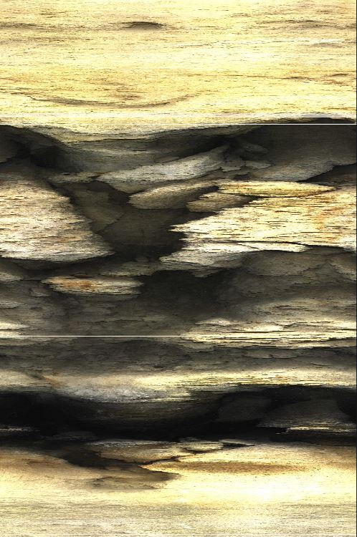
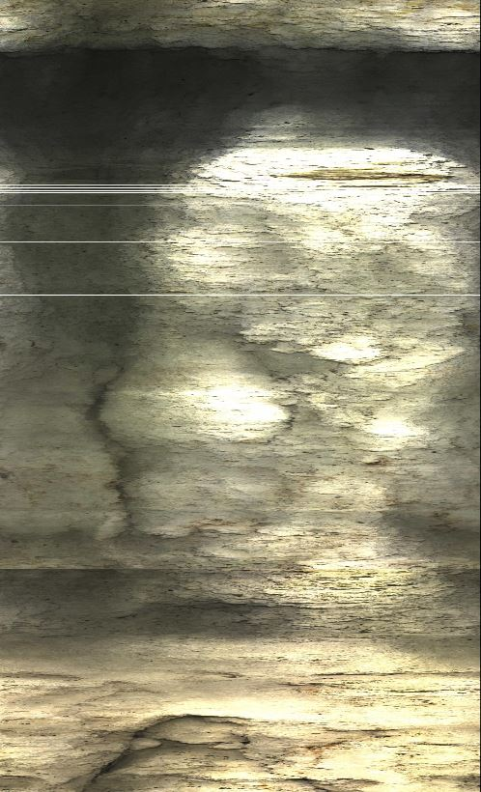
Mriehel stratigraphy logs
-17m aWT
SWL ~ 2.74m amsl
-35m aWT
-70m aWT
STUDY AREA
EC PROFILES
AND STRATIGRAPHY
EC INTERFACES
CONCLUSIONS
-110m aWT
-80m aWT
Notes:
High heterogeneity and anisotropy
Preferential flow
Far away from abstraction BHs

Slide 5
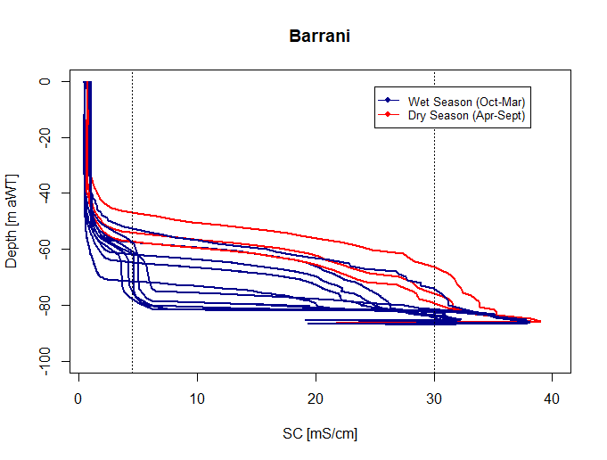
Barrani stratigraphy logs
SWL ~ 2.61m amsl
STUDY AREA
EC PROFILES
AND STRATIGRAPHY
EC INTERFACES
CONCLUSIONS
Notes:
Abstraction wells with variable discharging rates within the radius of influence

Slide 6
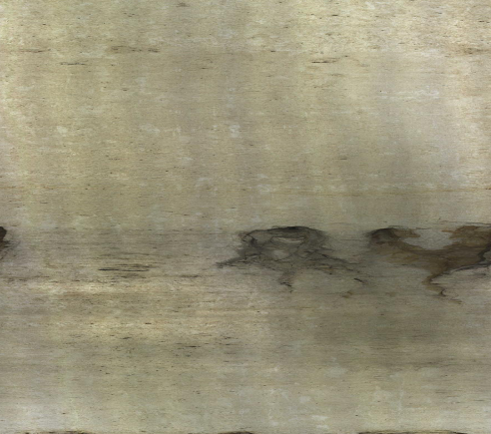
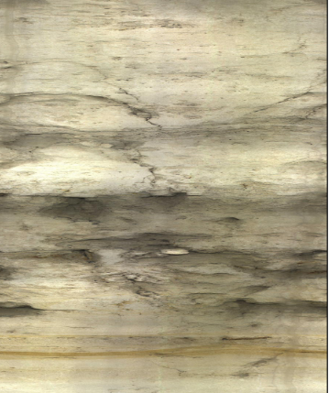
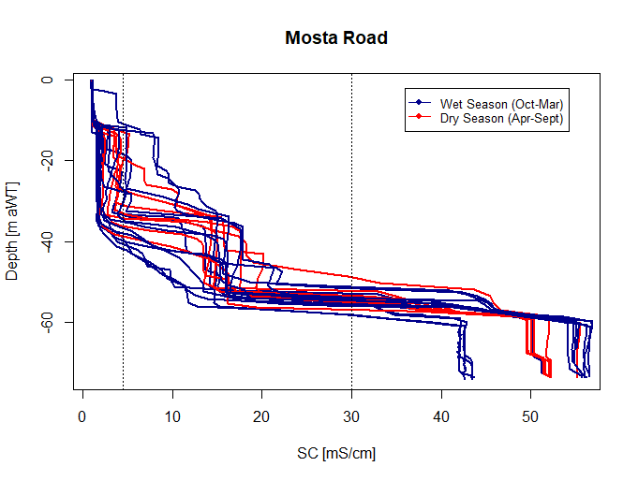
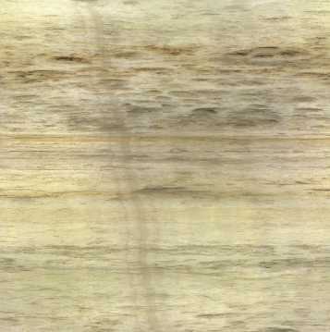

Mosta road stratigraphy logs
-10m aWT
SWL ~ 1.78m amsl
-31m aWT
-50m aWT
-58m aWT
STUDY AREA
EC PROFILES
AND STRATIGRAPHY
EC INTERFACES
CONCLUSIONS
Notes:
Preferential flow levels with mixing?
Some sort of contamination?

Slide 7


Interfaces fluctuations for each deep monitor borehole (Dmb)
Ghyben-Herzberg
$$(z=40 h_{f})$$
Field data
$$(z=30 h_{f})$$
STUDY AREA
EC PROFILES
AND STRATIGRAPHY
EC INTERFACES
CONCLUSIONS
Notes:
By using GH we are overestimating of about the 25% the freshwater availability in this aquifer system

Slide 8
conclusions
We identified occurrence mechanisms of three typical transition zones
30mS/cm interface depth results about 30 times the SWL
The outcomes of this study illustrate the value of monitoring the 4.5mS/cm interface in establishing an effective monitoring network
STUDY AREA
EC PROFILES
AND STRATIGRAPHY
EC INTERFACES
CONCLUSIONS
Notes:
Inferring a deviation from the GH theory

Slide 9
Bibliography
Fidelibus, M.D.; Balacco, G.; Gioia, A.; Iacobellis, V.; Spilotro, G. Mass transport triggered by heavy rainfall: the role of endorheic basins and epikarst in a regional karst aquifer. Hydrological Processes, 2016, 1 – 3, doi.org/10.1002/hyp.11037.
Ghyben, B. W. Nota in Verband met de Voorgenomen Putboring Nabij Amsterdam. Tijdschr. Kon. Inst. Ing 1888, 9, 8-22.
Herzberg, A. Die Wasserversorgung einiger Nordseebäder, J. Gasbeleucht. Wasserversorg 1901, 44, 815– 819, 842–844.
SEWCU (Sustainable Energy and Water Conservation Unit); ERA (Environmental and Resources Authority). The 2nd Water Catchment Management Plan for the Malta Water Catchment District 2015 – 2021. Government of Malta, 2015, 41 – 65, 107 – 124.

Slide 10

Thank you for your attention questions?
The MARSoluT project receives funding from the European Union’s Horizon 2020 research and innovation programme under the Marie Skłodowska-Curie grant agreement no. 814066. This project website reflects only the authors' views and the European Union is not liable for any use that may be made of the information contained therein.
francesco.demichele@gov.mt

