Slide 1

CLIMATE-ORIENTED TRANINGS IN THE FIELD OF CLIMATE SERVICES, CLIMATE CHANGE ADAPTATION AND MITIGATION
Valeriya Ovcharuk ¹, Alexander Mahura ², Tetiana Kryvomaz ³,
Enric Aguilar ⁴, Jon Olanо ⁴, Inna Khomenko ¹ , Oleg Shablii ¹,
Larisa Sogacheva ⁵, Putian Zhou ^{2,5}, Antti Mäkelä ⁵, Svitlana Krakovska ⁶,
Hanna Lappalainen ², Katja Lauri ², Laura Riuttanen ², Svyatoslav Tyuryakov ^{2 ,5}, Irina Bashmakova ²
¹ Odessa State Environmental University (OSENU), Odessa, Ukraine
² University of Helsinki, Institute for Atmospheric and Earth System Research, (UHEL-INAR), Helsinki, Finland
³ Kyiv National University of Construction and Architecture (KNUCA), Kyiv, Ukraine
⁴Centre for Climate Change (URV), Vila-Seca, Spain
⁵ Finnish Meteorological Institute (FMI), Helsinki, Finland
⁶ Ukrainian Hydrometeorological Institute (UHMI), Kyiv, Ukraine

Slide 2
Erasmus+ ClimEd Project
The Erasmus+ ClimEd (2021-2023; http://climed.network) project
“Multilevel Local, Nation- and Regionwide Education and Training in Climate Services, Climate Change Adaptation and Mitigation”
ClimEd project is aimed
at development of competency-based curricula for continuous comprehensive training of specialists in the field of climate services and additional education in climate change for decision-makers, experts in climate-dependent economic sectors, and public.
CimEd project training events are focused
on training the faculty/ teaching/ research staff and postgraduates at the ClimEd partner institutions and collaborating organizations in advanced educational and information-and-communication technologies for building a flexible multi-level integrated practice-based education system in the field of Climate Services, Climate Change Adaptation and Mitigation.

Slide 3
ClimEd Training - Events
Tr1 Competence-Based Approach to Curriculum Development for Climate Education
(19 April – 12 May 2021) / Online – completed
Tr2 Adaptation of the Competency Framework for Climate Services to conditions of Ukraine
(29 June – 26 August 2021) / Online – completed
Tr3 Digital tools and datasets for climate change education
(26 October – 12 November 2021) / Online – completed
Tr4 Learning courses’ development in climate services considering needs of different users
Spring 2023 – Onsite – In Preparation
Tr5 Applying different technologies of blended/on-line learning in education
Tr6 Mastering technologies of massive open on-line courses development for general public
Tr7 Skills to use climatic information and services for climate-dependent branches of economy
Notes:
http://climed.network/events/climed-trainings

Slide 4
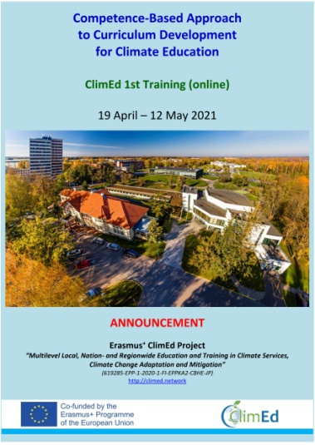
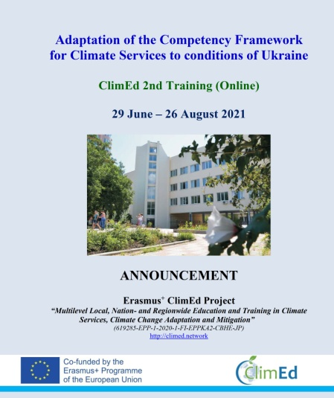
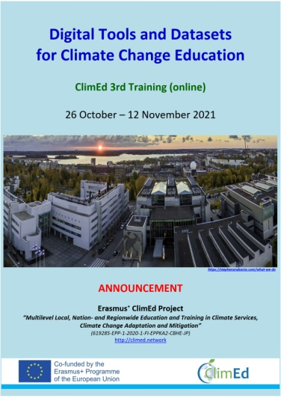
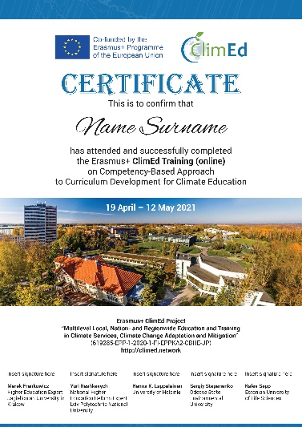
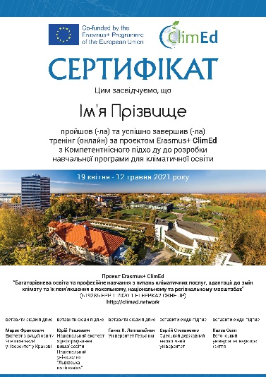
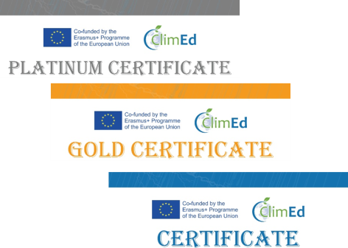
ClimEd Trainings - Approach
Development programme with specific focus of training (1-7)
Announcement of the training & opening web-page
(at http://climed.network/events/climed-trainings)
Web-applications/ evaluation/ informing
& assigning successful applicants
to groups/ granting access to Moodle system
Training event (lectures, home-work-assignments as group’s projects, presentations/ defences)
lecturing materials (slides & videos) are asap publicly available at web-page of the training
Evaluation of group’s presentations (by lecturers & organizing committee)
& awarding certificates
E-evaluation of the training
& of own (participants) learning outcomes
Self-evaluation (by ClimEd project) of the completed training

Slide 5
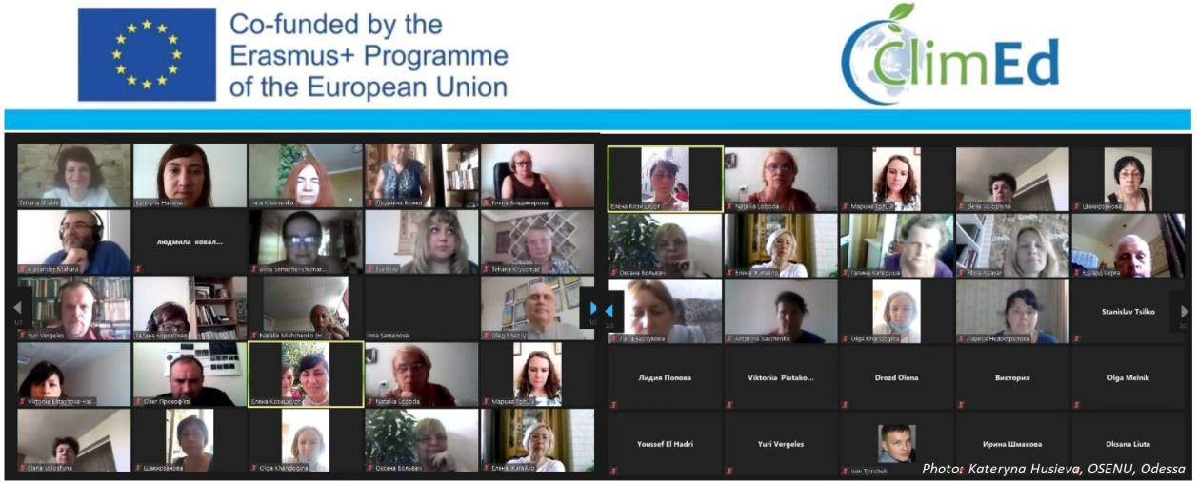
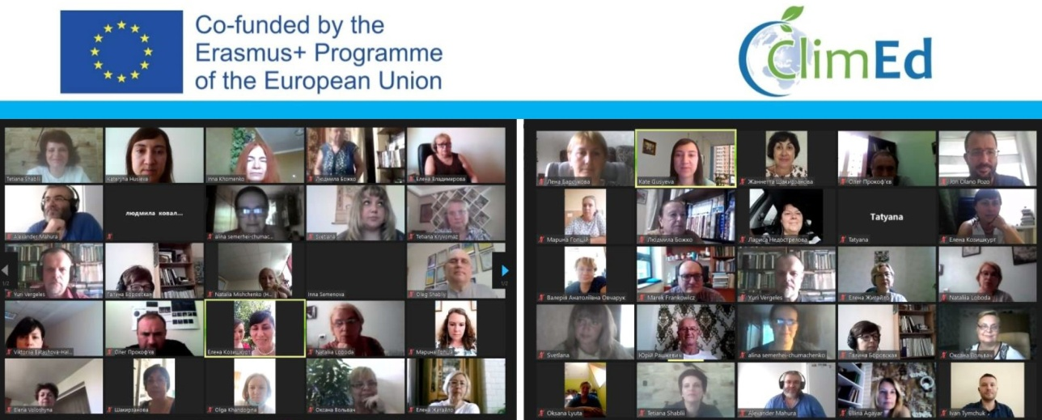
Covid19: Virtual Life in Online
Unfortunately, due to covid19 pandemic, the originally planned face-to-face trainings were required to be converted into online trainings & such trainings - divided into 3 consecutive blocks:
Online lecturing
Home-work-assignments (HWAs) as groups’ projects
Final oral presentations (projects’ defences) of HWAs with evaluation and feedbacks, discussions, and awarding certificates (corresponding to ECTS credits)

Slide 6
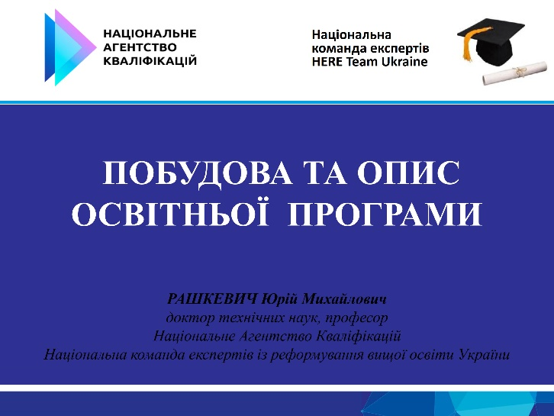
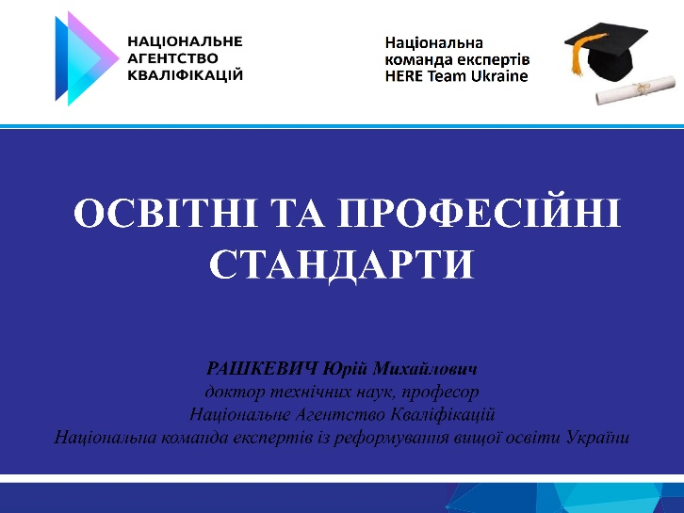
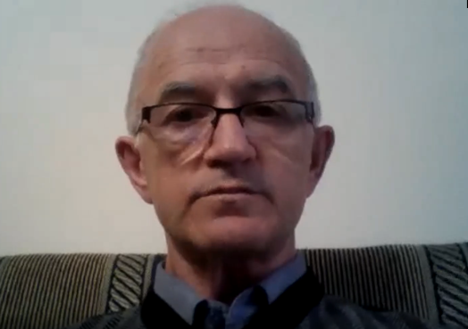
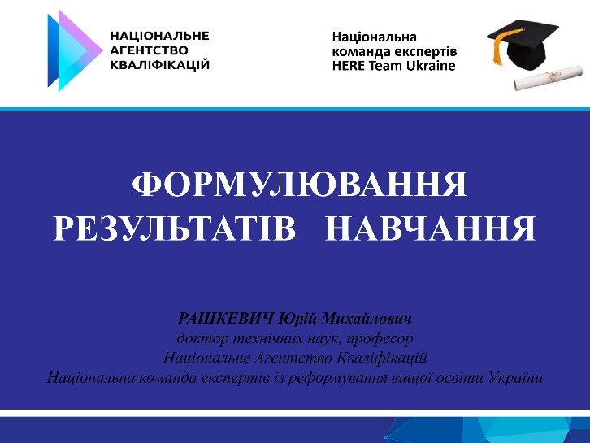
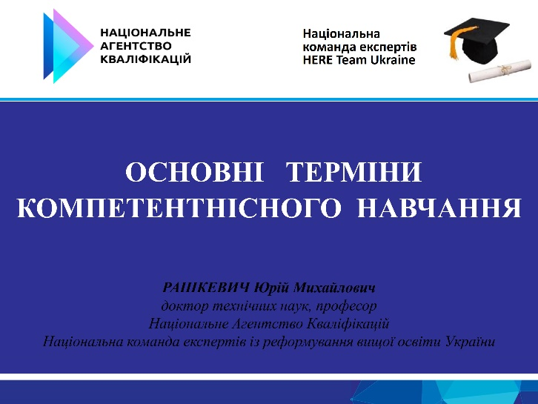
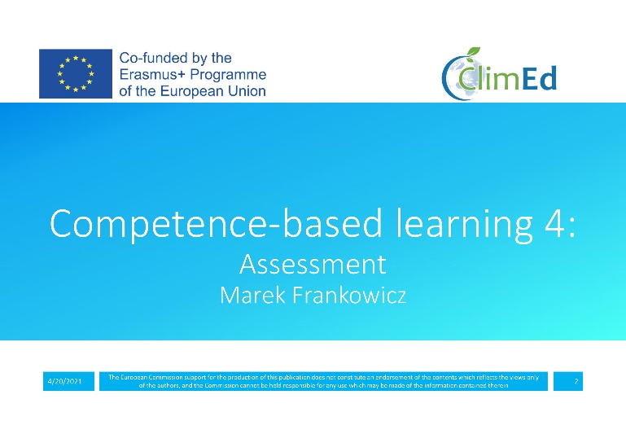
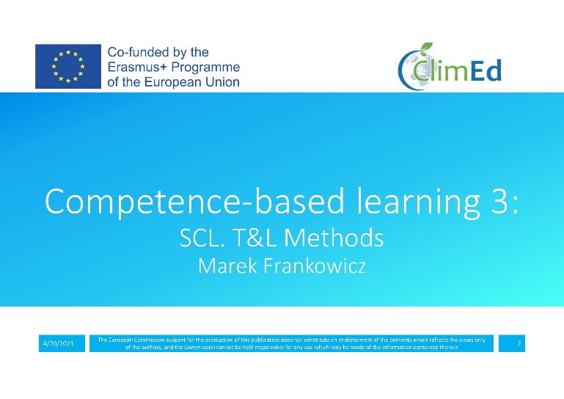
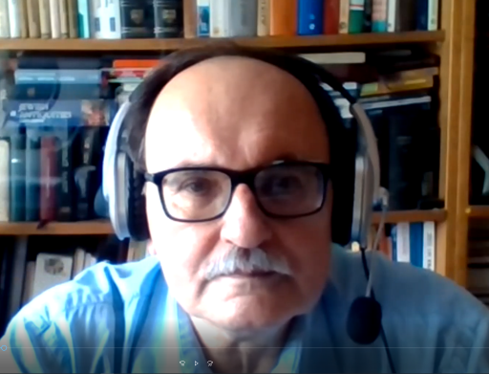

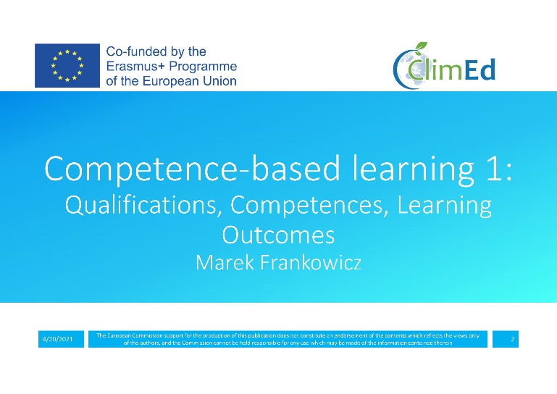
1st Training - Block-I: Lecturing
ClimEd 1st Training - The ClimEd Training Pioneers
Lectures (in Ukrainian)
by Prof. Yuri Rashkevych (Lviv Polytechnic National University, Lviv, Ukraine)
L1 – Basic terms of competence training L2 – Formulation of learning outcomes L3 – Educational and professional standards L4 – Building and description of educational program
Lectures on competence-based learning (in English)
by Prof. Marek Frankowicz (Jagiellonian University in Krakow, Krakow, Poland)
L5 – Qualifications, competences, learning outcomes
L6 – Curriculum design
L7 – Student-centred learning, teaching and learning methods
L8 – Assessment

Slide 7
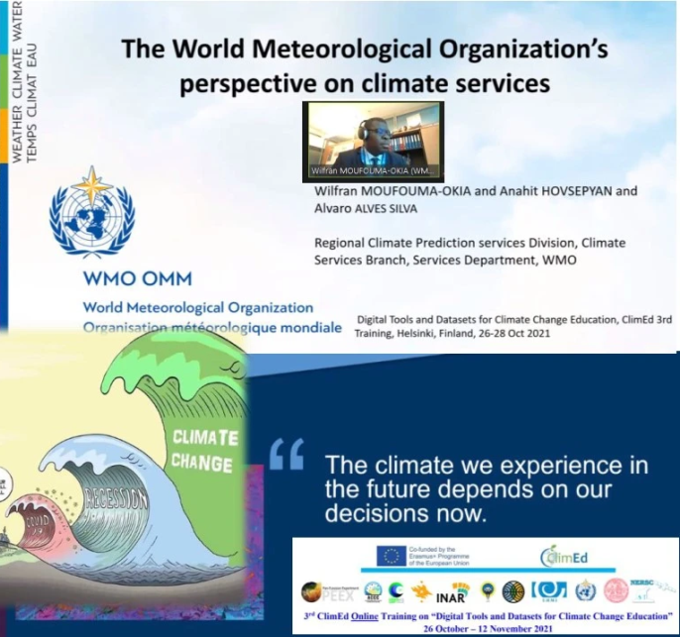

2nd & 3rd Trainings - Block-I: Lecturing
Lecturers from Poland, Spain, Ukraine
L1 – Qualification framework. Methodological and organizational approaches of its development
L2 – Establishing the WMO Competence Framework for Climate Services
L3 – The WMO Reform: facing and responding to new scientific and technological challenges
L4 – Present state of implementation of competence-based approach – best practices applied in Ukraine
L5 – The relationship between competence framework and qualifications framework…
L6 – Competencies framework vs. existing and foreseen programs
L7 – Education for Sustainable Development: teaching and learning practices and processes
L8 – Functional analysis.
L9-10 – Competence profiles. Competences and learning outcomes
L11 – Sustainability competencies’ frameworks: emerging teaching and research developments
L12 - Introduction to group homework assignments and discussions
Lecturers from Ukraine, Finland, Switzerland, Chech Republic, Norway
L1 – Regional focus of IPCC Assessment Report in Ukraine Context
L2 – UHMI activities in support climate related research: current status and perspectives
L3 – WMO integrated climate services: current status and perspectives
L4 – Observations for climatic variables: obs. system, specifics, challenges
L5 – Remote sensing/Satellite observations: current state, perspectives, databases, and applicability of results
L6 – Global scale climate modelling: current state, perspectives, databases, and applicability of results
L7 – Regional scale climate modelling: current state, perspectives, data/databases, and applicability of results
L8 – Urban scale modelling for climate applications
L9 – Climate related datasets, Copernicus related data
L10 – Tools for visualization and analysis of climate related data
L11 – Introductions to Home-Work-Assignments/ Group projects

Slide 8

Block-II: HWAs/ Groups’ Projects
ClimEd 1st Training
ClimEd Related HomeWork Assignments (HWAs as Projects) as Modules 1-2-3 (including specific directions)
12 Groups – work in the EULS Moodle system (Estonia) - 46 participants/”students”
Focuses of ClimEd related Modules “Towards climate-smart policy in the economic sector”
& “The economic sector transformation: changes, challenges and governance”
For directions: Agriculture, Energy, Technical Design and Construction, Urban Economy, Water Management, Health-care.
ClimEd 2nd Training
12 Groups - work in the OSENU Moodle system (Ukraine) - 56 participants/”students”
ClimEd 3rd Training
12 Groups - work in the OSENU Moodle system (Ukraine) - 45 participants/”students”
& all ClimEd trainings will use OSENU Moodle system

Slide 9
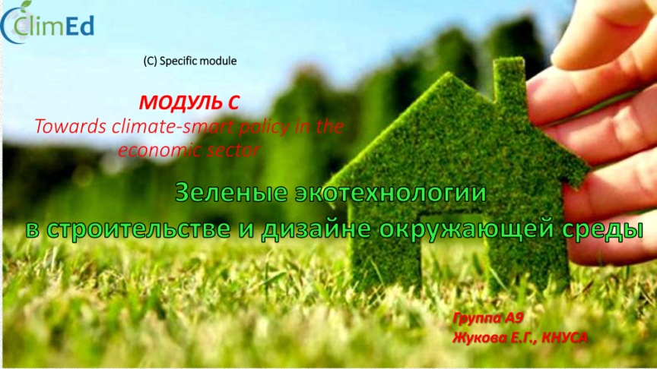
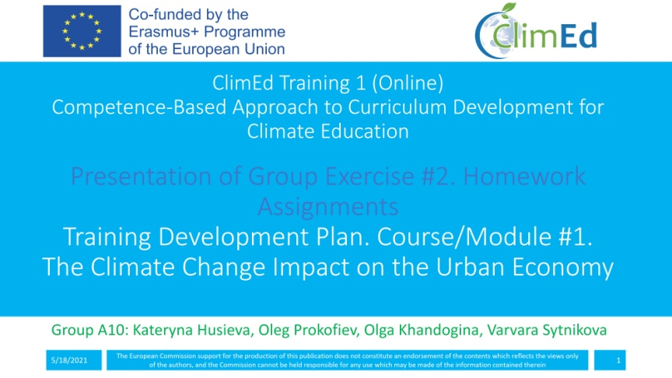
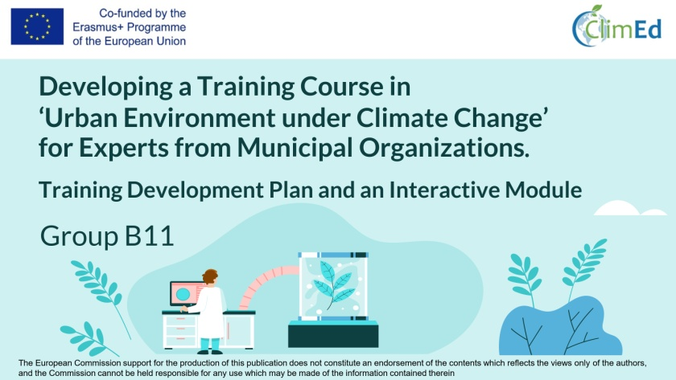
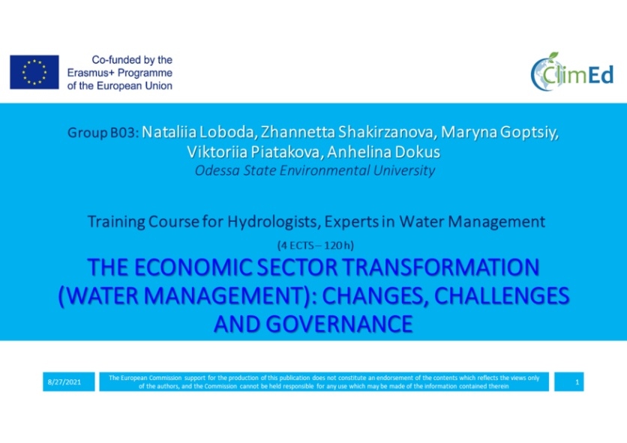
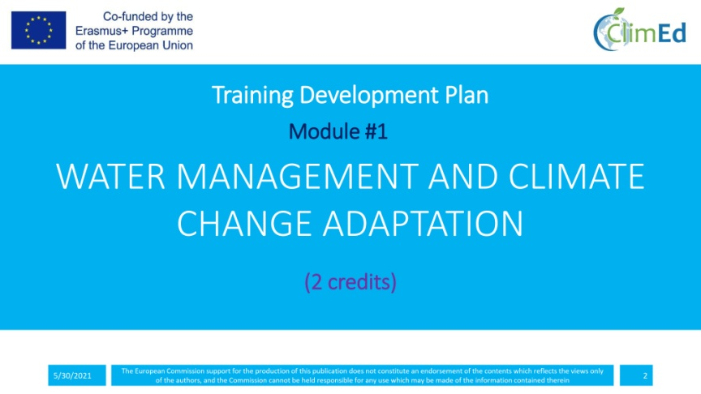
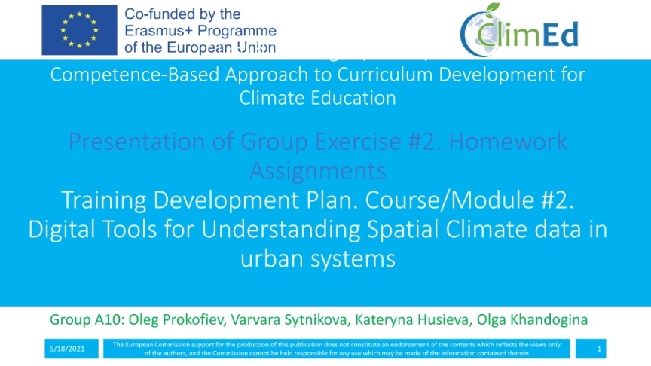
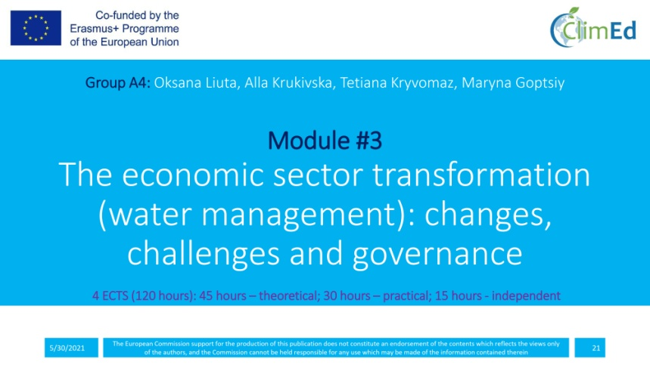

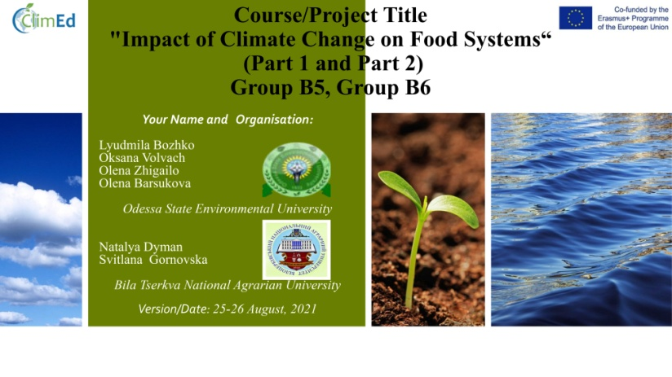
Block-III: Finals – HWAs/ Projects’ Defences
ClimEd 1st Training
ClimEd 2nd Training

Slide 10
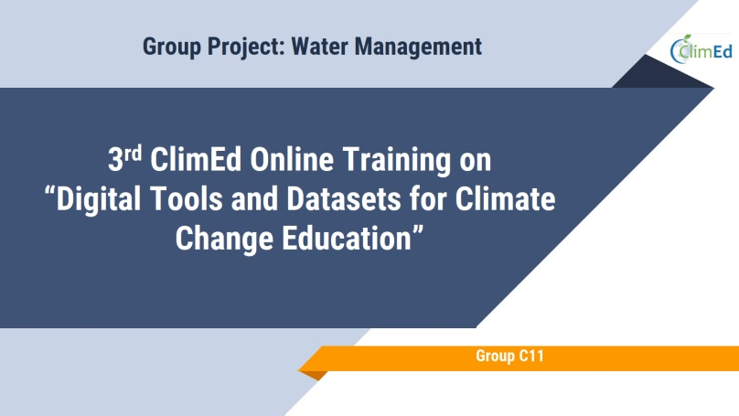
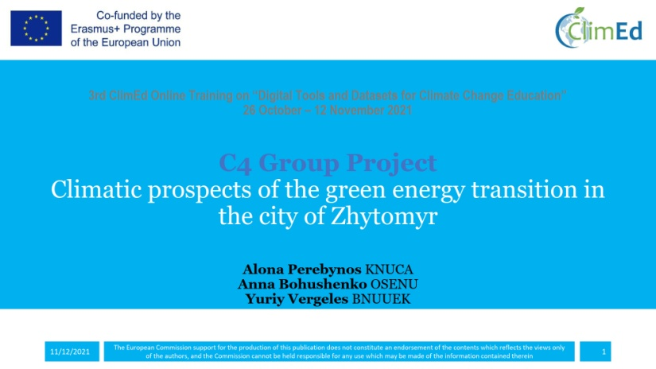
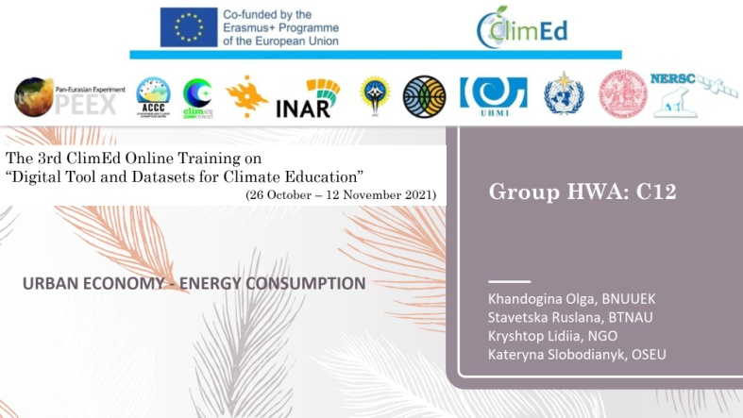
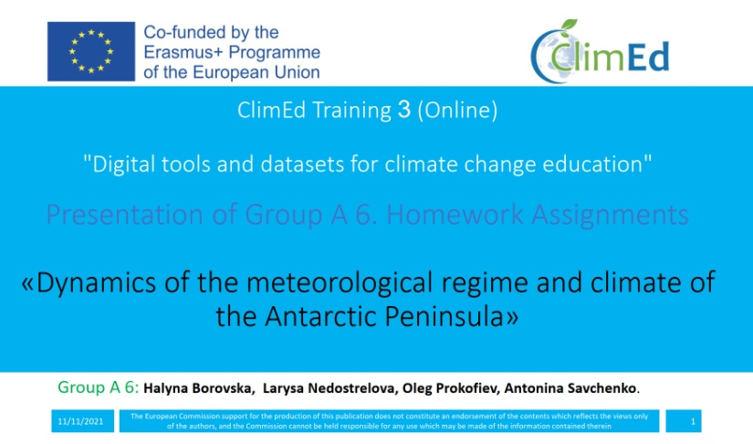
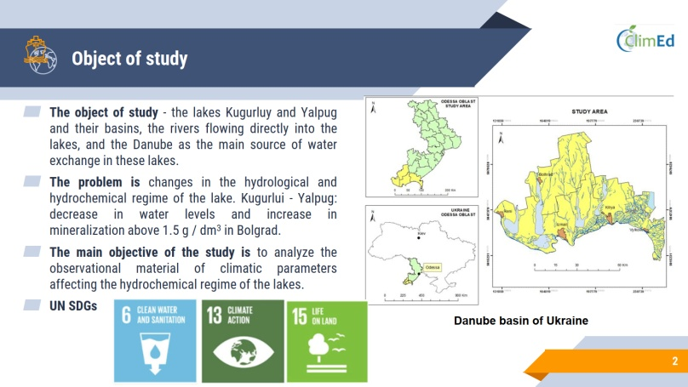
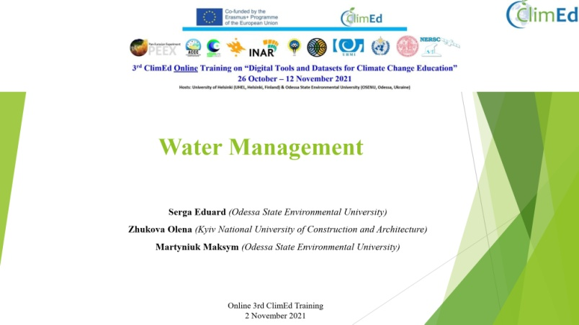
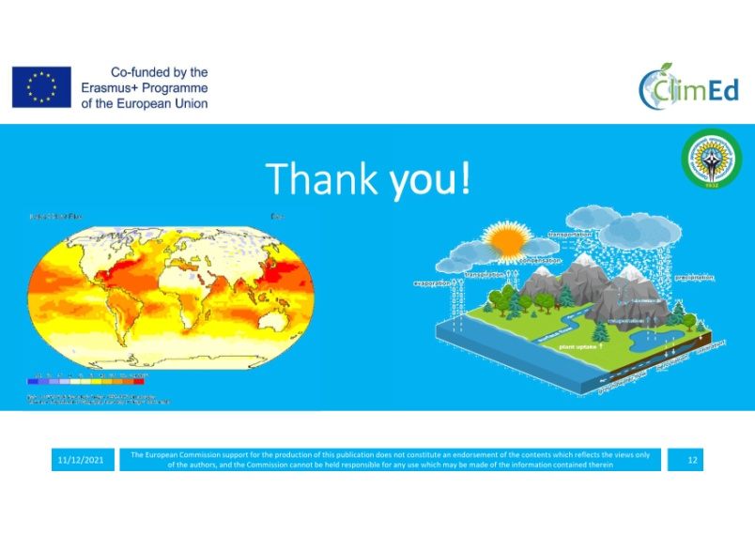
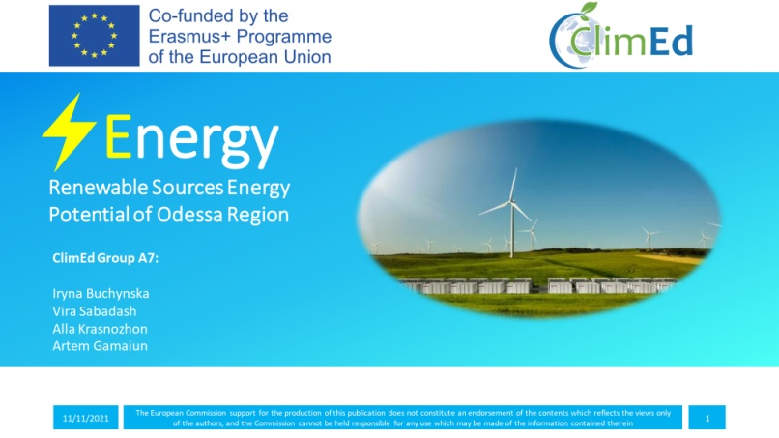
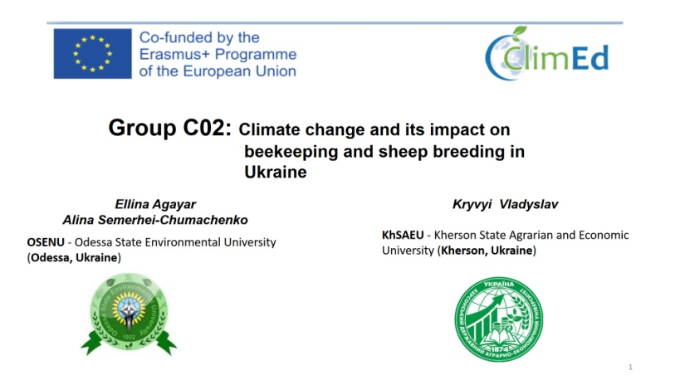
Block-III: Finals – Projects’ Defences
ClimEd 3rd Training

Slide 11
ClimEd Certificates Awarding
ClimEd 1st Training (Spring 2021)
2 Groups - highest scores of 9.31 & 9.13 - awarded certificates with distinction (“Platinum”)
4 Groups - certificates having the “Gold” status (with scores higher than 8.5)
Members of these 6 Groups - automatically accepted (i.e. without required application procedure) as approved participants for the ClimEd 2nd Training
ClimEd 2nd Training (Summer 2021)
2 Groups - highest scores of 9.64 & 9.30 - certificates with distinction (“Platinum”)
6 Groups - certificates having the “Gold” status
Members of these 8 Groups - automatically accepted for the ClimEd 3rd Training
ClimEd 3rd Training (Autumn 2021)
4 Groups - highest scores of 9.46, 9.29, 9.29, 9.26 - certificates with distinction (“Platinum”)
3 Groups - certificates having the “Gold” status
Members of these 7 Groups - automatically accepted for the ClimEd 4th Training

Slide 12
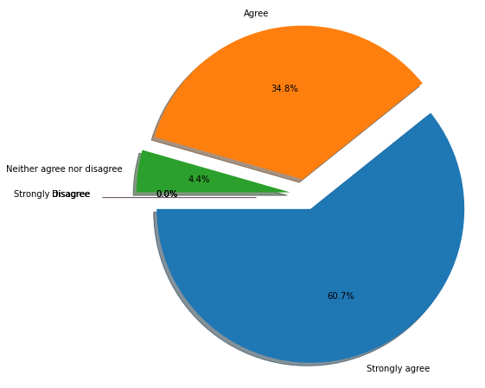
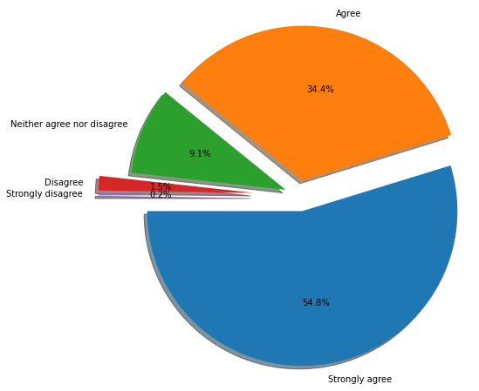
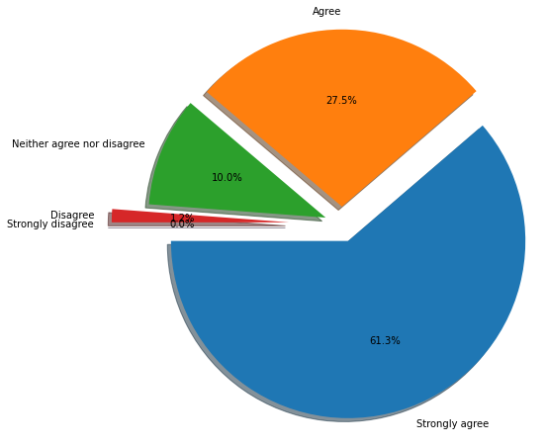
ClimEd Trainings e- Evaluations
Evaluation of the Training: Questionnaire N1
Scale: strongly disagree | disagree | neither agree nor disagree | agree | strongly agree
The lecturers were supportive and open to participants
The lecturers conducted the training excellently (clearly, sparkled interest etc.)
Training materials were of excellent quality (content, layout, clarity etc.)
Information about the training was sufficient (announcement, programme etc.)
I will recommend such training to my colleagues
Results: 1st Training 2nd Training 3rd Training

Slide 13
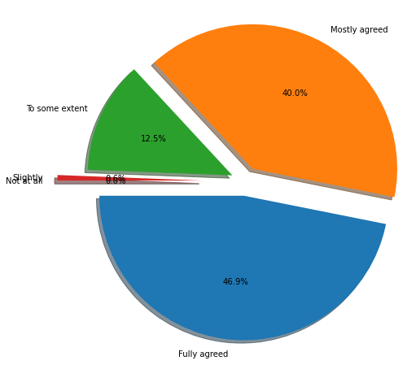
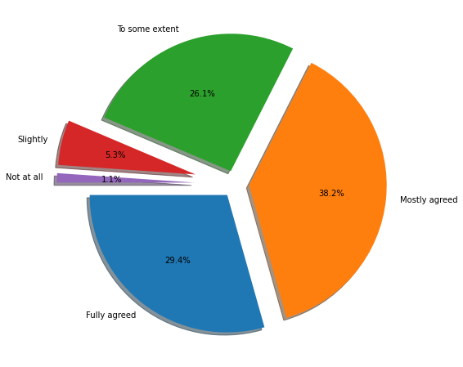
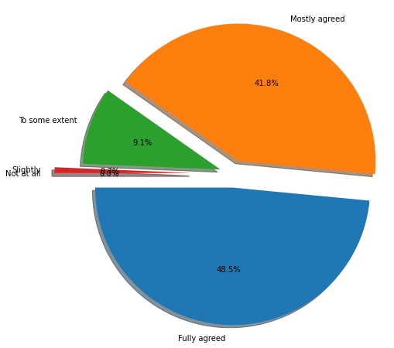
1st ClimEd Training e- Evaluation
Evaluation of (Own) the Learning Outcomes: Questionnaire N2
To which extent do you think that you developed the learning outcomes (competences/ abilities to) of the 1st ClimEd training?
Scale: not at all | slightly | somewhat/to some extent | mostly | fully
Results: 1st Training 2nd Training 3rd Training

Slide 14
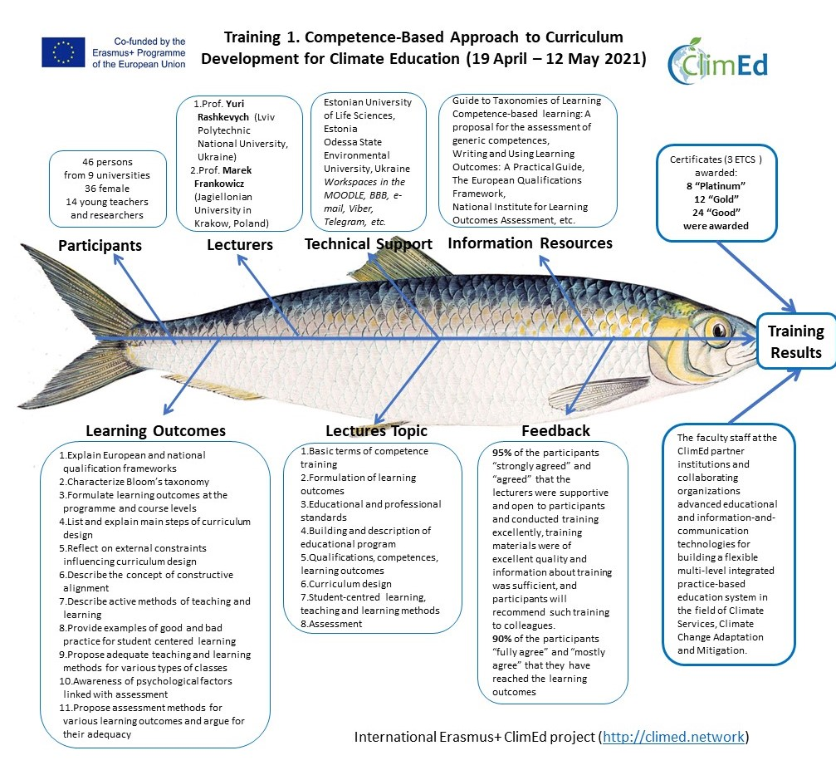
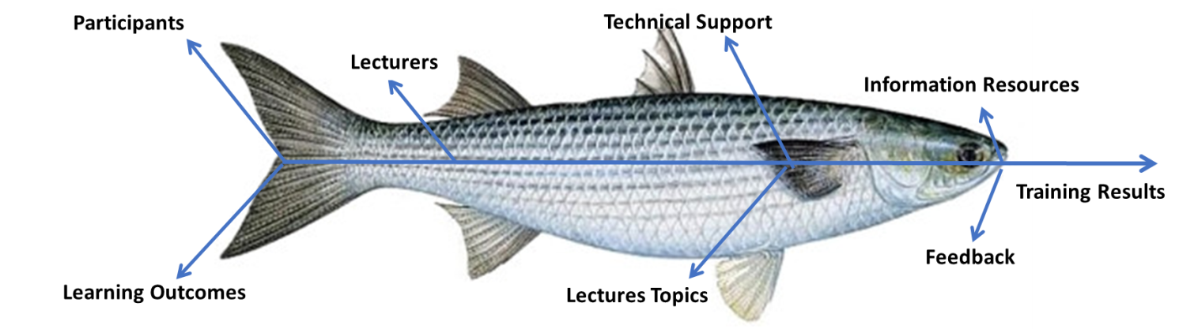
Self-Evaluation
ClimEd 1st Training (Estonia)
Participants
Lecturers
Lectures Topics
Technical Support
Information Resources
Learning Outcomes
Feedback
Training Results
International Erasmus+ ClimEd project (http://climed.network)
5/20/2022
The European Commission support for the production of this publication does not constitute an endorsement of the contents which reflects the views only
of the authors, and the Commission cannot be held responsible for any use which may be made of the information contained therein
14

Slide 15
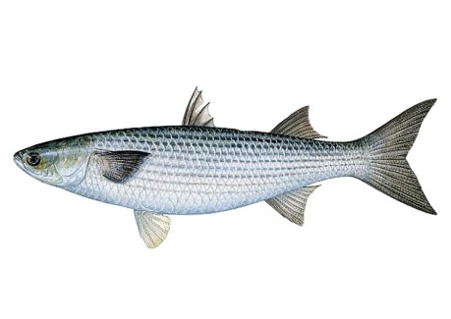
ClimEd 2nd Training (Ukraine)
Adaptation of the Competency Framework for Climate Services to conditions of Ukraine
(29 June – 26 August 2021)
56 persons
from 6 universities
46 female
10 young teachers and researchers
Profs. from the Universitat Rovira i Virgili, Tarragona, Spain:
Enric Aguilar, Manola Brunet, Gisella Cebrian, and Jon Olano;
Jagiellonian University in Krakow, Poland: Marek Frankowicz;
Lviv Polytechnic National University, Ukraine: Yurii Rashkevych;
National Agency for Higher Education Quality Assurance in Ukraine: Oleh Tiapkin;
National Agency for Qualifications in Ukraine: Inna Osadchuk
Sectoral Qualifications Frameworks, WMO Competency Framework for the Provision of Climate Services, WMO-1114 Bloom’s taxonomy, WMO Strategic Plan 2020-2030, WCAS: World Climate Applications & Services; WASP: World Adaptation Science Program, Mesoscale Convective Systems in Southeastern South America, WMO/Eumetcal Online Course for Trainers of RA-VI, Refresher Course for Aeronautical, Meteorological Forecasters at RHMSS, Practical Meteorological Course, etc.
Odessa State Environmental University, Ukraine
Workspaces in the Moodle system, Zoom-hosting, e-evaluations, e-mail, Viber, Telegram, etc.
Participants
Technical Support
Lecturers
ClimEd training certificates
= 4 ECTS:
10 “Platinum”
32 “Gold”
14 “Ordinary”
Information Resources
Training Results
The participants of the training have obtained new/ upgraded (virtual
learning environment, pedagogical, team work, presentation, etc.) skills; further own work/developments are
needed in improving teaching and learning methods, formulation of learning outcomes, assessment,
individualized approaches, etc.; and subject areas of importance are remained as climate vs. healthcare, energy
sector, water management, urban problems, construction sector, agriculture, economical factors, and general
issues.
Feedback
Learning Outcomes
Lectures Topics
100% - overall rating as ”very good” and “good”;
92% - “strongly agree” and “agree” that training was relevant and helpful for their jobs; practically
100% - satisfied with training content & lecturers were supportive and open to participants, time investment for such a was OK for about 81%, training materials were of excellent quality
basic principles of the development and scope of competencies and qualifications frameworks
competence-based education principles and practices
knows the education for sustainable development core components, processes and practices that promote competencies’ development
reference learning outcomes to National qualification framework levels
define an appropriate competences from competence framework for implementation into a curricula
identify teaching and learning methods that promote competencies’ development
identify appropriate assessment tools for competencies’ development
select and differentiate between different typologies of assessment tools for measuring competencies’ development
link WMO competencies for climate services to university-level training experiences
identifies WMO competencies framework and its potential usage
explains the different stages involved in the creation of a competencies framework
analyses the contour conditions for defining and implementing a competencies framework
knows the different stages involved in climate services production
Qualification framework. Methodological and organizational approaches of its development
Establishing the WMO Competence Framework for Climate Services
The WMO Reform: facing and responding to new scientific and technological challenges
Present state of implementation of competence-based approach – best practices applied in Ukraine
The relationship between competence framework and qualifications framework. Practices of transformation national, sectoral & other frameworks in different countries
Competencies framework vs. existing and foreseen programs
Education for Sustainable Development: teaching and learning practices and processes
Functional analysis.
Competence profiles. Competences and learning outcomes
Sustainability competencies’ frameworks: emerging teaching and research developments
International Erasmus+ ClimEd project (http://climed.network)
Notes:
http://climed.network/wp-content/uploads/2021/09/ClimEd_2nd_Training_sumup_vdfin.pdf
Lectures topics
Qualification framework. Methodological and organizational approaches of its development
Establishing the WMO Competence Framework for Climate Services
The WMO Reform: facing and responding to new scientific and technological challenges
Present state of implementation of competence-based approach – best practices applied in Ukraine
The relationship between competence framework and qualifications framework. Practices of transformation national, sectoral and other frameworks in different countries
Competencies framework vs. existing and foreseen programs
Education for Sustainable Development: teaching and learning practices and processes
Functional analysis. Inna Osadchuk, National Agency for Qualifications in Ukraine
Competence profiles. Competences and learning outcomes
Sustainability competencies’ frameworks: emerging teaching and research developments
LO
basic principles of the development and scope of competencies and qualifications frameworks
competence-based education principles and practices
knows the education for sustainable development core components, processes and practices that promote competencies’ development
reference learning outcomes to National qualification framework levels
define an appropriate competences from competence framework for the implementation into a curricula
identify teaching and learning methods that promote competencies’ development
identify appropriate assessment tools for competencies’ development
select and differentiate between different typologies of assessment tools for measuring competencies’ development
link WMO competencies for climate services to university-level training experiences
identifies WMO competencies framework and its potential usage
explains the different stages involved in the creation of a competencies framework
analyses the contour conditions for defining and implementing a competencies framework
knows the different stages involved in climate services production

Slide 16
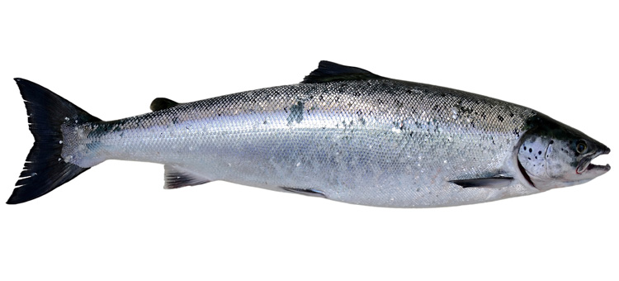
ClimEd 3rd Training (Finland)
Digital Tools and Datasets for Climate Change Education
(26 October – 12 November 2021)
45 persons
(including 30 female and 15 male; and 15 young researchers) from 10 universities & 8 organizations
Wilfran Moufouma - Okia World Meteorological Organization
Svitlana Krakovska - Ukrainian Hydrometeorological Institute
Antti Mäkelä, Larisa Sogacheva - Finnish Meteorological Institute
Putian Zhou, Alexander Mahura - University of Helsinki
Tomas Halenka - Charles University in Prague
Igor Ezau - Nansen Environmental and Remote Sensing Center
Inna Khomenko - Odessa State Environmental University
Climate Data Store Toolbox, climate.copernicus.eu, Python (Anaconda/ Jupyter Notebook), NCO and CDO, Integrated Data Viewer, NCView, Metview, etc.
The participants have obtained new/ upgraded basic knowledge about IPCC
Assessment Report, current activities in support climate related research in Ukraine; WMO mechanisms and
entities for provision of operational seasonal forecasts, current limitations of WMO regional climate outlook
forums and reasons to expand portfolio of climate products, key features of objective seasonal forecasts; existing
types, specifications and challenges of meteorological/climate observation systems; main principles, instruments,
satellite Earth Observations products; Earth System Modelling, basic information of CMIP6 and its datasets;
needs, use and advantages of regional climate models for local/regional impact studies; urban integrated system
approach, principle modeling strategies at fine spatial resolution in the atmospheric boundary layer; datasets at
Copernicus Climate Change Service (C3S) Climate Data Store (CDS); and better understanding possibilities of
C3S CDS Toolbox in climate data visualisation and analysis as well as skills in usage of C3S CDS Toolbox for
group projects (as small-scale research projects) and skills in group’s (as the team) developing and realizing
research plan, and presenting research project results.
Odessa State Environmental University - workspaces in the Moodle system, web-page with training materials, e-evaluations; University of Helsinki - Zoom-hosting; e-mail, Viber, Telegram, etc.
Participants
Technical Support
Information Resources
Lecturers
ClimEd training certificates
= 3 ECTS:
15 “Platinum”
11 “Gold”
16 “Ordinary”
Training Results
Learning Outcomes
Lectures Topics
Feedback
Basic knowledge of:
regional focus of IPCC Assessment Report in Ukraine context
activities in support climate related research in Ukraine
WMO mechanisms and entities for provision of operational seasonal forecasts, current limitations of WMO regional climate outlook forums and reasons to expand portfolio of climate products, key features of objective seasonal forecasts
existing types, specifications and challenges of meteorological/climate observation systems
main principles, instruments, satellite Earth Observations products
Earth System Modelling, basic information of CMIP6 and its datasets
needs, use and advantages of regional climate models for local/regional impact studies
urban integrated system approach, principle modeling strategies at fine spatial resolution in the atmospheric boundary layer
datasets at Copernicus Climate Change Service (C3S) Climate Data Store (CDS)
Understanding possibilities of C3S CDS Toolbox in climate data visualisation and analysis
Skills in usage of C3S CDS Toolbox for group projects (as small-scale research projects)
Skills in group’s (as the team) developing and realizing research plan, and presenting research project results
Regional focus of IPCC Assessm. Report in Ukraine context.
UHMI activities in support climate related research: current status and perspectives.
WMO integrated climate services: current status and perspectives.
Observations for climatic variables: observation system, specifics, challenges.
Remote sensing/Satellite observations: current state, perspectives, databases, and applicability of results.
Global scale climate modelling: current state, perspectives, databases, and applicability of results.
Regional scale climate modelling: current state, perspectives, data/databases, and applicability of results.
Urban scale modelling for climate applications.
Climate related datasets, Copernicus related data.
Tools for visualization and analysis of climate related data.
90% of the participants estimated overall
rating for this course as ”very good” and “good”,
84% - training materials were of excellent quality
97% - information about training was sufficient, 91% - participants will recommend such training to colleagues
70% - “fully agreed” and “mostly agreed” that they have obtained/ improved their competencies and
got skills in usage of the C3S CDS Toolbox remotely/ virtually working as groups.
International Erasmus+ ClimEd project (http://climed.network)
Notes:
http://climed.network/events/climed-trainings/climed-training-3-online/
Lecture 1 – Regional focus of IPCC Assessment Report in Ukraine Context. Svitlana Krakovska, Ukrainian Hydrometeorological Institute, Ukraine (slides, video)
Lecture 2 – UHMI activities in support climate related research: current status and perspectives. Svitlana Krakovska, Ukrainian Hydrometeorological Institute, Ukraine (slides, video)
Lecture 3 – WMO integrated climate services: current status and perspectives. Wilfran Moufouma Okia, World Meteorological Organization, Switzerland (slides, video)
Lecture 4 – Observations for climatic variables: obs. system, specifics, challenges. Antti Mäkelä, Finnish Meteorological Institute, Finland (slides, video)
Lecture 5 – Remote sensing/Satellite observations: current state, perspectives, databases, and applicability of results. Larisa Sogacheva, Finnish Meteorological Institute, Finland (slides – 4321, video)
Lecture 6 – Global scale climate modelling: current state, perspectives, databases, and applicability of results. Putian Zhou, University of Helsinki / Finnish Meteorological Institute, Finland (slides, video)
Lecture 7 – Regional scale climate modelling: current state, perspectives, data/databases, and applicability of results. Tomas Halenka, University Charles in Prague, Checz Republic (slides, video)
Lecture 8 – Urban scale modelling for climate applications. Igor Esau, Nansen Environmental Remote Sensing Center, Norway (slides, video)
Lecture 9 – Climate related datasets, Copernicus related data. Antti Mäkelä, Finnish Meteorological Institute, Finland (slides, video)
Lecture 10 – Tools for visualization and analysis of climate related data. Antti Mäkelä, Finnish Meteorological Institute, Finland (slides, video)
Introductions to Home-Work-Assignments/ Group projects. Alexander Mahura, UHEL-INAR; Svitlana Krakovska, UHMI; Putian Zhou, UHEL/FMI; Larisa Sogacheva, FMI; Inna Khomenko, OSENU (slides, video)
Climate Competencies (ClimComp) Collaborating project – questionnaire. Joula Siponen, University of Helsinki (video)
https://climate.copernicus.eu --- register and get access / Toolbox (documentation, editor, API, application gallery) ➢ https://confluence.ecmwf.int/display/CKB/How+to+install+and+use+CDS+API+on+Windows ➢ Welcome to the Climate Data Store: https://cds.climate.copernicus.eu/#!/home ➢ APPLICATIONS: https://cds.climate.copernicus.eu/#!/search?text=&type=application ➢ ERA-5 EXPLORER: https://cds.climate.copernicus.eu/cdsapp#!/software/app-era5-explorer?tab=app ➢ DATASETS: https://cds.climate.copernicus.eu/#!/search?text=&type=dataset ➢ CMIP6 data portal: https://esgf-node.llnl.gov/search/cmip6 ➢ ANACONDA: https://docs.anaconda.com/anaconda/install (on different platforms) ➢ Visualization with Python: https://matplotlib.org & https://matplotlib.org/stable/gallery/index.html ➢ CDO (Climate Data Operators) - tool set for working on climate and NWP model data: https://code.mpimet.mpg.de/projects/cdo & downloads (https://code.mpimet.mpg.de/projects/cdo/files) & documentation (https://code.mpimet.mpg.de/projects/cdo/wiki/Cdo#Documentation) ➢ NCO (netCDF Operator) - toolkit manipulates and analyses data stored in netCDF-accessible formats: http://nco.sourceforge.net ➢ wgrib – manipulate, inventory and decode GRIB files: https://www.cpc.ncep.noaa.gov/products/wesley/wgrib.html ➢ wgrib2: https://www.cpc.ncep.noaa.gov/products/wesley/wgrib2/convert_wgrib2.html ➢ IDV (Integrated Data Viewer) - 3D geoscience visualization and analysis tool (on Win, Mac, Linux platforms): https://www.unidata.ucar.edu/software/idv ➢ Metview : https://confluence.ecmwf.int/display/METV

Slide 17
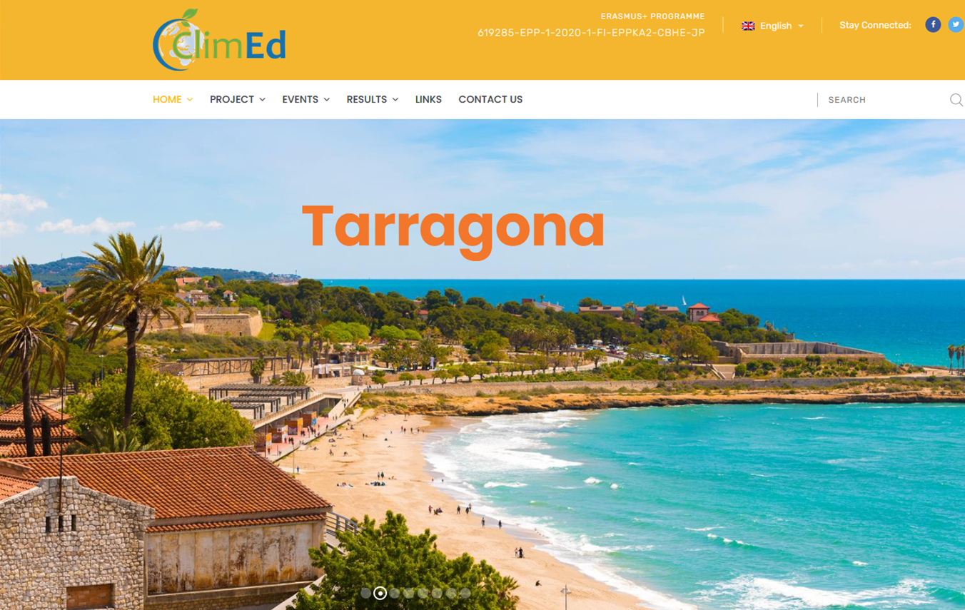
See you at 4th ClimEd Training
Spring 2023
host: Universitat Rovira i Virgili, Spain
Developing learning courses
in climate services
considering needs of different users

Slide 18
TIMES ARE IN GMT + 1 (CET). Time in Finland, Estonia and Ukraine is +1
Monday, 30th May 2022. Block I. Climate Datasets (Related to C1 and C2.Create and Manage Datasets and Derive Products from Climate Data)
9:00-10.00 | Registration.
10:00-10.15 | Welcome from FTG Dean – Marta Nel·lo and URV ClimEd Team Leader – Enric Aguilar
10.15-10.30 | Welcome from ClimEd European Coordinator – Hanna Lappalainen / Sviatoslav Tyuriakov /Sergiy Stepanenko
10.30-11.15 | Lecture I. Observational Climate Datasets. A quick review - Enric Aguilar
11.15-11.30 | Coffee-break
11.30–12.15 | Lecture II. Quality Control of Observational Climate Datasets using INQC- Enric Aguilar
12.15-13.00 | LUNCH
13.00-13.45 | Lecture III. Climate data Homogenization. Concepts and examples. - Enric Aguilar
13.45-14.00 | Coffee-break
14.00-14.45 | Lecture IV. Climate Indices calculation using Climpact – Enric Aguilar
14.45-15.00 | Coffe-break
15.00- 16.00 | Introduction to work in groups. Jon Olano
16.00-17.00 | Time to work in groups
Tuesday, 1st June 2022. Block II. CO-Creation. (Related to C5. Communicate Climatological Information to Users)
9.00-9.45 | Lecture V. Co-Creation and user engagement methodology. Alba Font / Jon Olano/ Anna Boqué
9.45 -10.00 | Coffee-break
10.00-12.00 | Group Workshop. Alba Font / Jon Olano/ Anna Boqué/Òscar Saladié/
12.00-13.00 | LUNCH
13.00-14.00 | Group Workshop (Continue) . Alba Font / Jon Olano/ Anna Boqué/Òscar Saladié/
14.00-14.15 | Coffee-break
14.15-15.00 | Lecture VI. Communication of Climate Services. Anna Boqué
15.00-17.00 | Time to work in groups

Slide 19
Wednesday, 2nd June 2022. Block III. Projections (Related to C3. Create and interpret climate forecasts, climate projections and model output)
Lecture VII. “Climate Projections for Climate Services” (TBC)
Coffee-break
Lecture VIII. “Climate Projections for Climate Services” (TBC)
LUNCH
Lecture IX. Examples: POTENCLIM (Oleg, Anna, Jon) , Surf Climate Service (Anna); Beach Tourism (Jon)
Coffe Break
Time to work in groups
Thursday, 3rd June 2021. Block IV, Economics and CS
9.00-9.45 | Lecture X. “Climate Change Economics”. Juan Antonio Duro – ECO-SOS
9.45-10.00 | Coffee-break
10.00-10.45 | Lecture XI.” Climate Policies”. José Manuel Gimñenez - ECO-SOS
10.45-10.45 | Coffee-break
10.45-12.00 | Lecture XII. Economic Valorization of Climate Services. Sonia Quiroga
12.00-13.30 | LUNCH
13.30-14.30 | Lecture XIII. Potential uses of CS in Tourism. Salvador Anton / Jon Olano
14.30 -15.00 | Coffe Break
15.00-17.00 | Time to work in groups
Friday, 4th June 2022. Block V. Group Reporting on Projects and awarding ceremony.
9.00-9.45 | Reporting (Expositions. 15min/group)
9.45-10.00 | Coffee-break
10.00-10.45 | Reporting (Expositions. 15min/group)
10.45- 11.00 | Coffee-break
11.00-11.45 | Reporting (Expositions. 15min/group)
11.45-12.00 | Coffee-break
12.00-12.45 | Reporting (Expositions. 15min/group)
12.45-14.00 | Lunch
14.00 | Concluding Remarks and awarding ceremony for training certificates. URV ClimEd Team
 | Clousure of 4th Training. Alexander Mahura (WP5 Leader) or Sviatoslav Tyuriakov (ClimEd PM). Announcement of 5th training.

Slide 20
Acknowledgements
Special Thanks
All lecturers of the 1st & 2nd & 3rd trainings – Marek Frankowicz, Yurii Razhkevych, Enric Aguilar, Gisela Cebrián Bernat, Manola Brunet, Jon Olano, Oleh Tiapkin, Inna Osadchuk, Svitlana Krakovska, Wilfran Moufouma Okia, Antti Makela, Larisa Sogacheva, Putian Zhou, Tomas Halenka, Igor Esau – for their professionalism, enthusiasm and commitment to the training
EULS & OSENU teams for continuous technical support (1st training - EULS & 2nd & 3rd trainings - OSENU Moodle systems, Zoom-hosting, e-evaluations, etc.), continuous web-update of the training materials during the entire period of the trainings
All materials of the 1st & 2nd & 3rd trainings (slides and videos of lectures, presentations of exercises and homework-assignments as group projects, etc.) are available at
http://climed.network/events/climed-trainings/climed-training-1-online/
http://climed.network/events/climed-trainings/climed-training-2-online/
http://climed.network/events/climed-trainings/climed-training-3-online/
Disseminated – PEEX community Blog/NewsLetters (https://peexhq.home.blog)

Slide 21
Thank you! Дякую! Kiitos! Tack! Gracias! Спасибо! Aitüma! Дзякуй!

