Slide 1
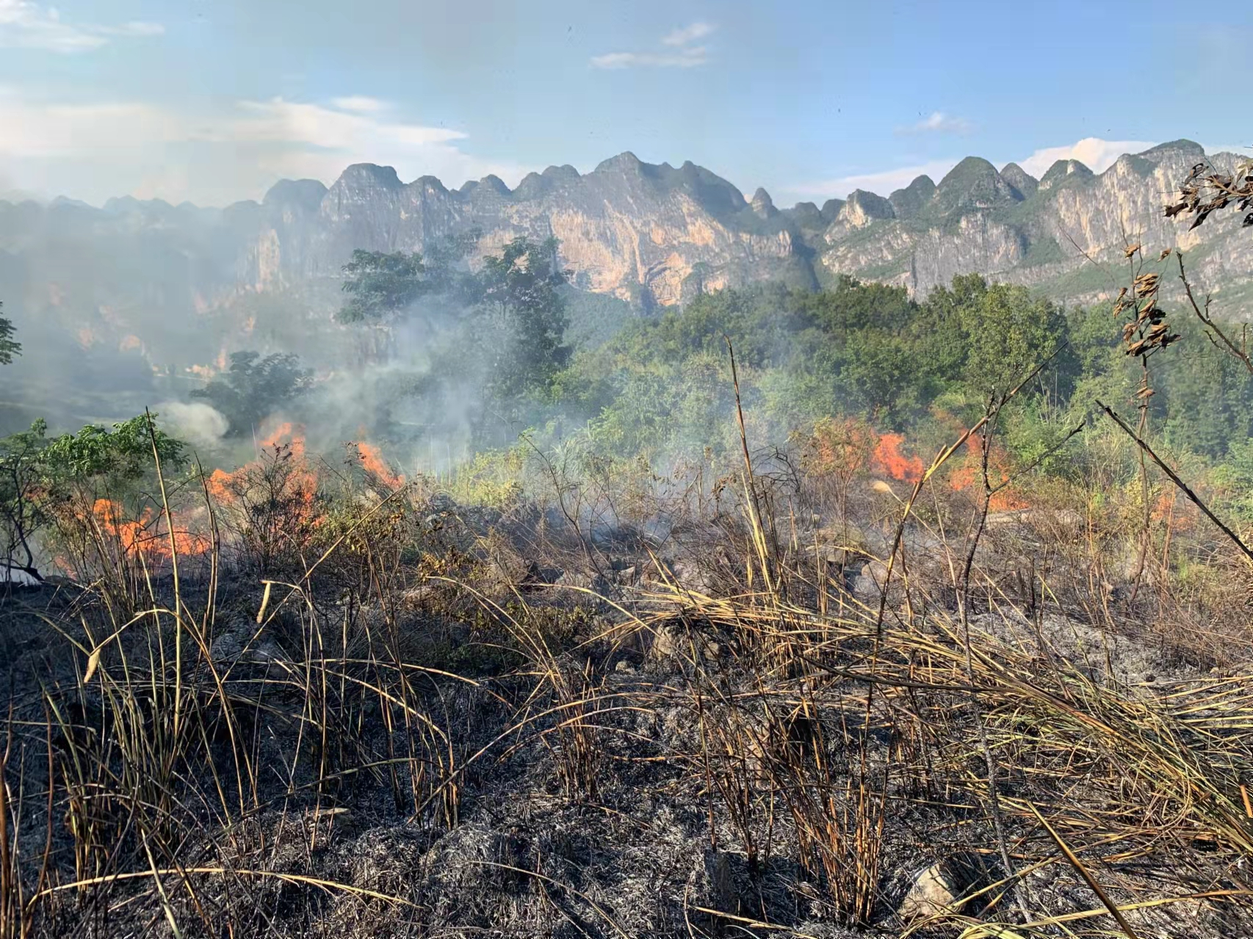


Evapotranspiration process under typical herb cover after wildfire
Kemin Liu and Lunjiang Wang
ljwang5@gzu.edu.cn
Guizhou university, college of forestry, Guiyang 550018, Guizhou China

Slide 2

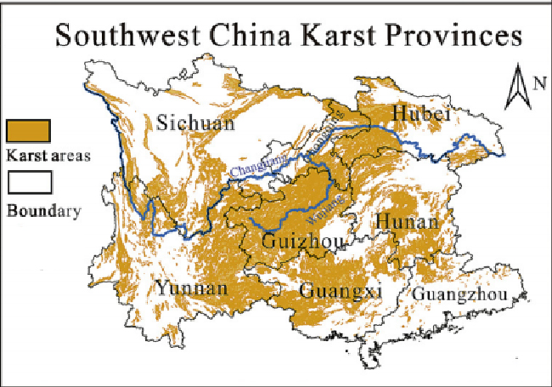

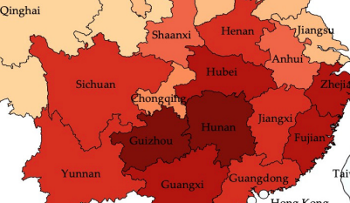
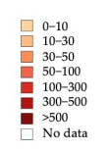
1.1 Background
The karst ecosystem in southwest China is characterized by shallow soil.
There were 1977 fires, with burned area of 24,300 hm² from 2011 to 2017(Zhang, et al.2021).Wildfires can cause serious soil erosion.
Vegetation restoration protoratects land surface from erosion. Soil moisture limits vegetation development.
Evapotranspiration contributes largely to soil moisture loss.

Slide 3



1.2 Objective
Change in evapotranspiration as affected by different burning severity
Difference in evapotranspiration of land surface with artemisia and cogongrass
Effects of climate on evapotranspiration after wildfire

Slide 4
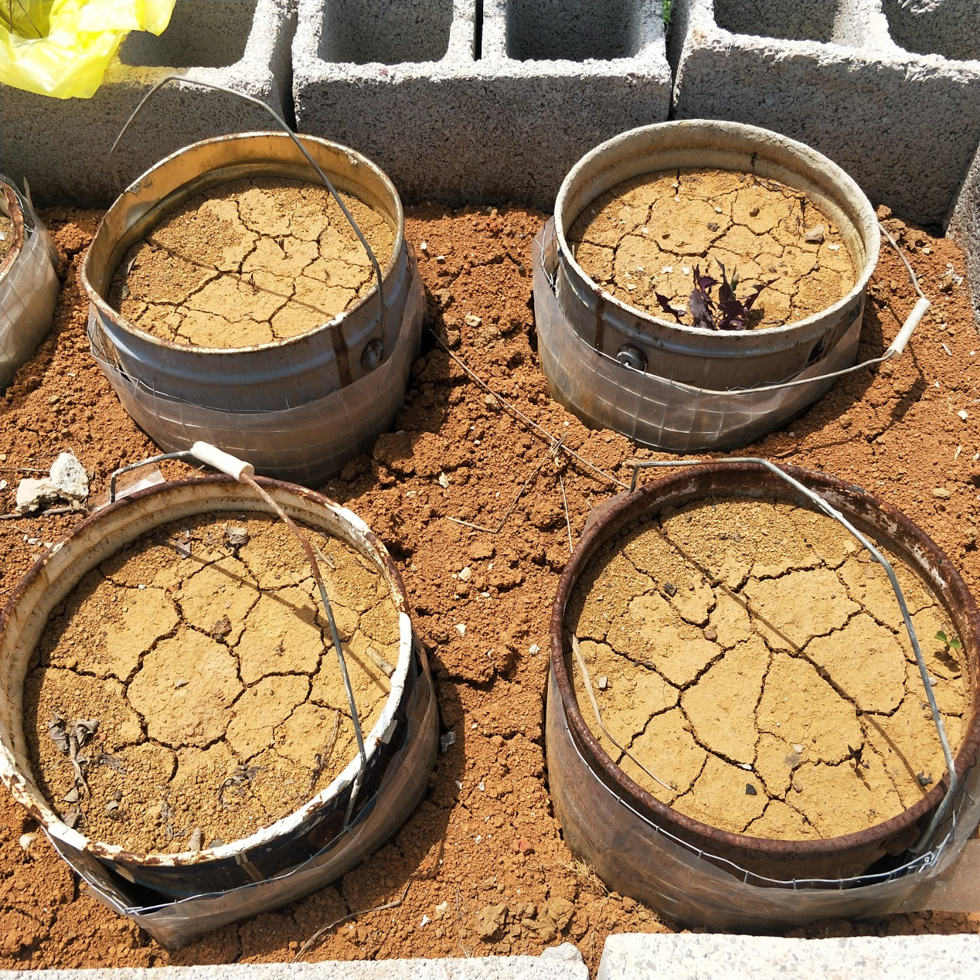
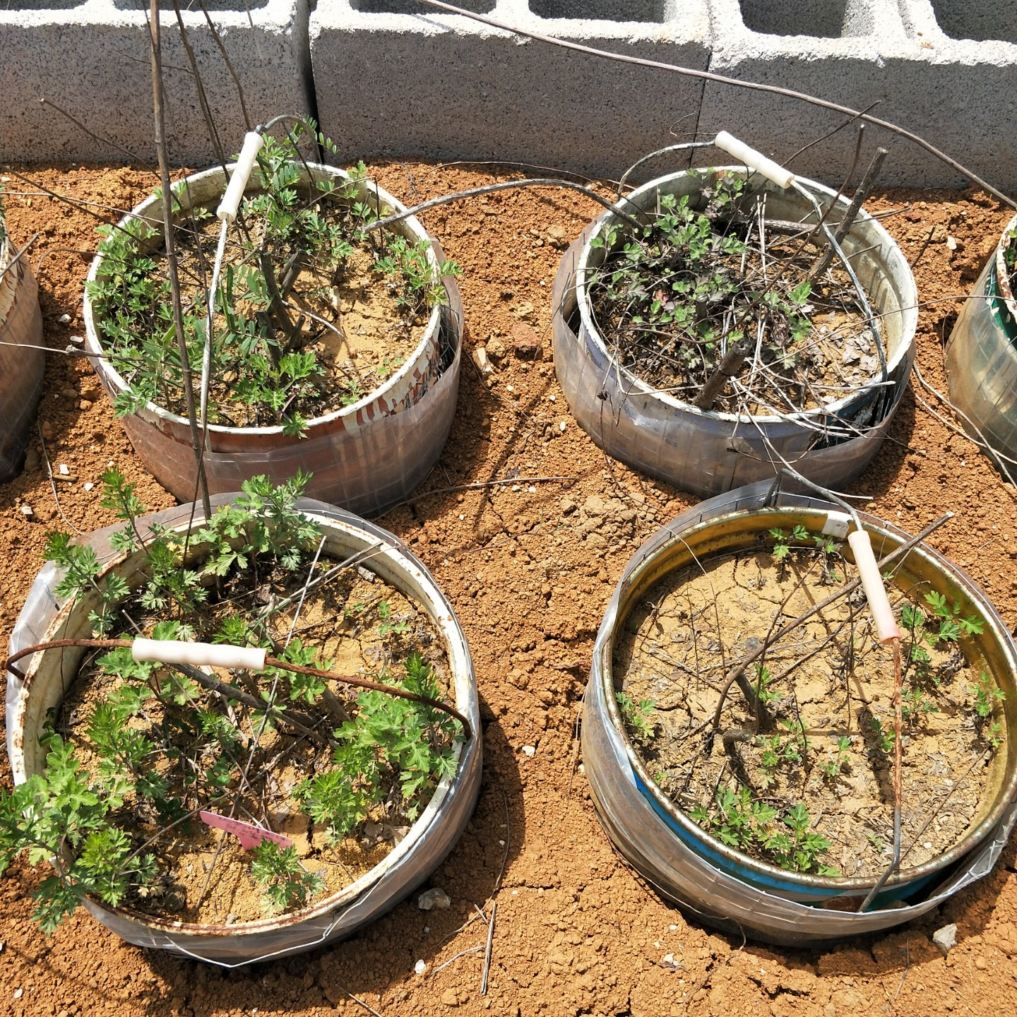
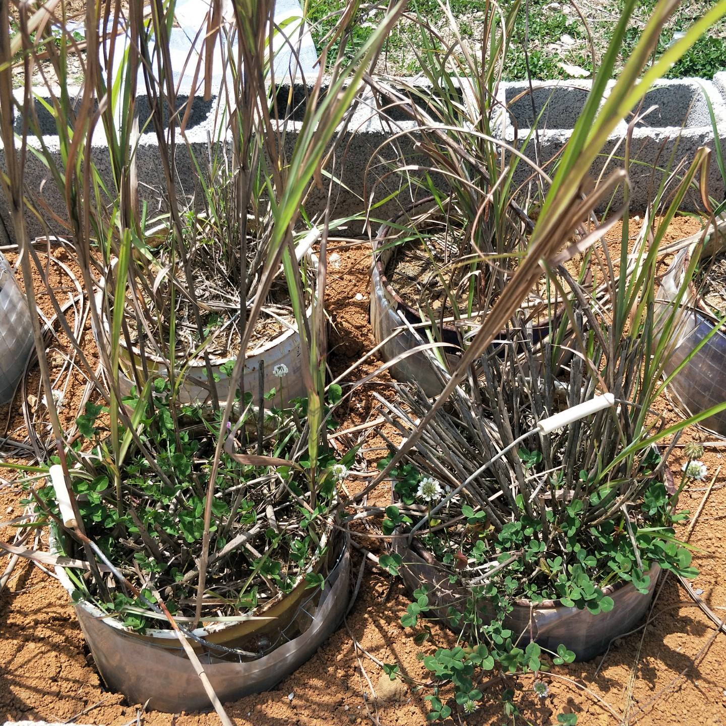
2 Method
Control
Artemisia
Cogongrass
Compositae Artemisia Artemisia dubia Wall. ex Bess.
Gramineae Saccharum Saccharum arundinaceum Retz.
Experimental plant cultivation

Slide 5
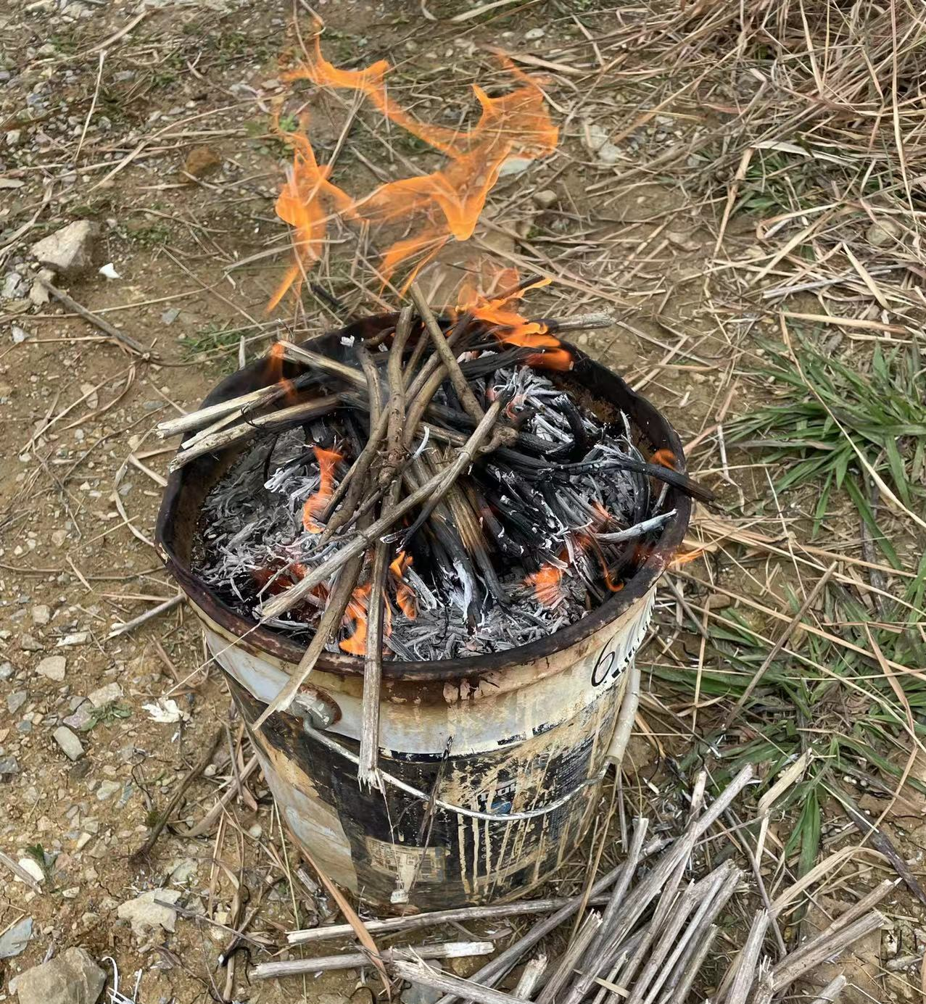
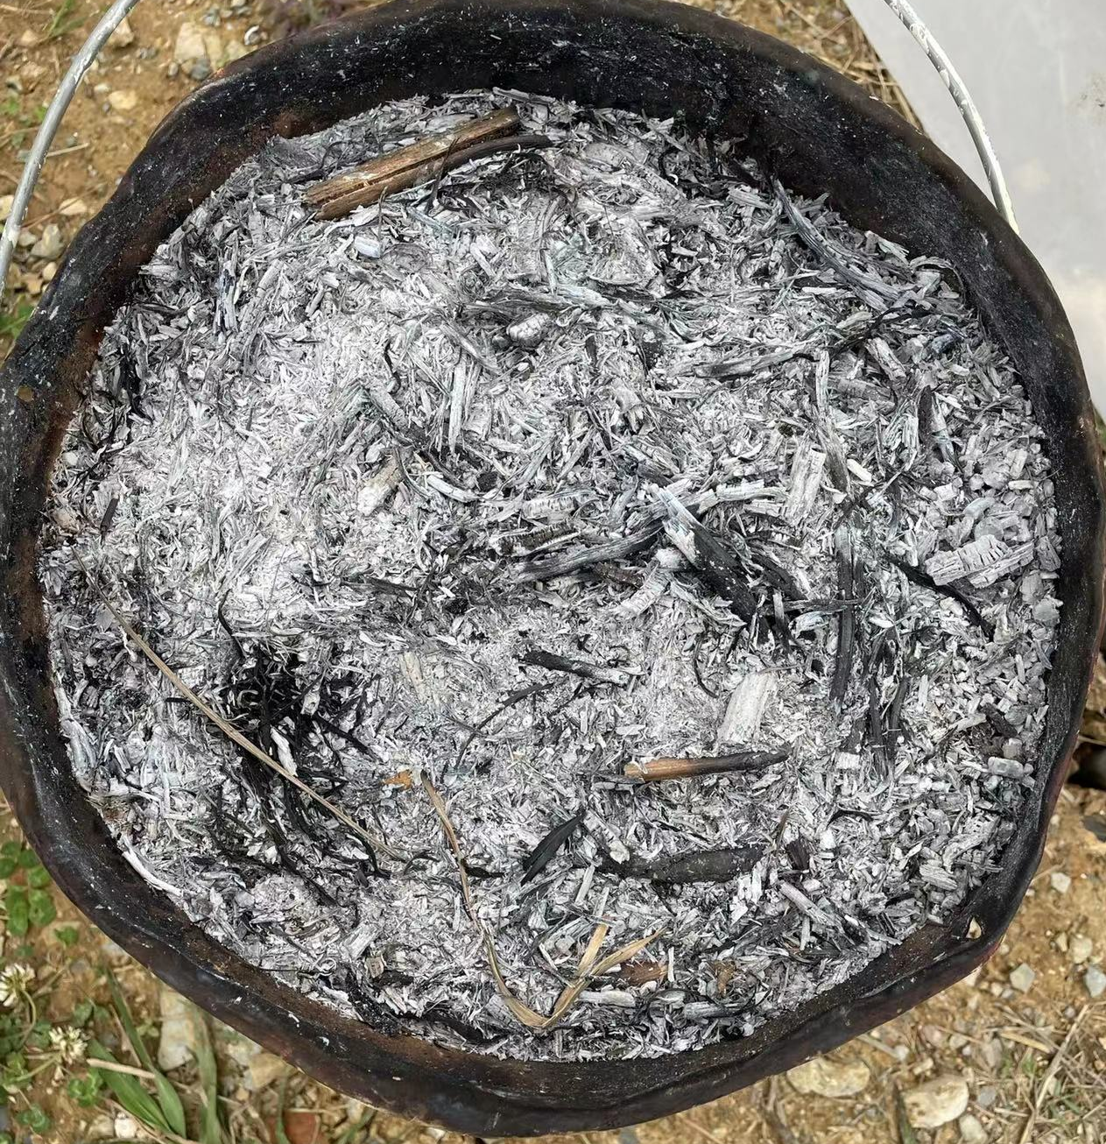
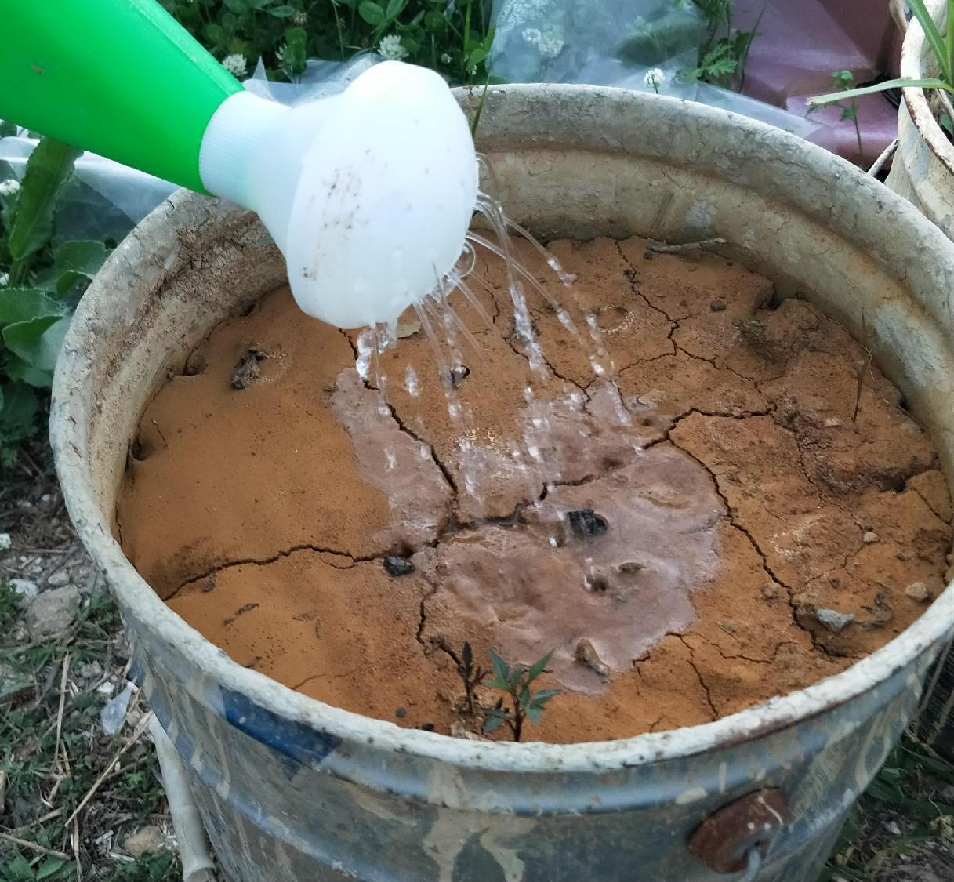
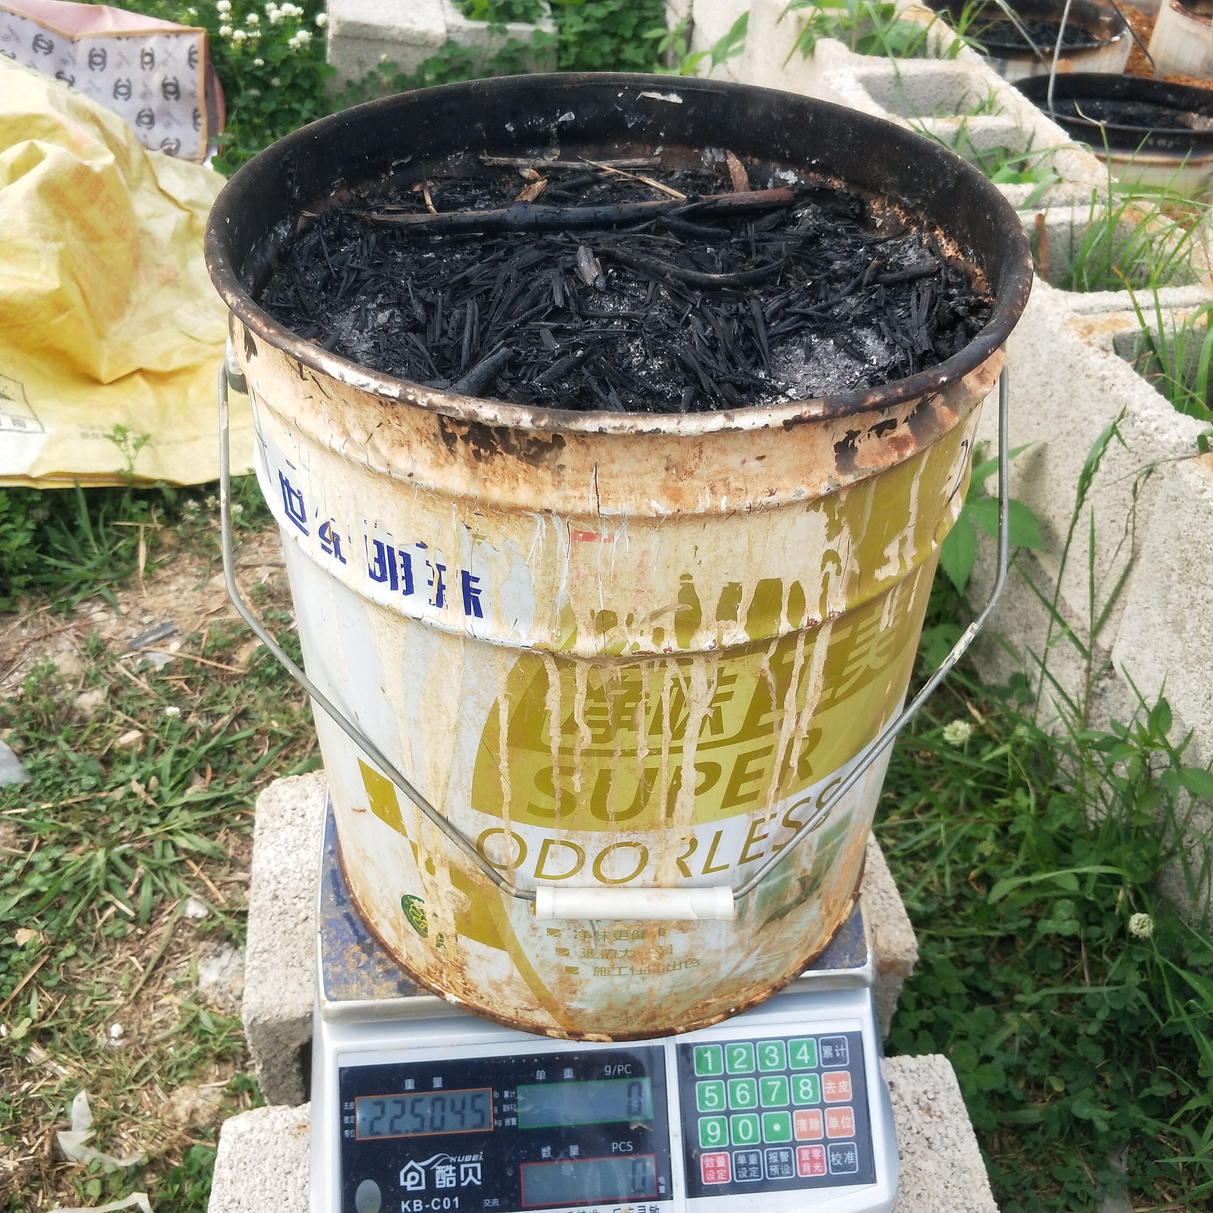
Forestry College of Guizhou University
2 Method
Table 1. Classification criteria for different burning severity.
 | Mild | Medium | Strong
The burning time（min） | 5 | 20 | 60
The thickness of the ash（cm） | 0.7 | 1.77 | 2.75
Soil temperature after burning （℃） | 70-80 | 120-140 | 180-200
burning
after burning
watering
weighting

Slide 6
Forestry College of Guizhou University
3 Result
3.1 Change in evapotranspiration as affected by different burning severity
With the increase of burning severity, evapotranspiration decreases.This phenomenon was not obvious in plant 1, probably because plant 1 was more responsive to changes in other factors.

Slide 7
Forestry College of Guizhou University
3 Result
3.2 Difference in evapotranspiration of land surface with artemisia and cogongrass
There was no obvious difference in evapotranspiration variation between the two plantations in the same period.
The evapotranspiration change of control group was significantly higher than that of two plant groups.

Slide 8
Forestry College of Guizhou University
3 Result
Average daily temperature curve to compare evapotranspiration
3.3 Effects of climate on evapotranspiration after wildfire
Evapotranspiration has the same trend as temperature.
When the temperature rises, the evapotranspiration increases

Slide 9
Forestry College of Guizhou University
3 Result
3.3 Effects of climate on evapotranspiration after wildfire
Average daily Radiation curve to compare evapotranspiration
Precipitation to compare evapotranspiration

Slide 10
明德至善 博学笃行
Forestry College of Guizhou University
4 Conclusion
Wildfire acts on soil and plants, resulting in a decrease in ET, the impact of wildfire on evapotranspiration increases with the increase of burning severity.
Wildfire destroyed plants in tub, resulting in similar ET results of the two plants, and due to the effect of wildfire, the ET of both plants was smaller than that of the control group.
In the experiment, the curve of weather elements was basically consistent with the change trend of ET, indicating that temperature, radiation and precipitation had a significant impact on ET. Therefore, we could see that these three weather elements were the main influencing factors of ET.

Slide 11


Thanks for your attention！
presented by Kemin Liu

