Slide 1




Prediction of hourly runoff in the Savitri River basin in India: Use of a local approximation approach
HS3.1
Authors: Namitha Elza Saji, V Jothiprakash, Bellie Sivakumar,
Indian Institute of Technology Bombay

Slide 2

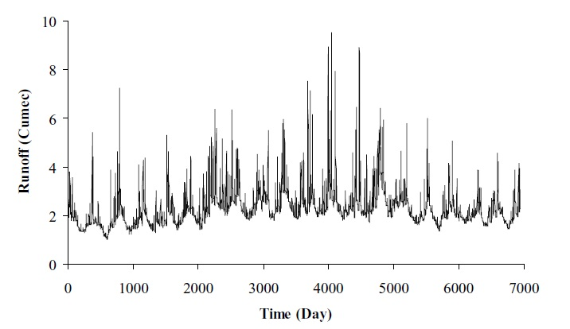
Nonlinear Local Approximation method of Prediction
Time series of hydro-meteorologic variables are the main input for hydrologic prediction
Hydro-meteorologic time series have both deterministic and stochastic component
Available hydrologic prediction concepts either considers deterministic or stochastic nature of time series
Chaos theory considers both deterministic and stochastic nature of a series
Nonlinear local approximation method of prediction (NLAP) method is for forecasting the future values of a variable using the concepts of chaos theory.
Figure 1: Time series plot for daily runoff (Source: Islam and Sivakumar 1999)

Slide 3

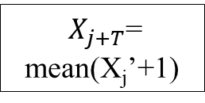
Nonlinear Local Approximation method of Prediction
Phase space reconstructed in dimension ‘m’
(Last vector is Y_{j})
Identifying k number of nearest neighbour of Y_{j} as Y_{j}’ , j’ <j
Finding X_{j}’+1 = m^{th} element of Y_{j}’+1
$X_{j+T}$= mean(X_{j}’+1)
Find vector Y_{j}’+1
Example: For dimension 2
Y₁ = (X₁, X₂)
Y₂ = (X₂, X₃)
Y₃ = (X₃, X₄)
Y₄ = (X₄, X₅)
Y₅ = (X₅, X₆)
Y₆ = (X₆, X₇)
Y₇ = (X₇, X₈)
Y₈ = (X₈, X₉)
Y₉ = (X₉, X₁₀)
Suppose Y₅ and Y₃ are the two nearest neighbours of Y₉
Y_{j}’ = Y₅ & Y₃
Y_{j}’+1 = Y₆ & Y₄
Y₆ = (X₆, X₇)
Y₄ = (X₄, X₅)
X_{j}’+1 = X₇ & X₅
X₁₁ = mean (X₇ & X₅ )
Prediction accuracy depends on embedding dimension (m) and number of nearest neighbours (k) considered

Slide 4
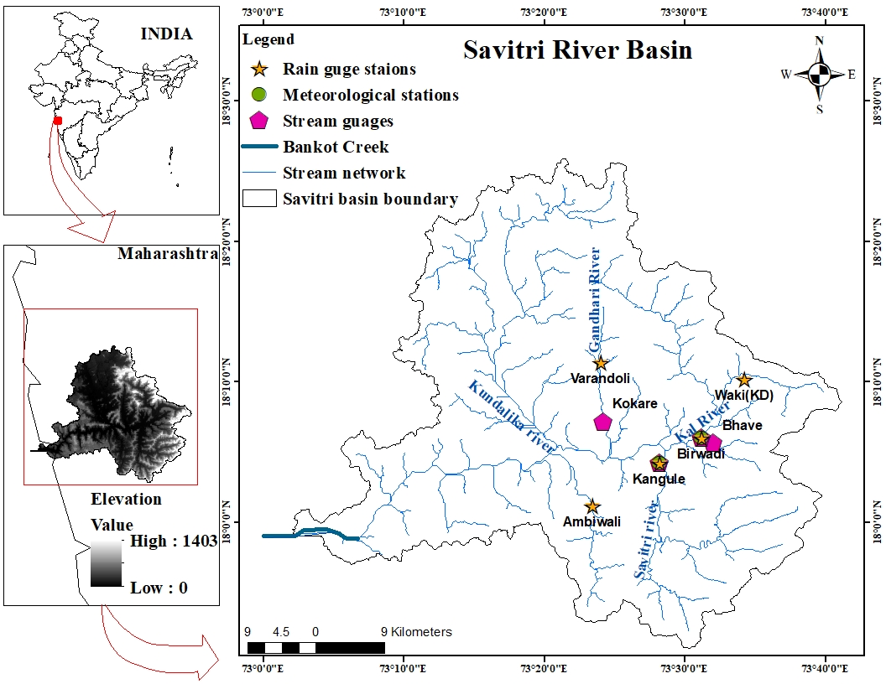
Study area – Savitri River Basin
One of the west flowing river basins in India
Basin has a total area of 2262.42 km²
Lies within the global coordinates of 18⁰20′ N to 17⁰50′ N and 73⁰07′ E to 73⁰41′ E.
Originates in the Mahabaleshwar plateau and flows down for a length of 95.1 km to join the Arabian Sea at Bankot Creek.
Hourly runoff series for the monsoon season from four stream gauges for a common period 2000-2010 is used
Figure 2: Location of Savitri river basin

Slide 5
Methodology
Phase space reconstruction using hourly runoff from 2000 to 2009
Identified complexity (dimension) by False Nearest Neighbour (FNN) approach
Predicted hourly runoff during 2010 using local approximation
Prediction accuracy checked by:
Correlation coefficient (CC)
Nash –Sutcliffe efficiency (NSE)
Normalized root mean square error (NRMSE)

Slide 6
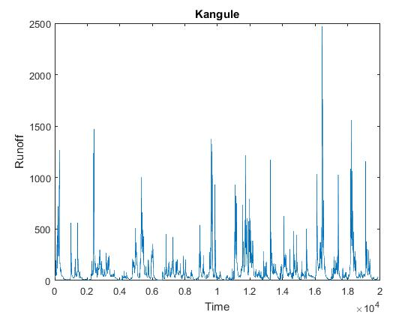
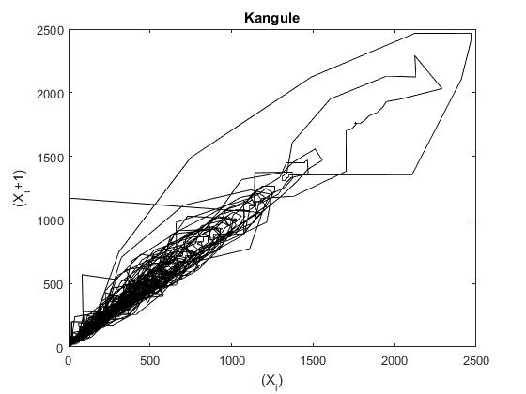
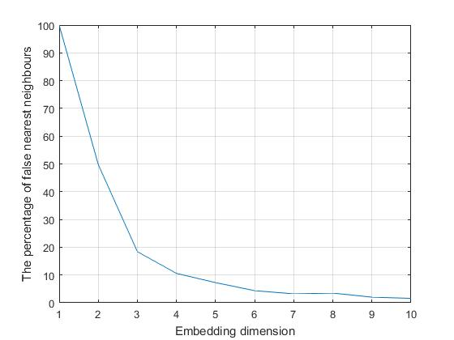
Results
Kangule station
a)
b)
c)
Figure 3: a) Time series of hourly runoff at Kangule station, b) Phase reconstructed for hourly runoff series at Kangule station, c) FNNplot for hourly runoff series at Kangule station
Optimum embedding dimension =9

Slide 7
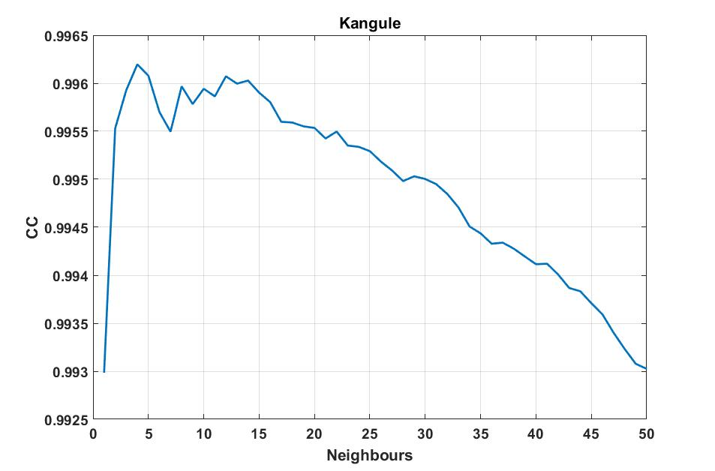
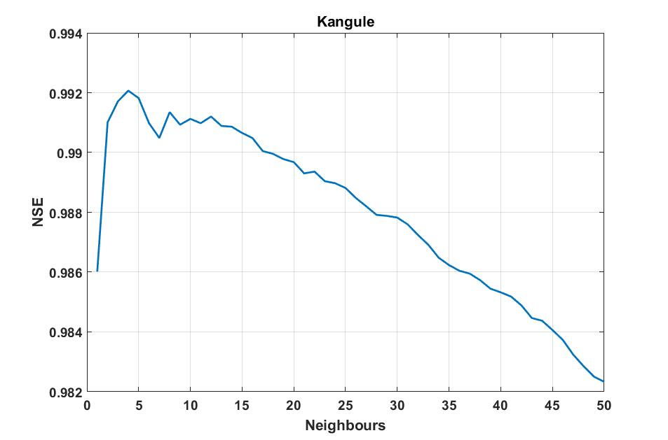
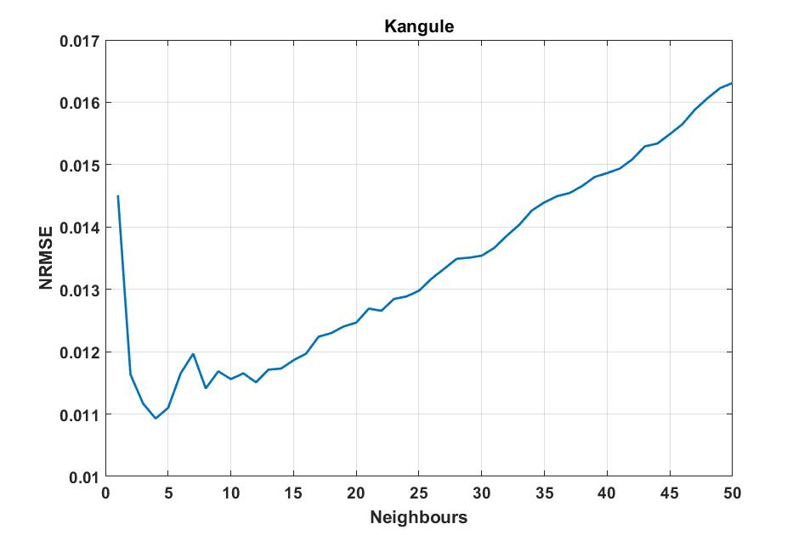
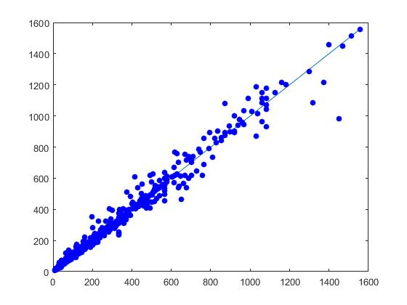
Local approximation prediction accuracy
a)
b)
c)
Figure 4: Local approximation prediction accuracy at Kangule station shown by a) CC, b) NSE, c) NRMSE
CC = Correlation coefficient, NSE = Nash-Sutcliffe efficiency, NRMSE = Normalized root mean square error
Optimum number of neighbours = 4
m=9 & k=4
Figure 5: Scatter plot for predicted and observed hourly runoff at Kangule station

Slide 8
Conclusions
Station | Optimum Embedding dimension | Optimum Number of neighbours | CC | NSE | NRMSE
Kangule | 9 | 4 | 0.996 | 0.992 | 0.011
Bhave | 13 | 3 | 0.980 | 0.961 | 0.014
Birwadi | 6 | 22 | 0.998 | 0.995 | 0.010
Kokkare | 9 | 23 | 0.996 | 0.993 | 0.011
CC = Correlation coefficient, NSE = Nash-Sutcliffe efficiency, NRMSE = Normalized root mean square error
Prediction accuracy achieved is comparable with more complicated techniques
One time step ahead prediction accuracy is good

Slide 9
References
Dhanya, C.T., & Kumar, N. D., (2011), “Predictive uncertainty of chaotic daily streamflow using ensemble wavelet networks approach”, Water Resources Research, Vol. 47, W06507, doi:10.1029/2010WR010173.
Fathima, T.A., & Jothiprakash, V., (2014), “Behavioural analysis of a time series– A chaotic approach”, Sa¯dhana¯Vol. 39, Part 3, 659–676, Indian Academy of Sciences.
Farmer DJ, Sidorowich JJ (1987) Predicting chaotic time series. Phys Rev Lett 59:845–848
Gharde K. D., Kothari M. (2015) Application of ANN and Fuzzy Logic Algorithms for Streamflow Modelling of Savitri Catchment, Journal of Earth System Sciences 124, N0.5, pp. 933-943
Islam, M. N., & Sivakumar, B., (2002), “Characterization and prediction of runoff dynamics: a nonlinear dynamical view”, Advances in Water Resources,25, 179–190.
Kennel, M.,B., Brown, R., & Abarbanel, H., D., I., (1992), “ Determining embedding dimension for phase-space reconstruction using a geometrical construction”, PHYSICAL REVIEW A, VOLUME 45, NUMBER 6.
Sivakumar, B., (2003), “Forecasting monthly streamflow dynamics in the western United States: a nonlinear dynamical approach”,Environmental Modelling & Software,18 (2003) 721–728.
Sivakumar, B., (2017), “Chaos in hydrology: bridging determinism and stochasticity”, Springer, Dordrecht
Sivakumar, B., Berndtsson, R., & Persson, M., (2001), “Monthly runoff prediction using phase space reconstruction”, Hydrological Sciences Journal, 46:3, 377-387, DOI: 10.1080/02626660109492833.
Srivalli, Ch. N. S., Jothiprakash, V., & Sivakumar, B., “Complexity of streamflows in the west-flowing rivers of India”, Stochastic Environmental Research and Risk Assessment (2019) 33:837–853, https://doi.org/10.1007/s00477-019-01665-3.
Vignesh, R., Jothiprakash, V., & Sivakumar, B., (2015), “Streamflow variability and classification using false nearest neighbour method”, Journal of Hydrology ,531 706–715.

Slide 10
Thank you

Slide 11
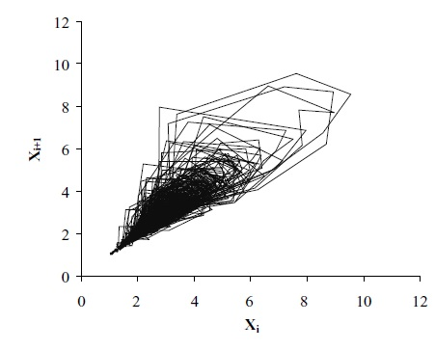
Phase space reconstruction
Represents the state of a system
The coordinates represents variables of the system
Gives an idea about how that system evolves over time
The arrangement of points in the phase space result in attractor
A well-defined attractor is a representation of presence of chaos in the system
Figure : Phase space diagram for daily runoff (Source: Islam and Sivakumar 1999)

Slide 12
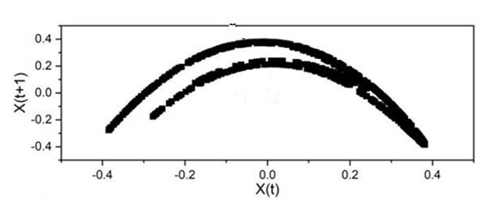
SINGLE VARIATE PHASE SPACE RECONSTRUCTION
According to Takens’s embedding theorm for dimension 2
Z_{j}= (X_{j}, X_{j+τ}, X_{j+2τ}, …, X_{j+(d-1)τ})
Z₁ = (X₁, X₂)
Z₂ = (X₂, X₃)
Z₃ = (X₃, X₄)
Z₄ = (X₄, X₅)
Z₅ = (X₅, X₆)
Z₆ = (X₆, X₇)
Z₇ = (X₇, X₈)
Z₈ = (X₈, X₉)
Z₉ = (X₉, X₁₀)
N=10, Assuming τ =1, d=2 ,Δt =1
Z_{j}= (X_{j}, X_{j+1})
j → 1, 2, …, N-(d-1)τ/Δt
= 1,2,..9,10-(2-1)1
= 1,2,3…9

Slide 13
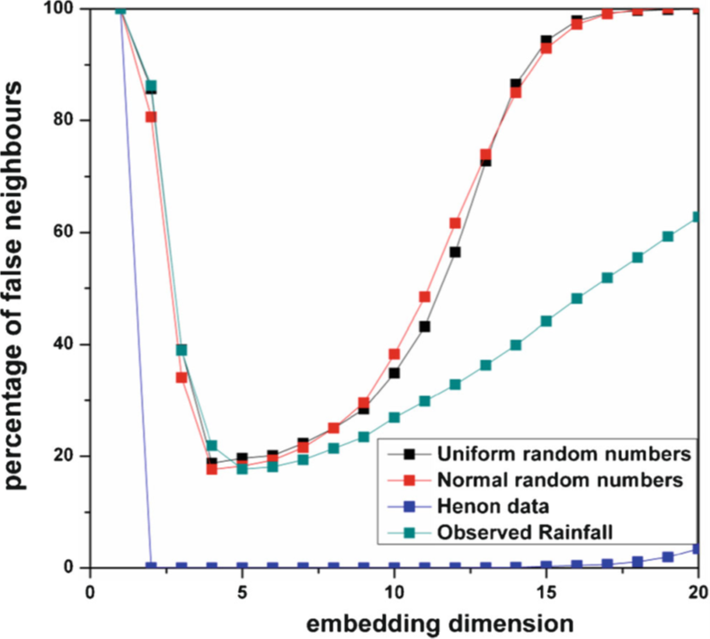
FNN METHOD
The FNN algorithm for dimension d=2
Neighbours for d=2
Z_{1,} Z₄
Z_{2,} Z₆
Z_{3,} Z₅
Z_{4,} Z₈
Z_{5,} Z₉
Z_{6,} Z₂
Z_{7,} Z₁
Z_{8,} Z₇
Z_{9,} Z₃
False Neighbours for d=2
Z_{1,} Z₄
Z_{2,} Z₆
Z_{3,} Z₅
Z_{4,} Z₈
Z_{5,} Z₉
Z_{6,} Z₂
Z_{7,} Z₁
Z_{8,} Z₇
Z_{9,} Z₃
For d=2, τ=1
Z₁ = (X₁, X₂)
Z₂ = (X₂, X₃)
Z₃ = (X₃, X₄)
Z₄ = (X₄, X₅)
Z₅ = (X₅, X₆)
Z₆ = (X₆, X₇)
Z₇ = (X₇, X₈)
Z₈ = (X₈, X₉)
Z₉ = (X₉, X₁₀)
For Z₁
D_{1,2}
D_{1,3}
D_{1,4}
D_{1,5}
D_{1,6}
D_{1,7}
D_{1,8}
D_{1,9}
For Z₂ to Z₈
…
….
….
….
….
….
….
….
For Z₉
D_{9,1}
D_{9,2}
D_{9,3}
D_{9,4}
D_{9,5}
D_{9,6}
D_{9,7}
D_{9,8}
Check distance and loneliness criteria (Kennel et al 1992)
If both criterions are satisfied, it is a false neighbour.
Count total number of false neighbours
FNN plots of time series under behavioural study. (Source:Fathima & Jothiprakash 2014)
D_{1,2} = $\sqrt{{{(x}_{1}−x_{2})}^{2}+({x_{2}−x_{3})}^{2}}$ = Euclidian distance between Z₁ & Z₂ and so on

