Slide 1
A Comparison of three deep learning-based methods for large-scale urban flood mapping using SAR data
Jie Zhao^{1,2}, Yu Li¹, Patrick Matgen¹, Ramona Pelich¹, Renaud Hostache³, Wolfgang Wagner², Marco Chini¹,
¹ Department of Environmental Research and Innovation, Luxembourg Institute of Science and Technology.
² Research Group Remote Sensing, Department of Geodesy and Geoinformation, Vienna University of Technology
³ Institut de recherche pour le développement

Slide 2
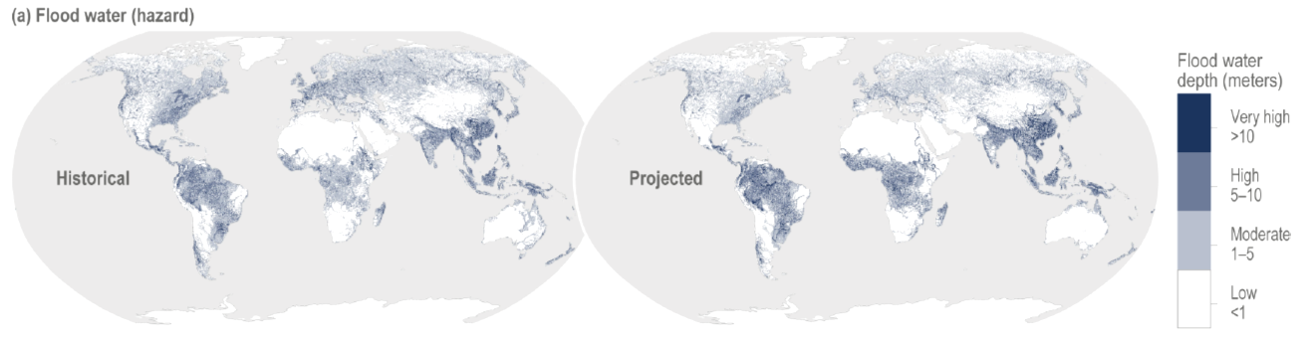
Introduction
According to IPCC 2022 report, the likelihood of floods is increasing and more and more populations are exposed to floods.
The urban flood mapping are really important as more than 55% of the world’s population lives in urban areas.
It is still challenging due to the complex and heterogeneous structure of urban areas:
Mixture of vegetation, buildings, bare soils, etc.
Caretta, M.A., A. Mukherji, M. Arfanuzzaman, R.A. Betts, A. Gelfan, Y. Hirabayashi, T.K. Lissner, J. Liu, E. Lopez Gunn, R. Morgan, S. Mwanga, and S. Supratid, 2022: Water. In: Climate Change 2022: Impacts, Adaptation, and Vulnerability. Contribution of Working Group II to the Sixth Assessment Report of the Intergovernmental Panel on Climate Change [H.-O. Pörtner, D.C. Roberts, M. Tignor, E.S. Poloczanska, K. Mintenbeck, A. Alegría, M. Craig, S. Langsdorf, S. Löschke, V. Möller, A. Okem, B. Rama (eds.)]. Cambridge University Press. In Press.
Risk of historical (1961-2005) & projected (2051-2070) river flooding

Slide 3
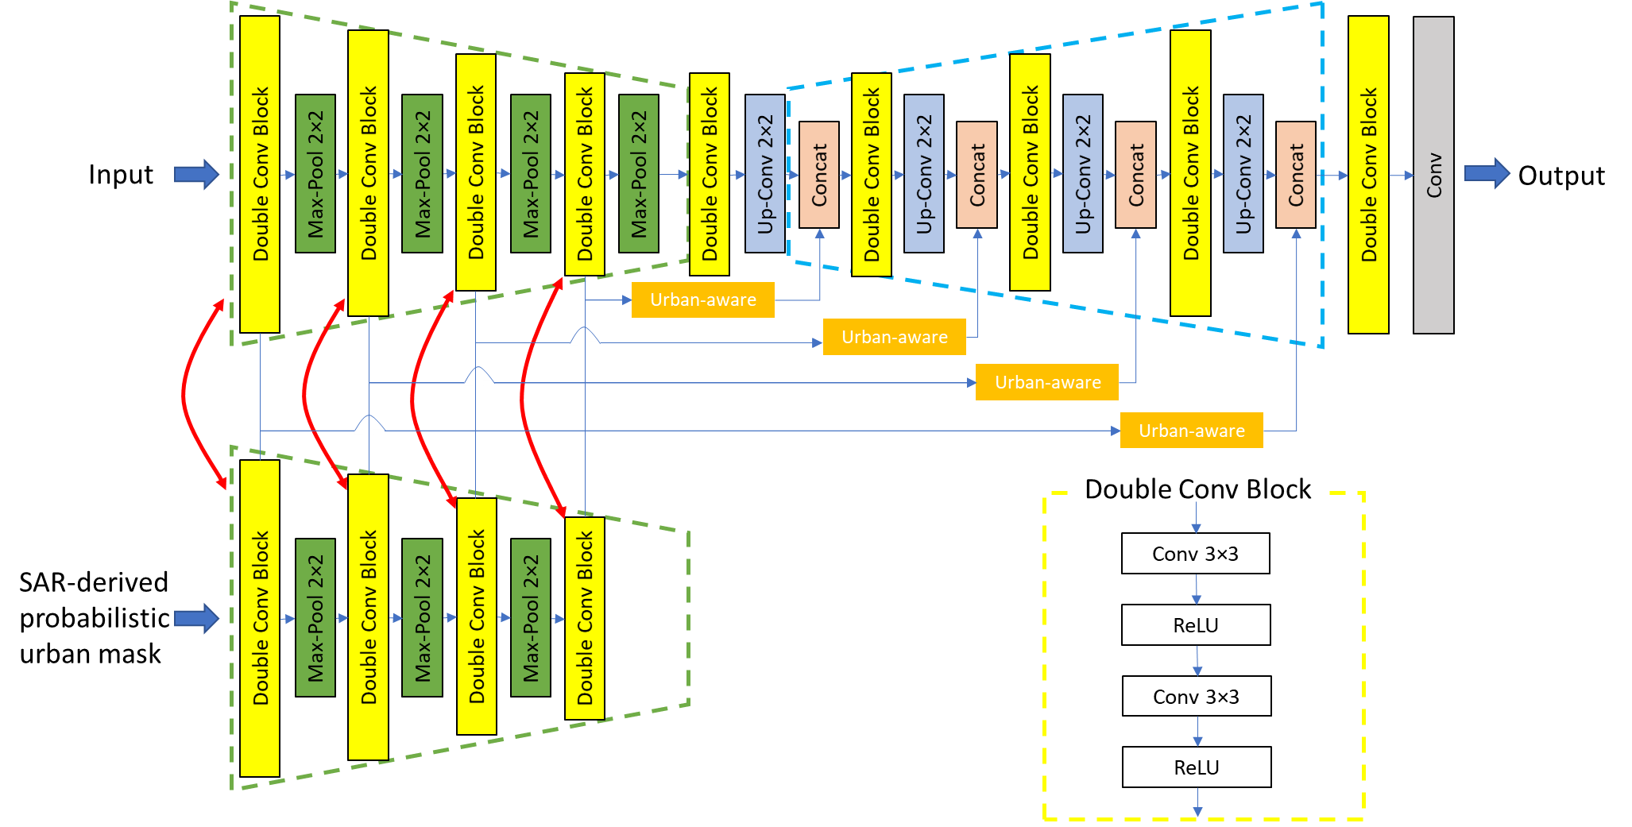
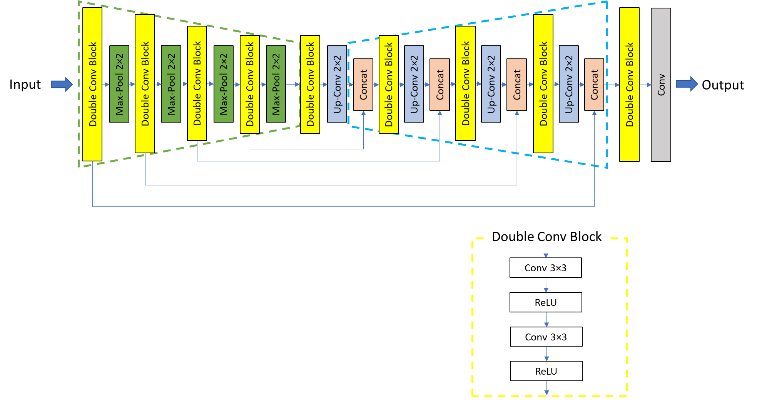
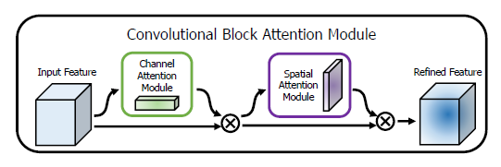
Deep Learning models
Urban-aware U-Net
Red line: blocks share the same parameters.
The orange block is our proposed urban-aware module.
Backbone: U-Net
Ronneberger, O., Fischer, P., & Brox, T. (2019). U-Net: Convolutional networks for biomedical image segmentation. arXiv 2015. arXiv preprint arXiv:1505.04597.
CBAM
CBAM
CBAM
CBAM
Several attention mechanisms:
Channel attention
Attention-gate
CBAM
Woo, S., Park, J., Lee, J. Y., & Kweon, I. S. (2018). Cbam: Convolutional block attention module. In Proceedings of the European conference on computer vision (ECCV) (pp. 3-19).

Slide 4
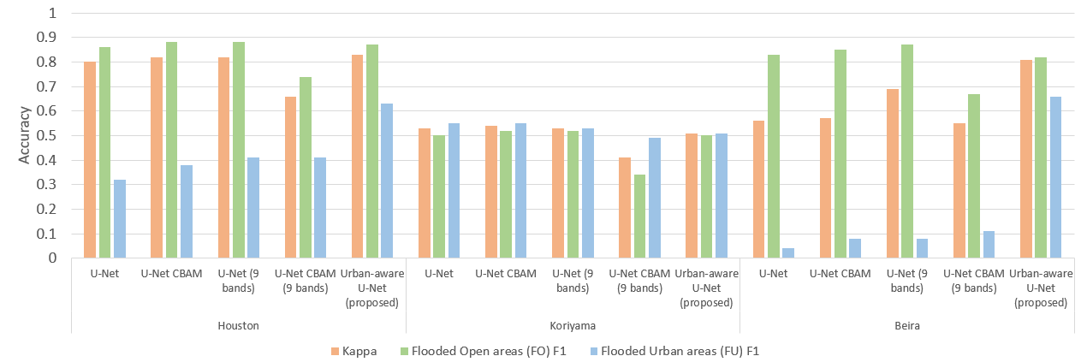
Results
SAR-derived urban mask is used as additional input data.

Slide 5
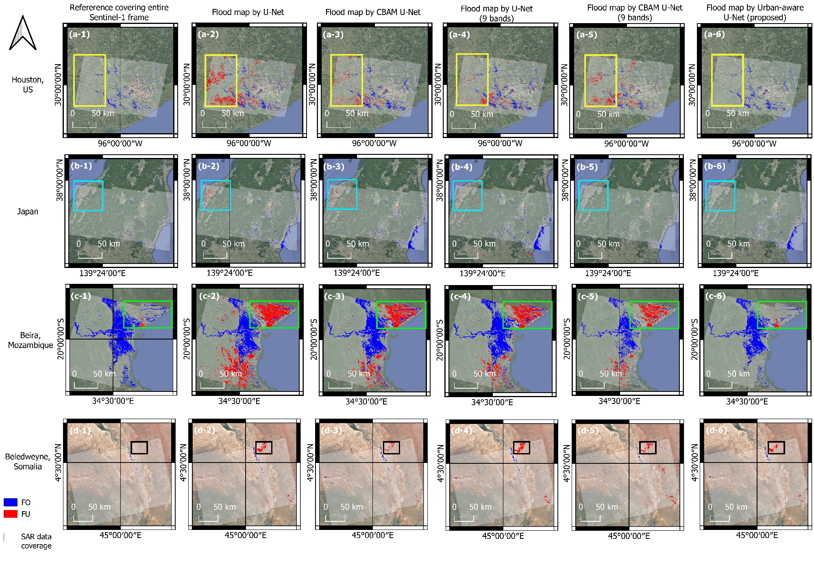
Results
SAR-derived urban mask is used as additional input data.
The proposed method outperformed compared with previous models (U-Net & U-Net with CBAM) at a large-scale flood mapping.

Slide 6
Conclusions and Outlook
Among these three DL models, the urban-aware U-Net outperforms compared with U-Net and CBAM U-Net in large-scale flood mapping.
More robust
Similar computation complexity
The urban-aware module has been used as a plugin module to the traditional U-Net model.
It is expected to be combined with other image segmentation CNN models

Slide 7


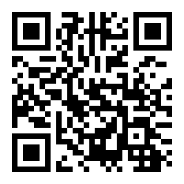
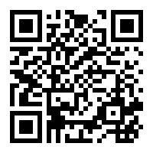
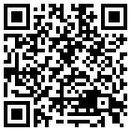
LinkedIn
ResearchGate
Thank you for your attention!
please feel free to contact me for any further discussion or collaboration

