Slide 1
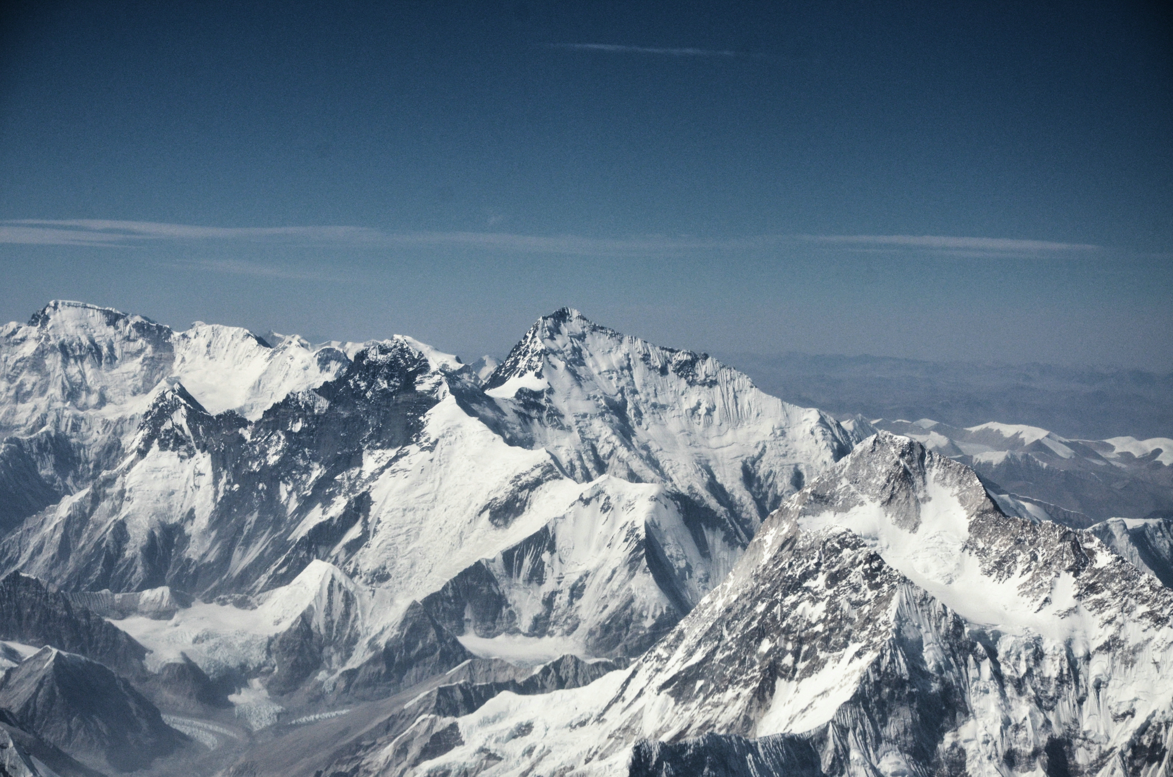
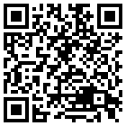


Systematic errors in Cryosat-2 swath elevations
Jan Haacker, Bert Wouters, Cornelis Slobbe
Abstract
DOI: 10.5194/egusphere-egu22-4946
Image: Zhangwei Ding (distributed via imaggeo.egu.eu)

Slide 2
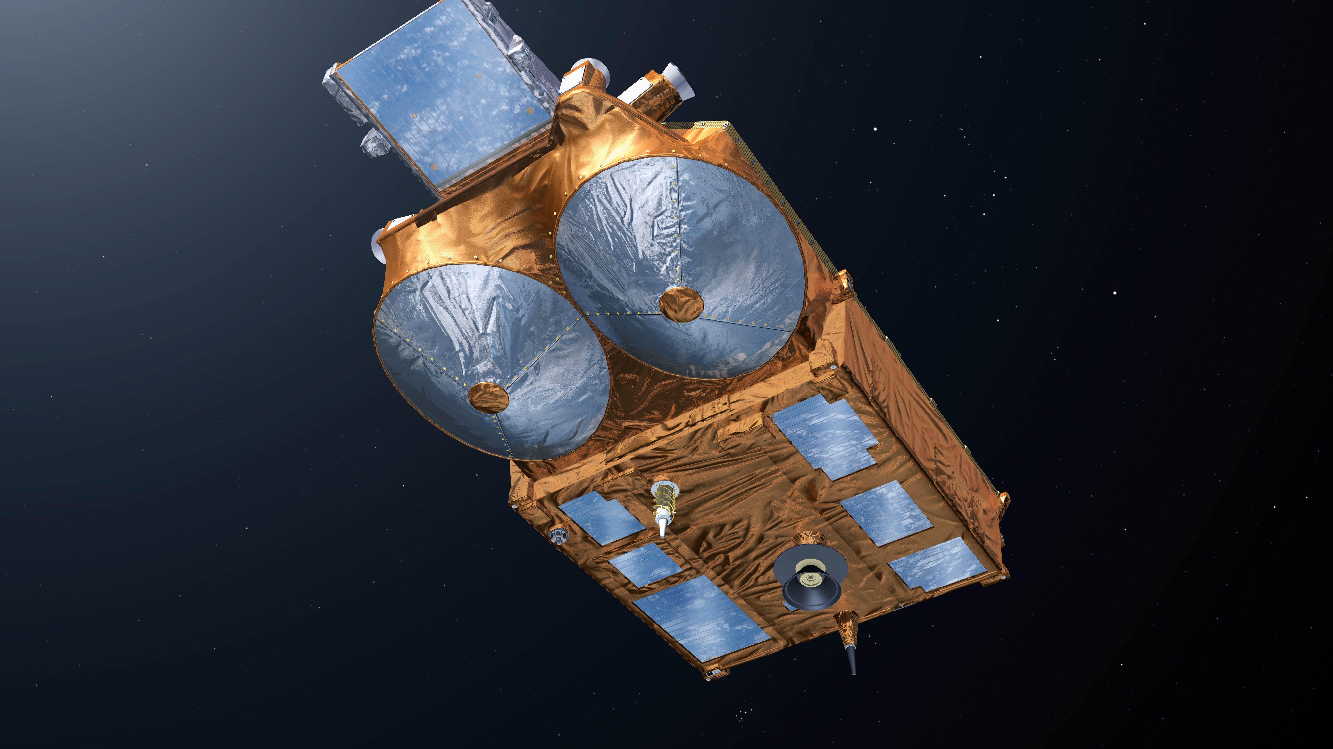
CryoSat-2: a SARIn altimeter
Image: ESA/P. Carril

Slide 3

Remote sensing of mountain glaciers
Glaciers melt quickly
Data is difficult to obtain
CryoSat-2 swath is promising
500 x 500 m
Monthly
Image: Zhangwei Ding (distributed via imaggeo.egu.eu)

Slide 4
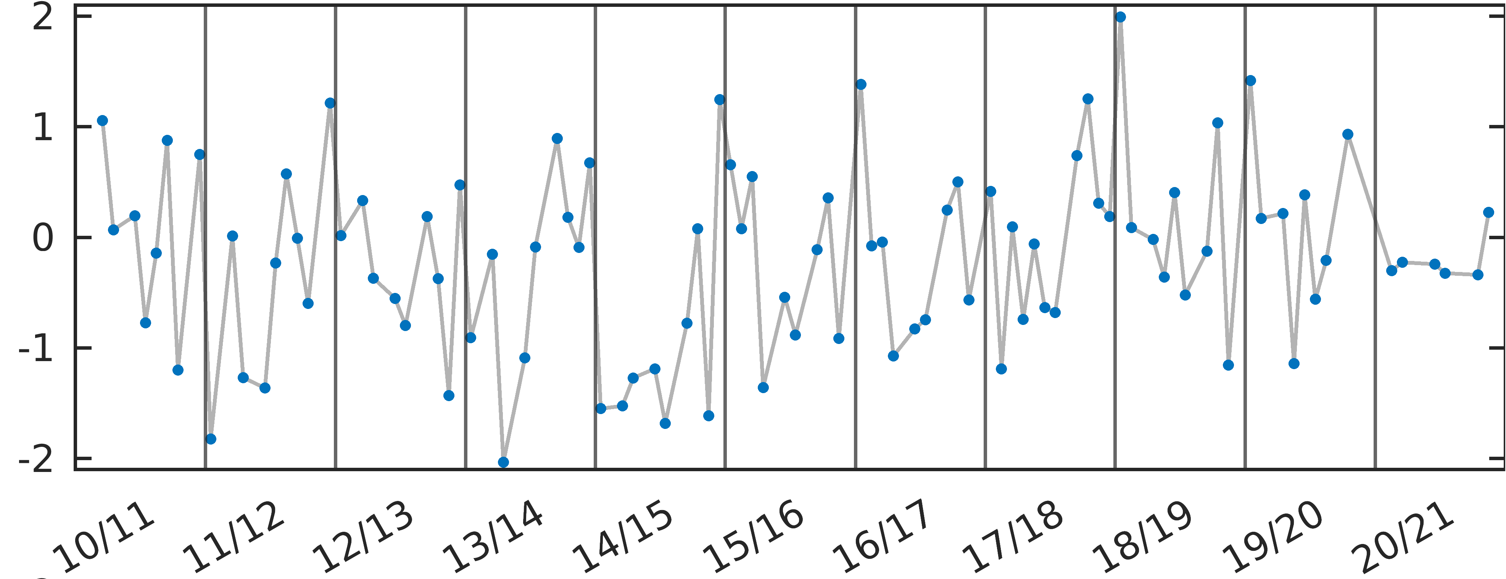
Confusing results
Elevation change [m]
Monthly time series for a 1 x 1 km grid cell
Glaciological year

Slide 5
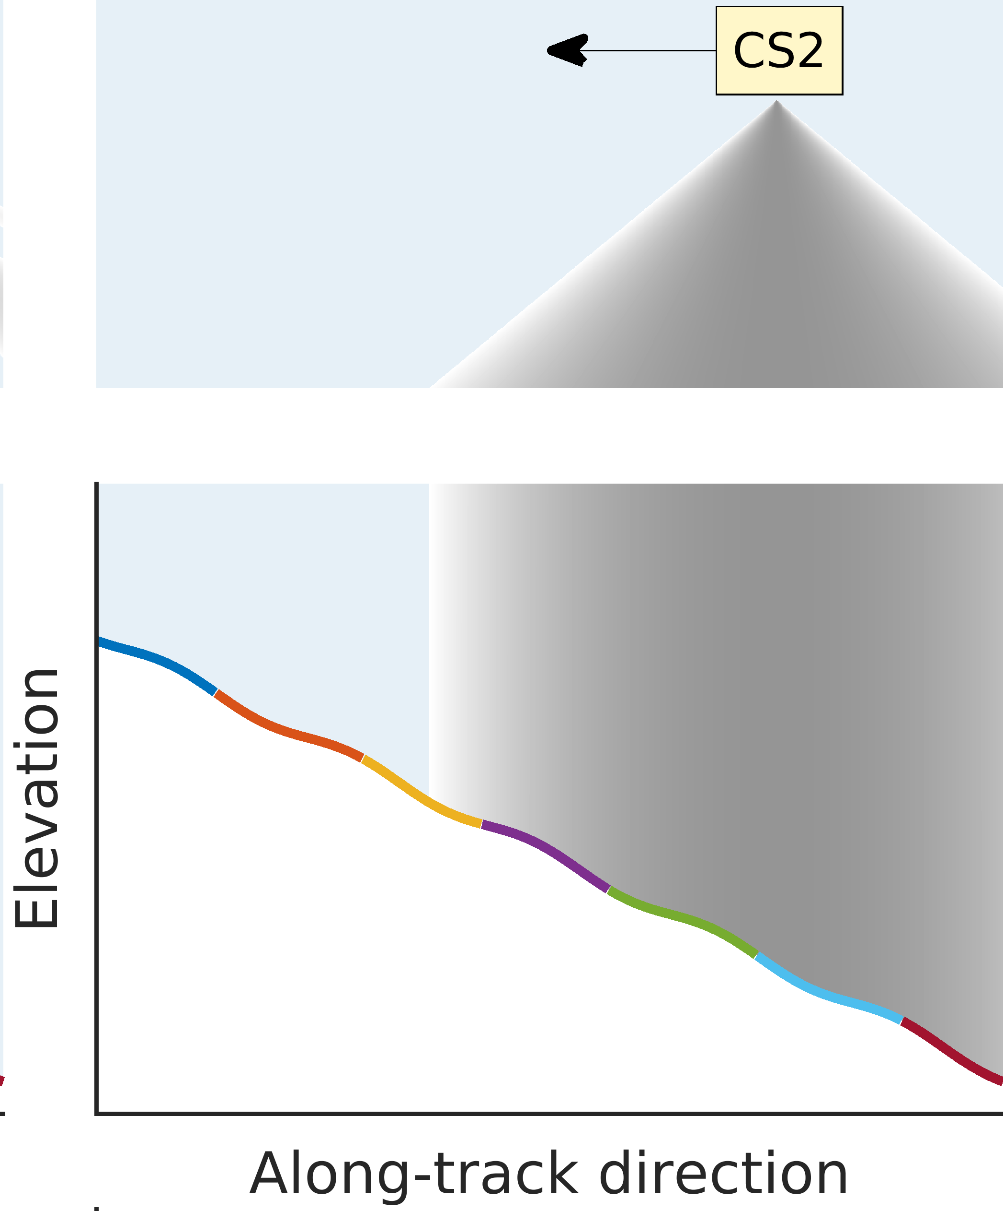
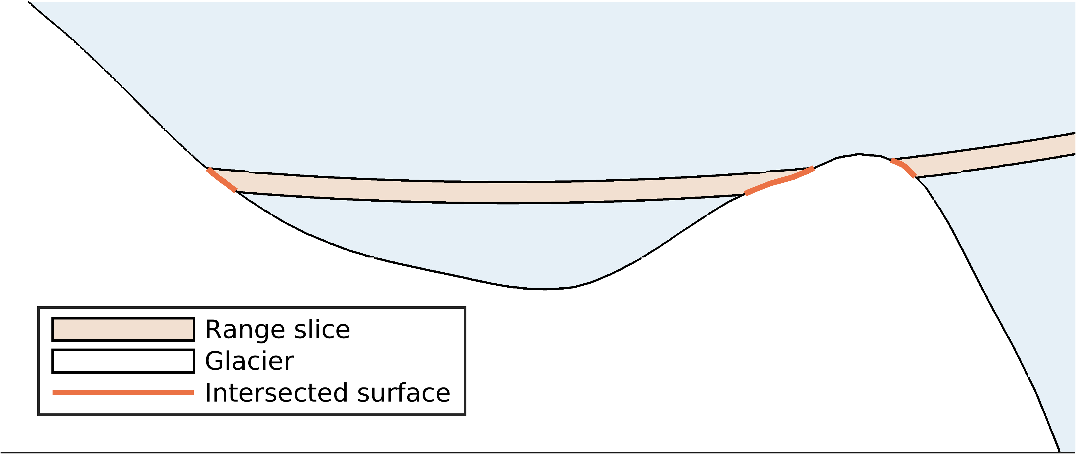
Issues are method intrinsic
Ghosting
Superposition

Slide 6
Issues are method intrinsic
Ghosting
Superposition
Errors on O(10 m)

Slide 7
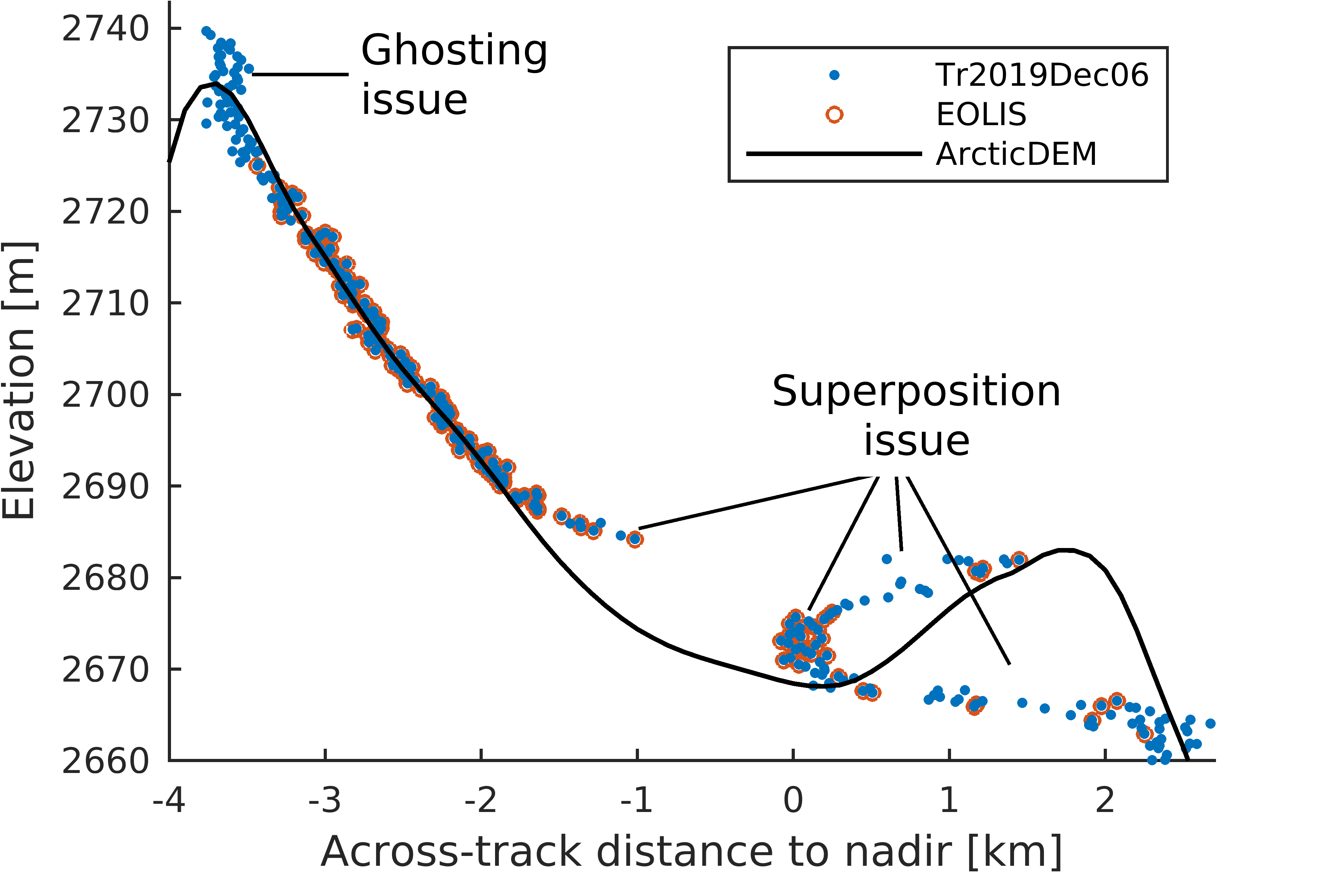
Example of affected waveform

Slide 8
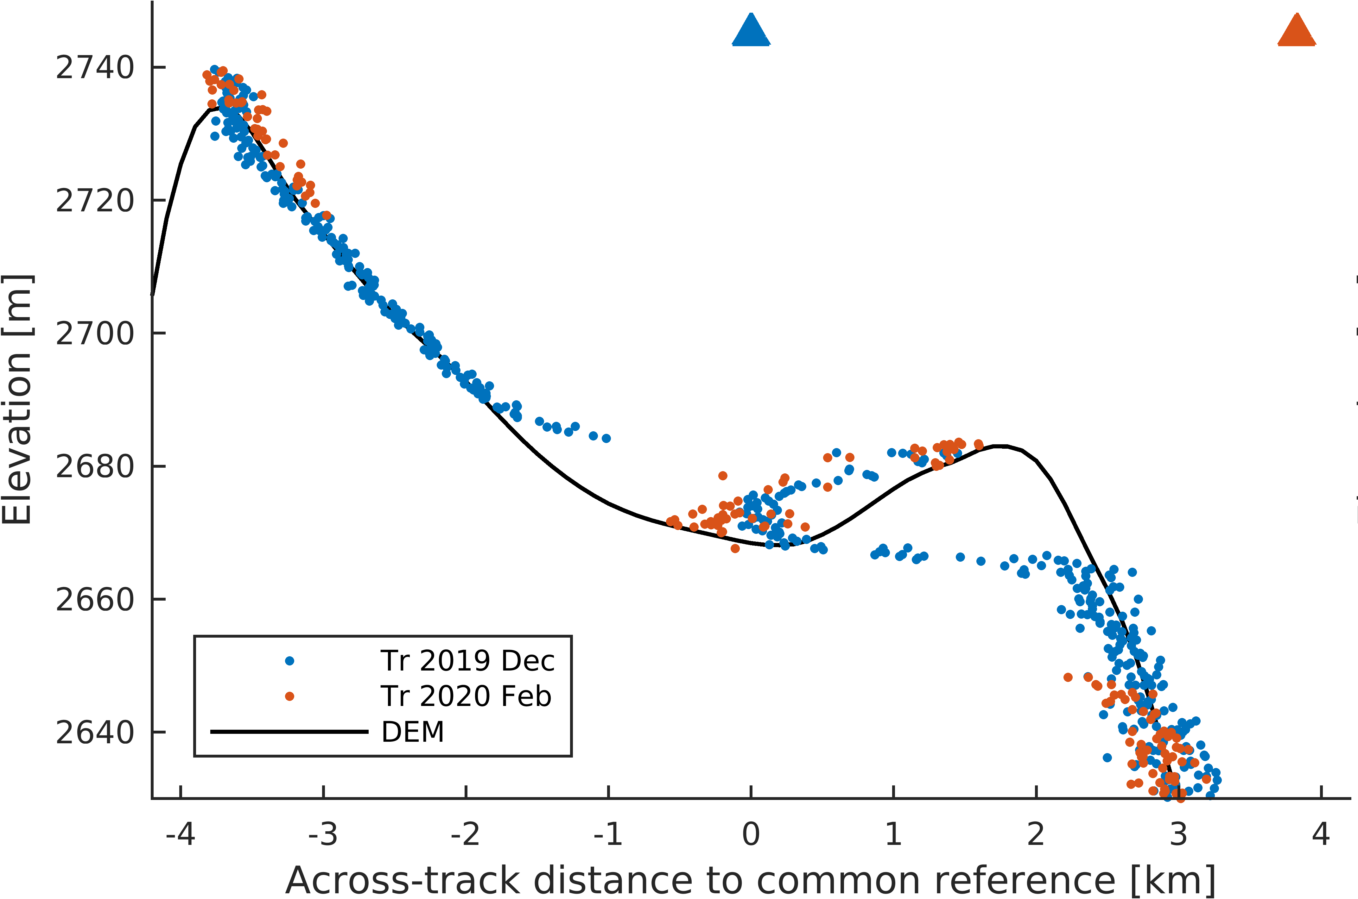
Small change of perspective can have large consequences

Slide 9
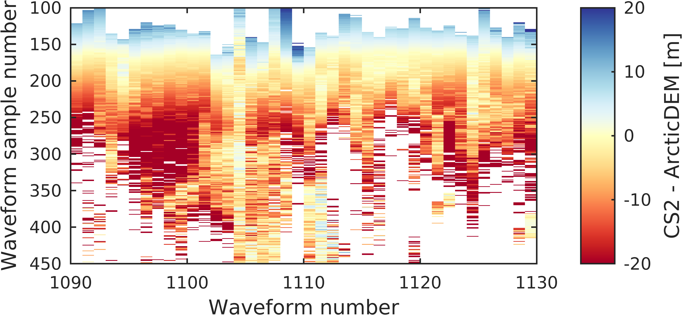
Many waveforms are affected!

Slide 10
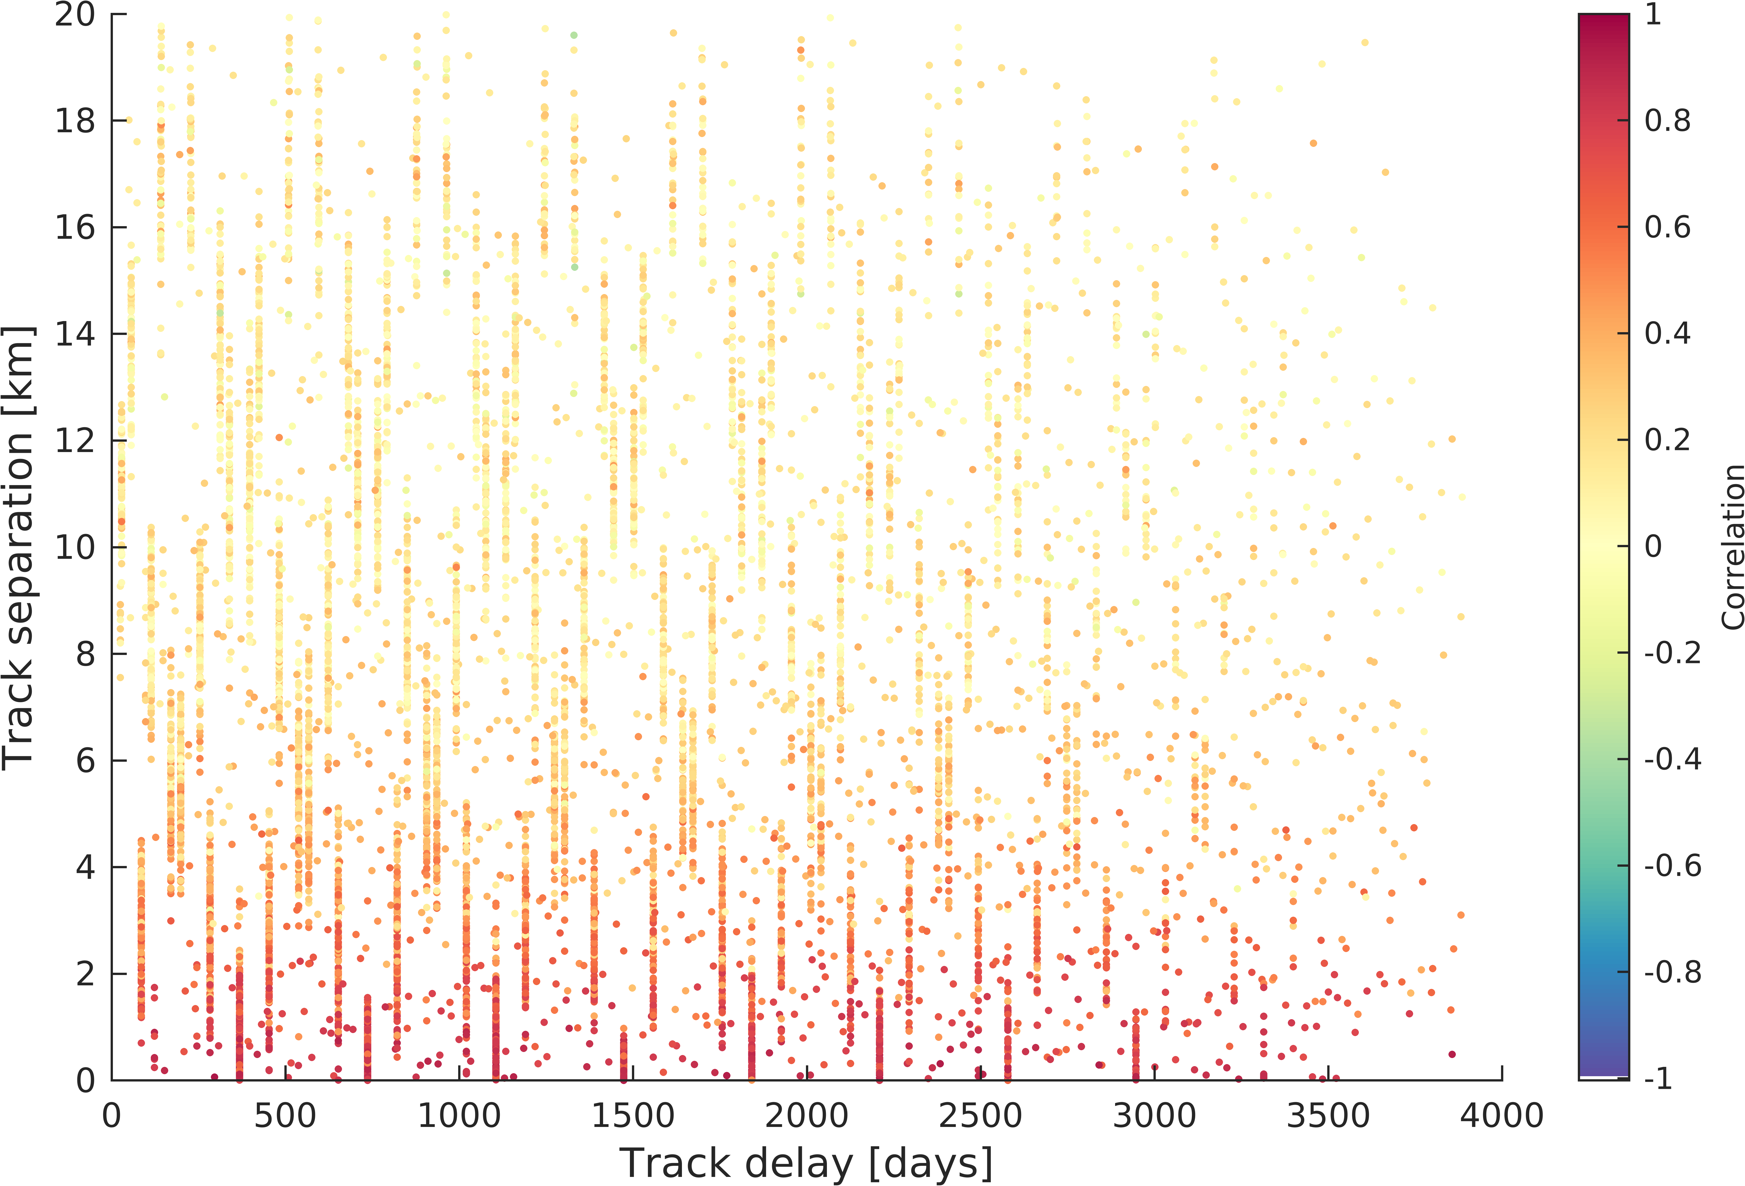
Errors are correlated to the sensor perspective
369-day periodicity
↓
Entangled with seasons

Slide 11
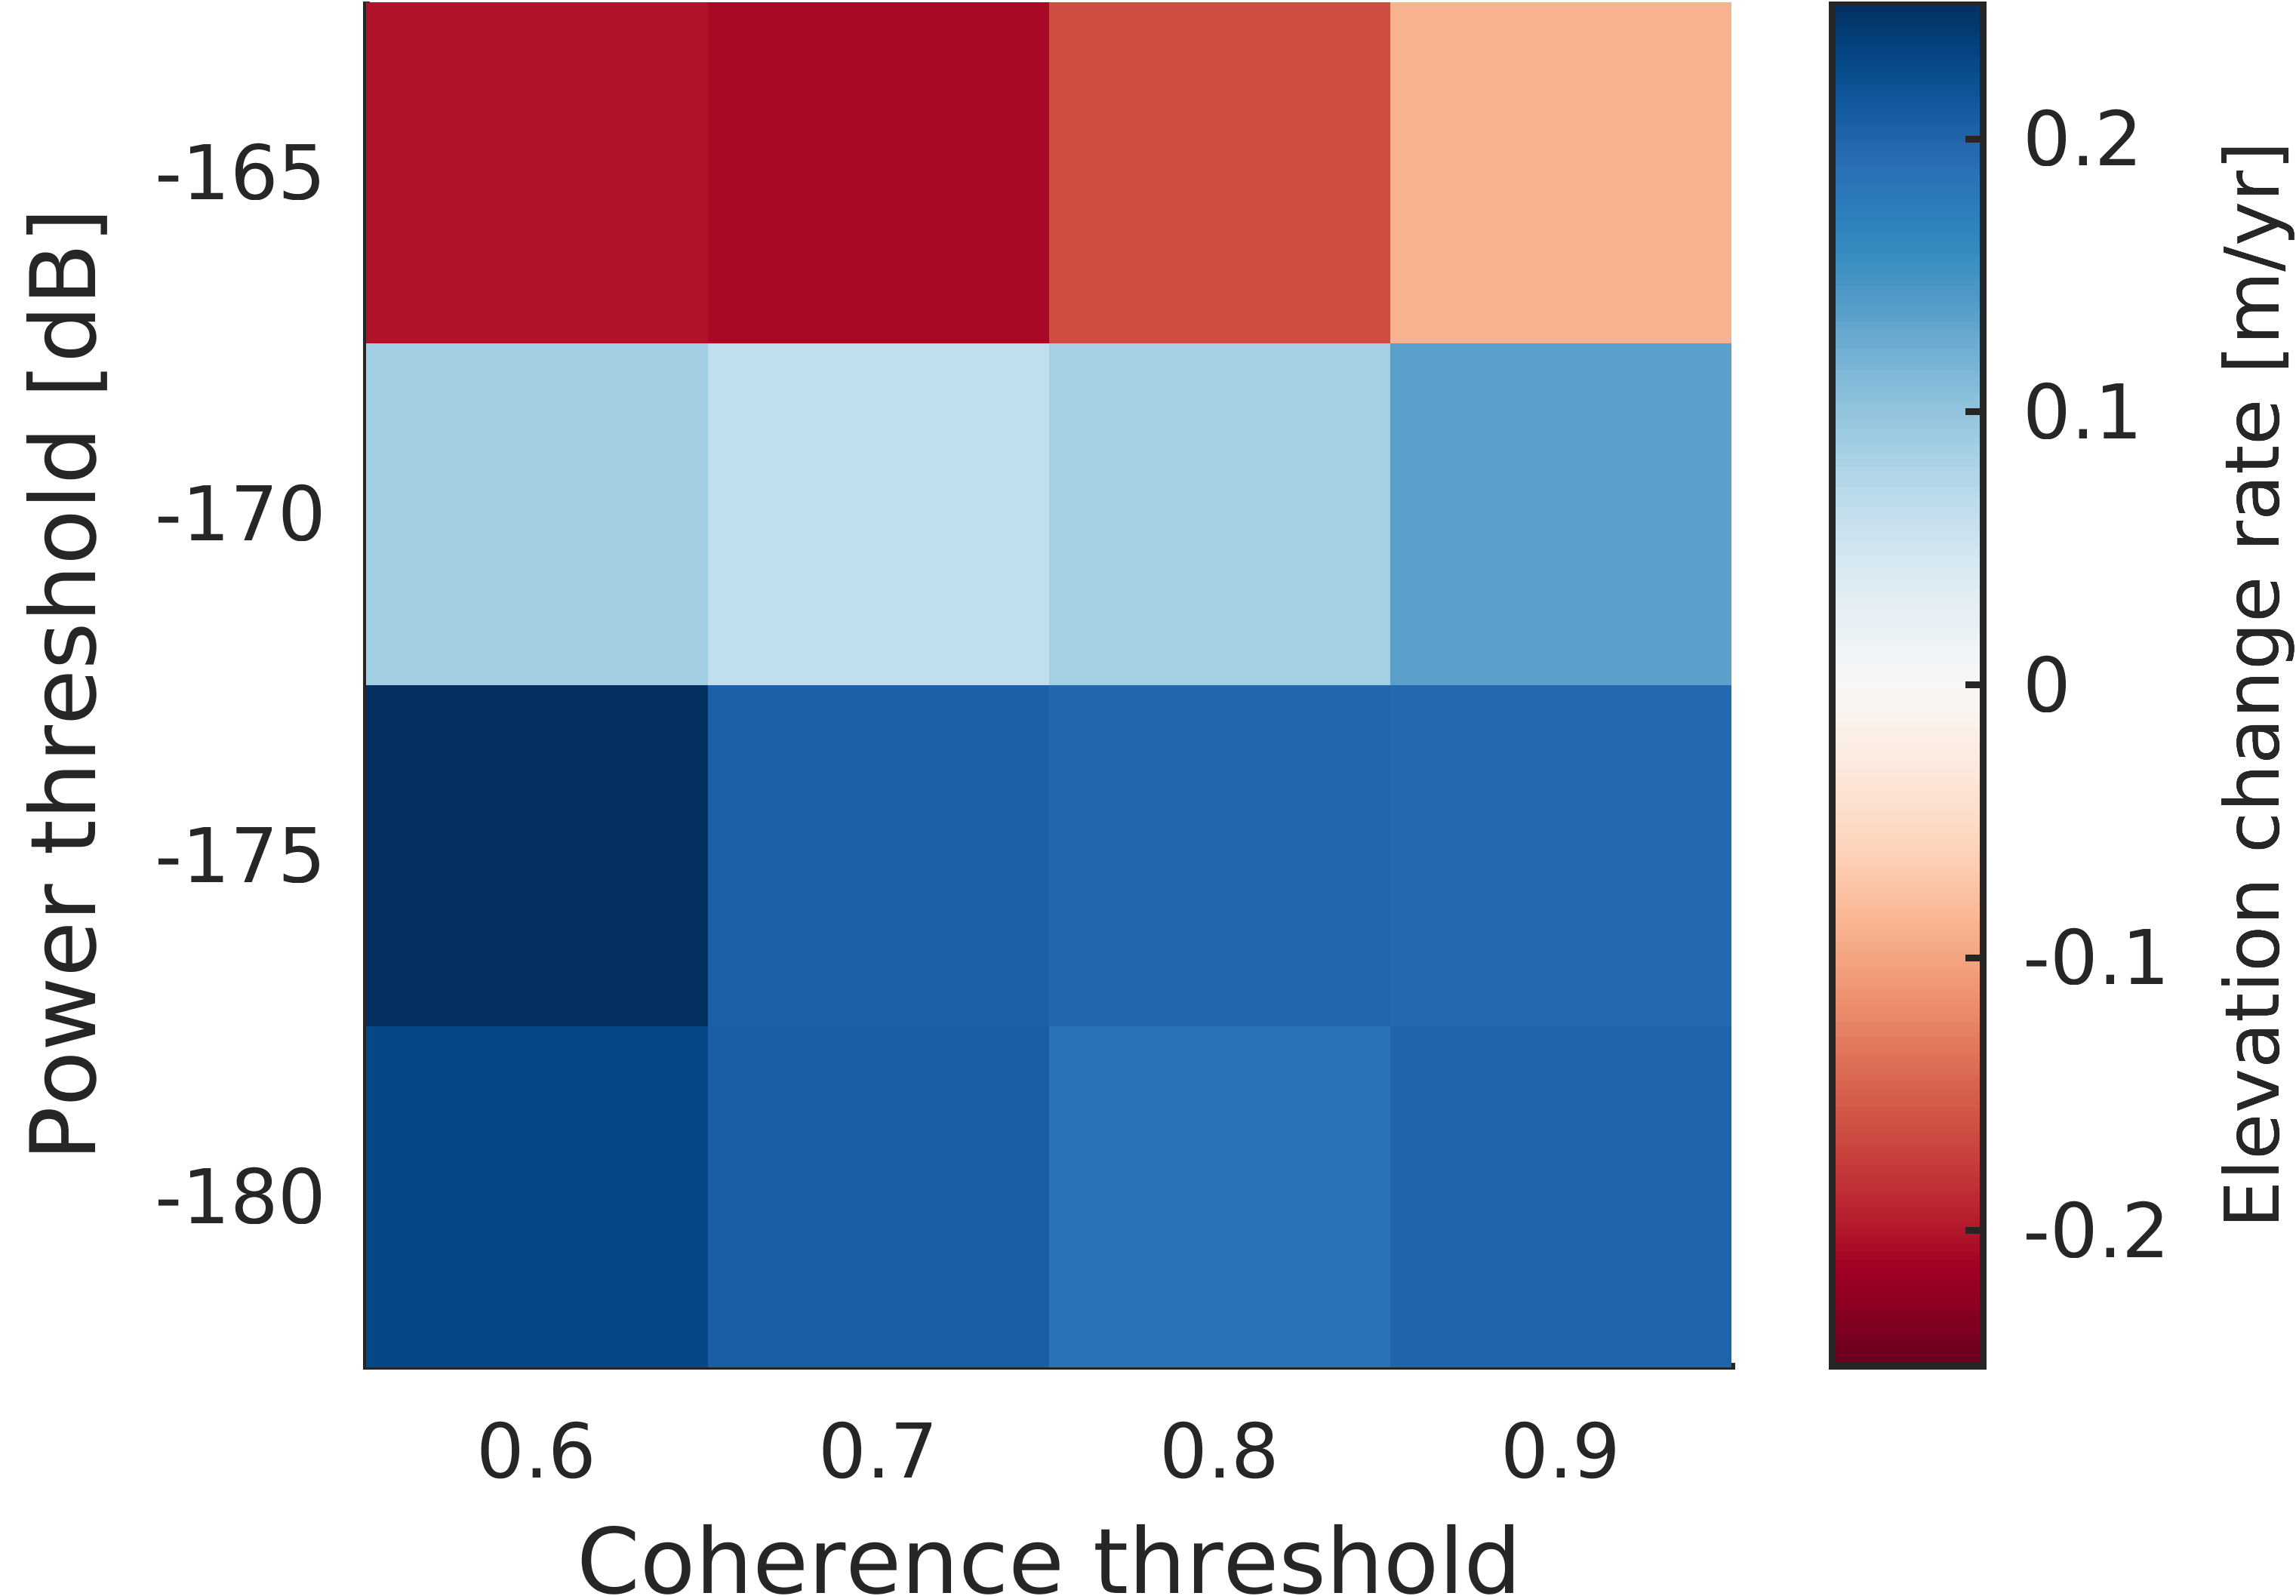
Data editing impacts annual change rates of 25 km² test region
In previous studies:
Power​ | Coherence​
-150 dB​ | ca. 0.84​
non​ | 0.8
non​ | 0.7​
-170 dB​ | 0.6​

Slide 12
Time series diverge and fluctuations surprise

Slide 13

Take-homes
Systematic errors in Cryosat-2 swath elevations
Jan Haacker
Bert Wouters
Cornelis Slobbe
Systematic errors in CryoSat-2 swath elevations
Order of magnitude: 10 m
! 369-day periodicity
Thresholds influence results
Abstract
DOI: 10.5194/egusphere-egu22-4946
Image: Zhangwei Ding (distributed via imaggeo.egu.eu)

Slide 14
References (1/3)
Swath processing | L. Gray et al., “Interferometric Swath Processing of Cryosat Data for Glacial Ice Topography,” The Cryosphere, Dec. 2013, doi: 10.5194/tc-7-1857-2013.
500 x 500 m resolution | E.g.: P. Tepes, N. Gourmelen, P. Nienow, M. Tsamados, A. Shepherd, and F. Weissgerber, “Changes in elevation and mass of Arctic glaciers and ice caps, 2010–2017,” Remote Sensing of Environment, vol. 261, p. 112481, Aug. 2021, doi: 10.1016/j.rse.2021.112481. L. Foresta et al., “Heterogeneous and rapid ice loss over the Patagonian Ice Fields revealed by CryoSat-2 swath radar altimetry,” Remote Sensing of Environment, vol. 211, pp. 441–455, Jun. 2018, doi: 10.1016/j.rse.2018.03.041.
Monthly time series | E.g.: A. Morris, G. Moholdt, and L. Gray, “Spread of Svalbard glacier mass loss to Barents Sea margins revealed by CryoSat‐2,” Journal of Geophysical Research: Earth Surface, Jul. 2020, doi: 10.1029/2019JF005357. L. Jakob, N. Gourmelen, M. Ewart, and S. Plummer, “Spatially and temporally resolved ice loss in High Mountain Asia and the Gulf of Alaska observed by CryoSat-2 swath altimetry between 2010 and 2019,” The Cryosphere, vol. 15, no. 4, pp. 1845–1862, Apr. 2021, doi: 10.5194/tc-15-1845-2021.

Slide 15
References (2/3)
ArcticDEM | C. Porter et al., “ArcticDEM.” Harvard Dataverse, 2018. doi: 10.7910/DVN/OHHUKH.
EOLIS point data | N. Gourmelen et al., “CryoSat-2 swath interferometric altimetry for mapping ice elevation and elevation change,” Advances in Space Research, vol. 62, no. 6, pp. 1226–1242, Sep. 2018, doi: 10.1016/j.asr.2017.11.014.
Data editing/threshold usage | L. Gray et al., “Interferometric Swath Processing of Cryosat Data for Glacial Ice Topography,” The Cryosphere, Dec. 2013, doi: 10.5194/tc-7-1857-2013. L. Gray, D. Burgess, L. Copland, T. Dunse, K. Langley, and G. Moholdt, “A revised calibration of the interferometric mode of the CryoSat-2 radar altimeter improves ice height and height change measurements in western Greenland,” The Cryosphere, vol. 11, pp. 1041–1058, 2017, doi: 10.5194/tc-11-1041-2017. N. Gourmelen et al., “CryoSat-2 swath interferometric altimetry for mapping ice elevation and elevation change,” Advances in Space Research, vol. 62, no. 6, pp. 1226–1242, Sep. 2018, doi: 10.1016/j.asr.2017.11.014.

Slide 16
References (3/3)
Data editing/threshold usage | V. Helm, A. Humbert, and H. Miller, “Elevation and elevation change of Greenland and Antarctica derived from CryoSat-2,” The Cryosphere, vol. 8, no. 4, Art. no. 4, 2014, doi: 10.5194/tc-8-1539-2014. L. Foresta, N. Gourmelen, F. Pálsson, P. Nienow, H. Björnsson, and A. Shepherd, “Surface elevation change and mass balance of Icelandic ice caps derived from swath mode CryoSat-2 altimetry,” Geophysical Research Letters, vol. 43, no. 23, p. 12,138-12,145, 2016, doi: 10.1002/2016GL071485. A. Garcia-Mondéjar, N. Gourmelen, M. J. Escorihuela, M. Roca, A. Shepherd, and S. Plummer, “Multisurface Retracker for Swath Processing of Interferometric Radar Altimetry,” IEEE Geoscience and Remote Sensing Letters, vol. 16, no. 12, pp. 1839–1843, Dec. 2019, doi: 10.1109/LGRS.2019.2913635.

