Slide 1




Soil quality assessment in a chronosequence of landslides in Garhwal Himalayas, Uttarakhand, India
Deepesh Goyal, Varun Joshi
University School of Environment Management
Guru Gobind Singh Indraprastha University, New Delhi-110078, India

Slide 2
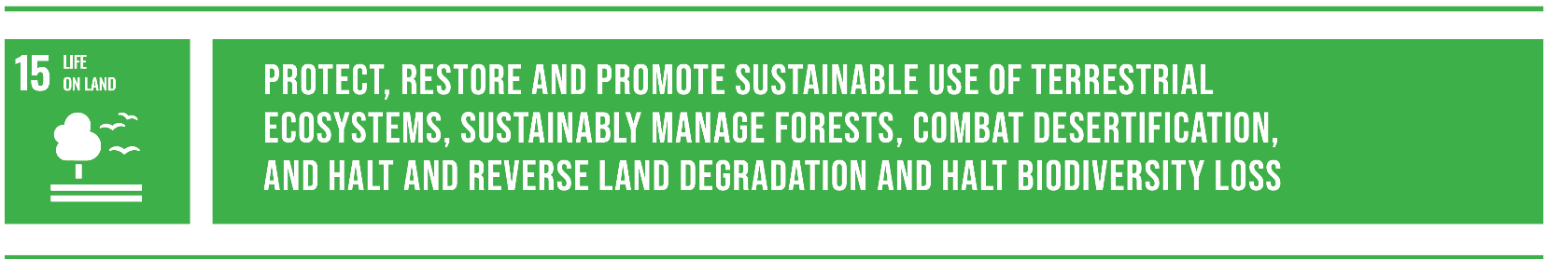

BACKGROUND
Mid to Long Term
Understanding risk and identification of areas of
greatest loss. Mitigate potential problems in advance of event.
Ongoing & Long Term
Prepare agencies, private sector and communities for the next event. Maintain state of “Readiness”
Short Term & Long Term
Once the event and the immediate threat to life, property and the environment
is over, recovery can begin.
Damage Assessment,
Stabilise & Provide
First responders save and secure lives and assess damage.
Coordination of resources and provision of critical supplies.

Slide 3
INTRODUCTION
Landslides are one of the major natural disasters: -
excessive damage to infrastructure and loss of lives every year
can have long-term impacts on the ecosystem and environment
The Indian Himalayan Region (IHR) is considered as one such “hotspot” of landslides due to : -
the intense monsoon precipitation, frequent tectonic activity
weak geologic condition
very steep and rugged topography.
The Garhwal Himalaya of Uttarakhand state has traversed by many faults, Main Central Thrust (MCT), Vaikrita Thrust.
Rainfall pattern of the study area (IMD).
Tectonic framework of the study area.

Slide 4
The effects of landslides on the natural environment (losses of soil resources) have received little consideration and such information about the status of loss of soil resource in the landslide disturbed areas in Garhwal Himalayas is lacking, therefore, an attempt is made through the present study with the aim to estimate the effects of landslides on soil quality.
Objectives: -
Evaluate the soil quality of landslide disturbed and undisturbed sites in Garhwal Himalayas.
Recovery status of soil after the landslide occurrence.
Determine which soil parameters may limit the recovery of soil with time.

Slide 5
STUDY AREA
SOIL MAP OF STUDY AREA
Geographical location of the study area in Alaknanda watershed, Uttarakhand, India
Illustrated map shows the selected sites have a similar soil type i.e., Lithic Udorthents (Entisols). Source: NBSS&LUP

Slide 6
Characteristics of studied landslide sites and reference (control) site in Garhwal Himalayas
Sites | Year of landslide occurrence (age) | Coordinates (WGS 84) |  | Elevation (m a.s.l.) | Slope (º) | Aspect | Parent material | Dominant vegetation
 |  | Longitude | Latitude
L1 | 2013 (6 yr) | 79.00045º | 30.63432º | 1764 | 32 | West | Schist | Bidens tripartita Ageratina adenophora
L2 | 2003 (16 yr) | 79.46626º | 30.47813º | 1423 | 38 | North East | Dolomite, phyllite | Pteris vittata Ageratina adenophora
L3 | 1998 (21 yr) | 79.08413º | 30.56447º | 1256 | 34 | South | Schist, gneiss | Verbascum thapsus Colebrookea oppositifolia
L4 | 1993 (26 yr) | 79.02279º | 30.59877º | 1672 | 28 | East | Quartzite, Schist | Scutellaria scandens Debregeasia salicifolia Rumex hastatus Quercus leucotrichophora
 | Reference (control) site | 79.00729º | 30.62489º | 1711 | 26 | North East | Schist, phyllite | Quercus leucotrichophora Rhododendron arboreum
In the study area, 22 landslide sites are identified based on the field survey, available literature and information from local people.
Four landslide sites are selected varying in age from 6 to 26 years after the occurrence of landslide along-with the reference site.

Slide 7
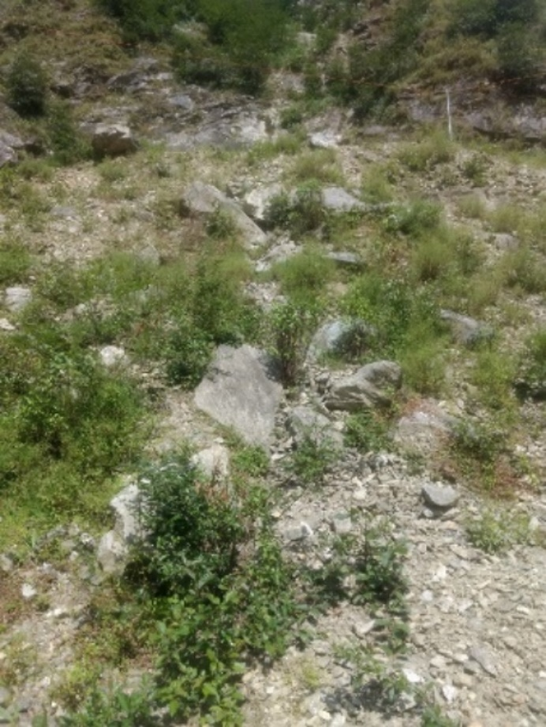
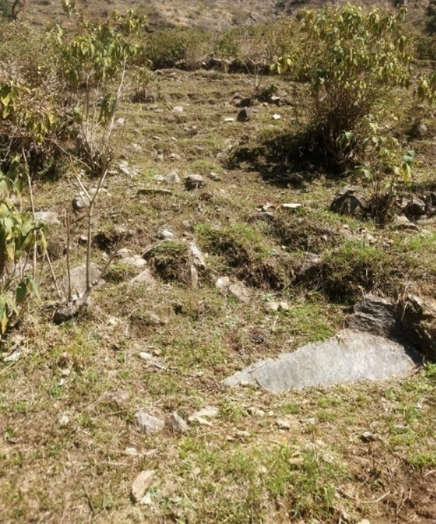
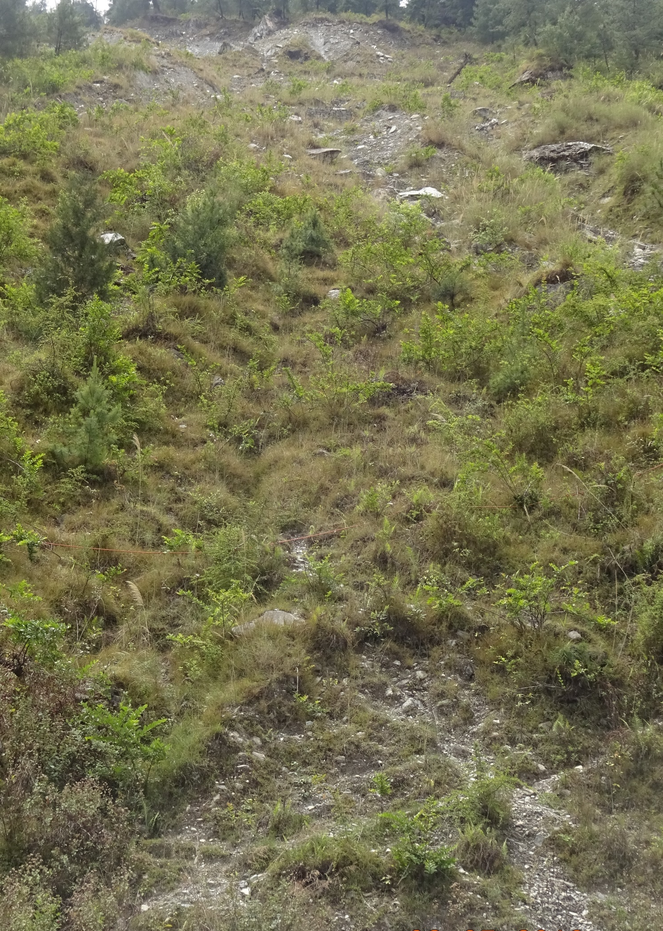
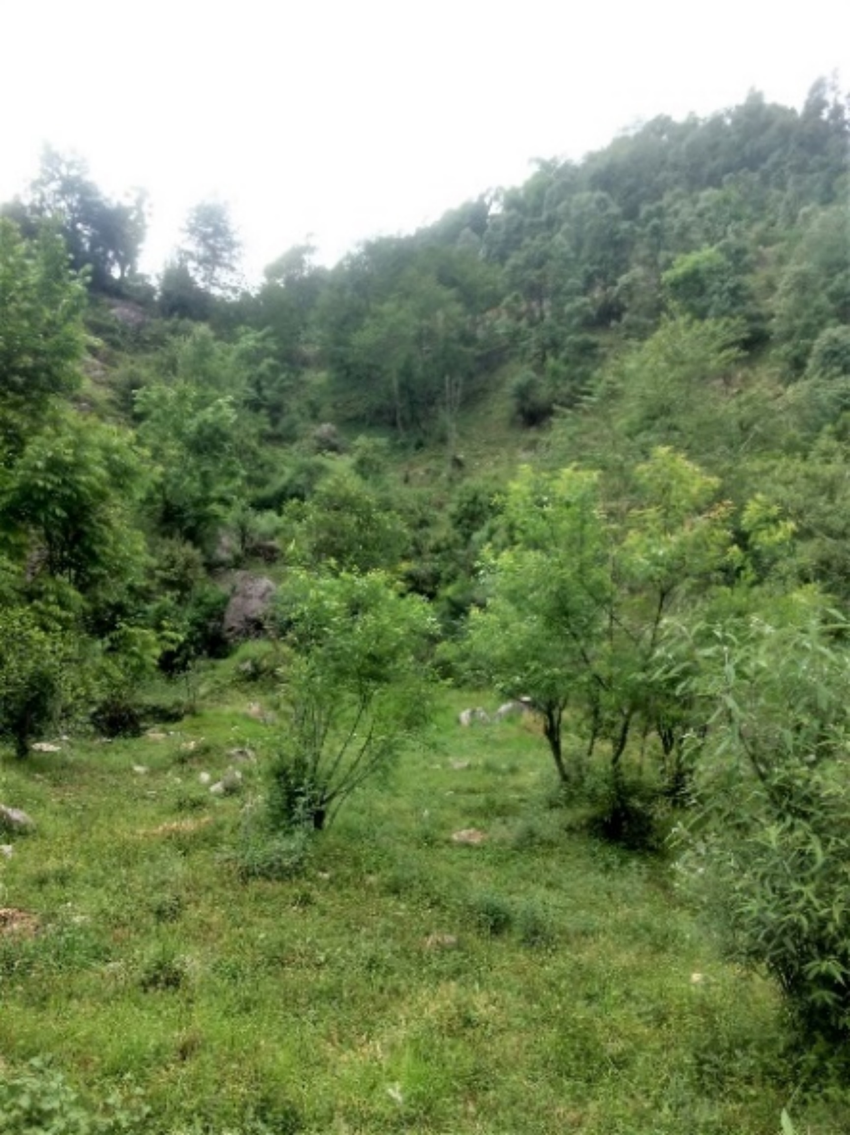
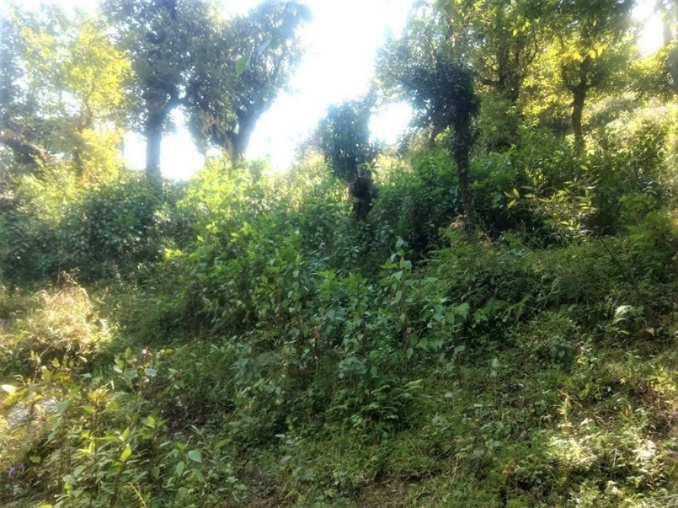
a
b
c
2013
2003
1998
d
e
1993
Reference site
Photos of the study sites. (a-e) On-site photos taken during the field survey.

Slide 8
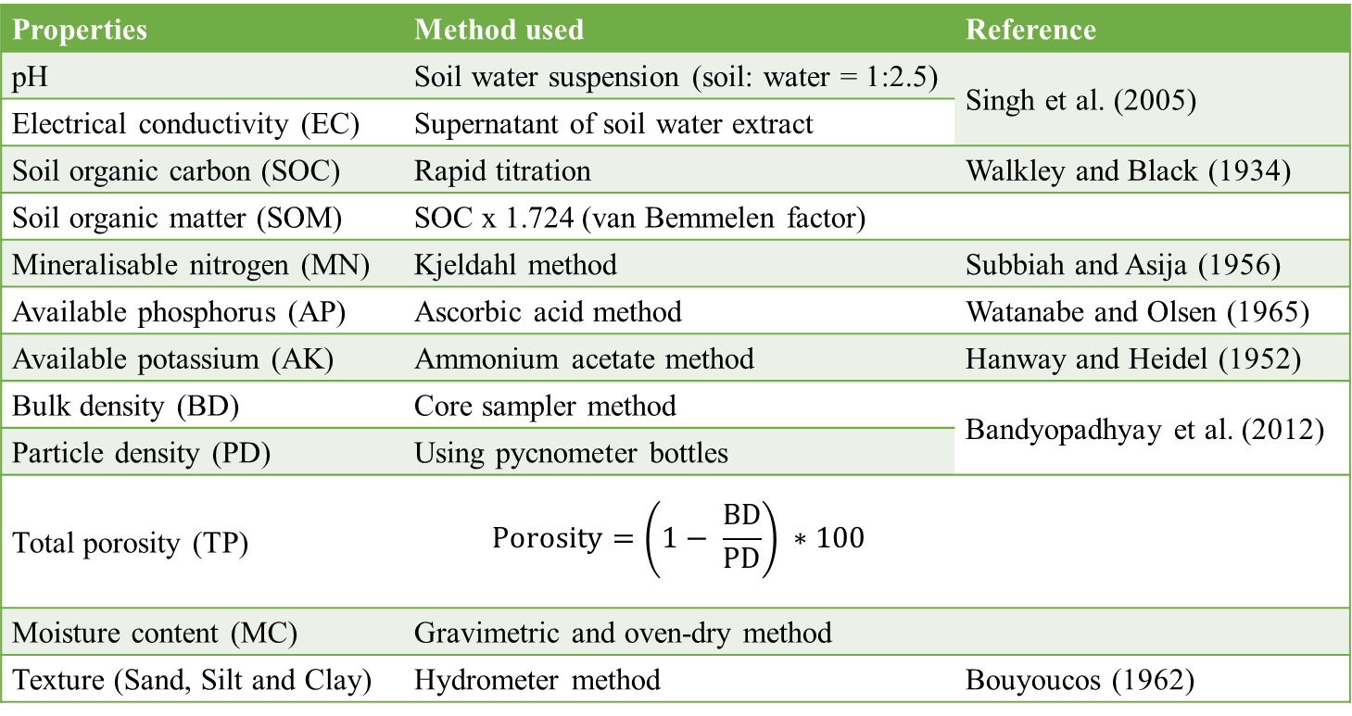
METHODS
Composite soil samples were collected from all the sites at a regular grid of about 5m.
Collected samples were air dried, sieved and were kept in sealed polyethene bags.
Methods used for the analysis of selected properties of soil in the present study.
Properties | Method used | Reference
pH | Soil water suspension (soil: water = 1:2.5) | Singh et al. (2005)
Electrical conductivity (EC) | Supernatant of soil water extract | Singh et al. (2005)
Soil organic carbon (SOC) | Rapid titration | Walkley and Black (1934)
Soil organic matter (SOM) | SOC x 1.724 (van Bemmelen factor)
Mineralisable nitrogen (MN) | Kjeldahl method | Subbiah and Asija (1956)
Available phosphorus (AP) | Ascorbic acid method | Watanabe and Olsen (1965)
Available potassium (AK) | Ammonium acetate method | Hanway and Heidel (1952)
Bulk density (BD) | Core sampler method | Bandyopadhyay et al. (2012)
Particle density (PD) | Using pycnometer bottles | Bandyopadhyay et al. (2012)
Total porosity (TP) | $$Porosity=\left(1− \frac{BD}{PD}\right) ∗100$$
Moisture content (MC) | Gravimetric and oven-dry method
Texture (Sand, Silt and Clay) | Hydrometer method | Bouyoucos (1962)

Slide 9
RESULTS

Slide 10
Soil physico-chemical properties in landslide affected sites (L1, L2, L3 and L4) and control site.
The Principal Component Analysis (PCA) has been performed with all the parameters among all the disturbed sites and the reference site.
The minimum data set (MDS) obtained includes soil organic carbon (SOC), available phosphorus (AP), and clay content.

Slide 11
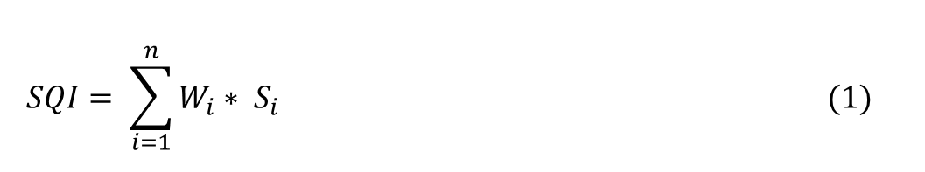
Soil Quality Index (SQI) scores have been calculated using the Integrated Quality Index (IQI) equation shown below: -
$$SQI= \sum_{i=1}^{n}{W_{i}}∗ S_{i} (1)$$
The disturbed sites L1, L2, L3 and L4 and reference site are having the SQI scores of 0.136, 0.279, 0.447, 0.604 and 0.882, respectively.
Mean soil quality index (SQI) values in landslide disturbed sites (L1, L2, L3 and L4) and control site (MF- mature forest). AP: Available phosphorus; SOC: Soil organic carbon.

Slide 12
CONCLUSIONS
In young landslide sites, the SOC and SOM content does not exceed 1 % which is a significance of preliminary restoration of soil quality.
The soil quality recovers much faster during the initial phase of succession.
Chemical characteristics recovers comparatively faster than the physical properties.
Mineralisable nitrogen (MN) shows a remarkable increase and reaches to about 96 % of the reference site.
Available P and K recovered to about 82 – 87 % of the reference (mature) site.
SOC, AP and clay are selected as the MDS based on the results of PCA.

Slide 13

FUTURE RECOMMENDATIONS
Insight site-specific long-term chronosequence studies are required.
Apart from physico-chemical characteristics of soil, biological parameters should also considered.
Governing of soil quality, especially in terms of soil nutrients should be accentuated in the process of recovery and restoration in landslide disturbed areas.

Slide 14

Email id : deepeshgoyal04@gmail.com

