Slide 1
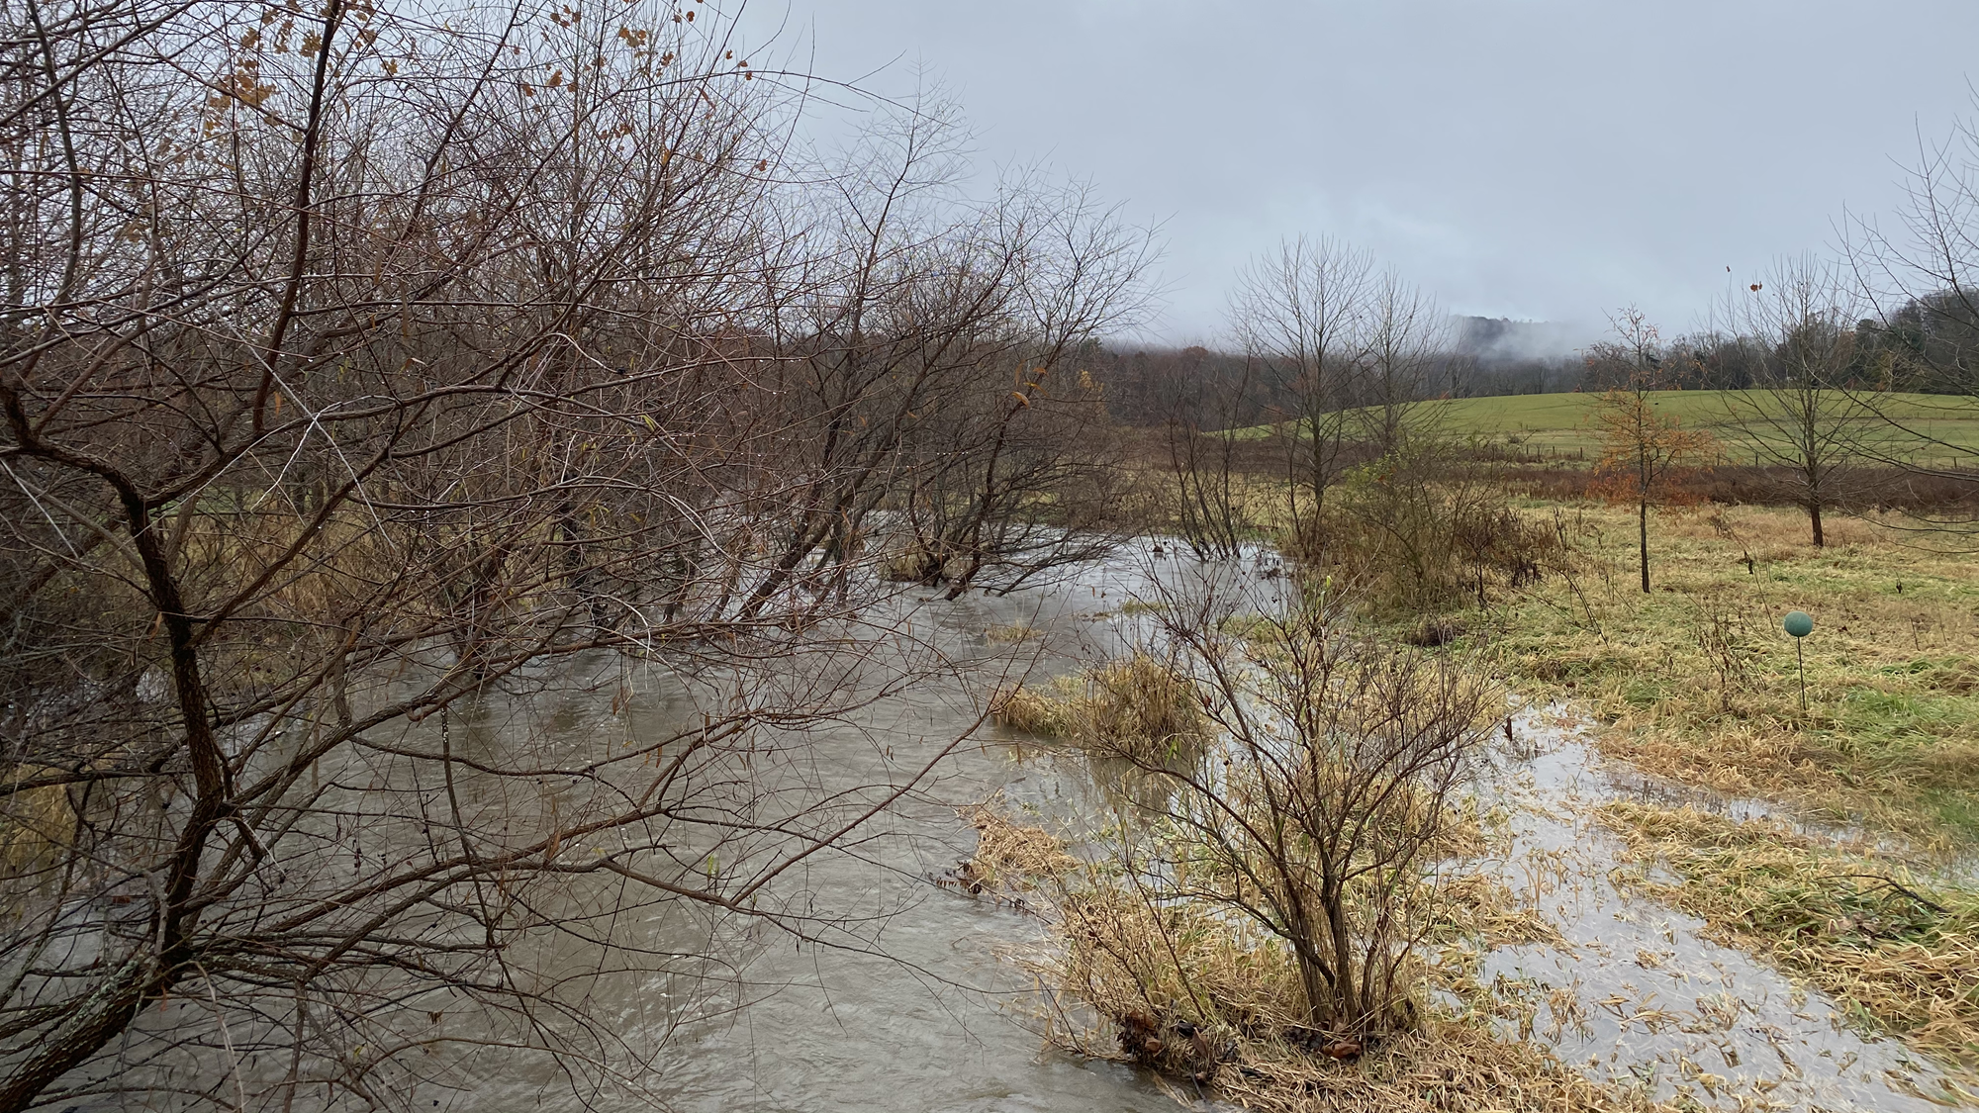




Stream solutes respond differently within and across flow conditions: a comparison of baseflow and higher flow events
Katherine X. Pérez Rivera, Stephen Plont, Morgan Wood, Felicity DeToll, Barbara R. Niederlehner, Kristen A. Bretz, Carla López Lloreda, and Erin R. Hotchkiss
@kathxpr

Slide 2
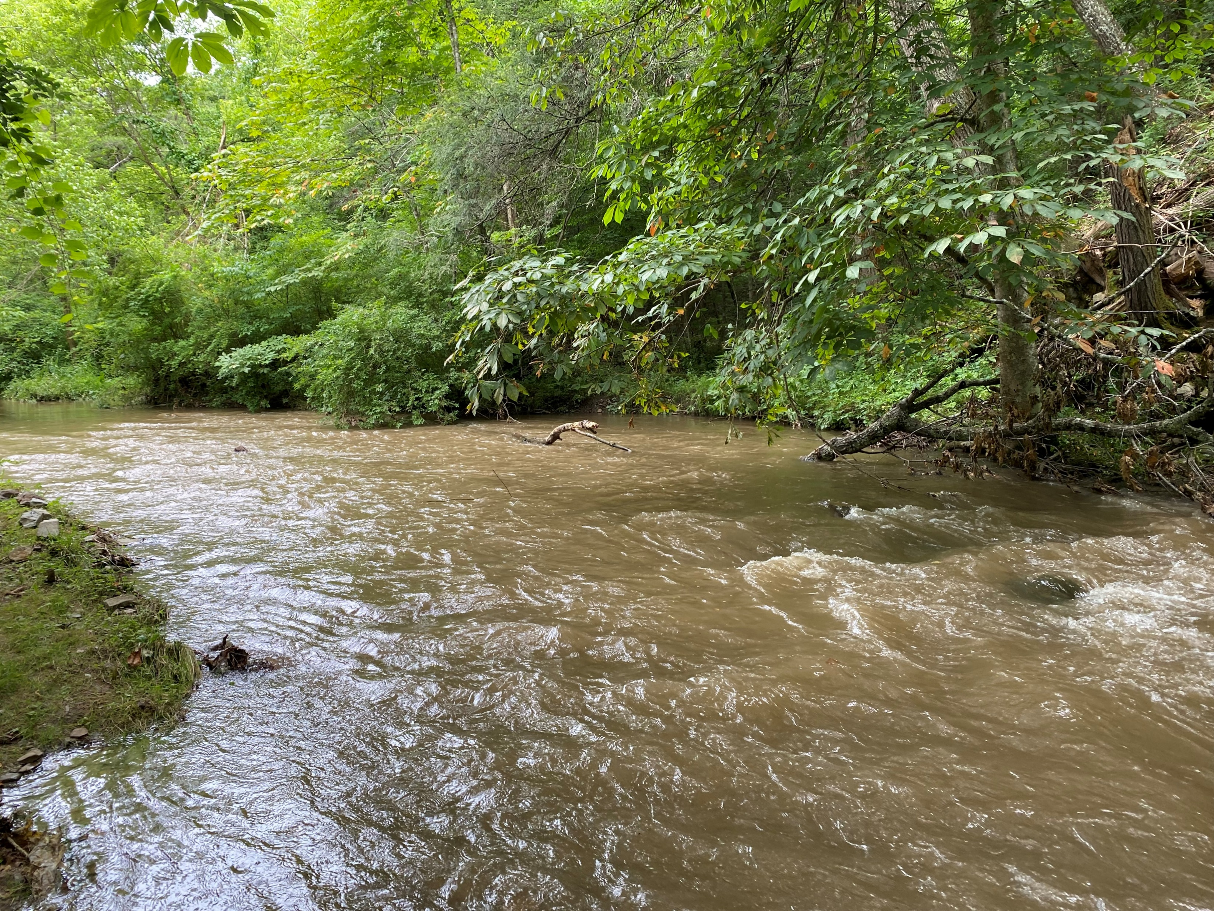
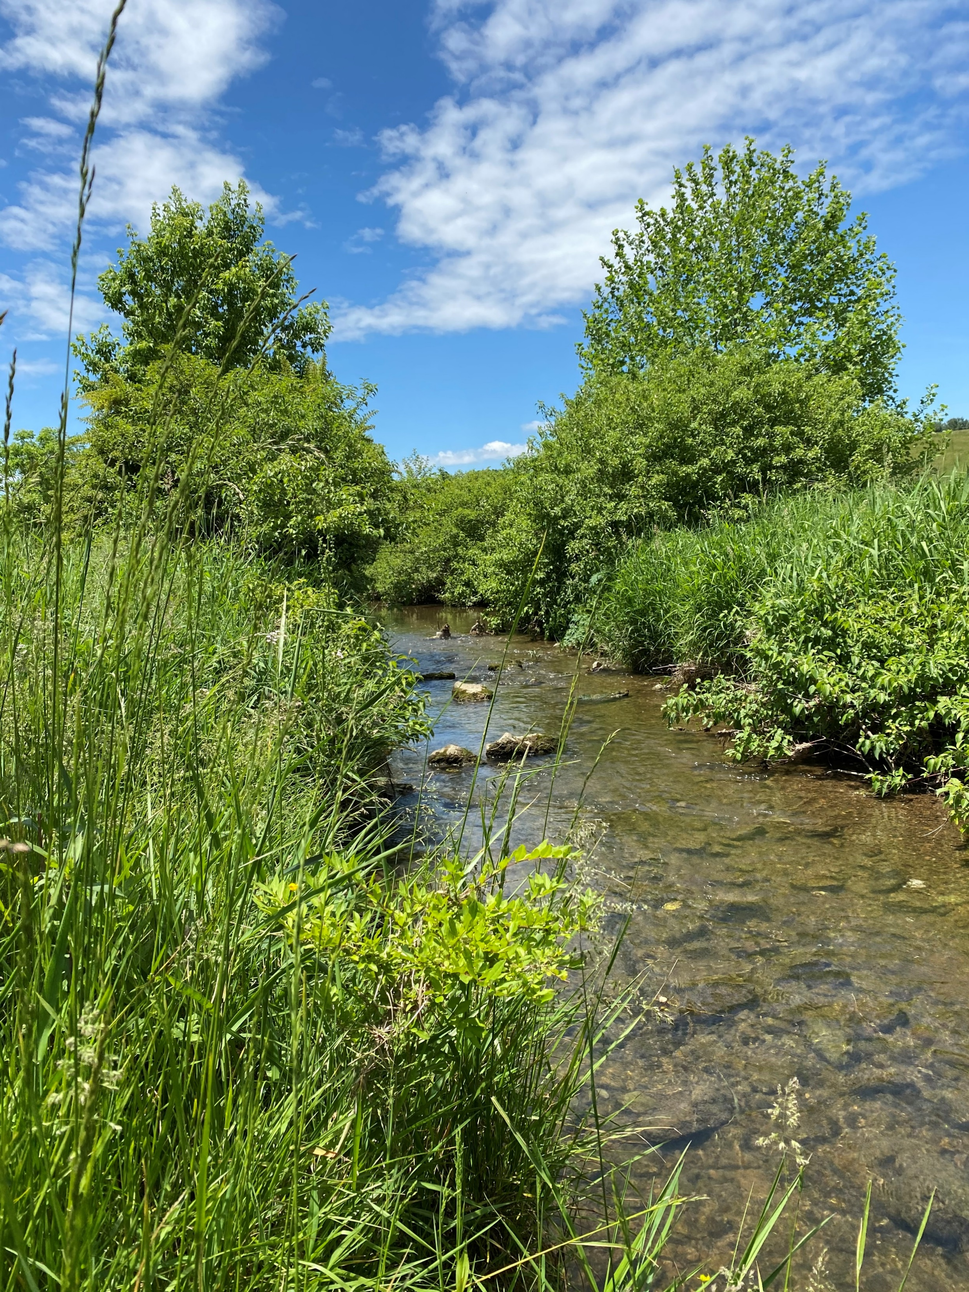
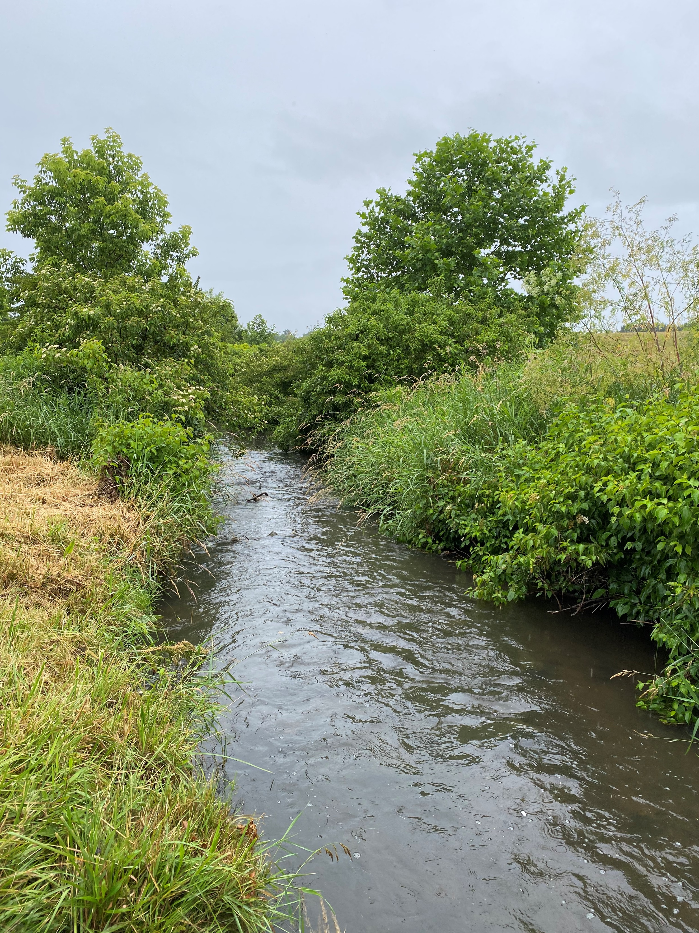
Streams are responsive to environmental change
How does hydrology influence solute concentrations?

Slide 3
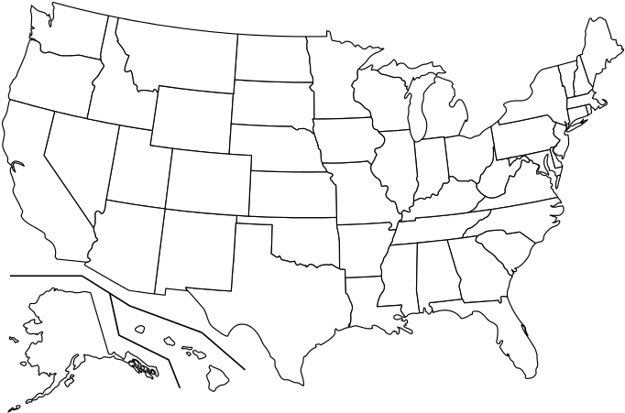
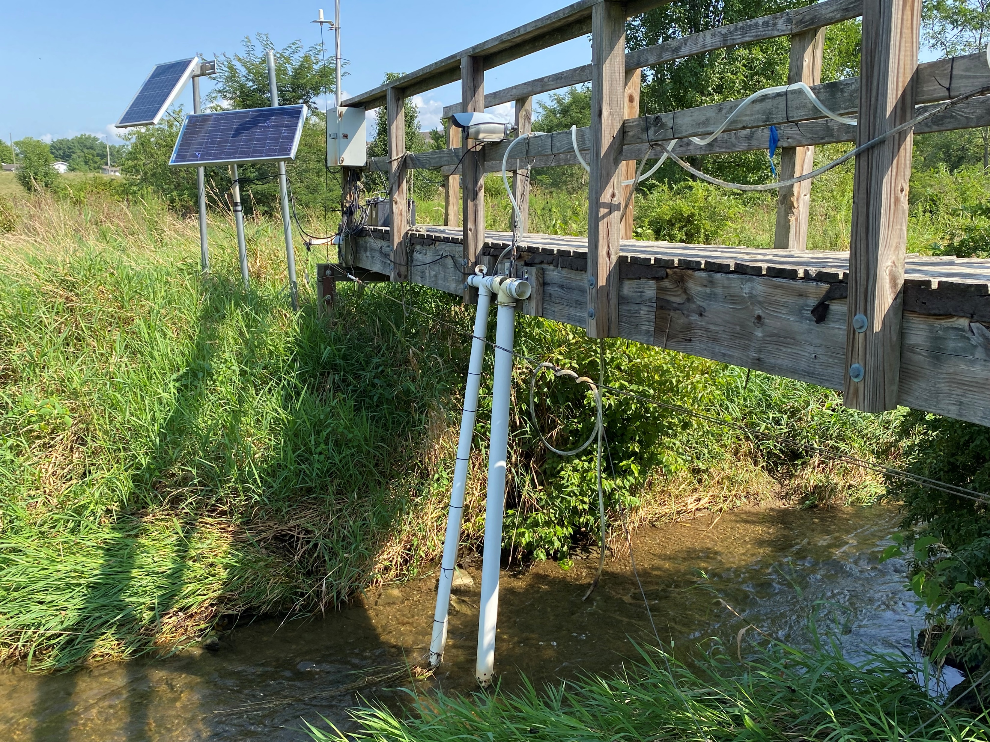
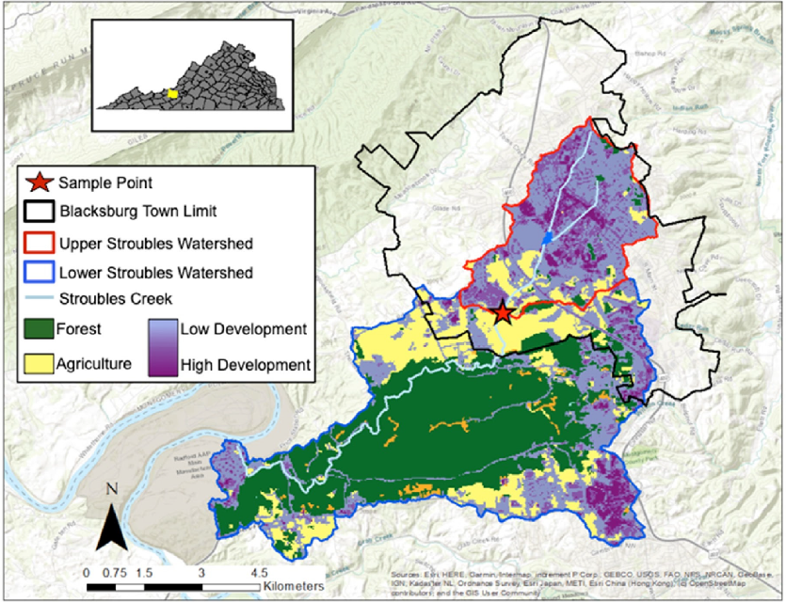
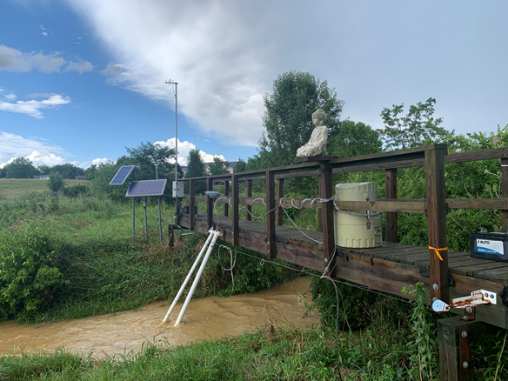
Stroubles Creek, Blacksburg, VA - USA
Baseflow
Highflow
Lakoba et al 2021. AC ES&T Water

Slide 4
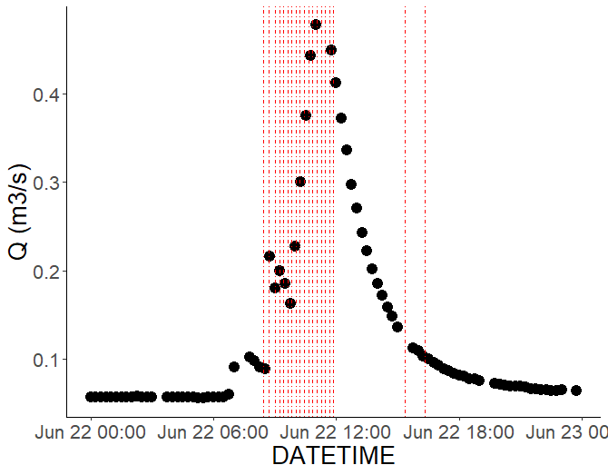
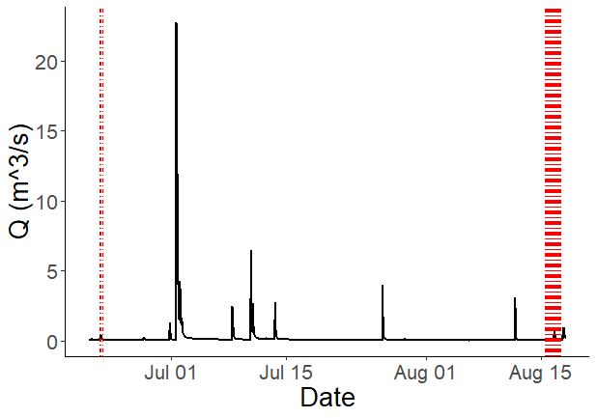
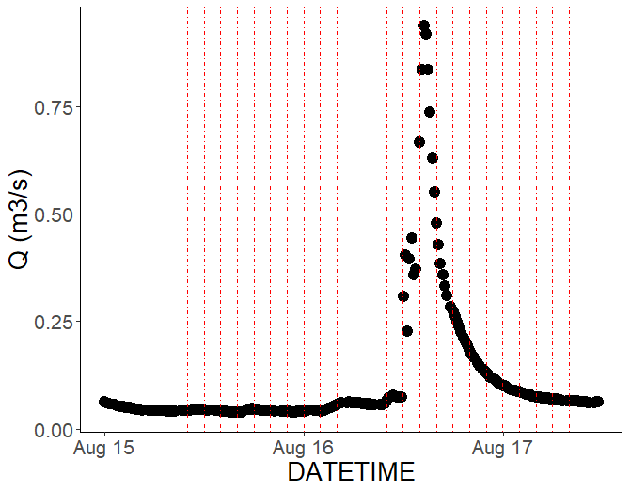
Variable flow conditions at Stroubles Creek during Summer 2021
66%
Q (m³/s)
Q (m³/s)
1071%
Q (m³/s)

Slide 5

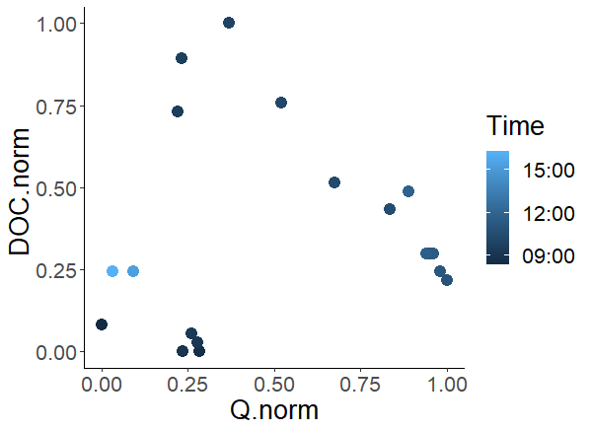
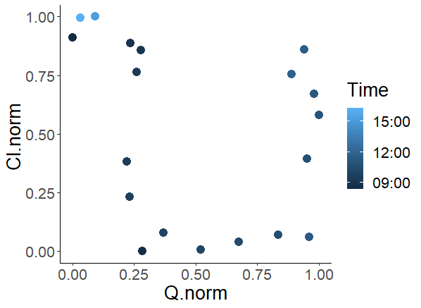

DOC and Cl have different behaviors and directionality
66%
Clock-wise loop:
DOC is concentrating and transport limited
Concentration peaks fast, quick flushing
end
Q (m³/s)
start
end
start
Counterclock-wise loop:
longer time for Cl to respond when flow is changing
Dilution; source limitation

Slide 6
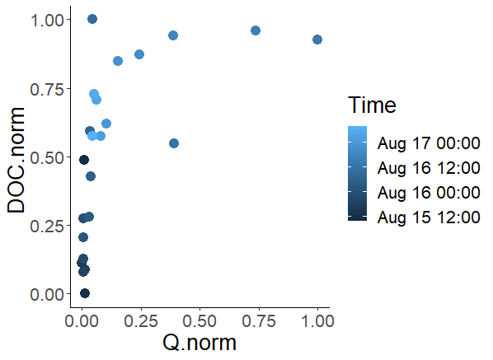

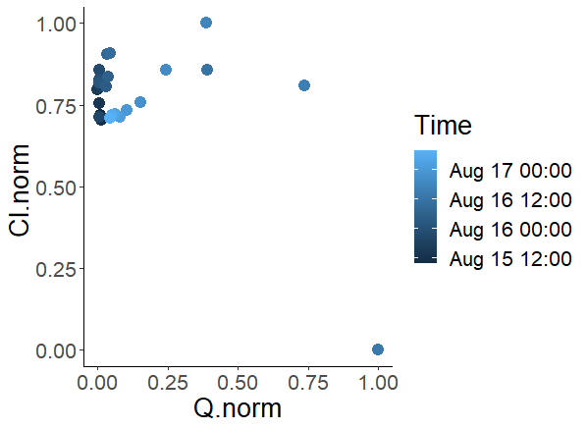
Magnitude of event influences solute response and behavior
1071%
Counterclock-wise loop:
longer time for DOC to respond when flow is changing
start
Q (m³/s)
Figure eight-shaped configuration:
Shift in the response of solute
Enrichment and dilution within a single event
start

Slide 7
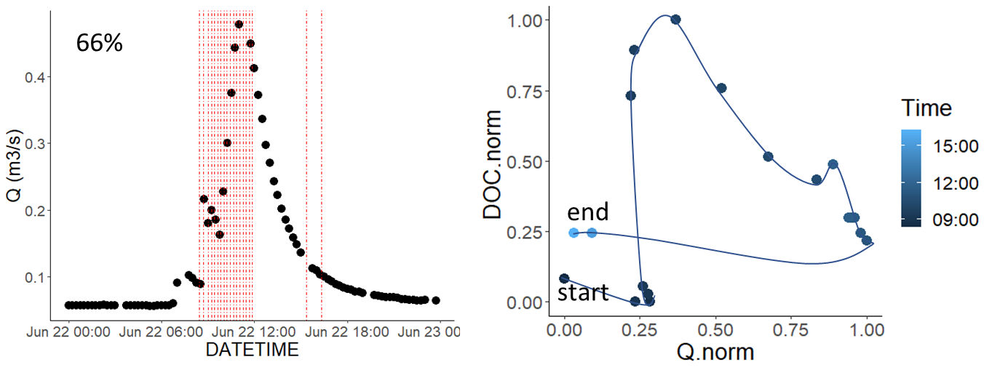
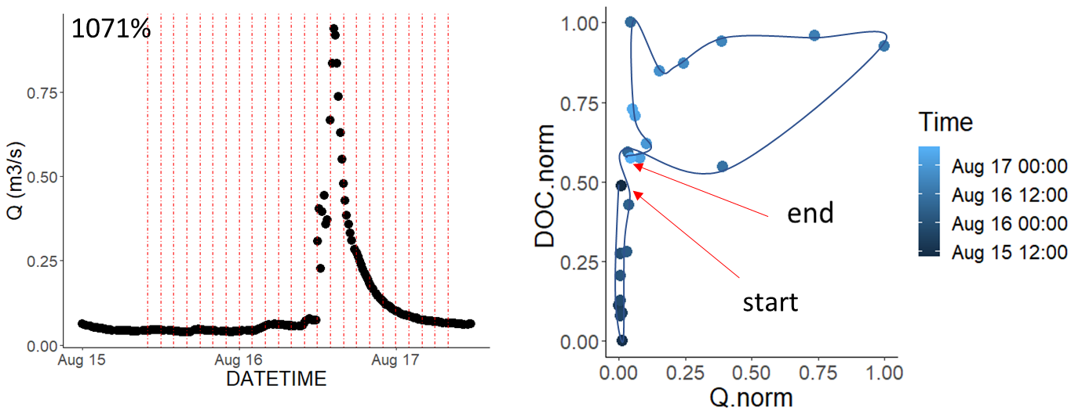
Solutes response differ. Event magnitude plays a big role!
Reactivity and timing of response is influenced by magnitude and duration of event
Solute behavior during “high flow” is challenged by time, immediate responses can be observed in shorter time intervals
Future work: incorporate sensor data, major cations and anions, characterize pulse curve (rising vs. falling limb responses)

