Slide 1






Integrating remote sensing and social media data advances assessment of cultural ecosystem services
Oleksandr Karasov
Stien Heremans
Mart Külvik
Artem Domnich
Iuliia Burdun
Ain Kull
Aveliina Helm
Evelyn Uuemaa
EGU22

Slide 2
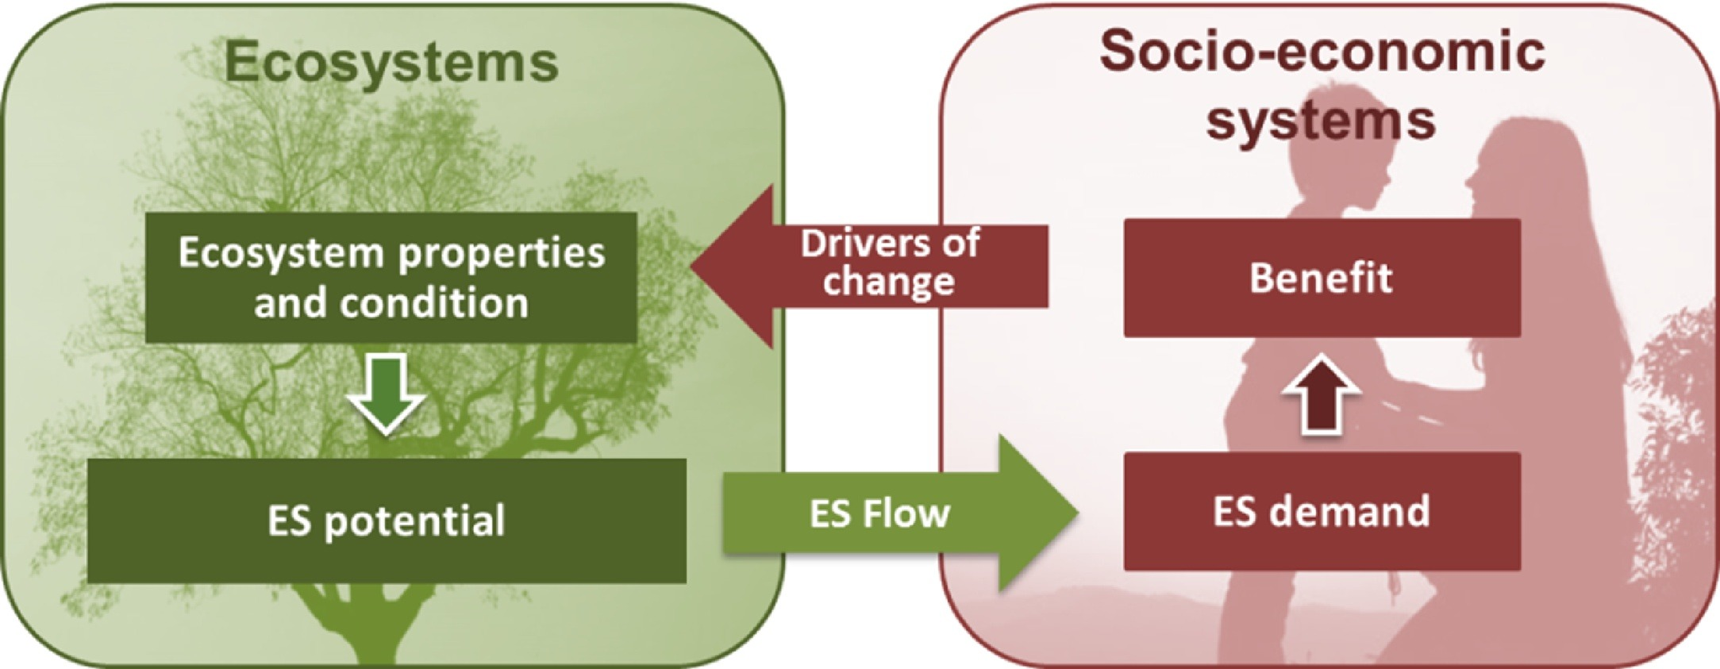
Context
Vallecillo et al., 2019

Slide 3
Research questions
Gap 1
Lack of replicable cultural ecosystem services (CES) supply assessment beyond Multiple‐Criteria Decision Analysis and Maxent models
How to reduce bias of a single modelling algorithm on CES supply mapping?
RQ1
Remote sensing potential is strongly overlooked in CES assessment
How remote sensing-based landscape attributes assist a spatially explicit assessment of CES supply?
Gap 2
RQ2
Little empirical evidence on landscape quality of populated areas
How many people reside in the areas of lower CES use opportunities?
Gap 3
RQ3

Slide 4
Data for CES demand mapping
Landscape watching
Outdoor recreation
Wildlife watching
9,983 Flickr and VK.com photographs, processed with Clarifai platform
3 CES categories obtained with Latent Dirichlet Allocation:
landscape watching - 6,153 photos
outdoor recreation - 2,345
wildlife watching - 1,484

Slide 5
Data for CES supply/accessibility mapping
526 indicators, based on:
Landsat 8 mosaic (2018)
Land Cover Model of Europe (Malinowski et al., 2020)
Sentinel-1 backscatter data
NASA SRTM Digital Elevation 30m
Digital Surface Model ALOS DSM: Global 30m
In total, 21 retained indicators

Slide 6
Brief quality of the models
Landscape watching |  |  | Outdoor recreation |  |  | Wildlife watching
Model | Cross-validation | AUC (±SD) | Model | Cross-validation | AUC (±SD) | Model | Cross-validation | AUC (±SD)
Boosted Regression Trees (BRT) | Train | 0.978 | BRT | Train | 0.965 | BRT | Train | 0.989
 | CV | 0.869 (±0.021) |  | CV | 0.837 (±0.014) |  | CV | 0.812 (±0.022)
Generalized Linear Model (GLM) | Train | 0.832 | GLM | Train | 0.842 | GLM | Train | 0.749
 | CV | 0.830 (±0.009) |  | CV | 0.829 (±0.017) |  | CV | 0.736
Multivariate Adaptive Regression Splines (MARS) | Train | 0.834 | MARS | Train | 0.838 | MARS | Train | 0.754
 | CV | 0.833 (±0.010) |  | CV | 0.832 (±0.015) |  | CV | 0.743 (±0.025)
Maxent | Train | 0.855 | Maxent | Train | 0.855 | Maxent | Train | 0.806
 | CV | 0.845 (±0.009) |  | CV | 0.840 (±0.016) |  | CV | 0.775 (±0.022)
Random Forest (RF) | Train | 0.904 | RF | Train | 0.879 | RF | Train | 0.851
 | CV | 0.903 (±0.009) |  | CV | 0.878 (±0.019) |  | CV | 0.854 (±0.021)

Slide 7
CES supply = environmental suitability
Landscape watching
Outdoor recreation
Wildlife watching
Sampling bias – low values mean low modelled suitability for taking photographs, not necessarily low landscape quality

Slide 8
Supply-population discrepancies
69.4% of Estonians reside in landscape watching hot spots, and 5.5%—in cold spots.
70.4% and 3.1% for outdoor recreation,
67.1% and 7.3% for wildlife watching

Slide 9
Supply-population discrepancies
69.4% of Estonians reside in landscape watching hot spots, and 5.5%—in cold spots.
70.4% and 3.1% for outdoor recreation,
67.1% and 7.3% for wildlife watching

Slide 10

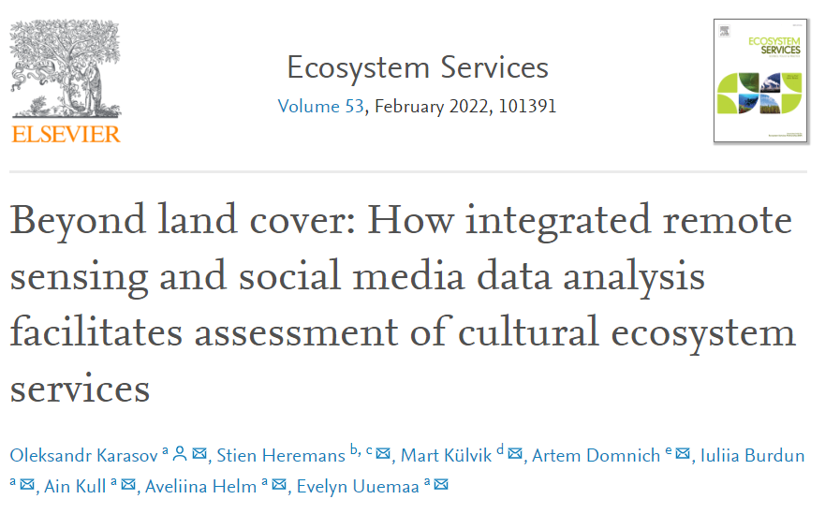
Take-home message
Remote sensing applications in the CES domain are in their infancy (Rose et al., 2015; Vaz and Santos, 2018; Vaz et al. 2020-2021), but explainable machine learning-based methods and social media data really help!

Slide 11
Indicator | Model | Description. GLCM - Gray Level Co-Occurrence Matrix | Landscape attribute interpretation | Formula reference
l8tcap_brightness_gearys_7 | Landscape watching, outdoor recreation | Local Geary's C index of spatial autocorrelation of the Tasseled Cap Brightness | Local dissimilarity of the soil brightness intensities in landscape | (Anselin, 1995)
l8sat_dent_7 | Landscape watching, outdoor recreation, wildlife watching | GLCM-based difference entropy of the colour saturation | The randomness of land cover colour intensities | (Haralick et al., 1973)
l8nir_mean_21 | Landscape watching | Mean focal statistics for the near-infrared band | Mean vegetation biomass | (Haralick et al., 1973)
s2glc_prom_21 | Landscape watching | GLCM-based cluster prominence of land cover classes | Uniformity of land cover classes | (Conners et al., 1984)
l8lumi_prom_21 | Landscape watching, outdoor recreation, wildlife watching | GLCM-based cluster prominence of the luminance (a grayscale derivative of RGB band combination) | Uniformity of land cover reflectance intensities | (Conners et al., 1984)
s2glc_corr_21 | Landscape watching | GLCM-based correlation of land cover designations | Spatial autocorrelation of land cover patches | (Haralick et al., 1973)
s1ratio_prom_21 | Landscape watching, outdoor recreation, wildlife watching | GLCM-based cluster prominence of VV and VH backscatter ratio | Uniformity of vegetation types and built structures | (Conners et al., 1984)
l8nir_sd_7 | Landscape watching | Standard deviation focal statistics for near-infrared band | Dispersion of NIR pixel intensities indicates patch edges
s1ratio_dent_7 | Landscape watching, outdoor recreation | GLCM-based difference entropy of VV and VH backscatter ratio | The randomness of vegetation types and built structures | (Haralick et al., 1973)
s2glc_contrast_7 | Landscape watching, outdoor recreation | GLCM-based contrast of land cover classes | Drastic land cover changes | (Haralick et al., 1973)
l8ndvi_dvar_21 | Outdoor recreation | GLCM-based difference variance of NDVI | Indicates patch edges in the landscape | (Haralick et al., 1973)
l8tcap_greenness_mean_21 | Outdoor recreation | Mean focal statistics of Tasseled Cap Greenness | Interior of vegetated patches
l8hue_ent_7 | Outdoor recreation | GLCM-based entropy of landscape hues | The randomness of landscape hues | (Haralick et al., 1973)
l8tcap_brightness_sd_21 | Outdoor recreation | Standard deviation focal statistics for Tasseled Cap Brightness | Dispersion of soil brightness intensities in landscape
s2glc_contrast_21 | Wildlife watching | GLCM-based contrast of land cover classes | Drastic land cover changes | (Haralick et al., 1973)
s2glc_prom_7 | Wildlife watching | GLCM-based cluster prominence of land cover classes | Uniformity of land cover classes | (Conners et al., 1984)
alos_imcorr1_7 | Wildlife watching | GLCM-based information measure of correlation for digital surface model | Indicates wetlands and water bodies in the landscape | (Haralick et al., 1973)
s2glc_dent_7 | Wildlife watching | GLCM-based difference entropy of land cover designations | The randomness of land cover classes in landscape | (Haralick et al., 1973)
l8nir_gearys_7 | Wildlife watching | Local Geary's C index of spatial autocorrelation of the near-infrared band | Local dissimilarity of vegetation and edges of patches | (Anselin, 1995)
l8swir1_gearys_7 | Wildlife watching | Local Geary's C index of spatial autocorrelation for shortwave infrared band | Local dissimilarity of moisture conditions and edges of landscape patches | (Anselin, 1995)
l8tcap_brightness_sd_7 | Wildlife watching | Standard deviation focal statistics for the Tasseled Cap Brightness | Dispersion of soil brightness and edges of patches

Slide 12
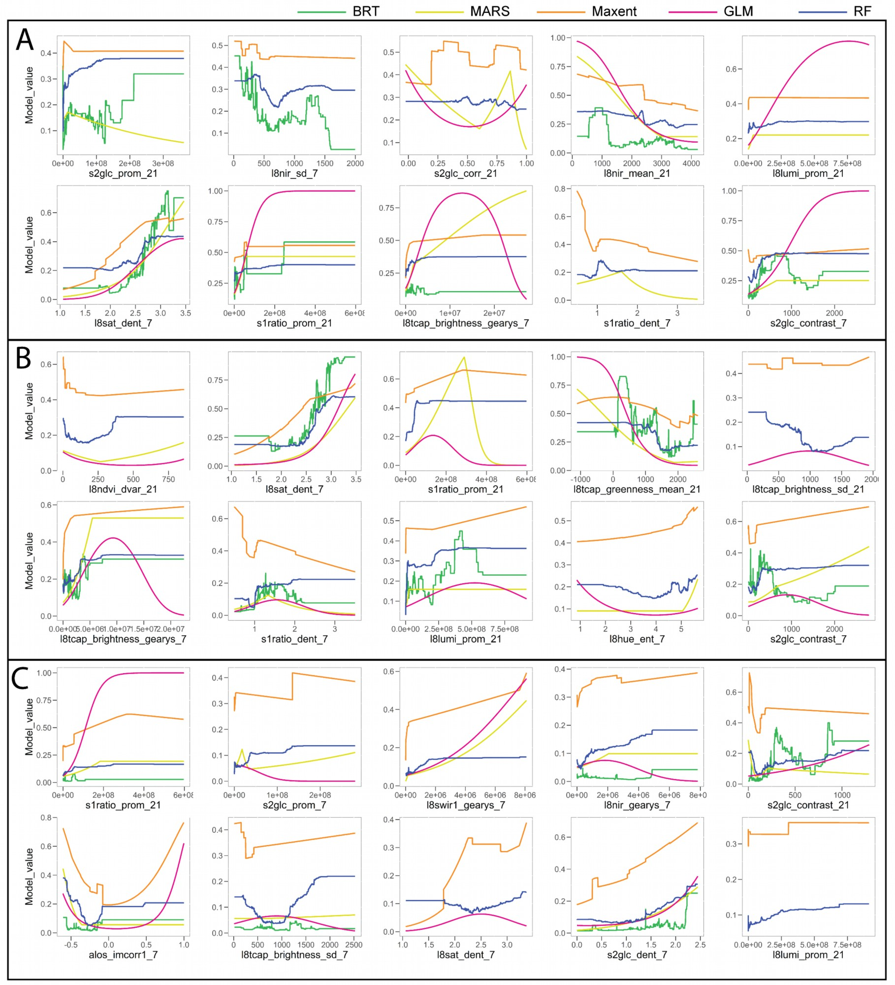
Relationships between indicators and landscape watching
The most important: randomness of landscape colour intensities and green vegetation (l8sat_dent7 and l8nir_mean_21)

Slide 13
Relationships between indicators and outdoor recreation
The most important: randomness of colour intensity (l8sat_dent7), followed by randomness and uniformity of vertical landscape structure (s1ratio_dent_7 and s1ratio_prom_21)

Slide 14
Relationships between indicators and wildlife watching
The most important: land cover diversity (s2glc_dent_7 and s2glc_contrast_21).

Slide 15
Accesibility-population discrepancies
Low accessibility indicates lower opportunities for CES use (Ala-Hulkko et al., 2016).

Slide 16
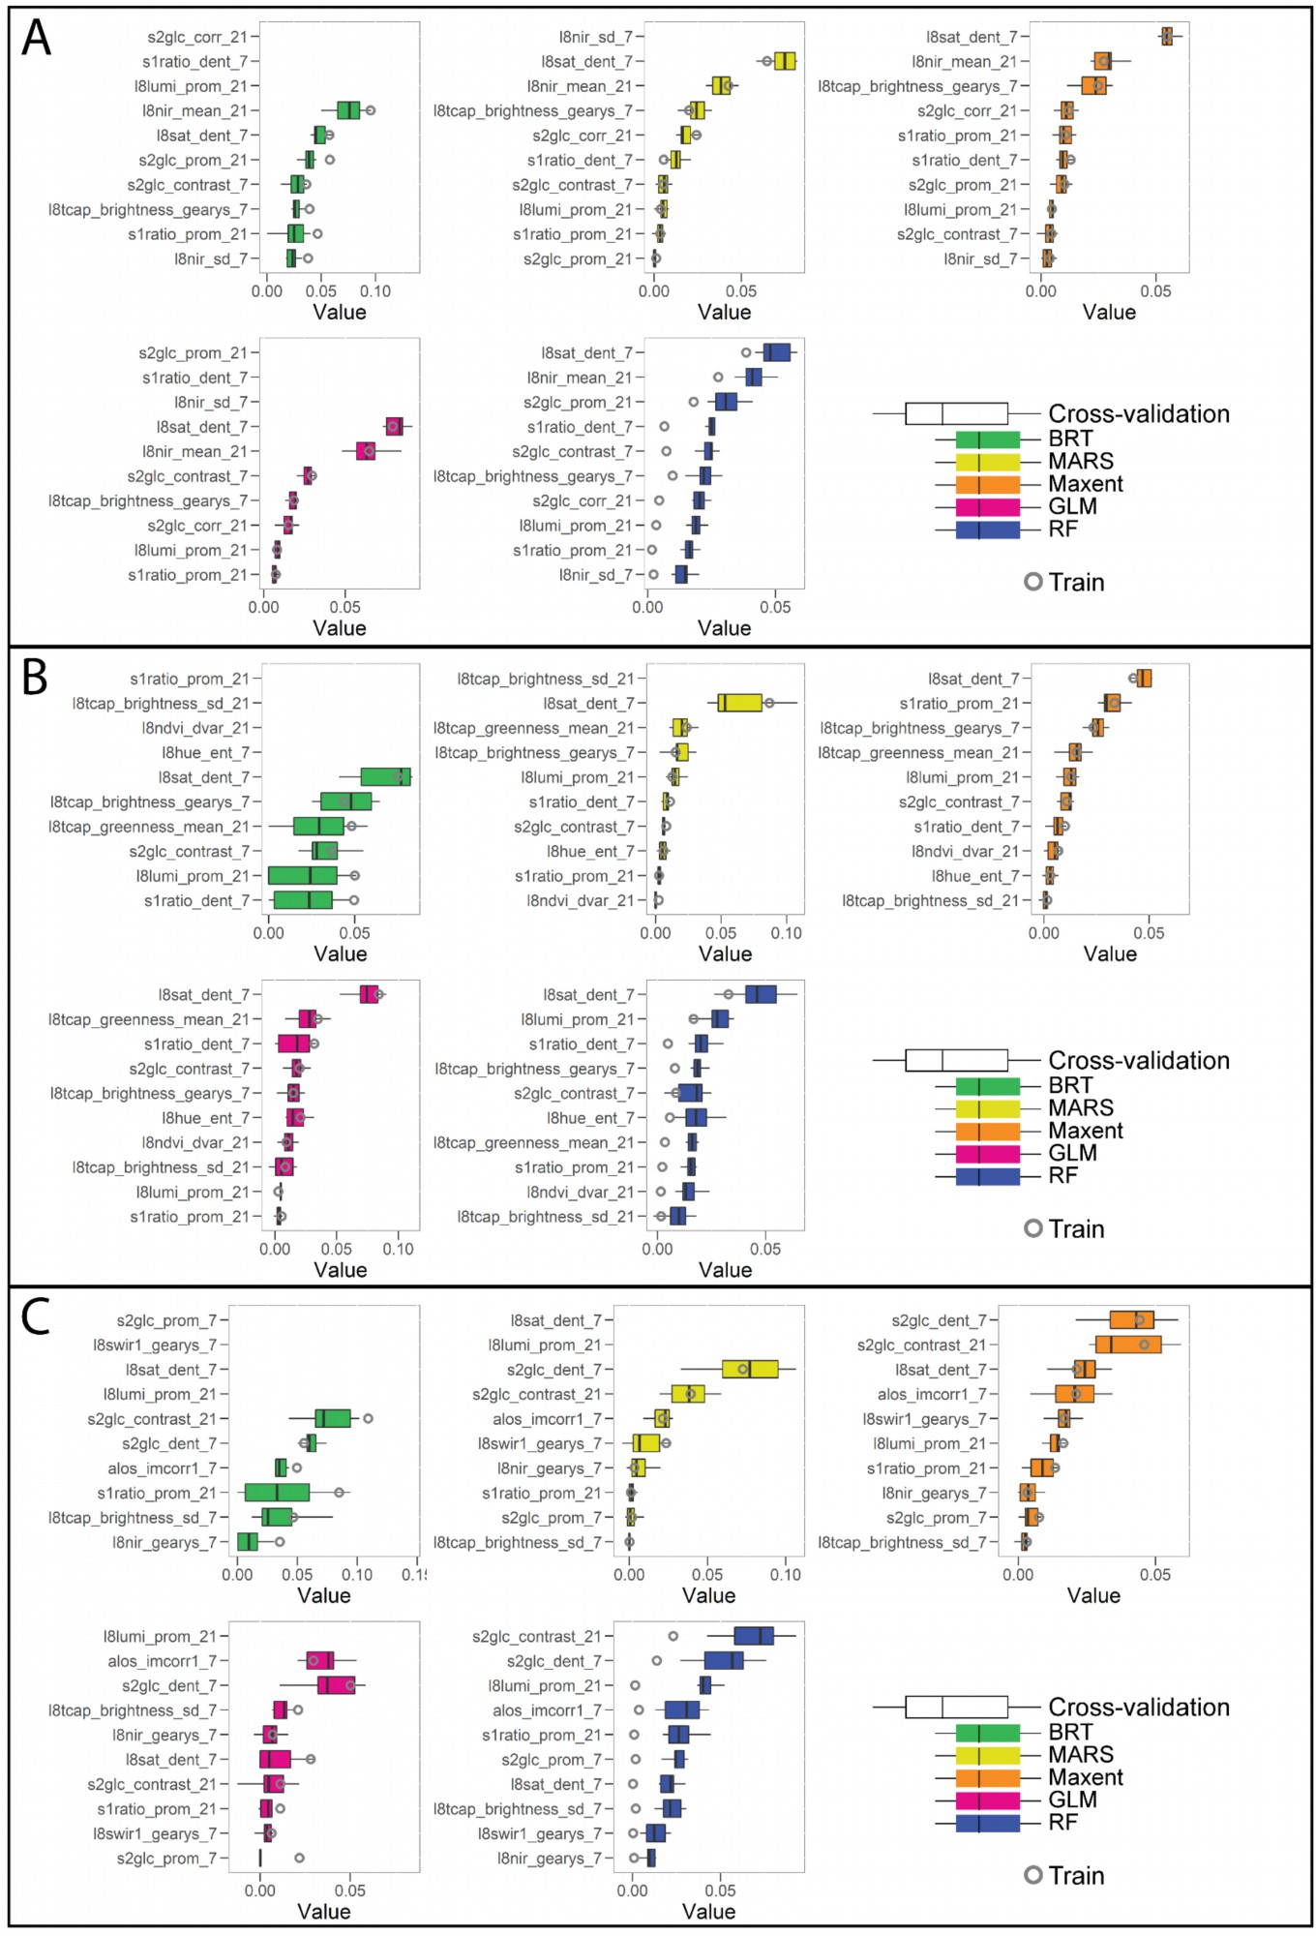
Relative importance of landscape watching indicators
The most important: randomness of landscape colour intensities and green vegetation (l8sat_dent7 and l8nir_mean_21)

Slide 17
Relative importance of outdoor recreation indicators
The most important: randomness of colour intensity (l8sat_dent7), followed by randomness and uniformity of vegetation types (s1ratio_dent_7 and s1ratio_prom_21)

Slide 18
Relative importance of wildlife watching indicators
The most important: land cover diversity (s2glc_dent_7 and s2glc_contrast_21).

