Slide 1

Psychology in high-performance teams
EUROMOONMARS
Celia Avila-Rauch - Brent Reymen - Bernard Foing

Slide 2
PSYCHOLOGY
It is a multifaceted discipline that includes different areas of action (social behaviour, mental health, cognitive and emotional processes) and human development. Personal self-knowledge will help us to know where our limitations and capacities are, focus on our tasks and express our desires in an assertive way.
EUROMOONMARS
Celia Avila-Rauch- Brent Reymen- Bernard Foing

Slide 3
- Mental preparation of individuals and teams, team training and ongoing psychological support, as well as the application of HUMAN FACTORS and ergonomics.
- Making human performance safe and successful during and after the mission
- High- performance Teams often experience a series of stressors that might have an impact on who individuals think and feel while in their work.
SPACE PSYCHOLOGY
EUROMOONMARS
Celia Avila-Rauch- Brent Reymen- Bernard Foing

Slide 4
High-performance teams are focused in:
1. Work with the issues and apply innovative thinking.
2. Clarify the personal values, shared respect and identity
3. Assess the risks and keep the team on track
4. Focus on building bridges and creating a team spirit
5. Empathy
6. Effectively Communication
7. The power of the Emotions
8. Cognitive Processes
EUROMOONMARS
Celia Avila-Rauch- Brent Reymen- Bernard Foing

Slide 5
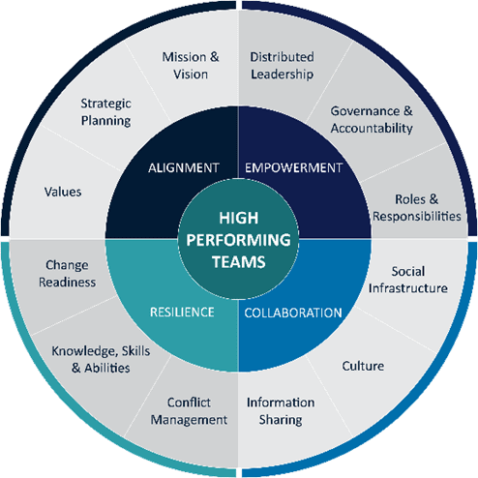
Commander (provide the answer)
Manager (organise process)
Leadership (ask questions)
EUROMOONMARS
Celia Avila-Rauch- Brent Reymen- Bernard Foing

Slide 6
HOW SPACE PSYCHOLOGY CAN BENEFIT THE TEAM?
- When you mask your emotions, you limit your cognitive capacity.
- Living aligned with your personal values moves your motivation from obsession to dedication and communication.
- Identifying your role in the group will focus your attention on constructive problem-solving.
- When we are paralyzed, it is difficult to see issues with perspective, but doing can help us move above the situation.
- Focusing on a positive mindset, will allow our brain to become rational and logical again.
- Deep breathing lowers your stress hormones by 30%, which haves an instant physiological impact on our body.
- Focused attention has many benefits, including an increased immune system, better quality sleep and lower levels of depression and anxiety.
EUROMOONMARS
Celia Avila-Rauch- Brent Reymen- Bernard Foing

Slide 7
Our current research project in EMM is a theoretical descriptive form. It is focused on determining whether factors affecting human behaviour, cognitive processes and responsibilities in high-performance professions could have a significant long-term psychophysiological benefit if we apply emotional intelligence skills training.
EUROMOONMARS
Celia Avila-Rauch- Brent Reymen- Bernard Foing

Slide 8

Thank you
EUROMOONMARS
Celia Avila-Rauch- Brent Reymen- Bernard Foing

