Slide 1


Dynamics of Crustal-Scale Fluid Transport: Interaction between Darcy and Hydrofracture Fluid Flow
Tamara de Riese¹
Paul Bons¹, Enrique Gomez-Rivas², Till Sachau¹
Department of Geosciences, Eberhard Karls University Tübingen, Germany (2) Department of Mineralogy, Petrology and Applied Geology, University of Barcelona, Barcelona, Spain.
tamara.de-riese@uni-tuebingen.de

Slide 2
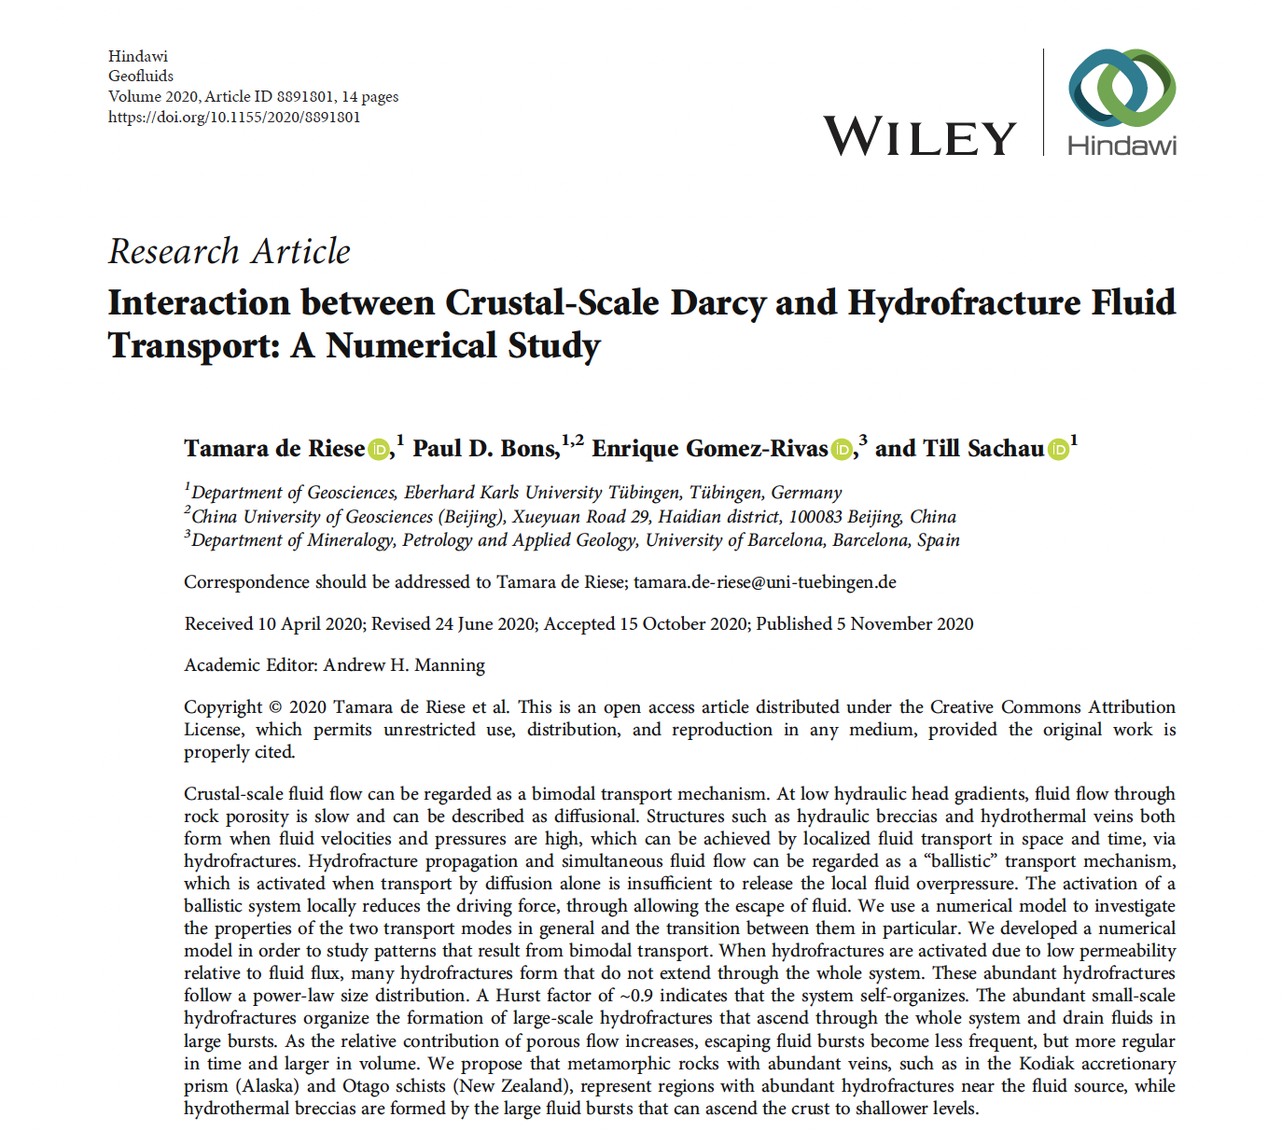
https://doi.org/10.1155/2020/8891801
Tamara de Riese

Slide 3
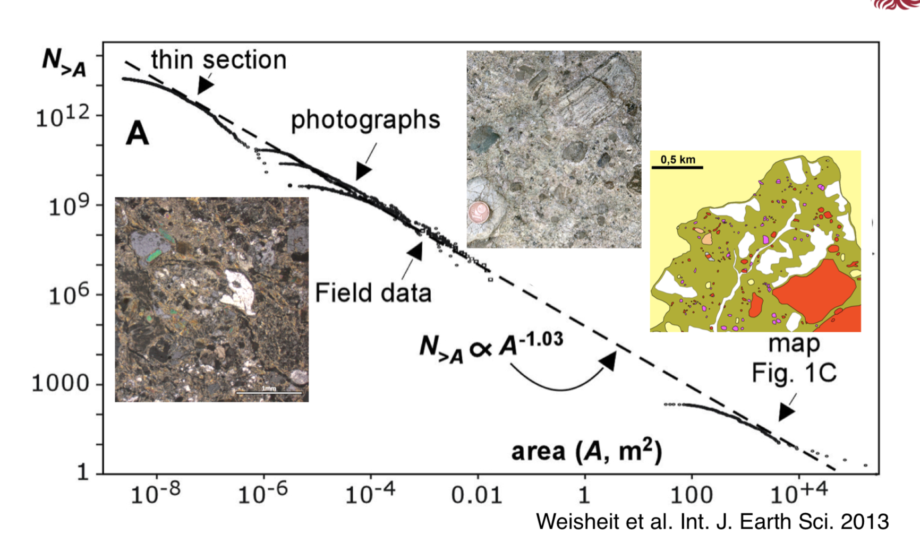
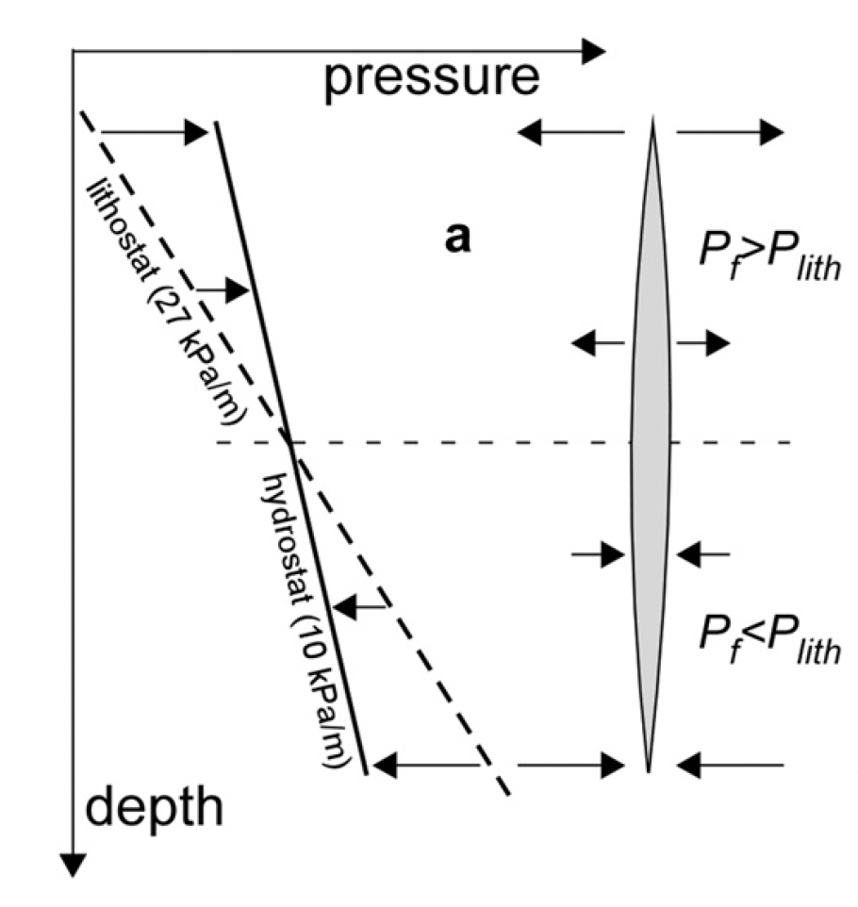
Dynamics of fluid flow in the crust
Hydraulic breccia in Black Forest, Germany
Hidden Valley breccia in Australia
(a)
(b)
de Riese et al., 2020
Crustal scale fluid flow models often assume continuously and slow fluid flow, driven by e.g. topography.
However, structures such as hydraulic breccias or crack-seal veins indicate fluid overpressures and high fluid velocities.
High fluid velocities and pressures can only be achieved by localised flow (e.g. via mobile hydrofractures: Bons, 2001).
Hydrofracture transport is activated when transport by diffusion Is not able to release the fluid overpressure.
Fluid sources: e.g. fluid release due to decompression or mineral dehydration reactions.
Bons et al., 2012
Tamara de Riese

Slide 4
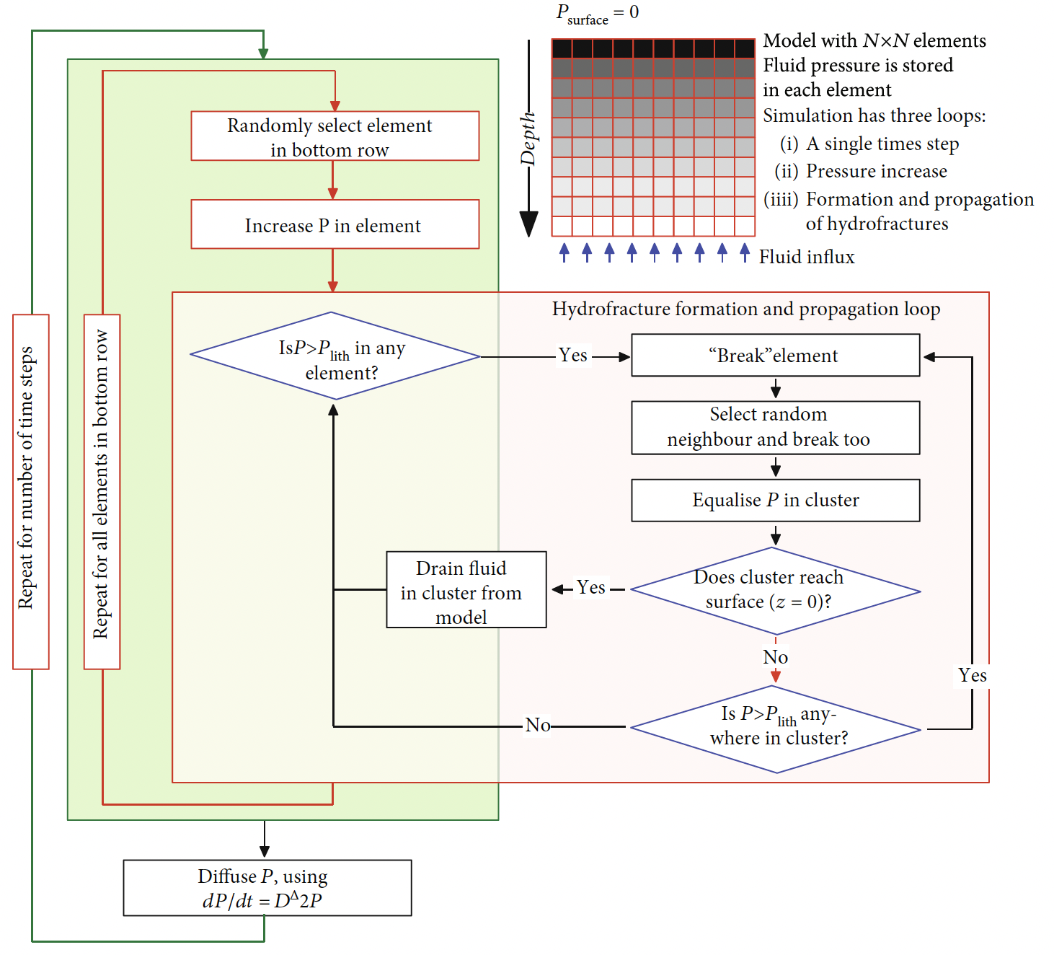
Modelling approach
2D numerical cellular automata model to investigate the properties of fast hydrofracture and slow Darcian flow, and the transition between them in particular.
Fluid is produced at the base of the model, with a fluid flux of 10⁻¹¹ m/s (typical for crustal metamorphic fluid fluxes at a depth of 10-15 km)
Darcian flow is modelled as an diffusive process.
Fluid production causes increasing fluid pressures. Hydrofractures develop and propagate together with the contained fluid as soon as fluid pressure reaches lithostatic pressure, which can activate an avalanche-like behaviour.
A diffusion/permeability coefficient D is varied, to investigate the transition from hydrofracture (low D) to Darcian-flow dominated (high D) behaviour.
A detailed model description can be found in de Riese et al. (2020).
de Riese et al., 2020
Tamara de Riese

Slide 5



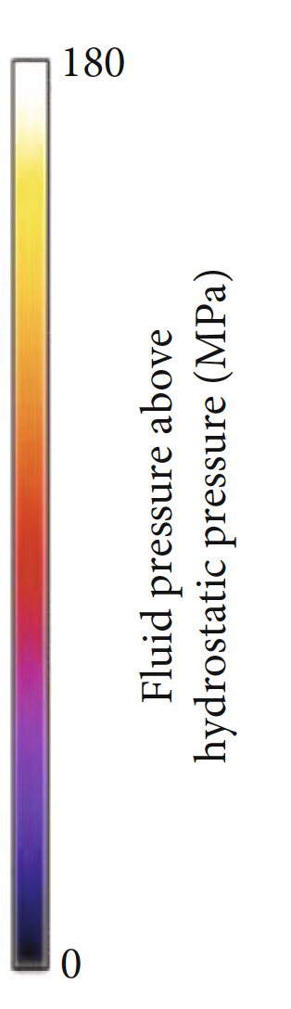
Evolution and dynamics of fluid pressure
Pure fracture flow
Interaction of hydrofracture + matrix flow
Pure matrix flow
D = 0
D = 2*10⁻⁶
D = 1*10⁻⁴
de Riese et al., 2020
All fluid pressure is transported via hydrofractures when D = 0 (low permeability)
At D = 10⁻⁴ fluid overpressure is transported by diffusional matrix flow with very few hydrofracture events
In between the two endmembers, hydrofracture flow and matrix flow interact with each other.
Sudden and fast bursts of hydrofractures
Tamara de Riese

Slide 6
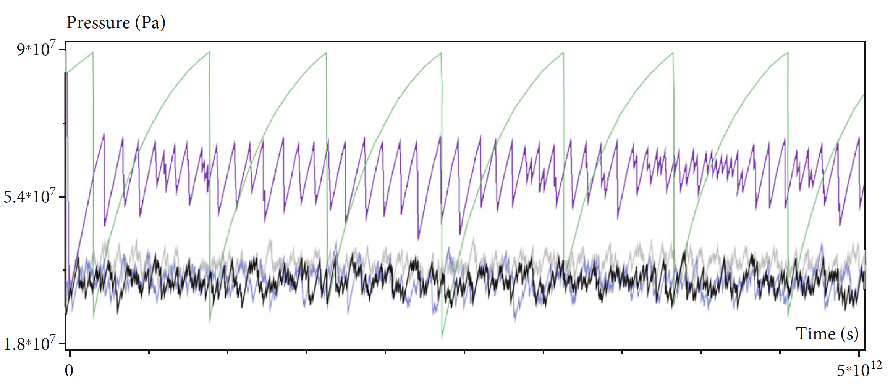
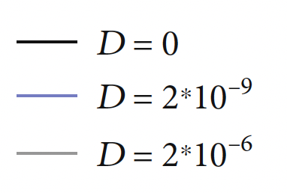
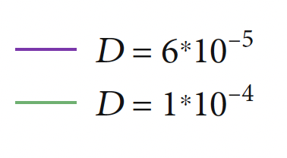
Fluctuations of mean pressure
de Riese et al., 2020
Pressure fluctuates strongly and shows intermittent behaviour in case of pure hydrofracture flow (D = 0, in black)
With a higher D (Darcian porous flow contributes increasingly) fluctuations of mean pressure become larger and more regular. The transition to Darcian-flow is characterised by few, but large events of fluid release
Tamara de Riese

Slide 7
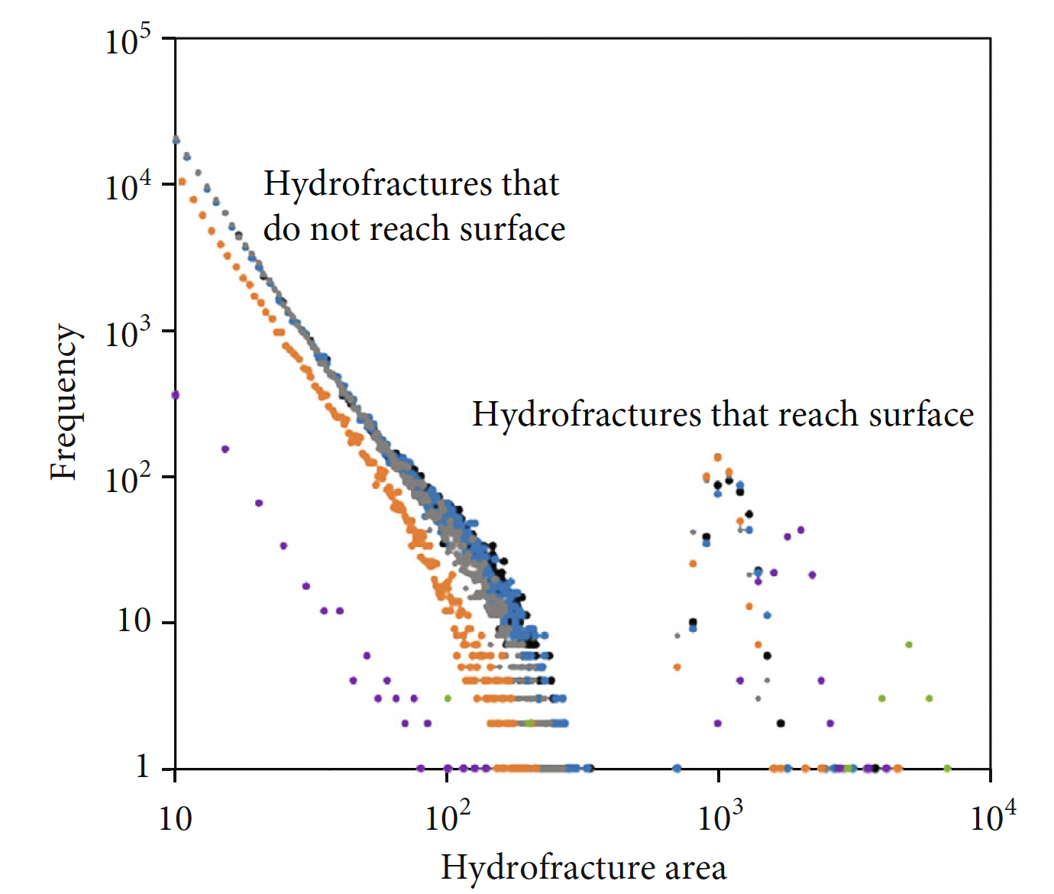
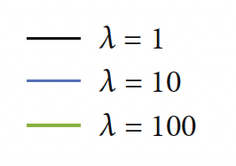
Statistical properties of hydrofracture size distributions
Frequency of hydrofracture sizes not reaching the top of the model box is power-law distributed. Power-law distributions emphasize that hydrofracture events can trigger avalanche-like merging of hydrofractures (power-law distributions are typical features of dynamical/intermittent and self-organising processes)
Larger part of hydrofracture events only lead to local fluid flow pulses within the source area
Hydrofractures reaching the surface of the model box are very large but their relative number is small. Their size distributions don‘t follow power-laws. They drain all the fluid and can be interpreted as „dragon-kings“, which coexist with the power-law distribution (associated with tipping points or bifurcations)
With increasing D hydrofracture frequencies decrease
Few but large events transport most of the fluid
de Riese et al., 2020
Tamara de Riese

Slide 8
Conclusions
Model illustrates the extreme dynamics that crustal-scale fluid flow can achieve.
Two kind of hydrofractures develop in the model. (1) Power-law distributed hydrofracture events, which don‘t reach the top of the model box, high in number but relatively small in size. These events could be those which produce crack-seal veins or vein-rich zones which are common in some metamorphic rocks (2) Very large but few hydrofracture events that reach the top of the model box and drain all the fluid. These large hydrofractures rapidly transport large fluid volumes from deep to shallow levels in the crust where they may form hydrothermal breccias.
In our model, the system self-organises when hydrofracture flow dominates.
Crustal fluid flow can be highly dynamical is certain geological settings, which may have major consequences for geo-engineering processes.
References:
Bons, P. D. (2001). The formation of large quartz veins by rapid ascent of fluids in mobile hydrofractures. Tectonophysics, 336(1-4), 1-17.
Bons, P. D., Elburg, M. A., & Gomez-Rivas, E. (2012). A review of the formation of tectonic veins and their microstructures. Journal of structural geology, 43, 33-62.
de Riese, T., Bons, P. D., Gomez-Rivas, E., & Sachau, T. (2020). Interaction between Crustal-Scale Darcy and Hydrofracture Fluid Transport: A Numerical Study. Geofluids, 2020
Weisheit, A., Bons, P. D., & Elburg, M. A. (2013). Long-lived crustal-scale fluid flow: the hydrothermal mega-breccia of Hidden Valley, Mt. Painter Inlier, South Australia. International Journal of Earth Sciences, 102(5), 1219-1236.
Tamara de Riese

