Slide 1
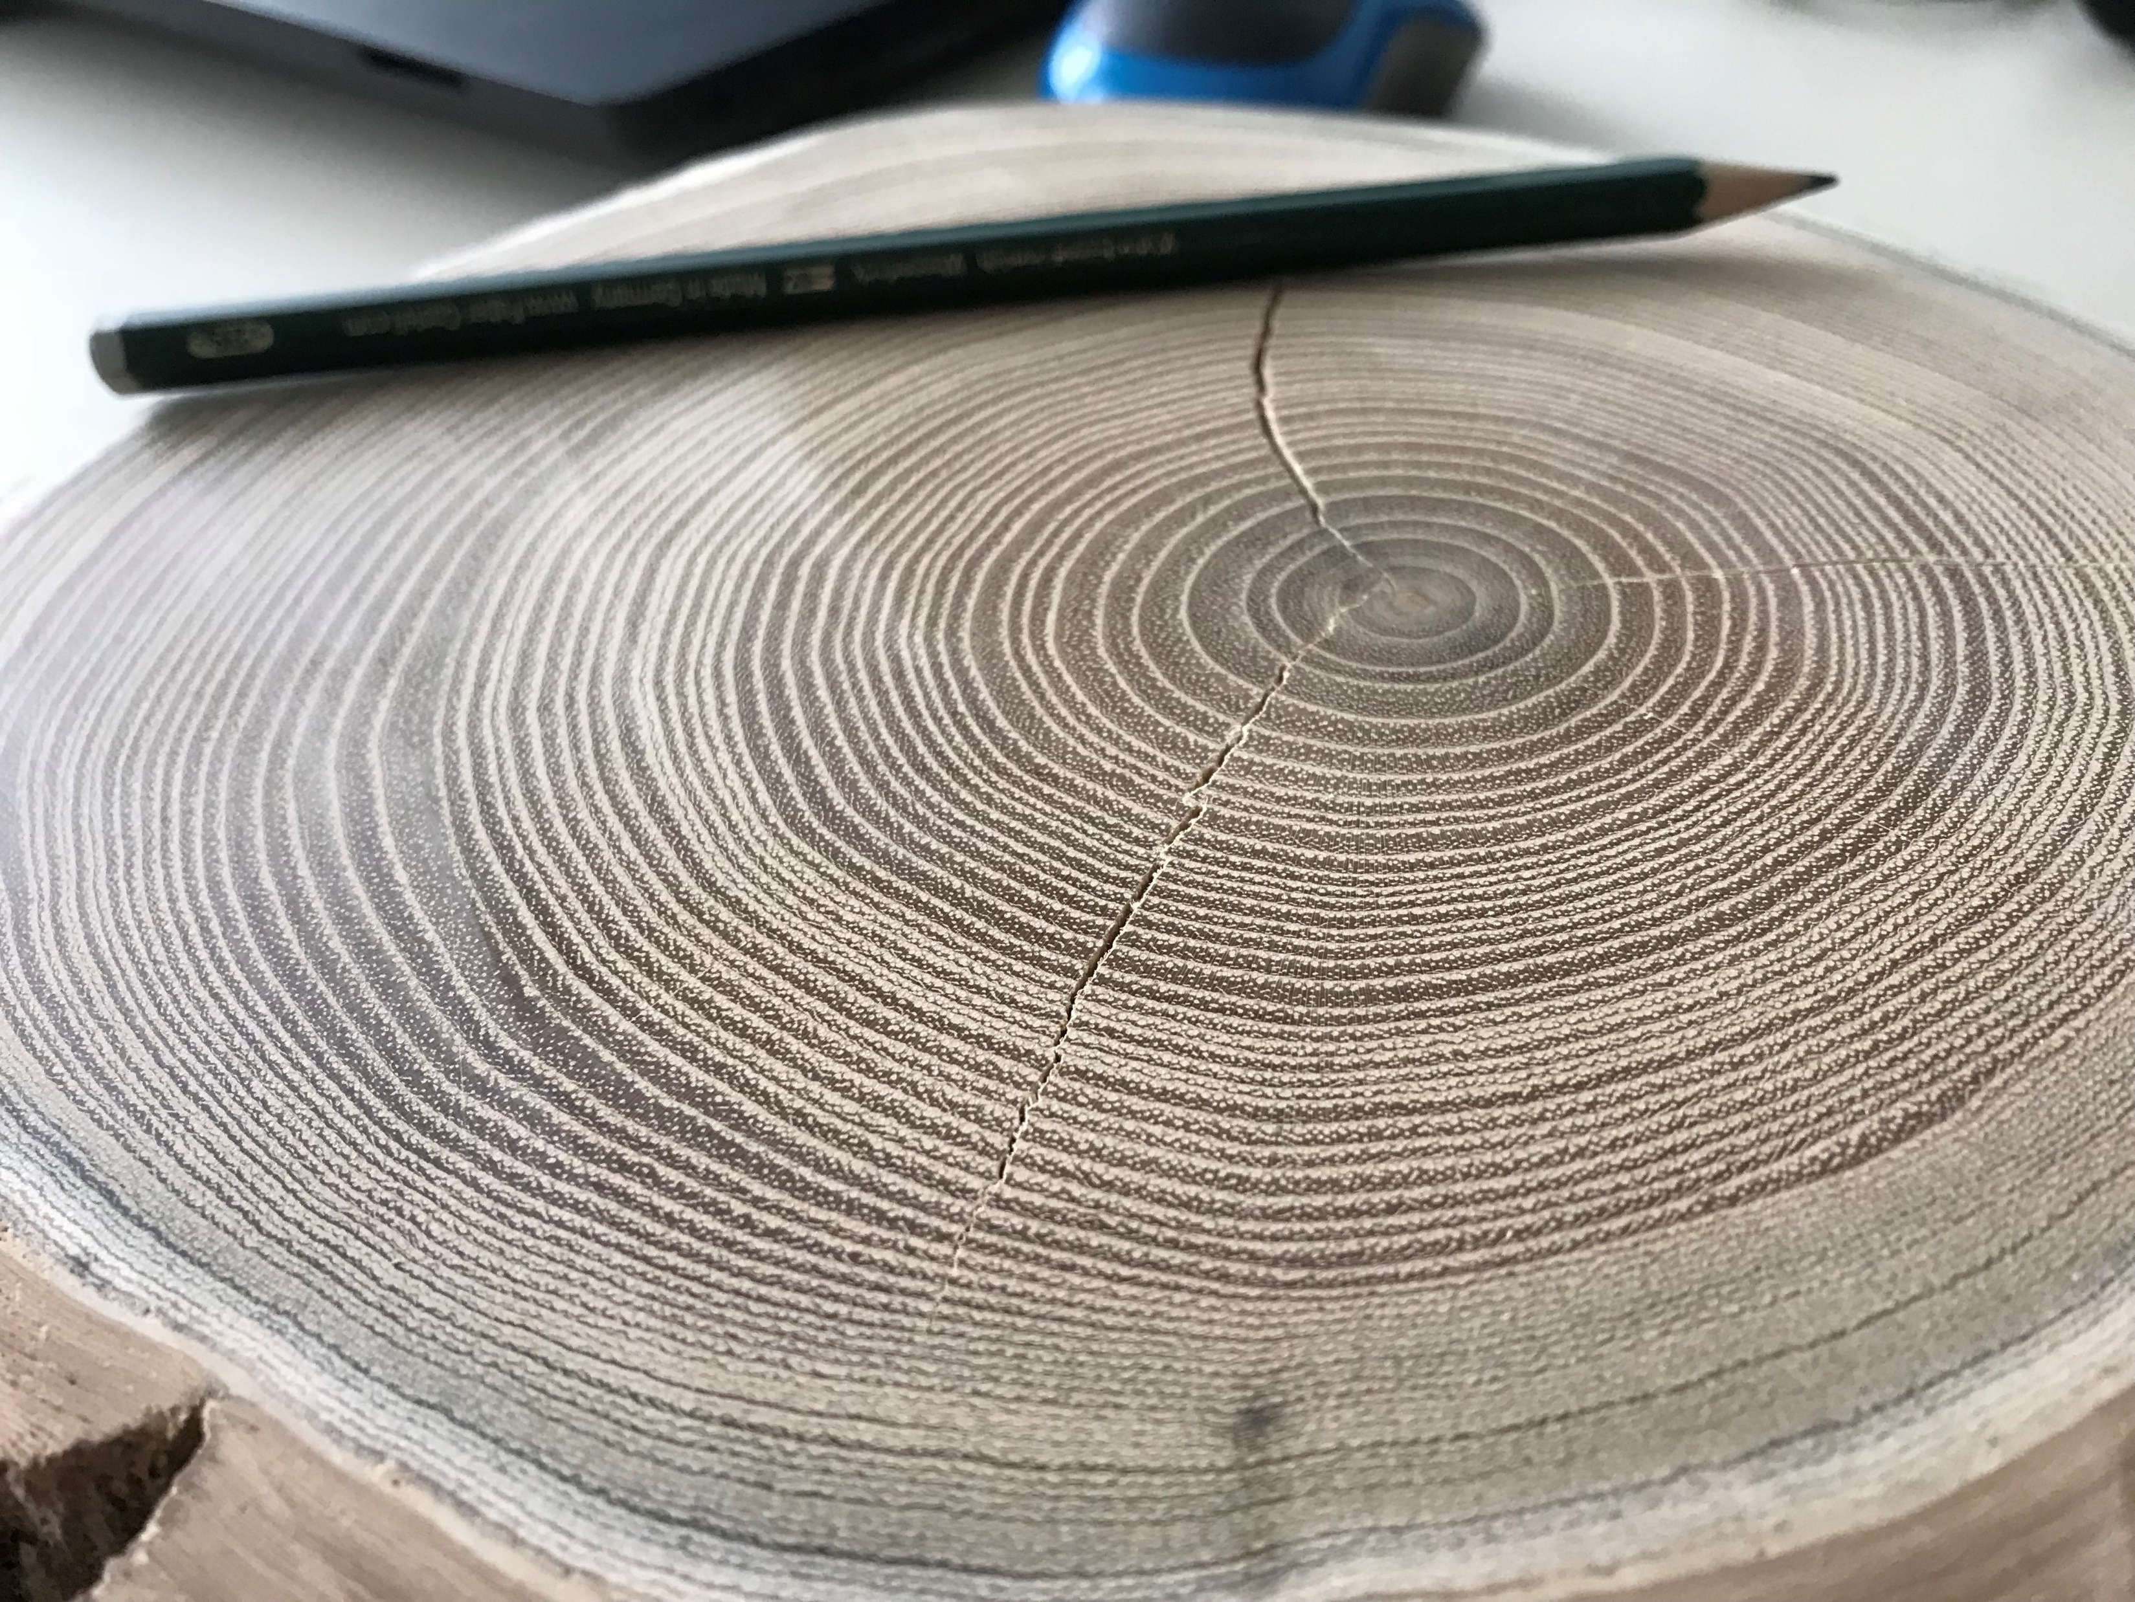


“Ștefan cel Mare”
University of Suceava
Tree-ring width as an indicator
for the Lower Danube streamflow
Nagavciuc V.*, Roibu C., Mursa A., Stirbu M., Popa I. and Ionita M.
*nagavciuc.viorica@gmail.com

Slide 2
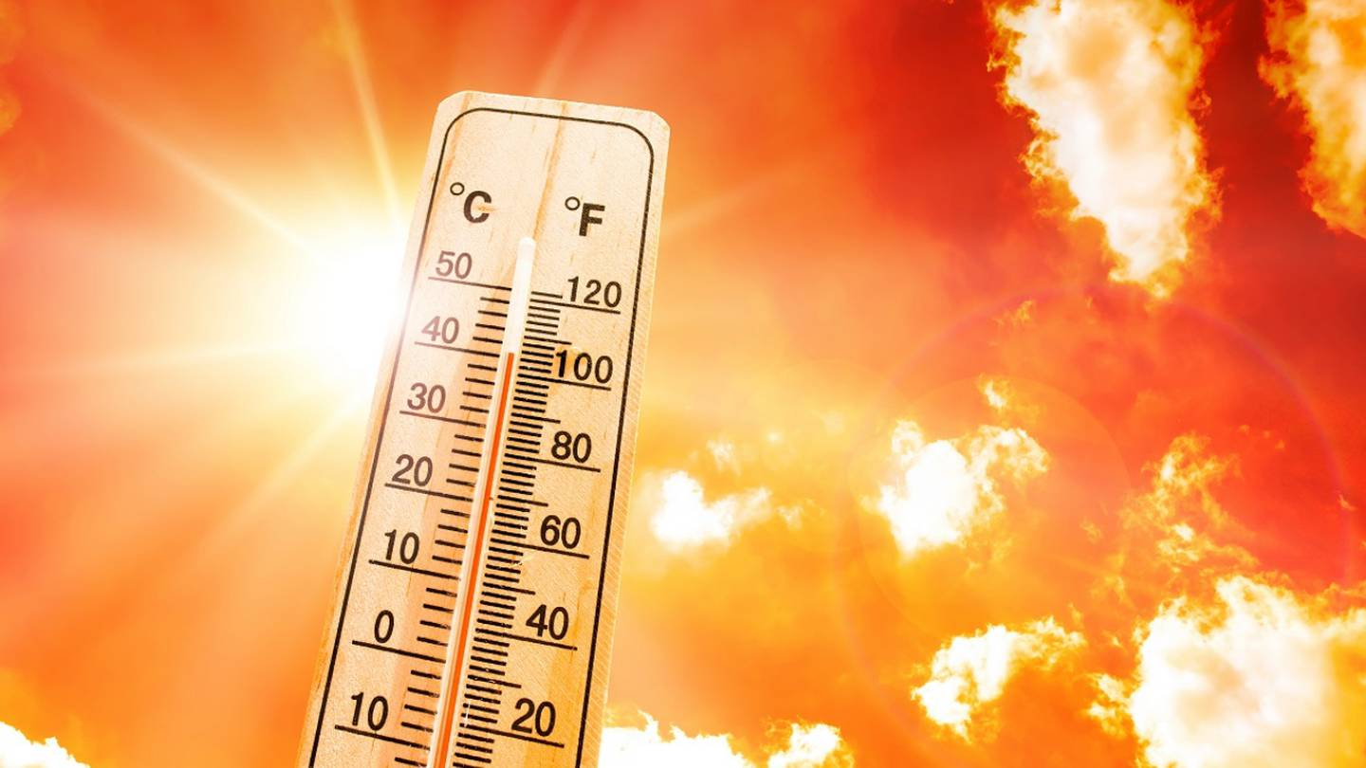
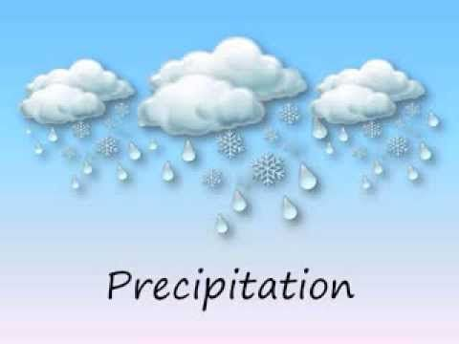
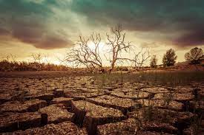
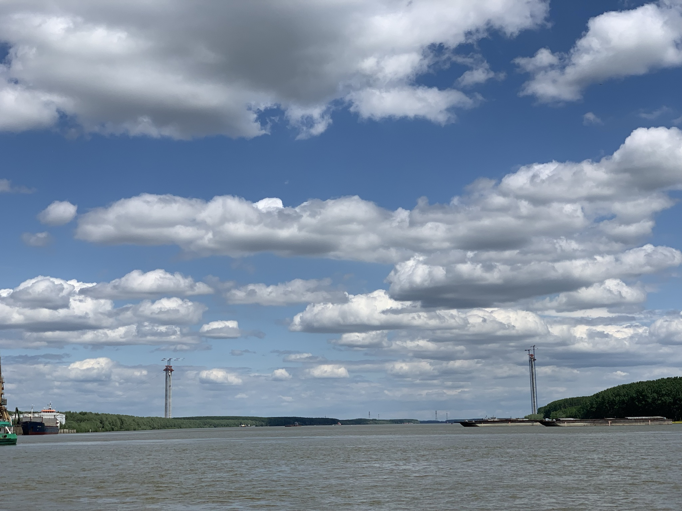
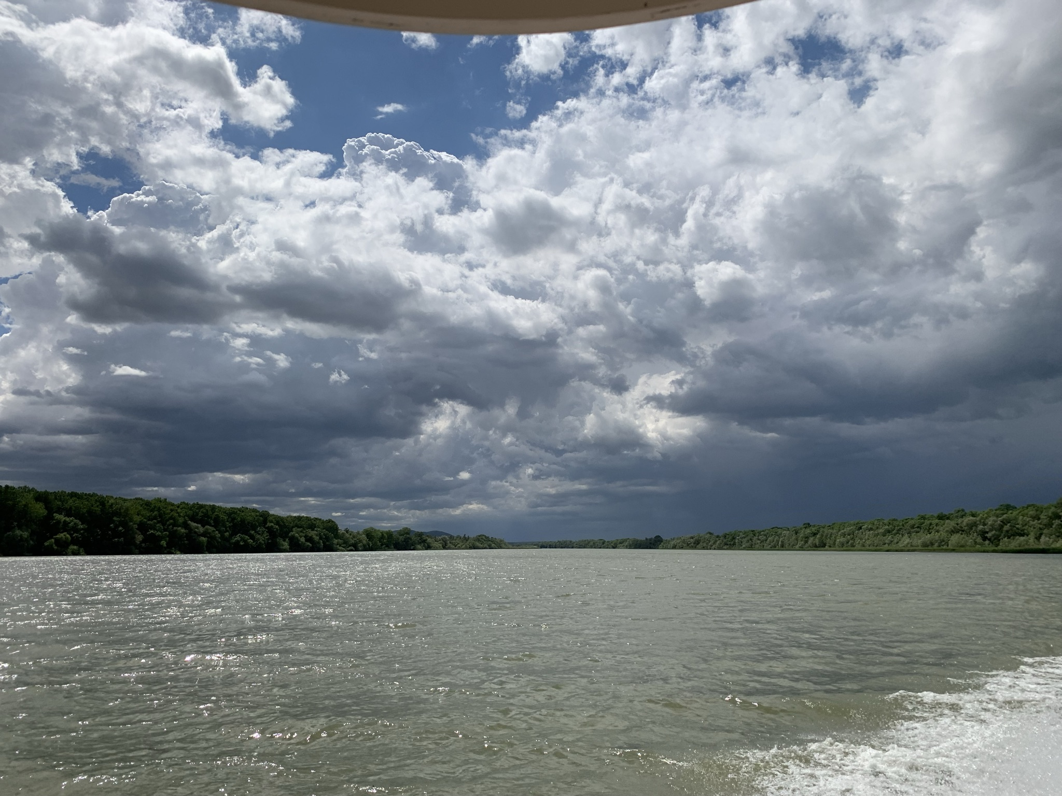
Temperature
Drought

Slide 3
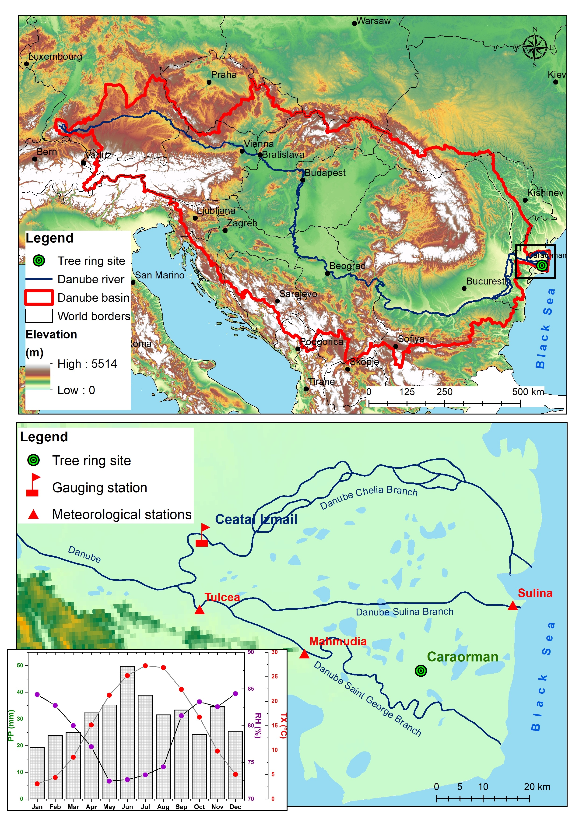

Slide 4
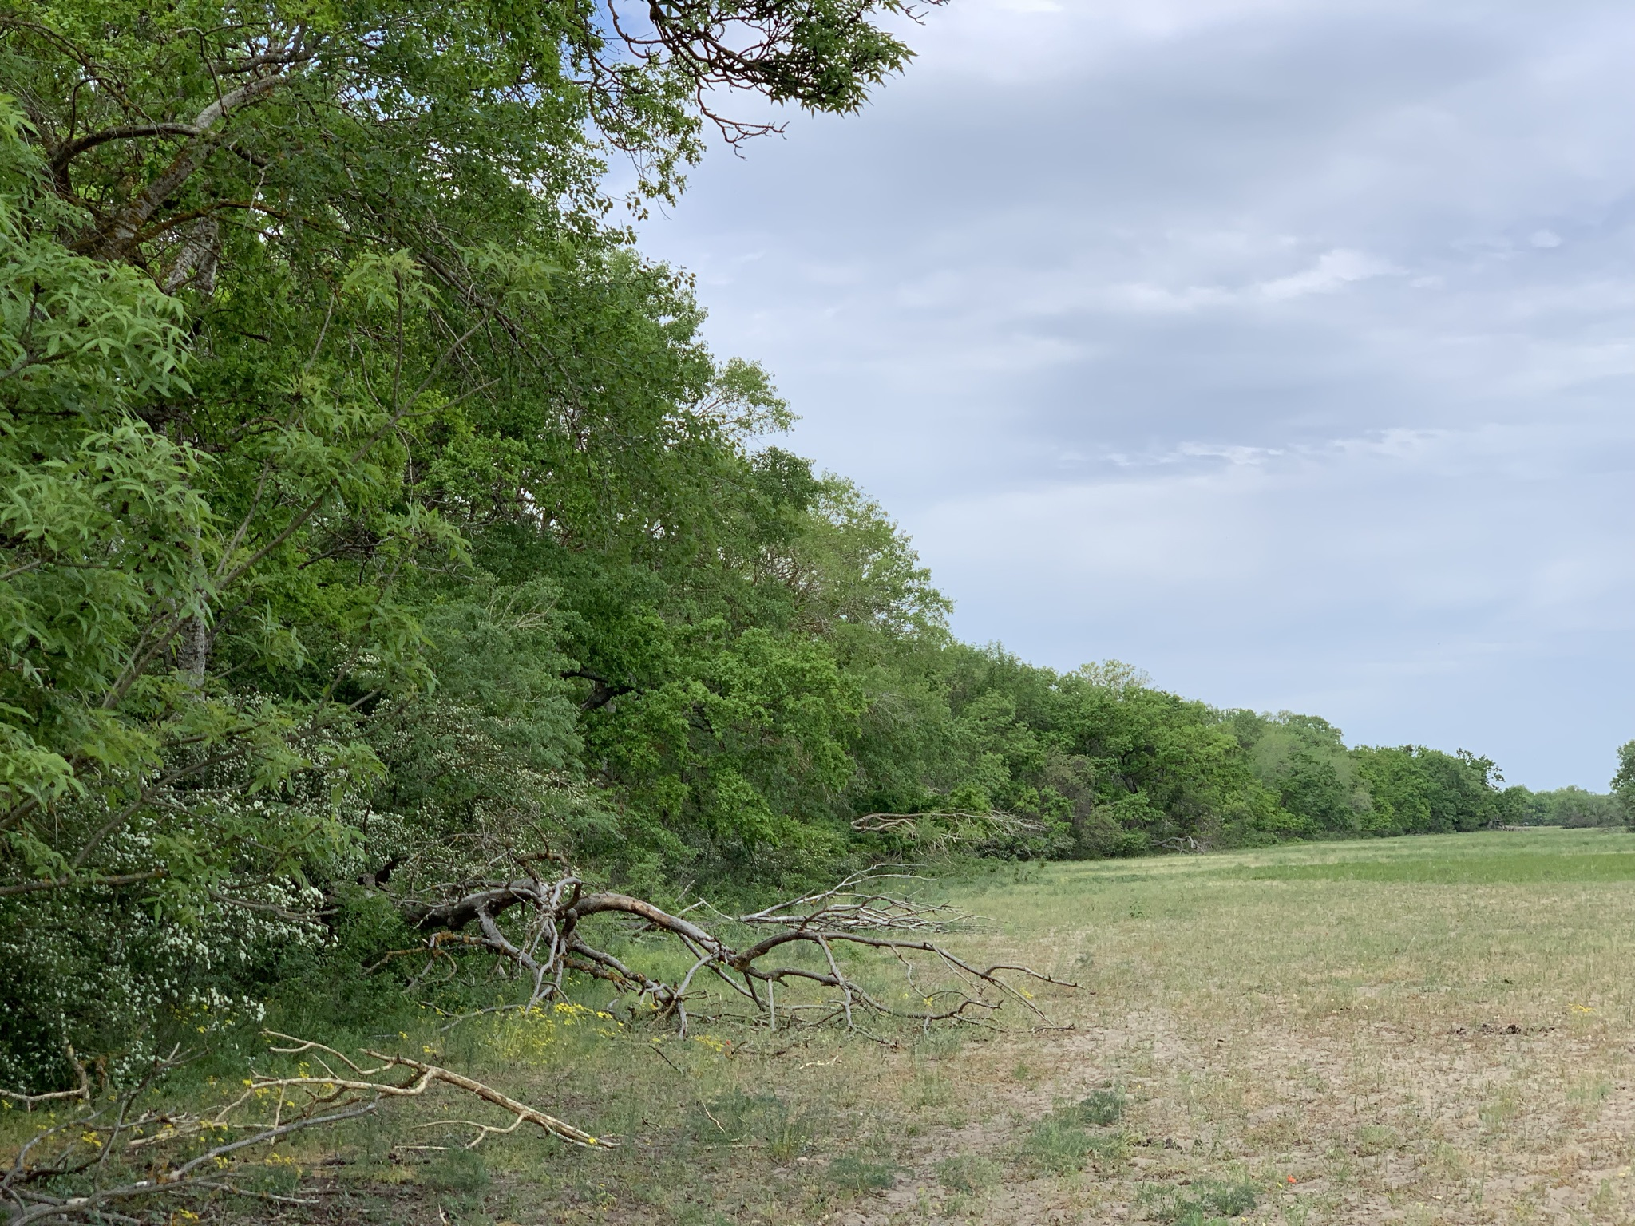
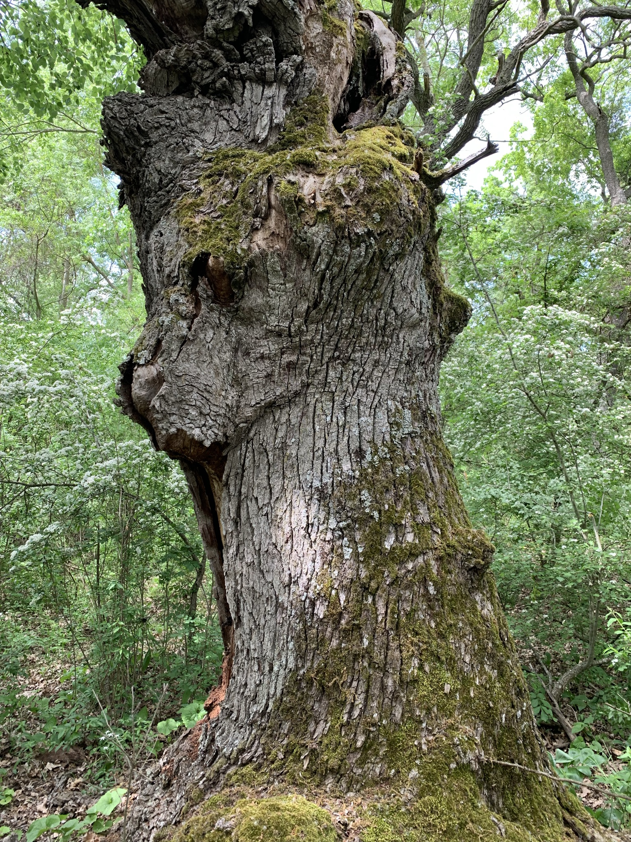
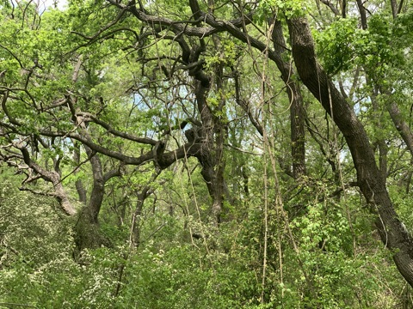
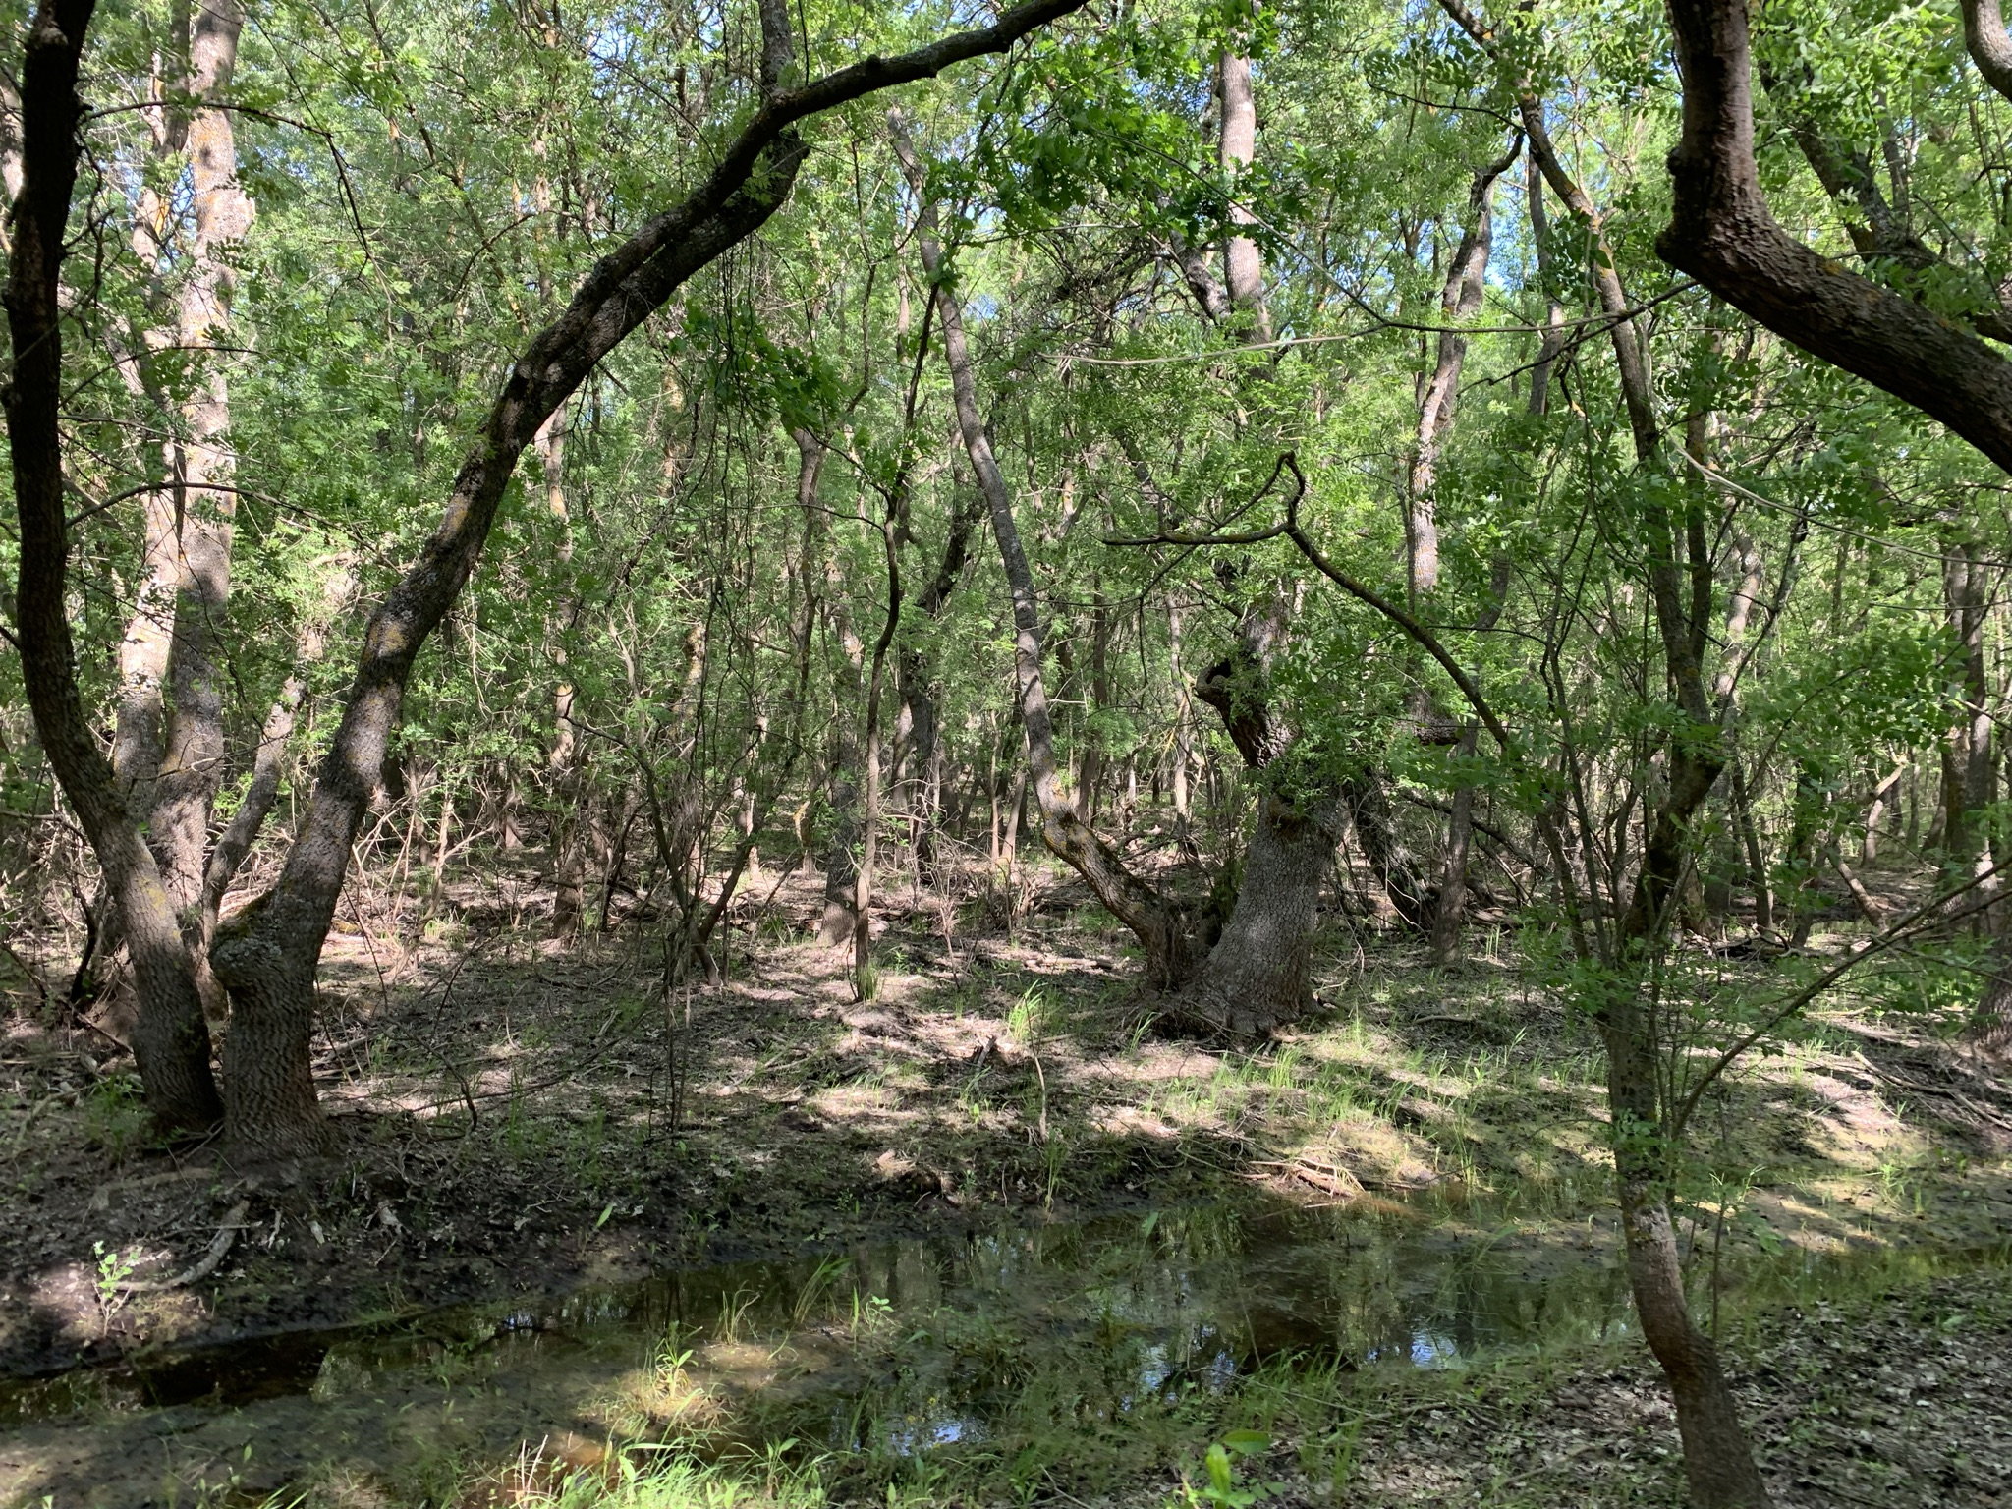
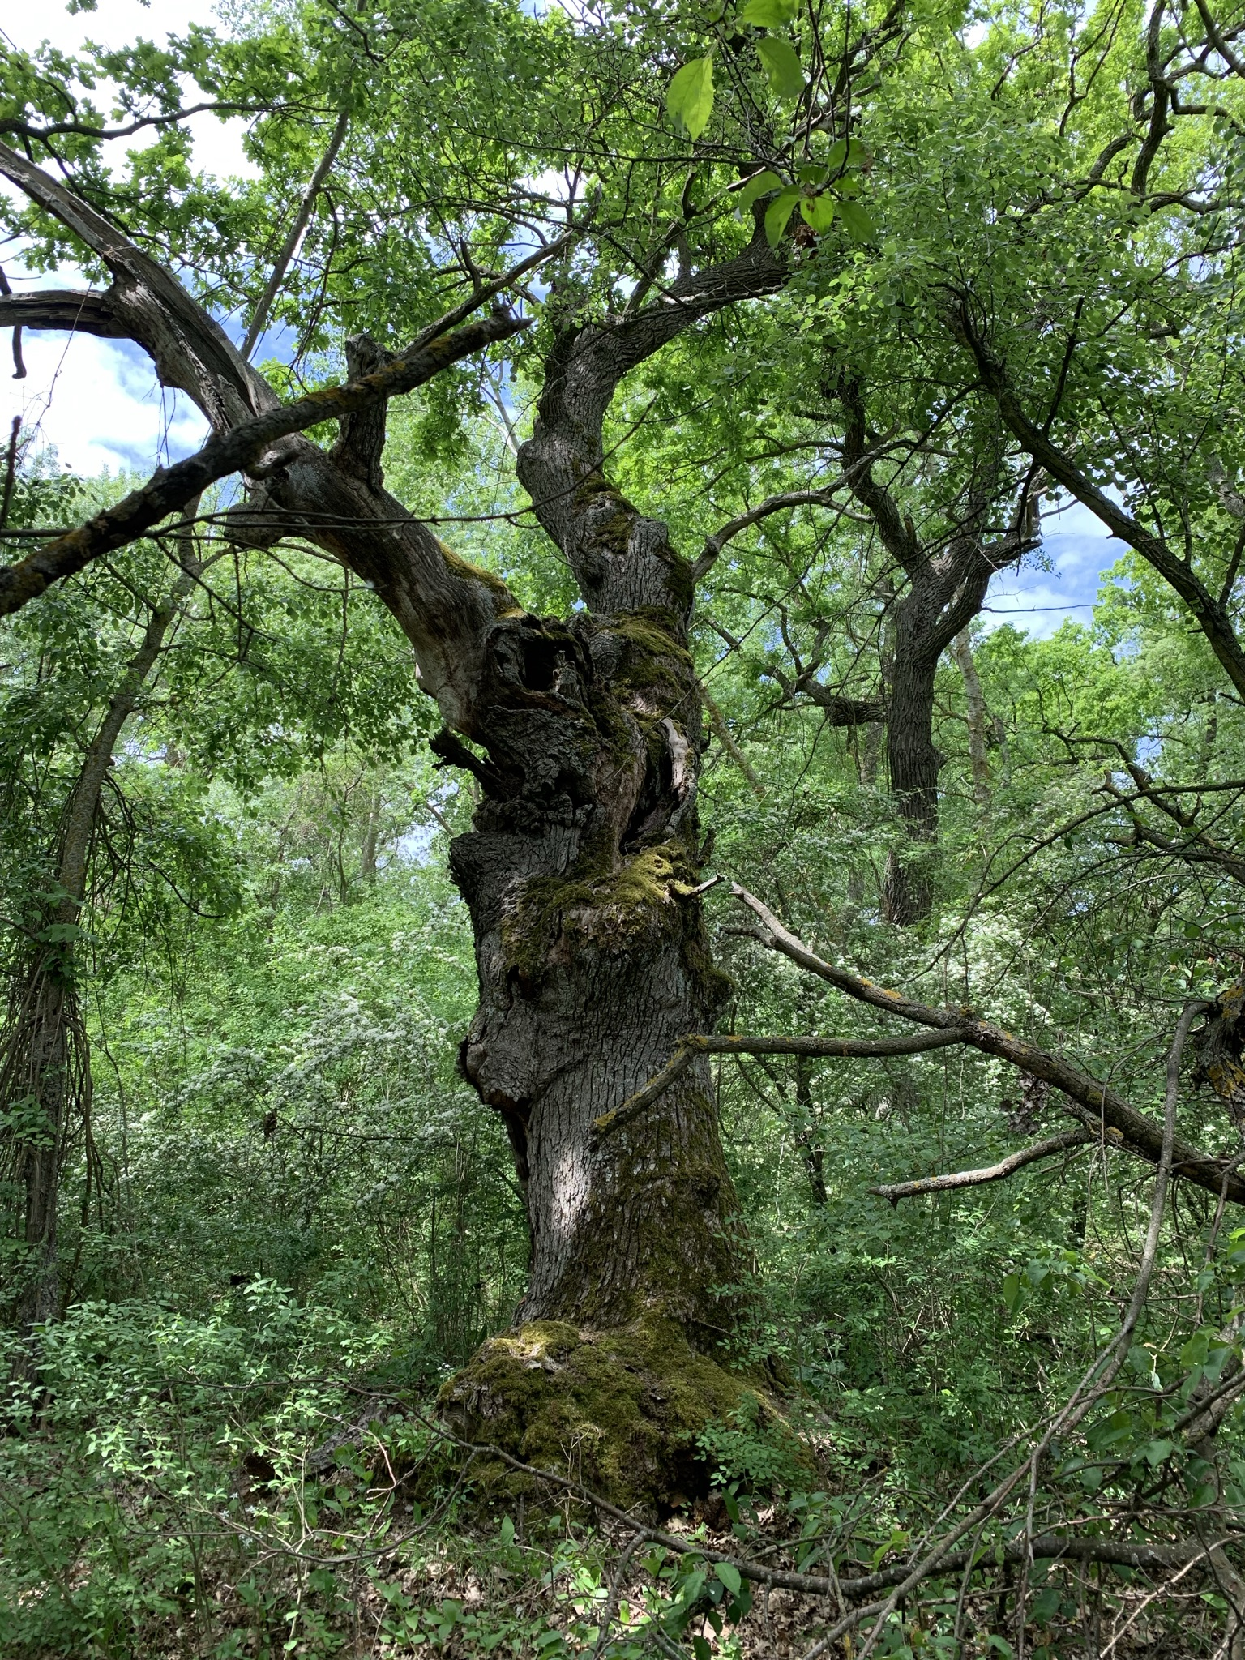
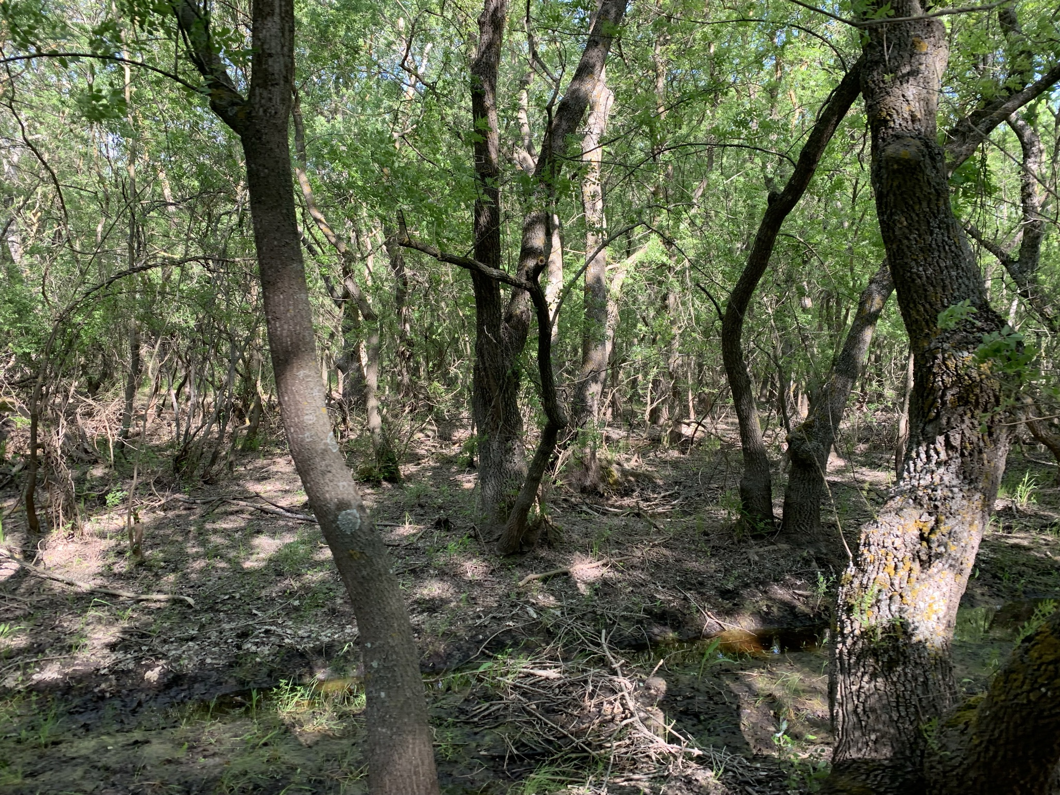

Slide 5
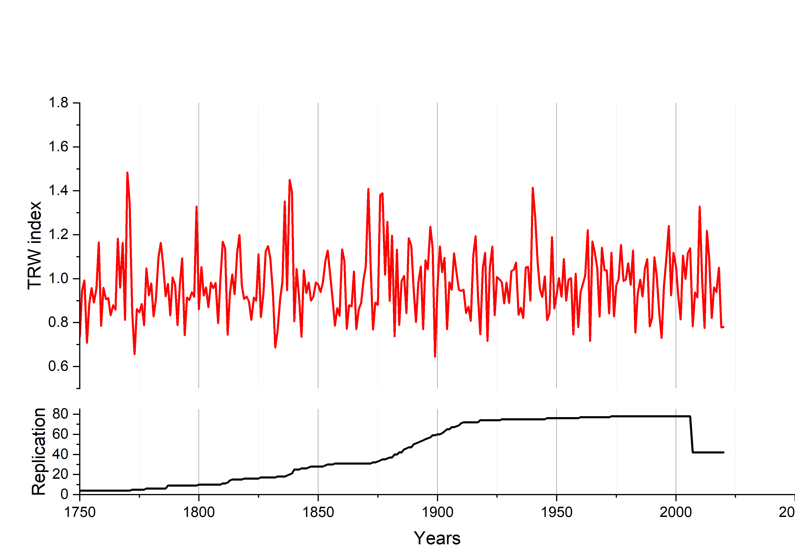

Slide 6
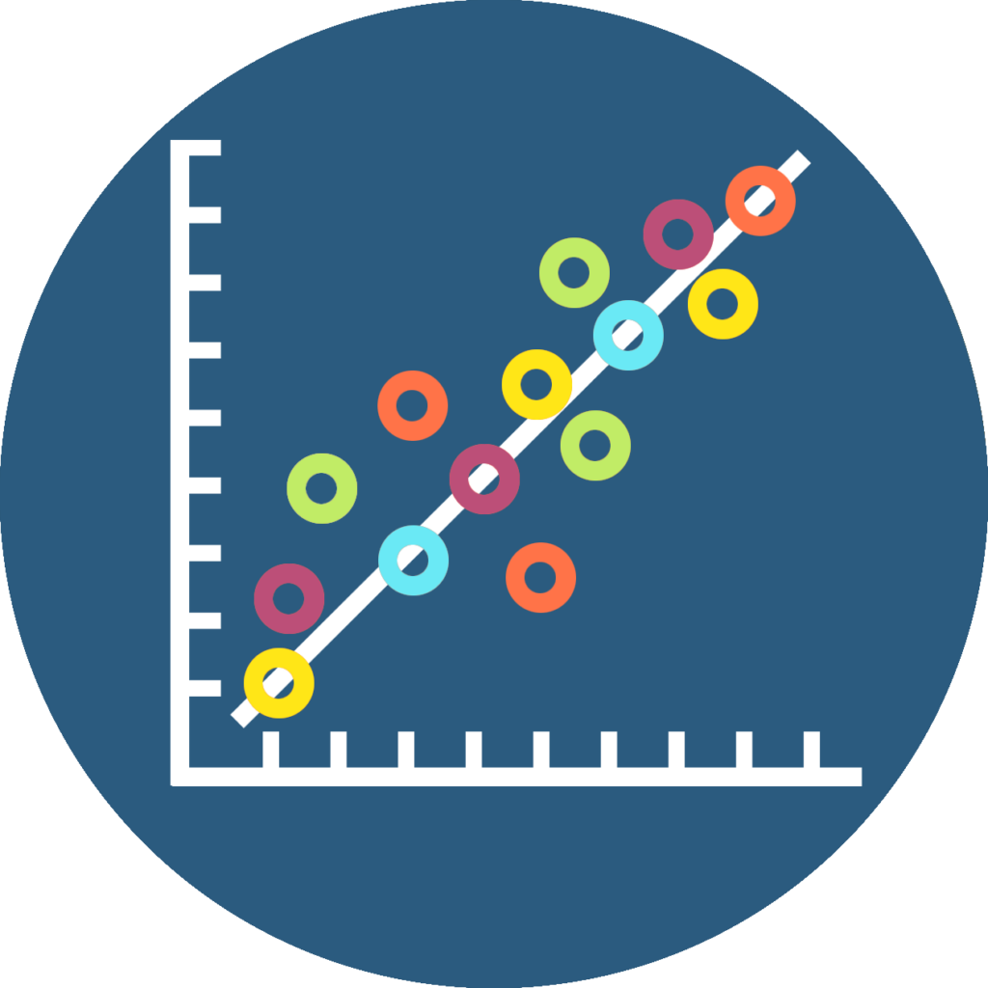
Hydro-climate analyses

Slide 7
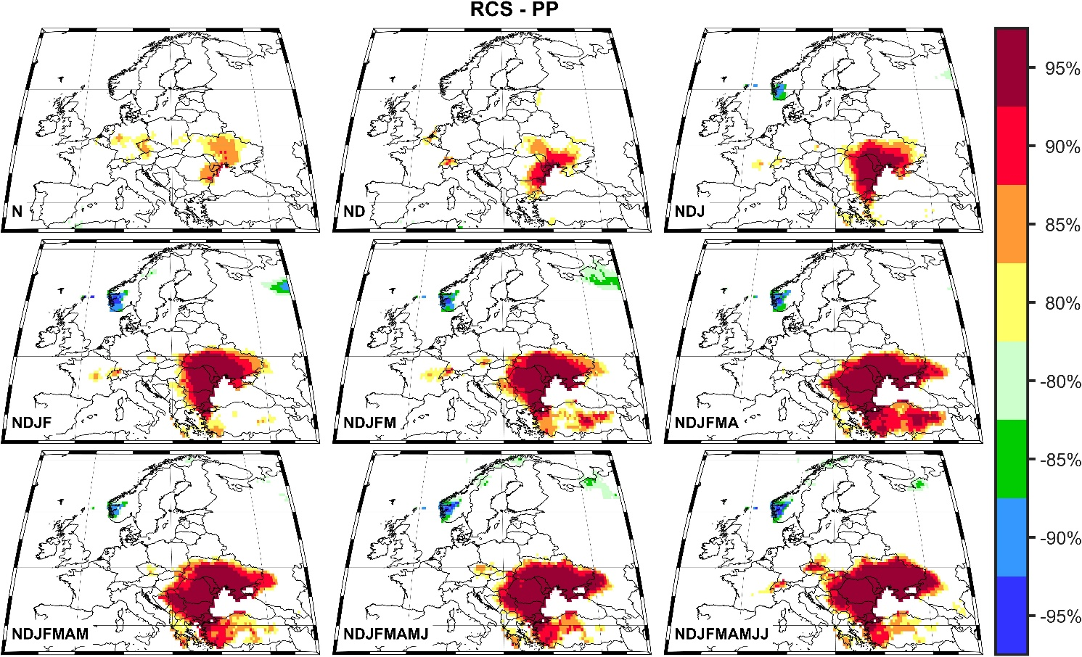
We found a positive significant correlation between the TRW index and the streamflow data from the Ceatal Izmail hydrometric station for the nine months period, from November previous year to July of the current year period: r = 0.70.

Slide 8
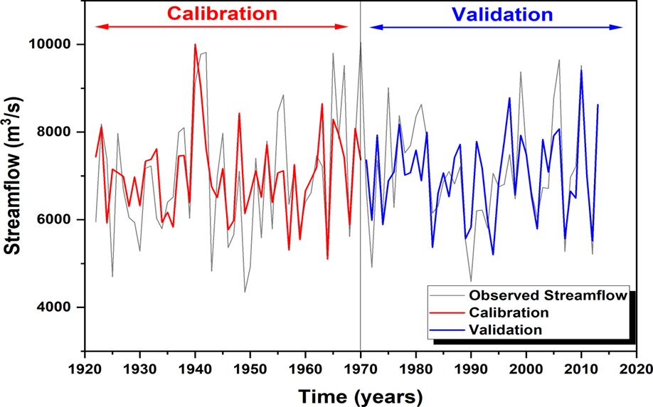

Slide 9
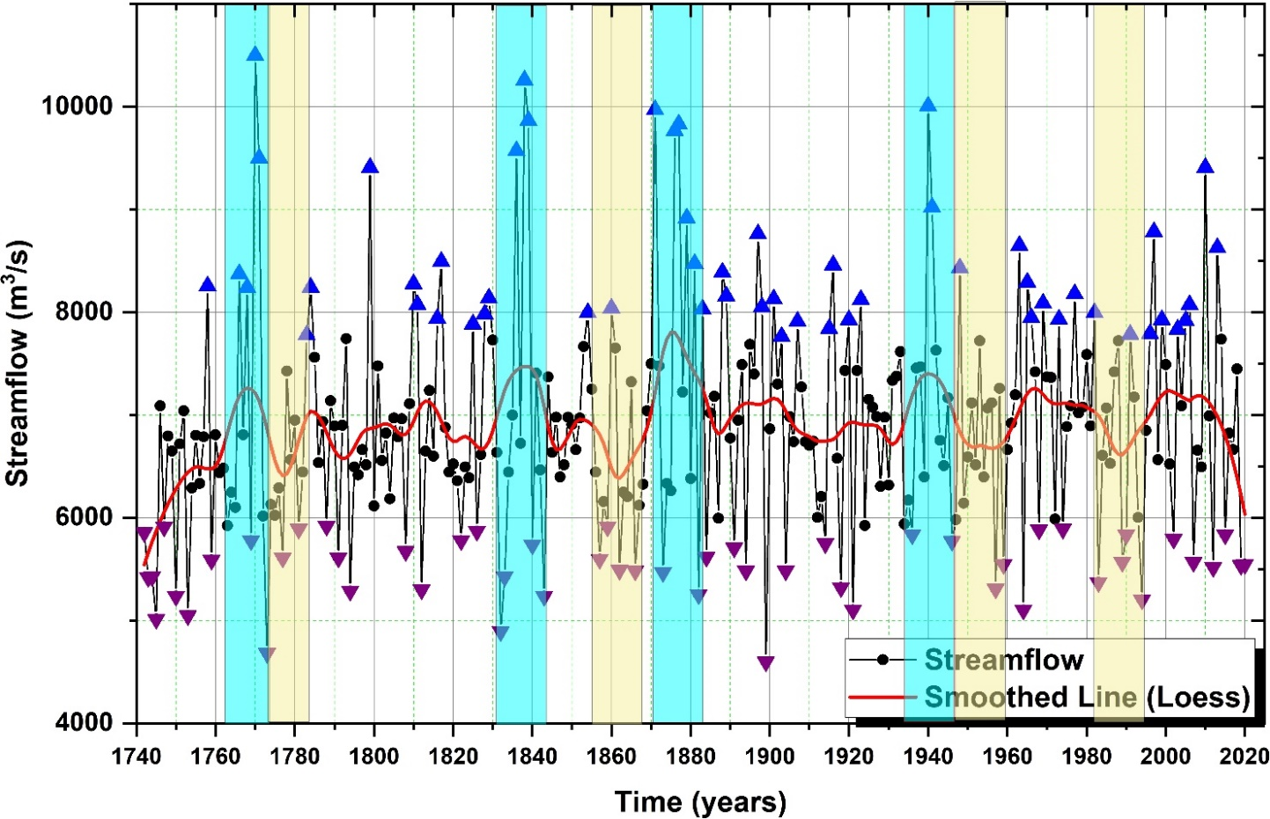

Slide 10
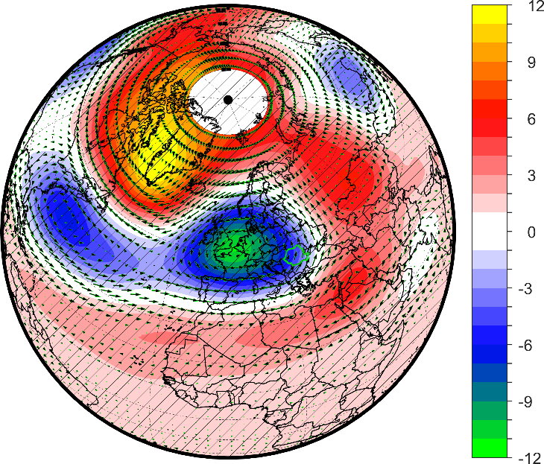
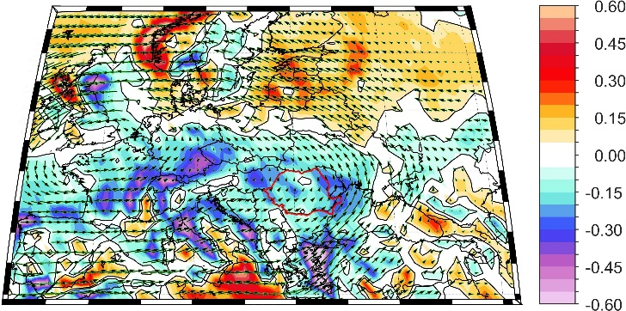
High TRW index

Slide 11
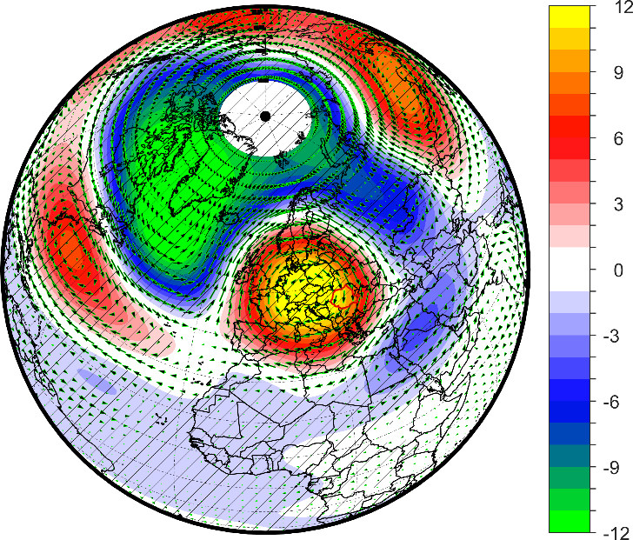
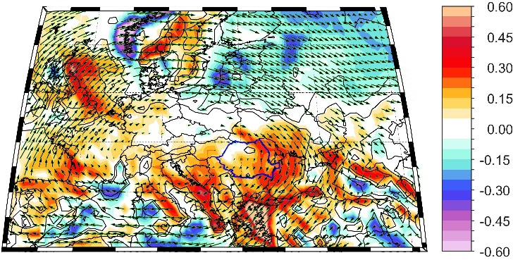
Low TRW index

Slide 12
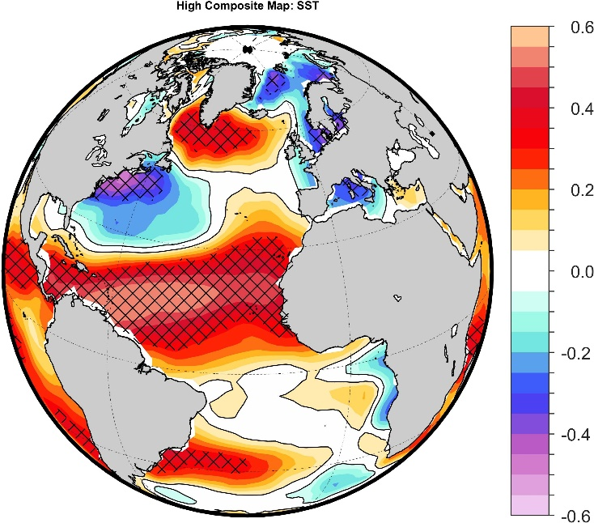
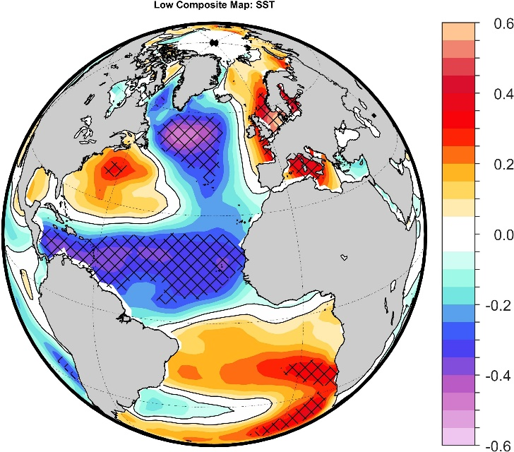
High TRW index
Low TRW index

Slide 13
Instead of conclusions
Why is this important?
The presented here streamflow reconstruction based on the tree-ring width is important not only for dendrohydrological studies but also for long-timescale analyses and evaluation of the Danube water availability at multi-centennial scales, especially due to the fact that observation data are rather short (<100 years) and insufficient to capture long-scale streamflow variations, necessary for developing the hydrological models and resource water planning.

Slide 14
Thank you for your attention!
This paper has been financially supported by a grant of the Ministry of Research, Innovation, and Digitization, CNCS/ CCCDI—UEFISCDI, project number PN-III-P1-1.1-PD-2019-0469, within PNCDI III, nr PD63/2020, Looking into the past to anticipate the future: Extreme climate variability in Dobrogea Region from a paleo perspective based on stable oxygen isotope in tree rings (DobrEx).
This paper has been financially supported within the project entitled "DECIDE-Development through entrepreneurial education and innovative doctoral and postdoctoral research", project code POCU/380/6/13/125031, project co-financed from the European Social Fund through the 2014–2020 Operational Program Human Capital.

