Slide 1







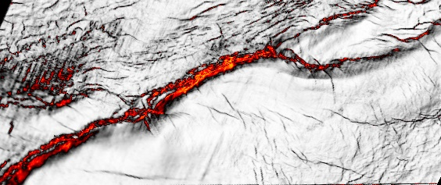
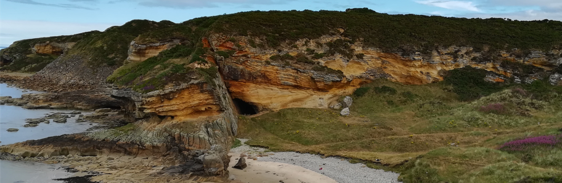

Correlating deformation events onshore and offshore in superimposed rift basins: the Lossiemouth Fault Zone,
Inner Moray Firth Basin, Scotland
Alexandra Tamas, Robert E. Holdsworth, John R. Underhill, Dan M. Tamas, Edward D. Dempsey, Dave McCarthy, Ken J.W. McCaffrey, and David Selby

Slide 2
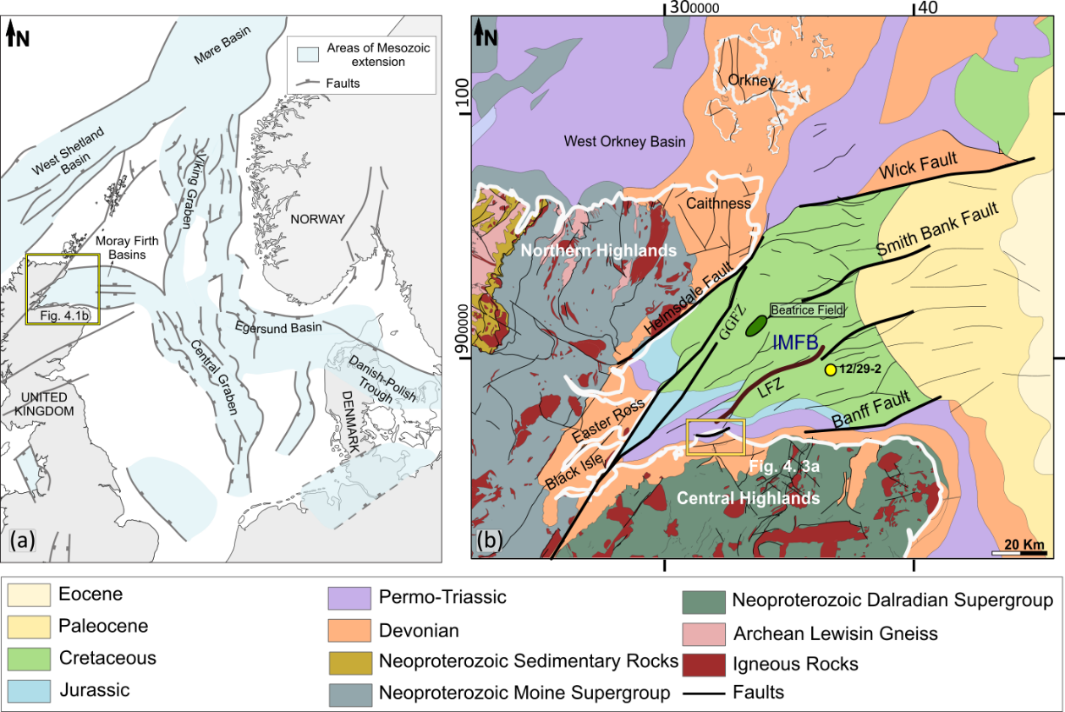
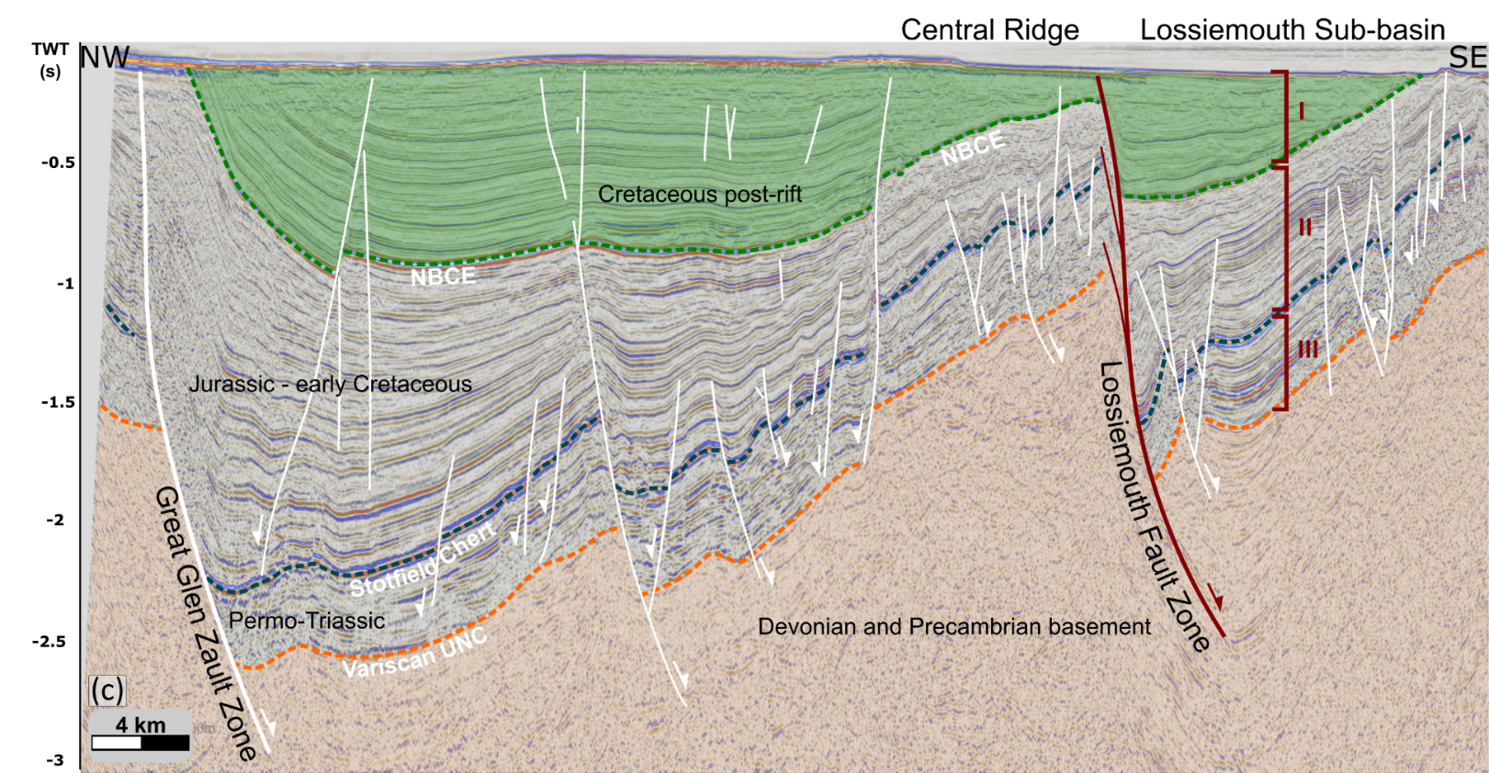
Inner Moray Firth Basin & the Lossimouth Fault Zone
Tamas et al. 2022
Western part of the North Sea trilete rift system, formed mainly in the Late Jurassic.
E–W faults observed in the Permo-Triassic rocks onshore are thought to represent subsidiary strands of the main offshore trace of the LFZ

Slide 3
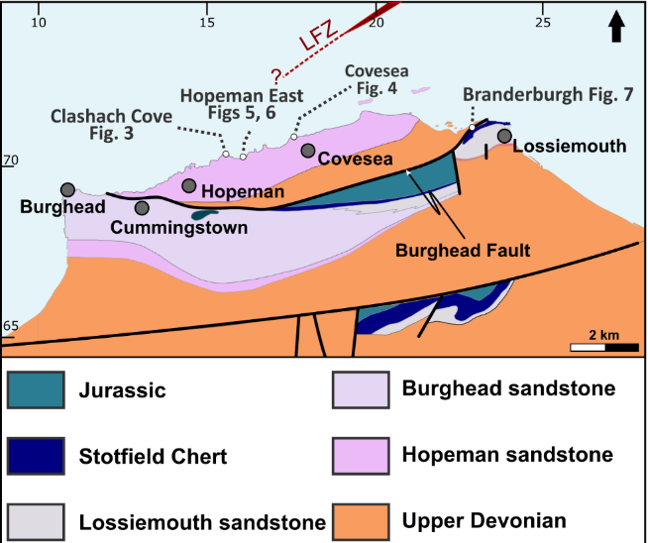
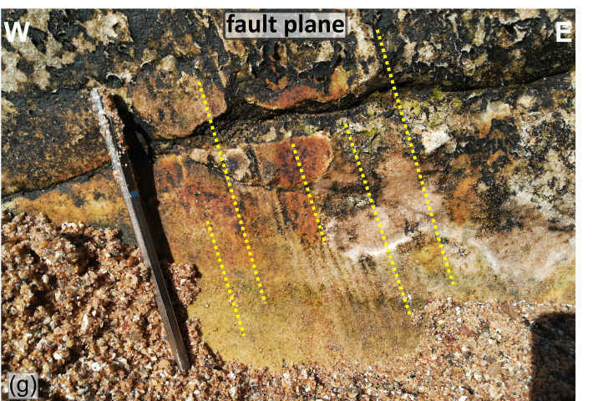
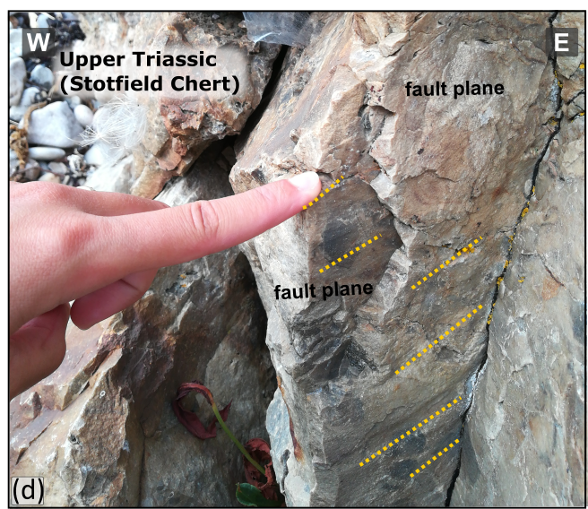
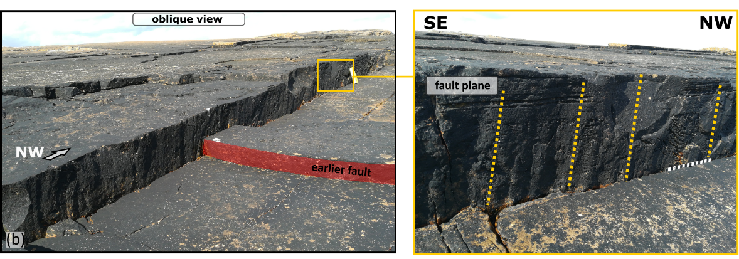
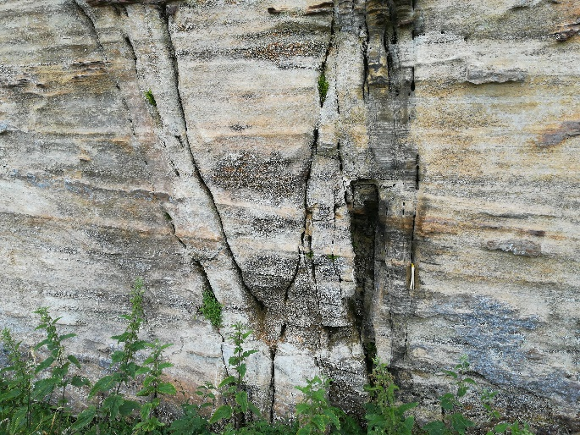
Onshore Deformation Patterns (Permo-Triassic Rocks)
The E-W- to NE-SW-trending faults
normal-sinistral oblique kinematics
normal-dextral oblique kinematics
NW-SE trending fractures and faults - dip-slip normal kinematics
NNE-SSW fractures and fracture corridors
ESE
WNW
Tamas et al. 2022

Slide 4
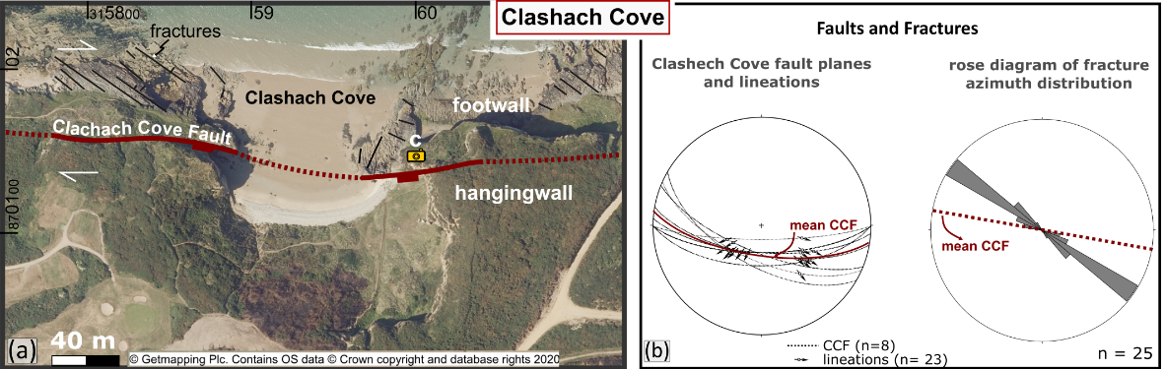
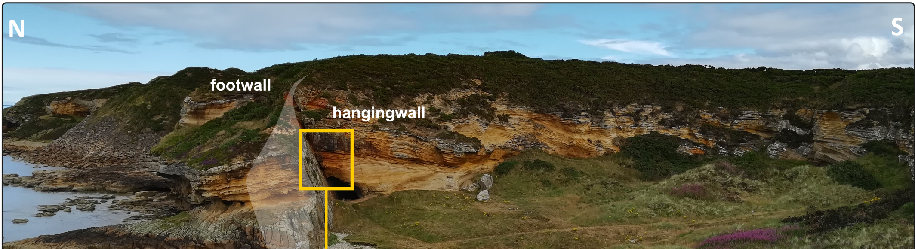
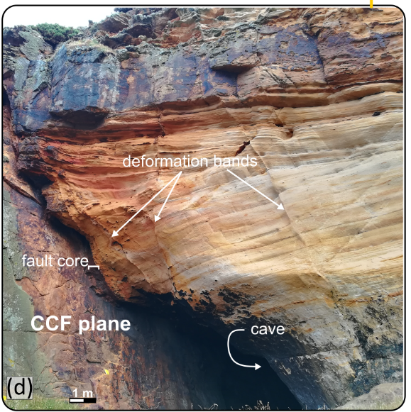
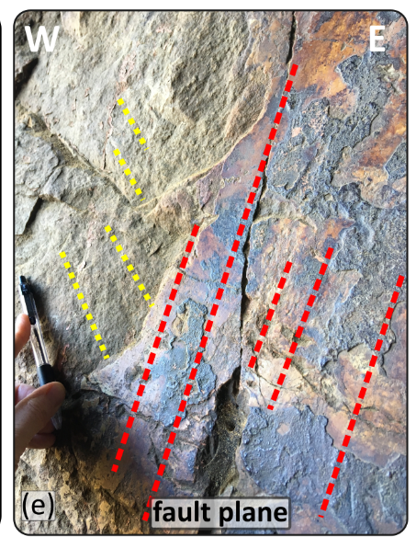
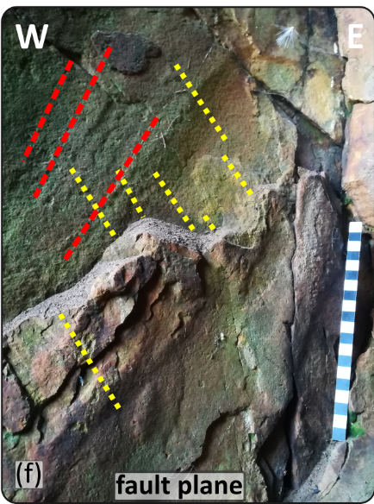
Evidence of fault reactivation!
Tamas et al. 2022
normal-dextral oblique kinematics
&
earlier normal-sinistral oblique slip

Slide 5
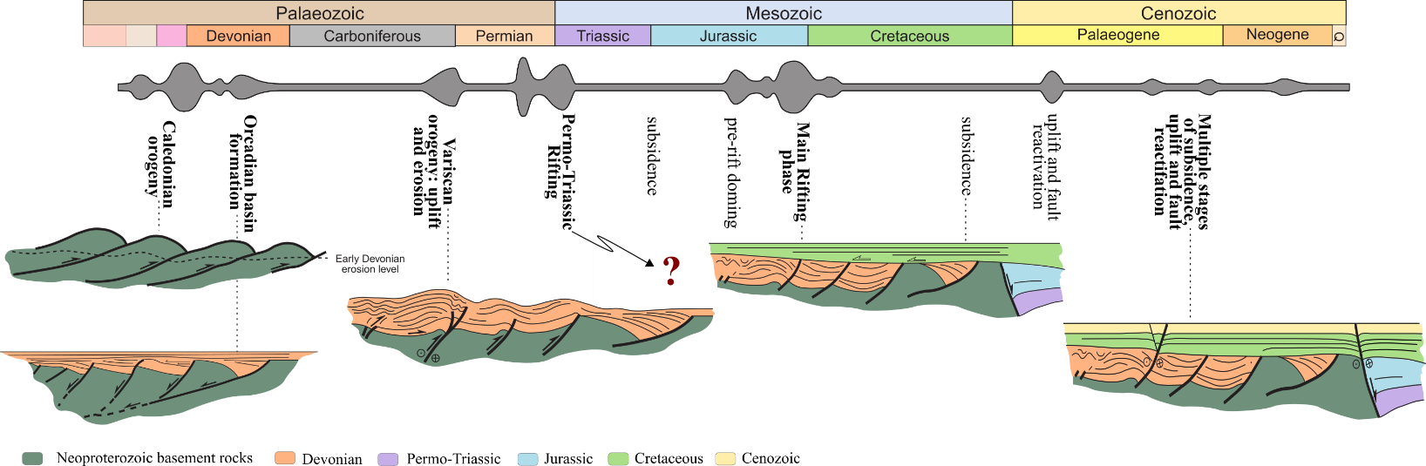
North Sea Development
Modified after Evans, D., Graham, C., Armour, A. & Bathurst, P. (editors and compilers) 2003. The Millennium Atlas: Petroleum Geology of the Central and Northern North Sea

Slide 6
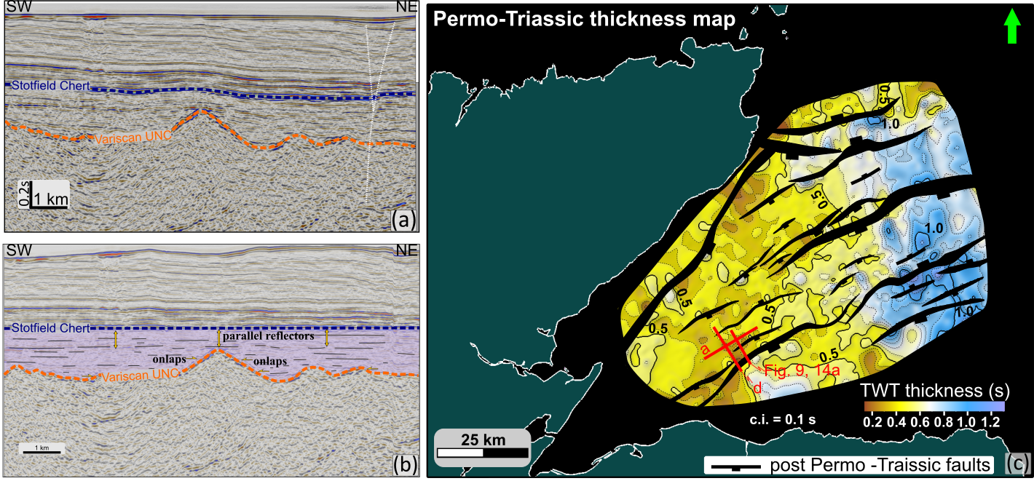
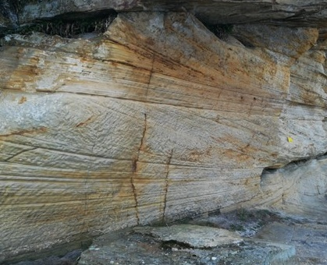
...is there Permo-Triassic rifting in the IMFB?
no evidence of growth strata onshore/offshore
Tamas et al. 2022
Subsidence and passive infill of the post-Variscan topography

Slide 7
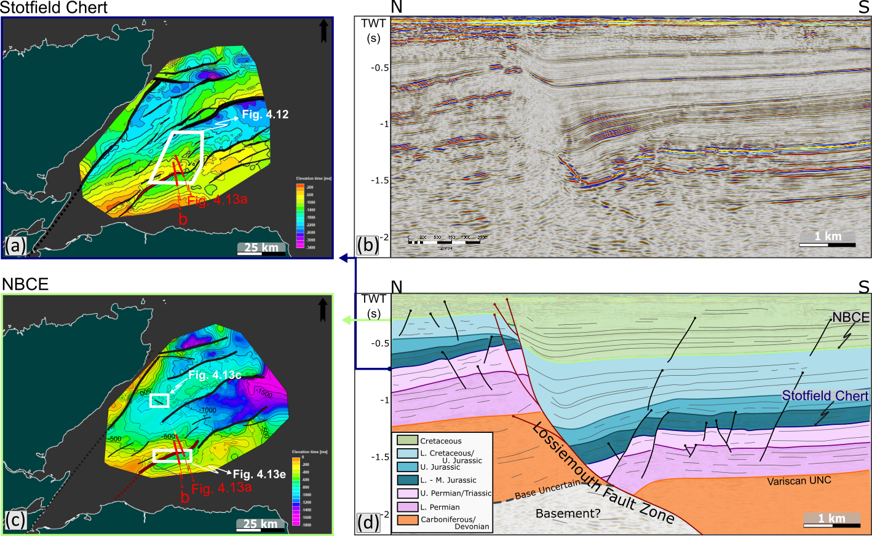
Syn- and Post-rift evolution
Top Triassic structural map
Tamas et al. 2022

Slide 8
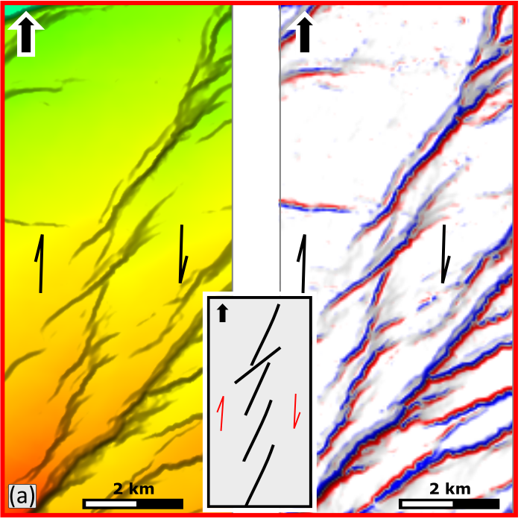
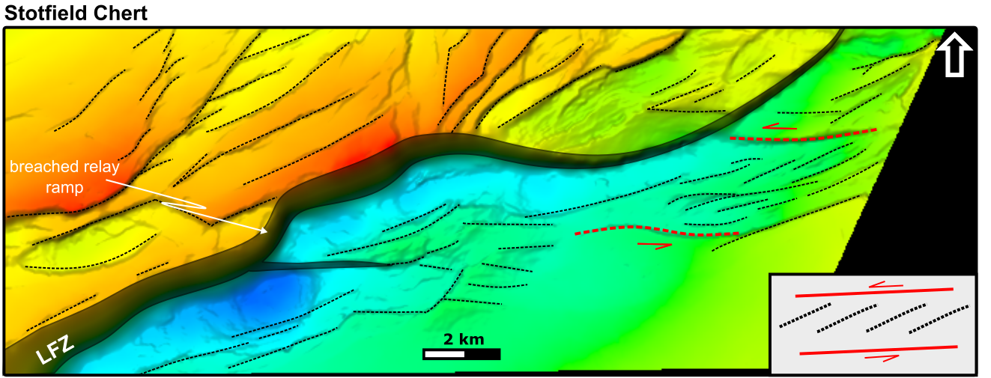

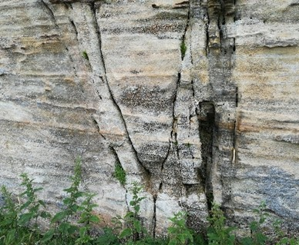
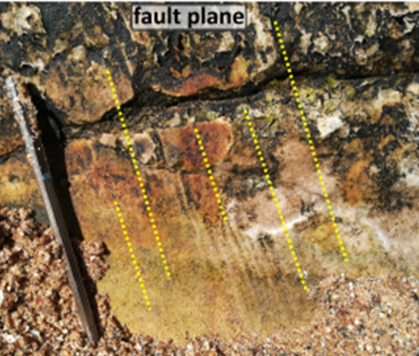
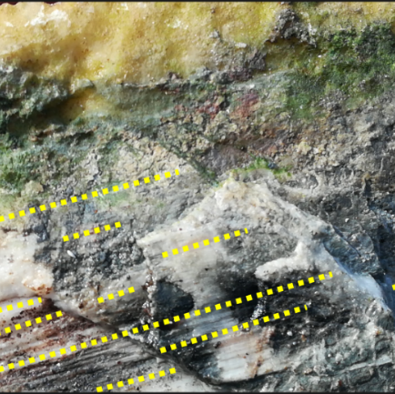
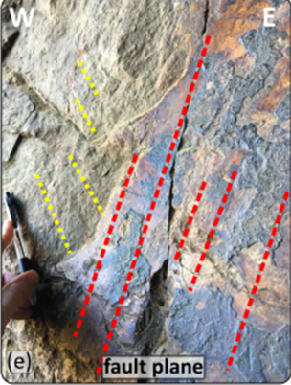
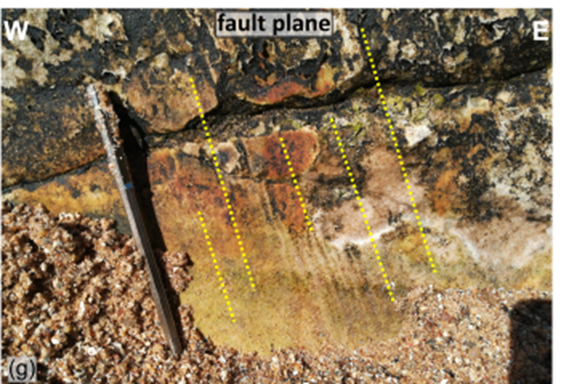
Syn-rift faulting (Late Jurassic –Early Cretaceous)
Top Triassic structural map
Tamas et al. 2022
The E-W- to NE-SW-trending faults - normal-sinistral oblique kinematics
NNE-SSW fractures and fracture corridors

Slide 9
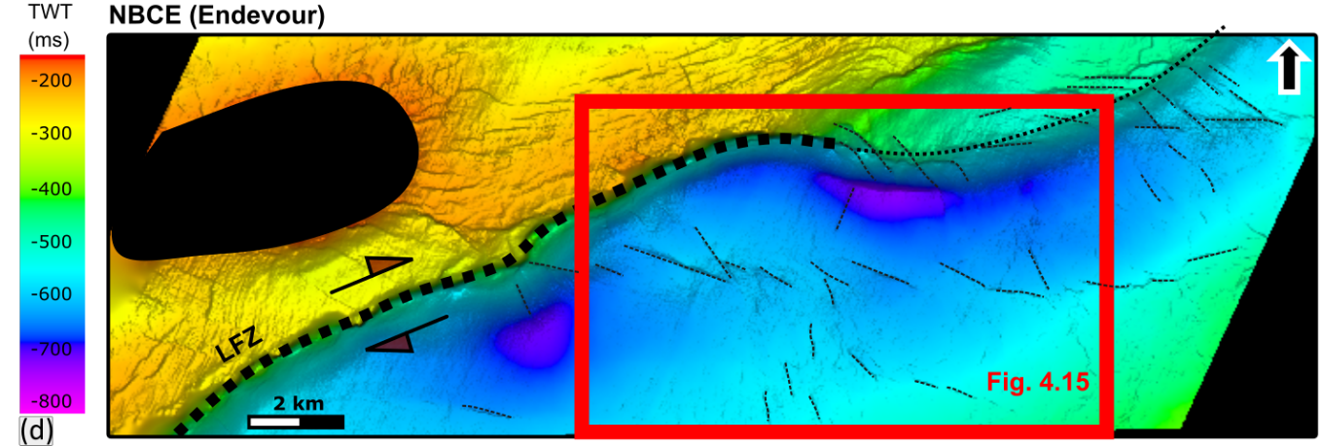
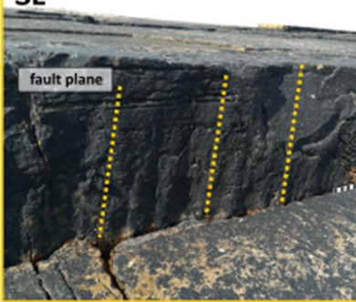
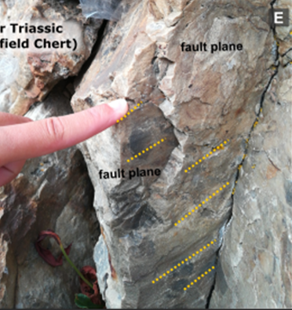
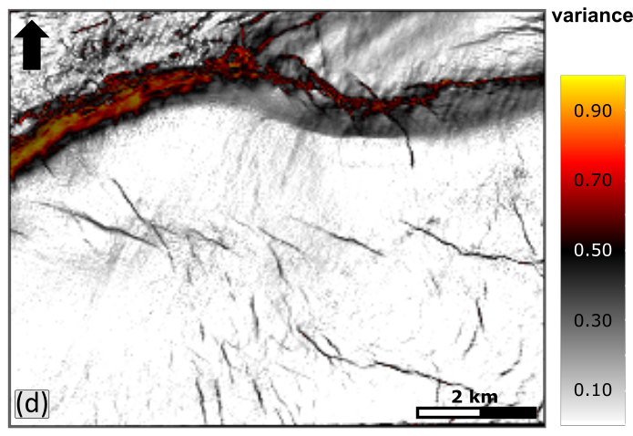
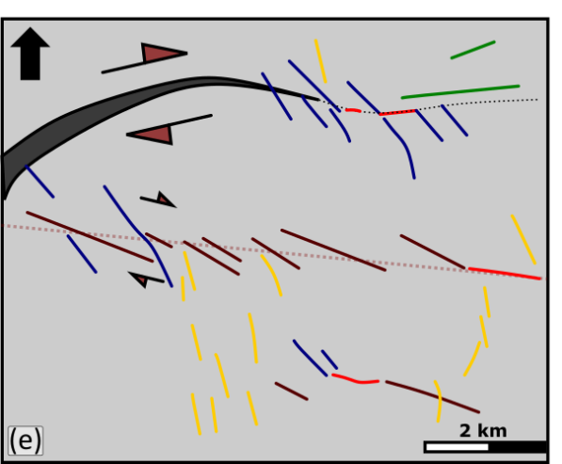
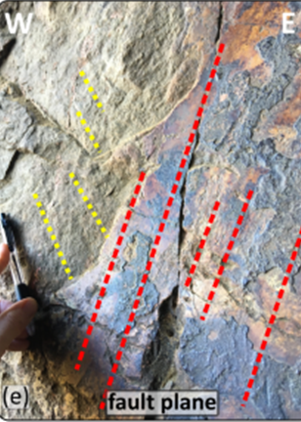
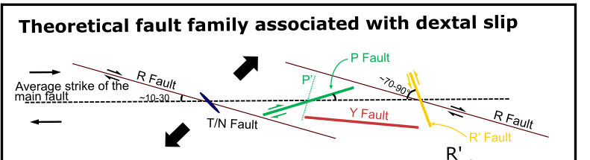
Post-rift dextral fault reactivation (Cenozoic)
NW-SE trending fractures and faults -> dip-slip normal kinematics
The E-W- to NE-SW-trending faults -> normal-dextral oblique kinematics
Tamas et al. 2022
Notes:
Likewise, if we look at post rift horizon we can observe a Riedel shear pattern suggesting dextral slip associated with the Lossiemouth fault reactivation which corelates with well with the onshore patterns.

Slide 10
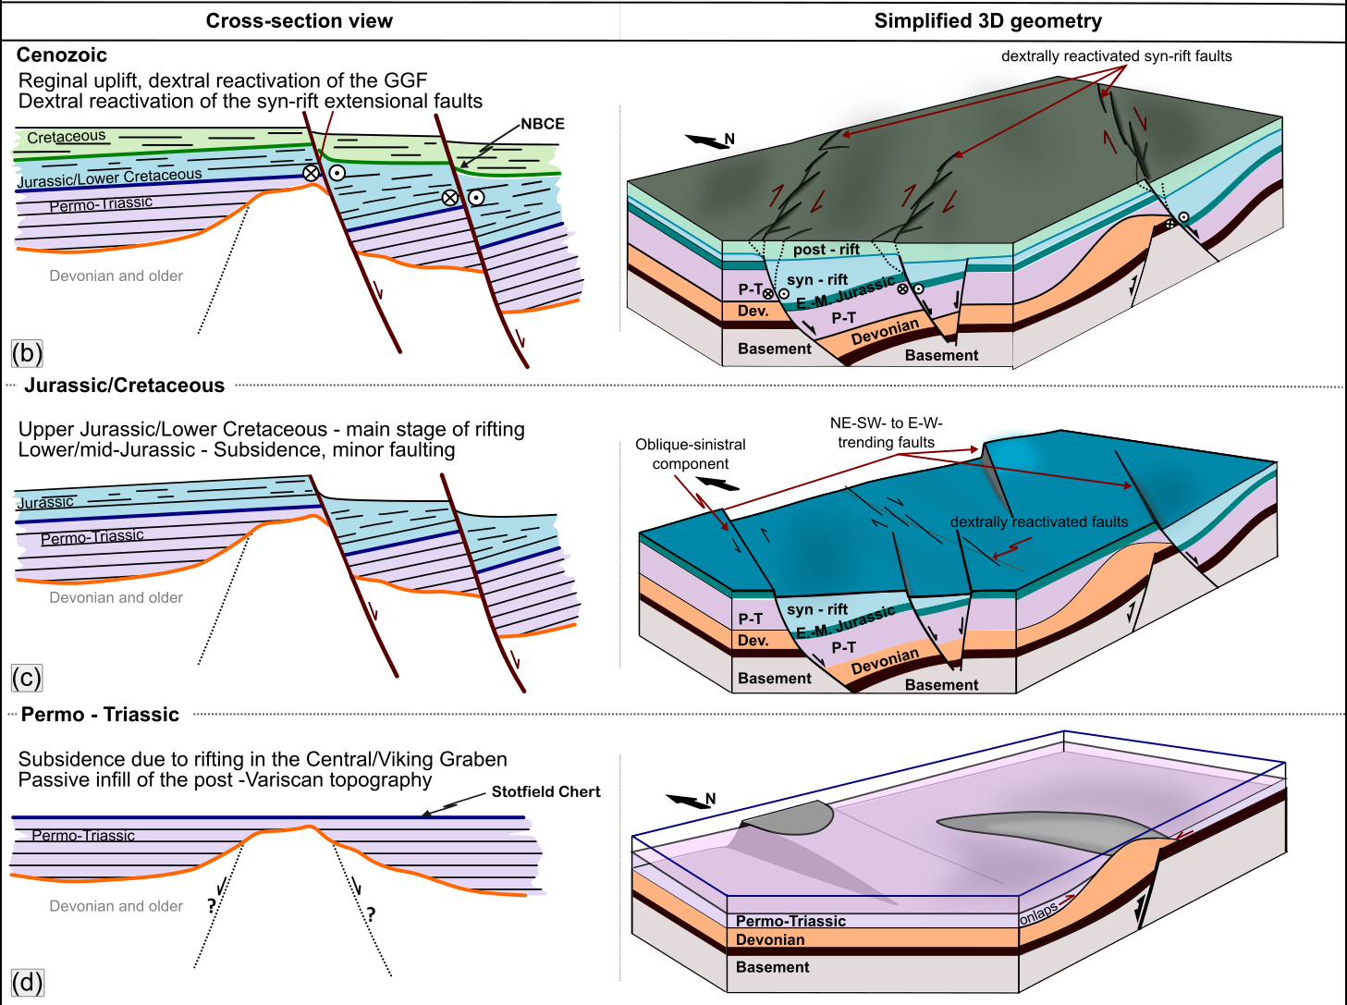
Onshore – Offshore Deformation History
Dextral reactivation of syn-rift faults associated with Riedel shear structures.
Oblique-sinistral component of the syn-rift faults and dextral reactivation of inherited (Devonian) structures.
Subsidence
Tamas et al. 2022

Slide 11
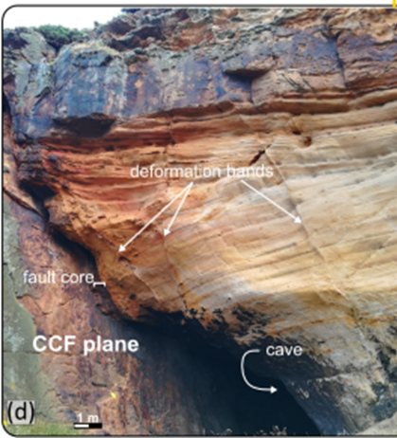
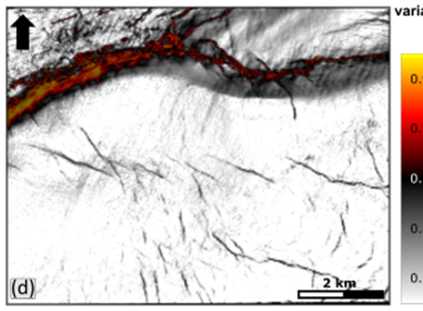
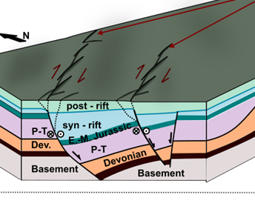
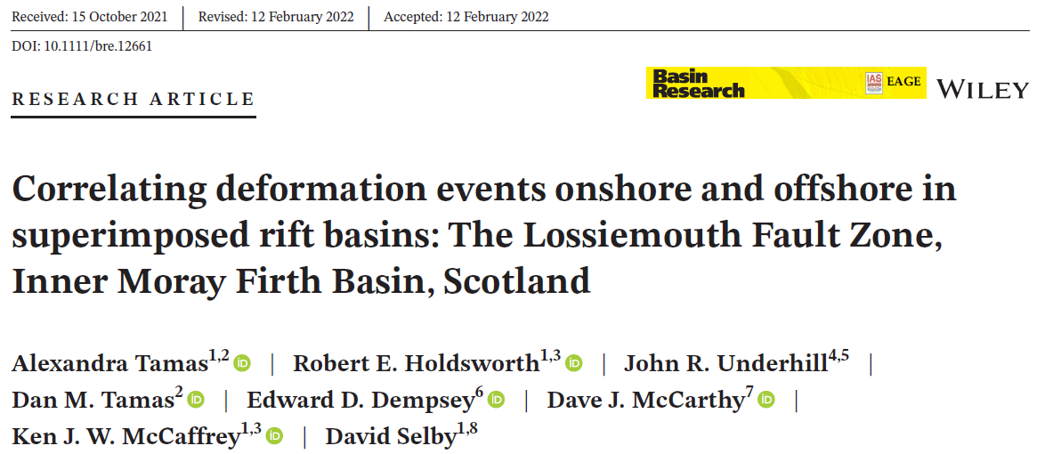

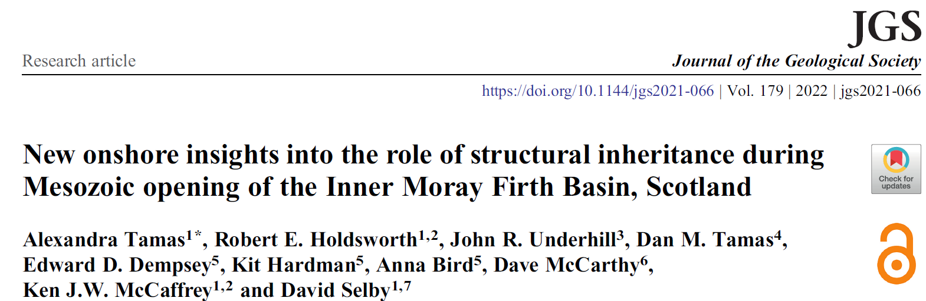

Conclusions and Implications
‘New information adds value, not from changing pre-drill risk, but from decisions made as a consequence.’
(Peel and Brooks, 2015)
Integration of fieldwork with subsurface interpretations has the ability to unlock the full potential of the area
IMFB is an active hydrocarbon exploration area
considered for CO2 storage & hosts the Acorn CO2 Storage Site
Thank you!

