Slide 1
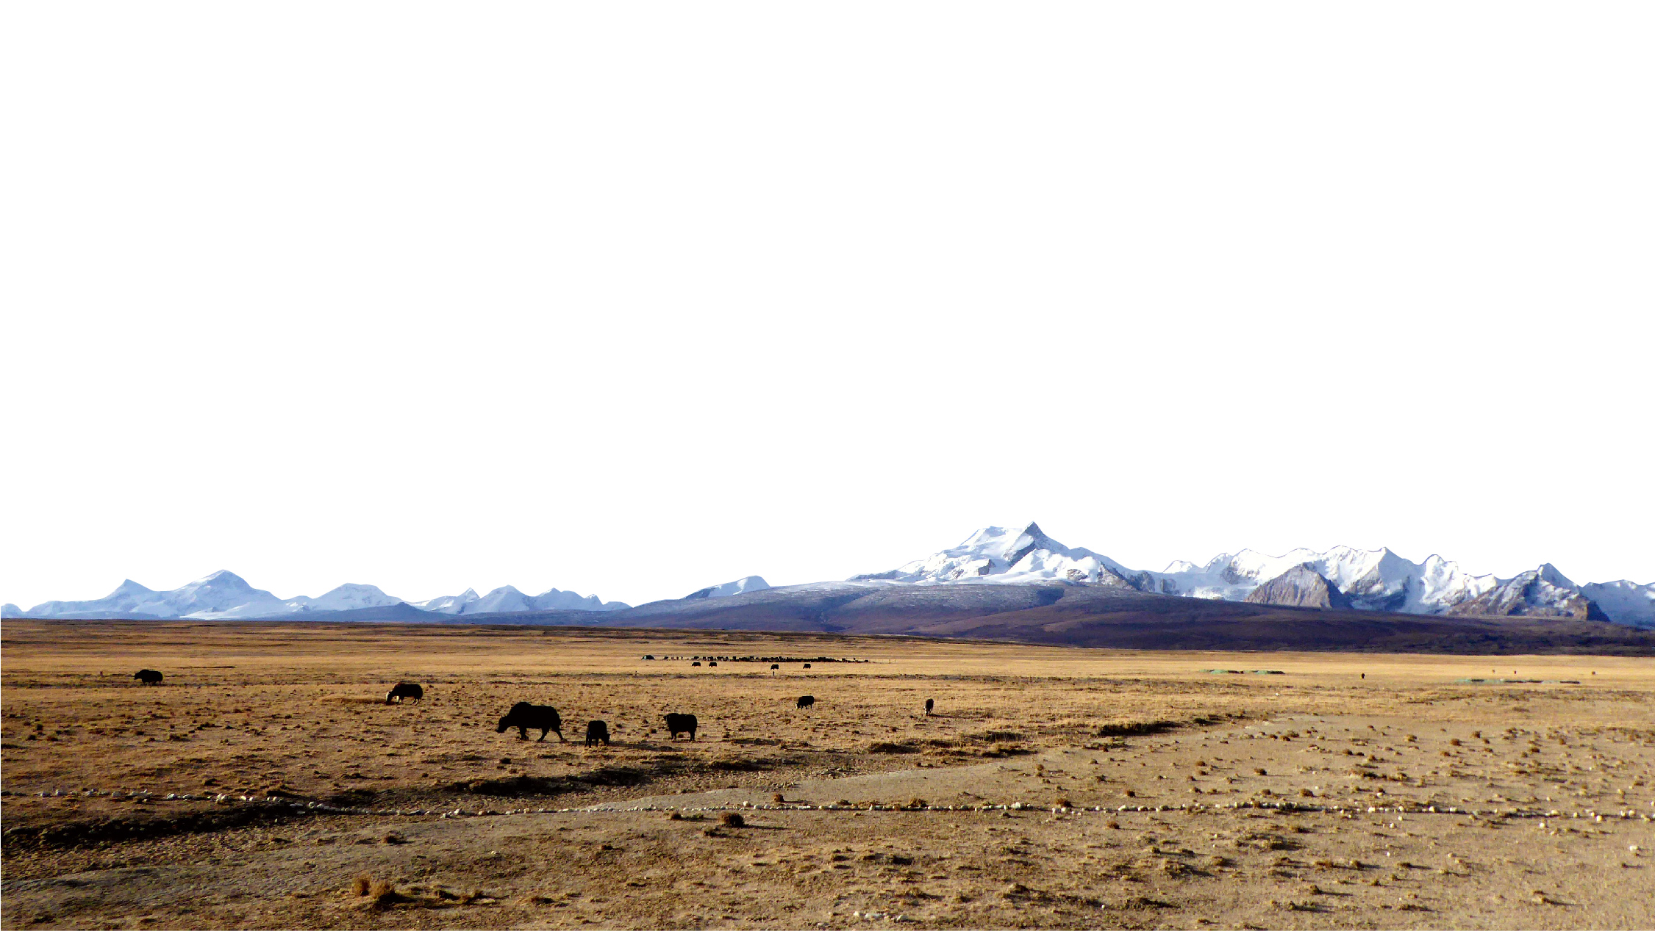





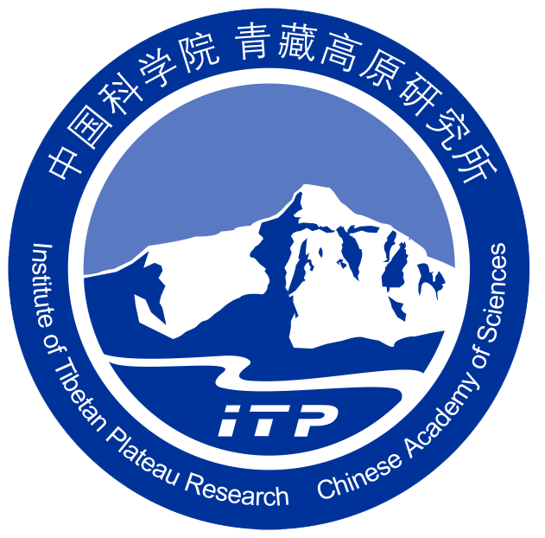

Impact of recent ground thermal changes on the hydrology of a Tibetan catchment and implications for lake level changes
Léo Martin, Sebastian Westermann, Michele Magni, Fanny Brun, Joel Fiddes, Yanbin Lei, Philip Kraaijenbrink, Tamara Mathys and Walter Immerzeel
Utrecht University
2022
Thursday, 26 May, HS2.1.4:
Mountain hydrology under global change: monitoring, modelling and adaptation
Credit: F. Brun

Slide 2
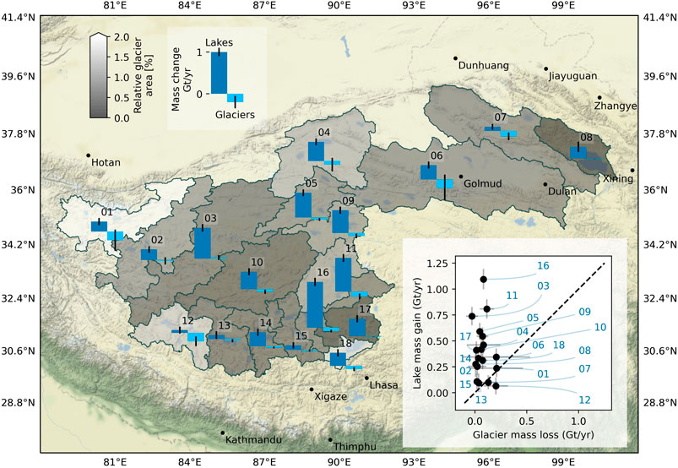

Impact of recent ground thermal changes on the hydrology of a Tibetan catchment and implications for lake level changes
Context
Hydrological changes in Tibetan endorheic catchments
Mechanisms at play in these changes ?
Role of the ground thermal regime and surface energy fluxes?
Brun et al. (2020)
For the 1994 – 2015 period
2
9

Slide 3
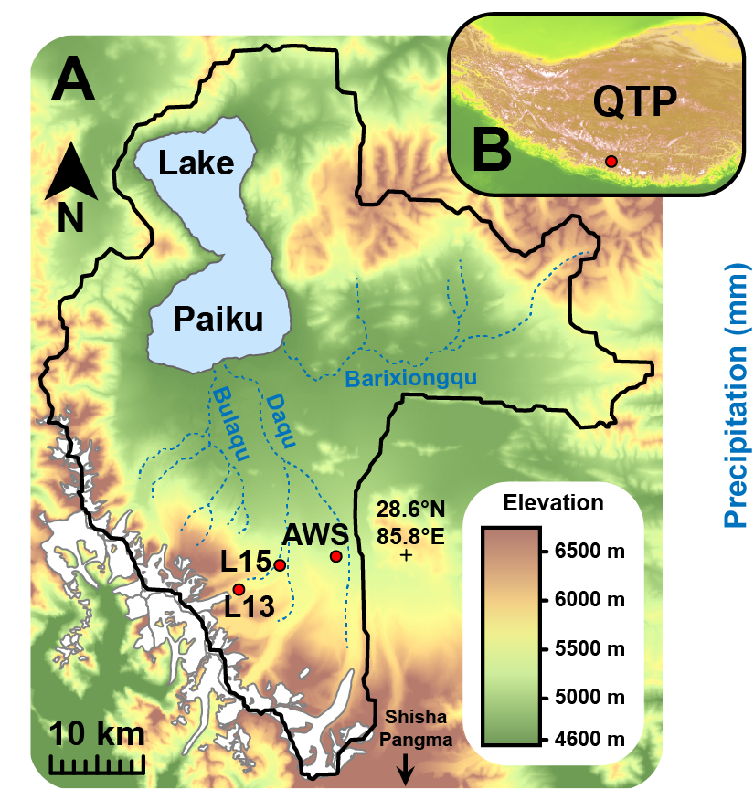
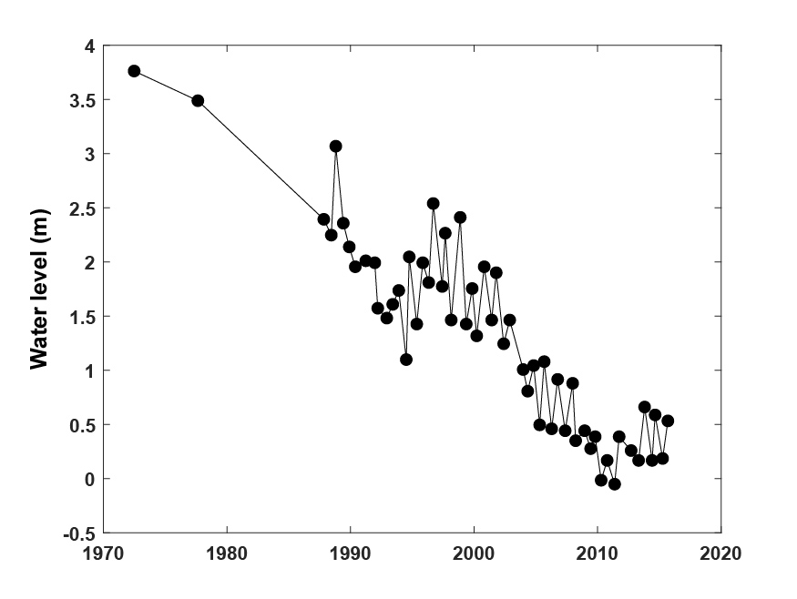
Impact of recent ground thermal changes on the hydrology of a Tibetan catchment and implications for lake level changes
The Paiku catchment
Lei et al. (2018)
Satellite altimetry
Lake level decrease
3
9

Slide 4
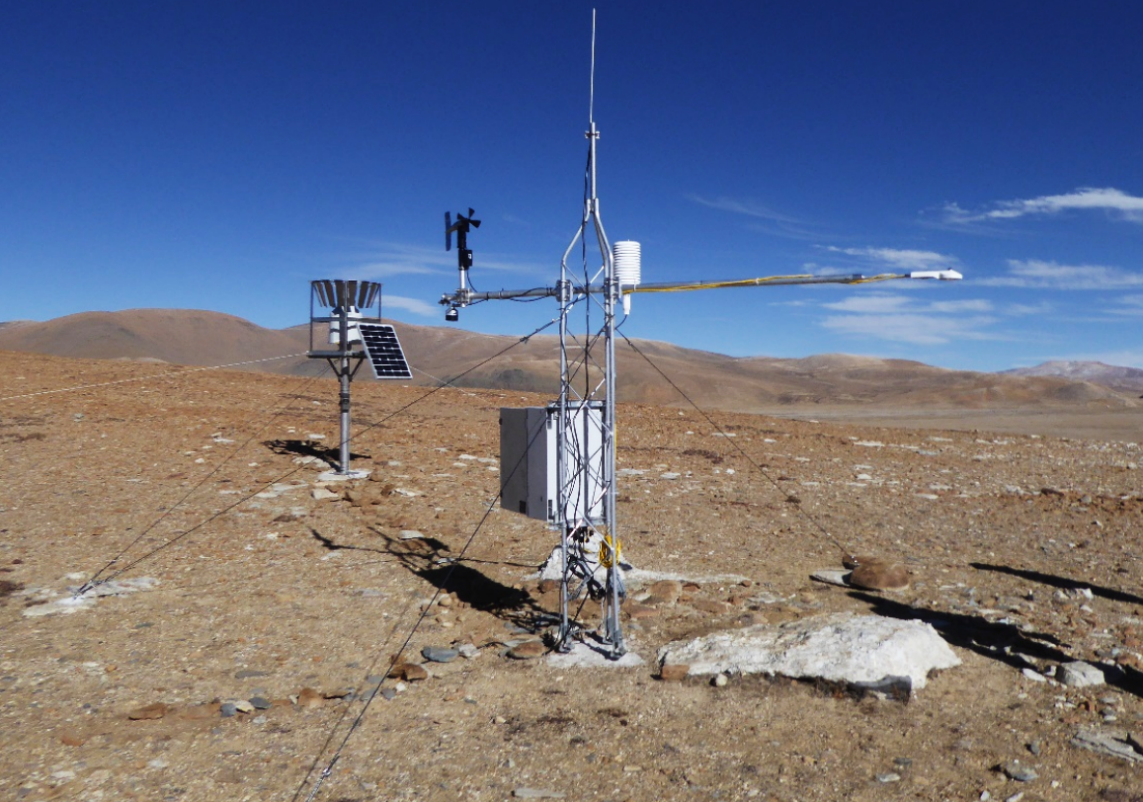

Impact of recent ground thermal changes on the hydrology of a Tibetan catchment and implications for lake level changes
Methodology
Weather station
Forcing data : TopoScale & ERA5
Subsampling based on physiography
Downscaling of ERA5 data
240 000 pixels → 400 simulations
(Fiddes et al., 2014)
Land Surface Model : CryoGrid
1D simulations covering the catchment
Freezing / Thawing in the ground
Surface : SEB, snowpack module
Infiltration (Richards eq.)
(Westermann et al., 2016)
Temperature
loggers
4
9
Notes:
Glacier metl

Slide 5
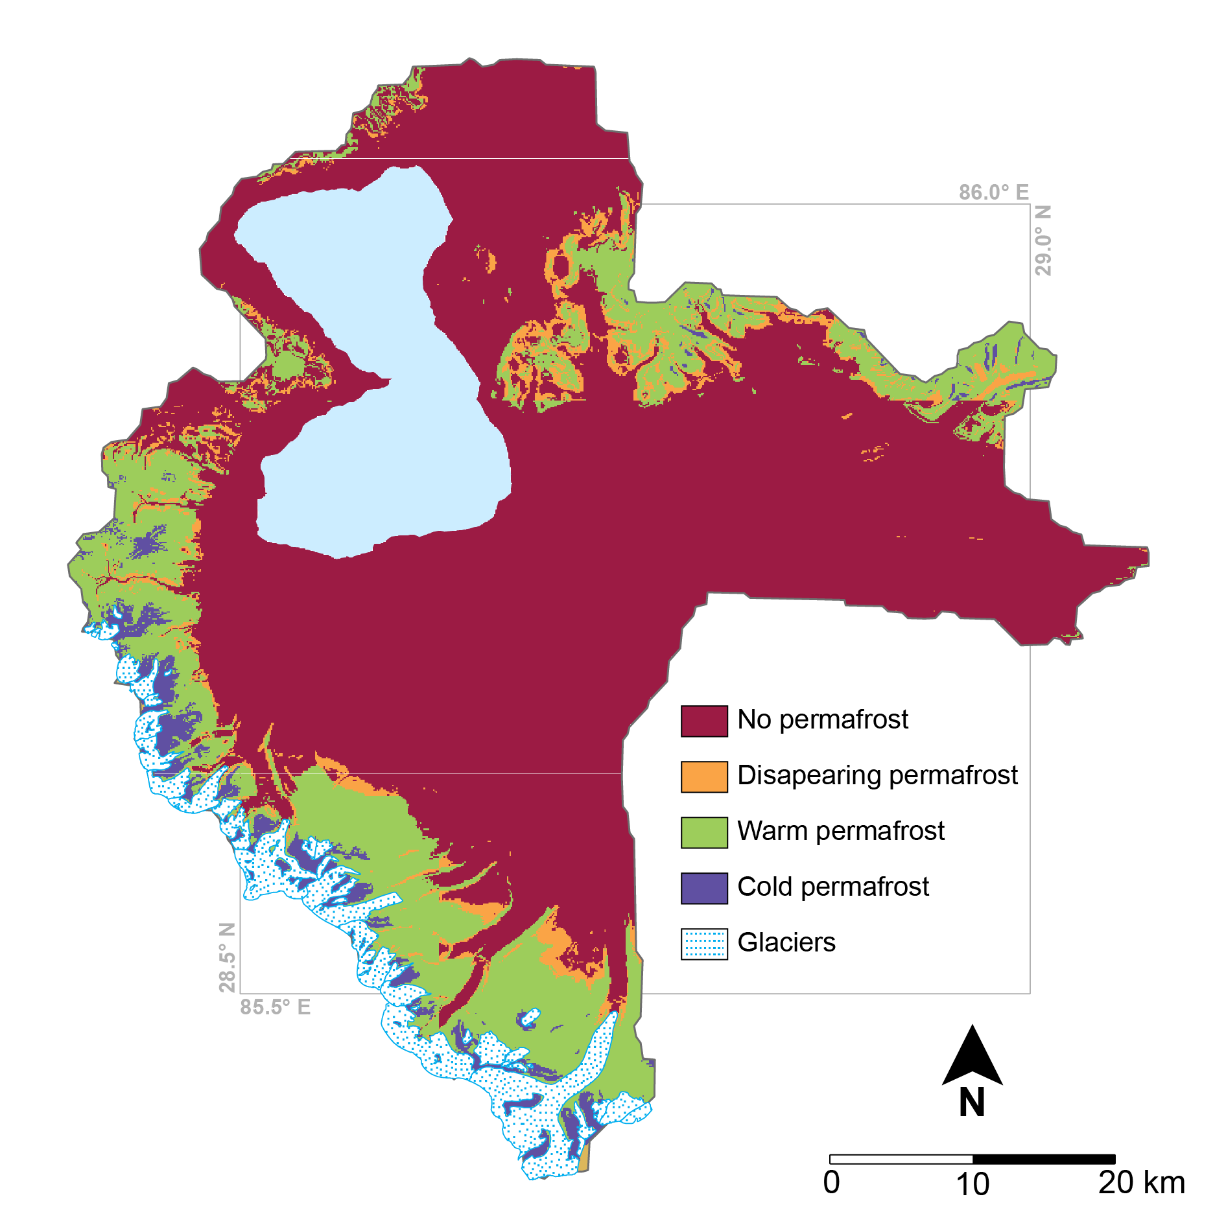
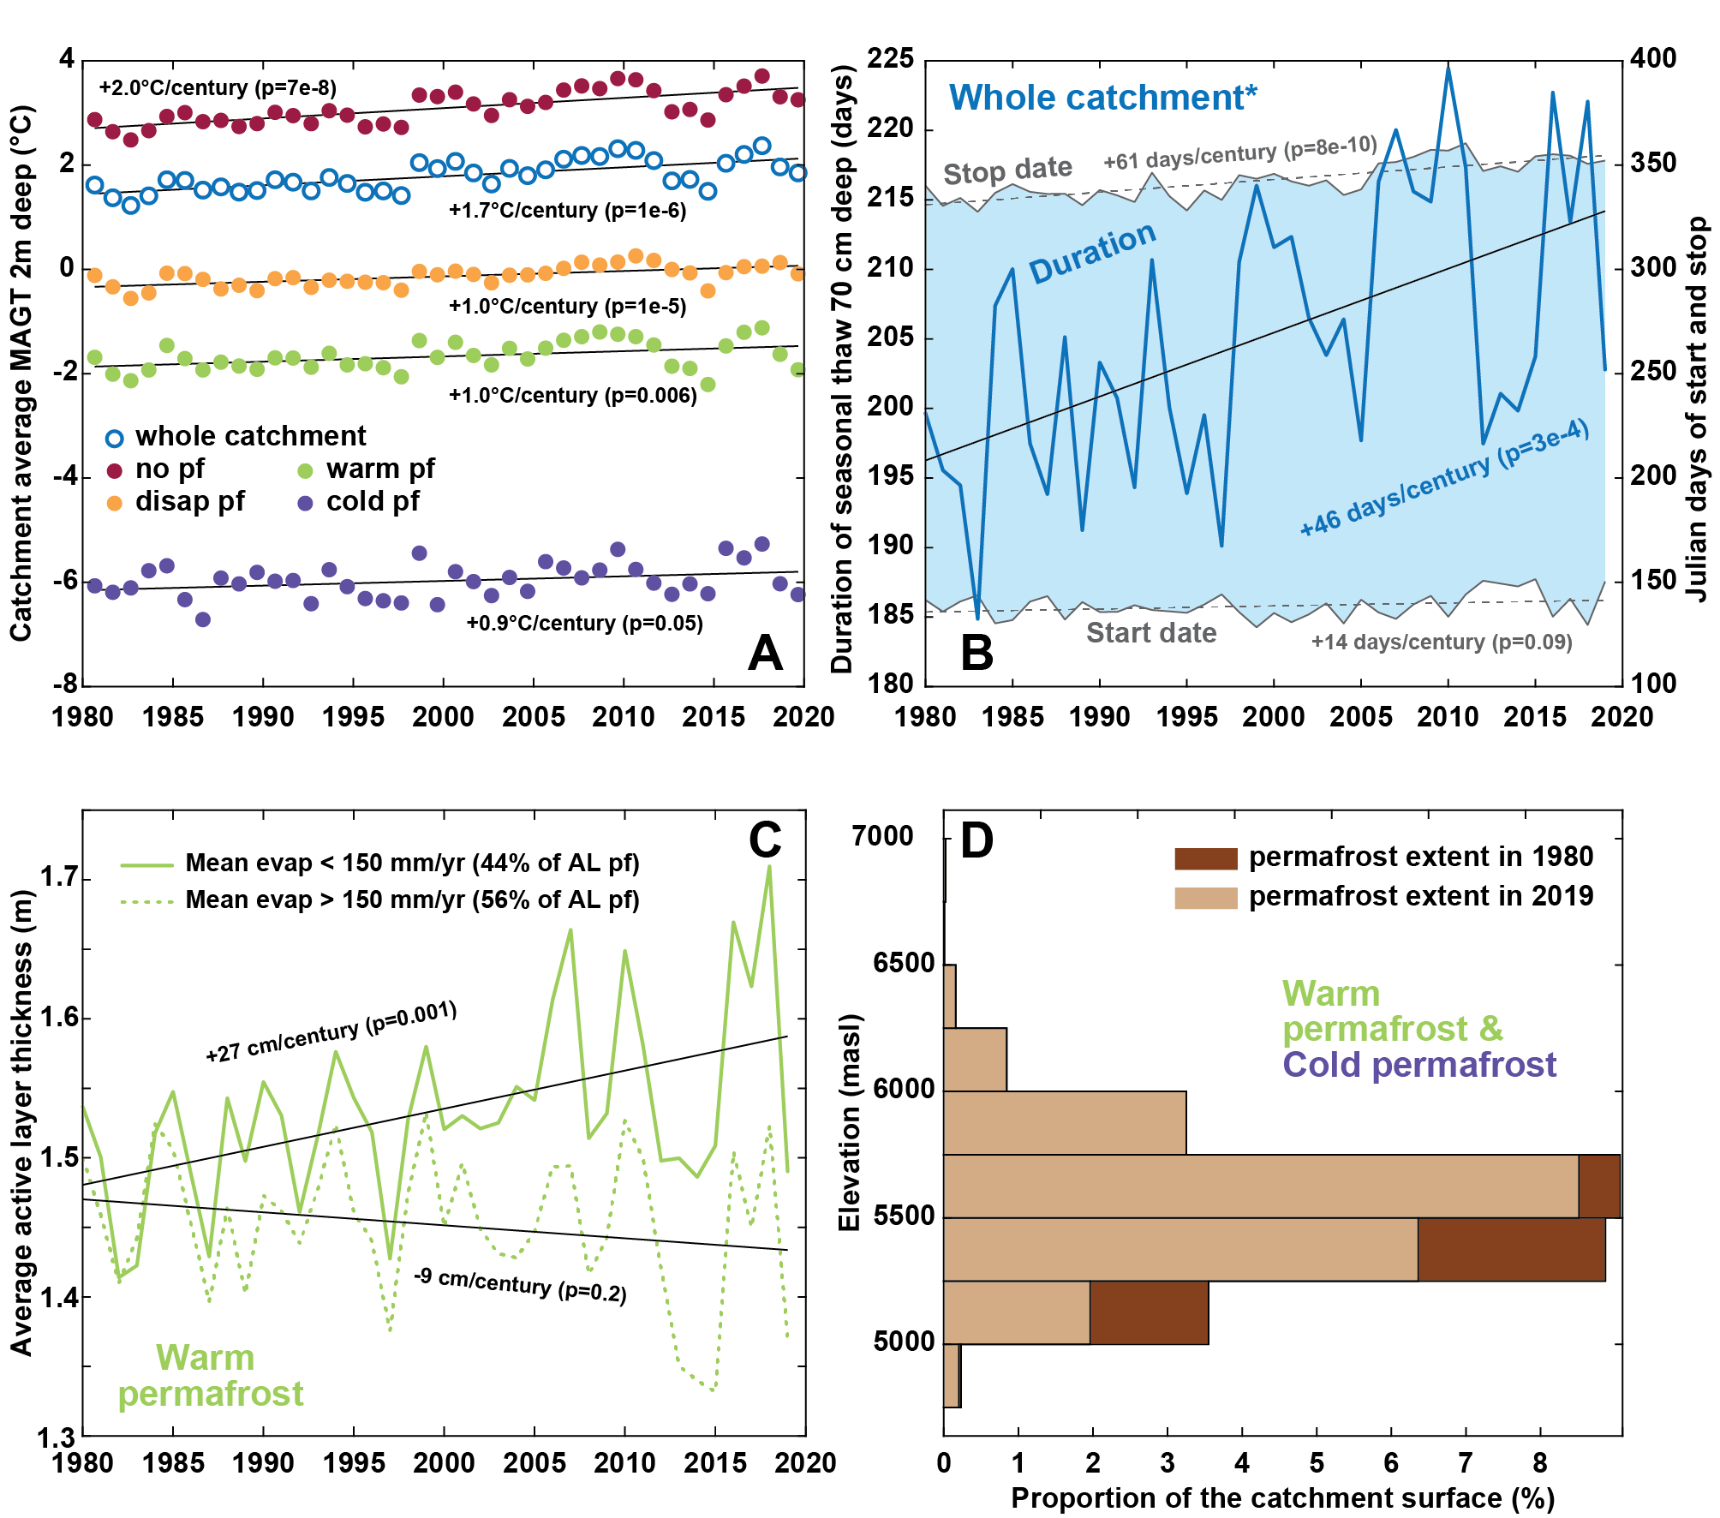
Impact of recent ground thermal changes on the hydrology of a Tibetan catchment and implications for lake level changes
Results
Martin et al. (In Prep)
5
9

Slide 6
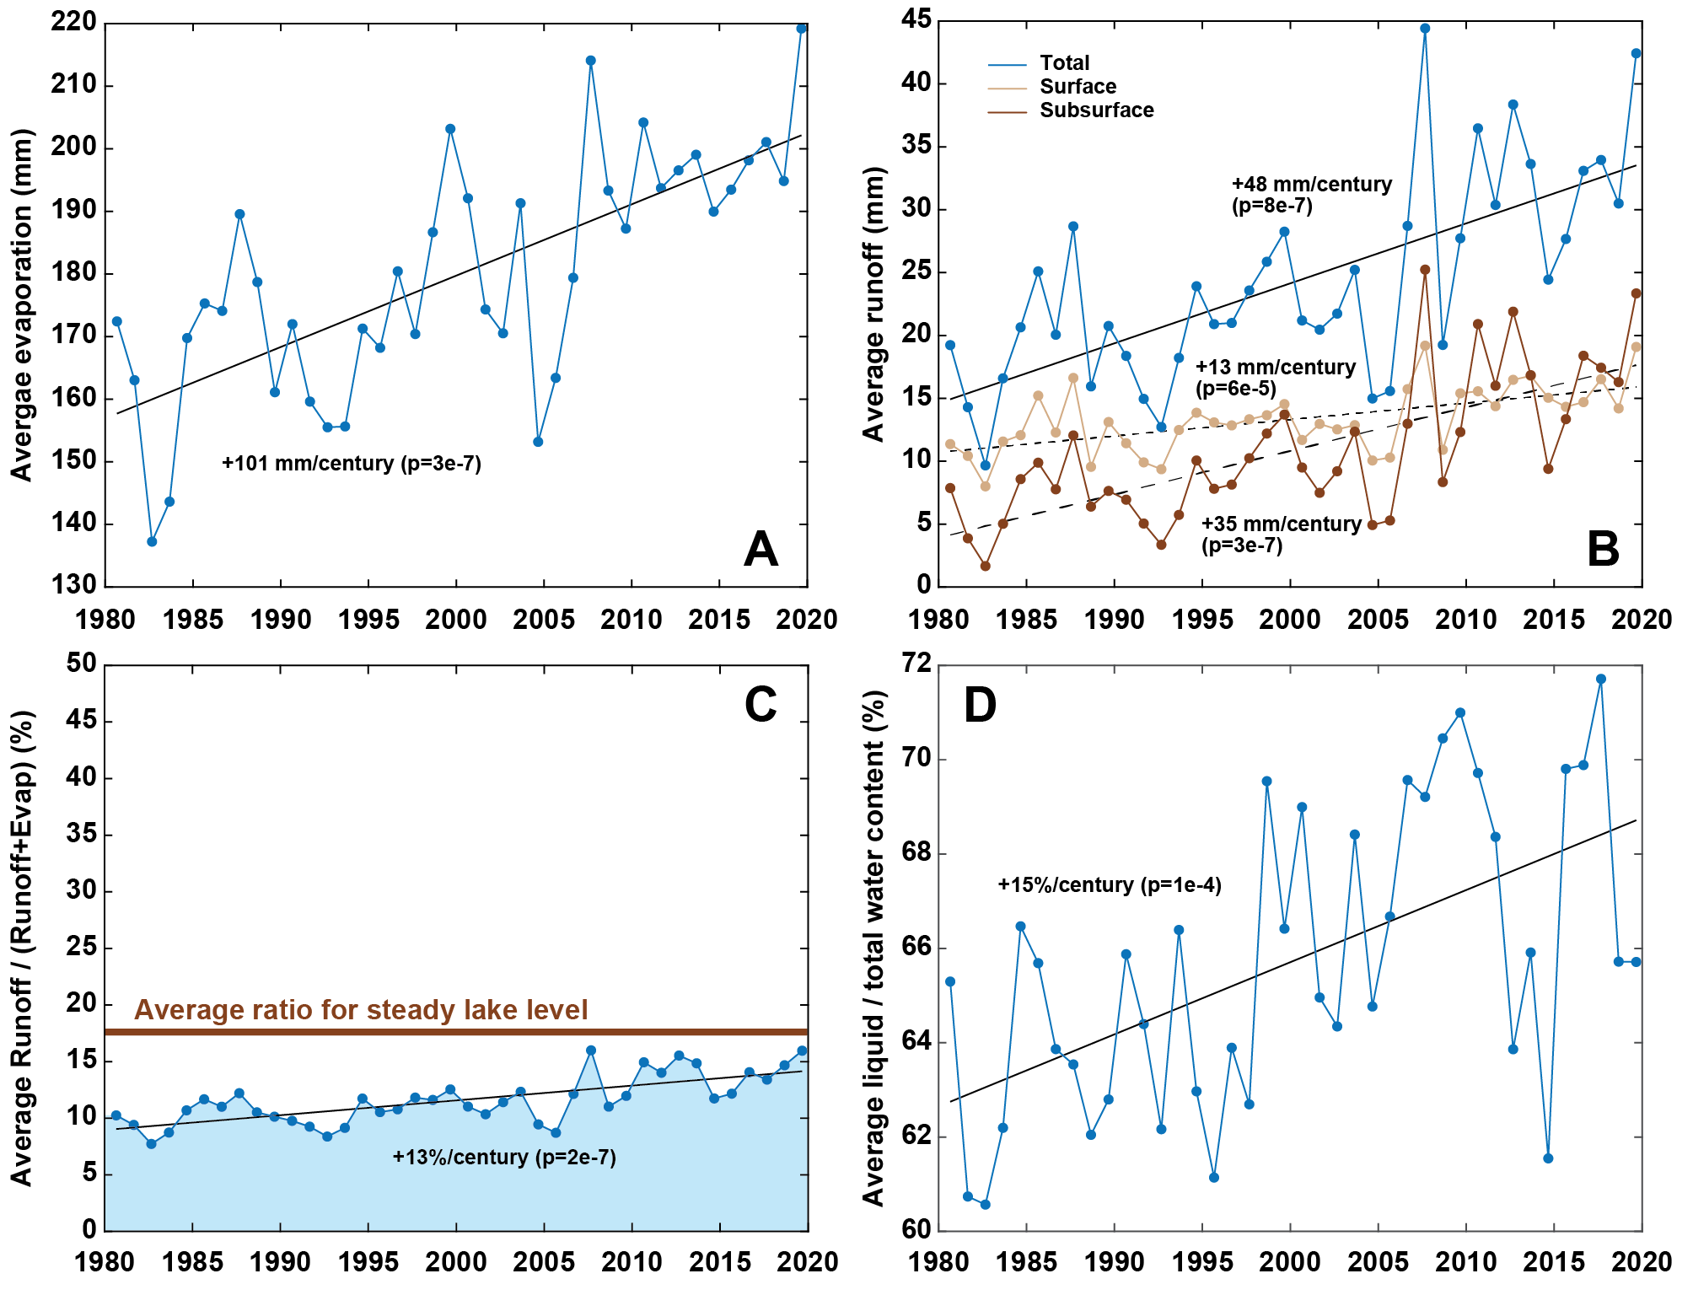
Impact of recent ground thermal changes on the hydrology of a Tibetan catchment and implications for lake level changes
Results
Martin et al. (In Prep)
6
9

Slide 7
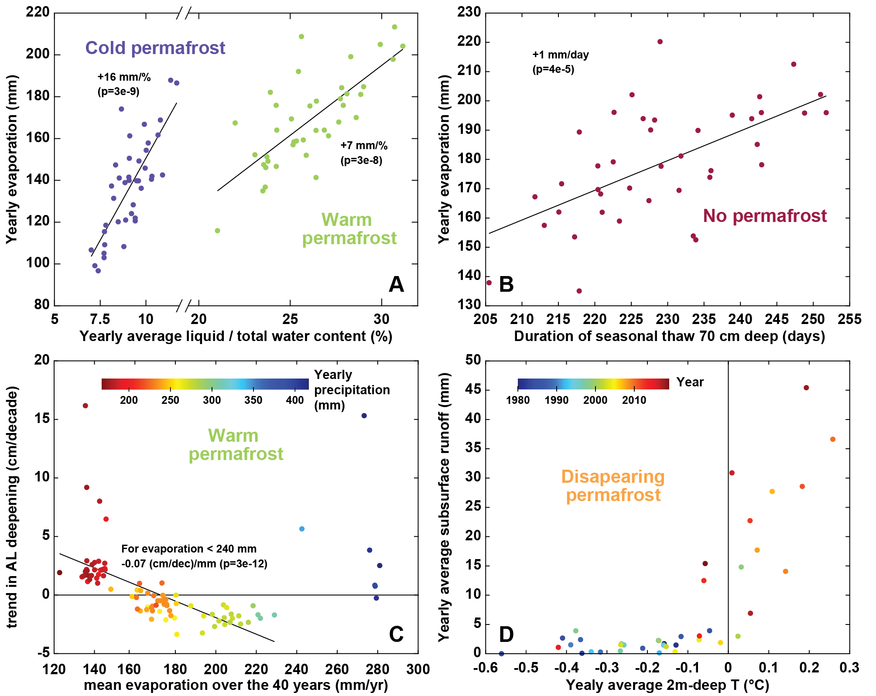
Impact of recent ground thermal changes on the hydrology of a Tibetan catchment and implications for lake level changes
Results
Martin et al. (In Prep)
7
9

Slide 8
Impact of recent ground thermal changes on the hydrology of a Tibetan catchment and implications for lake level changes
Results
Martin et al. (In Prep)
8
9

Slide 9
Impact of recent ground thermal changes on the hydrology of a Tibetan catchment and implications for lake level changes
Conclusion
Ground warming: +1.7°C per century (2 m deep)
  Increase liquid water availability
  Increase duration of seasonal thaw
  Both promote evaporation and runoff (supported by precipitation)
  But runoff increase more than evaporation because development of subsurface runoff, slowing down the lake level decrease
Cryo-hydrological approaches are key to understand climate driven hydrological changes in high mountain environments
9
9

