Slide 1


Emulating spatially resolved annual maximum temperatures of Earth system models using MESMER-X
Yann Quilcaille, Lukas Gudmundsson, Lea Beusch, Mathias Hauser, Sonia I. Seneviratne
EGU 2022
27.05.2022

Slide 2

Why emulating climate extremes?
Like other emulators: exploration of scenarios, test assumptions, evaluate uncertainties & variabilities
Impacts of climate change in scenarios:
  Climate change, and particularly climate extremes, will affect our entire social and economical system.
  These impacts are not accounted for in the development of transformation pathways
  These transformation pathways are the basis of climate scenarios
  Emulators retaining statistical, spatial and temporal structures would enable this coupling.
Weather-related disasters (2020 USD bn)
Weather, climate & catastrophe insight, 2020 Annual Report
(ERC Proof-of-Concept MESMER-X)
Notes:
Emulators are essential tools to accelerate the exploration of climate scenarios, to test assumptions and evaluate uncertainties.
Essentially, they are 2 families of emulators:
- simple climate models: MAGICC, FAIR, OSCAR, HECTOR, etc.
-

Slide 3
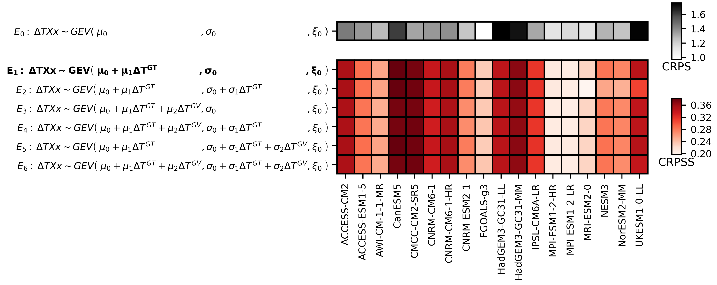
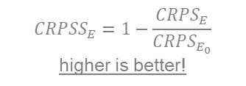
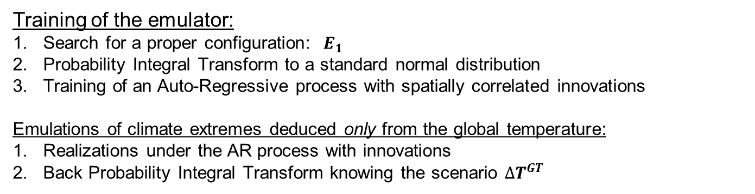
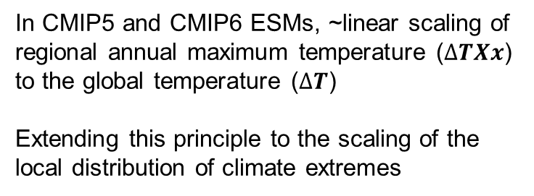
How? Illustration with annual maximum temperature (TXx)
Quadratic measure of the difference of the CDF of emulations and of the empirical CDF: lower is better!
In CMIP5 and CMIP6 ESMs, ~linear scaling of regional annual maximum temperature ($∆TXx$) to the global temperature ($∆T$)
Extending this principle to the scaling of the local distribution of climate extremes
Training of the emulator:
Search for a proper configuration: $E_{1}$
Probability Integral Transform to a standard normal distribution
Training of an Auto-Regressive process with spatially correlated innovations
Emulations of climate extremes deduced only from the global temperature:
Realizations under the AR process with innovations
Back Probability Integral Transform knowing the scenario ${∆T}^{GT}$
$${CRPSS}_{E}=1−\frac{{CRPS}_{E}}{{CRPS}_{E_{0}}}$$
higher is better!
Notes:
Global downward heat flux into the oceans: for transient / equilibrium differences
Continuous Rank Probability Score
Best improvement (high CRPSS) where there is more to do (high CRPS)
Not much improvement: mostly on low warming scenarios, eg ssp126. and not all ESMs. Could be improved if took up to 2300
I am proving that they were right!

Slide 4
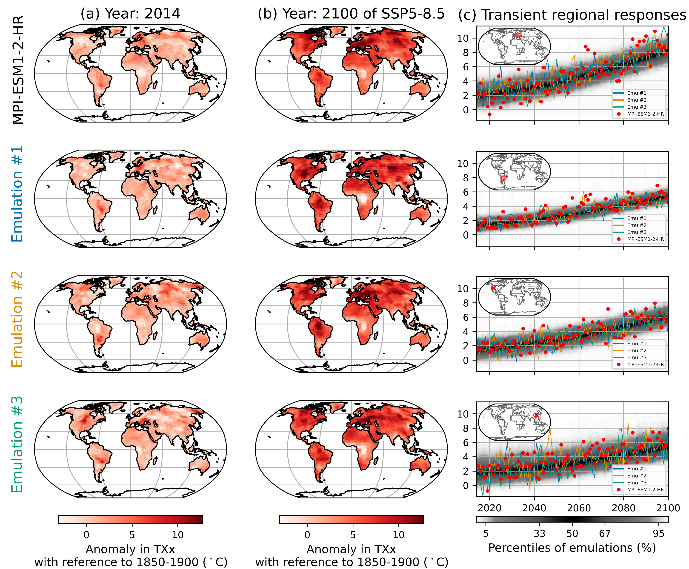
Emulations
Qualitatively:
Spatial patterns
Temporal evolutions

Slide 5
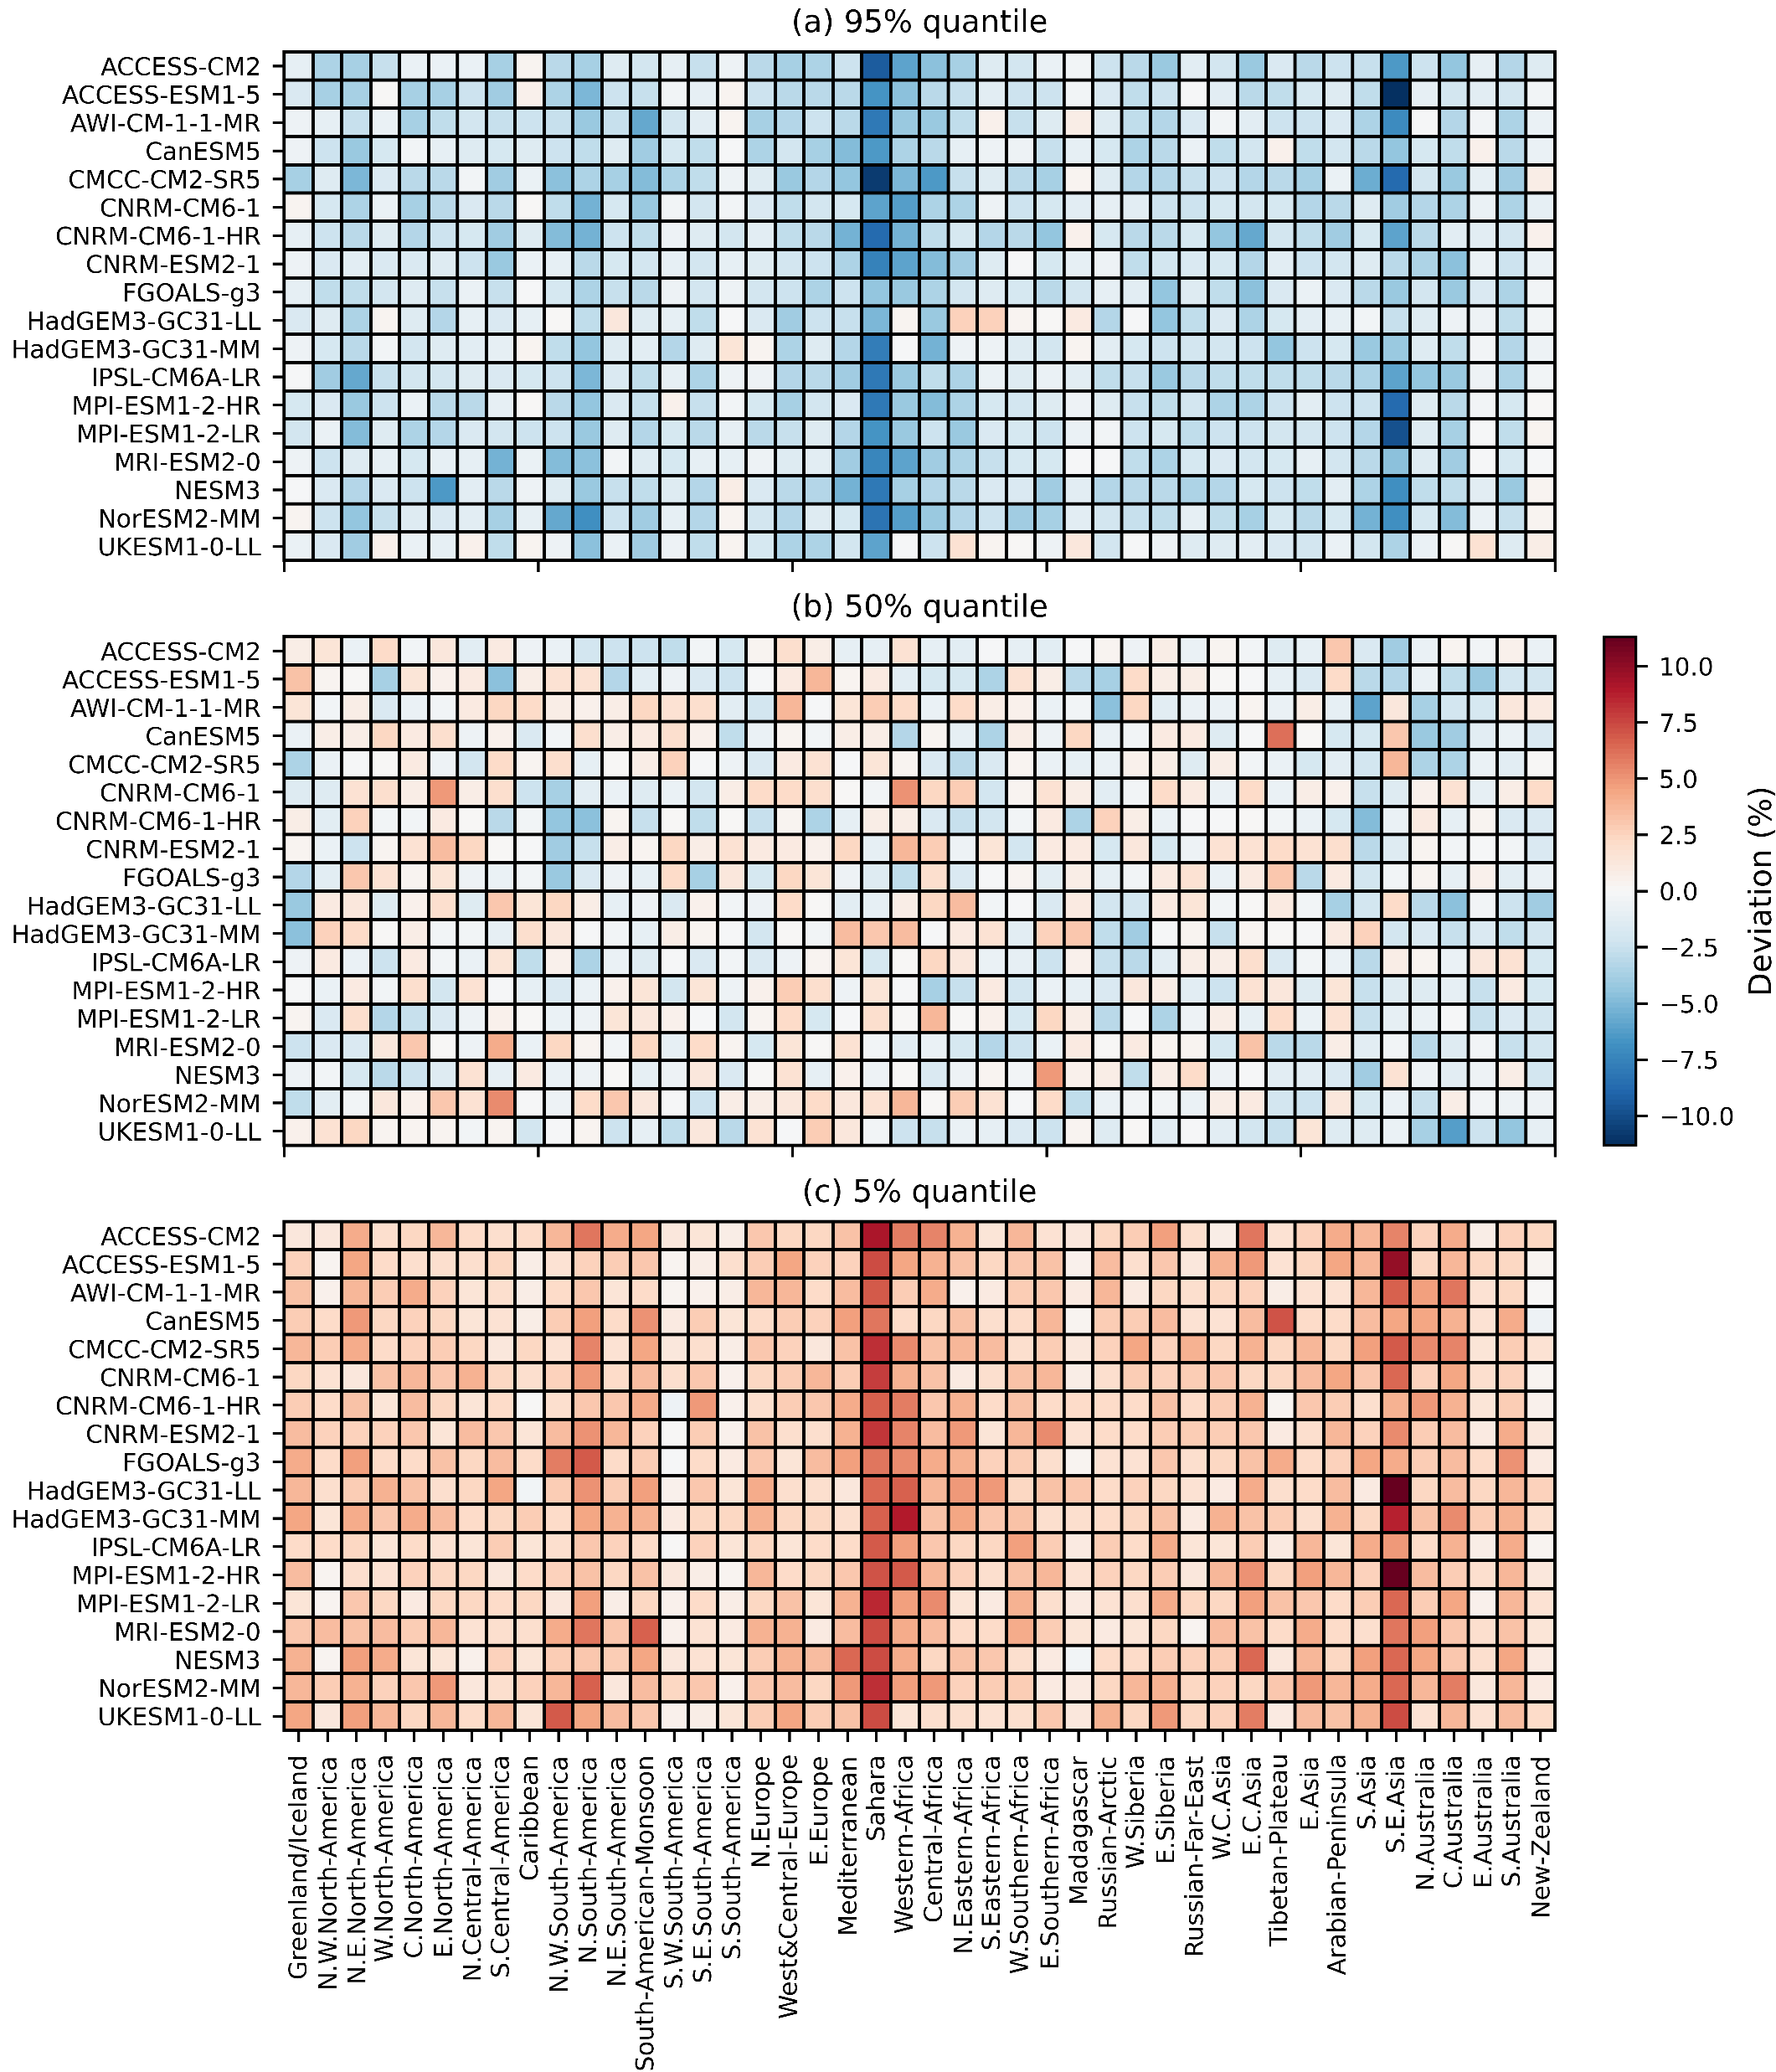
Performances of the emulations
Deviation = Quantile of emulations – quantile of ESM
Emulations underdispersive
Mostly in Sahara and South-East Asia
Deviation limited to 5% in most cases:
  95% quantile: in 93% of regions x ESMs
  50% quantile: in 99% of regions x ESMs
  5% quantile: in 92% of regions x ESMs

Slide 6
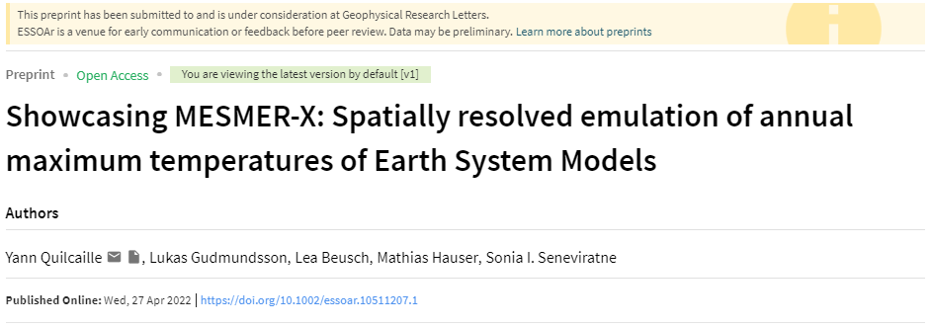
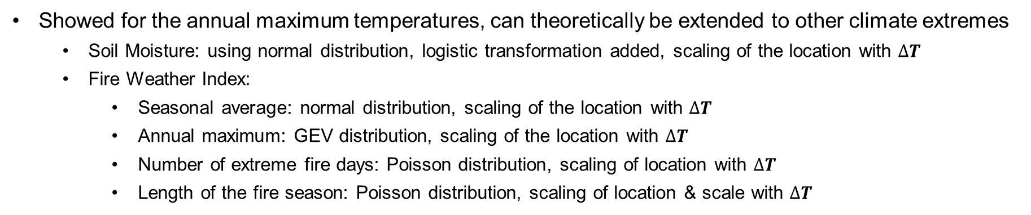
Conclusion & next steps
Development of a method for the training and emulation of local climate extremes, preserving:
  Statistical distributions
  Spatial patterns
  Temporal evolutions
Paper submitted in GRL
Showed for the annual maximum temperatures, can theoretically be extended to other climate extremes
  Soil Moisture: using normal distribution, logistic transformation added, scaling of the location with $∆T$
  Fire Weather Index:
    Seasonal average: normal distribution, scaling of the location with $∆T$
    Annual maximum: GEV distribution, scaling of the location with $∆T$
    Number of extreme fire days: Poisson distribution, scaling of location with $∆T$
    Length of the fire season: Poisson distribution, scaling of location & scale with $∆T$
Coming soon!
Yann Quilcaille: yann.quilcaille@env.ethz.ch

Slide 7
Thanks!
Yann Quilcaille, Lukas Gudmundsson, Lea Beusch, Mathias Hauser, Sonia I. Seneviratne
EGU 2022
27.05.2022

