Slide 1




Impact analogues for extreme impact event risk assessment
henrique.goulart@deltares.nl
Henrique M. D. Goulart, Karin van der Wiel, Christian Folberth, Juraj Balkovic, and Bart van den Hurk

Slide 2
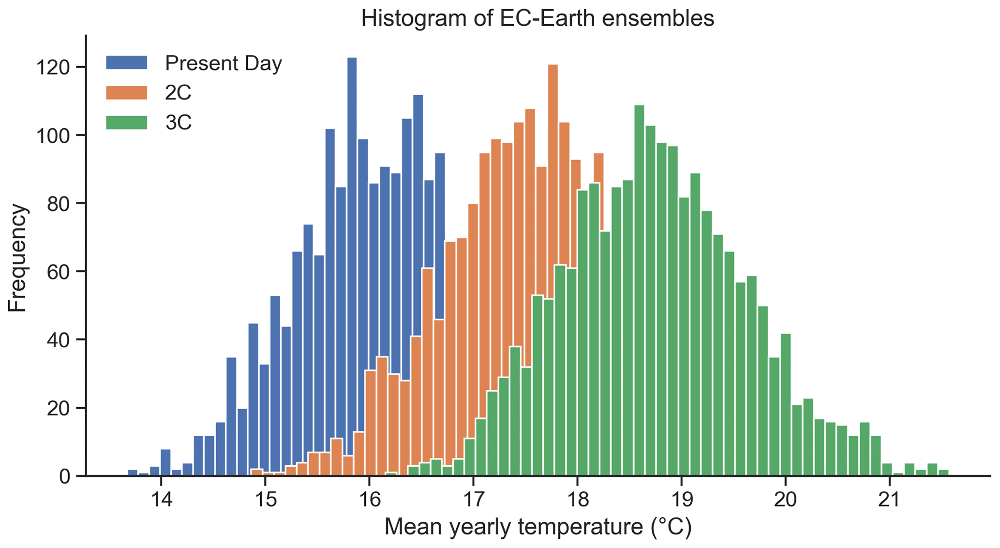
Climate risk estimation
Probabilistic approach:
  Not impact-oriented;
  Focus on mean conditions.
Physical climate storylines:
  Plausability;
  Focus on extremes;
  Analogues for future risk estimation.

Slide 3
Types of analogues
Event-based analogues (Sillmann et al., 2020, EF):
  Future events with similar characteristics of a past event.
Impact-based analogues (Van der Wiel et al., 2020, ERL):
  Future events with similar (or greater) impacts to the past event;
  Accounts for changes in the physical conditions leading to a similar impact;
  Requires an impact model.

Slide 4
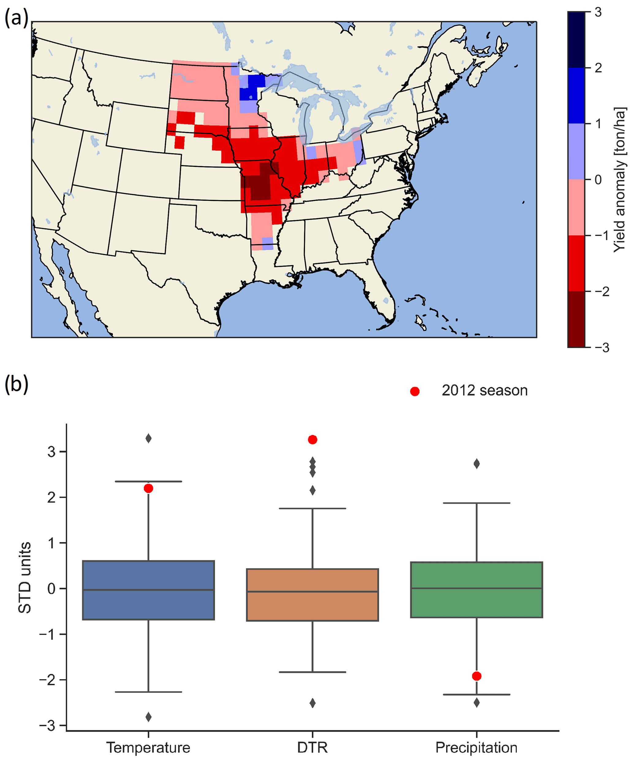
2012 soybean failures
United States of America, 2012;
  High temperatures;
  High diurnal temperature range (DTR);
  Low precipitation.
Record soybean prices.
Impact model:
Random forest
Historical data:
1916 - 2016

Slide 5
Types of analogues of the 2012 event
a) Event-based analogues:
Present day
2012 climatic conditions
Pre-industrial + 2C
Event analogues
Pre-industrial + 3C
b) Impact-based analogues:
Present day
Impact model
Pre-industrial + 2C
Impact analogues
2012 failure probability
Pre-industrial + 3C

Slide 6
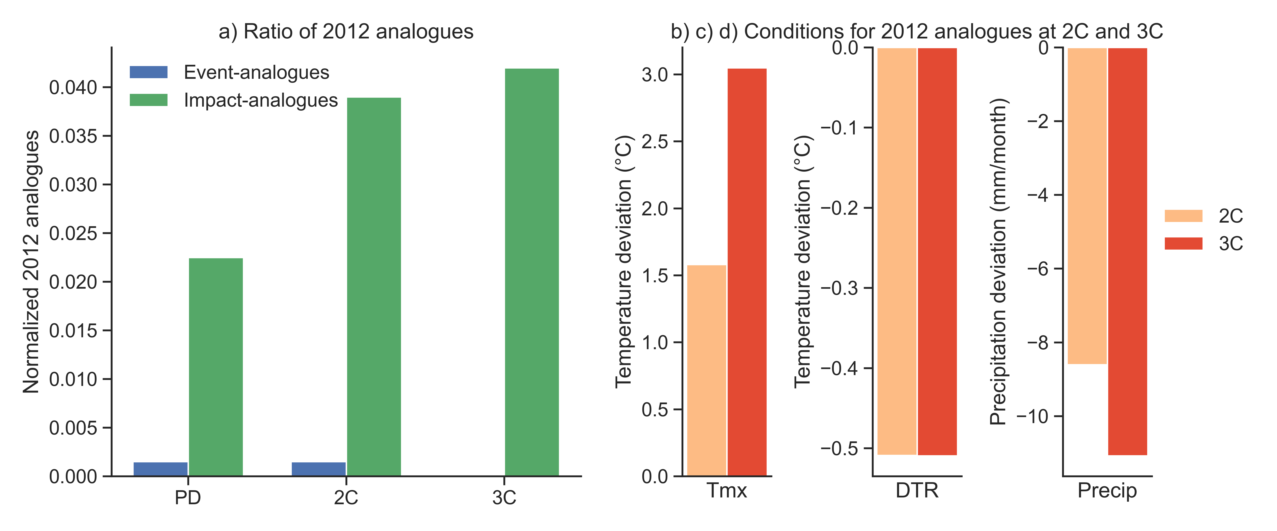
Future analogues of the 2012 season
Similar physical conditions (event analogues) do not increase with GW;
Events with similar failure probabilities (impact analogues) show increase with GW.

Slide 7
Climatic conditions of impact analogues
Impact analogues show higher maximum temperature, lower DTR and lower precipitation

Slide 8

Take-home messages
Defining analogues based on impacts or physical events lead to different outcomes;
Impact analogues are useful for future risk estimation.
Thank you!
Storylines of weather-induced crop failure events under climate change
H Goulart, K van der Wiel, C Folberth, J Balkovic, Bart van den Hurk - Earth System Dynamics, 2021
henrique.goulart@deltares.nl

Slide 9
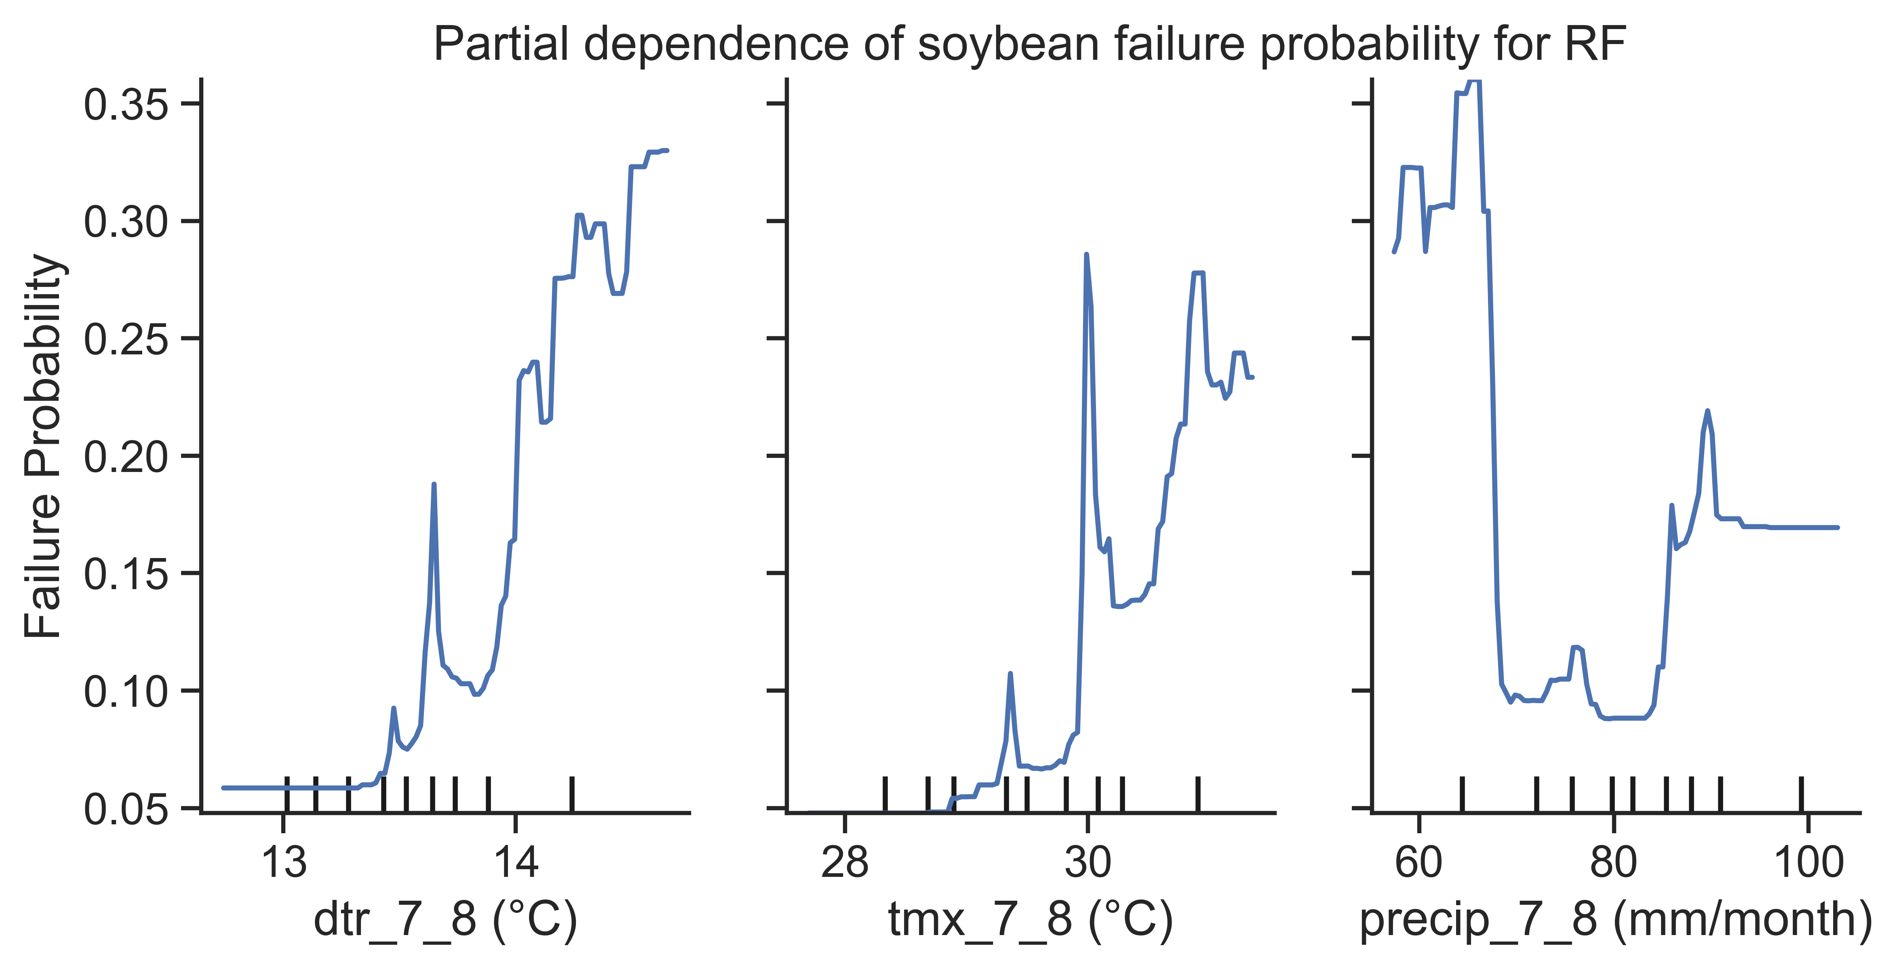
Crop-climate link
Variables | Months | Short
Maximum temperature | July and August | Tmx_7_8
Diurnal temperature range | July and August | Dtr_7_8
Precipitation | July and August | Precip_7_8
Impact model: Random Forest
Most important meteorological variables:
Associations between crop failure probability and meteorological variables:
  Higher Tmx and Dtr increase failure probability;
  Lower Precip increase failure probability;
  Non-linear links.

Slide 10
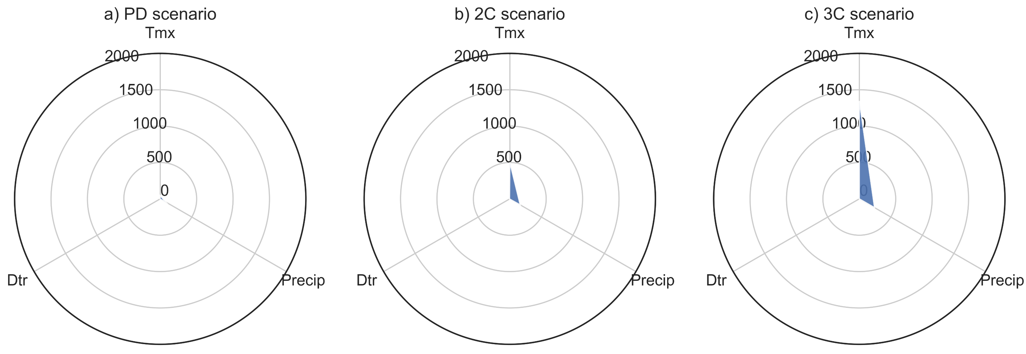
Why difference between event and impact analogues?
Temperature and precipitation show large increase in exceeding 2012 thresholds;
DTR never exceeds;

Slide 11
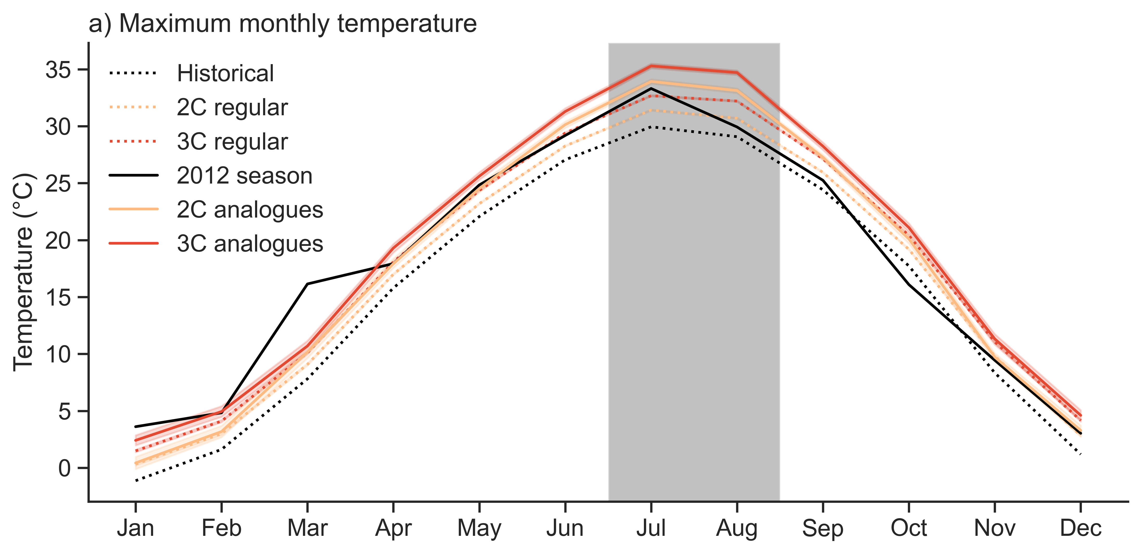
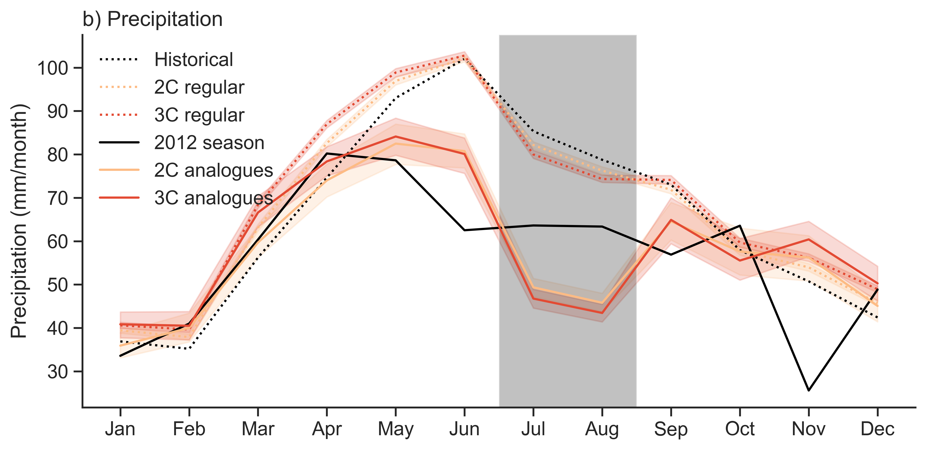
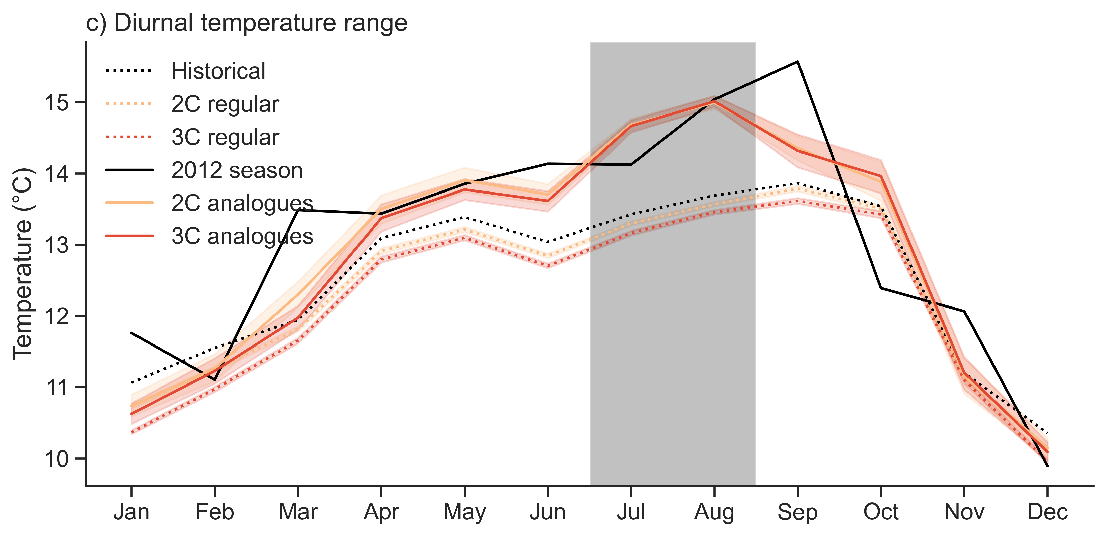
Impact analogues of the 2012 event
The 2012 analogues for GW are warmer, but even GW normal years are already very close to the 2012 season; (climatology)
Precip shows drier years during Jul-Aug, but slightly wetterin May-Jun.
DTR is decreasing with GW, but the 2012 analogues are close to the original 2012 season.

