Slide 1




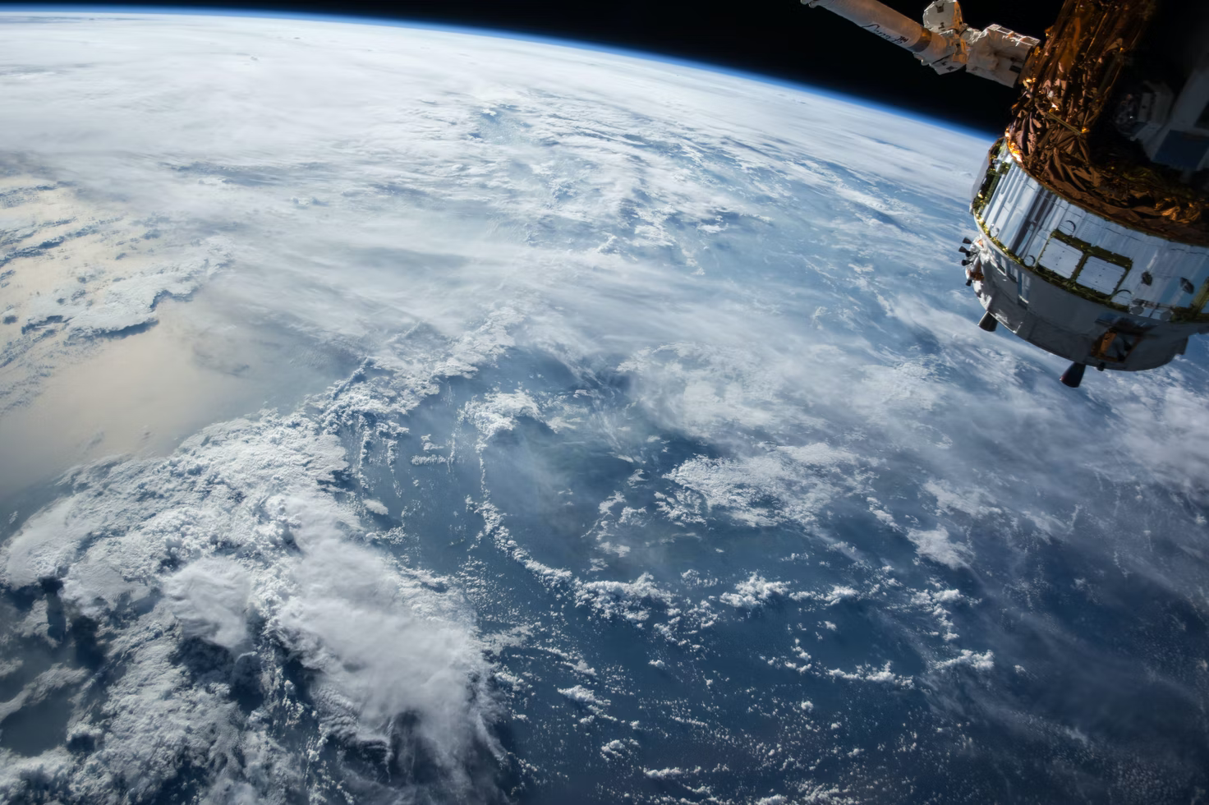


HALO-AC³: An airborne campaign to assess
the influence of airmass transport for Arctic Amplification
Can satellite images provide supervision for cloud systems characterization?
Dwaipayan Chatterjee, Hartwig Deneke, Susanne Crewell
HALO-AC3 Overview | IRF Kiruna | 24.3.2022
Susanne Crewell¹, Andre Ehrlich², Manfred Wendisch² and the HALO-AC³ Team
¹ University of Cologne, Germany; ² University of Leipzig, Germany
https://unsplash.com/photos/yZygONrUBe8
EGU 2022| Institute for Geophysics and Meteorology | University of Cologne | Chatterjee, Dwaipayan | 21.05.2022
Computational resources from

Slide 2



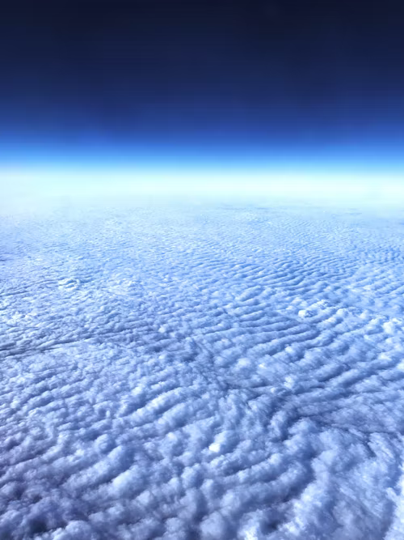




Motivation
Cloud system appearance (structure and distribution) results from complex interplay
of physical processes and large-scale environmental conditions
→ large interest in cloud classification
Cloud organization
cloud feedback
climate sensitivity
https://unsplash.com/s/photos/clouds
https://www.flaticon.com/

Slide 3

Our approach
Challenges
Cloud systems transform continuously
→ categories are transient
Likelihood of closeness should be assed by machine learning
Previous studies
Focus on tropical clouds over water
→ expand to central European domain
Include (at least some) human decisions
→ consider a purely data driven approach
Use a bottom-up approach where the network learns a suitable hidden representation of the data
https://www.flaticon.com/

Slide 4
Guiding Questions
1. How can we use deep learning to identify different cloud systems?
2. How can we physically interpret the identified classes?
3. What are the measures to identify the right number of classes?
4. Can the model generalise well on unseen data?

Slide 5

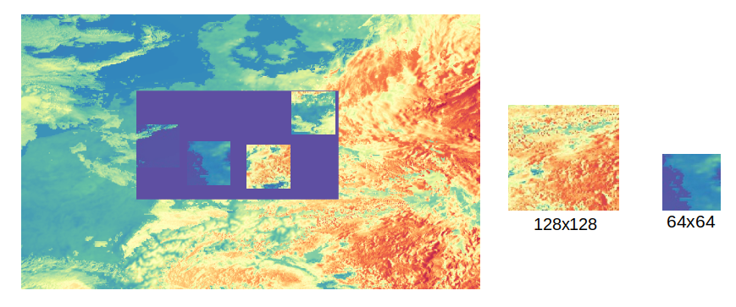
1. Satellite Data
Meteosat Second
Generation (MSG)
Meteosat Third Generation (MTG)
Satellite data
Enhanced resolution MSG data set (Deneke et al., AMT, 2021)
Cloud optical depth (COD) and 10 additional retrieval products, e.g. top of the atmosphere reflectivity, downwelling solar radiation
April to July 2013 + 2015
= central European domain
Two different sizes tested
4 random crops
at any instant
128x128
= 256x256 km
64 x 64
= 128x128km
https://www.flaticon.com/
Notes:
Say that you test two different domains ; Deneke et al., AMT, 2021 Increasing the spatial resolution of cloud property retrievals from Meteosat SEVIRI by use of its high-resolution visible channel: implementation and examples

Slide 6
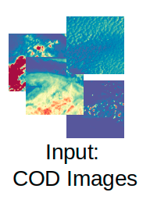

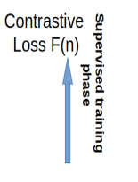
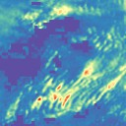

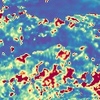
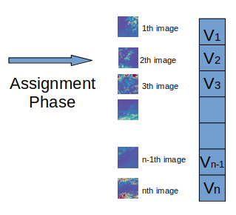
1. Deep Learning Architecture
Residual Network
N =1,2,.....49,50
Class 1
θ₂
θ₁
Class 5
Spherical K means
Facebook artificial intelligence research (FAIR) (Caron et al., 2018, 2021)
FAIR Open source Vision Self Supervised Learning (VISSL) library (Goyal et al., 2021)
.

Slide 7
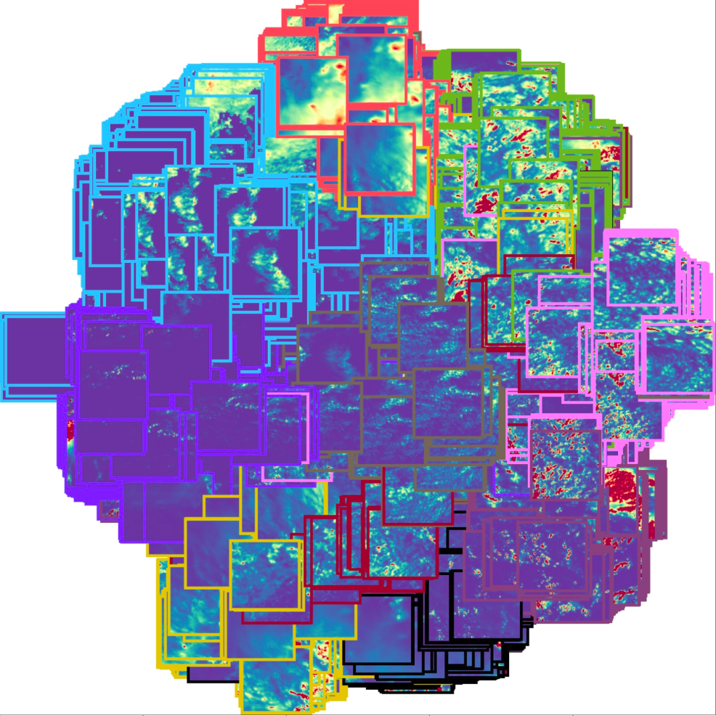
3. Classification result
Deep learning model assigns unique class (coloured frame) to each image

Slide 8
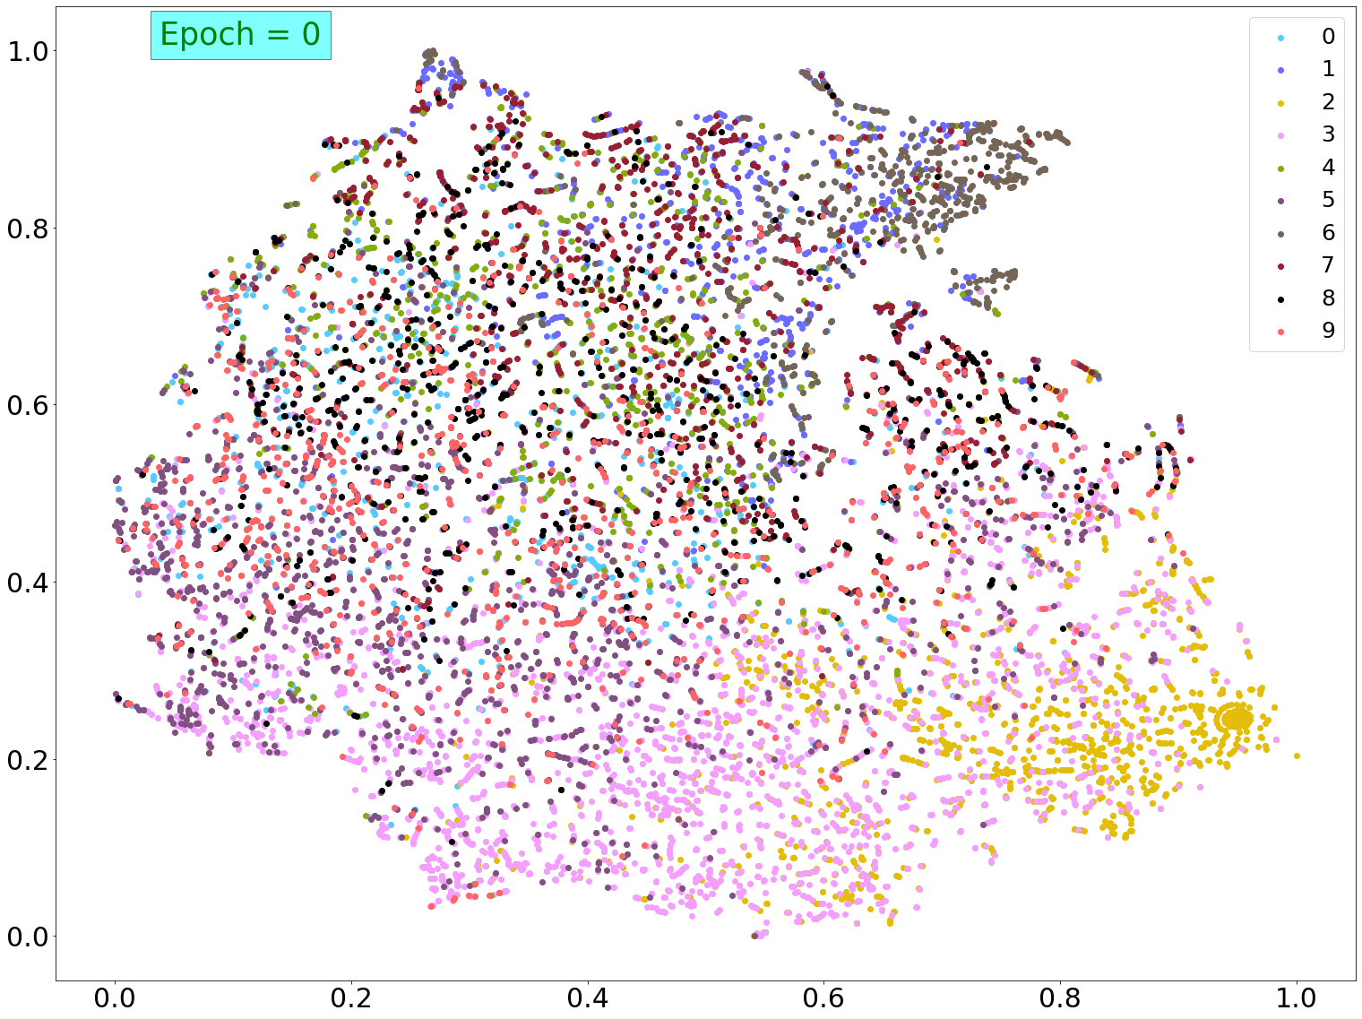
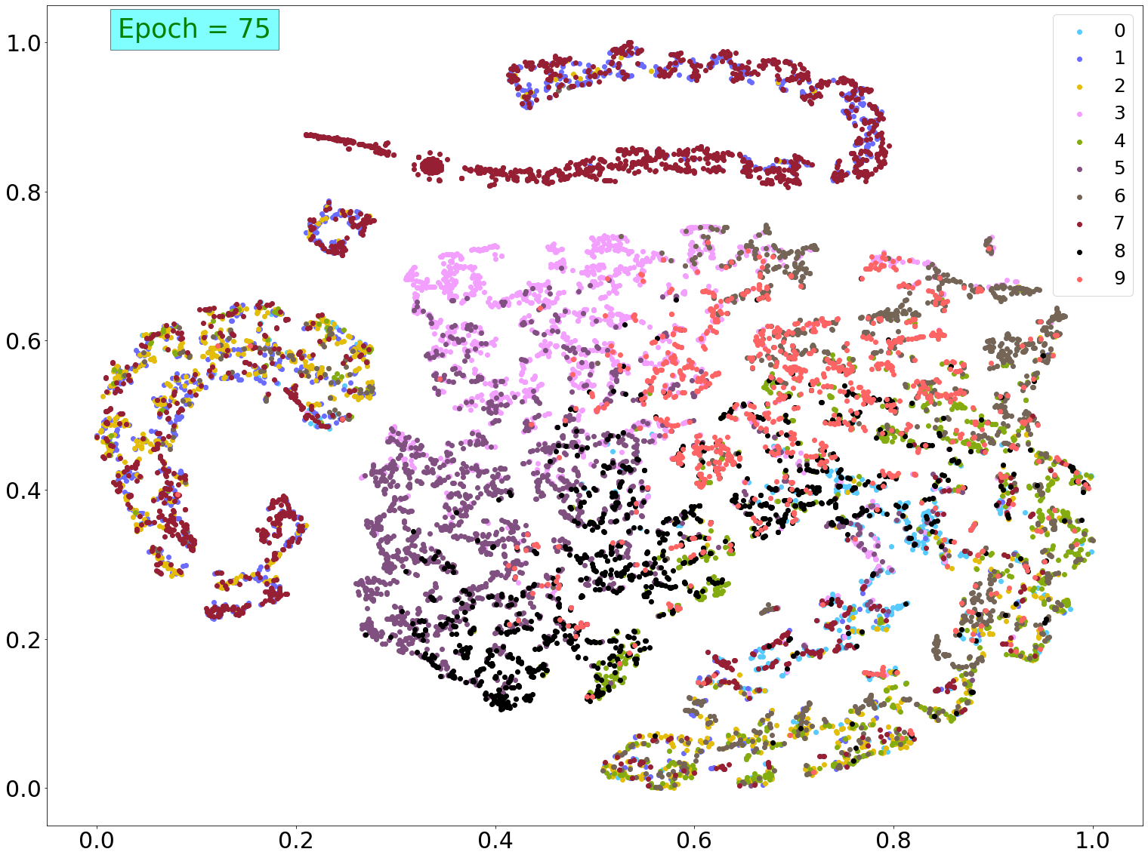
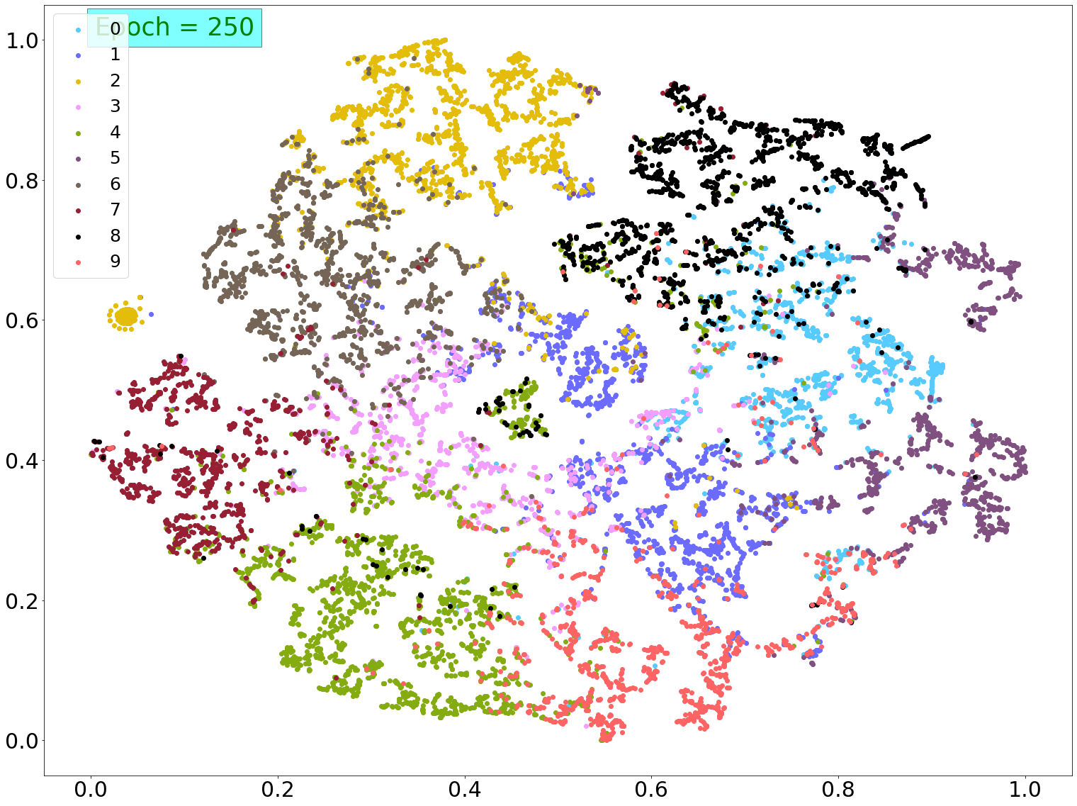
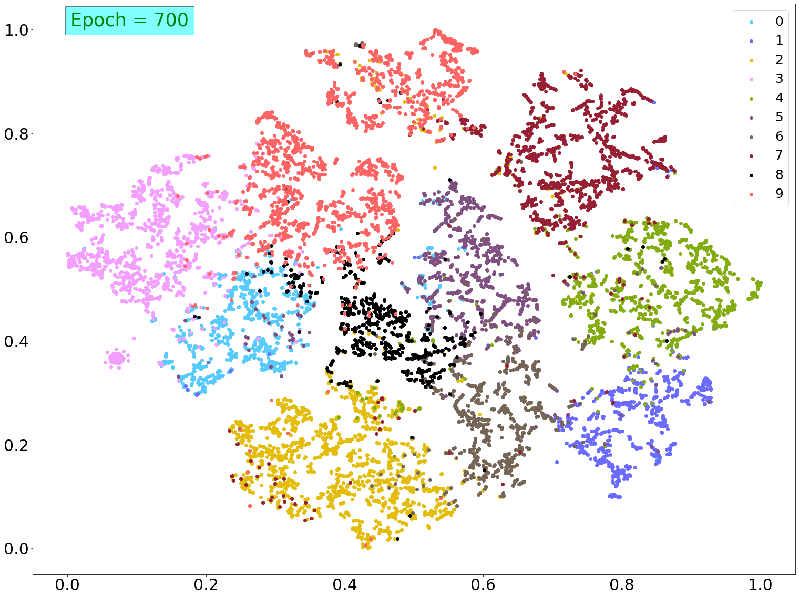
3. Classification: Evolution
Evolution of understanding by the deep neural network
Good convergence
achieved from 250 epoch
After 700 epoch clear segregation

Slide 9
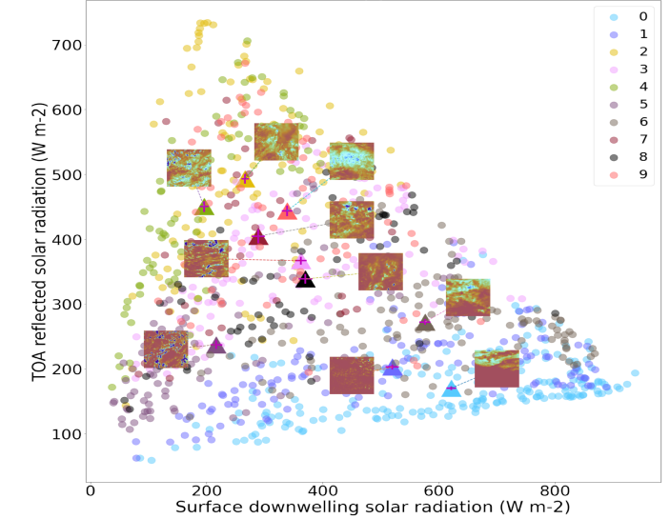
4. Gaining understanding: Physical significance
Centeroid position and closest image of one class
Deep convective
cloud systems
Clear sky

Slide 10
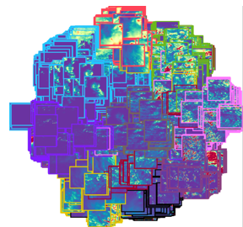
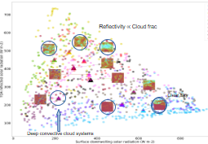
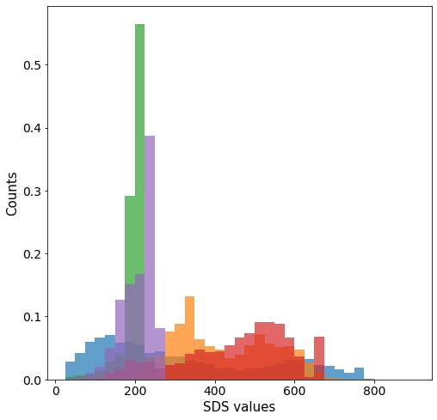
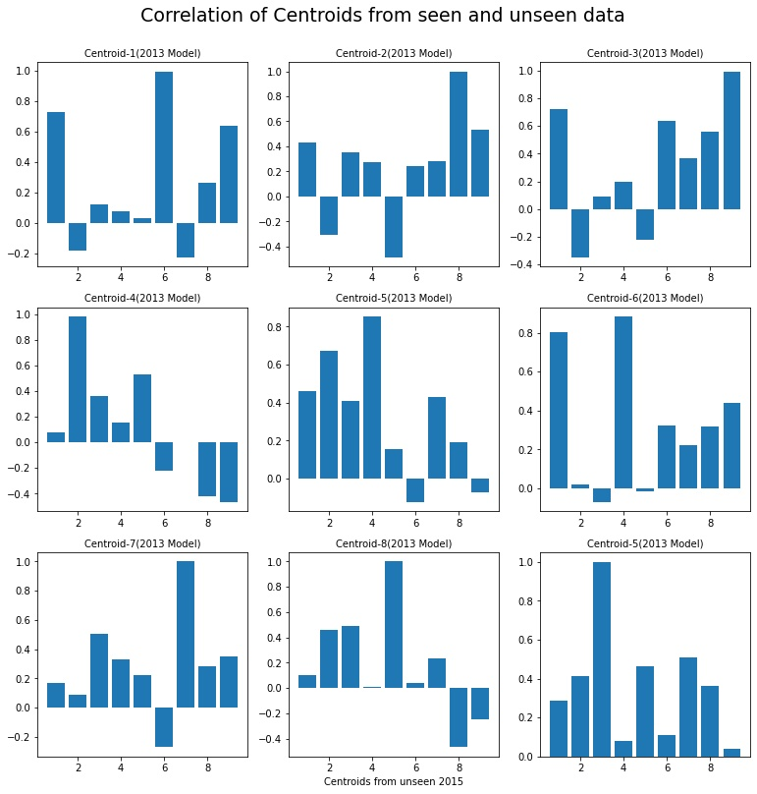
Conclusions
1. How can we use deep learning to identify different cloud systems?
DeepClusterV2 based self-supervised learning approach can identify distinct can cloud regimes in complex central European environment
2. How can we physically interpret the identified classes?
Satellite retrieval products support the physical interpretations of identified cloud regime classes
3. What are the measures to identify the right number of classes?
Depending on purpose of classification different metrics can be used
4. Can the model generalise well on unseen data?
Generalisation tested with unseen data using centroid embeddings
→ correlations up to 0.99 and similar distance distributions

Slide 11
Additional Materials

Slide 12
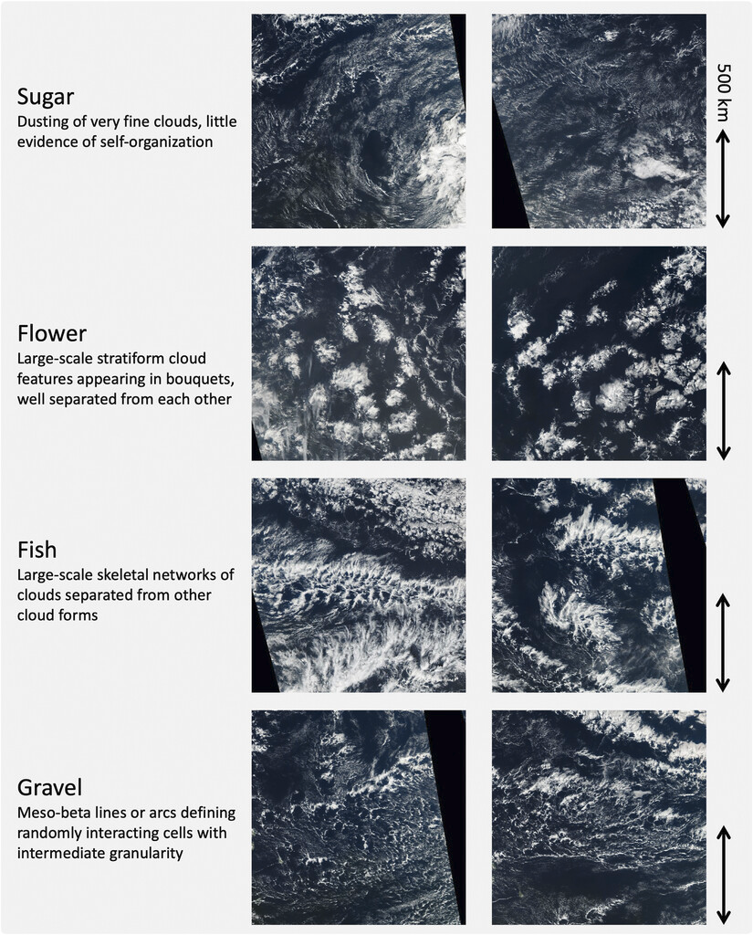
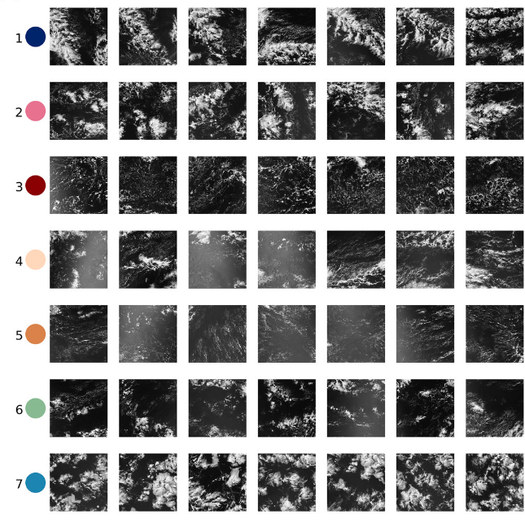
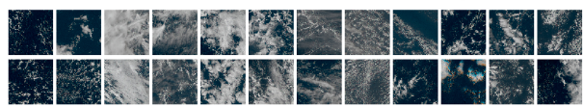
Previous Work
Visual inspection
Traditional approach of using human-defined metrics
Janssen et al., 2019
Unsupervised machine learning
Denby, 2019
Stevens et al., 2019
How can we classify cloud systems?

Slide 13
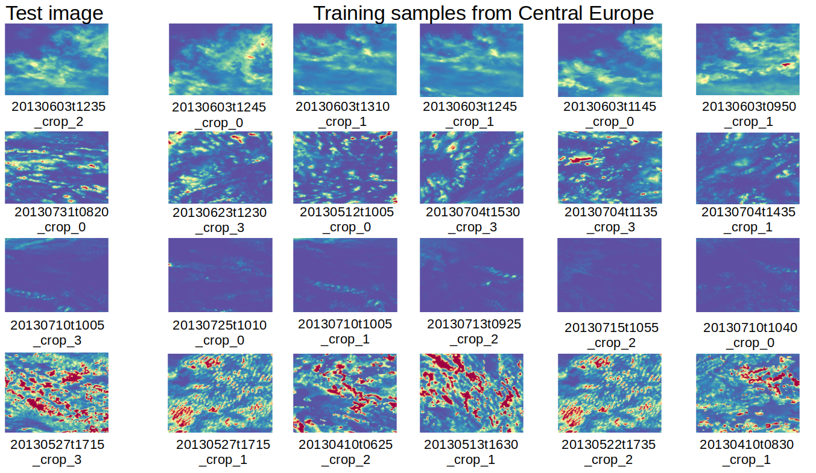
3. Classification: Closeness

Slide 14
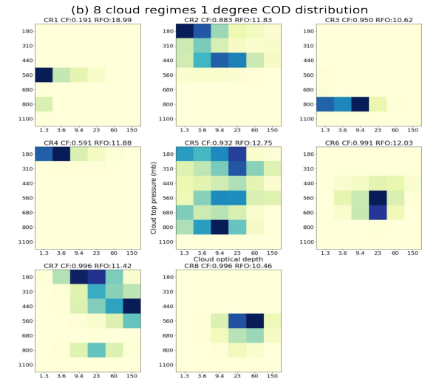
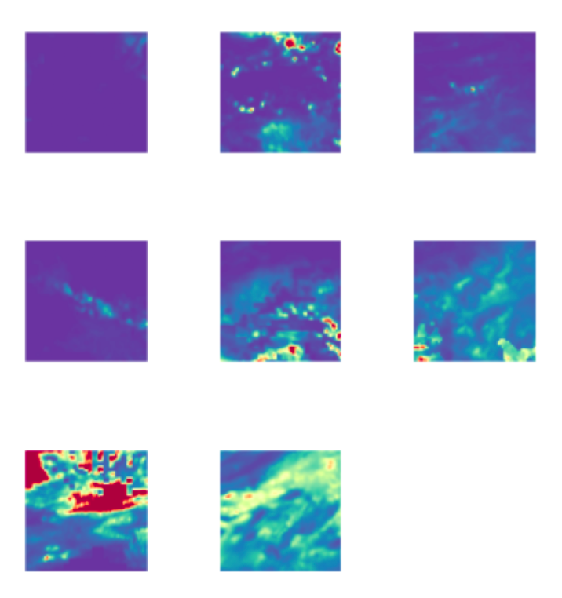
4. Gaining understanding: Number of classes
Images closest to centroids for 8 classes
Identify the useful lowest number of classes by reducing the correlation between classes
Joint frequency of occurrence of COT – cloud top
pressure for different classes

Slide 15
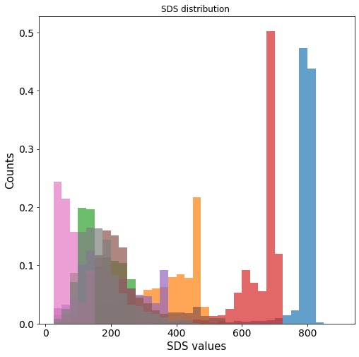
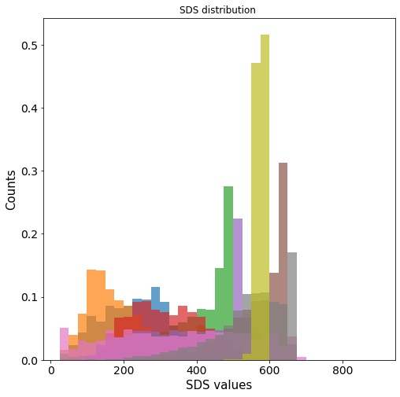
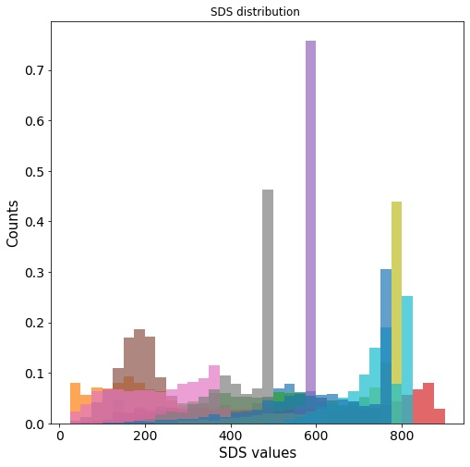
4. Gaining understanding: Targeted Parameter
Goal: Identification of highly variable conditions of solar energy
5 classes
8 classes
9 classes
10 classes
Surface downwelling radiation (SDS) (Wm⁻²)
Less
representaion
More classes
Repetition

Slide 16
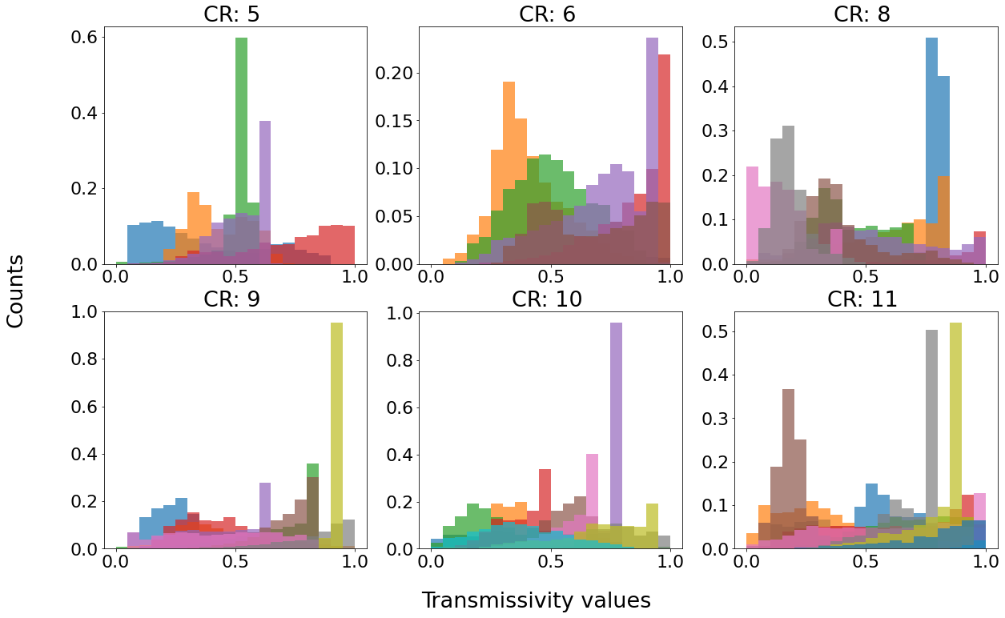
4. Gaining understanding: Targeted Parameter
Lower number of classification, less representation of distributions vs
higher classification repetition in distributions is observed

Slide 17
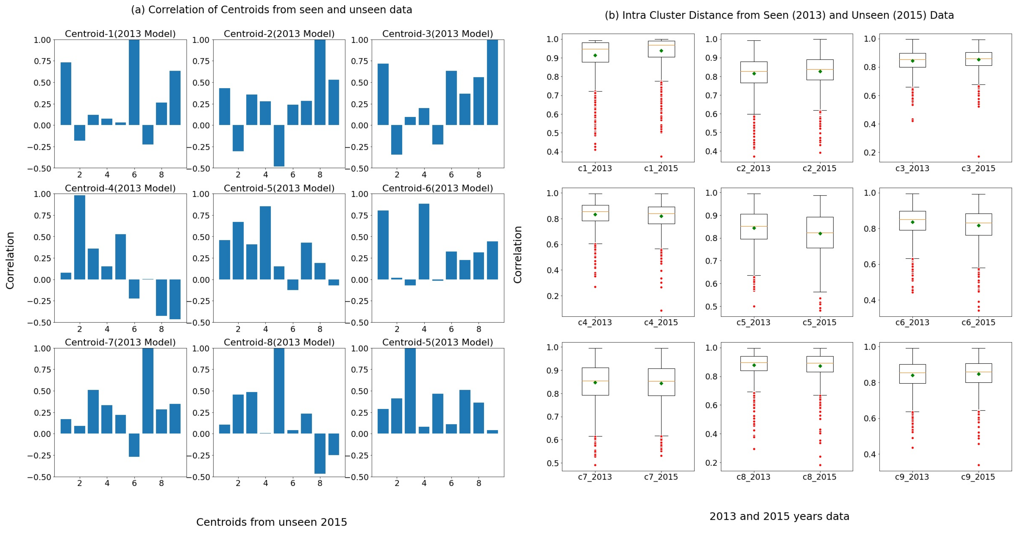
5. Generalization
Intra Cluster distance of seen and unseen data from Centroids Which are closely related as 0.99
show good consistency in the spread

