Slide 1
Combination of GNSS and VLBI data for consistent estimation of Earth Rotation Parameters
Display Material
EGU General Assembly | Vienna, Austria & Online | 25 May 2022
Lisa Lengert, Daniela Thaller, Claudia Flohrer, Hendrik Hellmers, Anastasiia Girdiuk
Federal Agency for Cartography and Geodesy (BKG), Department Geodesy, Frankfurt am Main, Germany

Slide 2


Agenda
Motivation
Input for Combination
Combination Scheme
Scaling and weighting of NEQs
Results
Daily Single-Technique Solutions
Multi-day GNSS Rapid and VLBI Intensives Combination
Multi-day GNSS Rapid, VLBI Intensives, and VLBI R1/R4 Combination
Conclusion and Outlook

Slide 3

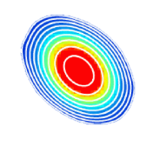

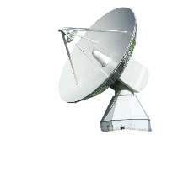
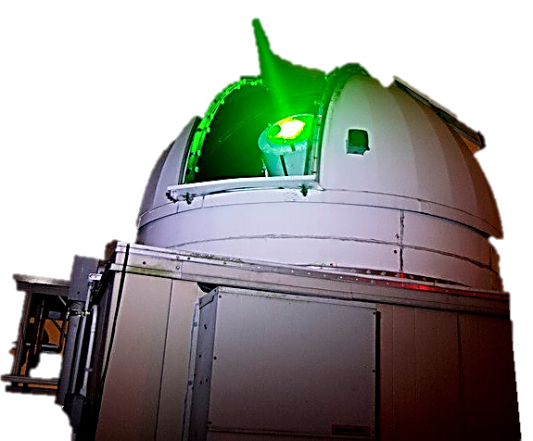
Motivation – Combination of GNSS, VLBI and SLR at NEQ level
  benefits of combination of VLBI and GNSS
  GNSS + VLBI INT daily resolution and shorter latency of a consistent set of all ERPs
  stabilization of the ERPs by multi-day combination
GNSS
VLBI
SLR
  stabilization of all ERPs through 24h VLBI R1/R4 two times a week
COMBI
  improvement of the combined ERP solution in particular through a stable contribution of LOD from SLR
ERP |  | INT | R1/R4
dUT1
LOD
Polar motion
  current ERP daily combination @ IERS RS/PC, @ IERS EOP PC
  combination at parameter level
IERS-14-C04
IERS-Bulletin-A
Techniques’ contributions to Earth Rotation Parameters (ERP)
  benefits of combination at NEQ level (SINEX)
  considers correlations
  consistent set of parameters
  assures same underlying reference frame
  (positive) impact on other technique-specific parameters

Slide 4
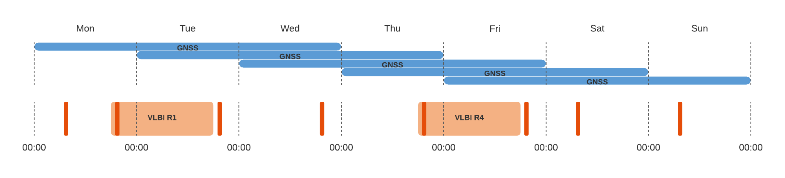
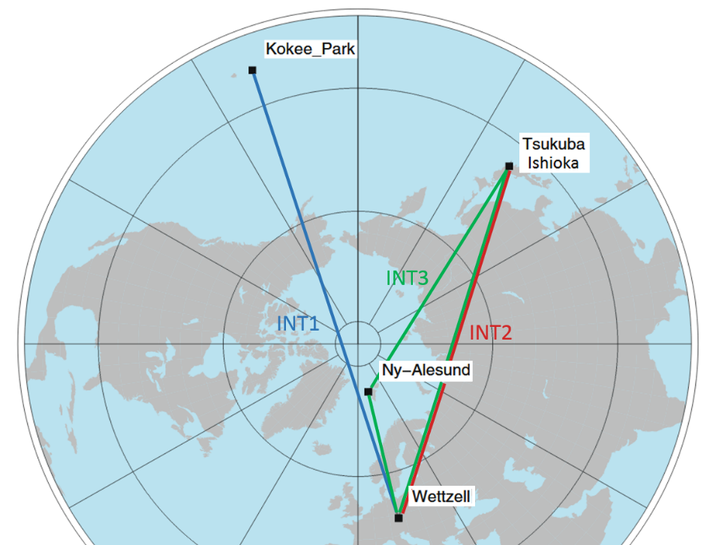
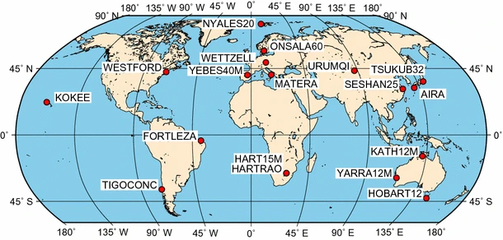
Input for Combination
72h-Rapid SINEX
IGS CODE AC
GNSS
VLBI
24h-R1/R4 SINEX
1h-Intensives SINEX
IVS BKG AC
VLBI Rapid Sessions (R1/R4)
Global network of 8-15 antennas for the estimation of all five EOP
24-hour observation twice per week
14 days latency
VLBI Intensive Sessions (INT)
Baselines optimized in East-West direction for the estimation of dUT1
1-hour observation per day, not equidistant in time
  INT1 Mon-Fri 18:30-19:30 UTC
  INT2 Sat-Sun 07:30-08:30 UTC
  INT3 Mon 07:30-08:30 UTC
1-2 days latency
[Luzum et al. in J Geod (2010) 84:399–402 DOI 10.1007/s00190-010-0372-8]
[Klopotek et al. in J Geod (2018) 92:457–469 DOI 10.1007/s00190-017-1072-4]

Slide 5
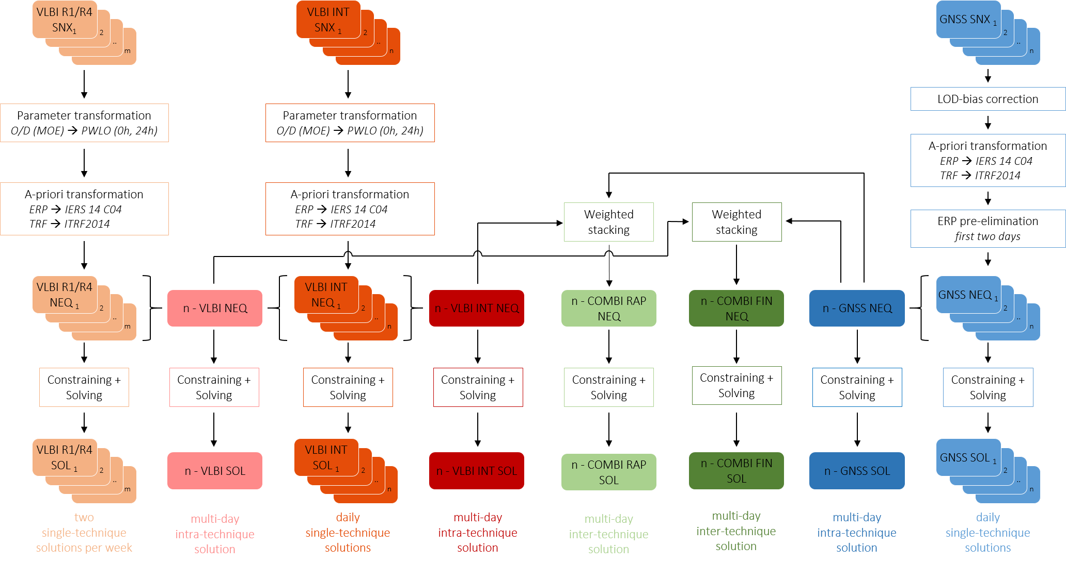
Combination Scheme
Input level
SNX
Transformations
and other
operations for
a consistent input
parameter
A priori
…
Normal equation level
NEQ
Constraining +
Solving
Solution level
SOL

Slide 6
Single-day, Single-technique Solutions
Input level
SNX
Normal equation level
NEQ
Solution level
SOL

Slide 7
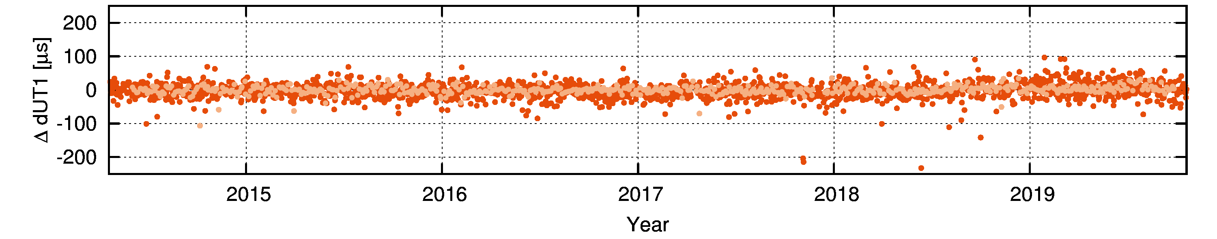
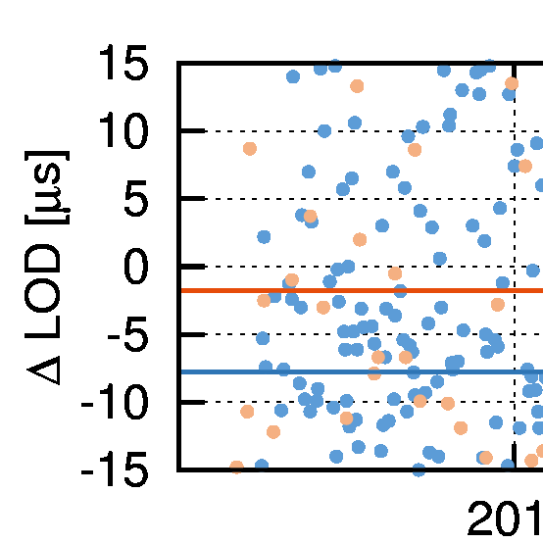
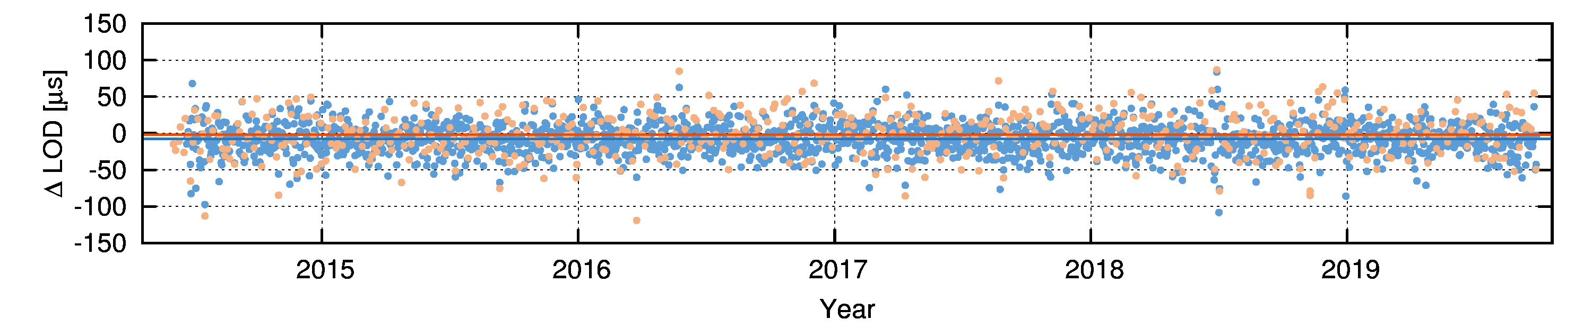
Single-day, Single-technique Solutions dUT1, LOD
WRMS [µs] | 18 | 10
Reference series: IERS-Bulletin-A
GNSS LOD-Bias of -7.8 µs per day
Can also be detected in a drift of the dUT1 parameter estimated
in the GNSS multi-day intra-technique combination (n-GNSS)
→ Corrected for further combinations
-7.8 µs

Slide 8
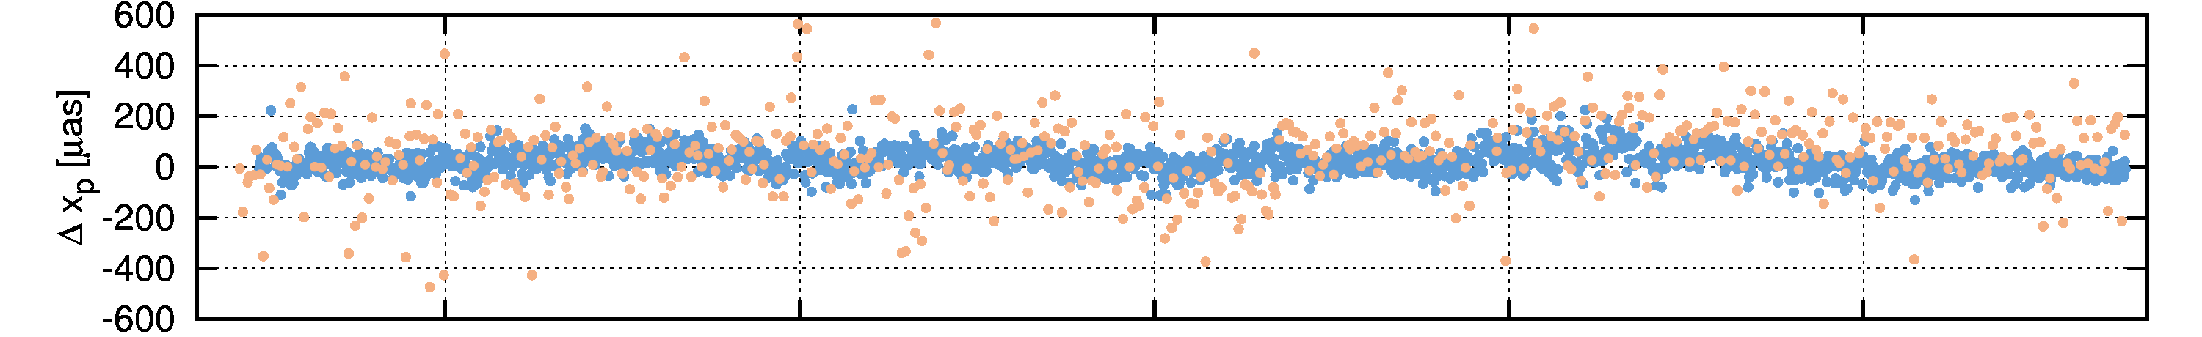
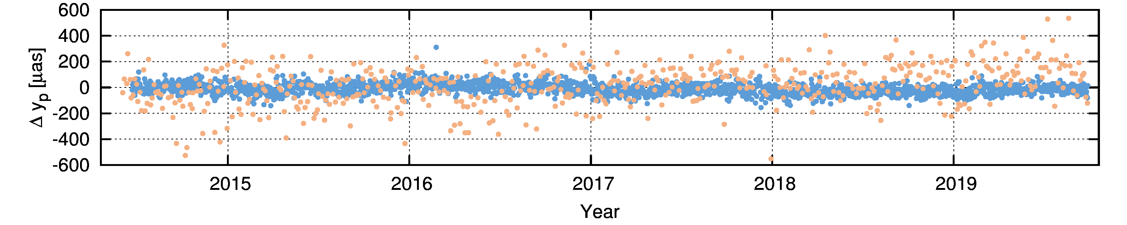
Single-day, Single-technique Solutions x-, y-pole
WRMS [µas] | 108 | 50
WRMS [µas] | 108 | 42

Slide 9
Scaling of the technique-specific NEQs
Input level
SNX
Normal equation level
NEQ
Solution level
SOL

Slide 10
Scaling of the technique-specific NEQs
Ratios of the average NEQ diagonal element per parameter group (TRF, pole, dUT1) between GNSS and VLBI
Imbalance in the size of the NEQ elements of both techniques
GNSS too weak compared to VLBI
→ Rescaling of the NEQs needed
TRF
TRF
Scale factor 16750 ≙ Ratio of the observation periods
72h : 24h : 1h
Used for all following combination results

Slide 11
Scaling of the technique-specific NEQs
Input level
SNX
Normal equation level
NEQ
Solution level
SOL

Slide 12
Constraining – Overview
Parameter (explicit) |  | VLBI R1/R4 | n-VLBI | VLBI INT | n-VLBI INT | n-COMBI RAP | n-COMBI | n-GNSS | GNSS
EOP | UT1-UTC (dUT1) | - | - | LOD fixed to IERS-14-C04 | - | - | - | first dUT1 fixed to IERS-14-C04 | first dUT1 fixed to IERS-14-C04
 | X-/Y-pole | - | - | fixed to IERS-14-C04 | fixed to IERS-14-C04 | - | - | - | -
 | nutation | - | - | - | - | - | - | - | -
TRF |  | minimum constraints (NNR/NNT for IVS core sites) | minimum constraints (NNR/NNT for IVS core sites) | fixed to ITRF2014 | fixed to ITRF2014 | GNSS: NNR/NNT for IGS core sites, VLBI: fixed to ITRF2014 | GNSS: NNR/NNT for IGS core sites, VLBI: fixed to ITRF2014 | minimum constraints (NNR/NNT for IGS core sites) | minimum constraints (NNR/NNT for IGS core sites)
CRF |  | fixed to ICRF-3 defining sources | fixed to ICRF-3 defining sources | - | - | - | - | - | -
technique- specific (GNSS) | Geocenter | - | - | - | - | fixed to zero | fixed to zero | fixed to zero | fixed to zero
 | Satellite PCO in Z-direction | - | - | - | - | fixed to a priori (SINEX) | fixed to a priori (SINEX) | fixed to a priori (SINEX) | fixed to a priori (SINEX)

Slide 13
Multi-day Combination of VLBI Intensives and GNSS – COMBI RAP Solutions
Input level
SNX
Normal equation level
NEQ
Solution level
SOL

Slide 14
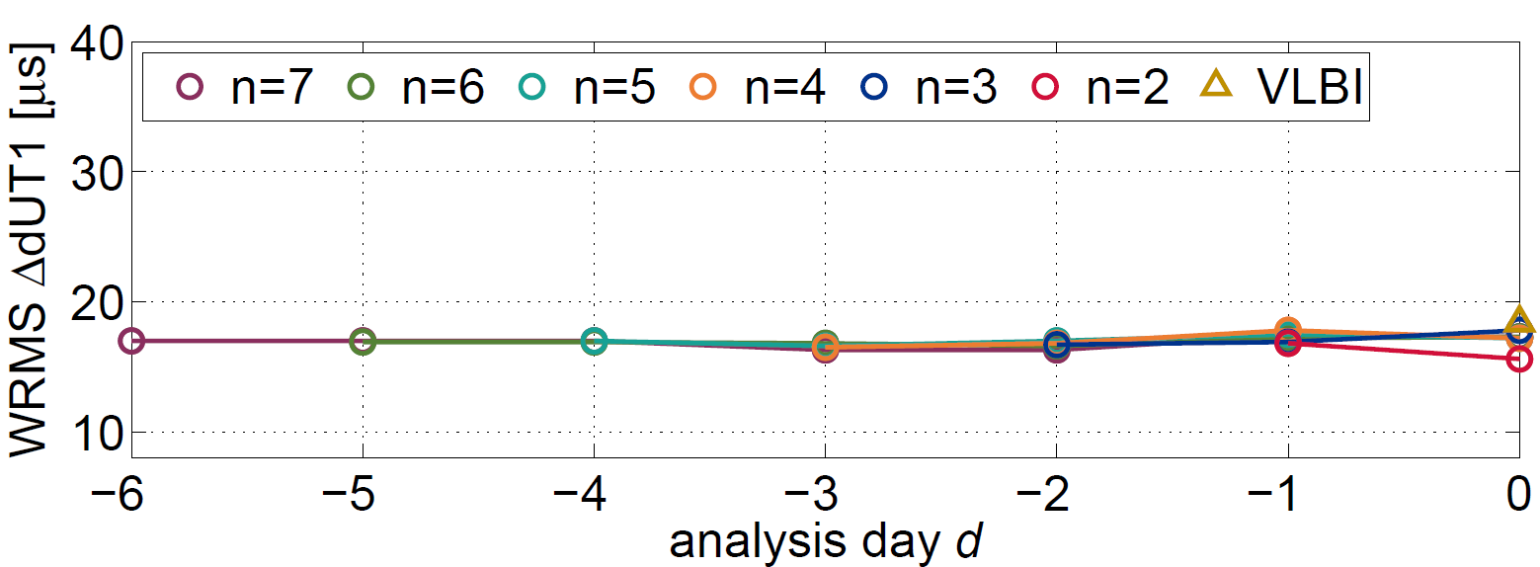
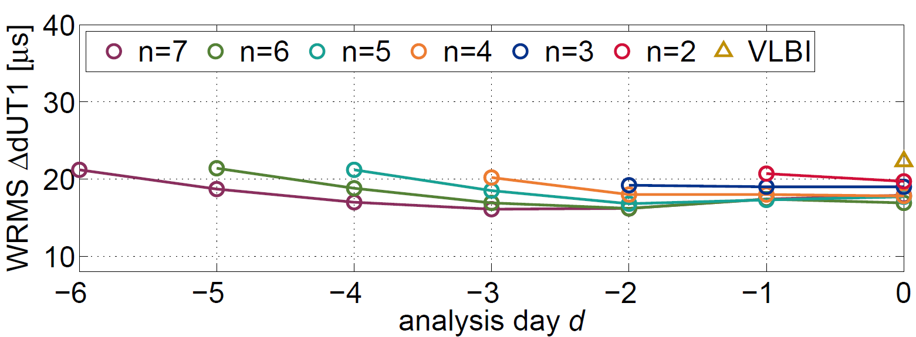

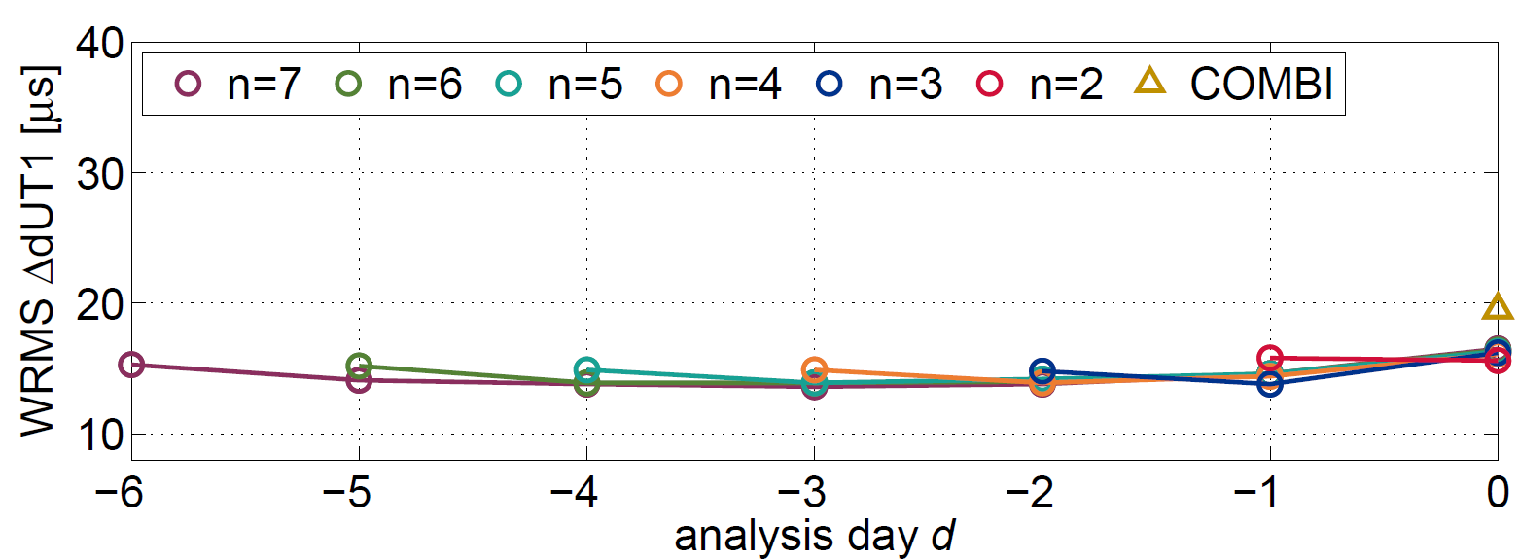
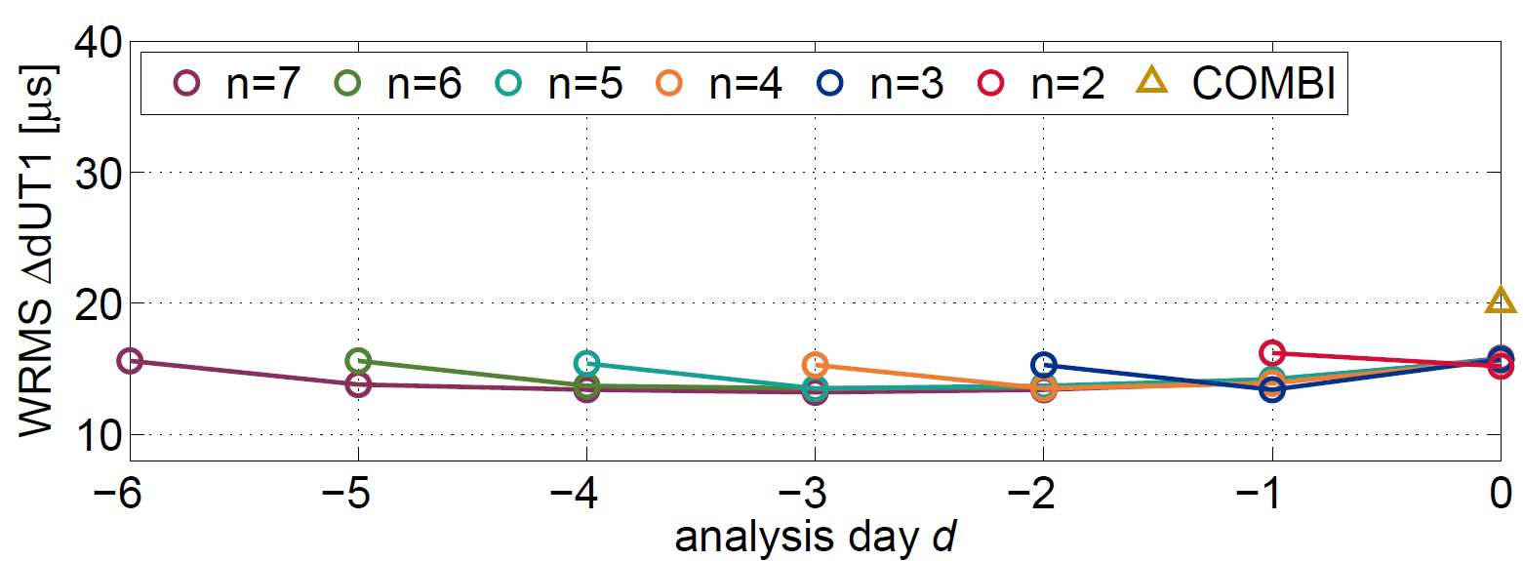
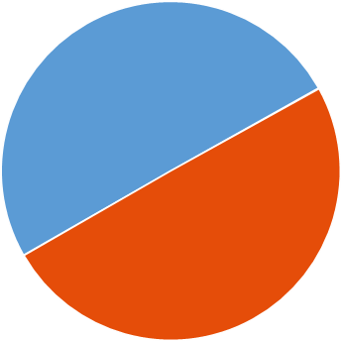
Multi-day Combination of VLBI Intensives and GNSS – COMBI RAP Solutions
Validation epoch: middle observation epochs of the VLBI INT
Validation epoch: 12:00 UTC
n – VLBI INT
Significant reduction of the WRMS values
constant level of accuracy regardless the number of combined days n
and the day of analysis d at INT epochs (15.6-17.8 µs)
no constraining of the LOD is required
n – VLBI INT
Significant reduction of the WRMS values
constant level of accuracy regardless the number of combined days n
and the day of analysis d at INT epochs (15.6-17.8 µs)
no constraining of the LOD is required
improves accuracies outside the INT observation period
n … number of combined days
d … analysis day [0…-(n-1)]
n – COMBI RAP
Significant reduction of the WRMS values
Bridging of VLBI data gaps with GNSS
Merging of the 24h-GNSS-LOD and high quality 1h-VLBI-INT-dUT1
→ high-quality 24h-dUT1 product with latency of 1-2 days
n – COMBI RAP
Significant reduction of the WRMS values
Bridging of VLBI data gaps with GNSS
Merging of the 24h-GNSS-LOD and high quality 1h-VLBI-INT-dUT1
→ high-quality 24h-dUT1 product with latency of 1-2 days
Accuracy independent of the irregularity of the VLBI INT observation period → regularly spaced time series
Reference series: IERS-Bulletin-A
Notes:
Contrary to the conventional estimated single-technique dUT1 from VLBI INT data, the accuracy of the inter-technique combined dUT1 estimate is independent of the irregularity of the INT observation period

Slide 15
Multi-day Combination of VLBI Intensives, VLBI R1/R4 and GNSS – COMBI FIN Solutions
Input level
SNX
Normal equation level
NEQ
Solution level
SOL

Slide 16
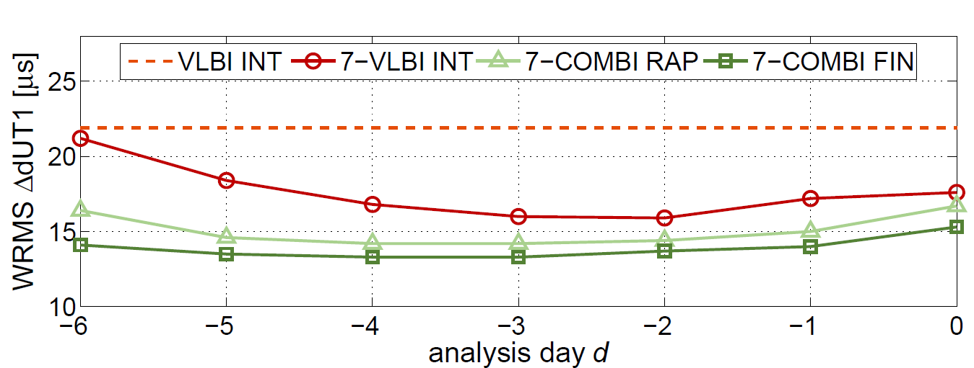
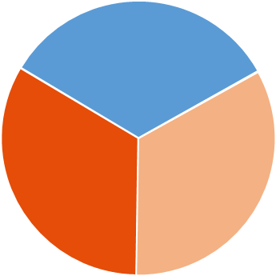
Multi-day Combination of VLBI Intensives, VLBI R1/R4 and GNSS – COMBI FIN Solutions
7-day VLBI INT
Significant reduction of the WRMS values
no constraining of the LOD is required
improves accuracies outside the INT observation period
Validation epoch: 12:00 UTC
7-day COMBI rapid
Significant reduction of the WRMS values
Bridging of VLBI data gaps with GNSS
Merging of the 24h-GNSS-LOD and high quality 1h-VLBI-INT-dUT1
→ high-quality 24h-dUT1 product with latency of 1-2 days
regularly spaced time series
7-day COMBI final
Significant reduction of the WRMS values
stabilization of all ERPs through 24h VLBI R1/R4 twice a week
→ high-quality 24h-dUT1 product with latency of 2 weeks
Reference series: IERS-Bulletin-A

Slide 17
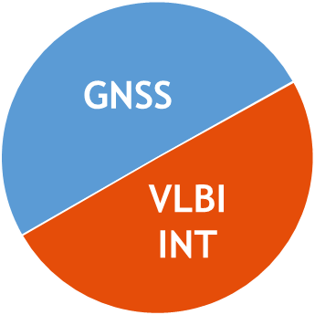
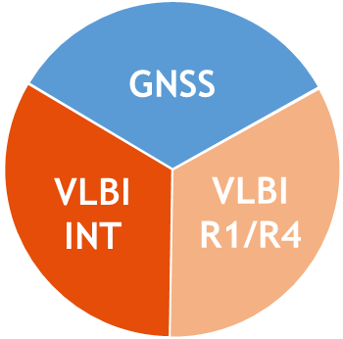
Summary
Combination of GNSS and VLBI provides a full and consistent set of ERPs
Combination based on homogenized, datum-free NEQs with same parameterization and a priori values of parameters
  Allows a rigorous combination on NEQ level
polar motion and LOD from GNSS complements dUT1 from VLBI INT
  Daily and consistent set of all ERPs with short latencies (1-2 days)
Multi-day combinations: Estimation of ERPs as continuous, piece-wise linear polygons
  Stabilizing effect on the estimated parameters, especially for dUT1
  regularly spaced time series (at e.g. 12:00 epochs) of dUT1 together with polar motion
stabilization of all ERPs through 24-hr VLBI R1/R4 two times a week
high-quality 24h ERP product with latency of 2 weeks

Slide 18

Outlook
GNSS
VLBI
INT
Extend the combination of GNSS and VLBI data by adding SLR sessions.
SLR has the potential to improve the combined EOP solution in particular through a stable contribution of LOD
VLBI
R1/R4
SLR
Development of an operational combined BKG-ERP product.

Slide 19
Thank you for your kind attention!
Federal Agency for Cartography and Geodesy
Section G1
Richard-Strauss-Allee 11
60598 Frankfurt am Main
Lisa Lengert
lisa.lengert@bkg.bund.de
www.bkg.bund.de
Phone +49 69 6333 - 449

