Slide 1
Case study of interacting large-scale solar wind phenomena in the heliosphere
Paul Geyer¹, Mateja Dumbović ¹ and Manuela Temmer ²
¹Hvar Observatory, Faculty of Geodesy, University of Zagreb
²Heliophysics Research Group, Institute of Physics, University of Graz
email: pgeyer@geof.hr

Slide 2
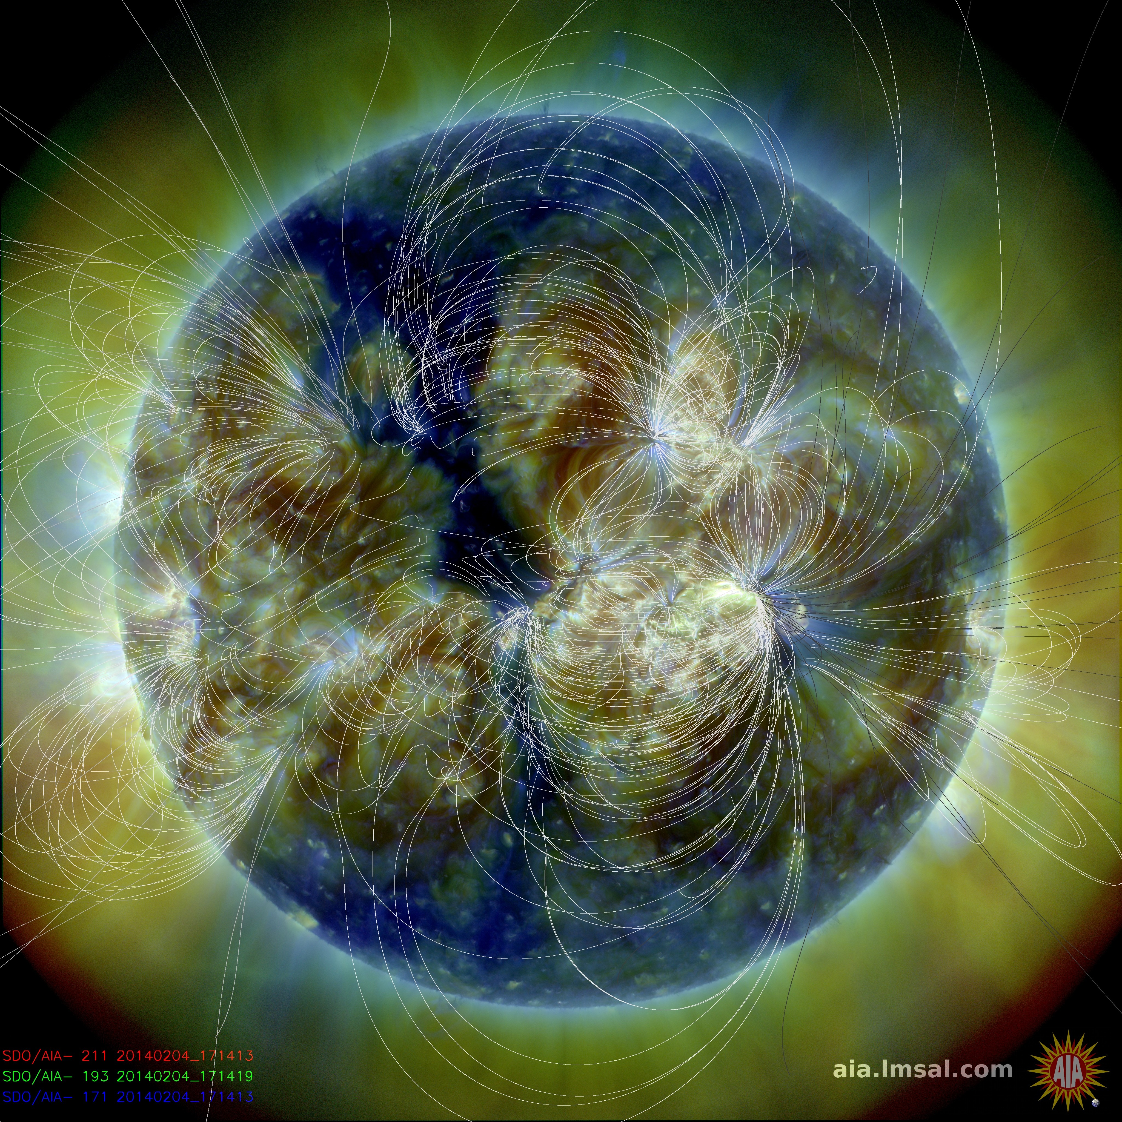
Flaring regions
CH
Remote dimming
Notes:
2 M-class flares (~3 hrs difference), evacuation of material in streamer footpoint (actually in between two loop systems). No brightenings observed (lack of interchange reconnection signatures). „Transient CH” same polarity as northern (‘wall’ of negative polarity). Eruption produced faint structure, region remained active afterward. No filament was erupted (as inferred from H-alpha)

Slide 3
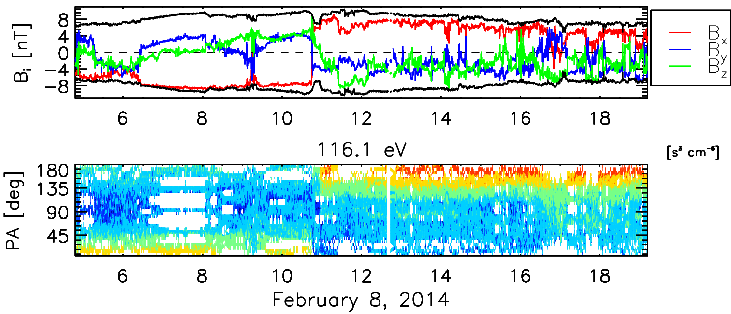
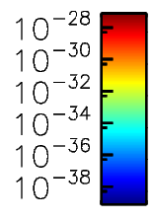
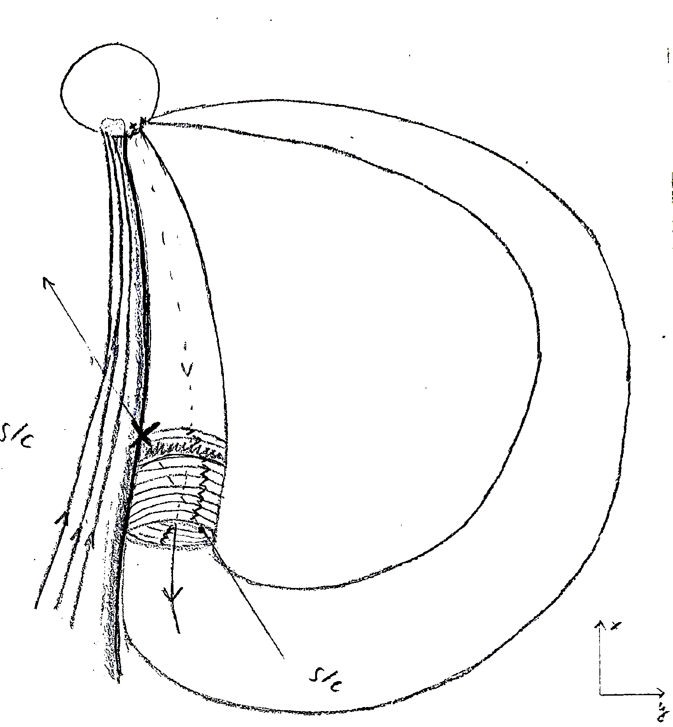
1
2*
3
CH
HSS
HPS
FR
AR
X
X
s/c
3
2*
1
X
X
X
X
X
X
3
2*
z_{GSE}
1
y_{GSE}
X_{GSE}
y_{GSE}
1
Notes:
Small FR-like signatures at the end of the ICME disturbance (as inferred from temp, composition, and speed), from GCS reconstruction: CME erupted toward south-east, flank hit at Earth (just „touching” the FR). Petschek-like reconnection at HCS crossing (slow mode wave), short passage through HPS (signified by drop-out), then high-speed stream.
PAD: 90° depletion, weak mirroring in the FR (trapped, accelerated electrons?), small drop-out inside FR, clear change in PAD at HCS crossing, HSS with clear unidirectional beam

