Slide 1





Quantifying the rate of erosion of simple terrestrial meteorite impact craters
Saranya R. Chandran¹, Shania James¹, Devika Padmakumar¹, Varsha M. Nair¹, and Sajinkumar Kochappi Sathyan^{1,2}
¹University of Kerala, Department of Geology, Trivandrum, India (saranyarchandran.geo@keralauniversity.ac.in)
²Department of Geological and Mining Engineering and Sciences, Michigan Technological University, Houghton 49931, MI, USA (skochapp@mtu.edu)

Slide 2

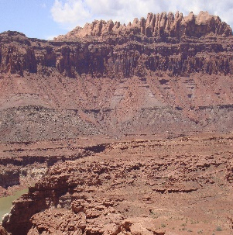
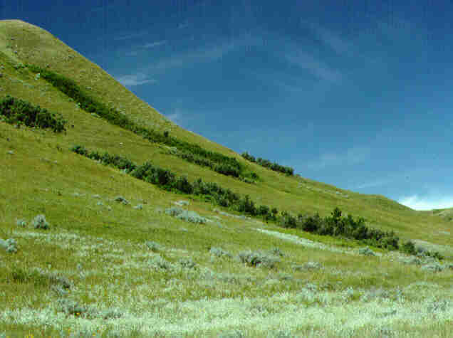
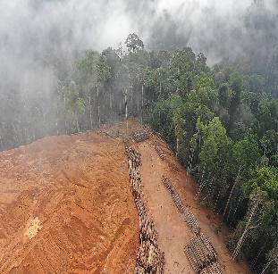


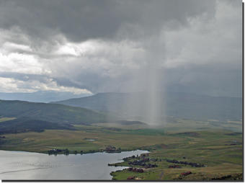
Introduction
Weathering and erosion are the chief exogenic processes that abrade the positive relief features as well as negate the negative features on the earth's surface.
Controlling factors
Climate
Lithology
Slope
Precipitation
Temperature
Vegetation
Anthropogenic factors
Erosion rates can be well studied in impetuous landforms such as volcanoes and meteorite impact craters

Slide 3
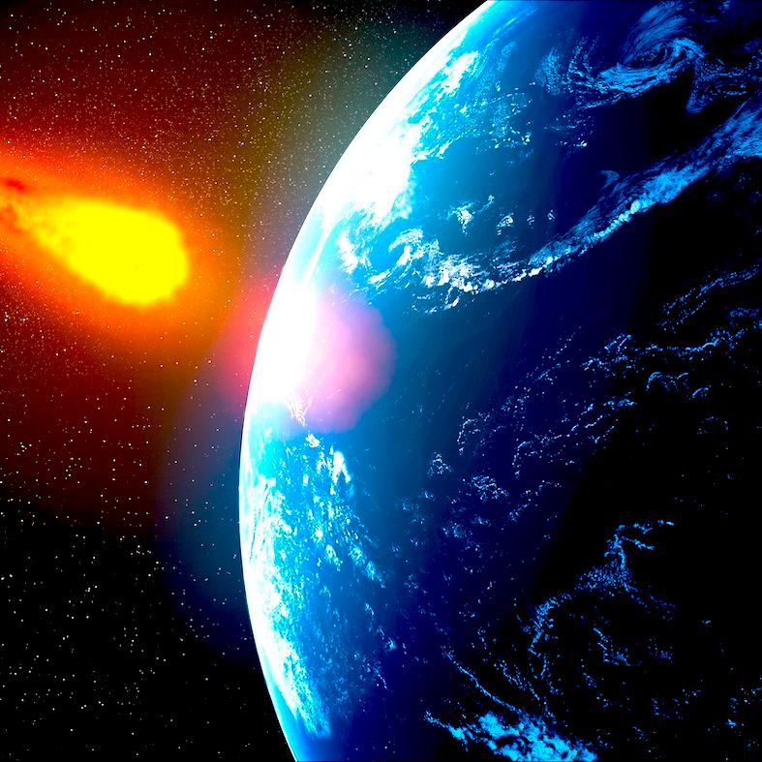
Impact cratering is a ubiquitous geological process that affects all planetary objects with a solid surface.
Quantification of erosion on meteorite impact craters is less attempted, except for Hergarten and Kenkmann (2019), Kenkmann (2021), Khosa et al. (2021) and Indu et al. 2022
Hergarten and Kenkmann (2019) attempt to quantify the rate of erosion as a function of climate and topography, using impact craters as a proxy.
Topography of the terrain has an important role in controlling the erosion rate.

Slide 4
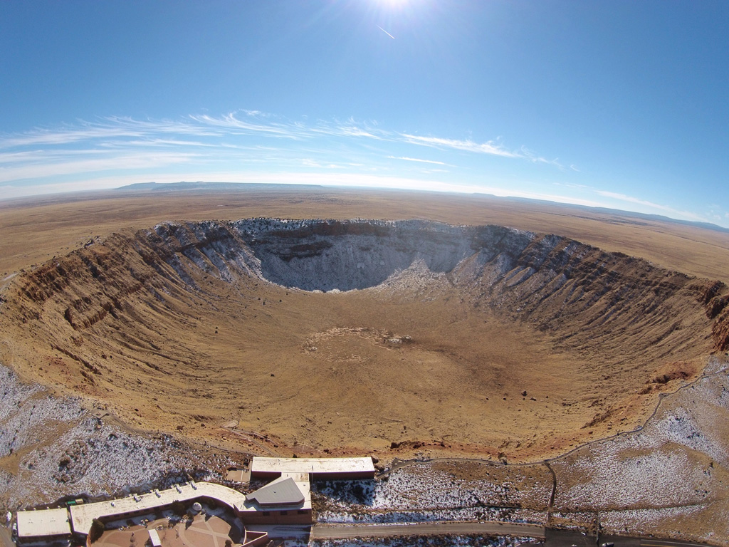
Simple meteorite impact craters on Earth are generally younger in age and they preserve their rimmed bowl shaped morphology, best exemplified by the Barringer crater in Arizona.

Slide 5
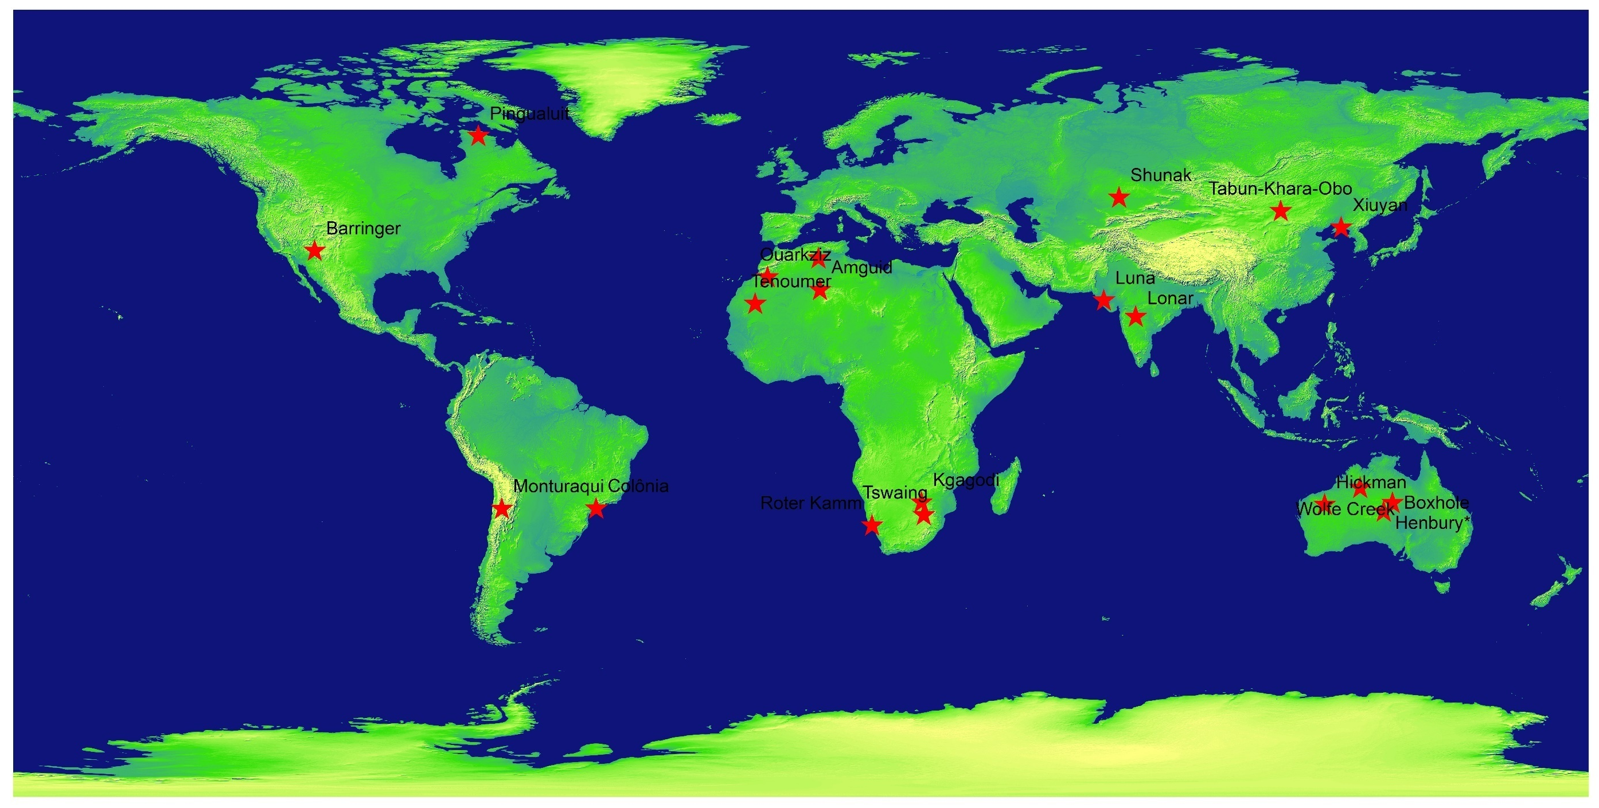
Selected Simple Meteorite Impact Craters for the study

Slide 6
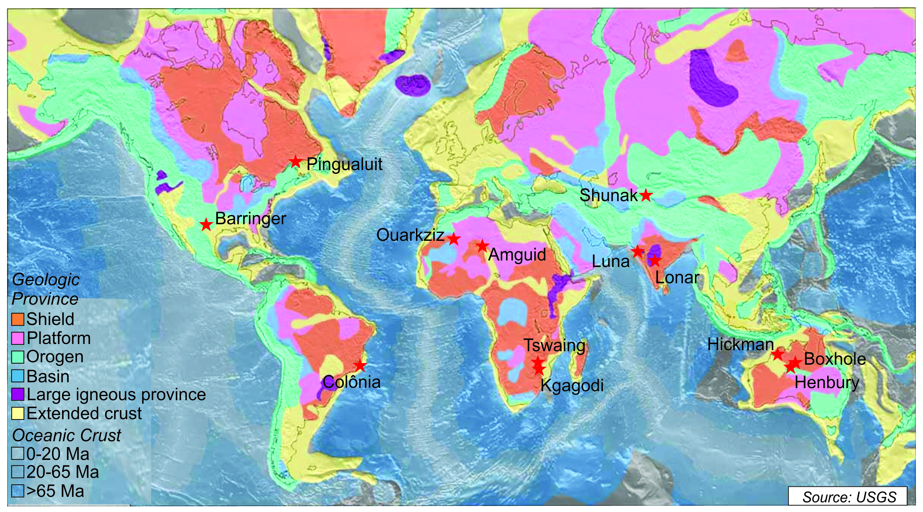
Geological province of the selected Simple Meteorite Impact Craters

Slide 7
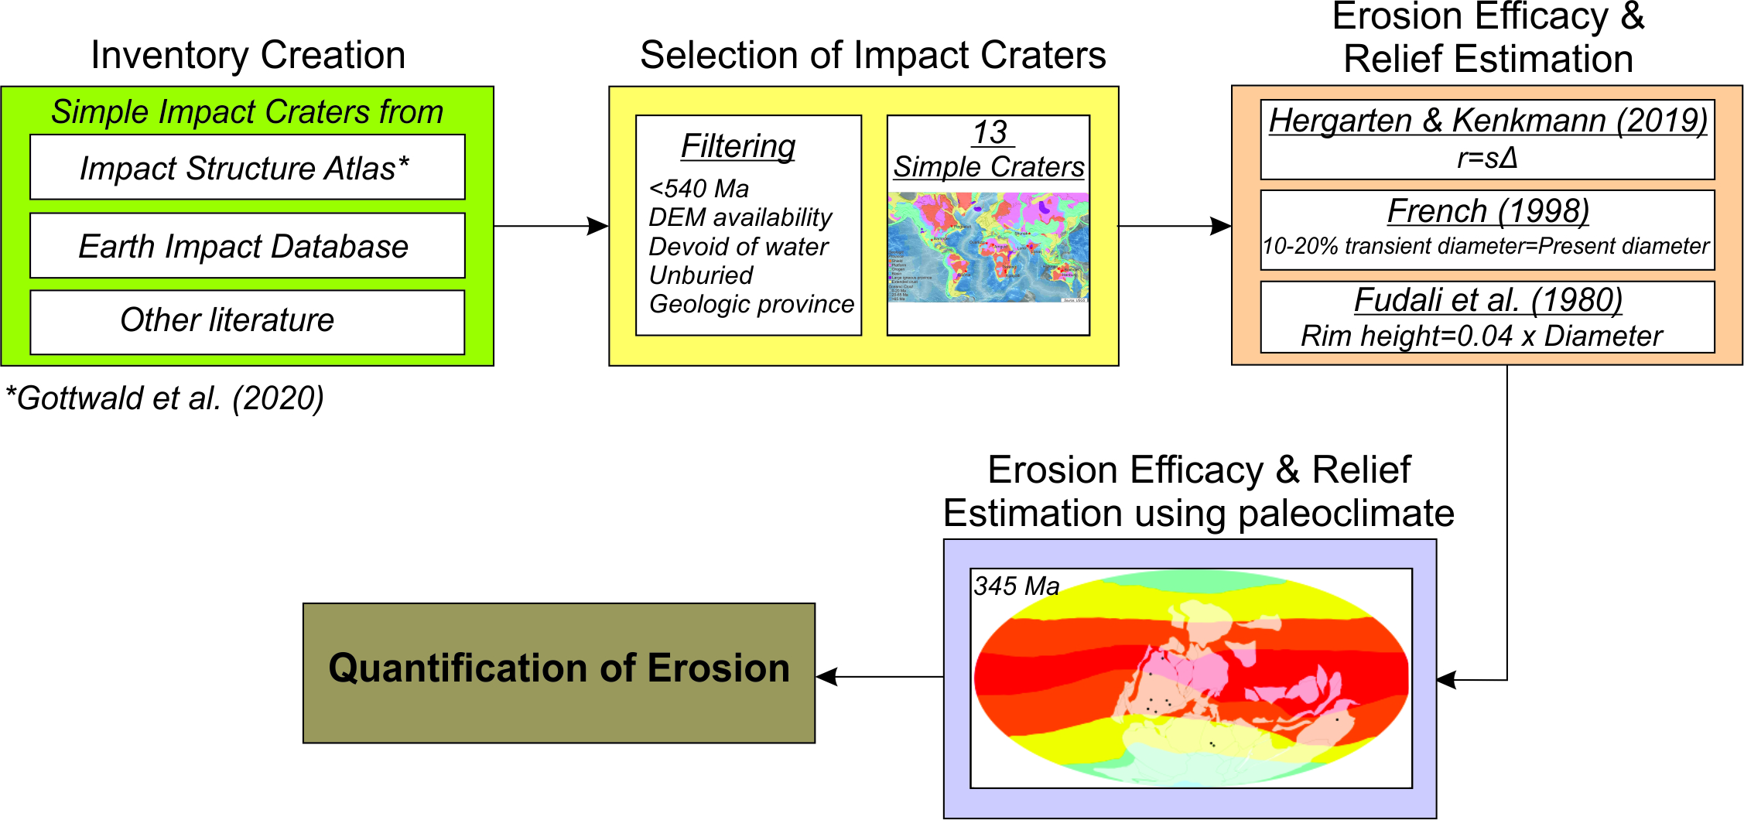
Methodology
Pike (1977) & Dence (1977)
Crater depth (relief)

Slide 8
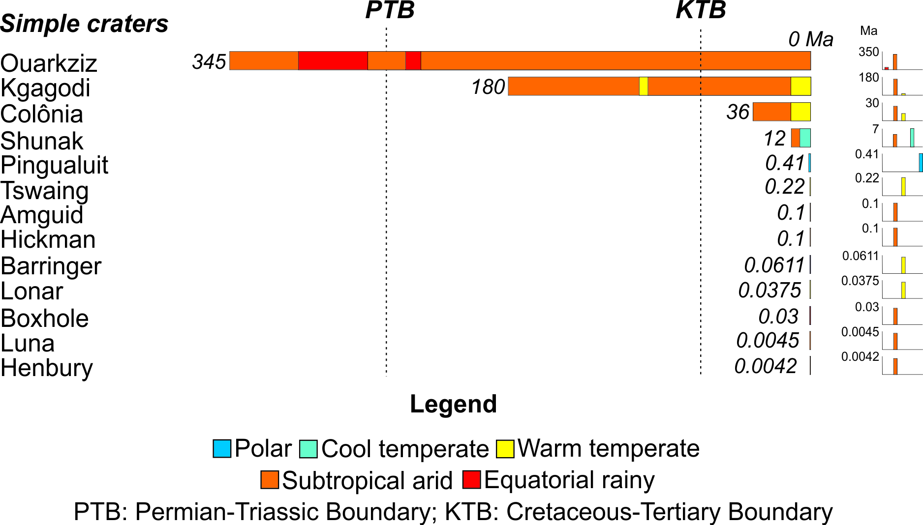
The temporal limit of craters in different climatic zone

Slide 9
Estimation of erosion efficacy (s):
Erosion efficacy is a quantitative measure that defines the extent of erosion of an entity while taking into accounts the respective climatic regimes
Climate zone | Equatorial rainy | Subtropical arid | Warm temperate | Cold temperate | Polar
Erosion efficacy values | 0.62 | 0.3 | 0.3 | 0.13 | 0.13
Erosion efficacy values of different climatic zones (Hergarten and Kenkmann 2019)
The final erosion efficacy of a crater that was in several climatic zones will be a combined effect of the many climatic zones

Slide 10
Estimation of initial depth (relief Δ) of craters:
Final crater diameter is 10-20% greater than the original transient cavity (French 1998; Keerthy et al. 2019).
Impact crater depth estimated using two equations; depth,
        d = 0.2 D_{R} Pike (1977)
        d = 0.33 D_{R} Dence (1977)
        where D_{R} is the transient crater diameter
        Estimation of erosion rate (r):
Rate of erosion, r = Δ s (Hergarten & Kenkmann 2019)
r estimated on the regional basis (Hergarten & Kenkmann 2019) as well as for individual craters.

Slide 11
Table showing the erosion efficacy and transient crater diameter estimated for the craters
SI No | Crater Name | Age (Ma) | Erosion Efficacy (s) | Present diameter (m) | Transient crater diameter (m)
 |  |  |  |  | 10% | 20%
1 | Henbury | 0.0042 | 0.3 | 180 | 163.64 | 150
2 | Luna | 0.0045 | 0.3 | 1200 | 1090.91 | 1000
3 | Boxhole | 0.03 | 0.3 | 170 | 154.55 | 141.67
4 | Lonar | 0.0375 | 0.3 | 1880 | 1709.09 | 1566.67
5 | Barringer | 0.0611 | 0.3 | 1180 | 1072.73 | 983.33
6 | Hickman | 0.1 | 0.3 | 260 | 236.36 | 216.67
7 | Amguid | 0.1 | 0.3 | 450 | 409.09 | 375
8 | Tswaing | 0.22 | 0.3 | 1130 | 1027.27 | 941.67
9 | Pinguluit | 1.4 | 0.13 | 3400 | 3090.91 | 2833.33
10 | Shunak | 12 | 0.13 | 2800 | 2545.45 | 2333.33
11 | Colonia | 36 | 0.3 | 3600 | 3272.73 | 3000
12 | Kgagodi | 180 | 0.3 | 3400 | 3090.91 | 2833.33
13 | Ouarkziz | 345 | 0.35 | 3500 | 3181.82 | 2916.67

Slide 12
Table showing the rate of erosion calculated for the geological province of the crater
SI No | Crater Name | Age (Ma) | Erosion Efficacy (s) | Relief (Δ) | Erosion rate (m/My)
1 | Henbury | 0.0042 | 0.3 | 112 | 33.6
2 | Luna | 0.0045 | 0.3 | 112 | 33.6
3 | Boxhole | 0.03 | 0.3 | 112 | 33.6
4 | Lonar | 0.0375 | 0.3 | 382 | 114.6
5 | Barringer | 0.0611 | 0.3 | 671 | 201.3
6 | Hickman | 0.1 | 0.3 | 112 | 33.6
7 | Amguid | 0.1 | 0.3 | 112 | 33.6
8 | Tswaing | 0.22 | 0.3 | 196 | 58.8
9 | Pinguluit | 1.4 | 0.13 | 172 | 22.36
10 | Shunak | 12 | 0.13 | 500 | 65
11 | Colonia | 36 | 0.3 | 138.6 | 41.58
12 | Kgagodi | 180 | 0.3 | 118.44 | 35.532
13 | Ouarkziz | 345 | 0.35 | 118.86 | 41.601

Slide 13
Table showing the rate of erosion calculated for individual craters
SI No | Crater Name | Pike (1977) |  | Rate of erosion, r (m/My) |  | Dence (1977) |  | Rate of erosion, r (m/My)
 |  | 10% | 20% |  |  | 10% | 20%
1 | Henbury | 32.73 | 30.00 | 9.82 | 9.00 | 54.00 | 49.50 | 16.20 | 14.85
2 | Luna | 218.18 | 200.00 | 65.45 | 60.00 | 360.00 | 330.00 | 108.00 | 99.00
3 | Boxhole | 30.91 | 28.33 | 9.27 | 8.50 | 51.00 | 46.75 | 15.30 | 14.03
4 | Lonar | 341.82 | 313.33 | 102.55 | 94.00 | 564.00 | 517.00 | 169.20 | 155.10
5 | Barringer | 214.55 | 196.67 | 64.36 | 59.00 | 354.00 | 324.50 | 106.20 | 97.35
6 | Hickman | 47.27 | 43.33 | 14.18 | 13.00 | 78.00 | 71.50 | 23.40 | 21.45
7 | Amguid | 81.82 | 75.00 | 24.55 | 22.50 | 135.00 | 123.75 | 40.50 | 37.13
8 | Tswaing | 205.45 | 188.33 | 61.64 | 56.50 | 339.00 | 310.75 | 101.70 | 93.23
9 | Pinguluit | 618.18 | 566.67 | 80.36 | 73.67 | 1020.00 | 935.00 | 132.60 | 121.55
10 | Shunak | 509.09 | 466.67 | 66.18 | 60.67 | 840.00 | 770.00 | 109.20 | 100.10
11 | Colonia | 654.55 | 600.00 | 196.36 | 180.00 | 1080.00 | 990.00 | 324.00 | 297.00
12 | Kgagodi | 618.18 | 566.67 | 185.45 | 170.00 | 1020.00 | 935.00 | 306.00 | 280.50
13 | Ouarkziz | 636.36 | 583.33 | 222.73 | 204.17 | 1050.00 | 962.50 | 367.50 | 336.88

Slide 14
Impact craters are ideal structures for measuring erosion because they are pristine geological features that have formed on the earth's surface with elevated morphological elements such as crater rims and central peaks, which can record the elevation variation due to denudational effects.
Each crater reflect unique erosional characteristics, primarily dependent on the climatic conditions it is exposed to.
However, the variations of the calculated values of erosion rate from the actual rate of erosion reported for some craters are attributed to the various local elements in the vicinity of the crater, including the influence of drainage, tectonic activities, precipitation, temperature, and lithology.

Slide 15

THANK YOU!

