Slide 1

Tectonic Characteristics and Controls on Hydrocarbon Accumulation in Middle Section of Western Sichuan Depression
Xinpeng Wang ^{1,2}, Shuping Chen¹, Chi Zhang² and Wenyong Li³
¹ College of Geosciences, China University of Petroleum, Beijing 102249, China
² Institute of Meteorology and Geophysics, University of Vienna, Vienna 1090, Austria
³ Sinopec Geophysical Research Institute, Nanjing 211103, China
EGU General Assembly 2022, Vienna
2022.05.26

Slide 2
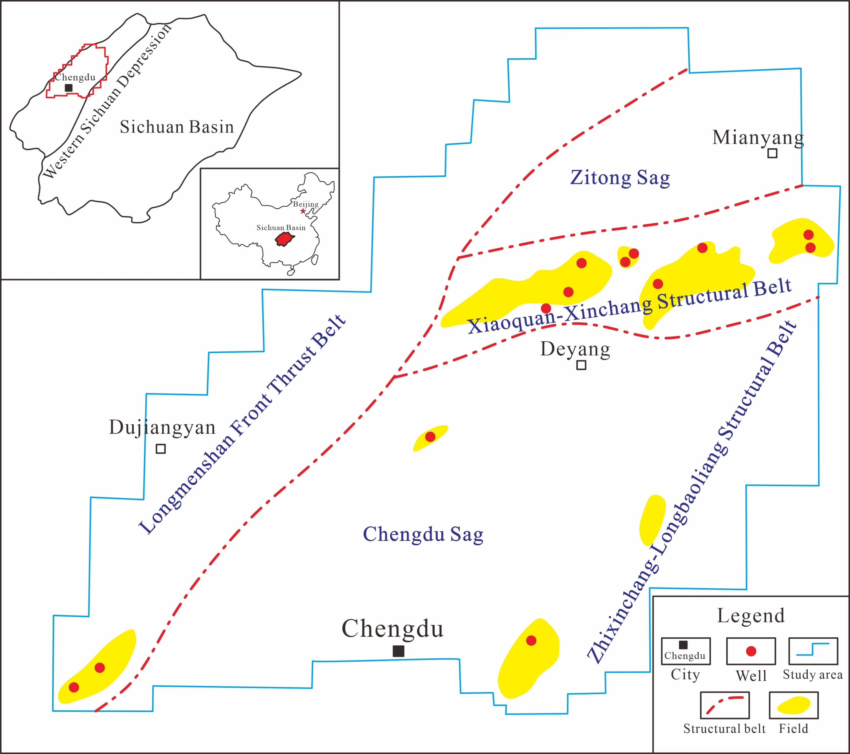
Overview
In recent years, the wells have obtained a lot of gas in Middle Section of Western Sichuan Depression.
great oil and gas
exploration potential
Existing problem
Multiple tectonic movements, which superimposed on each other
Low quality seismic data
Lacking a unified structural understanding
Significance
Reveal structural styles of the piedmont belt in the foreland basin and establish reliable evidences for the further exploration
Location of study area(adapted from SINOPEC)

Slide 3
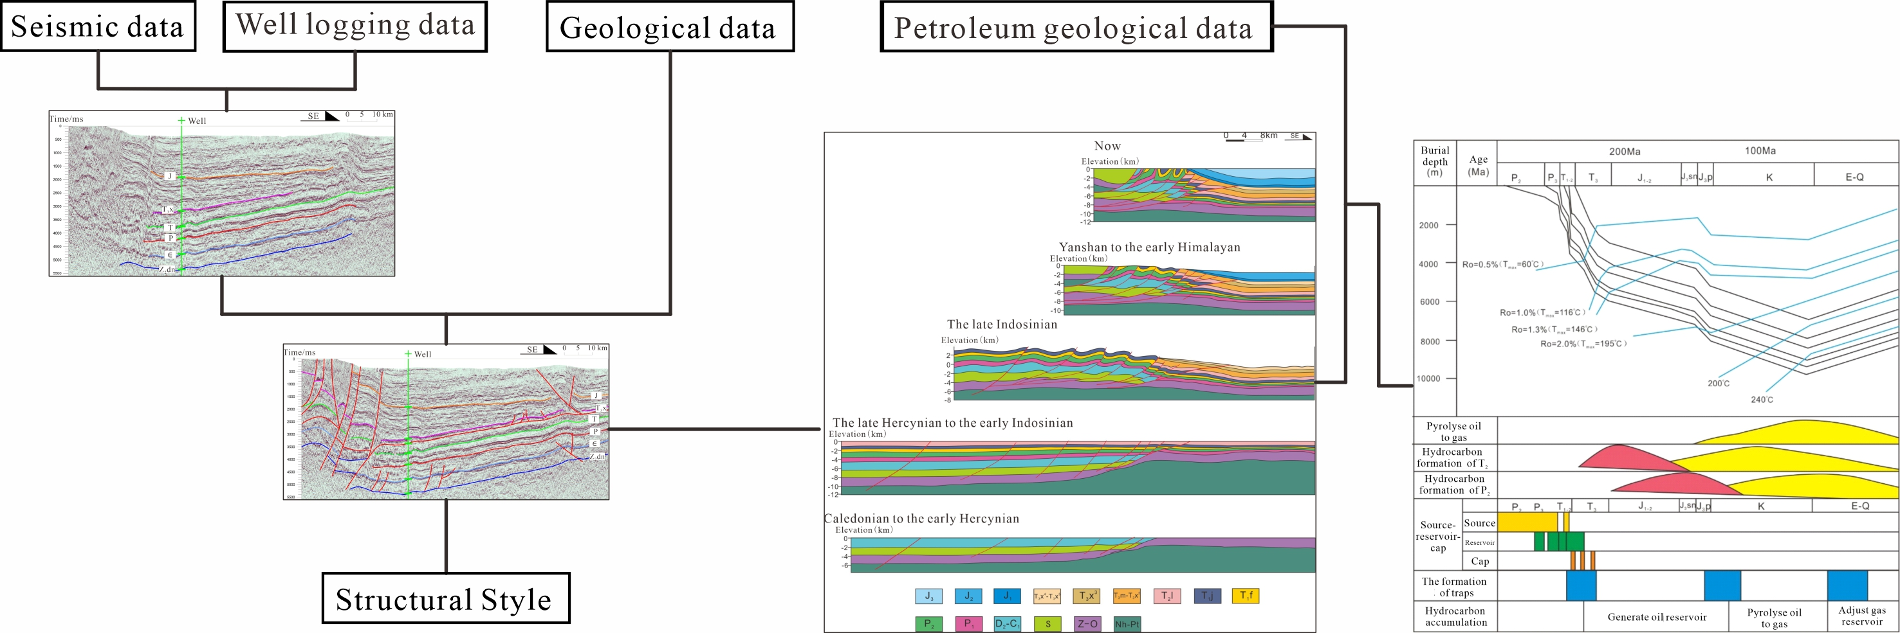
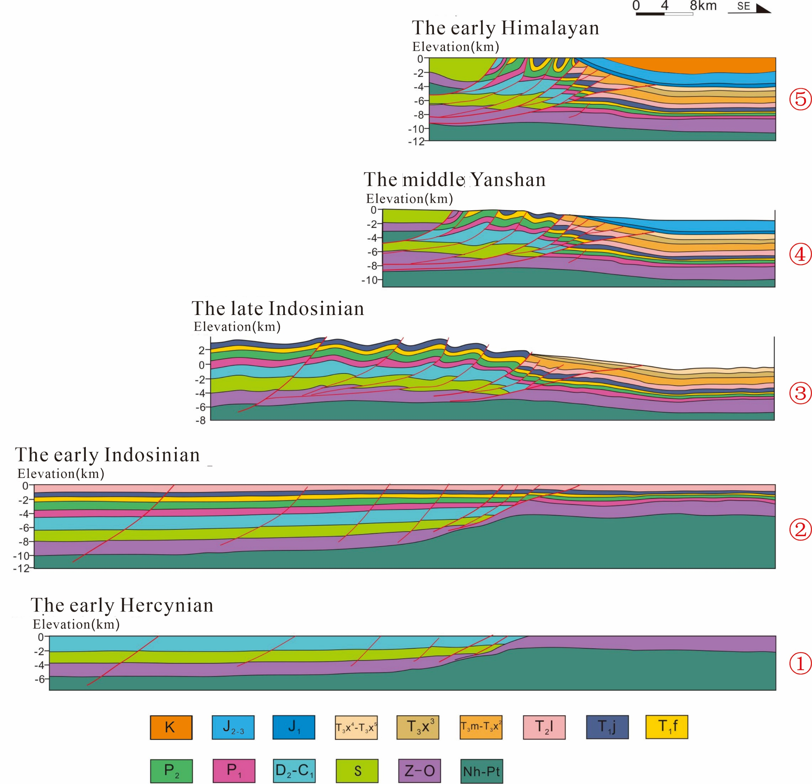
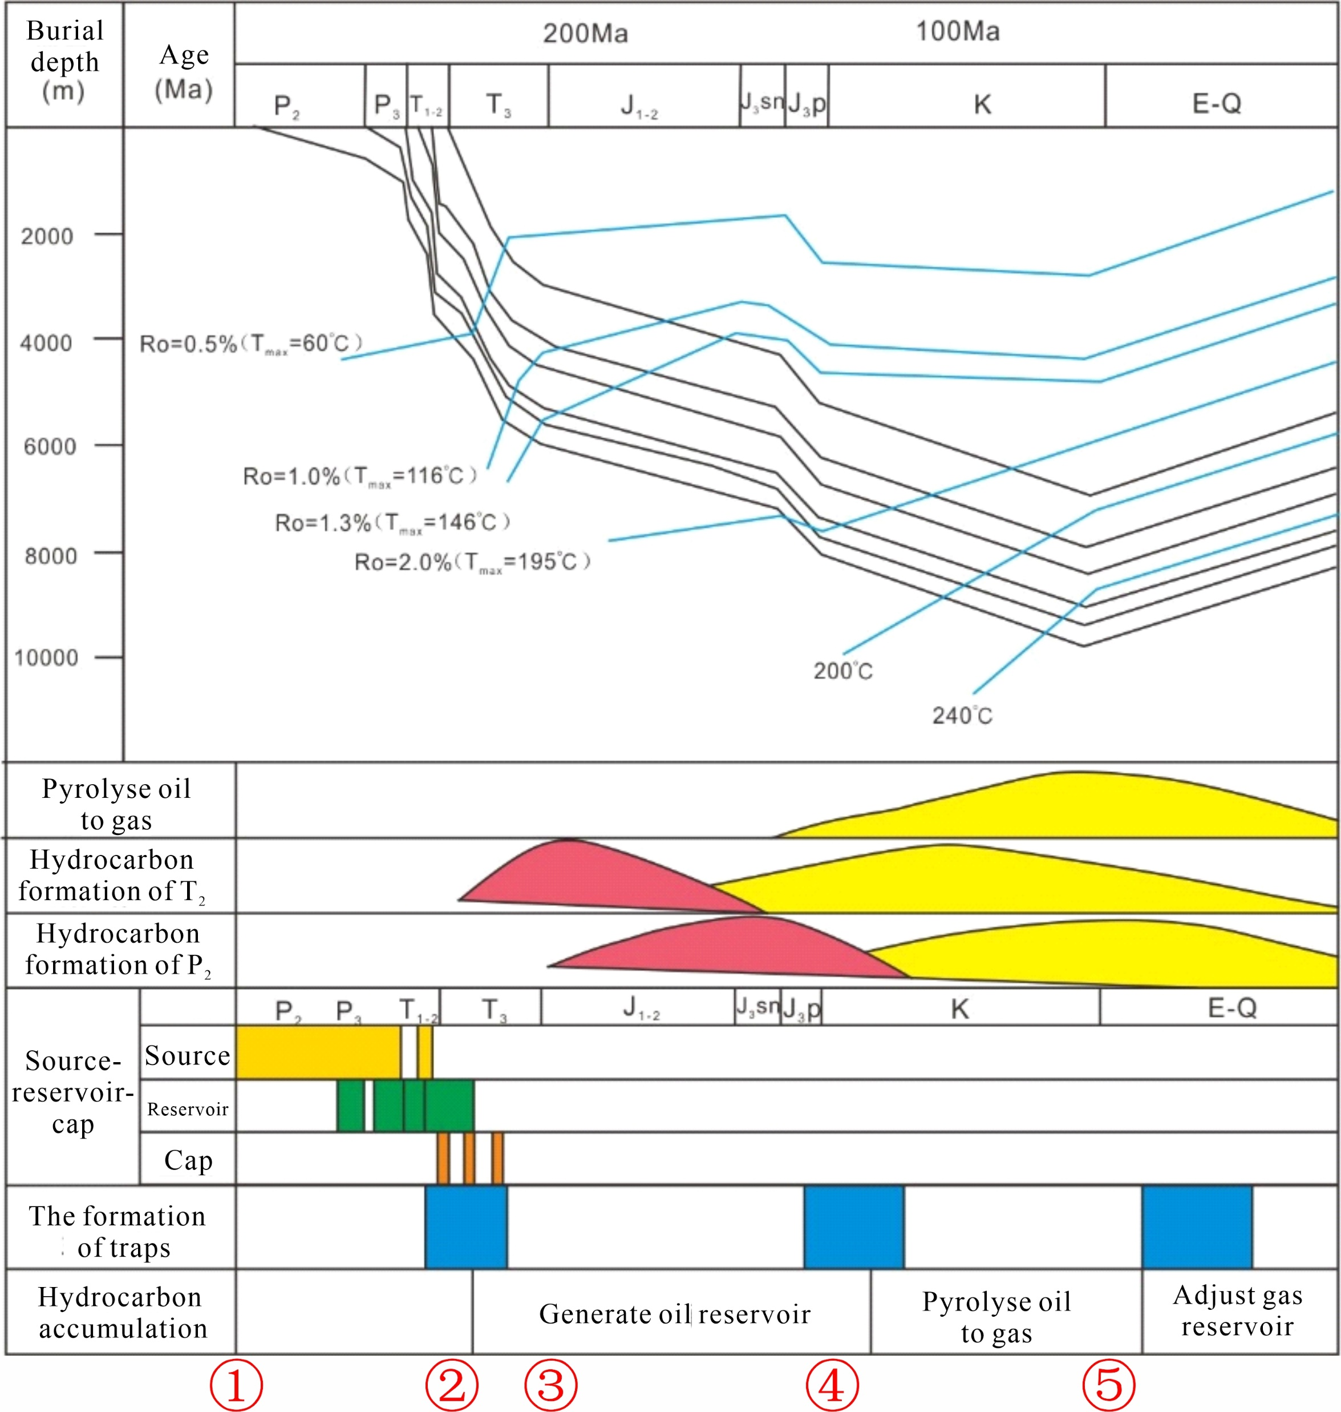
Data and methods
Data：Geological data, Seismic data, Well logging data and Petroleum geological data
Methods: Seismic interpretation technique and Balanced cross section technique
Technology Roadmap

Slide 4
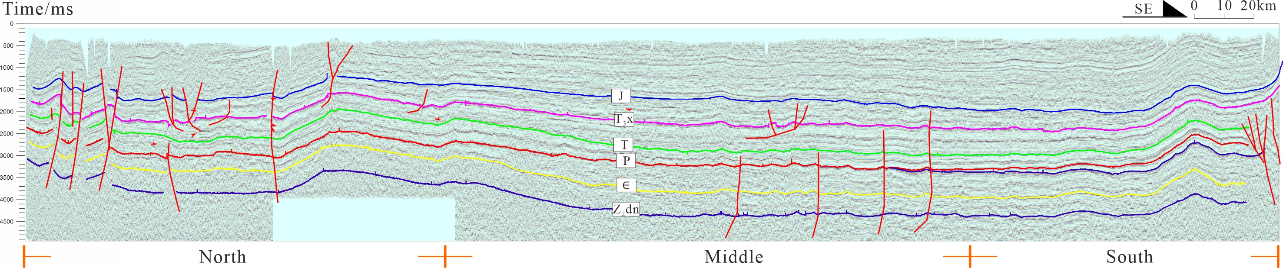
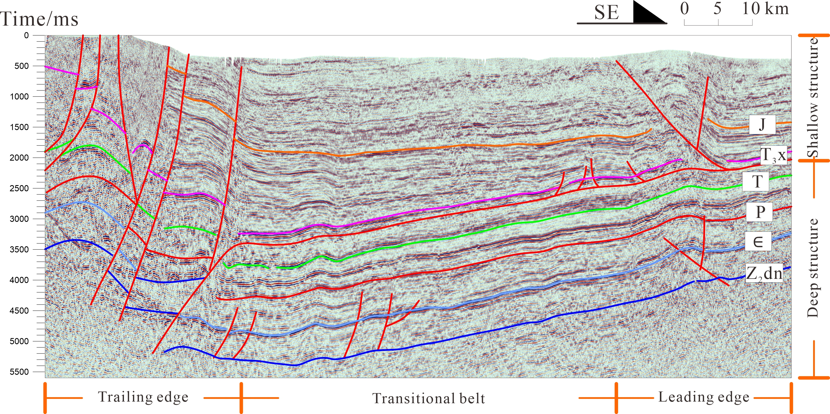
Results
The Middle Section of Western Sichuan Depression is characterized by north-south zonation, east-west zonation and up-down stratification.
North-south seismic profile
Reasons
North-south zonation: the surrounding mountains
East-west zonation: the moment of tectonic stress
Up-down stratification: the detachment surface
East-west seismic profile

Slide 5
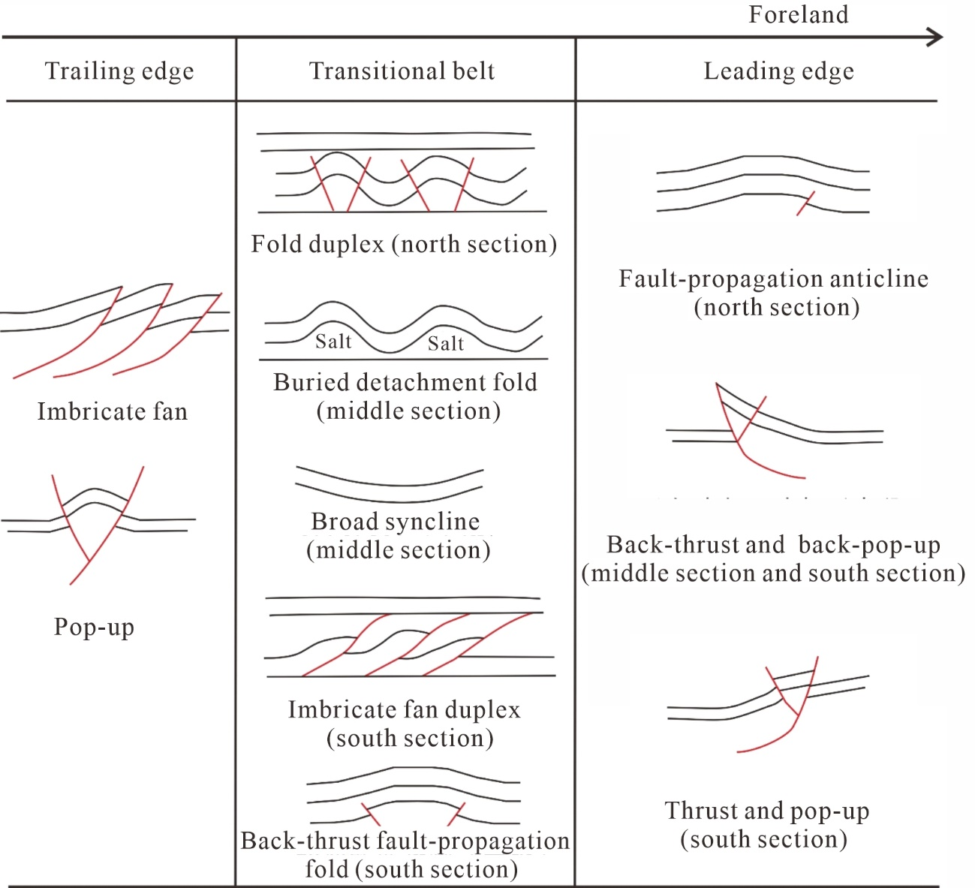
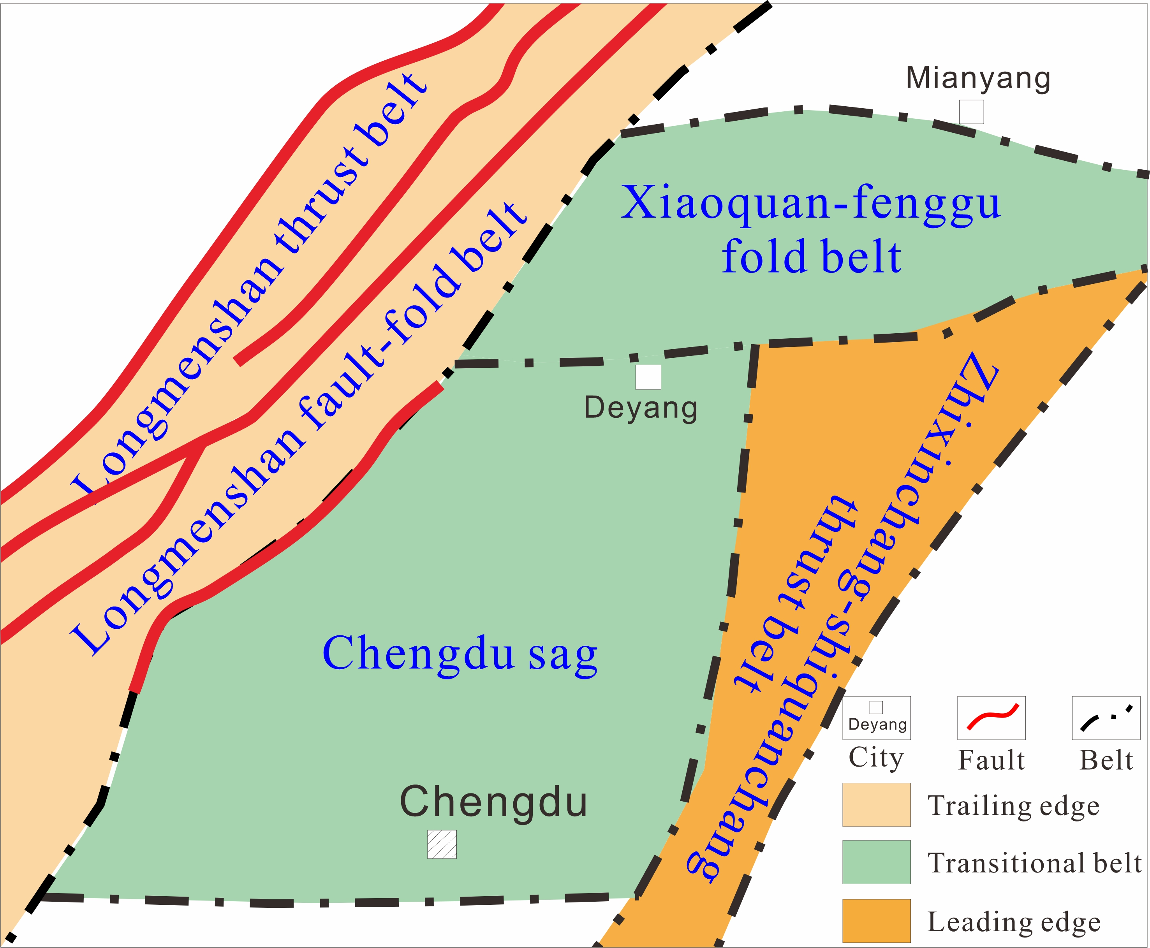
Results
On the whole, the sag is held by NE uplifting belt on both sides.
The summary table of structural styles
The map of tectonic division

Slide 6
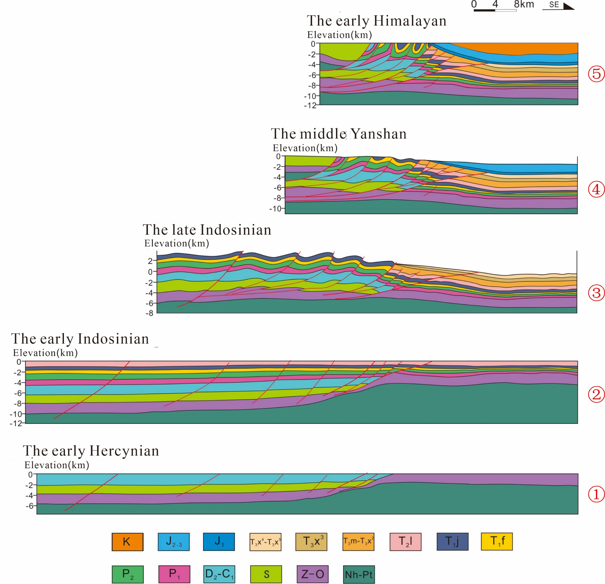
Results
Tectonic evolution and controls on hydrocarbon
Tectonic evolution map
Gas reservoir formation process(adapted from SINOPEC)

Slide 7
Conclusions
The middle section of Western Sichuan Depression is characterized by north-south zonation, east-west zonation and up-down stratification.
The middle section of Western Sichuan Depression is dominated by thrust, including thrust structures and fold deformation related to thrust faults.
The superior accumulation conditions and tectonic conditions make the middle section of Western Sichuan Depression show more favorable exploration potential.
Thanks!
Email: xinpeng_wang@yeah.net

