Slide 1




Do Large Earthquakes along Major Faults Synchronize in Time?
Eyüp Sopacı¹
Atilla Arda Özacar^{1,2}
¹ Geodetic and Geographic Information Technologies / Middle East Technical University/ Ankara/Turkey, eyup.sopaci@metu.edu.tr
² Geological Engineering Department / Middle East Technical University/ Ankara/Turkey, ozacar@metu.edu.tr
Sopaci&Özacar, EGU, 2022
1
Notes:
DSDFGDFH

Slide 2

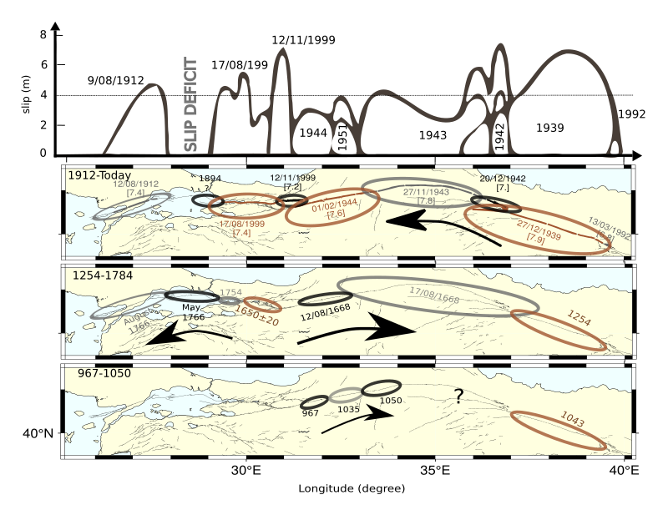
Motivation
Synchronized behavior of large earthquakes (NAF)
Is synchronized seismic activity a fact or just a coincidence?
Our previous analyses of triggering on spring-slider reveal followings are sensitive
Weakening terms
Direct velocity effect
“a” parameter
Stein et.al. (1996), Parsons. (2004),
Pondard et.al. (2007)
Sopacı & Özacar (2020)
Sopaci&Özacar, EGU, 2022
2
Notes:
DSDFGDFH

Slide 3
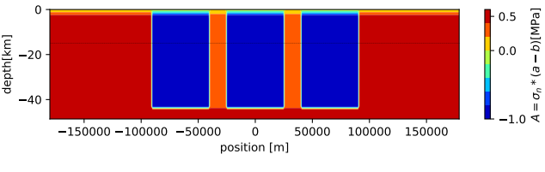
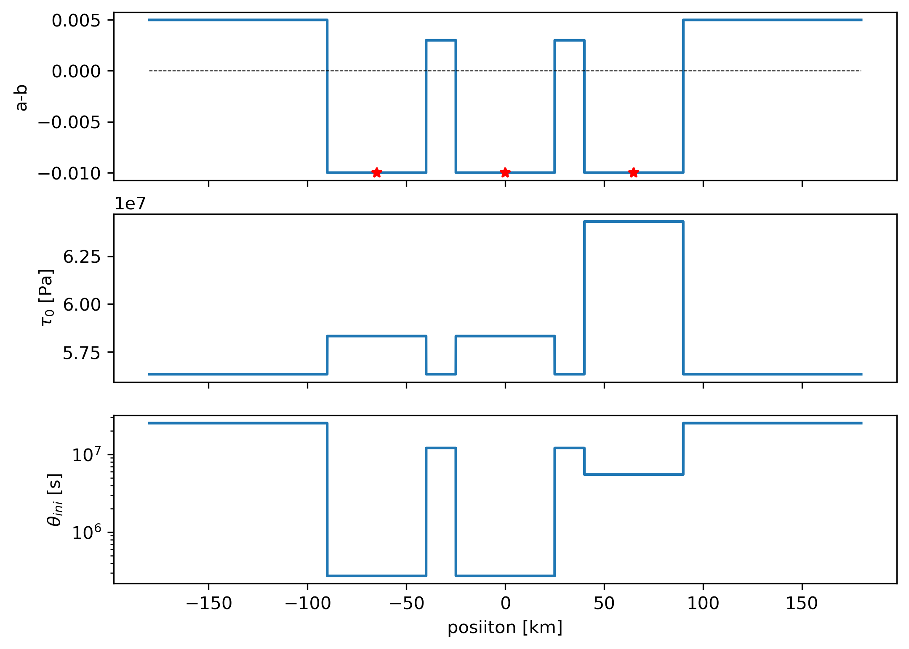

Simulation Set-up
2-5D continuum model using spectral boundary integral method obeying rate and state friction (Aging & Slip laws). Luo &Ampuero (2018)
W
Quasi-Dynamic (QD) & Full-Dynamic (FD) simulations Lapusta et.al. (2000)
λ: replication distance
a-b >0
creeping
a-b<0
asperity
barrier
W
V_{PL}
Spectral Earthquake Simulator
Sopacı & Özacar (in prep.)
Params. | min | max | default
a_{min} | 0.005 | 0.02 | 0.01
Dc (mm) | 2 | 16 | 8
L_{asp} (km) | 50 | 100 | 50
L_{bar} (km) | 5 | 20 | 15
a-b_{asp} | -0.01 | -0.005 | -0.01
a-b_{bar} | 0.000 | 0.005 | 0.003
σ_{n}(MPa) | 50 | 100 | 100
$$τ_{ini} [Pa]$$
V_{PL}:20mm/s, μ:30GPa, c_{s}:3km/s, W:50km
Notes:
DSDFGDFH

Slide 4
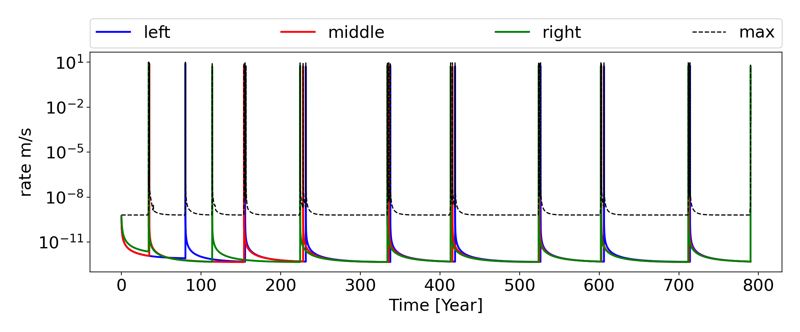
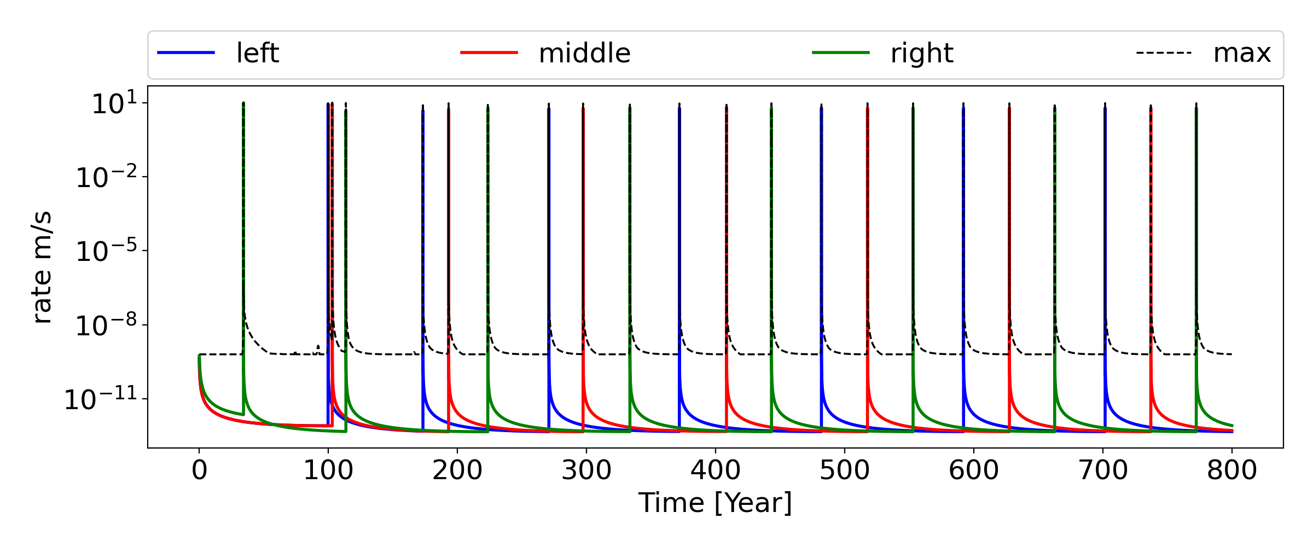
SYNCHRONIZATION
UN-SYNCH.

Slide 5
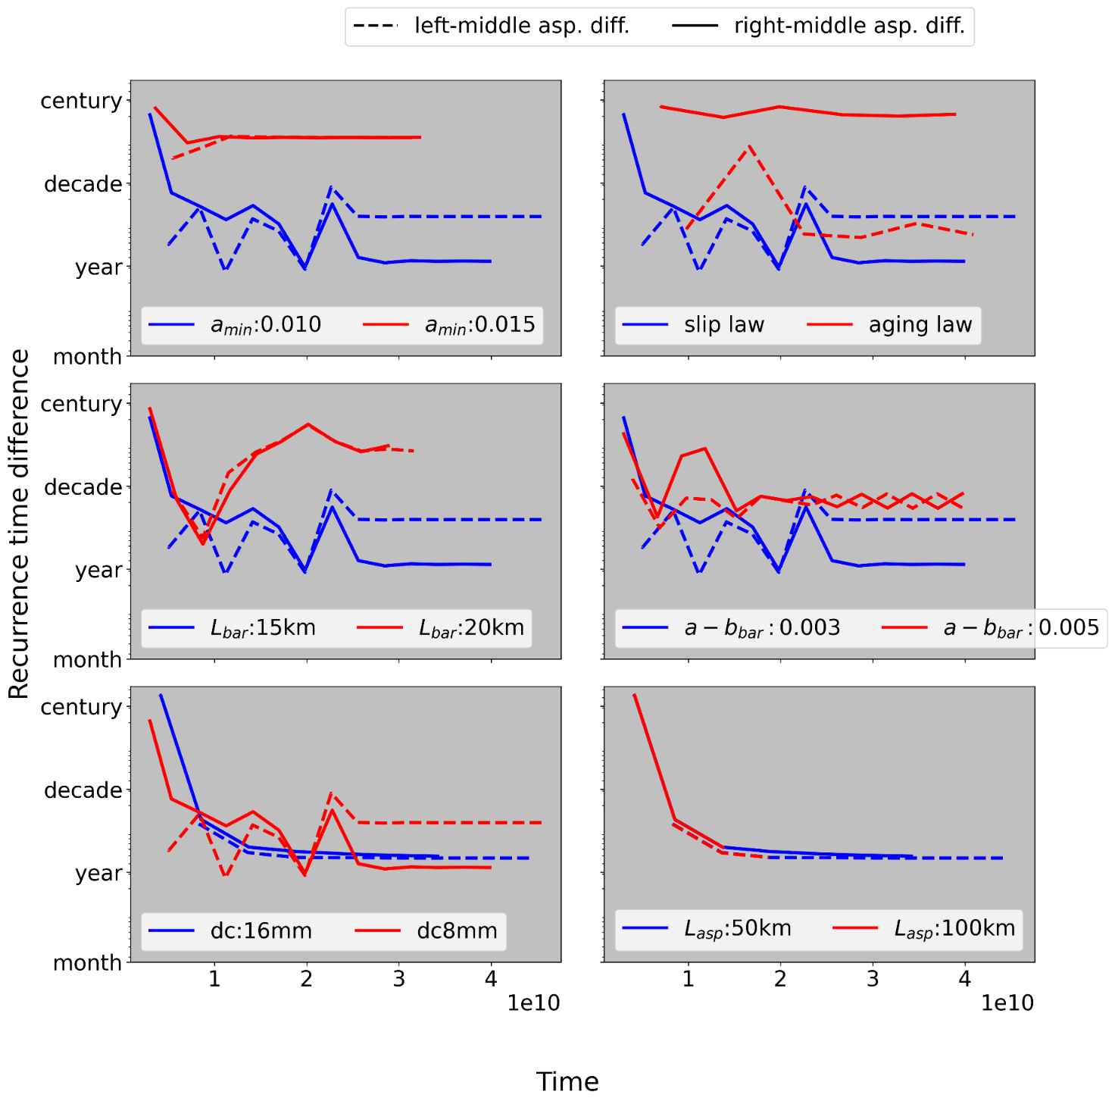
Sensitivity Analyses (QD)
higher direct velocity effect «a»; higher frictional strength to velocity, less synchronization
The state evolution law does change synch. The state that has stronger weakening term (slip law) leads synchronization.
Sync. also depends on barrier length (L_{bar}) and its frictional properties (a-b_{bar}).
Lower critical slip distance (dc) leads localized slips, thus slower synch.
The length of asperity (L_{asp}) is insensitive to synch., unlike to analog studies (Corbi et al., 2017; Rosenau et al., 2019)
L_{bar}: length of barrier
a-b_{bar}:barrier’s frictional property
L_{asp}:length of asperity
a_{min}: asperity’s direct velocity effect
Dc: critical slip distance
5
Sopaci&Özacar, EGU, 2022
Notes:
DSDFGDFH

Slide 6
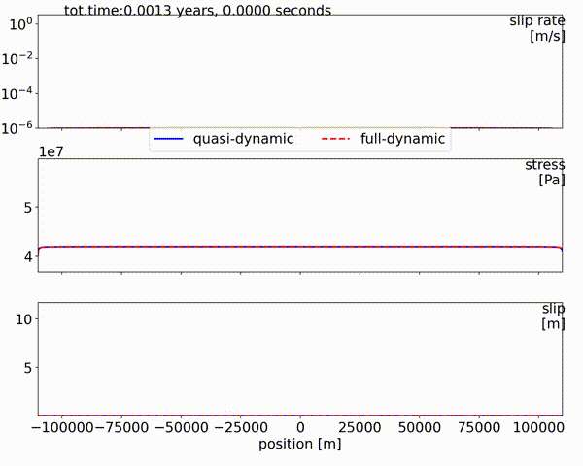
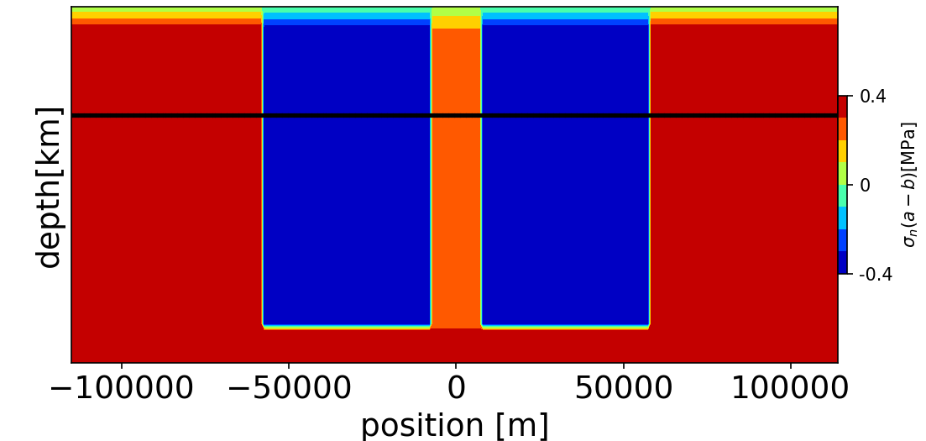
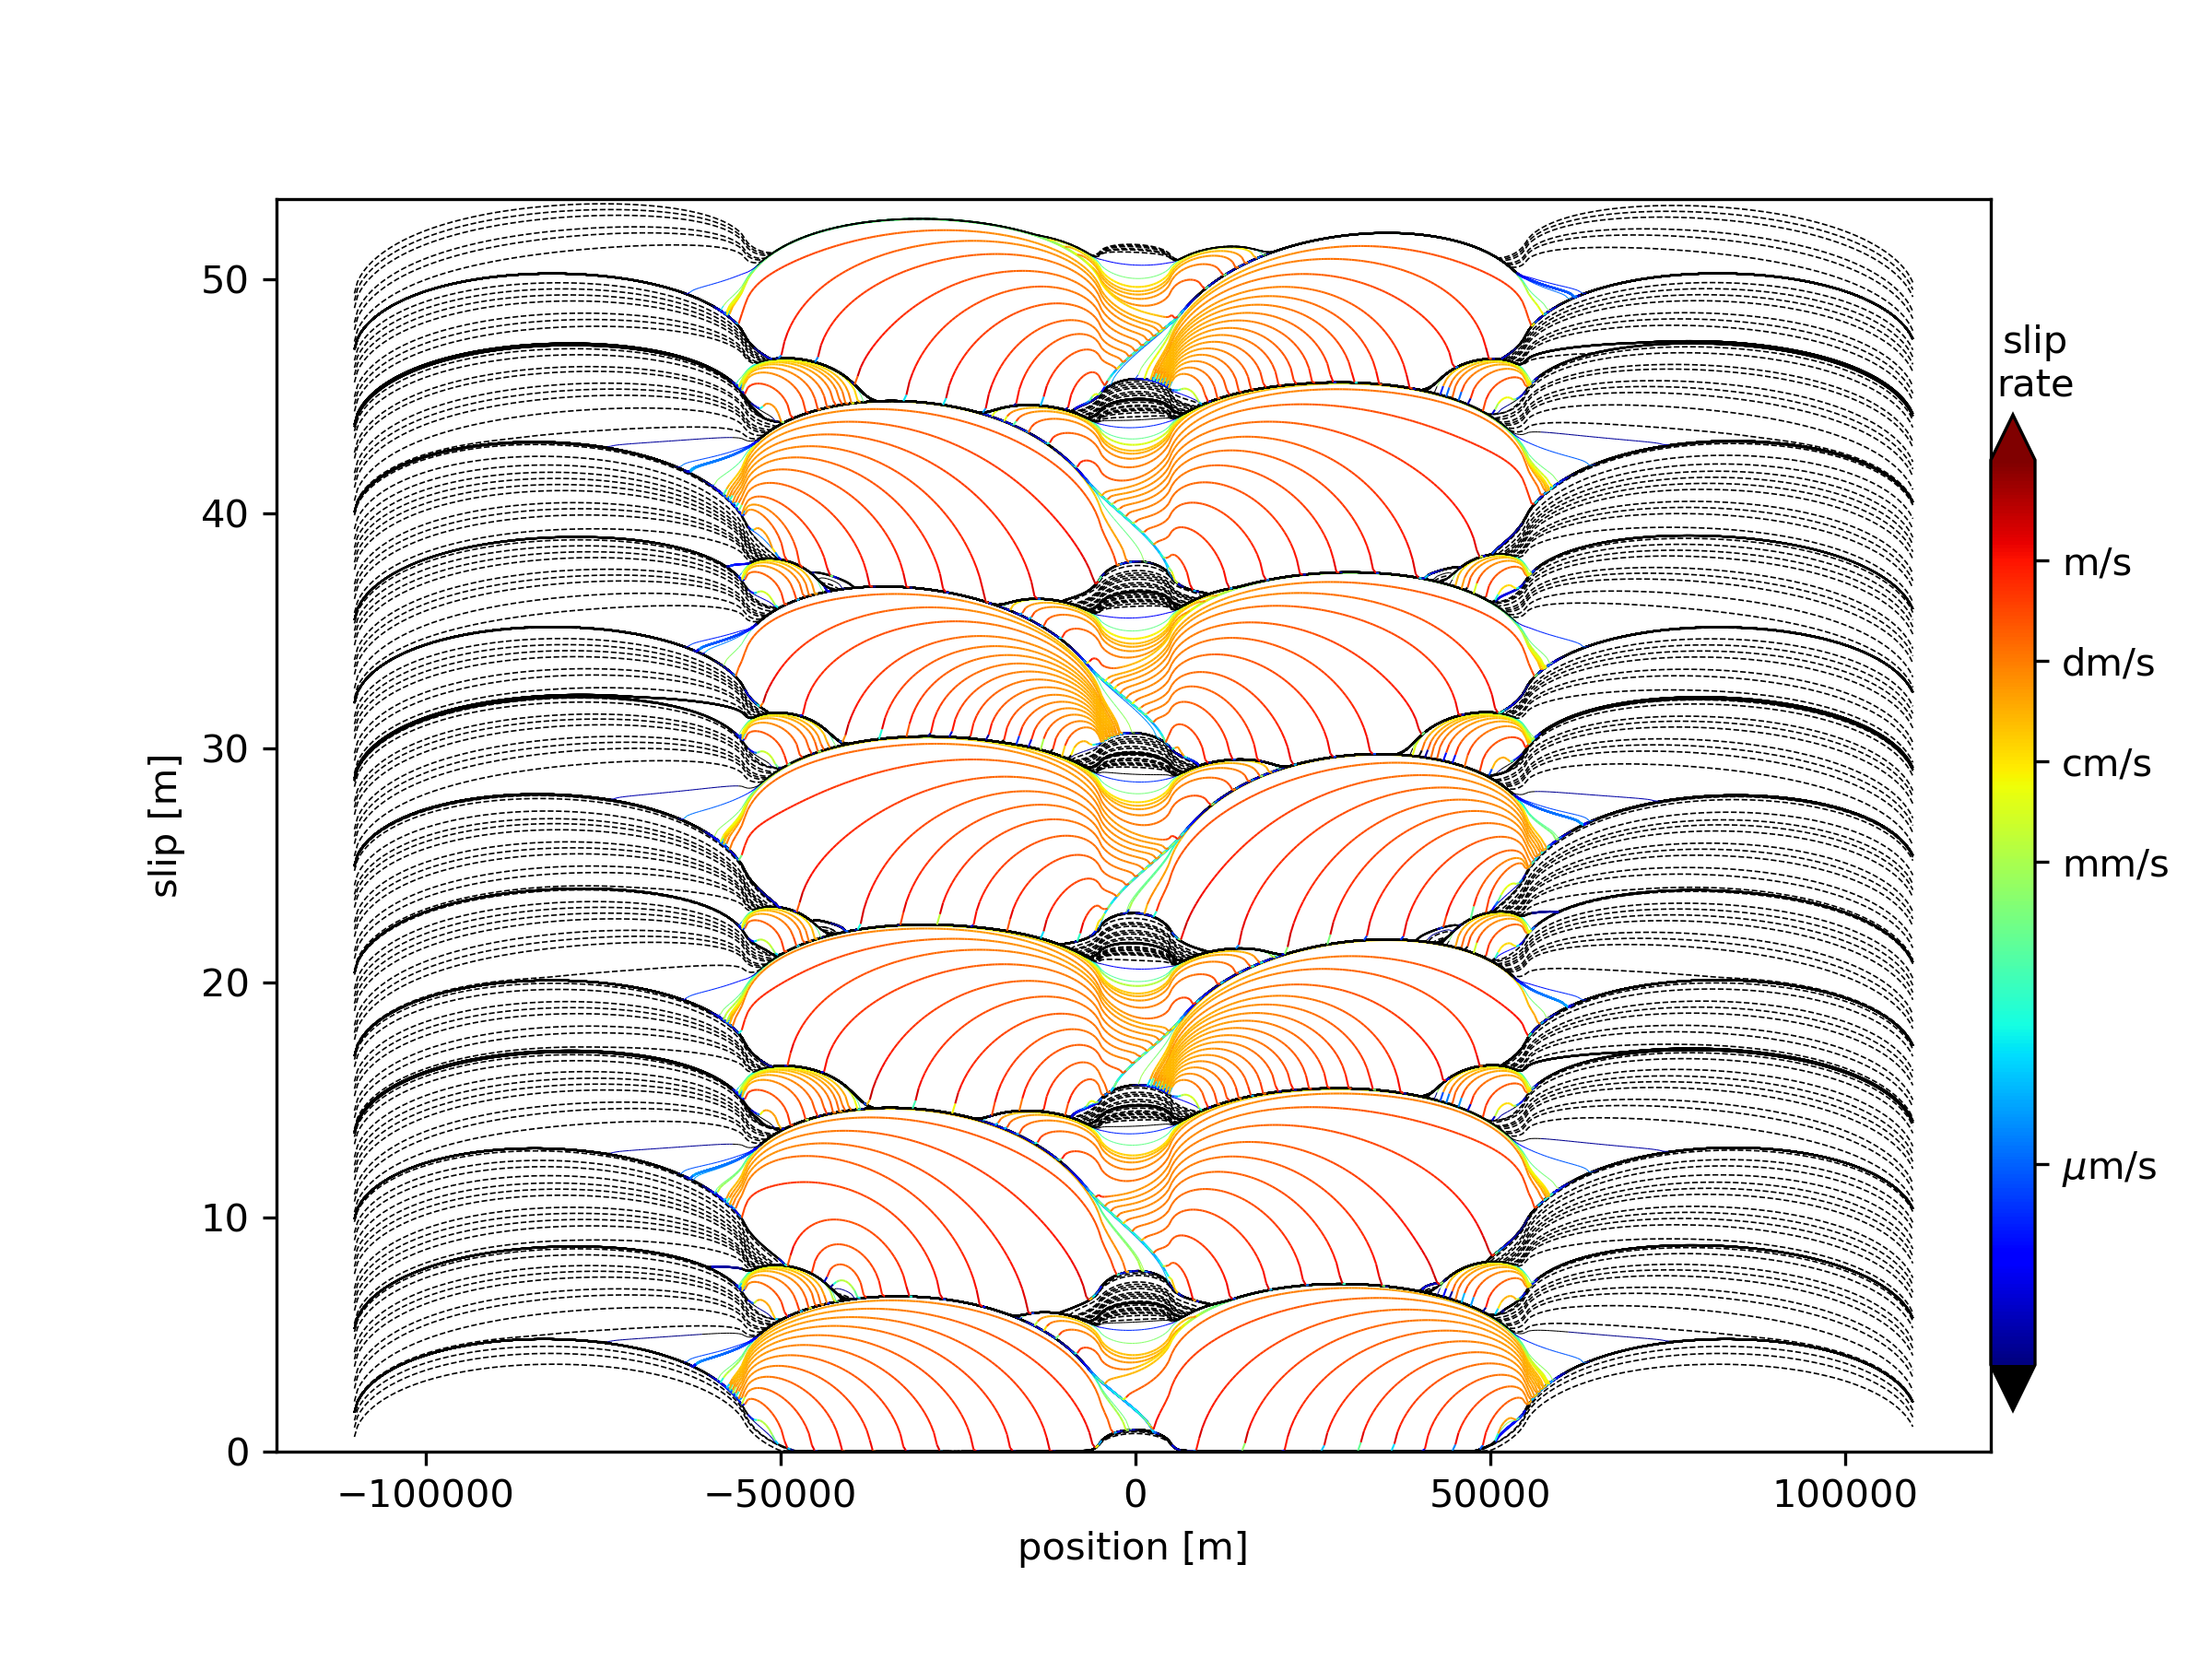
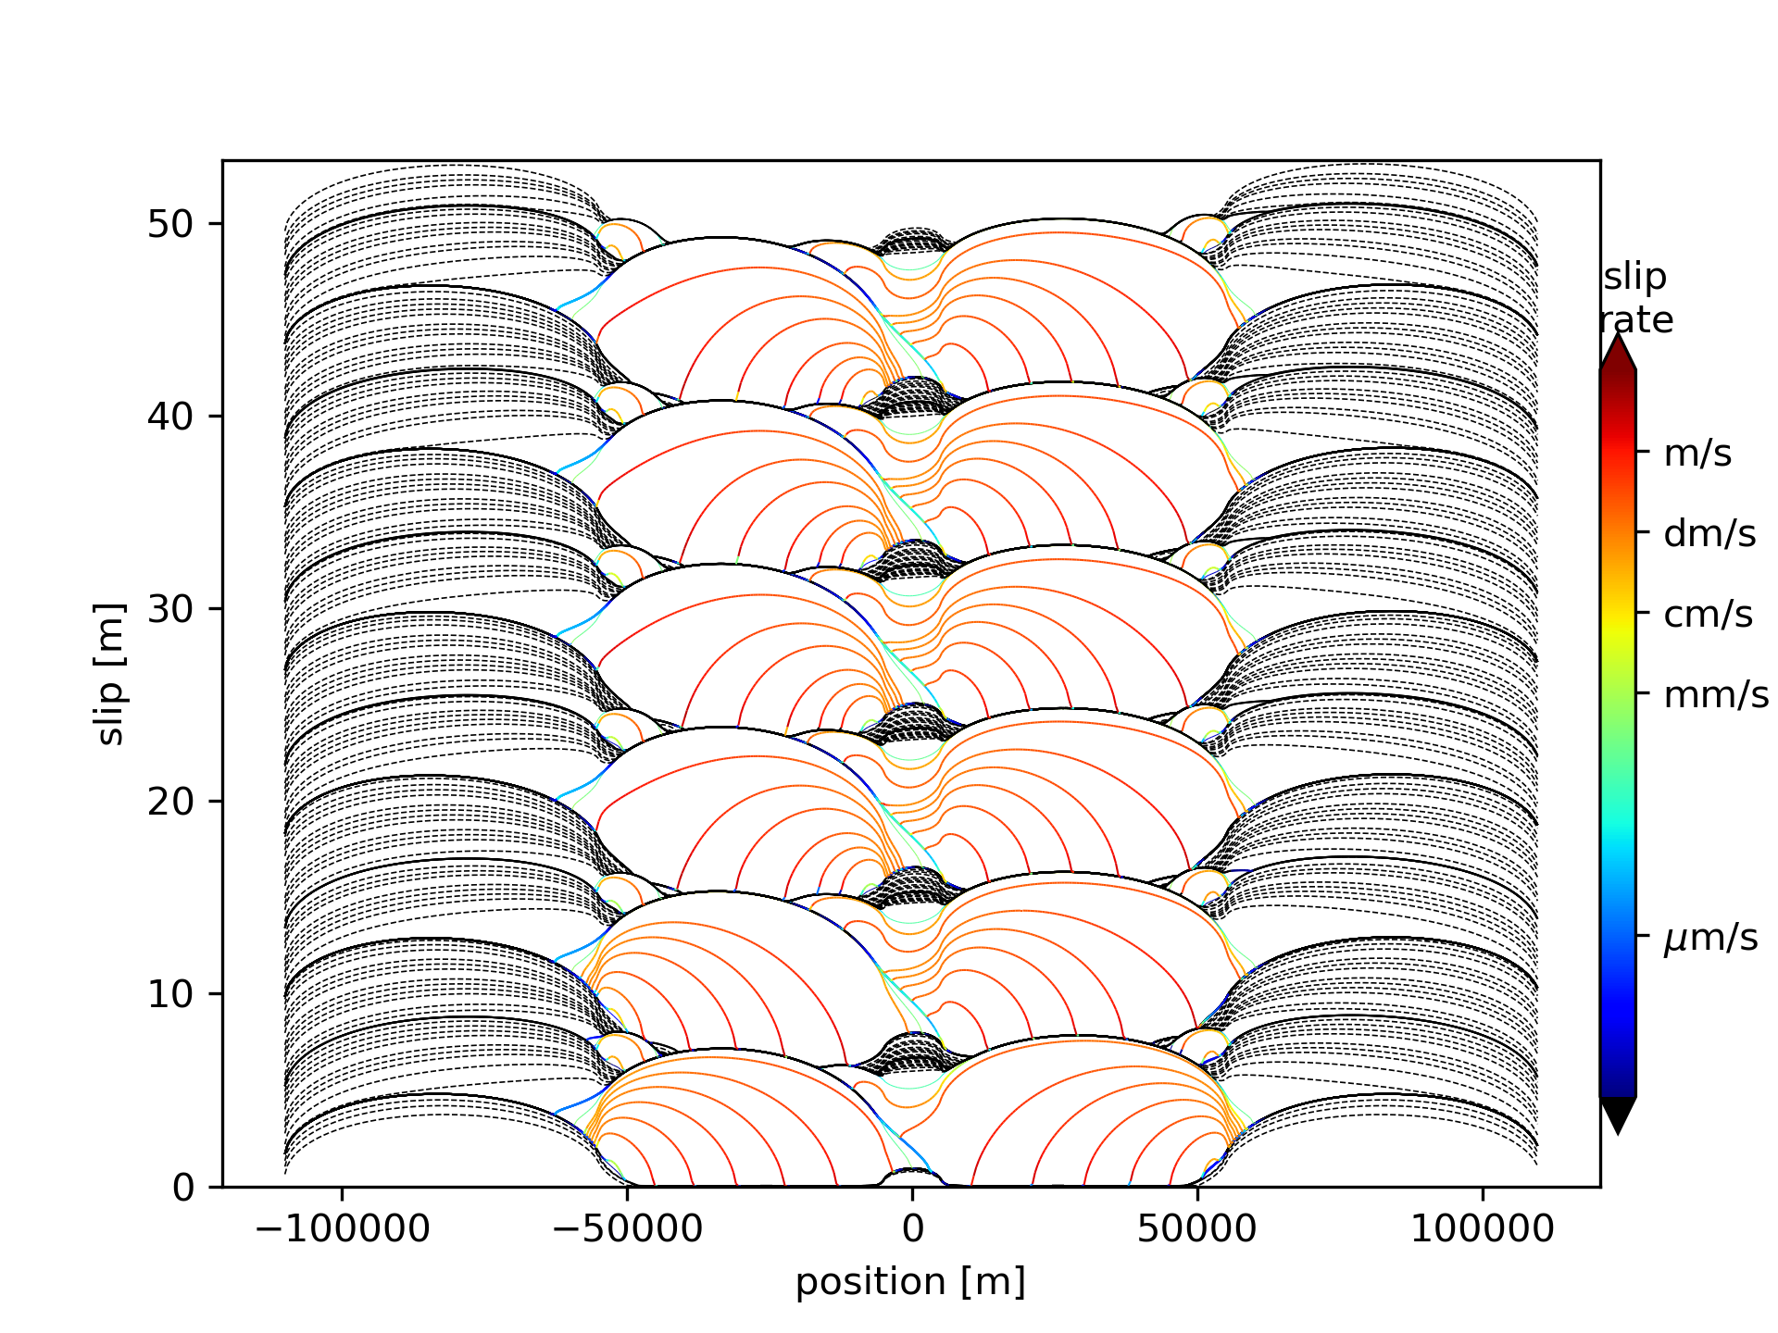
QD versus FD
Set-up,
identical two asperities. Aging law
(QD)
(FD)
Sopaci&Özacar, EGU, 2022
6
Notes:
DSDFGDFH

Slide 7
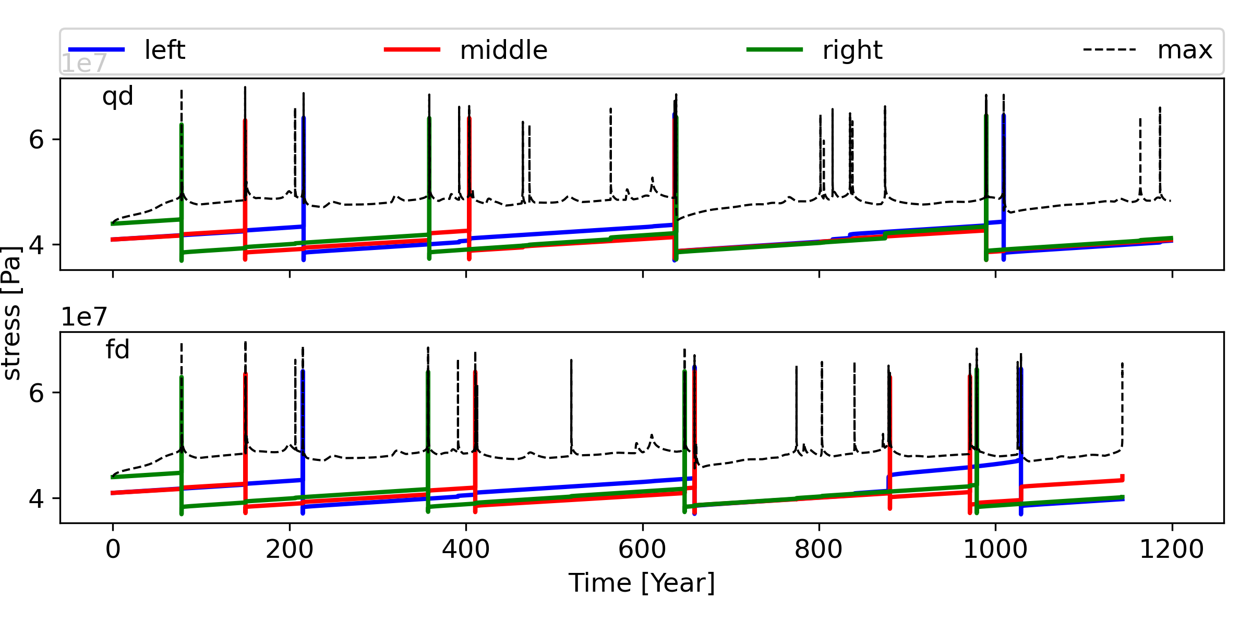
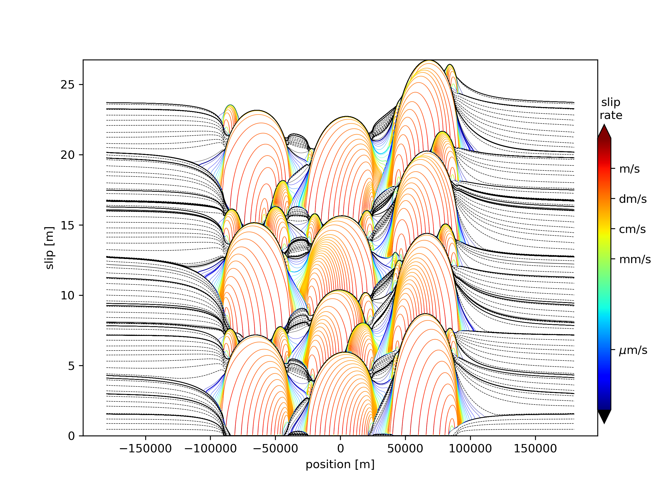
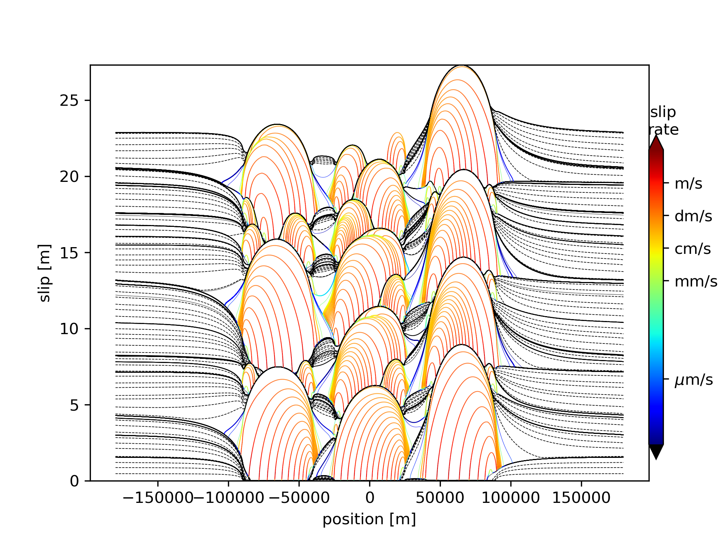
QD versus FD (synch.)
Params. | value
a_{min} | 0.01
b | 0.015
Dc (mm) | 16
L_{asp} (km) | 50
L_{bar} (km) | 15
a-b_{asp} | -0,005
a-b_{bar} | 0,003
σ_{n}(MPa) | 70
state | aging
(QD)
(FD)
Sopaci&Özacar, EGU, 2022
7
Notes:
DSDFGDFH

Slide 8
Conclusion & Discussion
According to our results, major faults that has initial stress heterogeneity may synchronize within a few earthquake cycle at specific conditions, resembling observed data along NAF.
Synch. Simulations are consistent with 1D simple spring-slider results on triggering simulations.
Synchronization is strongly sensitive to
weakening terms (state law)
direct velocity effect
barrier properties
Weakening terms (θ) ↑
Direct velocity effect (a) ↓
Barrier Length (L_{bar}) ↓
Barrier Fric. Prop. (a-b_{bar}) ↓
found insensitive to
asperity length
(unlike previous analog studies)
full dynamic effects (FD vs QD)
Asperity Length (L_{asp}) ↔
FD effects ↔
The smaller the critical slip distance, the more localized slip; thus, slower synchronization emerges.
Critical slip distance (Dc) ↑
8
Sopaci&Özacar, EGU, 2022
Notes:
DSDFGDFH

Slide 9
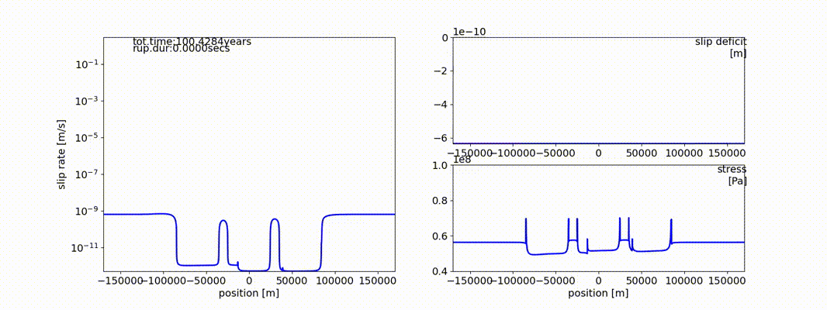

Cited References
Happy to answer your questions
Stein, R. S., Dieterich, J. H., & Barka, A. A. (1996). Role of stress triggering in earthquake migration on the North Anatolian Fault. Physics and Chemistry of the Earth, 21(4), 225-230.
Lapusta, N., Rice, J. R., Ben-Zion, Y., & Zheng, G. (2000). Elastodynamic analysis for slow tectonic loading with spontaneous rupture episodes on faults with rate- and state-dependent friction. Journal of Geophysical Research: Solid Earth, 105(B10), 23765–23789. https://doi.org/10.1029/2000jb900250
Parsons, T. (2004). Recalculated probability of M ≥ 7 earthquakes beneath the Sea of Marmara, Turkey. Journal of Geophysical Research: Solid Earth, 109(5), 1–21. https://doi.org/10.1029/2003JB002667
Pondard, N., Armijo, R., King, G. C. P., Meyer, B., & Flerit, F. (2007). Fault interactions in the Sea of Marmara pull-apart (North Anatolian Fault): Earthquake clustering and propagating earthquake sequences. Geophysical Journal International, 171(3), 1185–1197. https://doi.org/10.1111/j.1365-246X.2007.03580.x
Corbi, F., Funiciello, F., Brizzi, S., Lallemand, S., & Rosenau, M. (2017). Control of asperities size and spacing on seismic behavior of subduction megathrusts. Geophysical Research Letters, 44(16), 8227–8235. https://doi.org/10.1002/2017GL074182
Luo, Y., & Ampuero, J. P. (2018). Stability of faults with heterogeneous friction properties and effective normal stress. Tectonophysics, 733, 257-272. https://doi.org/10.1016/j.tecto.2017.11.006
Rosenau, M., Horenko, I., Corbi, F., Rudolf, M., Kornhuber, R., & Oncken, O. (2019). Synchronization of Great Subduction Megathrust Earthquakes: Insights From Scale Model Analysis. Journal of Geophysical Research: Solid Earth, 124(4), 3646–3661. https://doi.org/10.1029/2018JB016597
Sopaci, E., & Özacar, A. A. (2020, May). Investigation of Dynamic and Static Effects on Earthquake Triggering Using Different Rate and State Friction Laws and Marmara Simulation. In EGU General Assembly Conference Abstracts (p. 533).
Notes:
DSDFGDFH

Slide 11

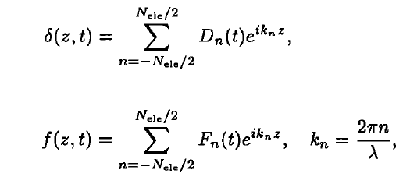
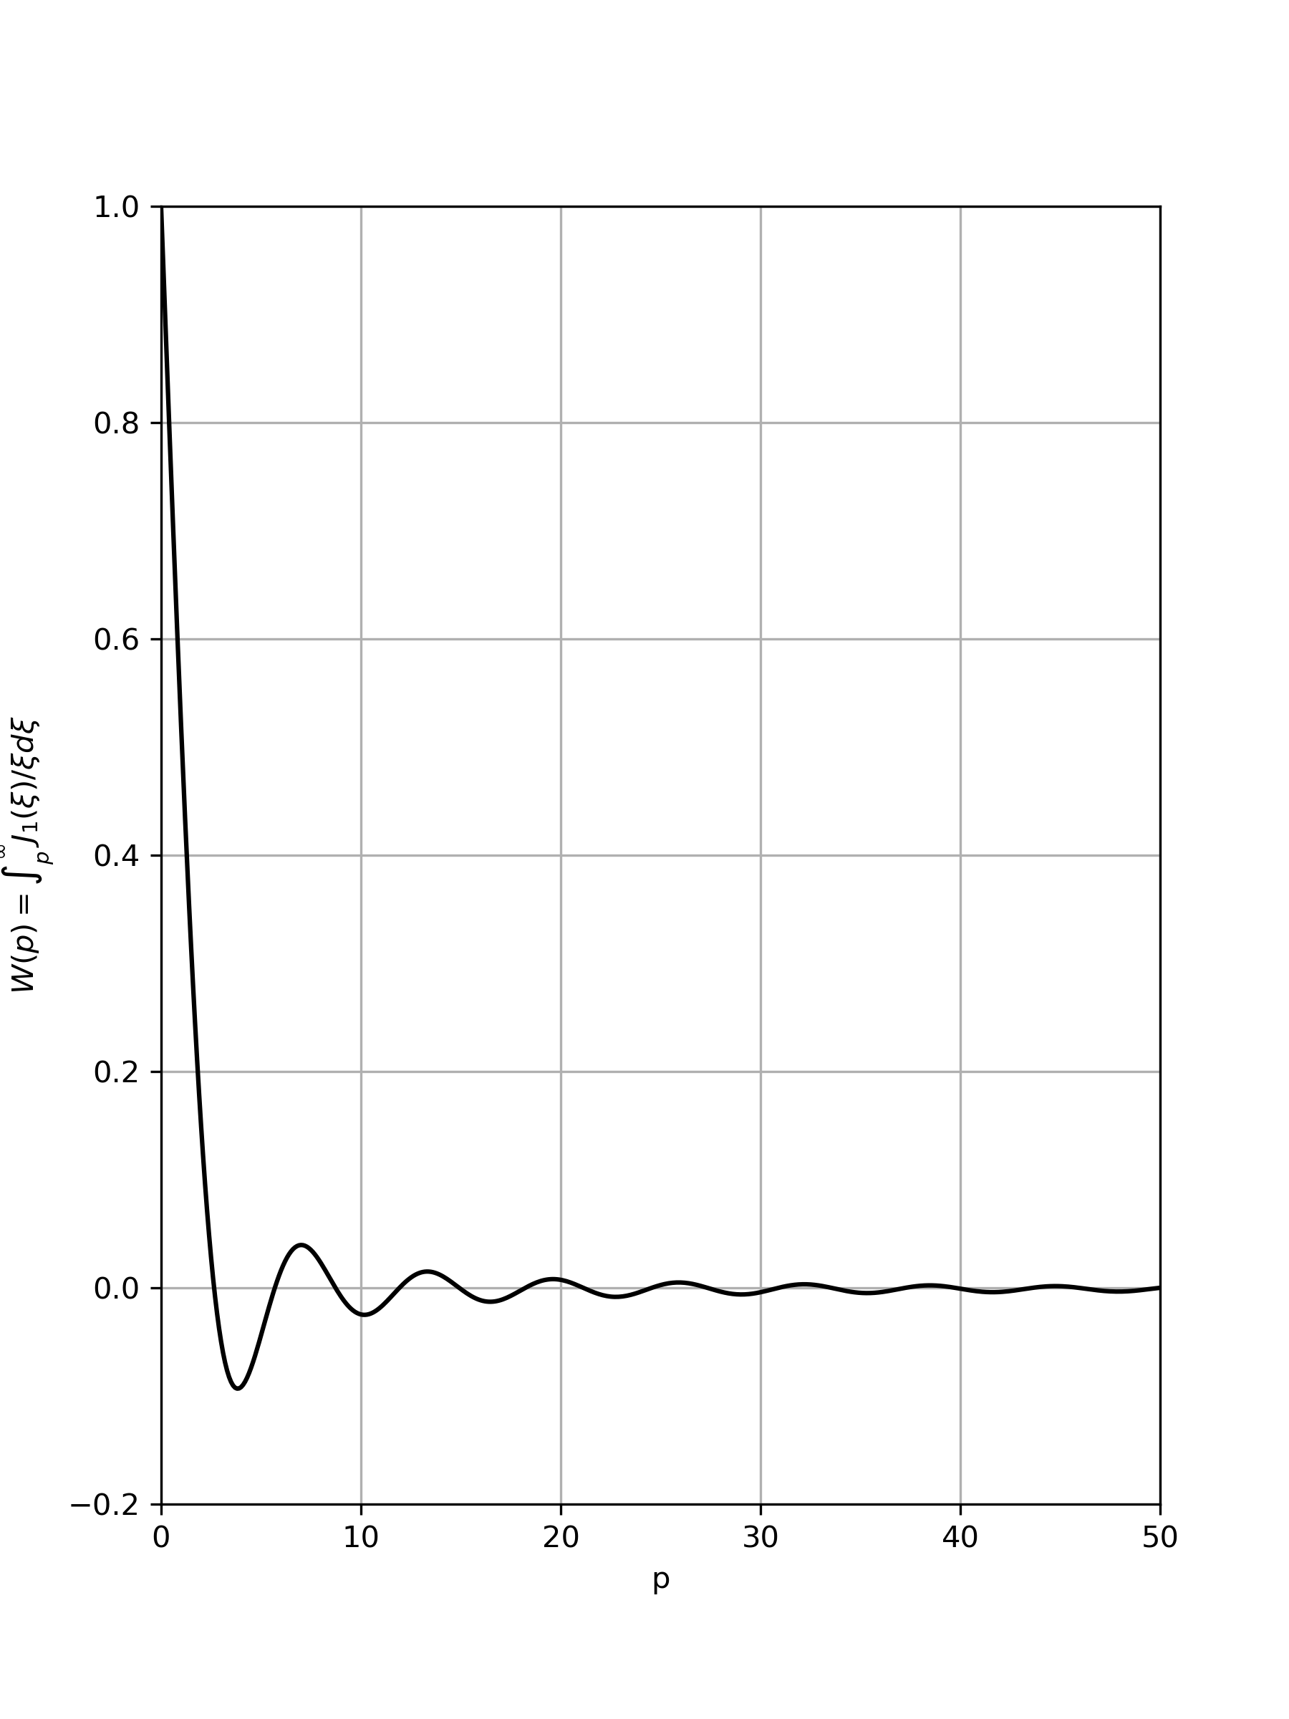
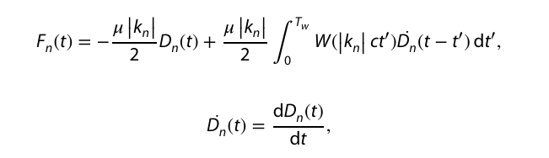
Supplementary: Elastodynamic Relation
Stress on the fault plane
τ: stress, τ⁰: loading stress, f:stress transfer function
µ: shear modulus, V: slip rate, c_{s}:shear velocity
z:space, t:time
Spectral representation
δ: slip
k_{n}:wave number
Dn, Fn : Fourier coefficients
λ : replication distance
Tw: Time window
Convolution kernel (Mode III)
Lapusta et.al. (2000)

Slide 12

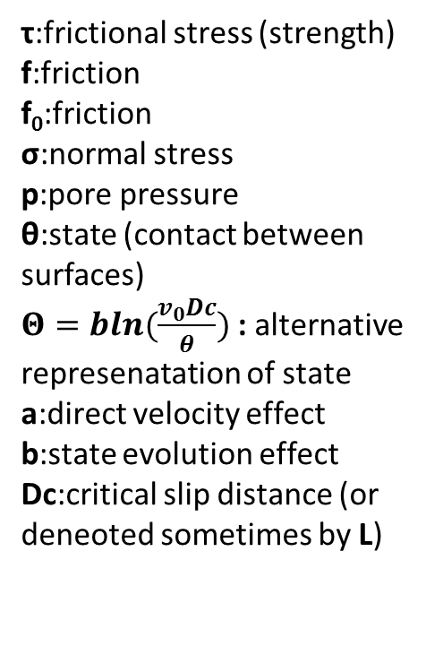


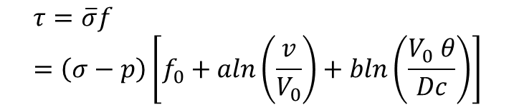
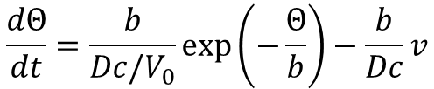
Supplementary: Rate and State Friction
$$τ=\overline{σ}f=\left(σ−p\right)\left[f_{0}+aln\left(\frac{v}{V_{0}}\right)+bln\left(\frac{V_{0} θ}{Dc}\right)\right]$$
τ:frictional stress (strength)
f:friction
f₀:friction
σ:normal stress
p:pore pressure
θ:state (contact between surfaces)
$Θ=bln(\frac{v_{0}Dc}{θ})$ : alternative represenatation of state
a:direct velocity effect
b:state evolution effect
Dc:critical slip distance (or deneoted sometimes by L)
Aging law
or
$$\frac{dθ}{dt}=1−\frac{vθ}{Dc}$$
$$\frac{dΘ}{dt}=\frac{b}{Dc/V_{0}}\exp\left(−\frac{Θ}{b}\right)−\frac{b}{Dc}v$$
Slip law
or
$$\frac{dΘ}{dt}=\frac{v}{Dc}[Θ−bln(\frac{V_{0}}{v})]$$
Aging law can sustain true stationary contact, but has flows when fitting the velocity step tests, due to its weak «weakening» term.
Slip law can not sustain true contact but has a better fitting performance to the velocity step tests.
(Nakatani, 2000)

Slide 13

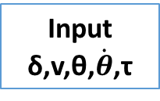

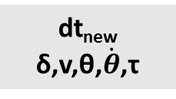

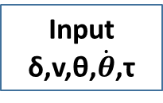
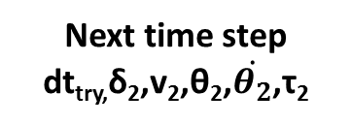
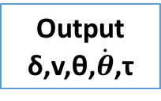

Supplementary: Time stepping
dt_{new}
δ,v,θ,$\dot{θ}$,τ
dt_{try}/2
Flow for the double half steps
dt_{try}
Flow for a full time step
Input
δ,v,θ,$\dot{θ}$,τ
Output
δ₁,v₁,θ₁,$\dot{θ_{1}}$,τ₁
Input
δ,v,θ,$\dot{θ}$,τ
Output
δ,v,θ,$\dot{θ}$,τ
dt_{try}/2
Input
δ₁,v₁,θ₁,$\dot{θ_{1}}$,τ₁
Output
δ₂,v₂,θ₂,$\dot{θ_{2}}$,τ₂
Error comparison
Modify error dt_{try}
Input
δ₂,v₂,θ₂,$\dot{θ_{2}}$,τ₂
Output
dt_{try}
Next time step
dt_{try,}δ₂,v₂,θ₂,$\dot{θ_{2}}$,τ₂
Romanet et.al. (2022)

