Slide 1

The Origin of Tropospheric Air Masses and Related Transport Processes Inferred from FTIR Measurements and Model Simulations in Western Pacific and South America
Xiaoyu Sun, Mathias Palm, and Justus Notholt
Institute of Environmental Physics, University of Bremen, Bremen, Germany
26.05.2022

Slide 2
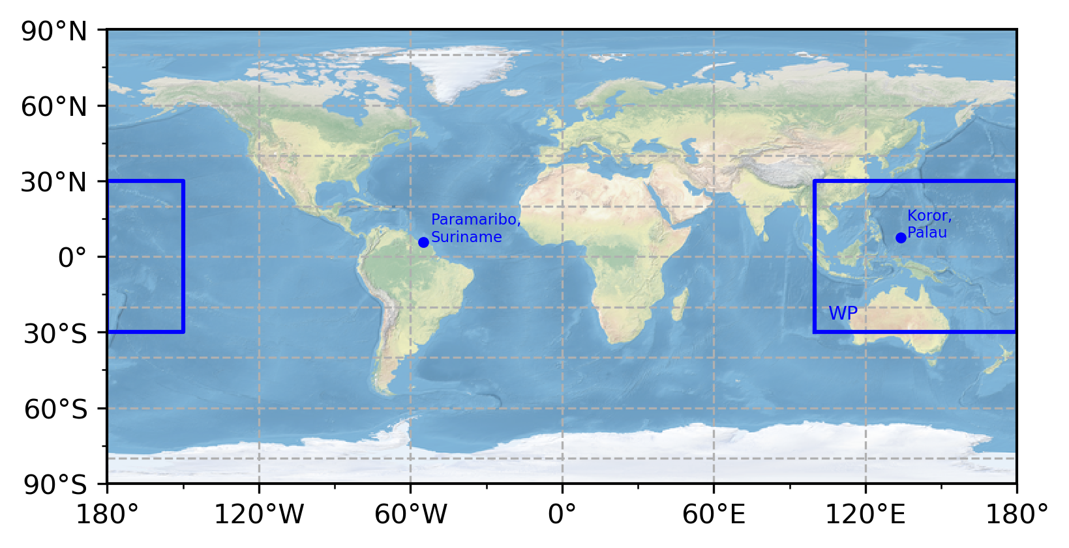
Sites and Instruments
Koror, Palau (7.5°N, 134.8°E)
Located in the Western Pacific (WP) region, considered as the major transport pathway from the troposphere into the stratosphere during Northern Hemispheric (NH) winter
Paramaribo, Suriname (5.8°N, 55.2°W)
Located in tropical South America
In comparison to Palau, a tropical site out of WP
Instrument: Bruker IFS 120
The observations are part of the Network for the Detection of Atmospheric Composition Change (NDACC)

Slide 3
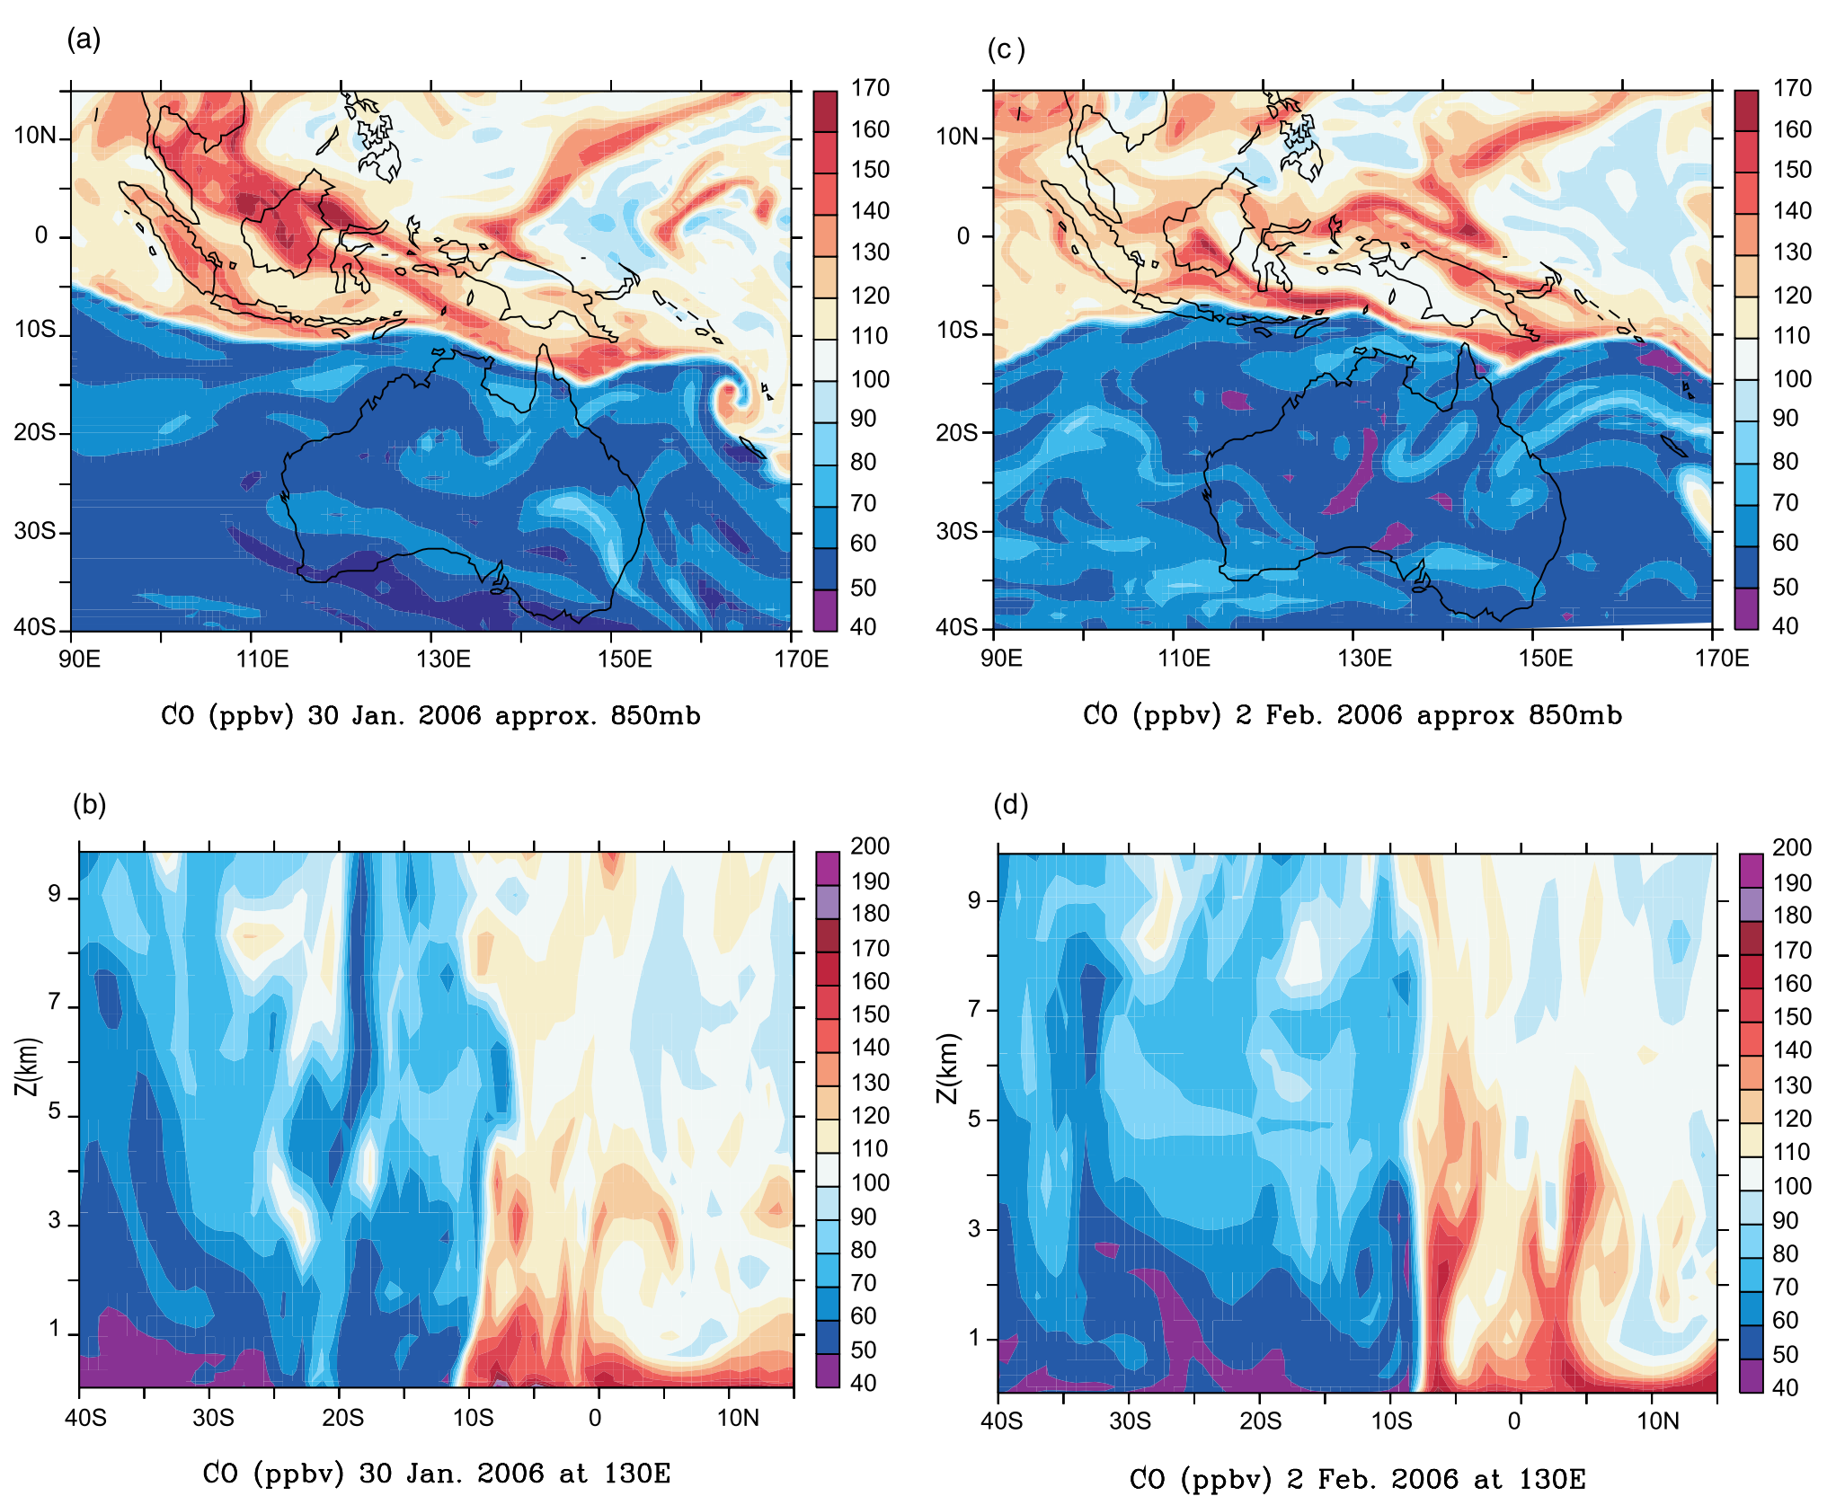
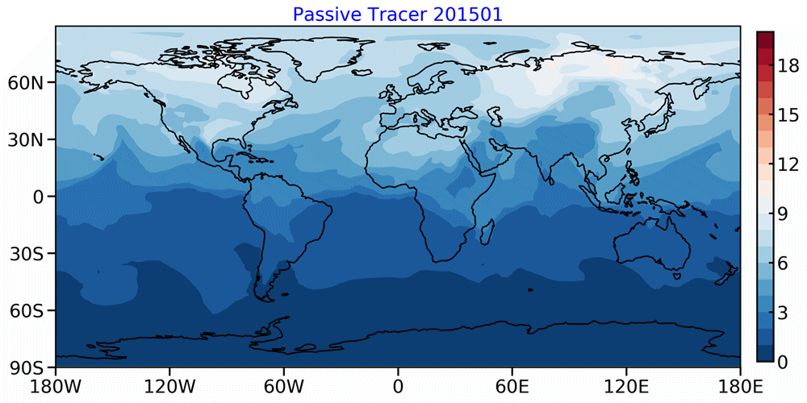
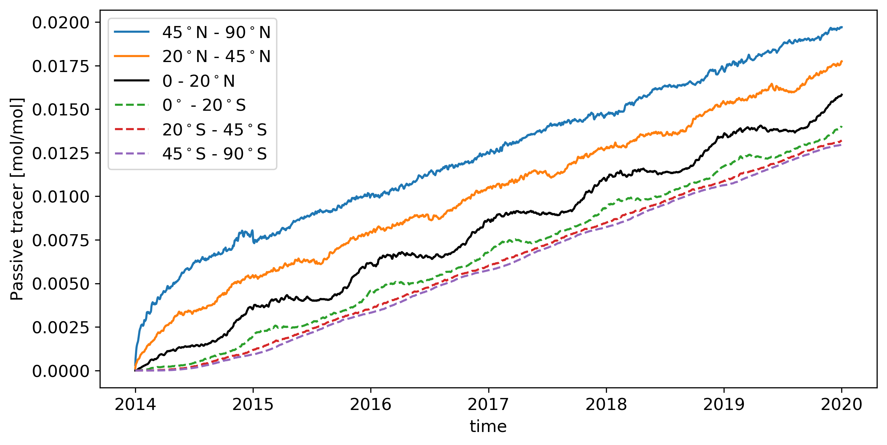
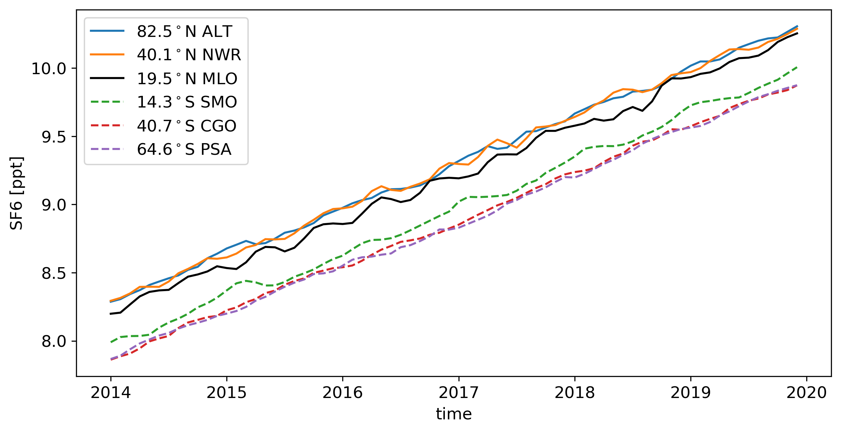
The Inter-hemispheric exchange
The chemical equator found in the WP by CO
Virtual Tracer Transport simulation by GEOS-Chem
CO modeled using the p-TOMCAT chemical transport model.
The model captures the difference in CO concentration on both sides of the chemical equator.
The tracer is uniformly and constantly released from 30° - 90°N (2014-2020)
Always higher amount of tracer in the NH and lower in the SH
---- An artificial pattern to capture the boundary between NH and SH
(Hamilton et al., 2008)
(Sun et al., 2022, in prep)

Slide 4
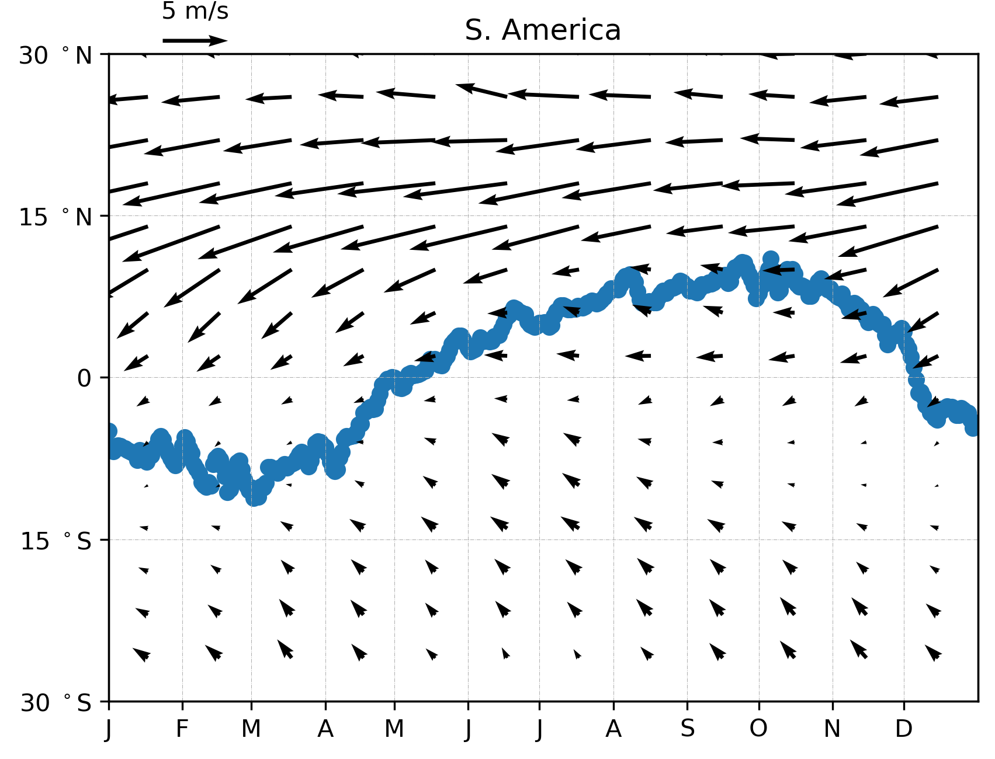
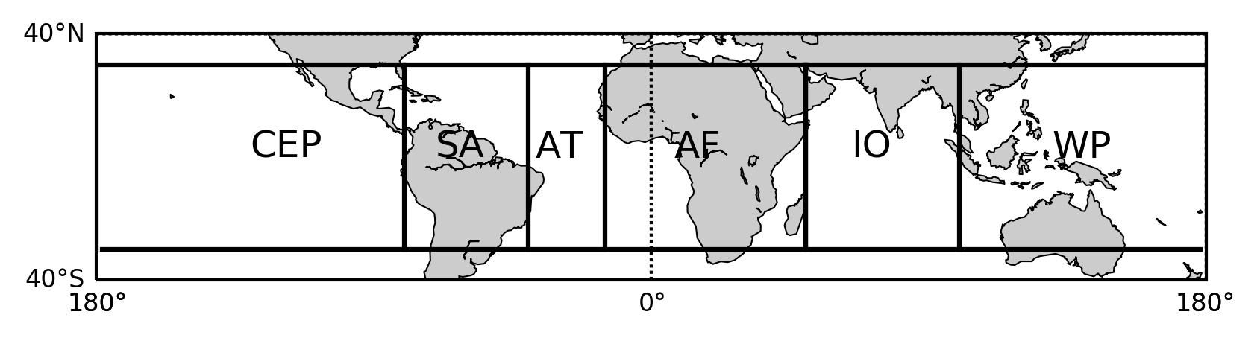
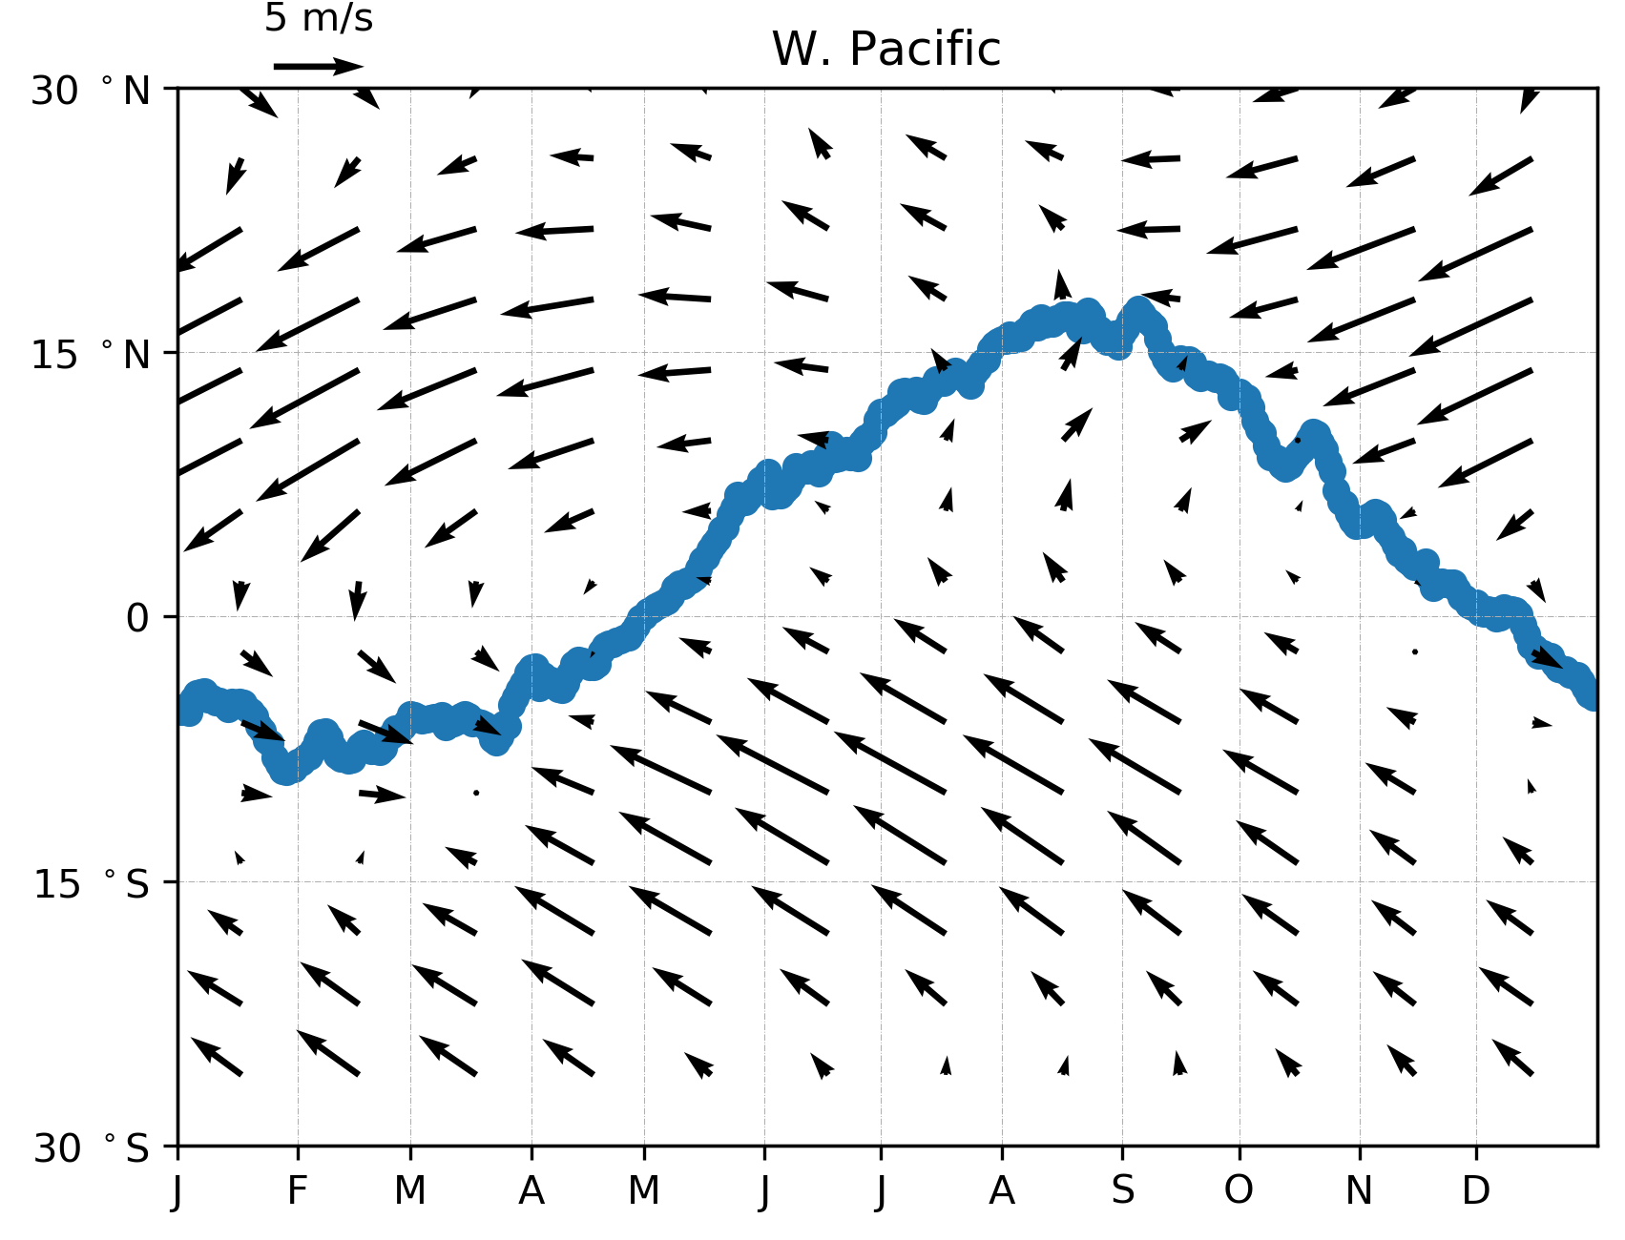
The Inter-hemispheric exchange
Paramaribo, 5.8° N
Chemical Equator
Paramaribo: from July to Nov., in SH
from Jan. to June and Dec., in NH
Koror: from June to Oct., in NH
from Jan. to May and Nov. to Dec. in NH
Koror, 7.5° N
Chemical Equator
Monthly averaged wind vectors from 2015 to 2019 from ERA5 (Hersbach et al., 2020) and daily averaged chemical equator, space averaged in S. America and W. Pacific
(Sun et al., 2022, in prep)

Slide 5
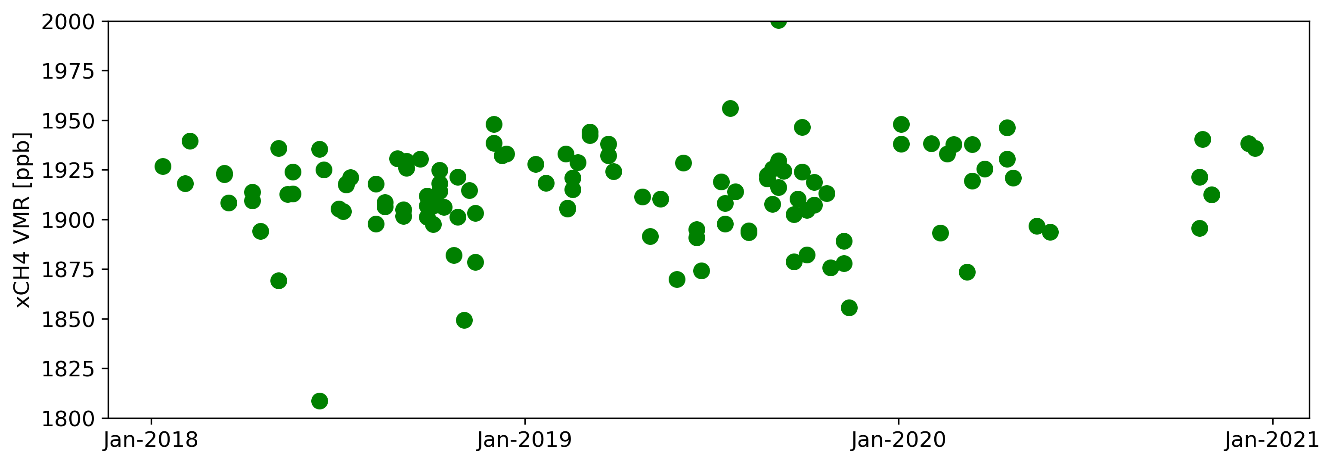
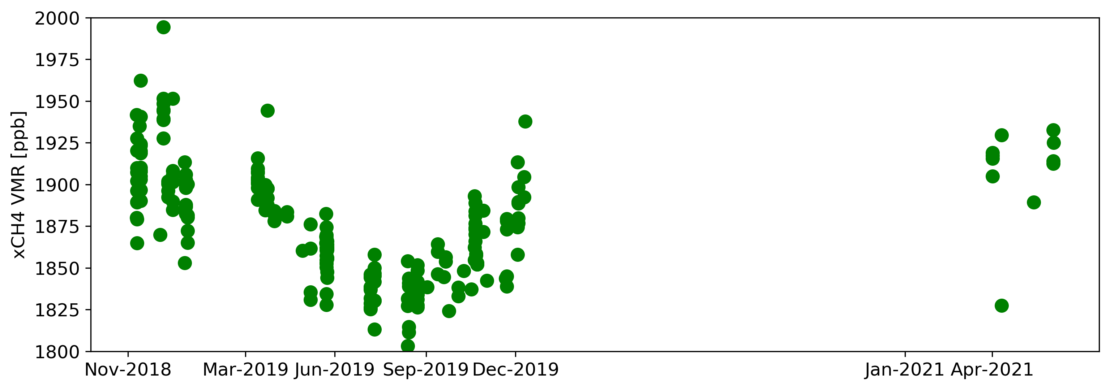
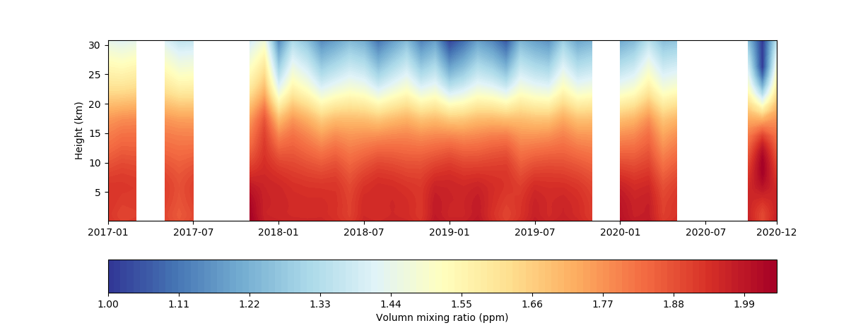
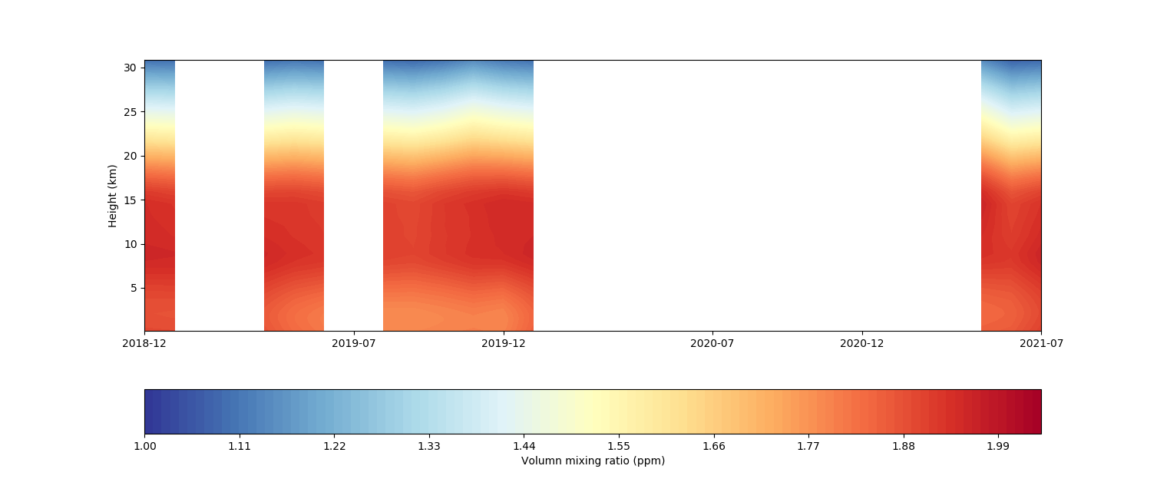
Results
Column averaged volume mixing ratio of CH₄ (2018-2021)
Paramaribo
Koror
Time series VMR of CH₄ (2018-2021)

Slide 6
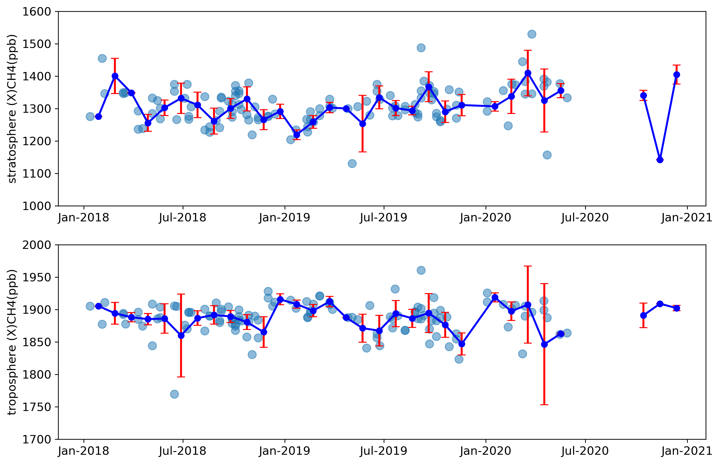
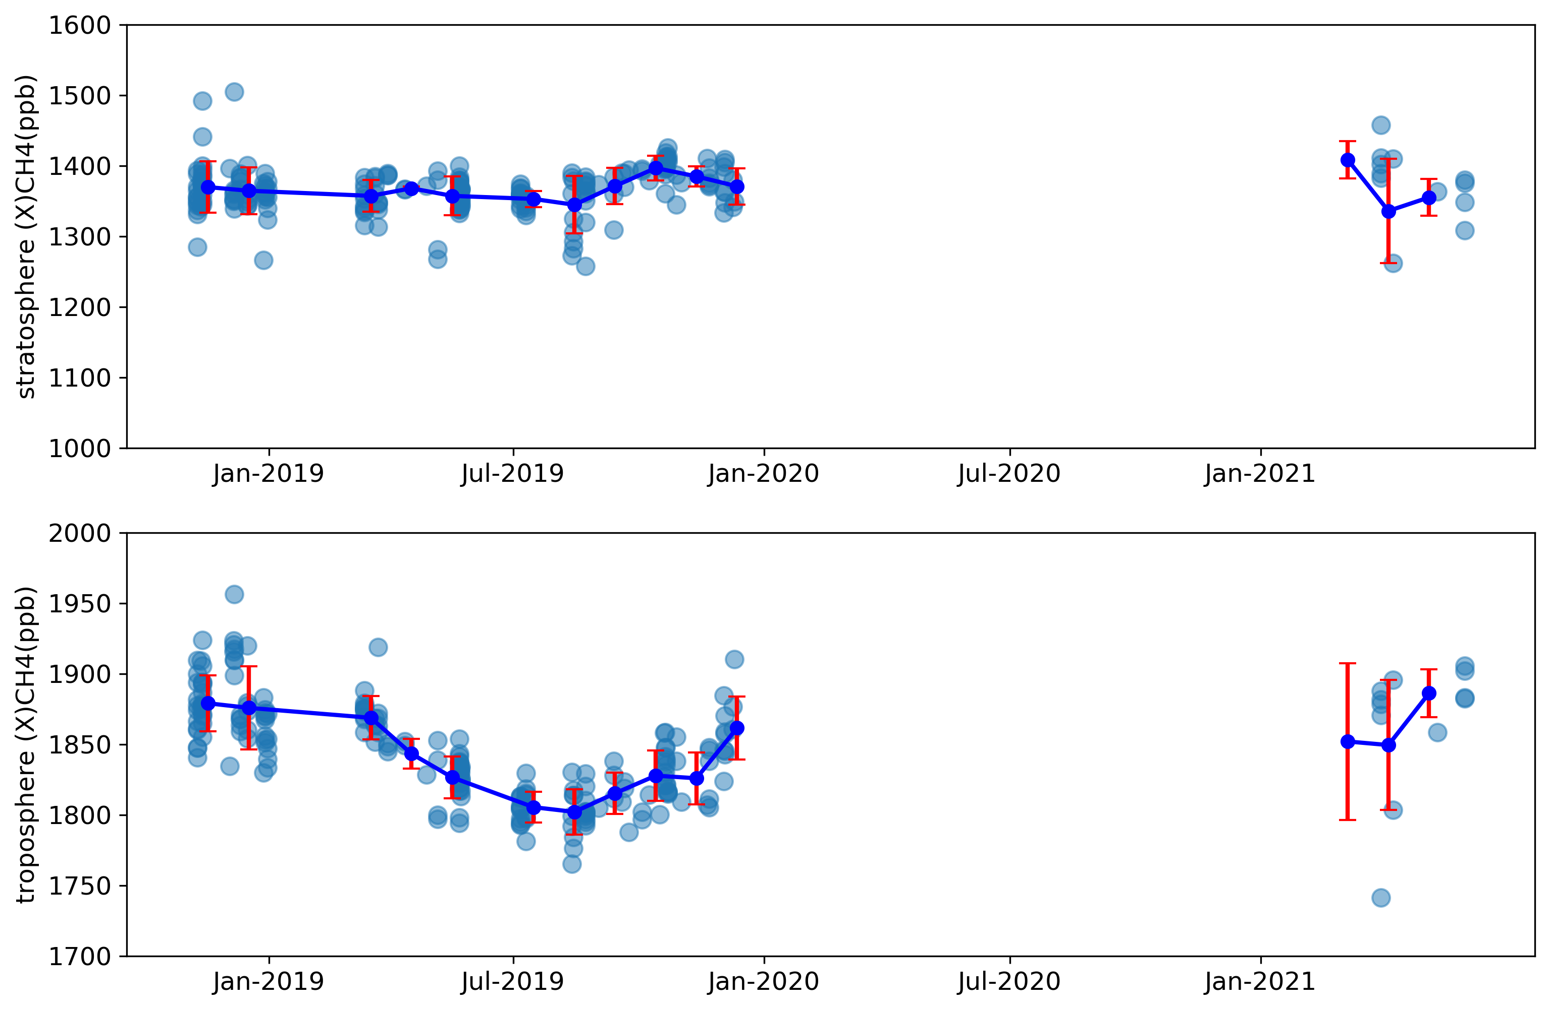
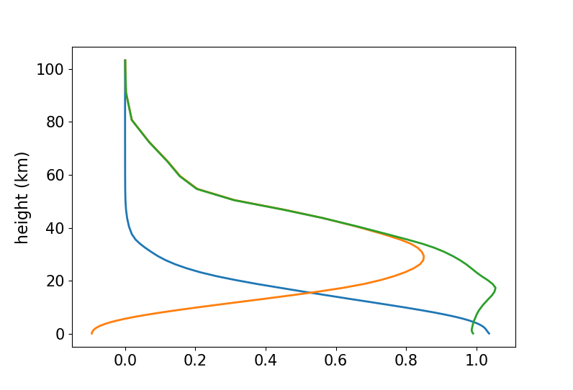
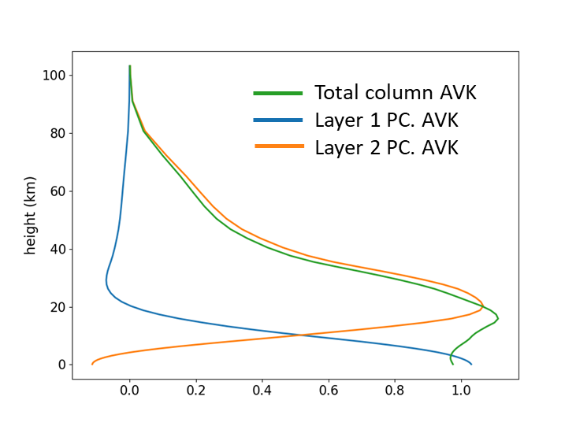
Tropospheric and Stratospheric XCH₄
Paramaribo
Koror
Separating the XCH₄ into two layers. Layer 1: from surface to free troposphere. Layer 2: from the stratosphere.
The total column AVK (green) and the partial column averaging kernels of two individual layers of the typical AVK of both sites.
Tropopause height: 16.0 km
Paramaribo
Koror
Notes:
Layer 1 (blue line): most of information from troposphere
Layer 2 (orange line): most of the information from the

Slide 7
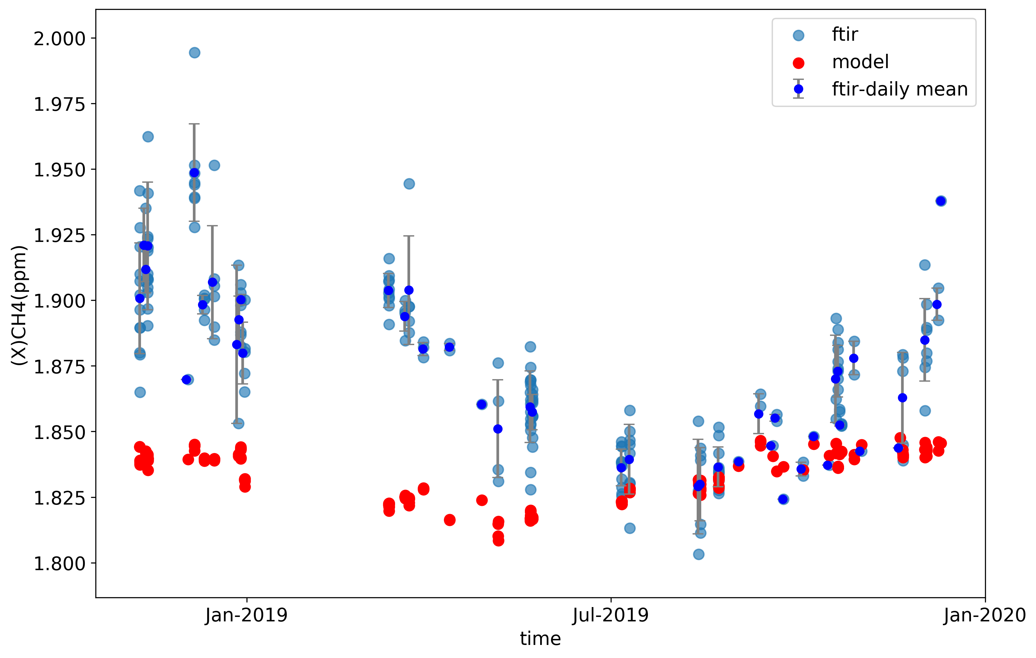
Tropospheric and Stratospheric XCH₄
Koror
Koror, 7.5° N
Chemical Equator
Comparison of XCH₄ from FTIR measurement with smoothed GEOS-Chem
Tropospheric XCH₄ shows minimum in July-November, and maximum in December- February.
Driven by the large-scale circulation of the Asian monsoon, the higher concentration of methane is from South-East Asia in wintertime from the NH and the Pacific Ocean from SH.
The GEOS-Chem model can capture the seasonal variation of methane concentration. But since anthropogenic source emissions are not included in the model, the concentration of CH4 is much lower than the observed value.
Sun, X. et al., 2022, in prep.
Notes:
And the observed methane concentration values ​​are more spread.

Slide 8
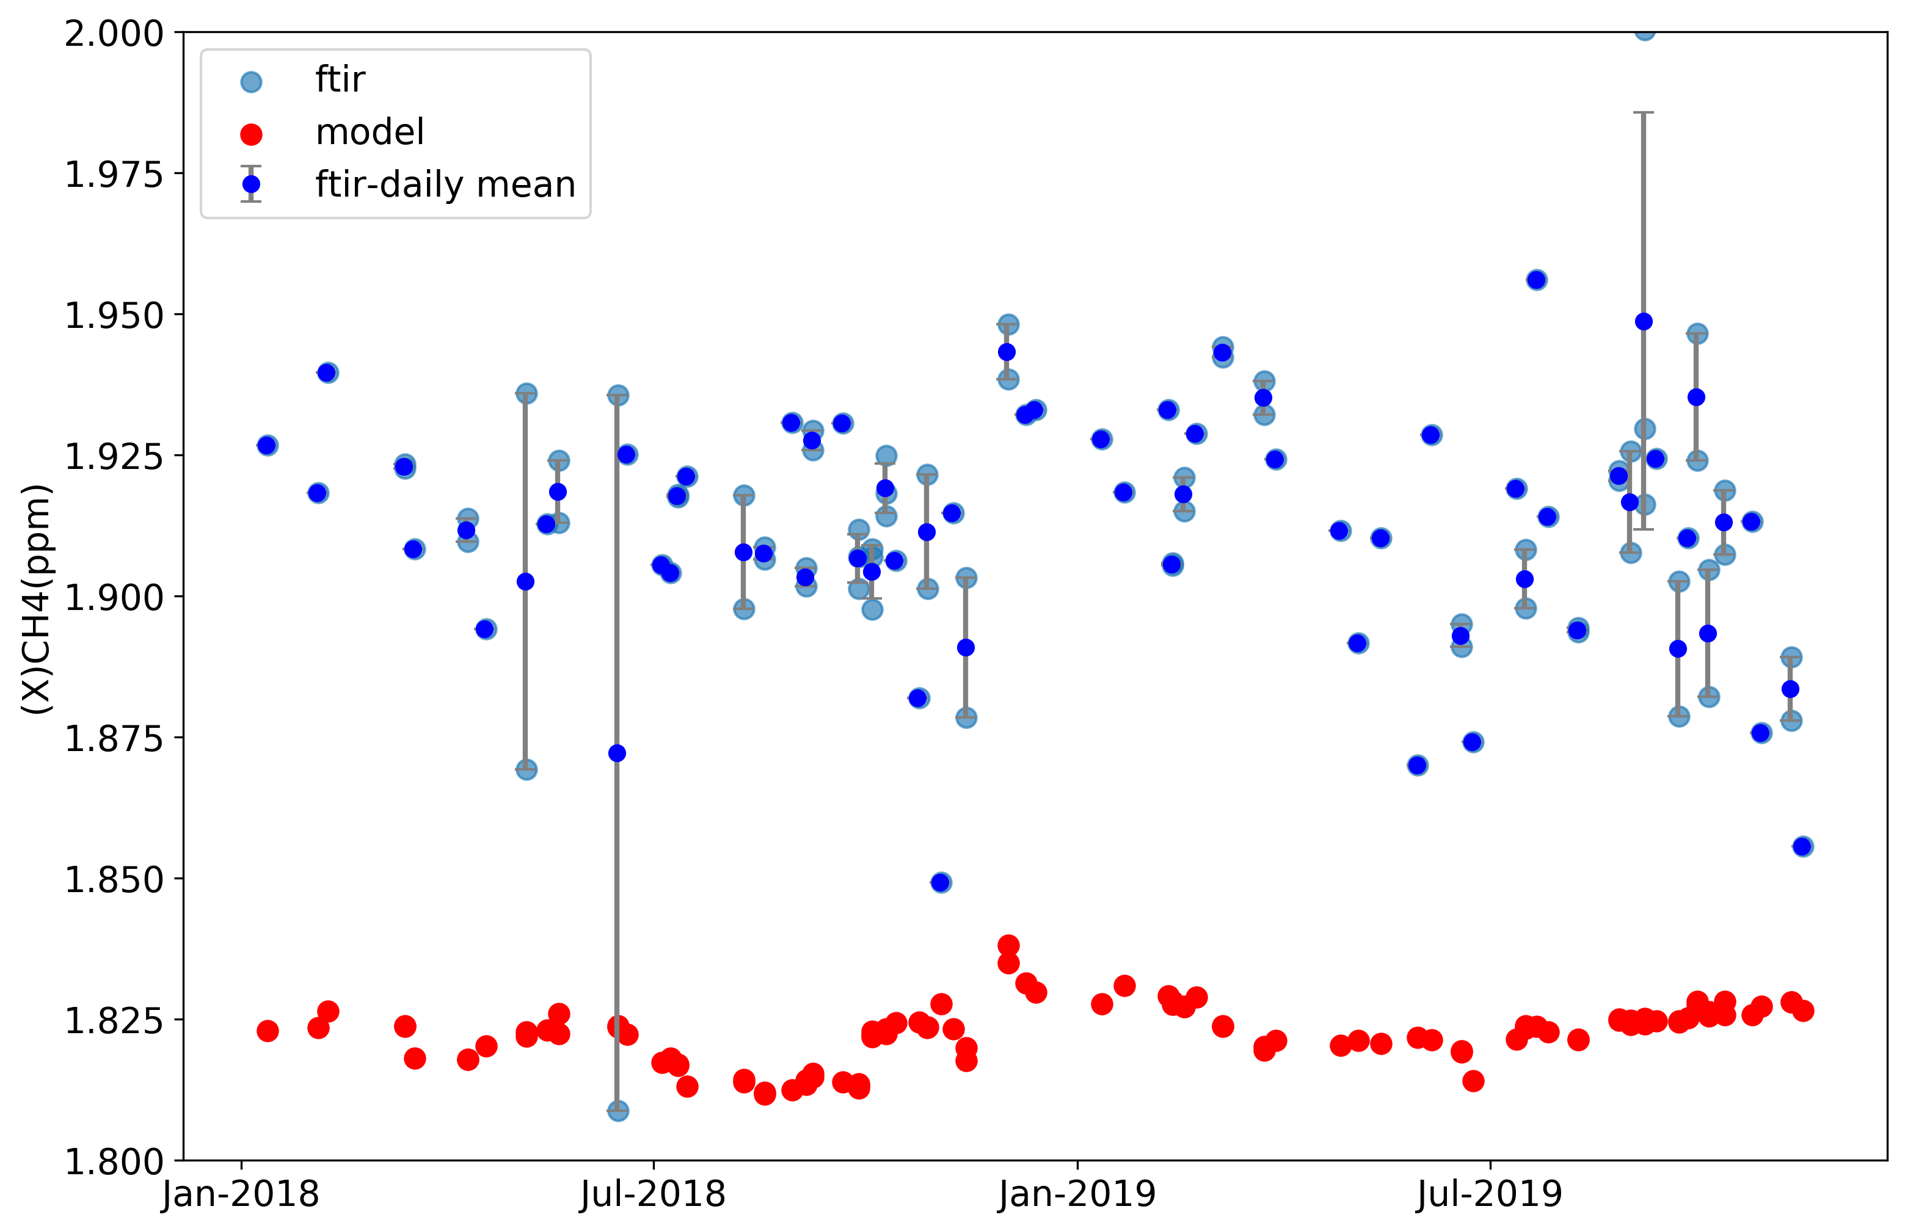
Tropospheric and Stratospheric XCH₄
Paramaribo
Comparison of XCH₄ from FTIR measurement with smoothed GEOS-Chem
Paramaribo, 5.8° N
Chemical Equator
Tropospheric XCH₄ shows a much smaller seasonal pattern than in Koror, relatively lower tropospheric XCH₄ in NH summer (JJA), and relatively higher tropospheric XCH₄ in NH winter (DJF).
Airmass origin is mainly from the Atlantic and the slighter north-gradient of methane in the S. America region than in W. Pacific.
To some extent, the GEOS-Chem model comparison results in Paramaribo are consistent with Palau, with lower value and less spread of the XCH₄, because of the lack of anthropogenic emission in the model.
Sun, X. et al., 2022, in prep.
Notes:
And the observed methane concentration values ​​are more spread.

Slide 9
Summary
Seasonal changes in CH₄ are associated with large-scale circulation and exchanges between the two hemispheres, especially in Palau, where low CH₄ concentrations in summer and high CH₄ concentrations in winter can be explained by seasonal shifts in CE. Paramaribo, on the other hand, is more affected by the easterly wind from the Atlantic Ocean and has less seasonal variation.
To some extent, The GEOS-Chem model can capture the seasonal variation of methane concentration. But since anthropogenic source emissions are not included in the model, the value of XCH₄ is much lower than the observed and the model is with less spread of the value.
Outlook
Analysis of Stratospheric
Comparison with the measurements in Burgos, Philippines (18.5°N, 120.65°E), a site just beside the Tropical Warm Pool

Slide 10
Thanks for your attention!
xiaoyu_sun@iup.physik.uni-bremen.de

