Slide 1





Identification and separation of infrasound signals from storms and quarry blasts via machine learning algorithms
Marcell Sebestyén Pásztor ^{1,2}
István Bondár ²
Contact author: pasztorms@gmail.com
1 ELTE Eötvös Loránd University, Institute of Geography and Earth Sciences, Department of Geophysics and Space Science, Budapest, Hungary
2 Institue for Geological and Geochemical Research, Research Centre for Astronomy and Earth Sciences, Budapest, Hungary
EGU22-5143
Session AS1.6
Notes:
Név nagyobb betűvel

Slide 2
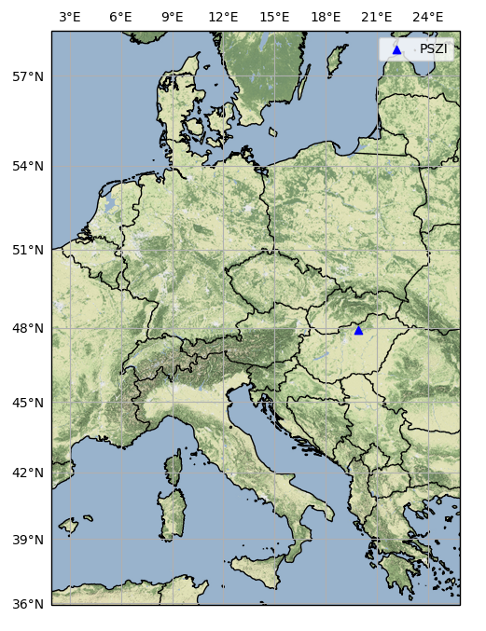
Introduction
1
The infrasound array in Hungary has been operational since May 2017 at Piszkés-tető. Since then, it has collected around a million PMCC detections from various known sources such as microbaroms quarry blasts storms, airplanes and so on. The already identified detections give the opportunity to train, test, validate and compare machine learning models, for identification and separation of infrasound signals from storms and quarry blasts.

Slide 3
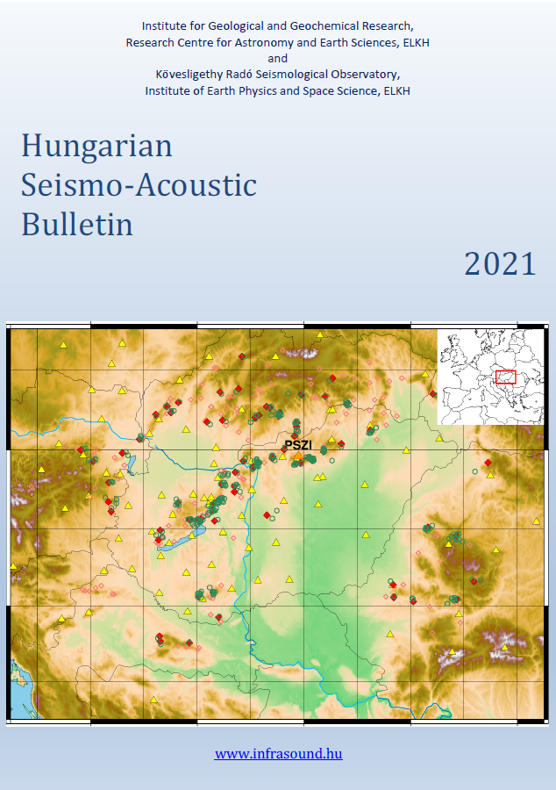
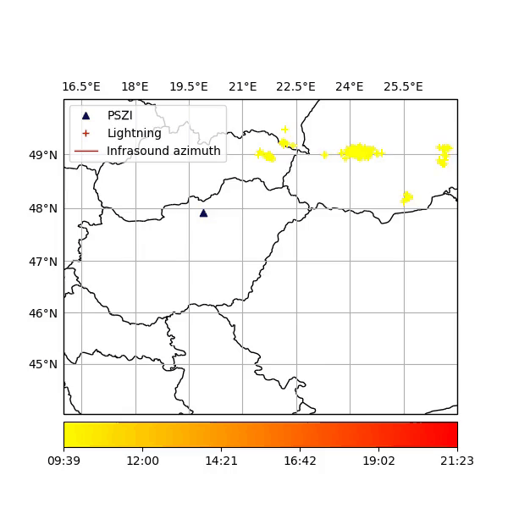
The data
2
The dataset contains identified signals from previous studies and from the Hungarian Seismo-Acoustic Bulletins.

Slide 4
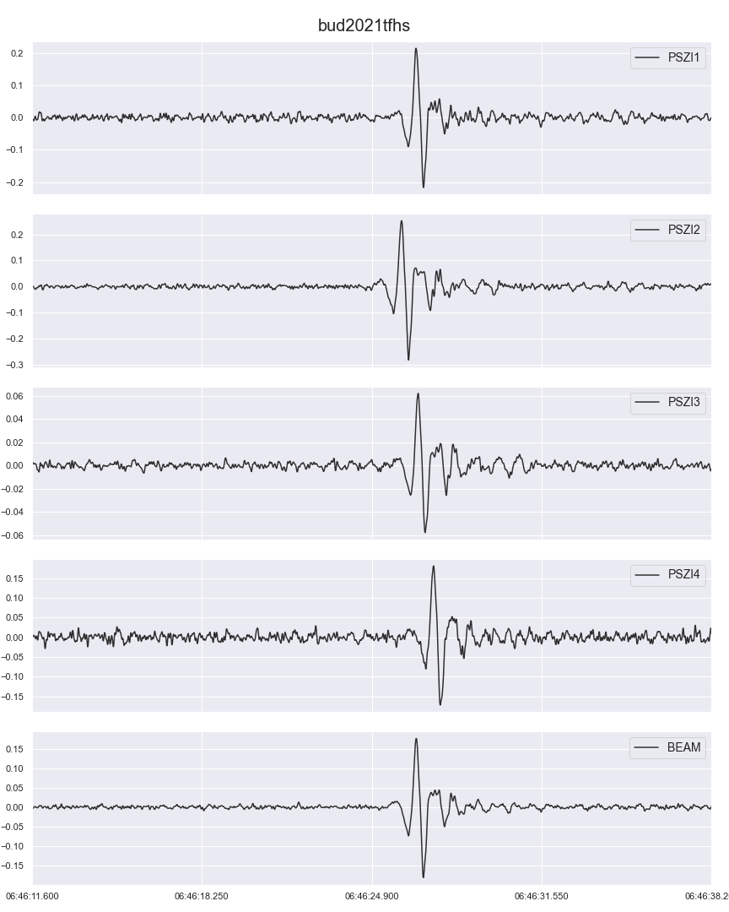
Preprocessing
3
Prior to performing the feature extraction from the raw waveforms, the waveforms were filtered with a 1-10 Hz bandpass filter in order to get rid of the very low frequency content caused mostly by microbaroms. The upper limit was set 10 Hz because of the cut-off frequencies of the MB3d microbarometers used at PSZI. After the filtering beams were created from the waveforms to improve the signal-to-noise ratio.
FIG: waveforms measured at PSZI array elements and calculated delay-and-sum beam for a quarry blast event.

Slide 5
Feature extraction
4
After augmenting the Quarry Blast signals in the Training set the following features were extracted from each detection and the corresponding beam and power spectrum. Features calculated for each frame of the spectrum were aggregated, mean and median were taken.
Time-domain
RMS energy
Signal-to-noise ratio
Amplitude envelope
Number of zero crossings/duration
Frequency-domain
Spectral centroid
Spectral bandwith
Spectral rolloff
Band energy ratio
Power spectral entropy
Singular spectrum entropy
Other
Hour of the day of the detection
Number of detections in box*
* The box is defined as +/- 30 minutes and +/- 10° from the given PMCC detection in the time-azimuth domain.

Slide 6
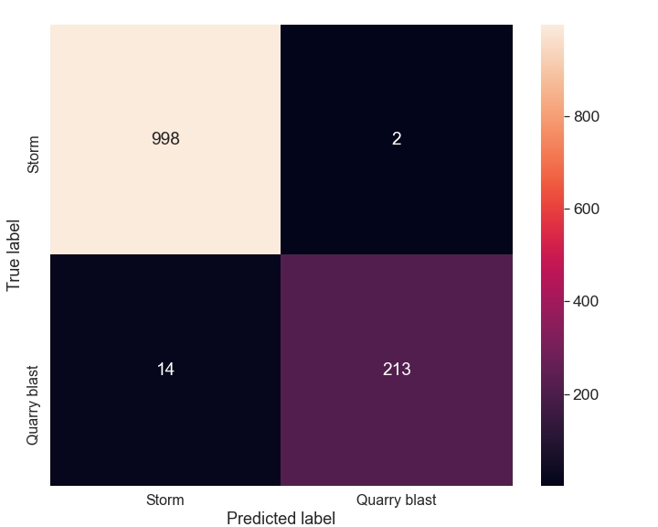
Model selection
5
Various Models e.g. Logistic Regression, SVM, Random Forest were tested.
~5000 events for training and ~ 1200 for testing.
Best hyperparameters were determined by 3 fold cross-validation.
ROC AUC metric was used to measure performance.
FIG: Confusion matrix of the best Random Forest model.

Slide 7
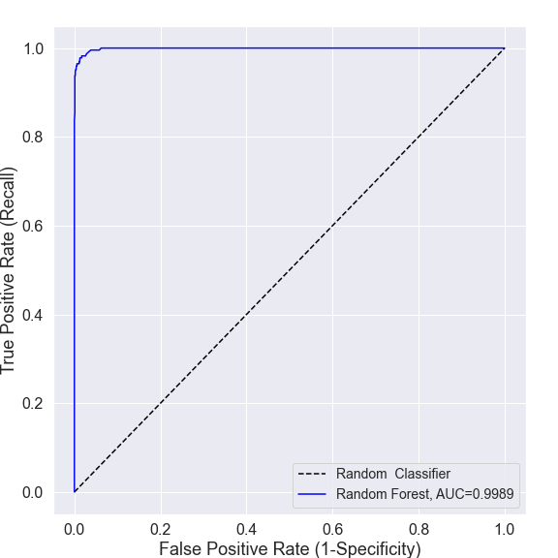
Model selection
6
Various Models e.g. Logistic Regression, SVM, Random Forest were tested.
~5000 events for training and ~ 1200 for testing.
Best hyperparameters were determined by 3 fold cross-validation.
ROC AUC metric was used to measure performance.
FIG: ROC curve for the best Random Forest model.

Slide 8
Summary & Discussion
7
Quarry blasts can be separated from storms.
High ROC AUC score was achieved with a simple model so the used features describe well the different type of events.
Future plans:
  Adding new detections from different sources e.g. planes or bolides
  Adding more detections from each category
  Trying out new features
Thank you for you attention!

Slide 9
Acknowledgement & References
This work was supported by
the Hungarian National Research, Development and Innovation Fund (K128152)
and by
the bilateral agreement between the Czech and Hungarian Academy of Sciences, NKM2018-10
(“Infrasound studies in Central Europe, PIs: István Bondár, Tereza Sindelarova”).
[1] Cansi, Y. (1995) An automated seismic event processing for detection and location: The P.M.C.C. method, Geophys. Res. Lett., 22, 1021–1024.
[2] e.g. Pásztor, M., Czanik, C., and Bondár, I.: Exploiting infrasound detections to identify and track regional storms, EGU General Assembly 2021, online, 19–30 Apr 2021, EGU21-6525, https://doi.org/10.5194/egusphere-egu21-6525, 2021.
[3] e.g. Bondár, I., M. Pásztor, C. Czanik, M. Kiszely, P. Mónus, B. Süle (2022). Hungarian Seismo-Acoustic Bulletin, 2021, ed: I. Bondár, ISSN: 2676-7902, Institute for Geological and Geochemical Research, Research Centre for Astronomy and Earth Sciences, ELKH Budapest and Kövesligethy Radó Seismological Observatory, Institute of Earth Physics and Space Science, ELKH, Sopron. 175 pp., 2022.
Link: http://infrasound.hu/index.php/en/hungarian-seismo-acoustic-bulletin
[4] Li, M., X. Liu, and X. Liu (2016). Infrasound signal classification based on spectral entropy and support vector machine, Appl. Acoust. 113, no. 2016, 116–120, doi: 10.1016/j.apacoust.2016.06.019.
EGU22-5143
Session AS1.6

